Slide 1
CSE 6324 Advanced Topics in Software Engineering
Team 8
1

Slide 2
Team Members
Akshata Raikar - 1002032638
Shovon Pereira - 1002073941
Devyani Singh - 1001959376
Ravi Rajpurohit - 1002079916
2

Slide 3
Project Vision
Acknowledging the importance of GAS value.
Separate tools analyzing Gas values
Detecting out-of-gas situation
Detecting inefficient code wasting Gas
Merge with another powerful tool Slither
Make a more robust and diverse tool
3

Slide 4
Project Features
Fuse multiple For-loops : When multiple For loops are running for the same length, sometimes they can be optimized by achieving the same task in one loop. In these cases, writing multiple loops can cost more Gas than necessary. A warning for such scenarios can be helpful in saving valuable resources[4].
Map instead of Array: In the case of memory access, searching elements, and dynamic sizing, maps are more efficient as compared to arrays in terms of gas usage and time spent[10].
Redundant SSTORE: Whenever a disk storage operation takes place, disk access costs significant gas value[4]. To optimize this, disk access should be minimized.
Calculate Cost of Contract: It is important to know if a smart contract function exceeds the gas allowed for execution or gas limit. This will allow the developer to know the need for optimization before execution through this detector[4].

Slide 5
Software Development Plan
Iteration 1:
Implemented and tested the 1st detector – Identify Fusible Loops.
Analysis of Gas saved by this detector.
Iteration 2:
Successfully implemented 2nd detector i.e. suggest to use map instead of arrays.
Test the gas saving for detector 2 for smart contracts.
Planned pseudocode for 3rd feature - detect redundant storage use.
Documentation.
Iteration 3:
Implement the remaining features- detect redundant storage use and calculate the cost of the contract.
Identify the edge cases.
Complete testing of all three features and verify usage for the final use.
Address the unhandled cases in a document.
5

Slide 6
Code Snippets
6

Slide 7
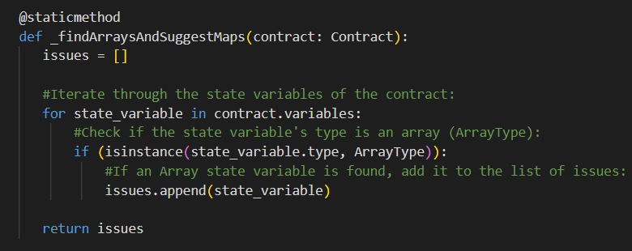
Array to mapping detector
7
Fig 1:Detector 2- ArrayToMapping detector code

Slide 8
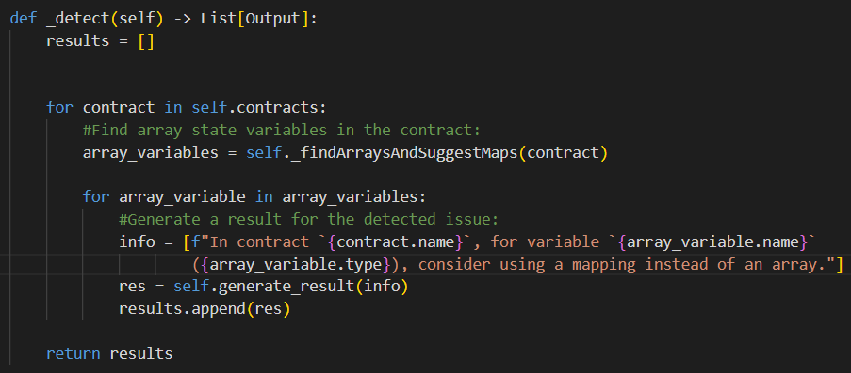
8
Fig 2: entry point for detector 2 – Array to Mapping

Slide 9
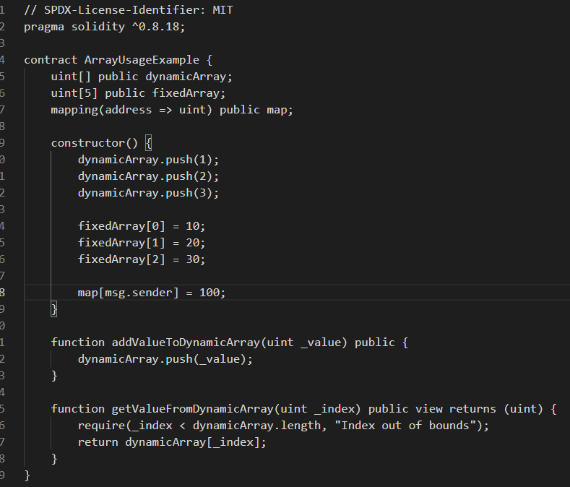
Smart Contract to Test
9
Fig 3: Smart Contract to test detector 2

Slide 10
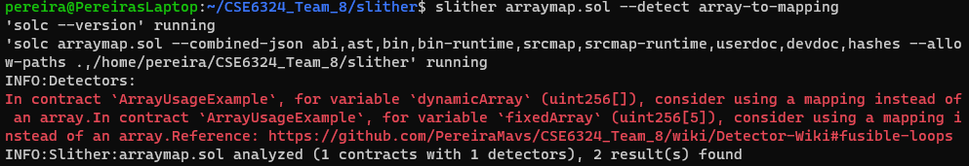
Terminal Snippet
10
Fig 4: Detetctor suggestions logs

Slide 11
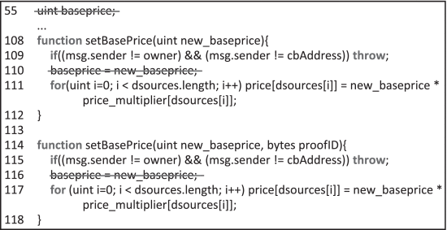
Detector 3 - Redundant SSTORE Operation
Fig 5: Redundant SSTORE scenario
11

Slide 12
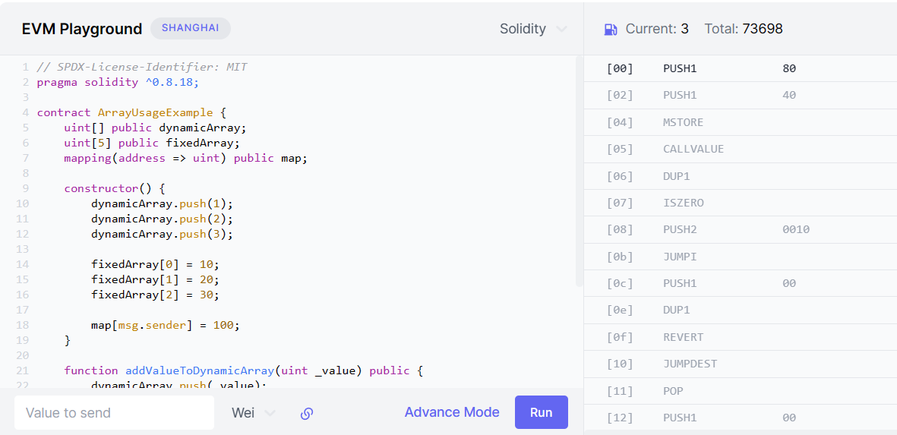
Gas Calculations
Fig 6 : Gas Consumption for arrays [8]
12

Slide 13
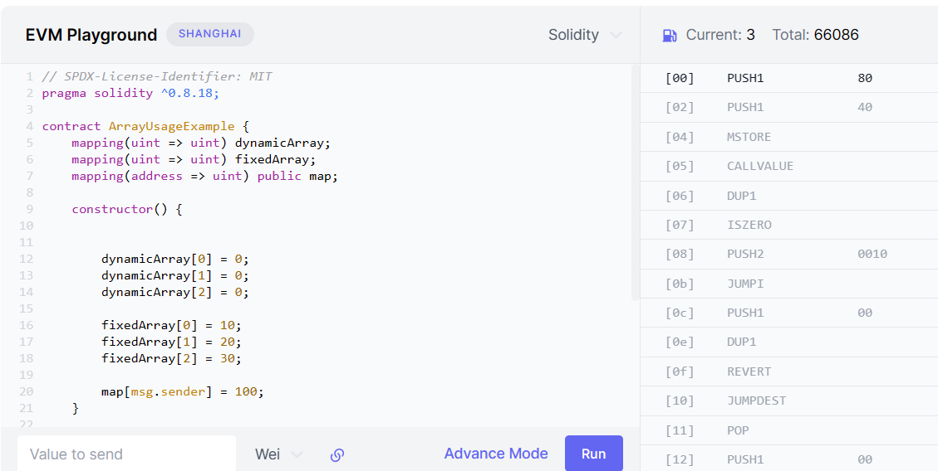
Gas Calculations
Fig 7 : Gas Consumption for Mapping [8]
Gas Consumption with mapping usage: 66086 Gwei 13
13

Slide 14
Risks
Problems faced in Iteration 2
After detecting SSTORE operation we could not find a feasible way to detect all possible execution paths.
Encountered problems during the testing of the newly added detector on WSL.
Failed to activate detector despite new build.
Resolved on another computer using Visual Studio.
Identifying edge cases for the proposed detectors.
Working on this by brainstorming, comparing with competitors, reading research papers, and recognizing the use cases in the coding community.
14

Slide 15
Future Risks
Problems anticipated for future iterations
Compromising overall performance of tool is a significant risk.
Adding new features brings this concern.
With final testing, this needs to be checked and addressed.
Depending on the use case, user may need to use inefficient looking code.
Like multiple for loops (detector 1).
Like use of array instead of mapping (detector 2).
These cases needs to be handled.
Else warnings need to be suppressed by user.
Finding and identifying SSTORE patterns to minimize redundant disk usage.
Challenging as Slither actually receives solidity files, not bytecode files.
15

Slide 16
Repository
https://github.com/PereiraMavs/CSE6324_Team_8
Version: 2.0 16

Slide 17
References
[1] S. S. Kushwaha, S. Joshi, D. Singh, M. Kaur and H. -N. Lee, "Ethereum Smart Contract Analysis Tools: A Systematic Review," in IEEE Access, vol. 10, pp. 57037-57062, 2022, doi: 10.1109/ACCESS.2022.3169902.
[2] https://ethereum.org/en/developers/docs/smart-contracts/ , accessed on 09/23/2023
[3] https://ethereum.org/en/developers/docs/gas/ , accessed on 09/23/2023
[4] T. Chen et al., "GasChecker: Scalable Analysis for Discovering Gas-Inefficient Smart Contracts," in IEEE Transactions on Emerging Topics in Computing, vol. 9, no. 3, pp. 1433-1448, 1 July-Sept. 2021, doi: 10.1109/TETC.2020.2979019.
[5] I. Ashraf, X. Ma, B. Jiang and W. K. Chan, "GasFuzzer: Fuzzing Ethereum Smart Contract Binaries to Expose Gas-Oriented Exception Security Vulnerabilities," in IEEE Access, vol. 8, pp. 99552-99564, 2020, doi: 10.1109/ACCESS.2020.2995183.
[6] https://github.com/crytic/slither, accessed on 09/23/2023
[7] https://arxiv.org/abs/2112.14771, accessed on 09/23/2023
[8] https://www.evm.codes/
[9] https://www.linkedin.com/pulse/optimizing-smart-contract-gas-cost-harold-achiando
[10] https://www.linkedin.com/pulse/how-reduce-smart-contract-gas-usage-arslan-maqbool
17

Slide 18
Thank You! Any Questions?
18

