Slide 1
CSE 6324 Advanced Topics in Software Engineering
Team 8
1

Slide 2
Team Members
Akshata Raikar - 1002032638
Shovon Pereira - 1002073941
Devyani Singh - 1001959376
Ravi Rajpurohit - 1002079916
2

Slide 3
Project Vision
Acknowledging the importance of GAS value.
Separate tools analyzing Gas values
Detecting out-of-gas situation
Detecting inefficient code wasting Gas
Merge with another powerful tool Slither
Make a more robust and diverse tool
3

Slide 4
Proposed Features
Out-of-gas situation
Inefficient code detector
Slither
4

Slide 5
Project Features
Fuse multiple For-loops : When multiple For loops are running for the same length, sometimes they can be optimized by achieving the same task in one loop. In these cases, writing multiple loops can cost more Gas than necessary. Hence a warning for such scenarios can be helpful in saving time and other resources.[4]
Map instead of Array: In the case of memory access, searching elements, and dynamic sizing, maps are more efficient as compared to arrays in terms of gas usage and time spent[10]
Redundant SSTORE: Whenever a disk storage operation takes place, disk access costs significant gas value[4]. To optimize this, disk access should be minimized.
Calculate Cost of Contract: It is important to know if a smart contract function exceeds the gas allowed for execution or gas limit. This will allow the developer to know the need for optimization before execution through this detector. 5

Slide 6
Software Development Plan
Iteration 1:
Explored and finalized the features/ detectors we are going to work on.
Explored the Slither tool and process for adding new detectors.
Working on the implementation and testing of the at least two proposed features in this iteration.
Iteration 2:
Plan out a pseudocode for implementing the 3rd feature.
Identify the edge cases for the first two features through testing.
Document everything for reference.
Iteration 3:
Convert the pseudocode for the 3rd feature and test it thoroughly.
Address the edge cases.
Complete testing of all three features and verify usage for the final time.
Address all the corner cases if still left in a document.
6

Slide 7
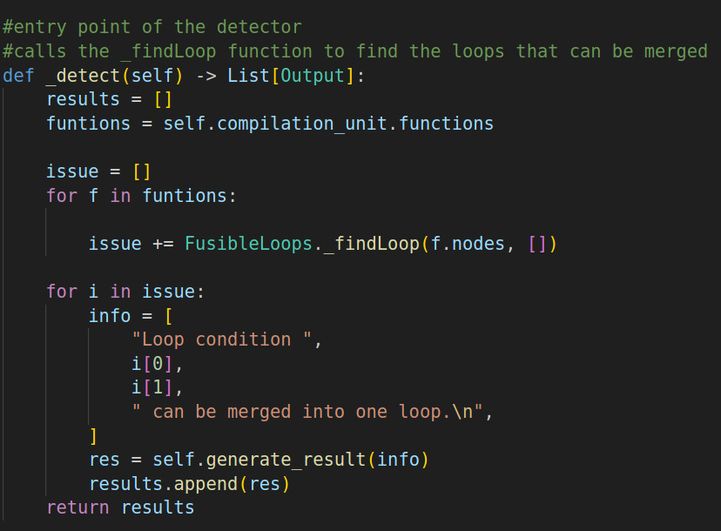
Code Snippets
7
Fig 1: Fusible loops detector code

Slide 8
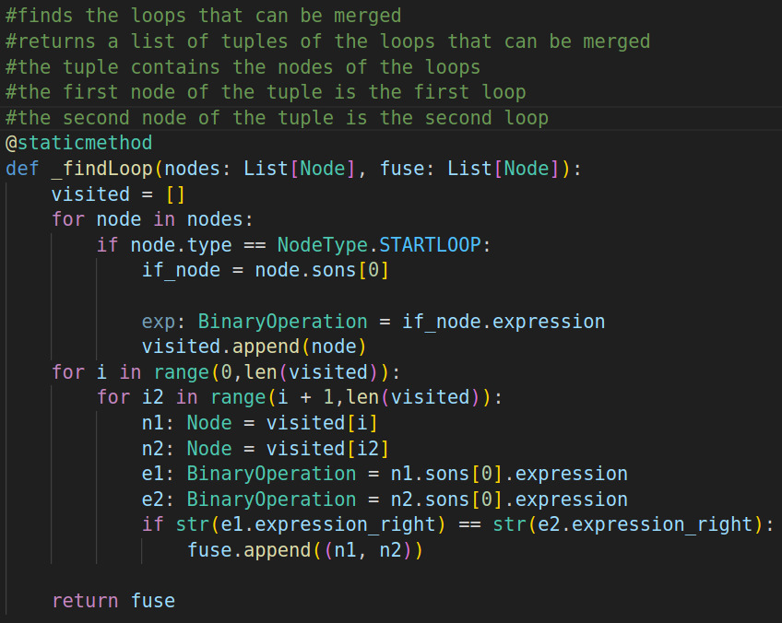
Code Snippets
8
Fig 2: Fusible loops detector code

Slide 9
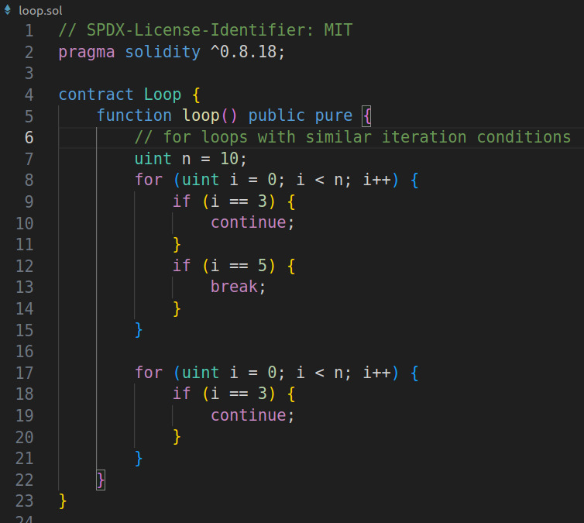
Smart Contract to Test
9
Fig 3: Smart Contract to test detetctor

Slide 10
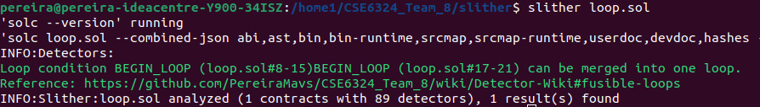
Terminal Snippet
10
Fig 4: Detetctor suggestions logs

Slide 11
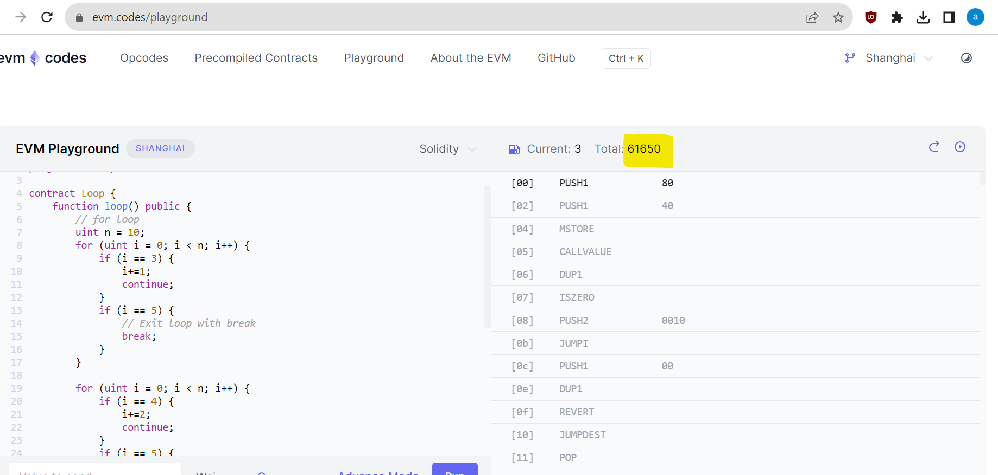
Gas Calculations
Gas Consumption with multiple loops: 61650 Gwei
11
Fig 5 : Multiple Loops Gas Consumption [8]

Slide 12
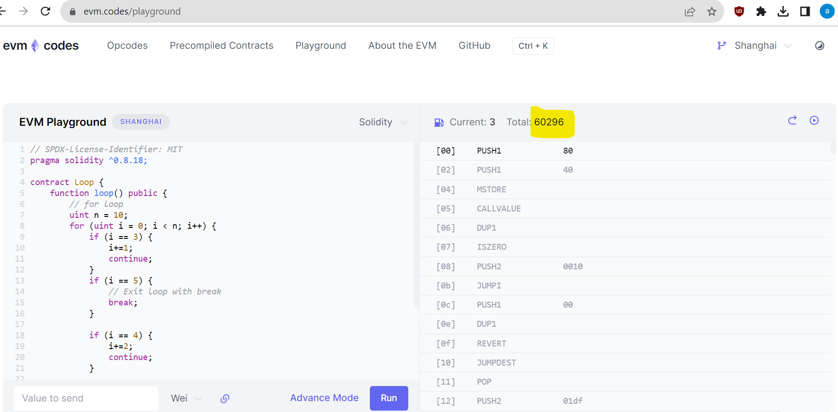
Gas Calculations
Gas Consumption with modified single loop: 60296 Gwei 12
12
Fig 6 : Modified Single Loop Gas Consumption [8]

Slide 13
Risks
Problems faced in Iteration 1 –
Faced issues with the makefile for the developer installation process in Slither. We resolved this by debugging the errors and using Stackoverflow.
As expected, due to a lack of familiarity with the Slither tool, we are facing difficulty in adding the detectors and testing them successfully.
13

Slide 14
Future Risks
Problems anticipated for future iterations –
Introducing new vulnerabilities while implementing new features is an important concern. We plan to do good research and take the support of the TA, Professor, and the developer community to identify cases for this.
The tool’s performance after adding the new features also brings a concern. If the performance is compromised in terms of time, it will require additional time to fix it. We plan to keep the last week of iteration 3 for this.
14

Slide 15
Repository
https://github.com/PereiraMavs/CSE6324_Team_8
Version: 1.0 15

Slide 16
References
[1] S. S. Kushwaha, S. Joshi, D. Singh, M. Kaur and H. -N. Lee, "Ethereum Smart Contract Analysis Tools: A Systematic Review," in IEEE Access, vol. 10, pp. 57037-57062, 2022, doi: 10.1109/ACCESS.2022.3169902.
[2] https://ethereum.org/en/developers/docs/smart-contracts/ , accessed on 09/23/2023
[3] https://ethereum.org/en/developers/docs/gas/ , accessed on 09/23/2023
[4] T. Chen et al., "GasChecker: Scalable Analysis for Discovering Gas-Inefficient Smart Contracts," in IEEE Transactions on Emerging Topics in Computing, vol. 9, no. 3, pp. 1433-1448, 1 July-Sept. 2021, doi: 10.1109/TETC.2020.2979019.
[5] I. Ashraf, X. Ma, B. Jiang and W. K. Chan, "GasFuzzer: Fuzzing Ethereum Smart Contract Binaries to Expose Gas-Oriented Exception Security Vulnerabilities," in IEEE Access, vol. 8, pp. 99552-99564, 2020, doi: 10.1109/ACCESS.2020.2995183.
[6] https://github.com/crytic/slither, accessed on 09/23/2023
[7] https://arxiv.org/abs/2112.14771, accessed on 09/23/2023
[8] https://www.evm.codes/
[9] https://www.linkedin.com/pulse/optimizing-smart-contract-gas-cost-harold-achiando
[10] https://www.linkedin.com/pulse/how-reduce-smart-contract-gas-usage-arslan-maqbool
16

Slide 17
Thank You! Any Questions?
17

