Slide 1
Asset Zip Management with PhysFS
Enric Pérez Rifà

Slide 2
Index
Objective
PhysFS
SDL_RWops
Code Structure
TODOs

Slide 3
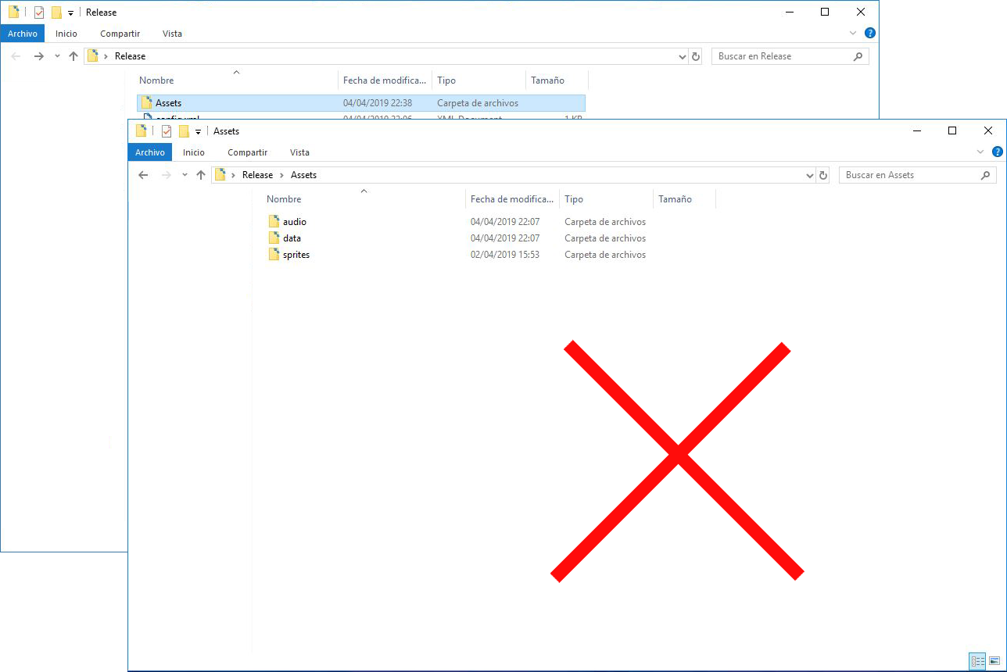
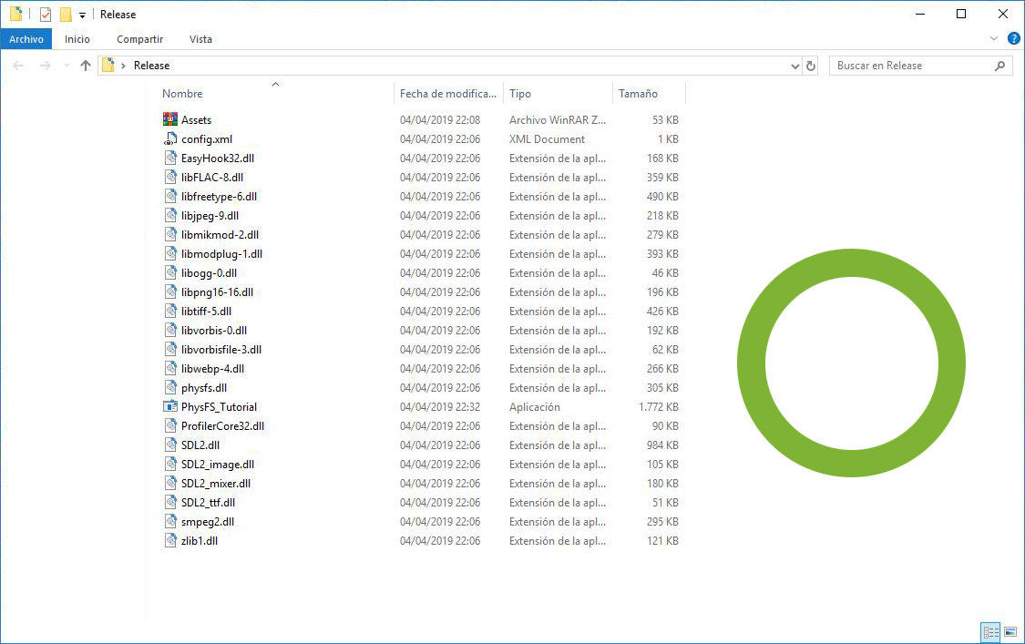
Objective

Slide 4
PhysFS
PHYSFS_init()
PHYSFS_deinit()
PHYSFS_mount(const char* newDir, const char* mountPoint, int appendToPath )
PHYSFS_addToSearchPath(const char* newDir, int appendToPath)
PHYSFS_openRead(const char* filename)
PHYSFS_fileLength(PHYSFS_file* handle)

Slide 5
PhysFS
PHYSFS_Read(PHYSFS_File* handle, void* buffer, PHYSFS_uint32 objSize, PHYSFS_uint32 objCount)
PHYSFS_close(PHYSFS_file* handle)
PHYSFS_getLastErrorCode()

Slide 6
SDL_RWops
IMG_Load_RW(SDL_RWops* src, int freesrc)
Mix_LoadWAV_RW(SDL_RWops* src, int freesrc)
Mix_LoadMUS_RW(SDL_RWops* src, int freesrc)
SDL_RWFromConstMem(const void* mem, int size)

Slide 7
Code Structure
Assets Zip

Slide 8
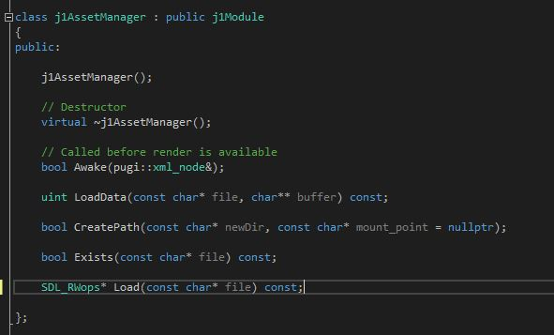
Code Structure

Slide 9

Code Structure

Slide 10

Code Structure

Slide 11
Code Structure

Slide 12
Code Structure

Slide 13
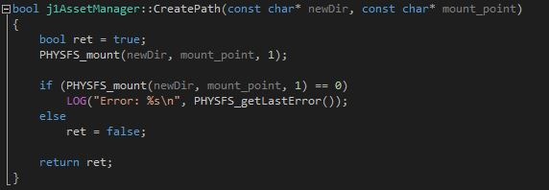
Code Structure

Slide 14
Code Structure

Slide 15
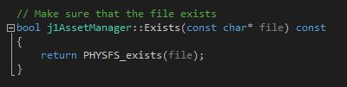
Code Structure

Slide 16
Code Structure

Slide 17
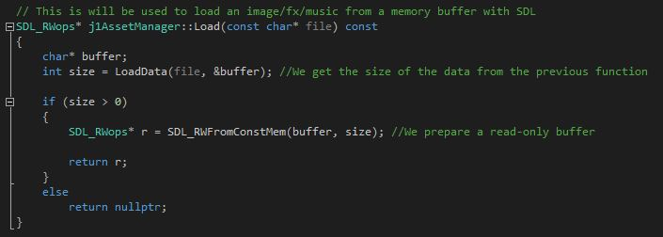
Code Structure

Slide 18
TODO 1: Initialize and close the PhysFS Library
Use the methods mentioned before

Slide 19
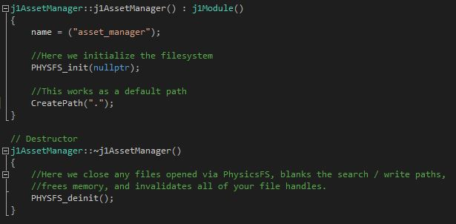
TODO 1: Solution

Slide 20
TODO 2: open an archive to the search path
Call a function in order to search the path where data is

Slide 21
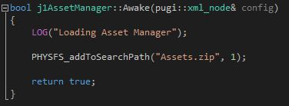
TODO 2: Solution

Slide 22
TODO 3: open and read the file we want to
You will need to use the correct function to open and read file
Make sure that the file is not nullptr
Also allocate memory in a buffer of the size of the file

Slide 23
TODO 4: read data from a PhysFS filehandle
Make sure that the lenght of the data readed is the same as the lenght of the file
If it is not, we delete the buffer
If they are the same, we return the lenght of the readed data
Finally, we close the handle used

Slide 24
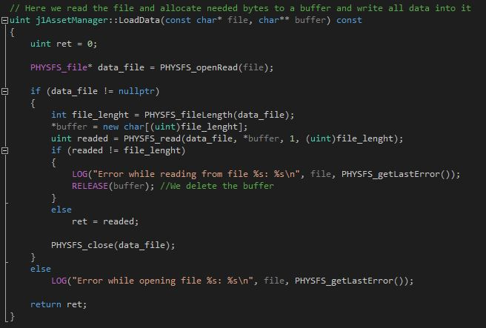
TODO 3 and 4: Solution

Slide 25
TODO 5: replace the functions into the new ones
Now we read from a memory buffer
Use the functions explained earlier in relation to SDL_RWops
Remember that you need to use different methods from the old ones

Slide 26
TODO 5: Solution

Slide 27
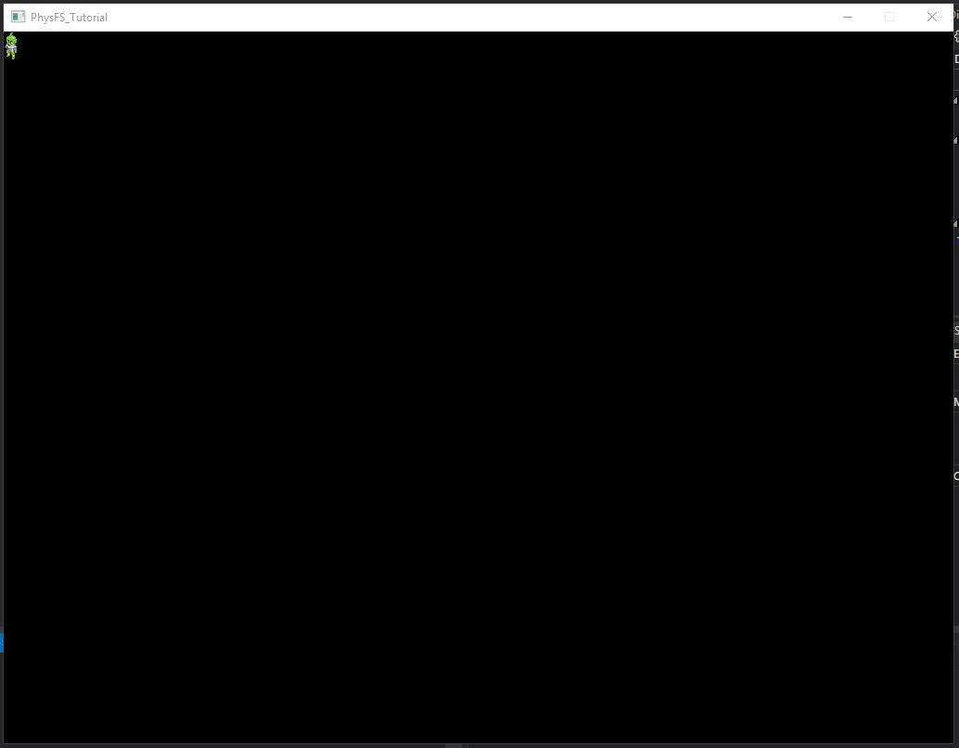
TODO 6 and Solution: Uncomment the methods

Slide 28
Contact
Email: enriic19@gmail.com
Thanks for your attention!

