Slide 1
PerfVec: Generalizable Performance Modeling using Learned Program and Architecture Representations
Lingda Li, Sairam Sri Vatsavai, Kuan-Chieh Hsu
Brookhaven National Laboratory
SIGMETRICS 2025
Stony Brook, NY

Slide 2

Agenda
PerfVec overview (30 mins)
Performance prediction demo/hands-on (30 mins)
Design space exploration (15 mins)
Source code (5 mins)
Open discussion (10 mins)
Repository: https://github.com/PerfVec/PerfVec
Source code and other materials used in this tutorial

Slide 3
PerfVec Overview

Slide 4
Performance Modeling for Computer Architecture
Essential to computer architecture research and engineering
New design evaluation, design space exploration, resource scheduling, …
Goals: speed, accuracy, and generalizability
Methodology | Speed | Accuracy | Generalizability
Analytical Modeling | Fast | Low | High
 |  | High | Low
Discrete Event Simulation | Slow | Variable | High
Emulation | Medium | Variable | Medium
Machine Learning (ML)-based Modeling | Fast | High | Low
ML-based Simulation | Medium | Variable | Medium
PerfVec (this work) | Fast? | High? | High?
Goal: explore better tradeoff using ML, especially on generalizability

Slide 5
Generalizable Performance Modeling
Performance is determined by both software and hardware.
A generic performance model should separate the impact of software (program) and hardware (microarchitecture).
When one changes, no need to re-model the other
Not trivial to achieve such separation
Complex interplay between program and microarchitecture
Several analytical models tried to do it manually.
PerfVec learns the separation automatically.

Slide 6
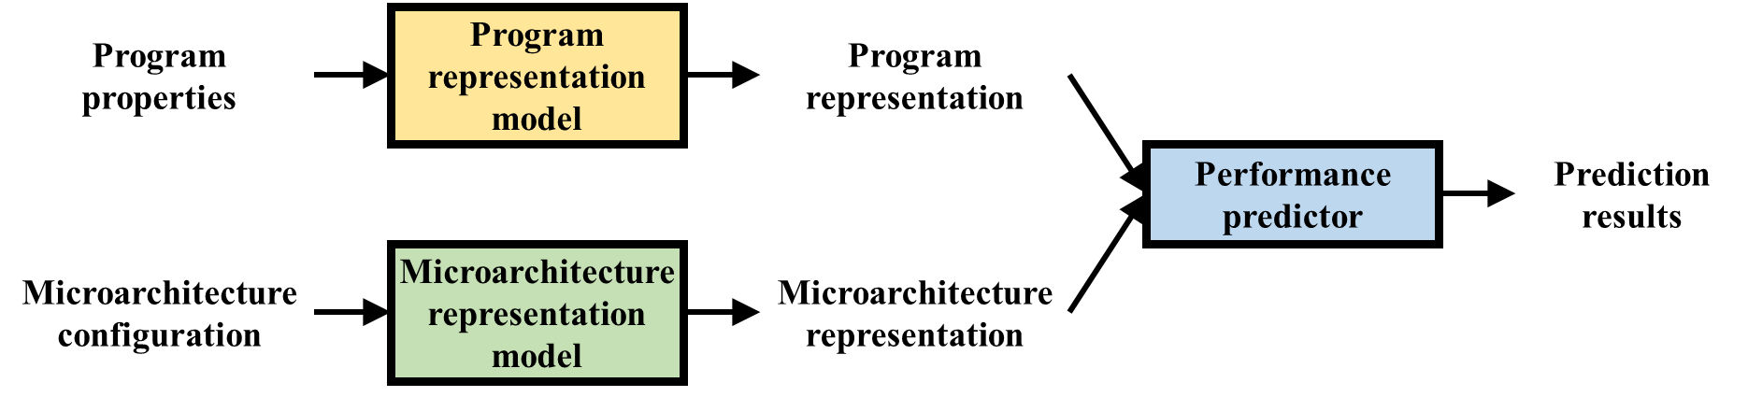
Learning Separation
Key idea 1: have two independent ML models to capture the performance impacts of program and microarchitecture, respectively
The same program representation is used to predict its performance on any microarchitecture, and vice versa.
independent
of each other
Focus of this work

Slide 7


Learning Program Representation
Input | Level of Detail | Limitation
Profiling info (e.g., performance counters) | Low | Often microarchitecture dependent Lack of low level details
Static program info (e.g., control flow graph) | Medium | Cannot capture dynamic execution (e.g., input impact) Huge graphs to learn from
Instruction execution trace | High | Huge amounts of instructions to learn from
Challenge: programs typical execute at least billions of instructions, and no ML model can deal with such long sequences.
Key idea 2: 1) learn the representations of individual instructions and 2) compose a program representation from those of all its executed instructions (divide-and-conquer)

Slide 8
Learning Instruction Representation
Performance determination factors of an instruction
Factor | Microarchitecture Independent Feature
Own properties | Static properties (e.g., operation type); dynamic behavior (e.g., branch direction); reuse distance; branch entropy
Co-running instructions | Co-running instructions’ properties
Instruction_{n}’s representation
Instruction_{i}’s features
Instruction_{i-1}’s features
…
Instruction_{i-c}’s features
…
Instruction
representation
model
Instruction_{i}’s representation
Program representation
…
Refer to the paper on how to compose program representation
A sequence model
(e.g., LSTM, Transformer)
Instruction₁’s representation
Generalizable across programs
Program traces are different sequences of instructions from the same set.

Slide 9
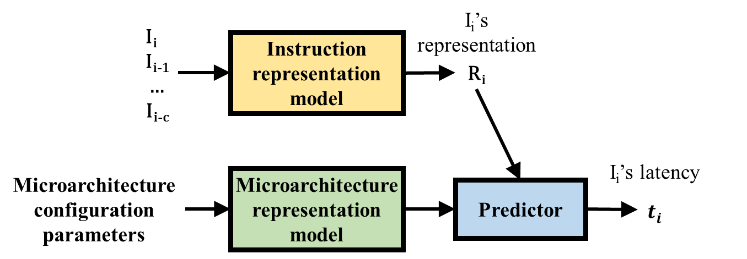
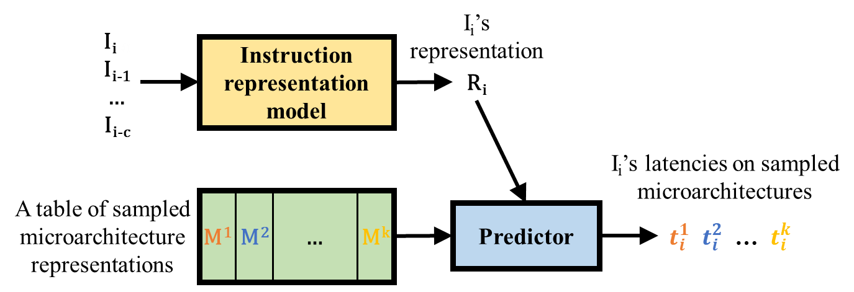
PerfVec Training
Replace the program representation model
Natural solution: training all models end-to-end
Challenge
Irregular and alterable microarchitectural space
Difficult to train a universal microarchitecture representation model
Hypothesis: training with a sufficient number of diverse microarchitectures enables generalizability to others.
Key idea 3: train the instruction representation model to predict instruction latencies on randomly selected microarchitectures for generalizability
Train representations of sampled microarchitectures jointly

Slide 10
Data Acquisition & Model Architecture
Instruction traces from gem5 simulation
Easy to obtain instruction level latency
Easy to configure microarchitectures
Programs
17 SPEC CPU2017 benchmarks
10 for training, 7 for testing
Microarchitectures
Randomly generated gem5 configurations
In-order/out-of-order cores, caches, memory, etc.
77 for training, 10 for testing
Model architecture
2-layer LSTM by default
See the paper for other architectures

Slide 11
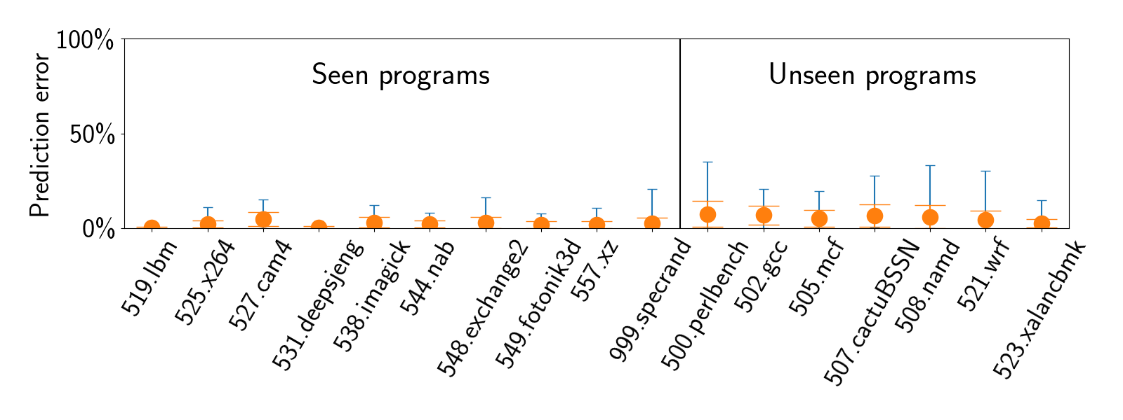
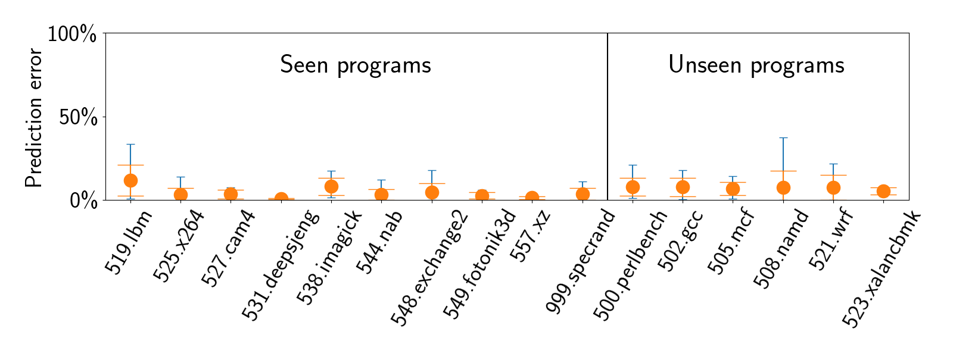
Generalizability Evaluation
Unseen programs
Unseen microarchitectures
Prediction error range against gem5 simulation across all microarchitectures
The trained model generalizes well to unseen programs and microarchitectures.

Slide 12
PerfVec Summary
High generalizability
Learn independent program and microarchitecture representations
Good accuracy
Learn program representations from instruction execution traces
Fast speed
Simple combination of program and microarchitecture representations
Many potential applications
Design space exploration, performance analysis, …
Code: https://github.com/PerfVec/PerfVec

Slide 13
Performance Prediction Demo/Hands-on

Slide 14
Agenda
Demo: cross-compile a program
Demo: gem5 simulation and trace generation
Hands-on: trace processing and prediction

Slide 15
Demo: Cross-compile a program
Input: Helloworld program written in C
Cross compiler: https://github.com/riscv-collab/riscv-gnu-toolchain
Platforms:
On Linux environment
With Dockerfile
Output: helloworld executable in RISC-V architecture.

Slide 16
Demo: gem5 simulation & trace generation
Input: executable
Simulator: gem5 https://github.com/lingda-li/gem5/tree/riscv
Output: trace.txt and trace.sq.txt

Slide 17
Hands-on: trace processing & prediction
Google Colab notebook
https://colab.research.google.com/drive/1ViJtzsbbUFXkSEYsdgne9iJsfCZq0UvJ#scrollTo=IS-7Ugikt7Cl

Slide 18
Design Space Exploration

Slide 19
PerfVec Use Cases
Performance modeling is essential for many tasks.
PerfVec can be used in them.
A case study: design space exploration (DSE)
Find the optimal design(s) given one/multiple objective function(s)
DSE example: L1 and L2 cache size exploration
Objective function: execution_time * (1000 + 10*L1_size + L2_size)
Similar to latency area product
Select the best cache sizes for 17 SPEC CPU2017 benchmarks

Slide 20
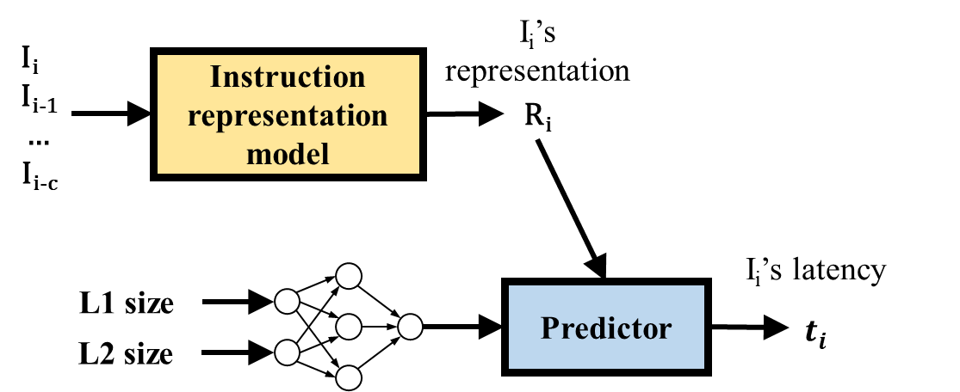
DSE Procedure
Froze during training
Train a microarchitecture representation model
Training data: gem5 simulation traces of 3 benchmarks on selected configurations
Predict the performance of all benchmarks
Use the trained microarchitecture representation model and existing program representations
A 2-layer MLP

Slide 21
DSE Results
Lower is better
Complete gem5 simulation: 600 hours
Previous ML-based DSE methods
Use selected simulation results to train program-specific models
Need to simulate many configurations for each program
PerfVec
Incur significantly less overhead with comparable quality
11 hours = 5 (data collection) + 6 (training)
Method | Overhead | Quality
ASPLOS06 | 150 | 4.4%
MICRO07 | 84 | 4.7%
DAC16 | 170 | 3.6%
PerfVec | 11 | 3.6%
Overhead: the time to construct models (hours)
Quality: how close the selected design is to the optimal design.
Ïpek et al. Efficiently exploring architectural design spaces via predictive modeling. ASPLOS 2006.
Dubach et al. Microarchitectural design space exploration using an architecture-centric approach. MICRO 2007.
Li et al. Efficient design space exploration via statistical sampling and adaboost learning. DAC 2016.

Slide 22
Source Code

Slide 23
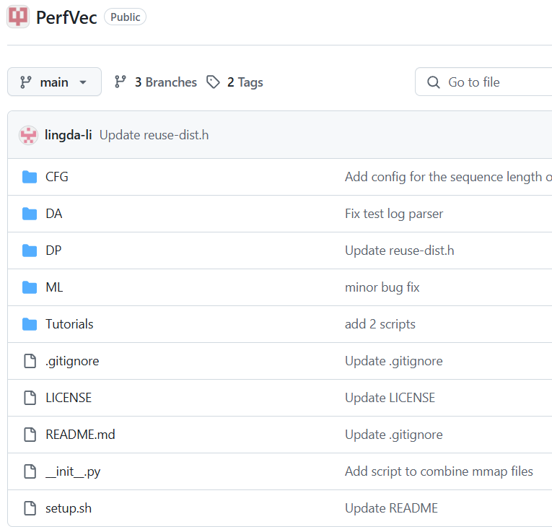
Top Level Folders
DP: data processing scripts for simulation traces
Implemented using Python (NumPy) and C++
ML: scripts for training, test, models, etc.
Implemented using PyTorch
CFG: configuration files for datasets
Tutorials: descriptive instructions and documents
DA: data analysis scripts

Slide 24
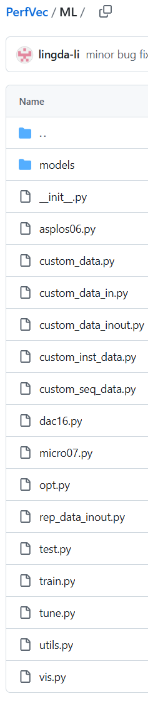
ML Folder
models: neural network architectures
LSTM, Transformer, CNN, MLP, …
train.py: train instruction representation models
test.py: test prediction accuracy of trained models
tune.py: fine-tune microarchitecture representation models and representations
custom_data*.py: data loaders for PerfVec datasets

Slide 25
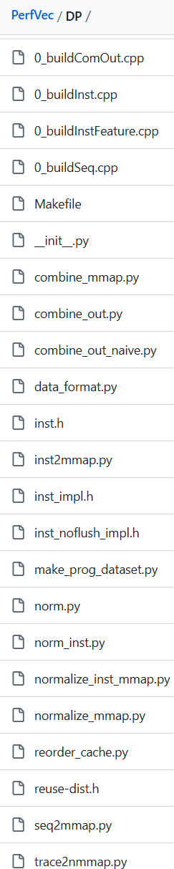
DP Folder
gem5 trace processing
0_buildInstFeature.cpp: numerical instruction feature generation
inst2mmap.py, trace2nmmap.py: convert a textual numerical trace to numpy memory mapping format for PyTorch input
normalize_*.py: dataset normalization
Training/test data generation
0_buildComOut.cpp, combine_out.py: generate prediction labels

Slide 26
Open Discussion
Questions?
Comments?
Collaboration opportunities?

