Slide 1


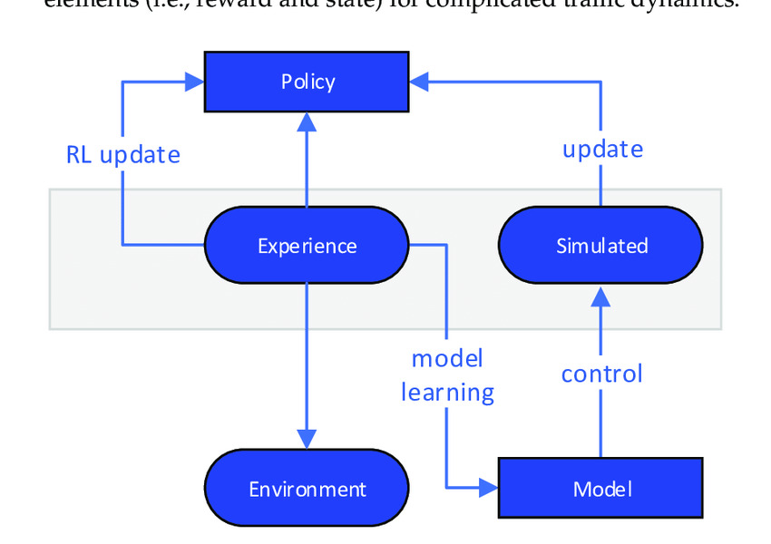

Q-SolarSwitch AI-Driven Smart Switching for Optimized Energy Consumption and Cost Savings
Perfect Cube
Problem Statement:
Energy Cost Fluctuation: Time-of-Use (TOU) tariffs create high energy costs during peak periods.
Energy Waste: Solar energy is often underutilized, leading to missed savings opportunities.
Lack of Smart Management: Existing systems lack real-time decision-making for switching between power sources.
Proposed Solution: AI-Driven Dynamic Power Management:
Deep Q-Learning Agent: Learns optimal energy usage patterns to switch between grid and solar energy based on tariffs.
Real-Time Energy Monitoring: Tracks consumption and potential savings in real-time.
Automated Energy Source Switching: Automatically switches power sources when solar usage can lead to higher savings.
Key Benefits:
Maximizes Savings: Reduces grid energy costs by using solar power during peak pricing.
Optimized Consumption: Smart scheduling of high-energy appliances during low-cost periods.
Improves Sustainability: Efficient use of renewable energy.

Slide 2
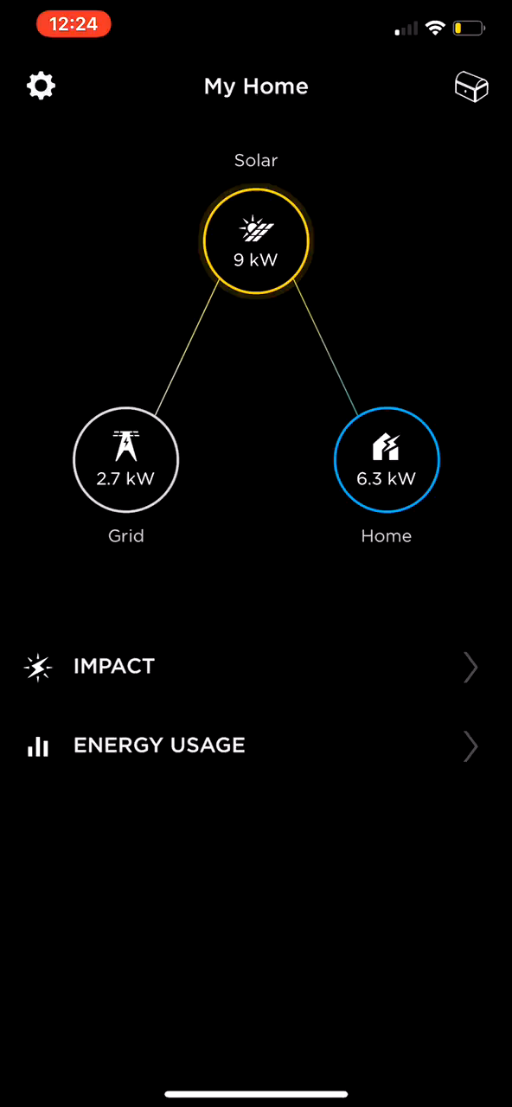
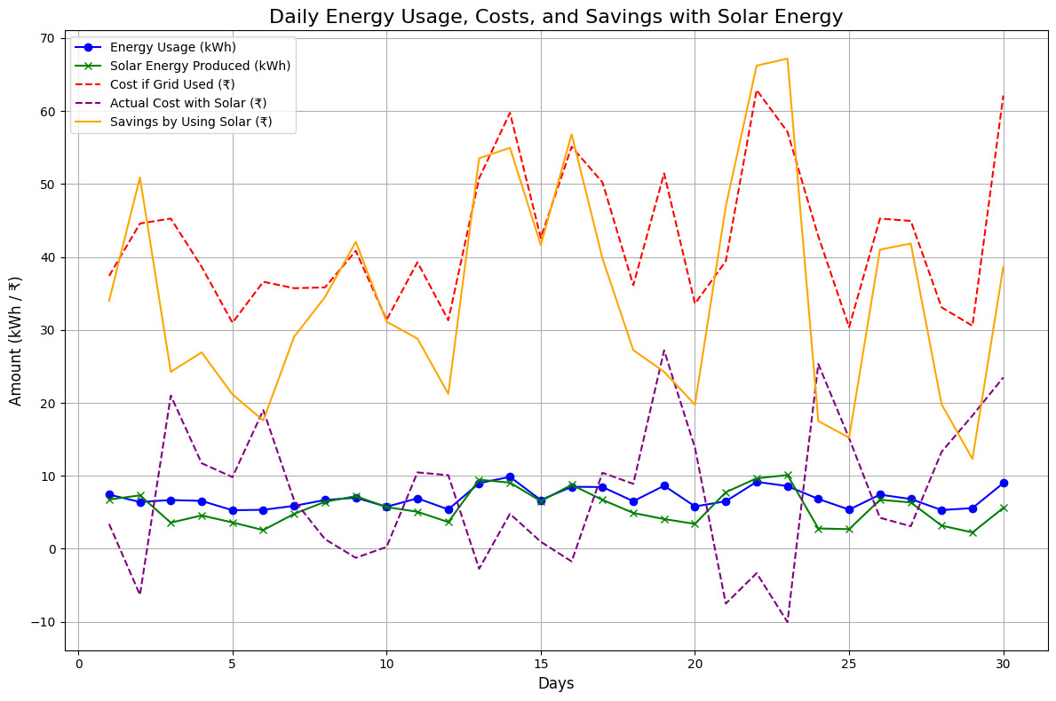
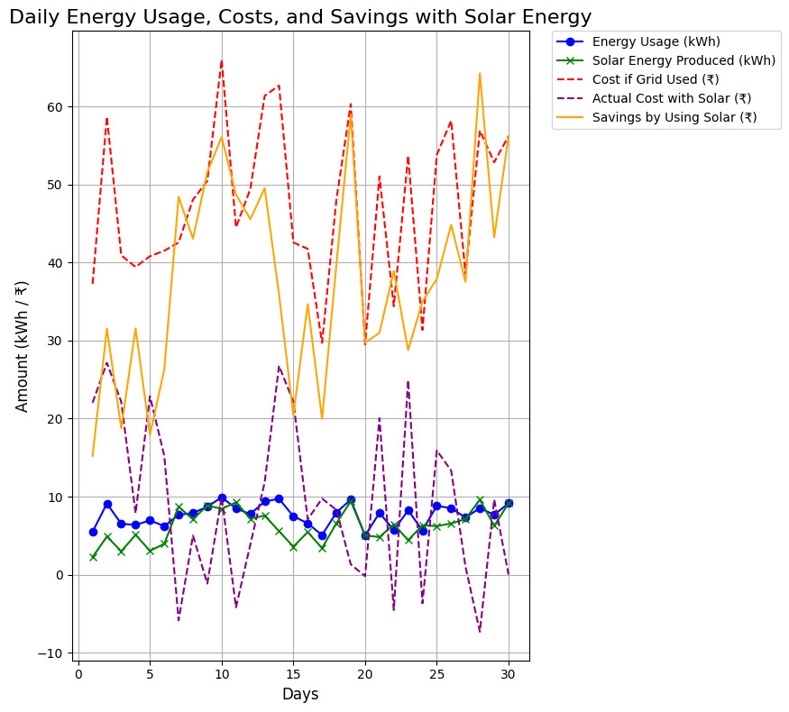
Perfect Cube
Business Impact:
Cost Reduction: Average 15%-25% reduction in energy costs for users.
Increased Efficiency: Improved energy utilization for households and businesses with solar installations.
Sustainability Goals: Helps businesses meet renewable energy targets and reduce their carbon footprint.
How It Works:
Monitor & Forecast: The system predicts future energy consumption and solar production.
Smart Scheduling: High-energy appliances (e.g., EV chargers, dishwashers) are scheduled during low-tariff periods.
Savings Calculation: Continuous monitoring of savings from solar energy usage vs. grid energy.
Next Steps for Deployment:
Pilot Testing: Implement in 10-20 solar-powered households for real-world data collection.
Cloud Deployment: Use AWS or Google Cloud to scale the backend for large user adoption.
Monitoring & Optimization: Set up dashboards (Grafana/Prometheus) for real-time performance and savings tracking.

