Slide 1


Hack4Industry
Problem Statement - Real time traffic management system for Jamnagar
Team Name- Team Omniscients
Members:
Rahul Panwar
Ansh Sharma
Harsh Raj
Kanishk Kushwaha
Shivansh Gupta
So, What’s the Problem in Jamnagar??

Slide 2
ALGORITHMIC APPROACH
Team Omniscients
Particle Swarm Optimization can be is a solution
Optimize four signals at Motikhavdi (North, South, East, West), linked to signals at the previous crossing (refinery gate) and next crossing (toward Jamnagar city).
Objective or Fitness: Minimizing cost function that is our delay cost function:
→Delay cost = Summation(Ti*Vi)+3.D(truck) + 10.D(Emergency)
Ti and Vi are delay and vehicle counts per direction, truck delays weighted more and Emergency vehicle defers weighted higher.
Variables: Green times for four directions (10-90s each). [N,S,E,W]
[ 1 particle = set of four green signals]
Particles: 20 particles, each a set of four green times, e.g.:
Particle 1: [50s N, 30s S, 20s E, 25s W].
Particle 2: [60s N, 25s S, 30s E, 20s W].
Position: [N, S, E, W green times]. | Velocity: Random, e.g., [3, -2, 1, -1] for Particle 1
@Hack4Industry Elimination Round- Template
2
Notes:
2

Slide 3
Team Omniscients
Evaluate Fitness with Computer Vision
Input: Cameras predict arrivals (e.g., 160 trucks from North in 25s at 40 km/h).
Example: Particle 1 [50, 30, 20, 25]:
--> Simulated delays: N = 30s, S = 45s, E = 65s, W = 60s, truck delay = 50s.
--> Cost = (30 × 400) + (45 × 300) + (65 × 200) + (60 × 150) + (3 × 50) = 12,000 + 13,500 + 13,000 + 9,000 + 150 = 47,650.
Initial G(best): Particle 2 [60, 25, 30, 20], cost = 45,200.
Update Particle Positions and Velocities
Vi(t+1) = w.Vi(t) + c1.r1.(P(best)i - Xi(t)) + c2.r2.(G(best) - Xi(t)) | c2 can be increased during truck surge
Xi(t+1) = Xi(t) + Vi(t+1)
Iterate and Optimize
Result: After 50(say) iterations, G(best) = [65,28,25,22], cost = 42,300 (N = 25s, S = 40s, E = 55s, W = 50s, truck delay = 40s).
→Coordination: Adjust adjacent crossings (e.g., refinery gate green at 65s synced with Motikhavdi North).
@Hack4Industry Elimination Round- Template
3
Notes:
3

Slide 4
SIMULATION DESCRIPTION
Team Omniscients
Network Structure - 3x3 grid of intersections (9 total intersections)
- 3x3 grid of intersections (9 total intersections)
- Each intersection has traffic signals in all four directions (N, S, E, W) - Each road is 240 pixels long with a width of 25 pixels
Vehicle Types
→ Regular vehicles:
Color-coded by direction:
North: Bright Red
South: Bright Blue
East: Bright Green
West: Bright Orange
→ Emergency vehicles:
- Bright Red color - Larger size (10 pixels radius) - Flashing white lights
4. Statistics Display
- Real-time vehicle counts
- Direction-wise traffic distribution
- Emergency vehicle tracking
- Intersection-specific timing information
- Simulation status indicator
Simulation Ahead !!
@Hack4Industry Elimination Round- Template
2

Slide 5
THE TECHNOLOGY STACK
Team Omniscients
Going step by step :
Particle Swarm Optimization is the heart of our solution which is powerful for adapting to dynamic environment. In Indian traffic problems, the traffic is very dynamic but we are still using the old predefined circuitries for timing the signals.
Data input through live CCTV traffic footages using Computer Vision (YoloV8n).
Making of simulation using Python and its libraries like numpy, pygame, matplotlib, time and others.
But how does signals change in real life?
@Hack4Industry Elimination Round- Template
2

Slide 6
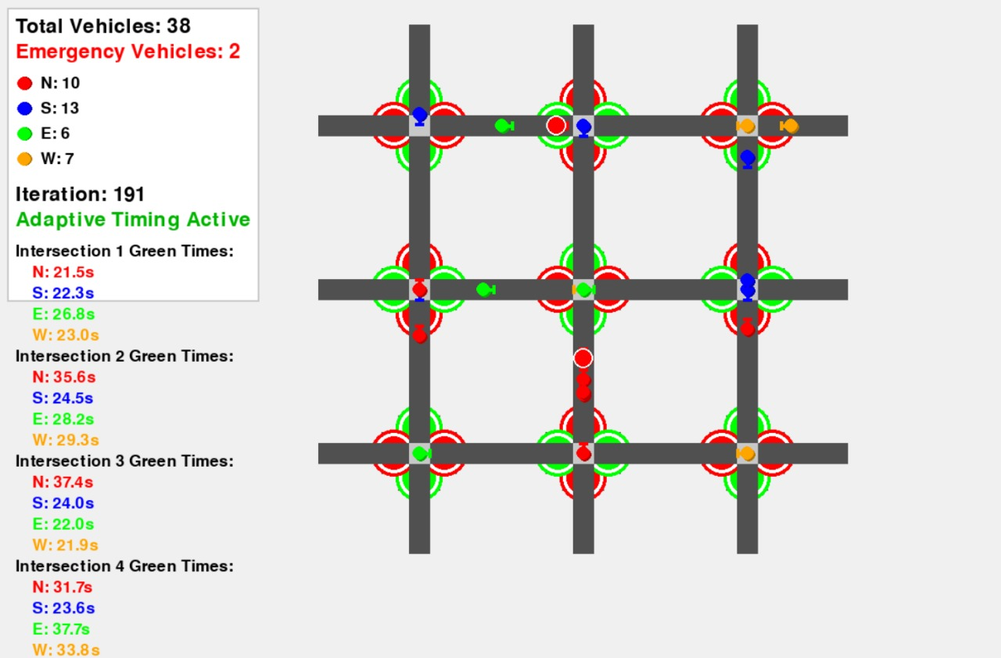
Team Omniscients
The Rerouting Solution
First of we have set a threshold for rerouting.
If the time of resolving the congestion or traffic on a particular direction is greater than the time after rerouting at the previous signal, then, just reroute on the previous signal for the same direction traffic. So that it reach the intersection next to the next intersection on time.
Now I’ll explain it with the help of this→
@Hack4Industry Elimination Round- Template
2

Slide 7
Team Omniscients
UNIQUENESS
Uniqueness: Why PSO only?
Works best for dynamic adaptation.
It reaches optimal solution in a fewer steps.
Implements multi-intersection PSO means adjacent intersection also optimize together.
@Hack4Industry Elimination Round- Template
4
Notes:
4

Slide 8
IMPACT AND BENEFITS
Team Omniscients
Potential impact on the target audience:
Lower waiting times leading to less fuel consumption.
Less dependency on traffic police.
Obviously, no more frustration of traffic.
Benefits of the solution (social, economic, environmental, etc.)
→ Environmental: Less fuel consumption leading to reduced pollution.
Economic: Reduced waiting time for industrial vehicles significantly benefit them.
Social: Signals can also be optimized for emergency vehicles crossing.
@Hack4Industry Elimination Round- Template
5
Notes:
5

Slide 9
RESEARCH AND REFERENCES
Team Omniscients
Knowledge gained through the last semester’s PAI subject.
News articles related to the road congestion and industrial vehicles problem in Jamnagar.
@Hack4Industry Elimination Round- Template
6
Notes:
6

Slide 10
Team Omniscients
THANK YOU!!
Q&A
@Hack4Industry Elimination Round- Template
6

