Slide 1
Cyclistic How does a bike share navigate speedy success?
Ren Guan

Slide 2
Agenda
Introduction
Analysis
Key Findings
Recommendations
Additional data

Slide 3
Introduction: About the Company
In 2016, Cyclistic launched a successful bike-share offering. Since then, the program has grown to a fleet of 5,824 bicycles that are geo-tracked and locked into a network of 692 stations across Chicago. The bikes can be unlocked from one station and returned to any other station in the system anytime.
There are two types of customers: casual riders, who refer to customers purchasing single-ride or full-day passes, and Cyclistic members, who are customers purchasing annual memberships.

Slide 4
Introduction: Characters and teams
Key Stakeholders:
Lily Moreno: The director of marketing
Cyclistic Marketing Analytics Team: A team of data analyst who are responsible for collecting and analyzing
Cyclistic executive team: The notoriously detail-oriented executive team will decide whether to approve the recommended marketing program.

Slide 5
Introduction: Key Task
Annual members are more profitable than casual riders.
Convert casual riders into members.
Uncover the primary disparities in usage trends between Casual and Member riders, with the aim of converting as many Casual riders to Member riders as possible, to secure the company's future success.

Slide 6
Analysis

Slide 7
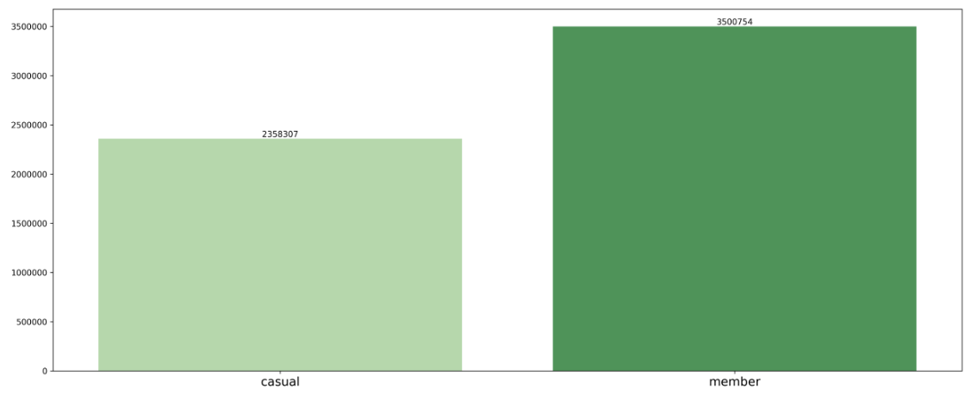
What did data tell us:

Slide 8
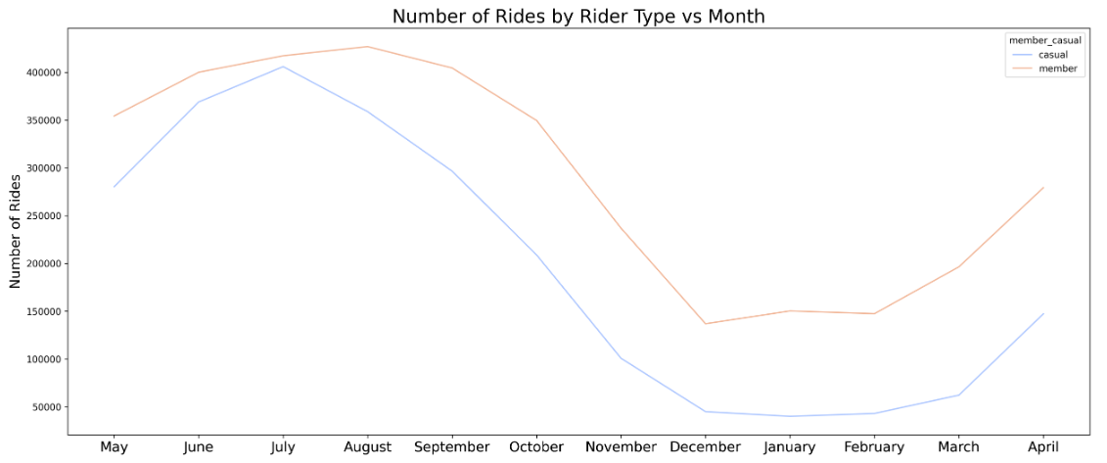
What did data tell us:

Slide 9
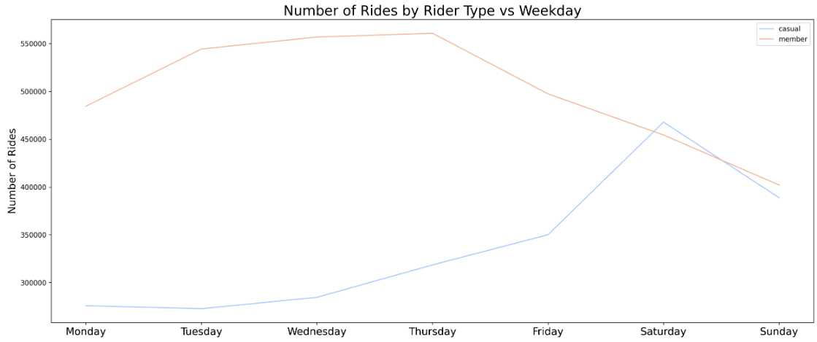
What did data tell us:

Slide 10
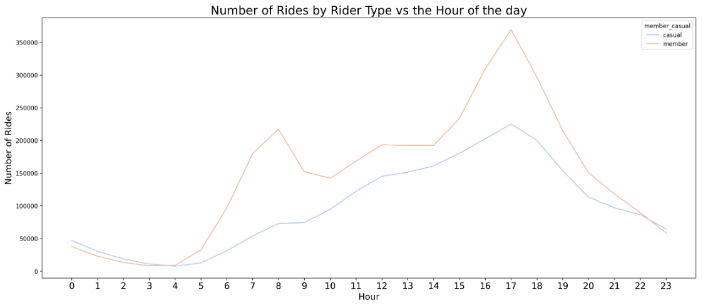
What did data tell us:

Slide 11
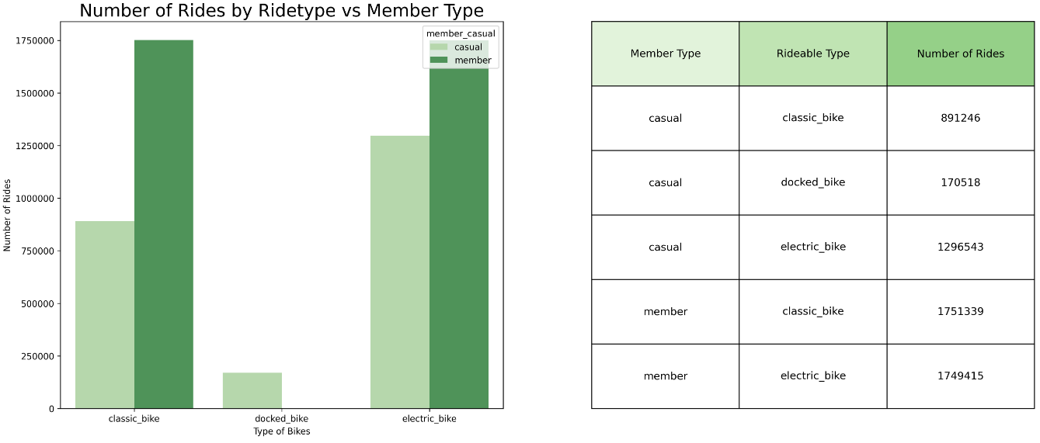
What did data tell us:

Slide 12
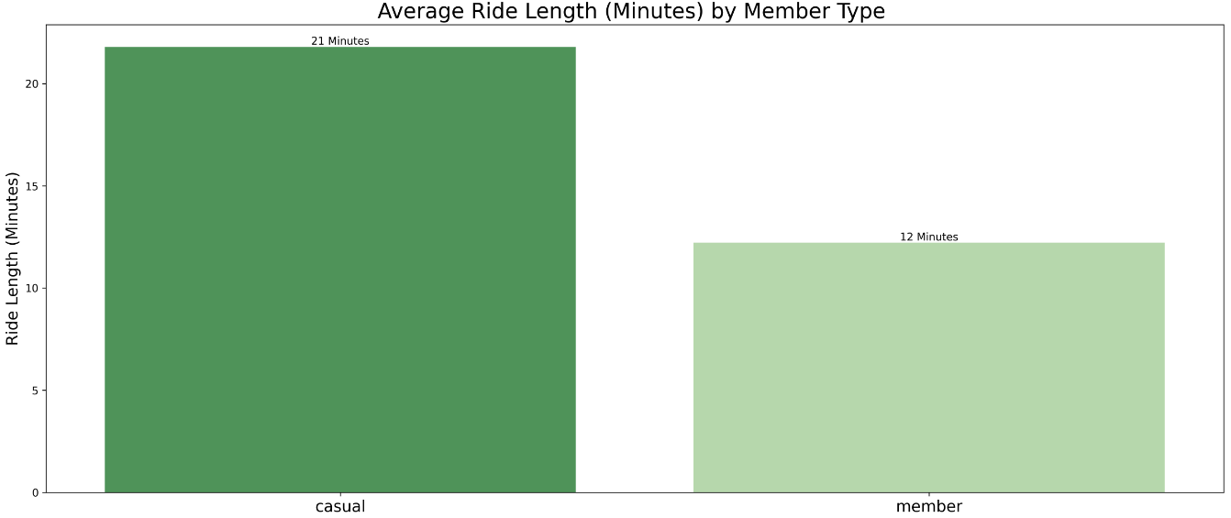
What did data tell us:

Slide 13
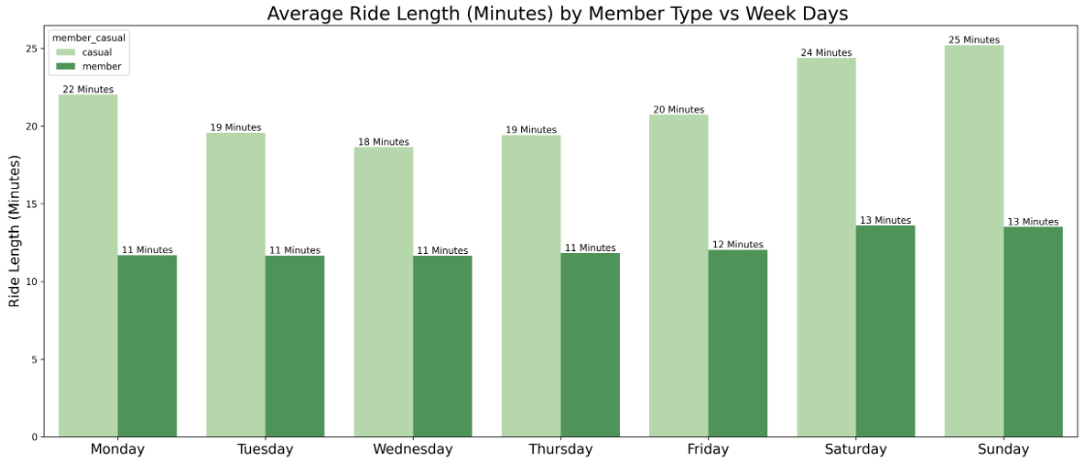
What did data tell us:

Slide 14
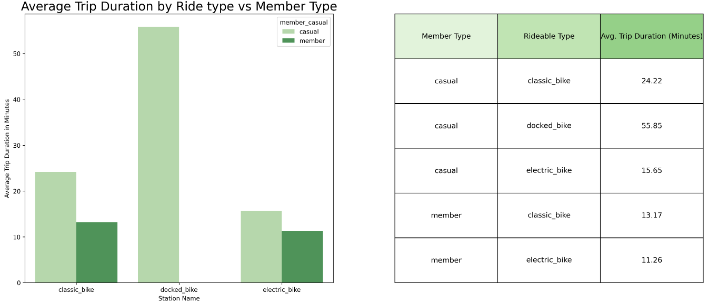
What did data tell us:

Slide 15
Key Findings

Slide 16
Key Findings: Summary
The summer months (June, July, and August) are the busiest time. Both types of users experience a significant increase in the number of cycling trips during the summer.
User portrait for cyclistic member: office professionals
User portrait ofr causal user: Uncertain, Diverse Composition

Slide 17
Key Findings: Summary
Member user do not show a clear preference between electric bikes and classic bikes, but they do not use docked bikes at all.
casual users show a clear preference for electric bikes over classic bikes.

Slide 18
Recommendations

Slide 19
Recommendations
Fleet Management: Adjust the fleet composition based on user preferences
Service Expansion: Explore ways to cater to causal users’ varying needs
Subscription Options: Consider introducing flexible subscription options tailored to users needs
Operational Efficiency: optimize resource allocation and operational efficiency

Slide 20
Additional Data

Slide 21
Additional Data could be considered
Weather Data: temperature, precipitation, weather conditions
User Feedback and Surveys: satisfaction, preferences, suggestions for improvement
Competitor Data: other bike-sharing providers or transportation modes
Demographic Data: age, gender, location of riders

Slide 22
Thank you
Ren Guan
lamkwun1995@Gmail.com

