Slide 1
Instruction for Expert Advisor
ALIGARH
ALIGARH

Slide 2
Something about me and my husband. He is a programmer. I’m forex trader. We started to write this expert about year ago. We always release new versions. We don’t know English so good =), so sorry for mistakes.
The last version always is here.
For downloading a data history use a script YURAZ_Create_Histor_CSV_From_MT5_for_MT4.
You can find an instruction in google =)
Our broker’s settings:
Leverage: 1:500
Digits: 5
Minimal trades: 100
Minimal period: from 2012 to current time (use long period for your tests).

Slide 3
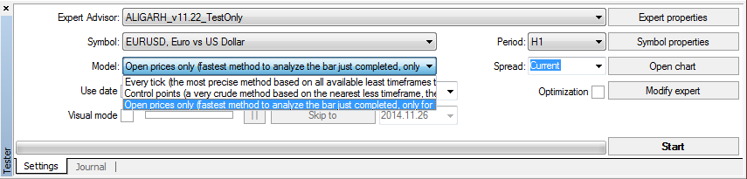
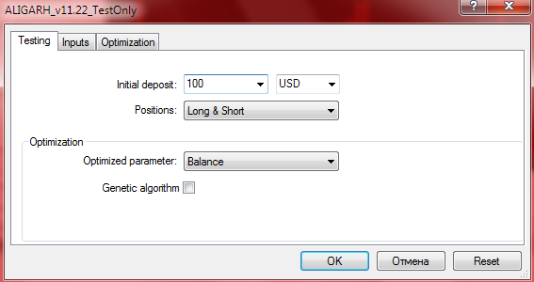
USE “Open price only”
OFF

Slide 4
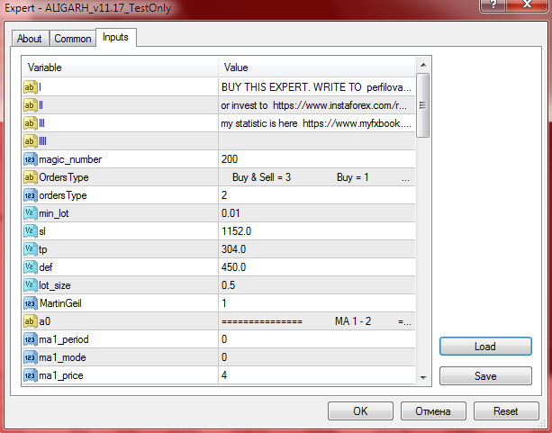
Parameters for EUR/USD
Any number > 0
Type of orders
(2 = only sell)
Minimal lot
Stoplose and TakeProfit (for 5 digits account)
(devide by 10 for 4 digits
account)
Lot = Balance / def
(if our balance is 2000$,
then lot = 2000/450 = 4.44)
(if calculated Lot < min_lot,
then we use min_lot)

Slide 5
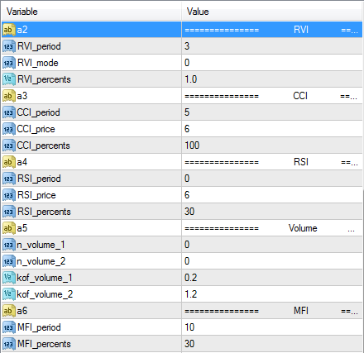
for using indicators make _period > 0
These indicators (RVI, CCI, MFI) will be used by expert, because _period > 0
These indicators (RSI, Volumes) are not used, because _period = 0

Slide 6
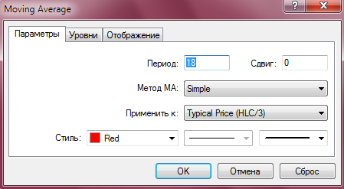
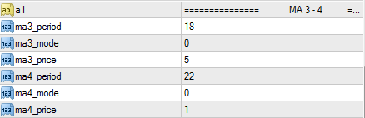
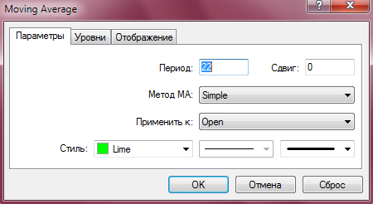
Moving Average 3 - 4 (MA 3- 4)
For buy: If MA3 > MA4, then buy
For sell: If MA3 < MA4, then sell

Slide 7
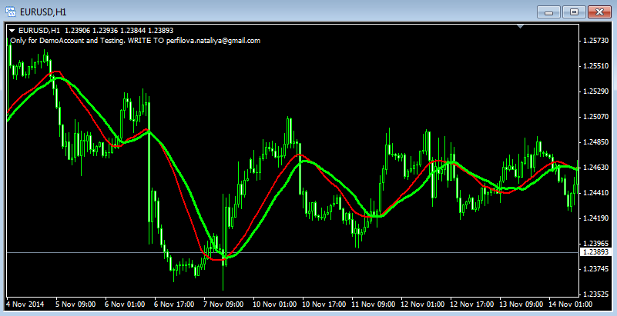
Moving Average 3 - 4 (MA 3- 4)
For sell orders: if MA3 is under MA4, then TRUE (we open sell order)

Slide 8

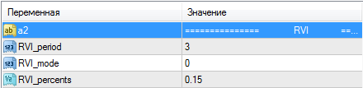
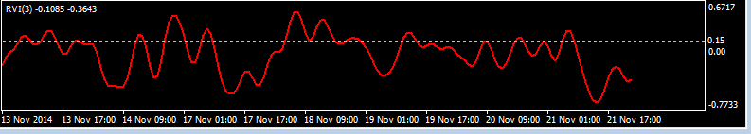
Indicator RVI
For sell orders: if RVI with period 3 is under the level 0.15, then TRUE (we open sell order)
For buy orders: if RVI with period 3 is over the level 0.15, then TRUE (we open buy order)

Slide 9
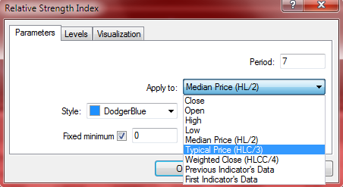
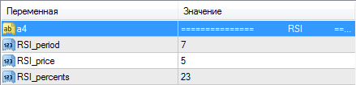
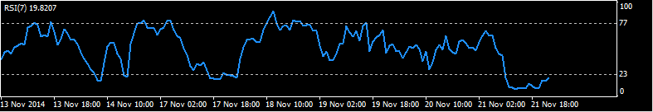
Indicator RSI
For sell orders: if RSI with period 7 is under the level 23, then TRUE (we open sell order)
For buy orders: if RSI with period 7 is over the level (100-23=77), then TRUE (we open buy order)

Slide 10
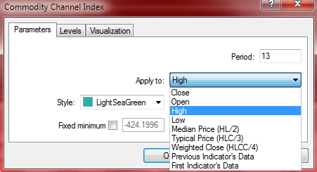
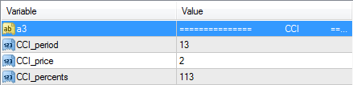
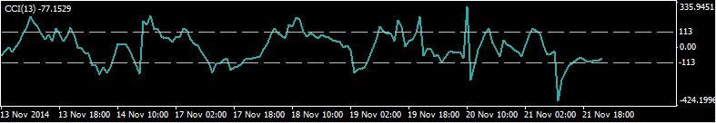
Indicator CCI
For sell orders: if CCI with period 13 is under the level -113, then TRUE (we open sell order)
For buy orders: if CCI with period 13 is over the level 113, then TRUE (we open buy order)

Slide 11
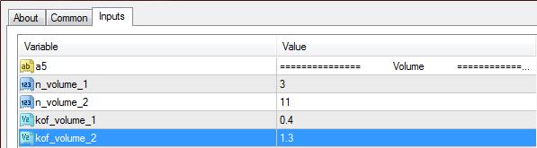
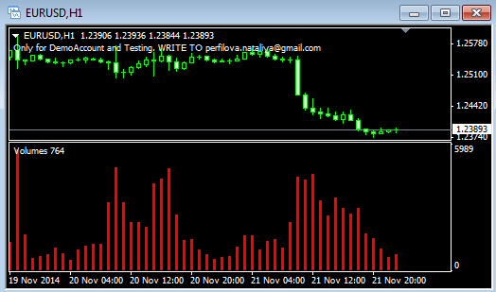
Indicator Volumes
sum(last 3 Volumes) / 3
if 0.4 < < 1.3
then TRUE
sum(last 11 Volumes) / 11

