Slide 1
Cloud Performance Engineering in DevOps
Site Reliability Engineer
Elastic Stack - ELK
Raushan Kumar

Slide 2
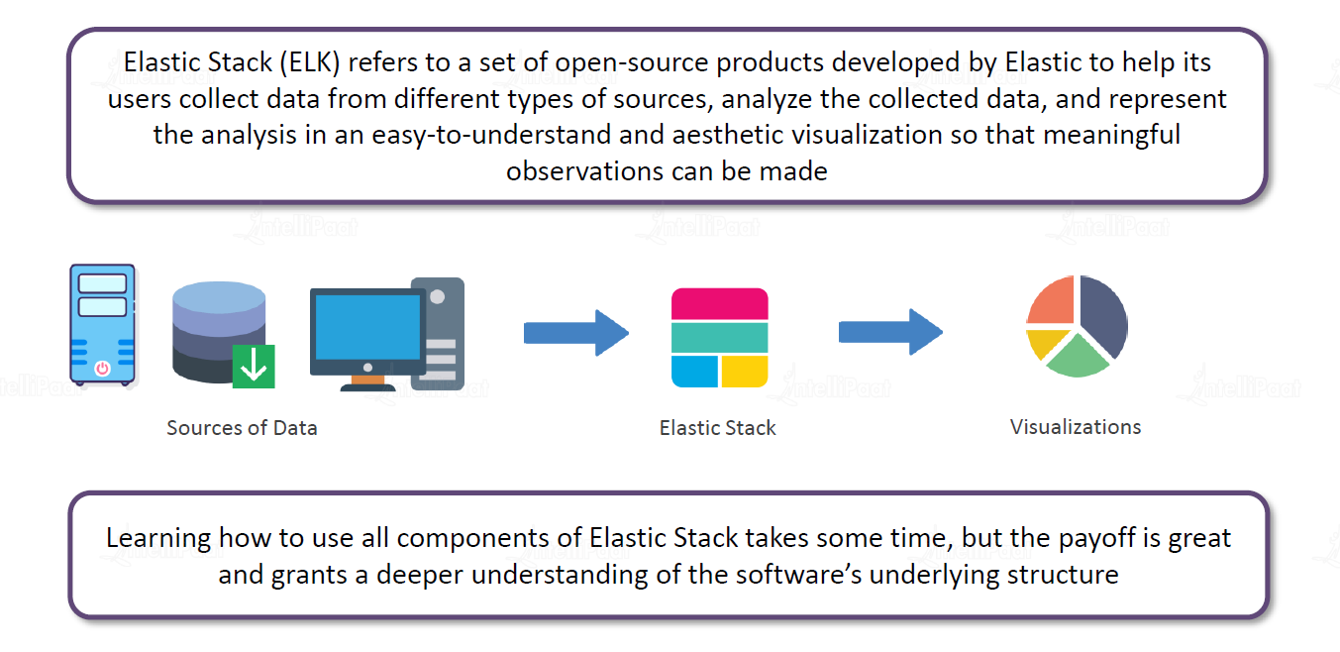
What is ELK?
Raushan Kumar

Slide 3
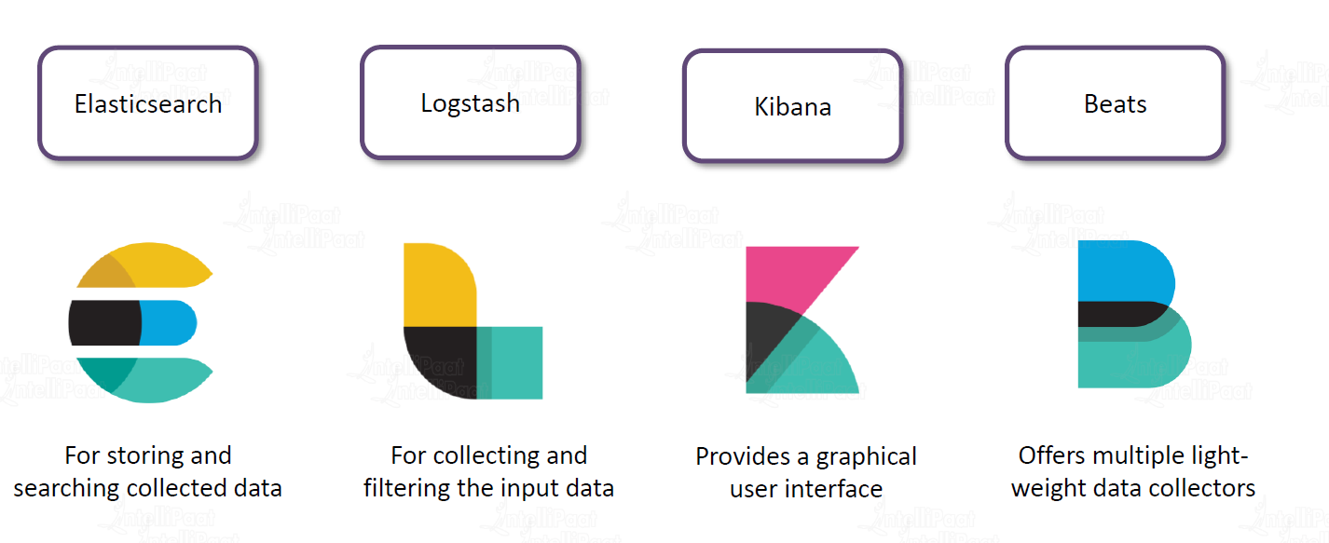
What are the components of ELK?
Raushan Kumar

Slide 4
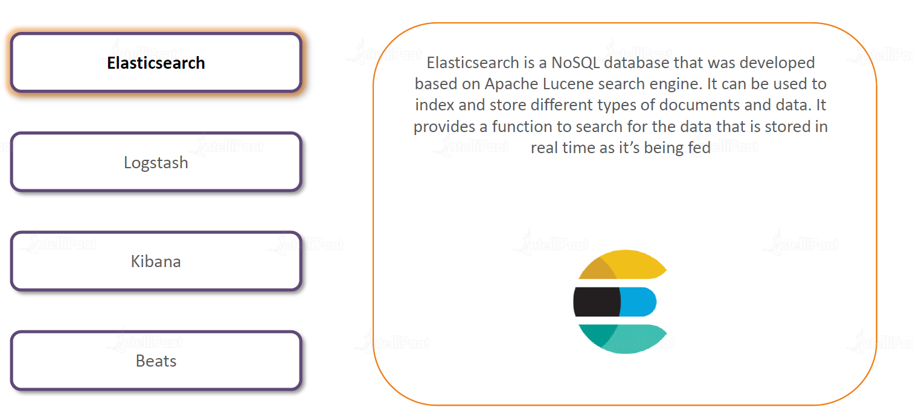
What are the components of ELK?
Raushan Kumar

Slide 5
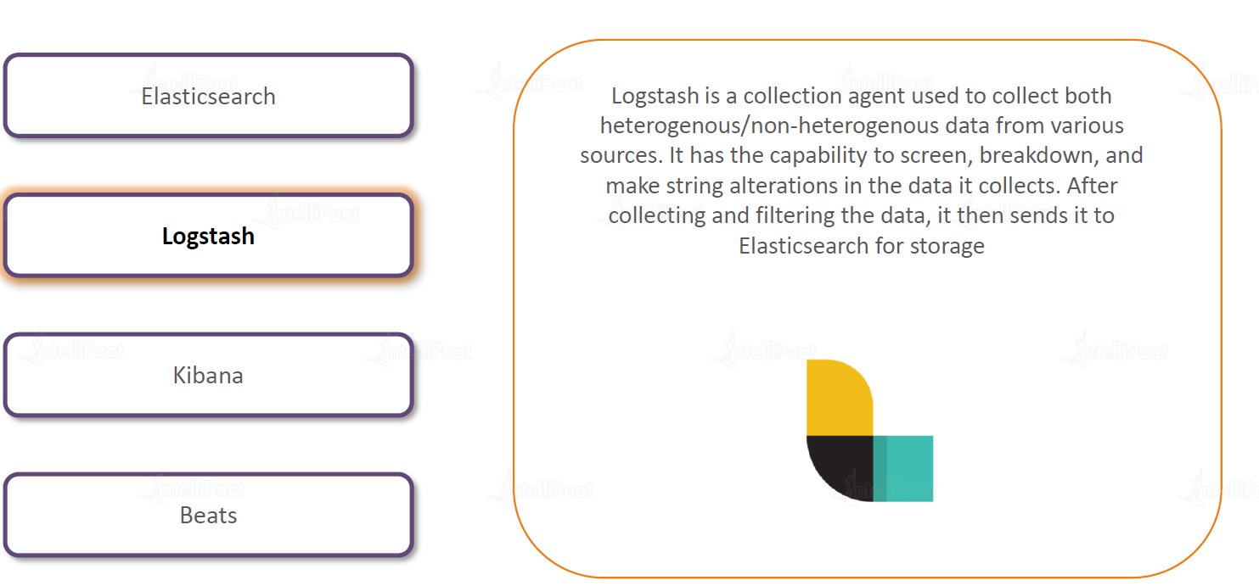
What are the components of ELK?
Raushan Kumar

Slide 6
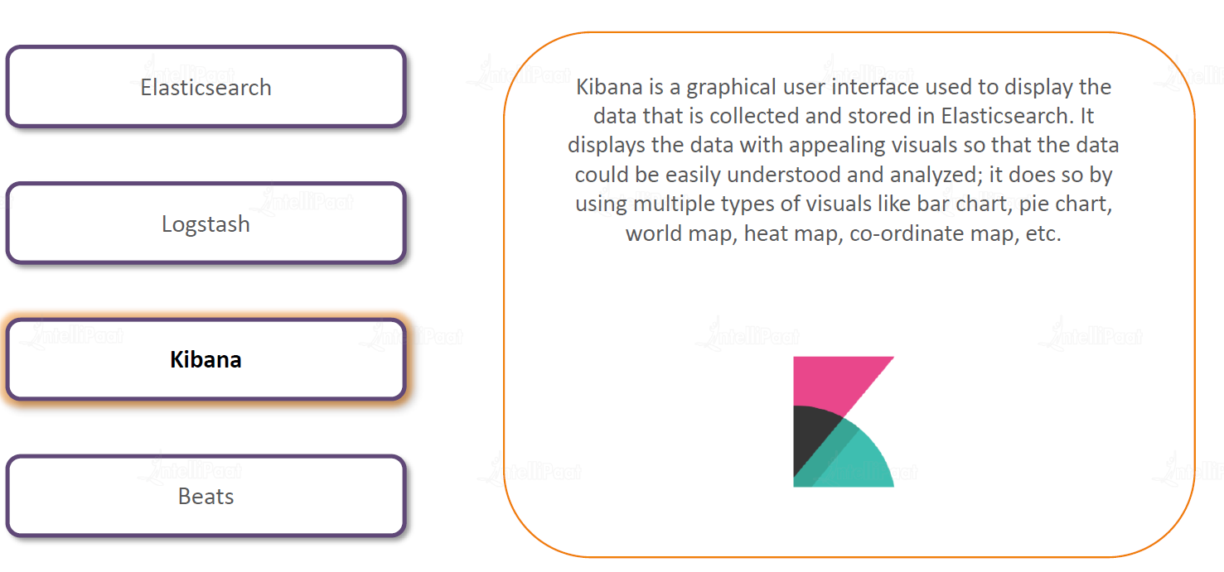
What are the components of ELK?
Raushan Kumar

Slide 7
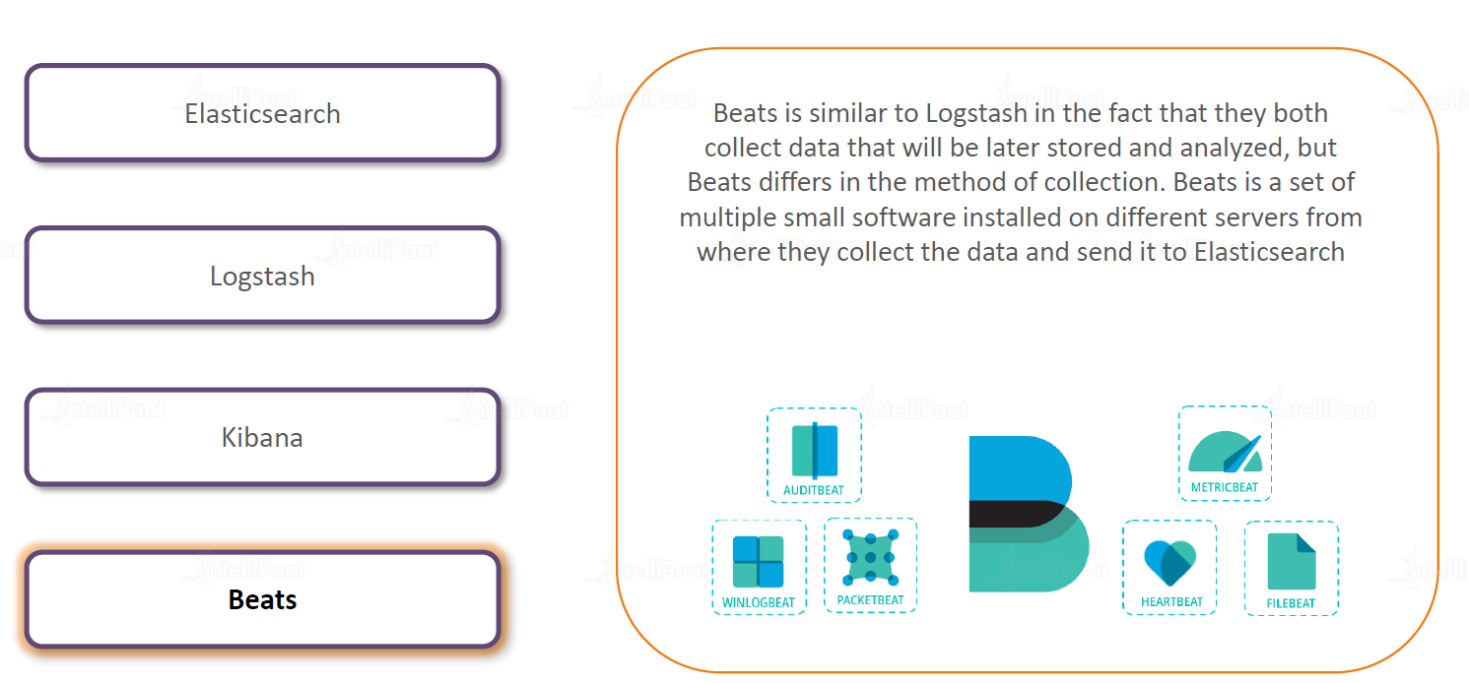
What are the components of ELK?
Raushan Kumar

Slide 8
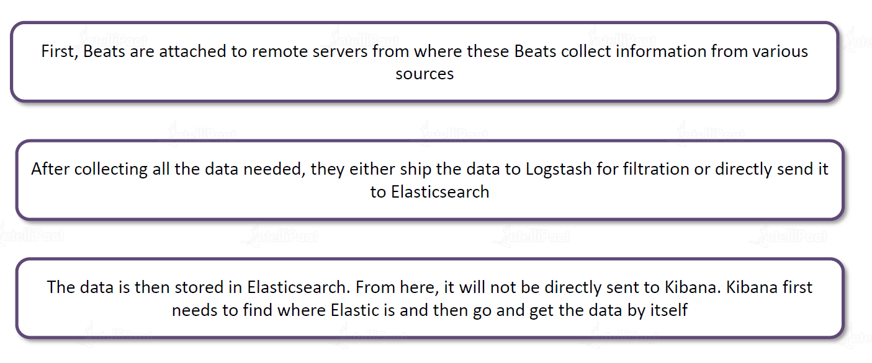
ELK Flow?
Raushan Kumar

Slide 9
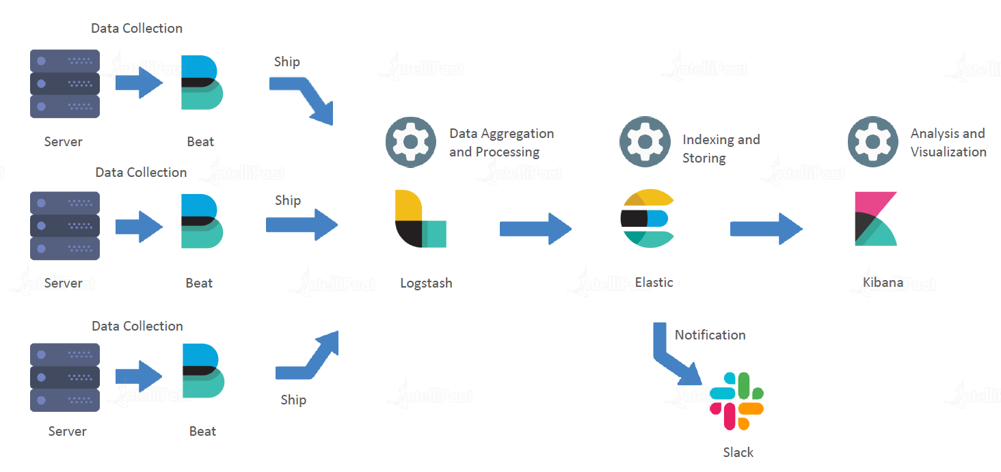
ELK Flow?
Raushan Kumar

Slide 10
Elastic Agent
Elastic Agent collects logs, metrics, traces, availability, security, and other data from each host in a single unified way.
With Elastic Agent you can collect all forms of data from anywhere with a single unified agent per host
Raushan Kumar

Slide 11
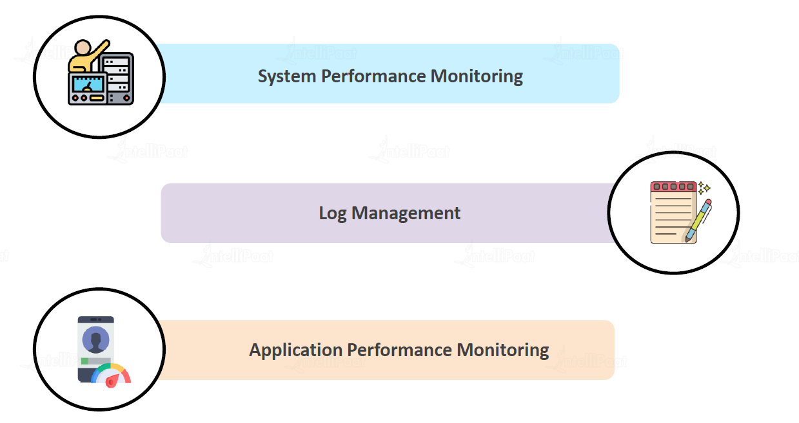
Features of ELK?
Raushan Kumar

Slide 12
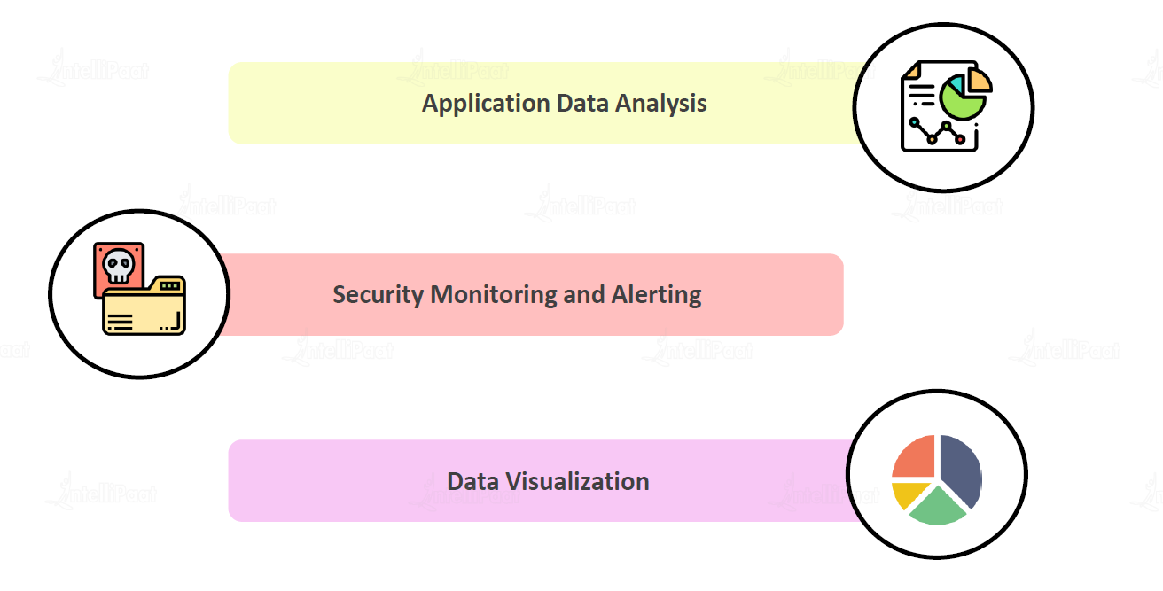
Features of ELK?
Raushan Kumar

Slide 13
Installation
Install on VM
2 vCPUS, 8 GiB RAM - t2.large
Elasticsearch → https://www.elastic.co/guide/en/elasticsearch/reference/current/targz.html
Kibana → https://www.elastic.co/guide/en/kibana/current/targz.html
Elastic Agent → https://www.elastic.co/guide/en/fleet/current/install-standalone-elastic-agent.html
Raushan Kumar

Slide 14
Installation
Kubernetes - using helm
https://artifacthub.io/packages/helm/elastic/elasticsearch?modal=install
https://artifacthub.io/packages/helm/elastic/logstash?modal=install
https://artifacthub.io/packages/helm/elastic/kibana?modal=install
Docker-Compose
https://github.com/raushan8586/ELKExample.git
Infra Requirements: 4 vCPUs, 16 GiB RAM
Raushan Kumar

Slide 15
Links
https://www.elastic.co/elastic-stack/
https://www.elastic.co/beats/
https://www.elastic.co/what-is/kibana-alerting
https://www.elastic.co/guide/index.html
https://demo.elastic.co/
Raushan Kumar

Slide 16

Q & A
Raushan Kumar
Notes:
In Slide Show mode, select the arrows to visit links.

Slide 17
Thank You!
Raushan Kumar

