Slide 1
Cloud Performance Engineering in DevOps
Site Reliability Engineer
Prometheus & Grafana
Raushan Kumar

Slide 2
What is Prometheus?
Prometheus is an open-source systems monitoring and alerting toolkit originally built at SoundCloud.
https://prometheus.io/docs/introduction/overview/
Raushan Kumar

Slide 3
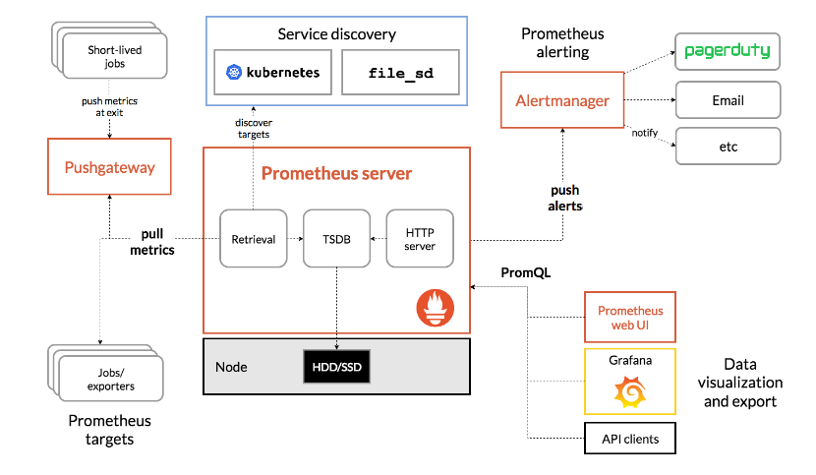
Prometheus Architecture?
Raushan Kumar

Slide 4
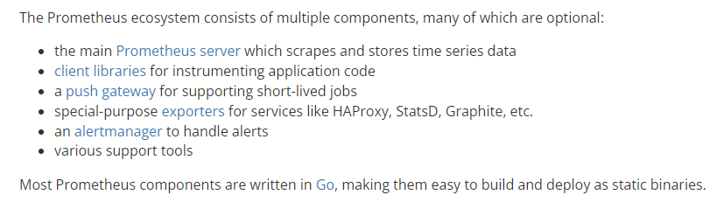
Components
https://prometheus.io/docs/instrumenting/exporters/
Raushan Kumar

Slide 5
Prometheus Installation
use t2.medium instance in AWS
https://docs.google.com/document/d/1uTO5E6ZexqPOcI6SdFnmXKxCFkOi7K1ZCB31bhjXU9k/edit?usp=sharing
Installation all the Prometheus components:
https://prometheus.io/download/#prometheus
Install Prometheus:
https://www.cherryservers.com/blog/install-prometheus-ubuntu
Install Node Exporter:
https://prometheus.io/docs/guides/node-exporter/
Raushan Kumar

Slide 6
Grafana Installation
use t2.medium instance in AWS
https://docs.google.com/document/d/1d6AS4qNrjhNXYIq0JqY4f7F_N2U8L5K-LR044afytmk/edit?usp=sharing
https://www.digitalocean.com/community/tutorials/how-to-install-and-secure-grafana-on-ubuntu-20-04
https://grafana.com/docs/grafana/latest/setup-grafana/installation/debian/
Raushan Kumar

Slide 7
Links
Raushan Kumar

Slide 8

Q & A
Raushan Kumar
Notes:
In Slide Show mode, select the arrows to visit links.

Slide 9
Thank You!
Raushan Kumar

