Slide 1
SWF Water Hack Challenge
Solid-Snow Track -
Group Members: Stephen Schertz, Adrian De Niz, Eric Brooks
Problem Statement:
Develop an algorithm for flagging questionable data in daily snow observations.
Our Approach:
Develop a random forest regressor model from training data and flag any far straying values in questionable data

Slide 2
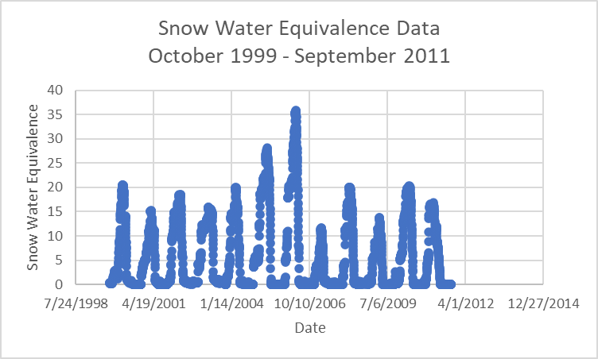

Slide 3
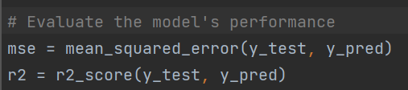
Accuracy Values of Our Model
Mean Squared Error: 0.285593704793388
R-squared: 0.9949477901177238
Method of Calculation:
Numpy

Slide 4
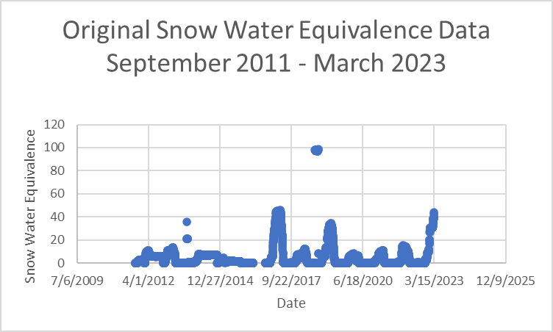

Slide 5
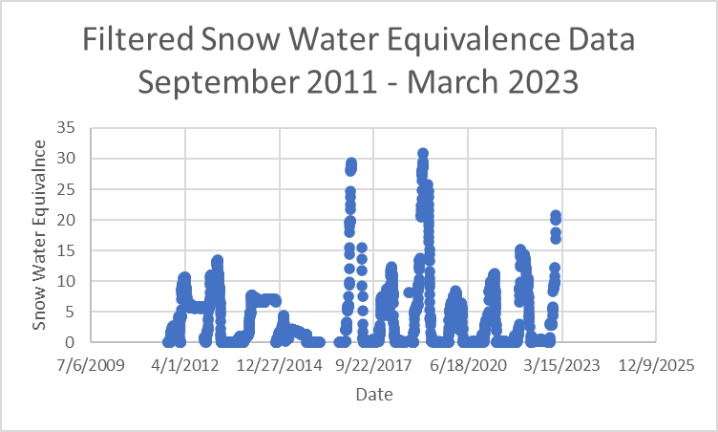

Slide 6
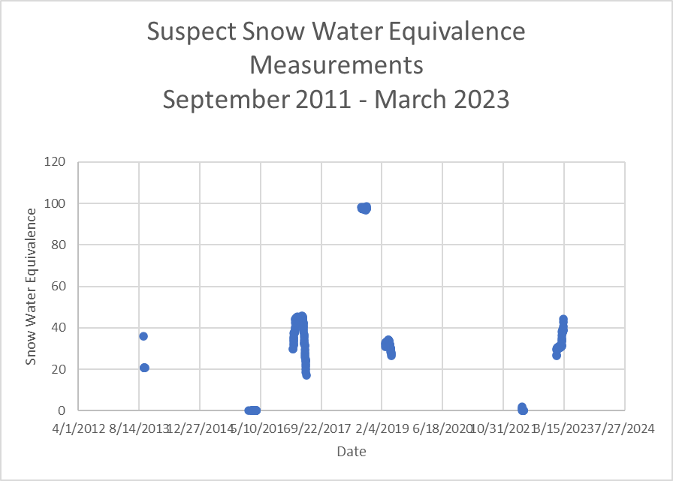
323 data points were marked as suspect

