Slide 1

MATRYCS Project
Modular Big Data Applications for Holistic Energy Services in Buildings
Daniele Antonucci
Daniele.antonucci@eurac.edu

Slide 2
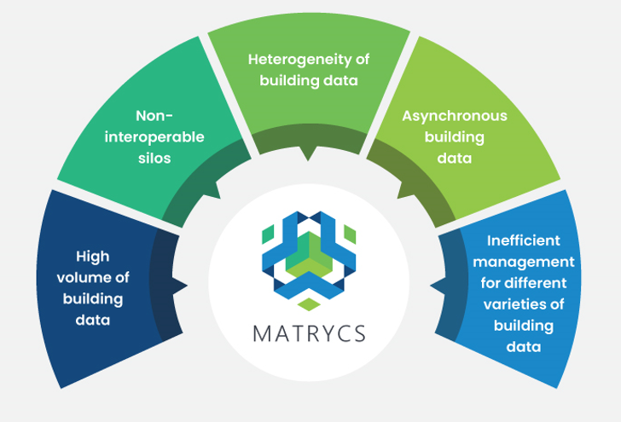
Background
Buildings are responsible for 40% of EU energy consumption
Buildings’ transformation into digital-enhanced edge hubs is needed
Ensure sustainability & resilience along the building’s life cycle

Slide 3
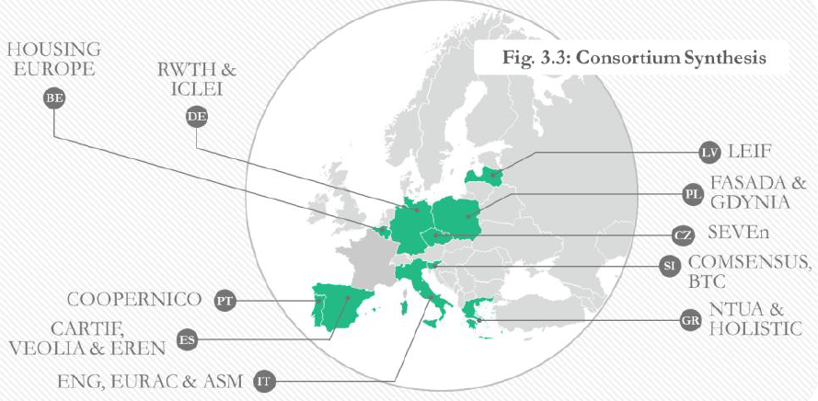
Overview
Research Centers/
Universities
Public Bodies/
Agencies
Non-Profit/ NGO
Large Enterprises/
Public Companies
Small Medium Enterprises
NTUA
CARTIF
RWTH
EURAC
GDYNIA
COOPERNICO
EREN
LEIF
ICLEI
SEVEN
HOUSING EUROPE
ENG
ASM
VEOLIA
HOLISTIC
COMSENSUS
BTC
FASADA
Title: | Modular Big Data Applications for Holistic Energy Services in Buildings
Funding: | European Union’s Horizon 2020 Research and Innovation Program (H2020)
Budget: | 4.577.835,00€
Lifetime: | October 2020 – September 2023 (36 months)
Coordination: | ENGINEERING - INGEGNERIA INFORMATICA SPA
Participants: | 18 partners from 10 Countries
Call/Grant | H2020-LC-SC3-EE-2020-1/101000158

Slide 4




OVERVIEW: Large Scale Pilots
MATRYCS results applied, implemented, demonstrated and validated in 11 real-life, large-scale pilots (LSP)
PERFORMANCE
Improving energy performance of buildings with predictive capabilities for energy demand.
DESIGN
Design of retrofitting actions, refurbishment and development of building infrastructure.
ICLEI
POLICY
HOUSING EUROPE
DE
Supporting policy making and policy impact assessment local and EU policies for buildings.
BE
LV
LEIF
PL
FASADA
GDYNIA
SI
BTC
FUND
Enhancing reliability and risk reduction of energy efficiency investments and evaluation of their bankability.
COOPERNICO
PT
VEOLIA
ES
EREN
IT
ASM

Slide 5
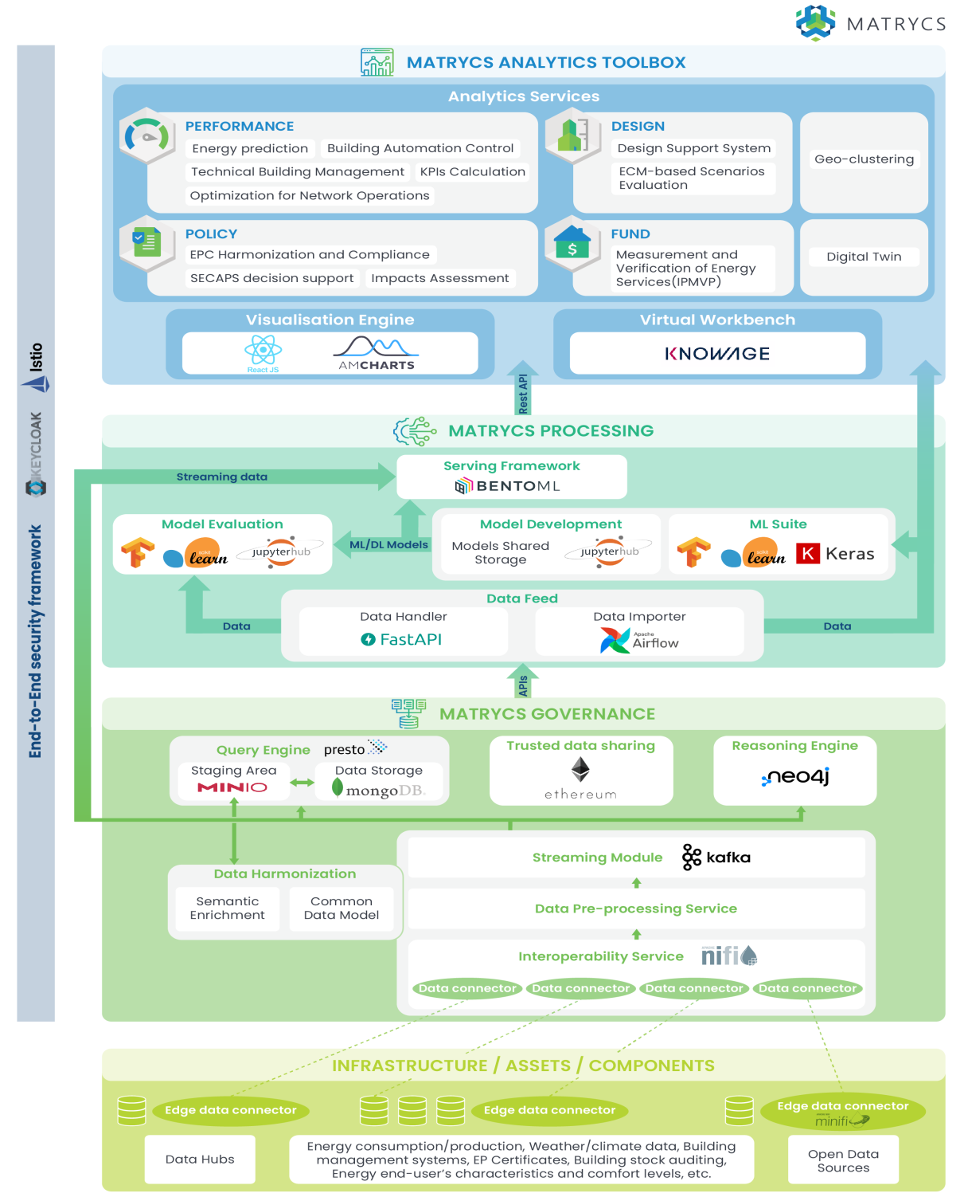



MATRYCS Reference Architecture
Big Data value chain
Deployment of the MATRYCS open, cloud-based data analytics toolbox along different deployment modes
Data Usage
Evolution and deployment of a technology enabler for a set of trained, high-quality Machine Learning and Deep Learning models
Data Analysis
Data Storage
Delivering a data governance technology enabler to facilitate cross-stakeholder data sharing, exchange and handling
Data Curation
Data Acquisition
Notes:
Alignment of the MATRYCS Reference Architecture with respect to the:
BDVA Reference Model
AIOTI High Level Architecture
FIWARE Open Reference Architecture
OpenDEI Reference Architecture
Bridge Reference Architecture
Data Space

Slide 6
Challenge: Energy/Temperature Prediction model
1st DataSet:
Energy production from PV system
Energy consumption of building located in Terni (center of Italy)
Output:
Identify and validate model to predict the energy production of PV and consumption of building.

Slide 7
Challenge: Energy/Temperature Prediction model
2nd DataSet:
Energy consumption of a flat and building
Indoor and outdoor temperature
Output:
Identify and validate model to predict the energy consumption of HVAC system.
Identify and validate model to predict the indoor and outdoor temperature

Slide 8
Challenge: Energy/Temperature Prediction model
Evaluation Criteria:
Cleaning data process: identify possible outliers and process data to be used by the model.
Validation of the overall process to identify the ML model.
Precision and accuracy of ML model: How well the model is able to predict values and how many times the ML model is correct overall.
Presentation of result. Define the best way to visualize the result, from type of graph to interface.

Slide 9
PRIZE
You and your team will receive 500€ Monni card (total amount for the team)

Slide 10

Present your winning solution at the MATRYCS Launch Event
Where? Brussels, Belgium
When? 25 September 2023, 14:00 – 18:30
What? Free travel and accommodation for 1 representative of the winning hackathon team! *
10 minute pitch in MATRYCS event programme
Stand to present your solution during breaks
Networking opportunities
* Terms: 1 night hotel, 2nd class travel, up to 600€ reimbursement, see conditions.

Slide 11
Daniele Antonucci
Daniele.antonucci@eurac.edu

