Slide 1
Credit Card Default Prediction using Machine learning Algorithms
SEIS 763-Machine Learning and Deep Learning
Team:
Sai Ratnam Peri
Mariyam Rajeev George
Elizabeth G. Tesfa
Bante A Alebachew
Prerana Sawant

Slide 2
Agenda
Data introduction
Data preprocessing and other challenges
Descriptive analysis
Algorithms used and performance

Slide 3
Data source:
https://www.kaggle.com/uciml/default-of-credit-card-clients-dataset
Default payments, history of payment, and bill statements of credit card clients in Taiwan from April 2005 to September 2005.
25 attributes and 30000 rows.
Data Introduction

Slide 4
Variables
COLUMN | DESCRIPTION | COLUMN | DESCRIPTION | COLUMN | DESCRIPTION
LIMIT_BAL | Amount of given credit | SEX | Gender (1=male, 2=female) | AGE | Age in years
MARITAL STATUS | Marital status (1=married, 2=single, 3=others) | EDUCATION | 1=graduate school, 2=university, 3=high school, 4=others, 5=unknown, 6=unknown | PAY_0 | Repayment status in Sep 2005 (-1=pay duly, 1=payment delay for 1month, 9=payment delay for 9 mon and above)
PAY_2 | Repayment status in August, 2005 | PAY_3 | Repayment status in July, 2005 | PAY_4 | Repayment status in June, 2005
PAY_5 | Repayment status in May, 2005 | PAY_6 | Repayment status in April, 2005 | BILL_AMT1 | Amount of bill statement in September, 2005
BILL_AMT2 | Amount of bill statement in August, 2005 | BILL_AMT3 | Amount of bill statement in July, 2005 | BILL_AMT4 | Amount of bill statement in June, 2005
BILL_AMT5 | Amount of bill statement in May, 2005 | BILL_AMT6 | Amount of bill statement in April, 2005 | PAY_AMT1 | Amount of previous payment in Sept, 2005
PAY_AMT2 | Amount of previous payment in August, 2005 | PAY_AMT3 | Amount of previous payment in July, 2005 | PAY_AMT4 | Amount of previous payment in June, 2005
PAY_AMT5 | Amount of previous payment in May, 2005 | PAY_AMT6 | Amount of previous payment in April, 2005 | default.payment.next.month | Default payment (1=yes, 0=no)

Slide 5
Process Flowchart
Data Selection
Data Preprocessing
Data Balancing
Comparison of Models
Generating Models using Train data
Predicting using Test Data
Regularization
Predicting using Test Data
Generating Models using Train data
Data Division: Test, Train

Slide 6
Goal
To predict if the customer has set default payments next month
Tools used:
Matlab
H2O package
Tableau
PyCharm for Python

Slide 7
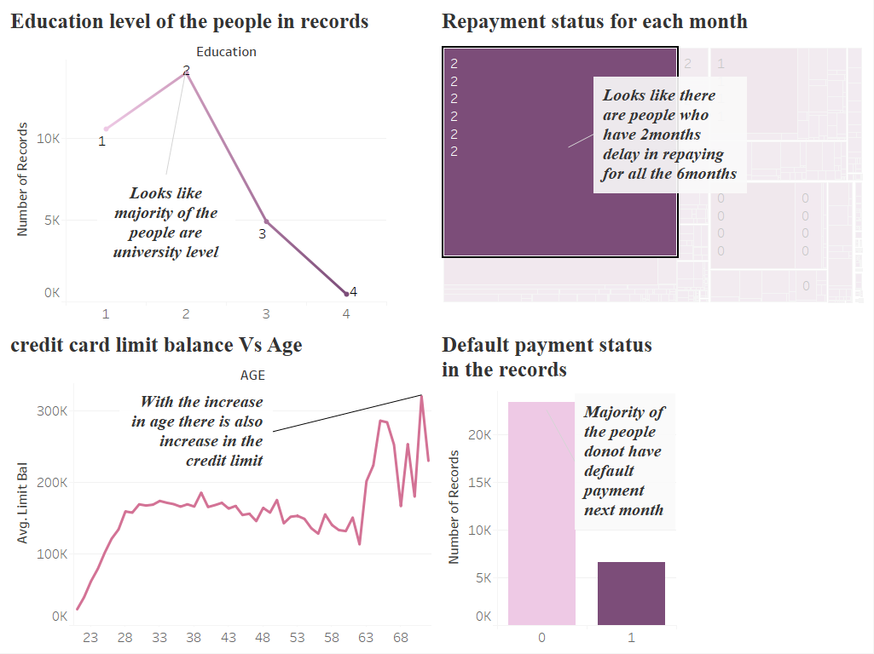
Descriptive Analysis

Slide 8
Data Preprocessing
Feature ‘Education’ has some values that were not mentioned in metadata, changed them to ‘other’ using MATLAB.
tmp=Data.EDUCATION;
tmp(tmp==0 |tmp==5 |tmp==6)=4;
Data.EDUCATION=tmp;
Feature ‘Marital status’ also has value zero which is not mentioned in metadata, changed it to other.
maritial=Data.MARRIAGE;
maritial(maritial==0)=3;
Data.MARRIAGE=maritial;
Changed data in categorical variables having values -2 to 8 to positive, code is as follows:
Data.SEPTREPAYSTS=DATA.SEPTREPAYSTS+3;
Data.APRREPAYSTS=DATA.APRREPAYSTS+3;
Data.AUGREPAYSTS=DATA.AUGREPAYSTS+3;
Data.JULYREPAYSTS=DATA.JULYREPAYSTS+3;
Data.JUNEREPAYSTS=DATA.JUNEREPAYSTS+3;
Data.MAYREPAYSTS=DATA.MAYREPAYSTS+3;
Converted Categorical variables to dummy and standardized the numerical variables
Obtained new data now has 30000 rows and 81 features with last feature as response variable.

Slide 9
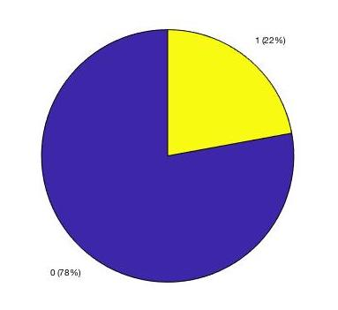
Binary response variables were hugely unbalanced and would lead to majority and minority issue
Training set was balanced with respect to response.
This reduced the dataset to 13645 rows.
Division :
Training 80%
Testing 20%

Slide 10
Models Used
Logistic Regression
K nearest neighbors
Support Vector Machine
Neural Network

Slide 11
Logistic Regression and Regularization(Lasso)
First run with 81 predictors
Accuracy 67%
Selected index and deleted the not-so-useful (30) predictors, dataset now has 50 predictors and reran the model and accuracy is again 67%

Slide 12
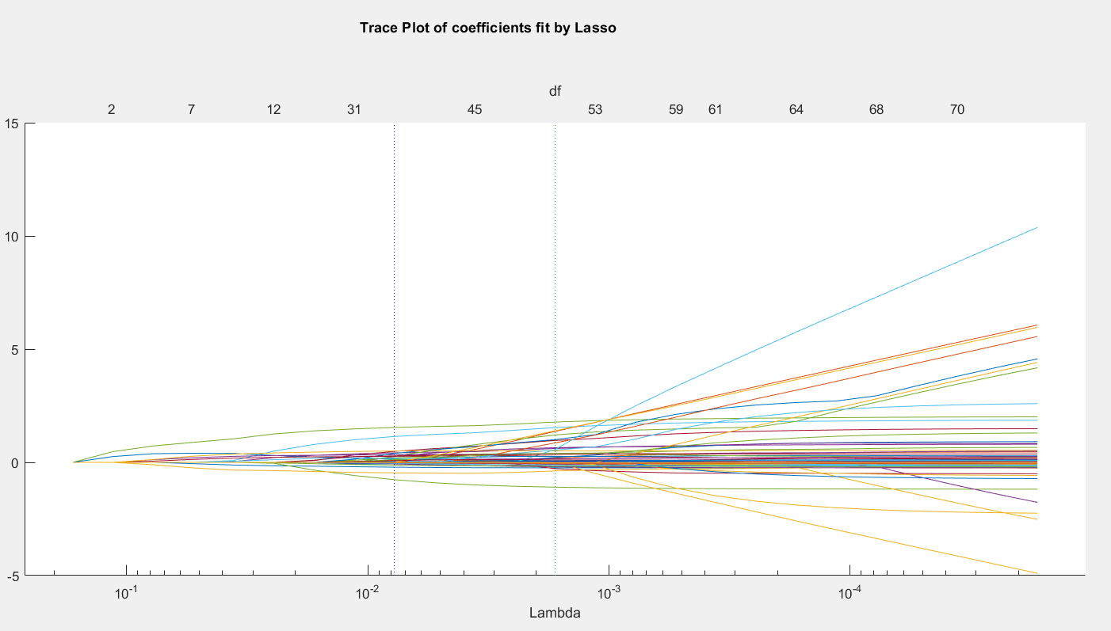
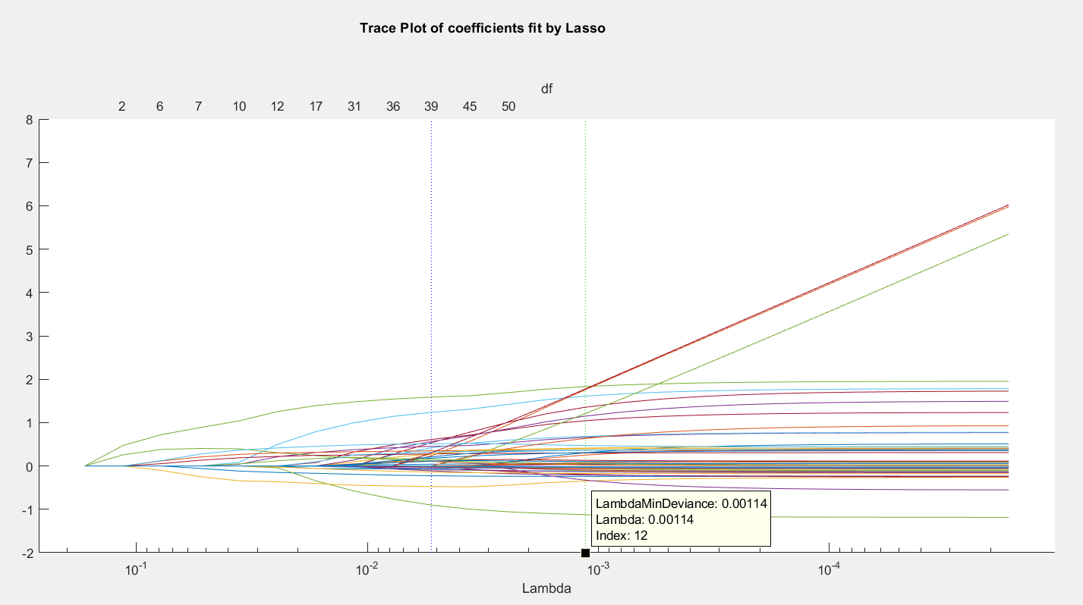
Lasso Plot
Before regularization After regularization
Notes:
Alpha =1;
Lambda =25
Selected index 15(1 SD) where 30 predictors became 0

Slide 13
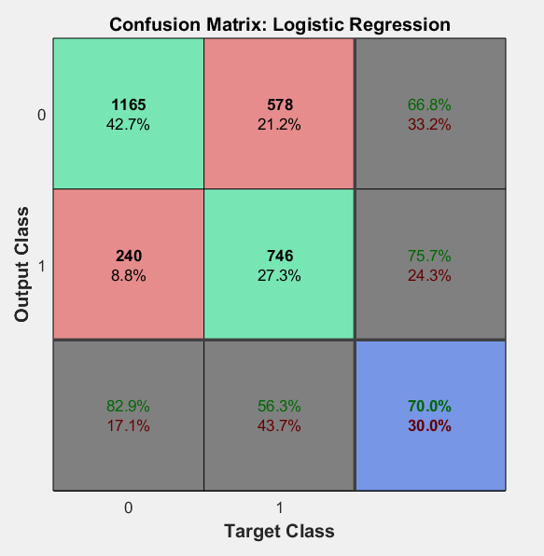
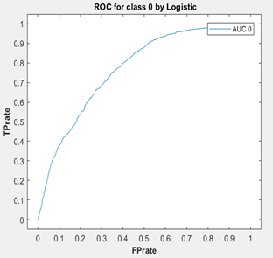
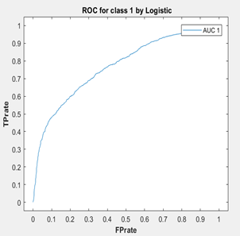
Results: Logistic Regression
Notes:
It took just 10 seconds to train the model on logistic regression

Slide 14
K Nearest Neighbor
Initially using 81 predictors, confusion matrix for testing data is:
Summary :
1106 | 299
571 | 753
Measurements | Classes
 | 0 | 1
Accuracy | 0.6812 | 0.6812
Precision | 0.7556 | 0.6119
Recall | 0.7872 | 0.5687
F1_Score | 0.7177 | 0.6338

Slide 15
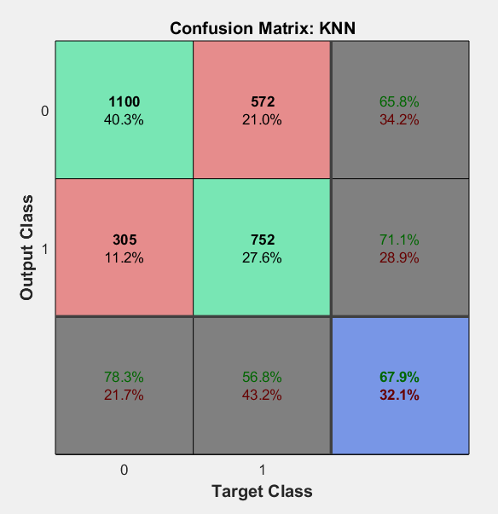
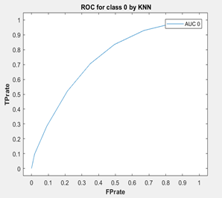
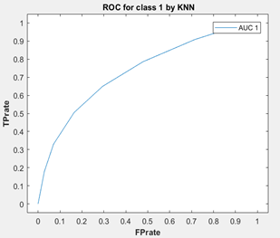
Results: K Nearest Neighbor
Notes:
KNN :
7 nearest neighbours
KNN fit 75% to training data and 67.9% to the test data
Also, ran KNN with different number of neighbours and from automatic statistical toolbox in matlab. Got almost same accuracy .
It took 188 seconds to train the model on knn

Slide 16
Support Vector Machine(SVM)
Model 1:
Initially using 81 predictors, confusion matrix is:
Summary :
4532 | 120
1118 | 230
Measurements | Classes
 | 0 | 1
Accuracy | 0.7937 | 0.7937
Precision | 0.8021 | 0.6571
Recall | 0.9742 | 0.1706
F1_Score | 0.8798 | 0.2709

Slide 17
Contd…
Recall and precision for class ‘1’ are very low.
Reason: Imbalance data problem in response variable

Slide 18
Contd…
Down-sampling on 0’s and oversampling on 1 response variables.
Divide this balanced data into training(70%),testing(30%) and rerun SVM classification algorithm.

Slide 19
Model 2:
Initially using 81 predictors, confusion matrix is:
Summary :
1333 | 794
608 | 1359
Measurements | Class 0 | Class 1
Accuracy | 0.6575 | 0.6575
Precision | 0.6868 | 0.6312
Recall | 0.6367 | 0.6909
F1 score | 0.6554 | 0.6597
Huge recall and F1 score improvement for class ‘1’ though at the expense information lose in class ‘0’.

Slide 20
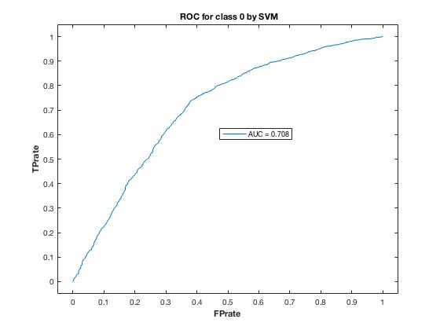
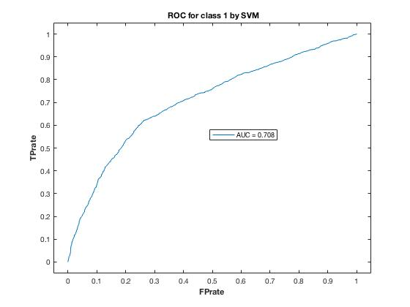
ROC for class 0 and class 1

Slide 21
Model 3:
After reducing the number of predictors from 81 to 50, the confusion matrix and accuracy is :
Summary :
1110 | 295
531 | 793
Measurements | Classes
 | 0 | 1
Accuracy | 0.6973 | 0.6973
Precision | 0.6767 | 0.7289
Recall | 0.7900 | 0.6012
F1_Score | 0.7288 | 0.6575

Slide 22
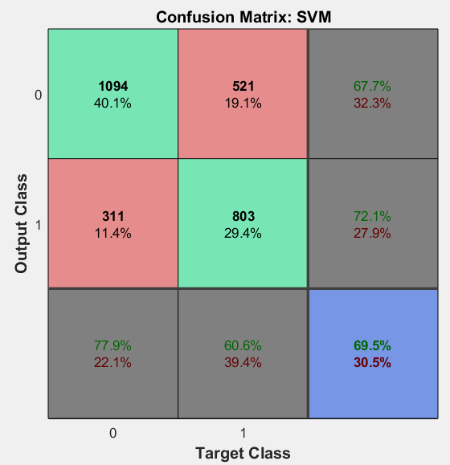
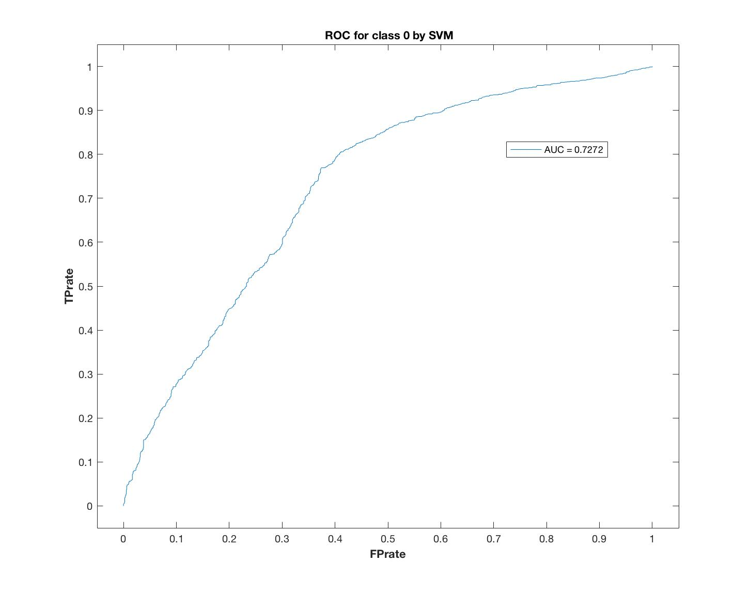
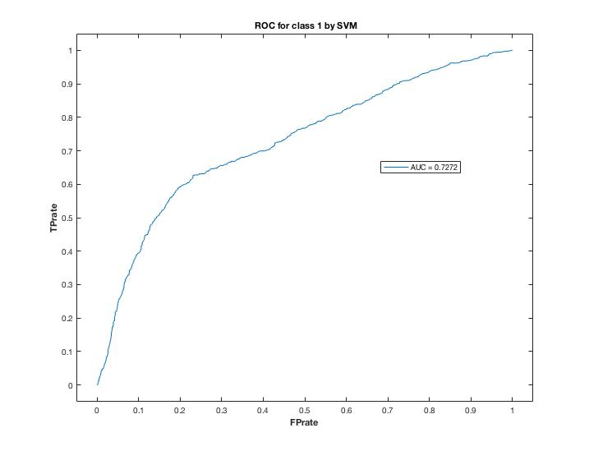
Results: Support Vector Machine
Notes:
KNN :
7 nearest neighbours
KNN fit 75% to training data and 67.9% to the test data
Also, ran KNN with different number of neighbours and from automatic styatistical toolbox in matlab. Got almost same accuracy .
It took 188 seconds to train the model on knn

Slide 23
Neural Network(NN)
Used h2o and python and dataset with 50 predictors
Run with hidden layer as 11,13,17,19 and 250 epochs
dl_2 = dl_250 = H2ODeepLearningEstimator(hidden=[11,13,17,19],checkpoint=dl_1, epochs=250,activation="rectifier",loss = "crossentropy") dl_2.train(x=x, y=y, training_frame=data_training)

Slide 24
Confusion Matrix of model2:
Confusion matrix (act/pred)
0 | 1 | Error | Rate
670 | 735 | 0.5231 | (735.0/1405.0)
206 | 1117 | 0.1557 | (206.0/1323.0)
876 | 1852 | 0.3449 | (941.0/2728.0)

Slide 25
Summary of model
Metric | Thresold | Value | Idx
Max f1 | 0.00923739 | 0.703622 | 371
Max f2 | 0.00149209 | 0.825182 | 397
Max accuracy | 0.0201603 | 0.705656 | 314
Max precision | 0.926457 | 0.70088 | 0
Max recall | 0.000281579 | .84 | 399
Max min_per_class_accuracy | 0.0291177 | 0.685409 | 341
Max_mean_per_class_accuracy | 0.0201603 | 0.697433 | 314

Slide 26
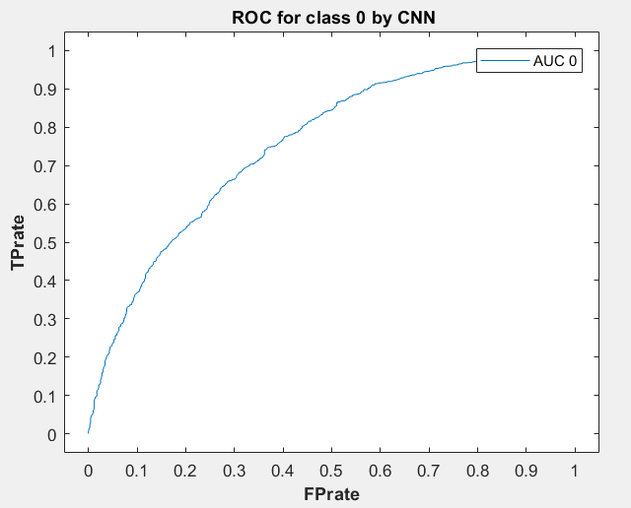
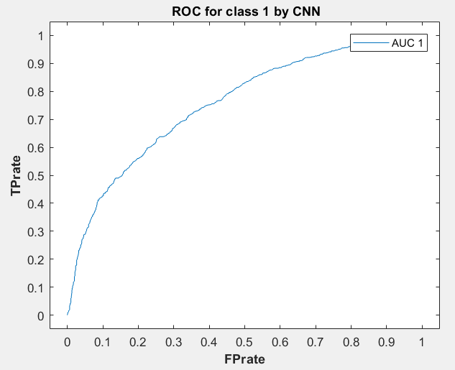
Results: Neural Network
Notes:
KNN :
7 nearest neighbours
KNN fit 75% to training data and 67.9% to the test data
Also, ran KNN with different number of neighbours and from automatic styatistical toolbox in matlab. Got almost same accuracy .
It took 188 seconds to train the model on knn

Slide 27
Measurements | Class 0 : No Default |  |  |  | Class 1 : Yes Default
 | Logistic Regression | KNN | SVM | NN | Logistic Regression | KNN | SVM | NN
Accuracy | 70.03 | 67.86 | 69.73 | 70.56 | 70.03 | 67.86 | 69.73 | 70.56
Precision | 82.92 | 75.56 | 67.67 | 82.51 | 56.34 | 61.19 | 72.89 | 56.23
Recall | 66.84 | 67.42 | 79.00 | 66.73 | 75.66 | 66.88 | 60.12 | 66.32
F Score | 74.02 | 71.77 | 72.88 | 70.36 | 64.59 | 63.38 | 65.75 | 62.71
ROC - AUC | 76.97 | 74.46 | 72.72 | 75.49 | 76.97 | 74.46 | 72.72 | 72.67
Prediction Quality: Comparison

Slide 28
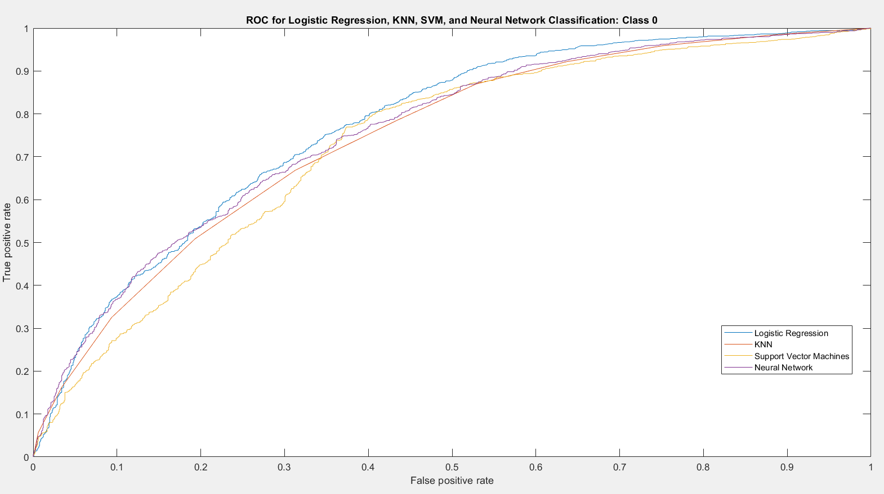
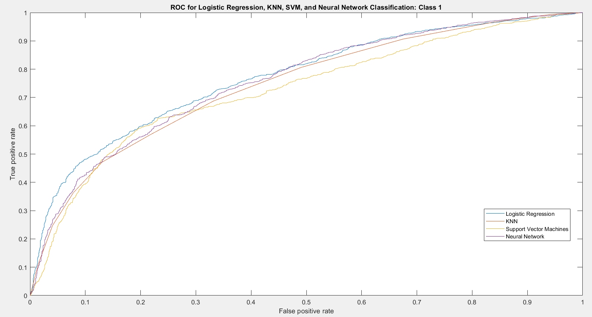
ROC Comparison

Slide 29
External References
Comparisons of data mining technique for prediction accuracy of probability of defaults in credit card clients: Cheng Yeh, Chen-hui Lien : https://bradzzz.gitbooks.io/ga-seattle-dsi/content/dsi/dsi_05_classification_databases/2.1-lesson/assets/datasets/DefaultCreditCardClients_yeh_2009.pdf
Prediction of Credit-Card Defaulters: A Comparative Study on Performance of Classifiers : Ajay Venkatesh , Ajay, Shomona Gracia : http://www.ijcaonline.org/archives/volume145/number7/ajay-2016-ijca-910702.pdf

Slide 30
THANK YOU

