Slide 1
U.S. AIRLINE PERFORMANCE & DELAY ANALYSIS
Fly emirates project
By - Peritosh Sinha

Slide 2
INTRODUCTION
The aviation industry generates large volumes of operational data every day. Flight delays and cancellations affect customer satisfaction, airline performance, and airport operations.
This project analyzes over 5.8 million U.S. domestic flight records to identify delay patterns, cancellation trends, airline performance, airport performance, and operational inefficiencies.
Objectives:
• Analyze flight delays and cancellations • Evaluate airline performance • Evaluate airport performance • Identify major delay causes • Generate business insights using Power BI

Slide 3
DATASET OVERVIEW
Datasets Used:
• Flights Dataset • Airlines Dataset • Airports Dataset
Dataset Statistics:
• Total Flights: 5,819,079 • Airlines: 14 • Airports: 322

Slide 4
TOOLS & METHODOLOGY
Tools Used:
• MySQL • SQL • MySQL Workbench • Power BI
Project Workflow:
CSV Files ↓ MySQL Database ↓ Data Cleaning & Transformation ↓ SQL Analysis ↓ Power BI Dashboard ↓ Business Insights
Data Preparation:
• Missing Value Handling • Flight Date Creation • Cancellation Reason Mapping • Data Integration

Slide 5
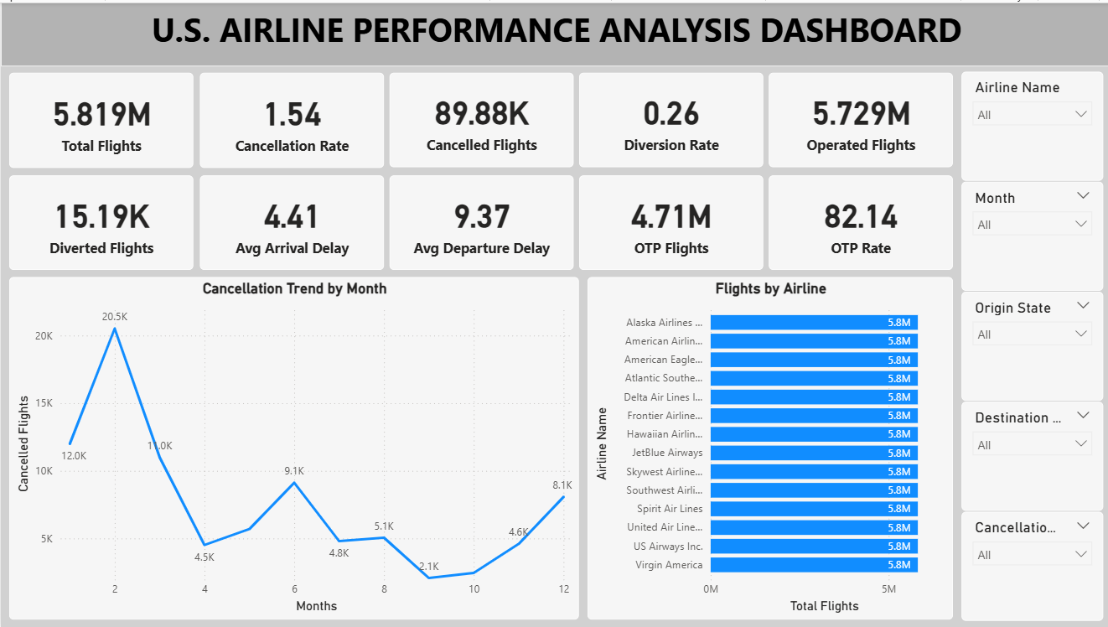
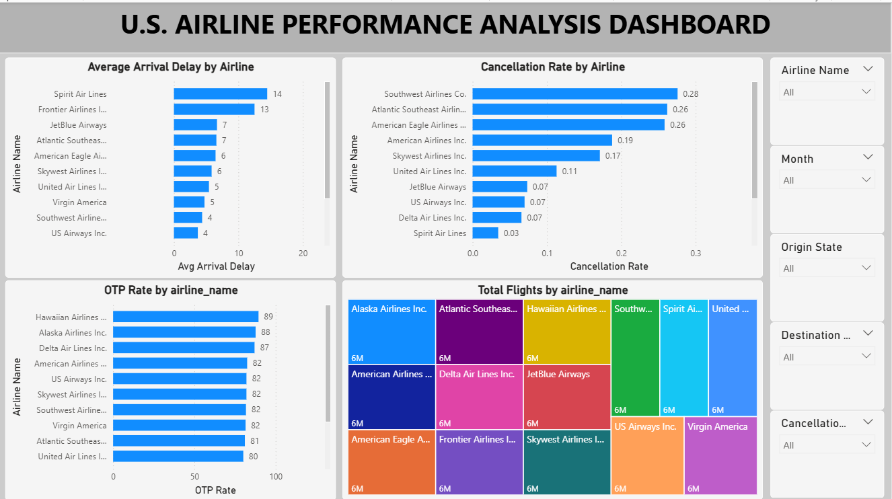
DASHBOARD

Slide 6
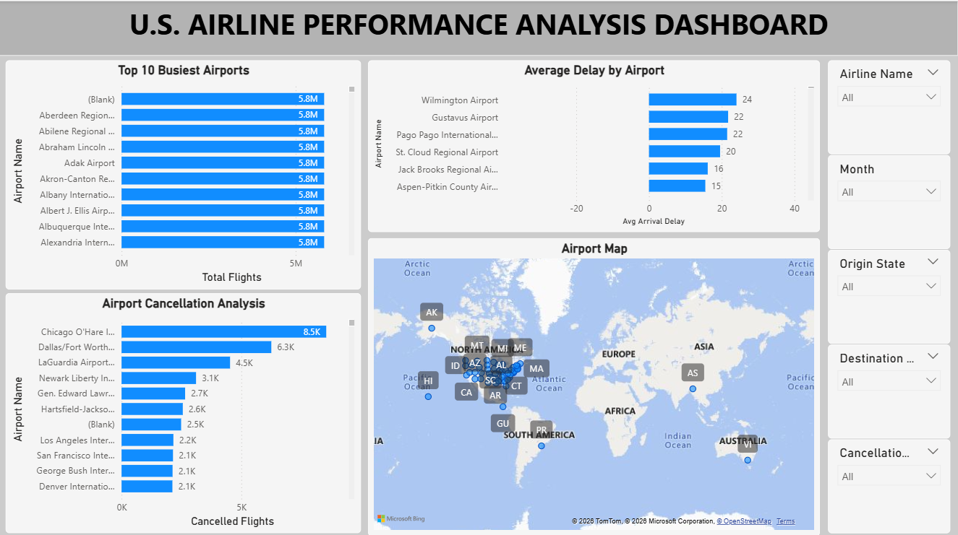
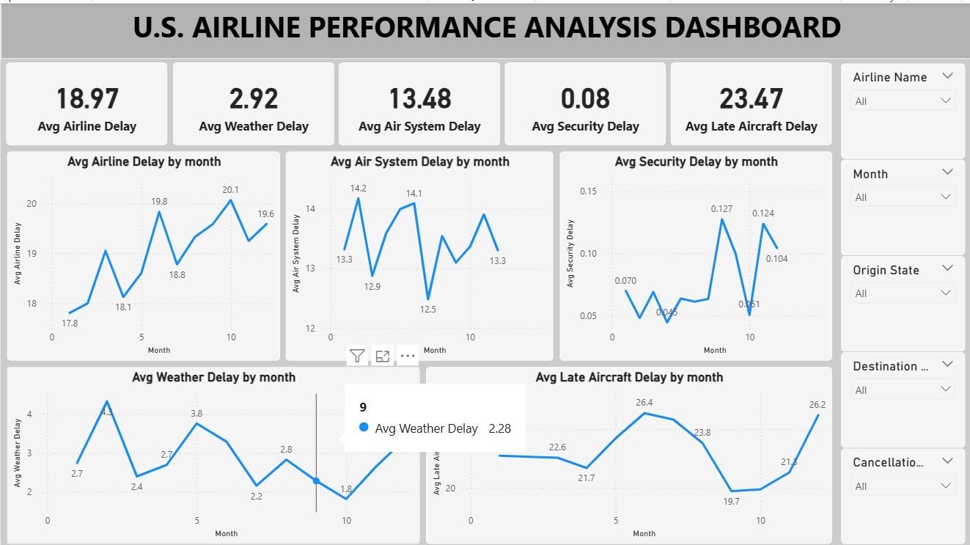
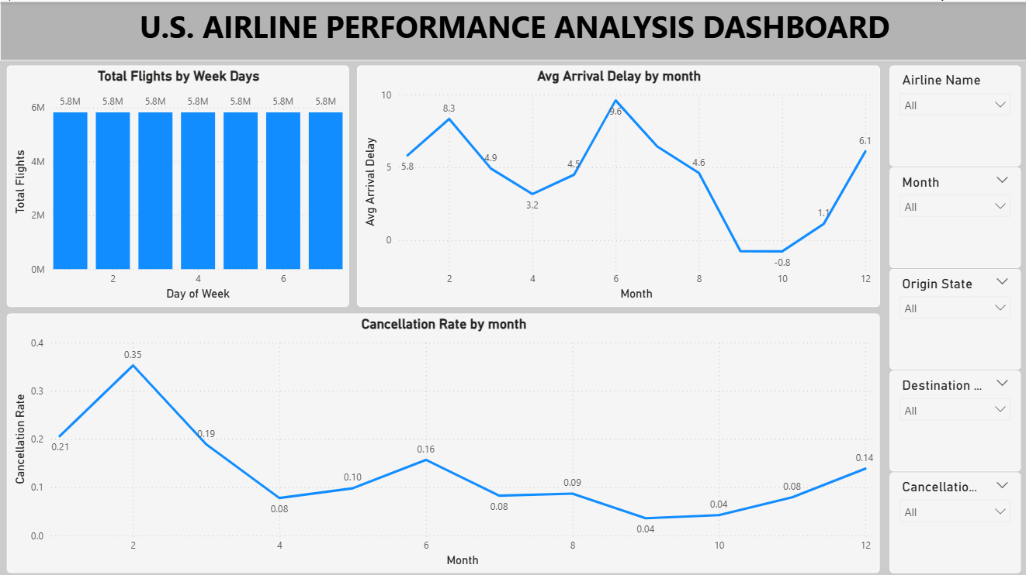

Slide 7
KEY INSIGHTS
More than 5.8 million flight records were analyzed.
OTP exceeded 80%, indicating strong operational efficiency.
Late Aircraft Delay was one of the largest contributors to overall delays.
Flight cancellations showed seasonal variations across months.
Certain airlines consistently performed better in terms of delays and OTP.
Major airports handled the majority of total flight traffic.
Weather conditions significantly impacted flight operations during specific periods.

Slide 8
Recommendation
• Improve aircraft turnaround efficiency. • Enhance weather contingency planning. • Optimize airport scheduling and resource allocation. • Monitor airline performance using KPI dashboards. • Use predictive maintenance to reduce operational disruptions.

Slide 9
Conclusion
This project successfully analyzed over 5.8 million U.S. domestic flight records using SQL and Power BI. The analysis identified important patterns in delays, cancellations, airline performance, and airport operations. The developed dashboard supports data-driven decision-making and helps improve operational efficiency and passenger satisfaction.
THANK YOU

