Slide 1

Smartphone
RelayServer
On-Premises Connector
On-Premises
Application
Tenant A
Tablet
RelayServer
RelayServer
On-Premises Connector
On-Premises
Application
Notebook
Tenant B

Slide 2

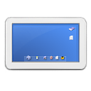



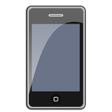
RelayServer
On-Premises Application
Mobile access to
On-Premises data

Slide 3
Location A
RelayServer
Location C
Connect office sites easily and securely
Location B

