Slide 1
PerkLab research methodology overview
Andras Lasso, PhD
Associate Director - Engineering
Laboratory for Percutaneous Surgery (PerkLab)
School of Computing
Queen’s University, Kingston, ON, Canada

Slide 2

PerkLab
About 20-25 members
From computer science, electrical engineering, and mechanical engineering departments and medical school
1/4 undergrad 1/4 Masters 1/4 PhD, postdoc 1/4 faculty, staff research engineers – continuity
Research focus:
Percutaneous interventions
Image guidance
Tool navigation
Translational research

Slide 3
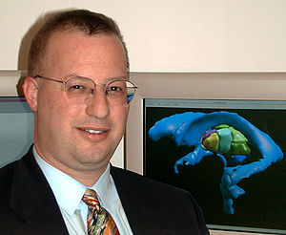
Scope
From algorithms to tools
Can it be done?
Prototypes
Is it worth doing?
Tools for translational research
Standard of care
Commercially available clinical “devices” with regulatory approval
Ron Kikinis, Harvard SPL, 2012

Slide 4
Reproducible research – theory
Scientific method: propose hypothesis, prove it by experiments
Mistakes, bias, … => repeatability
Full specification Victoria Stodden, Enabling reproducible research: licensing for scientific innovation
Research paper
Data (with description the data, how it was acquired, processed, including the source code that was used for processing, …)
Experiment (source code, instructions, parameters, …)
Results (source code, documentation, data, …)
Reduced duplicate efforts, higher credibility, higher quality outcome, community, …
J.P.A. Ioannidis, Why Most Published Research Findings are False, PLoS Med 2(8), 2004

Slide 5

Reproducible research – practice
By default openly available source code, full documentation, all data *sharing lots of data is getting difficult now
Permissive license – no strings attached
BSD: redistribution, modification, … all allowed
Provided as is
Don’t use the author name for endorsement
Don’t remove the license
Can we afford to give away all these?
Full disclosure mostly delayed until publication
Exceptional ideas are patented before publication
Maintain competitive advantage by continuous improvement
We get a lot in return

Slide 6





Industry best practices
Brought in by industry-trained staff members
Adopt procedures that increase quality & productivity
Keep overhead at the minimum
Usually no need to comply to external regulations (Health Canada, FDA, CE, …), just institutional ethics board
Learning these: investment with a short payback period

Slide 7
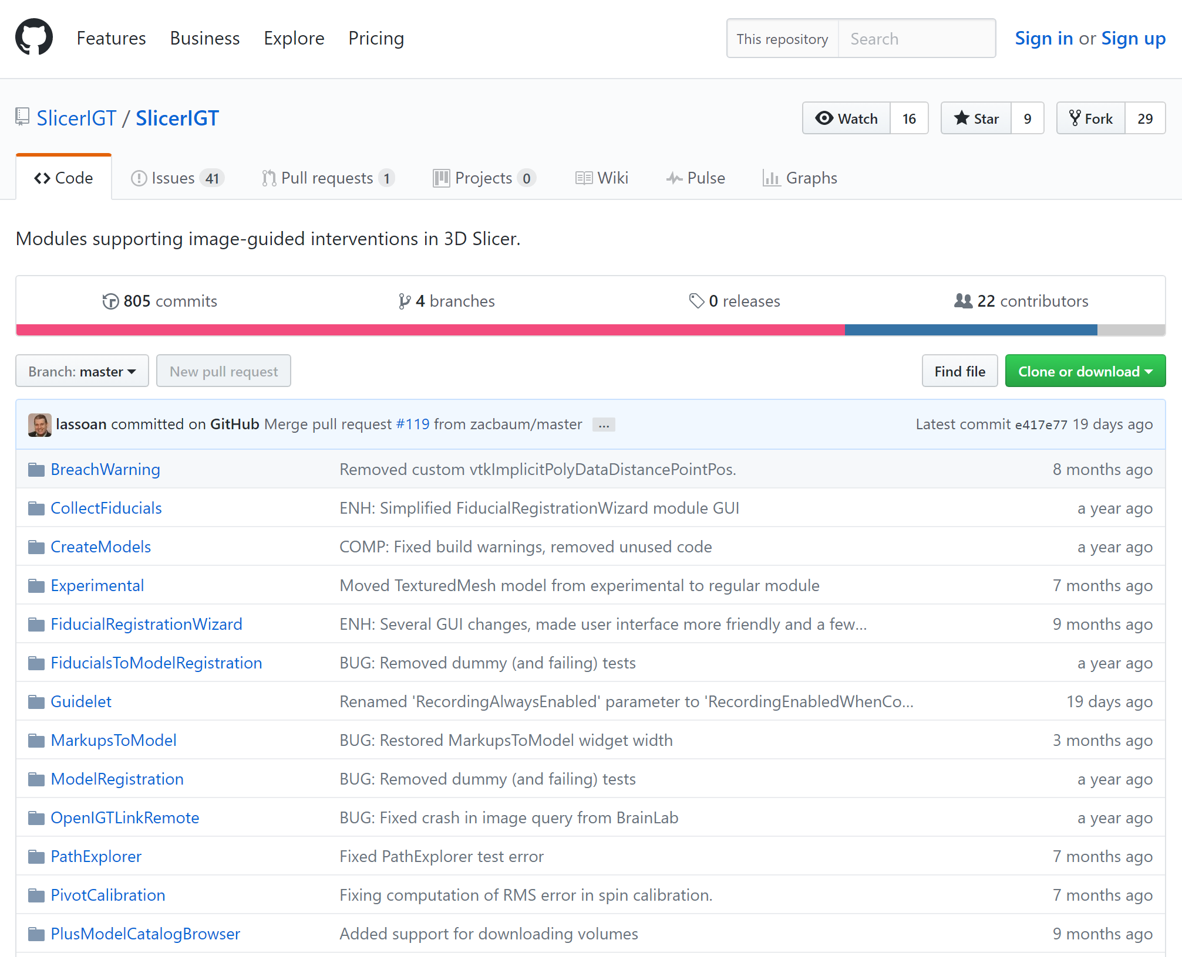
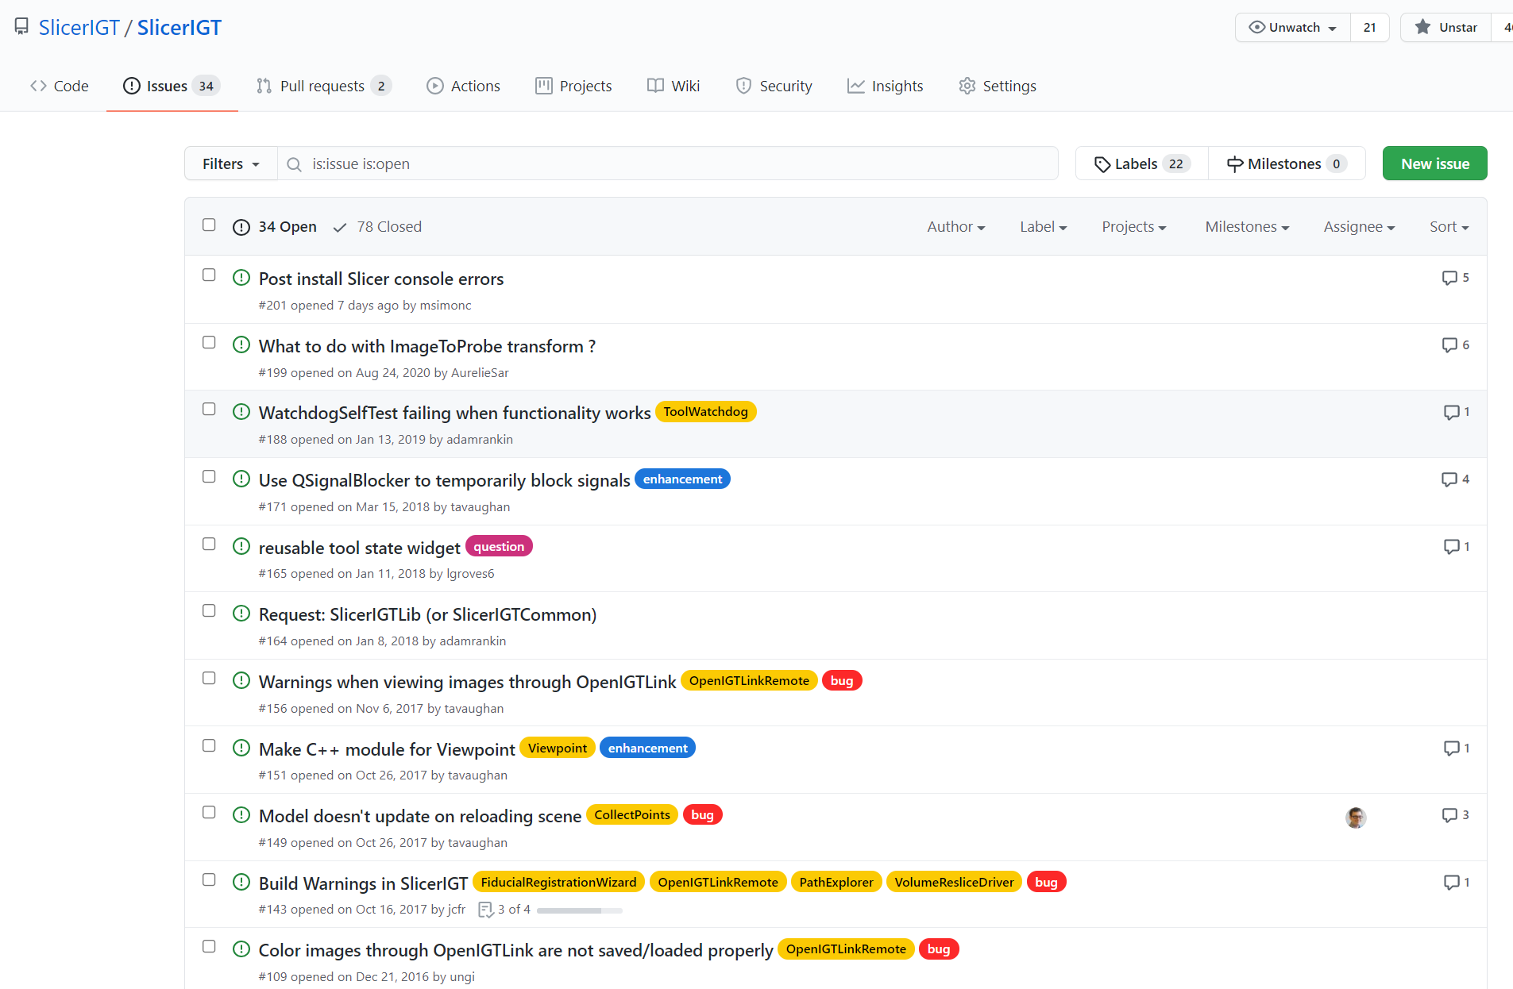
Planning, design, implementation
Web-based, integrated project management: GitHub or GitLab
GitHub: everybody is there, unlimited public repositories for free; free private repositories for university research labs; free continuous integration
Provided services:
revision control
code review
issue tracking: issues, releases, milestones, project boards
continuous integration: automated testing, documentation generation
website hosting, wiki
discussions (very limited), no private messaging

Slide 8
Planning, design, implementation
Documentation:
User manual:
Tutorials (PowerPoint, YouTube)
Reference manual (description of the software)
Developer manual:
Tutorials
Examples, tests
API documentation (Sphinx for Python, Doxygen for C++)
Design documentation
Hosting: readthedocs, github pages

Slide 9
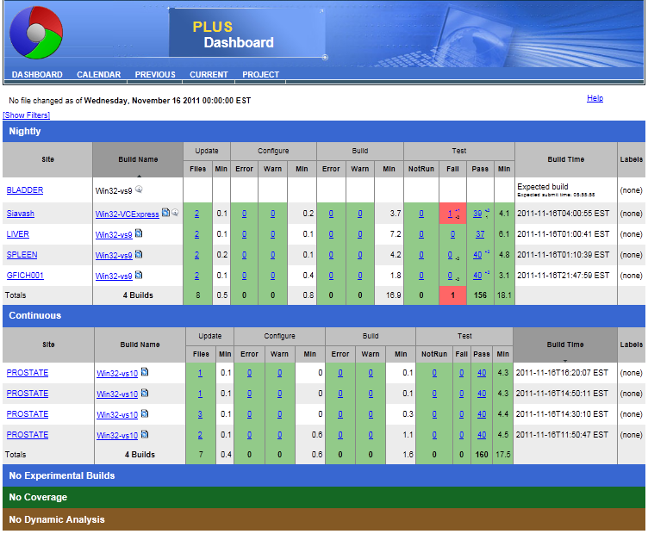
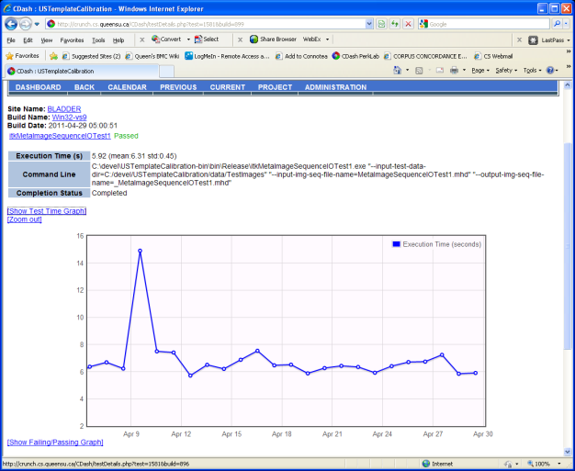
Verification
Automatic build and test (many frameworks for Python; CMake/CTest for C++)
Automated GUI testing is hard
Continuous integration: GitHub actions, CDash
CTest results reported on CDash

Slide 10
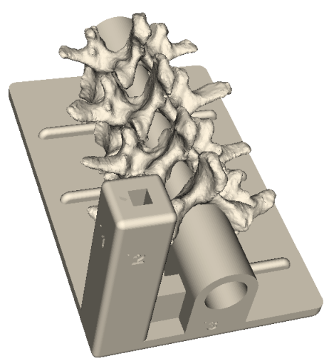
Validation
Fidelity levels: Simulated < Synthetic phantoms < Animal tissue (butcher shop) < Cadaver < Patient
Ethics approval: required for human subject studies (even if just filling out a form), evaluation on patient cases
Phantoms:
Hard tissue (bone): 3D printed, with Barium coating for X-ray visibility
Soft tissue: water based (agar, gelatin), PVC, silicon
Skin: super soft silicon rubber
Vessels: rubber tubes
Targets, validation points
http://perk-software.cs.queensu.ca/plus/doc/nightly/modelcatalog/

Slide 11
Software platform

Slide 12


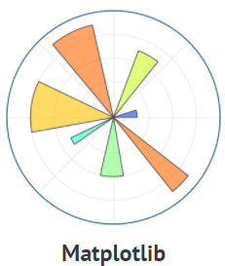
















Medical image computing software ecosystem (desktop+server)
Libraries, toolkits, packages
Applications
Data analysis algorithms
Visualization
User interface
3D Slicer
Communication
DCMTK
pydicom
SciPy
OpenIGTLink

Slide 13

3D Slicer architecture
0.01%
Slicelets
(custom Slicer applets)
LumpNav
...
ProstateNav
DICOMweb REST API
Slicer extensions
SlicerIGT
Breach warning
Neural networks
Pivot calibration
Model registration
...
Tool watchdog
...
Slicer VirtualReality
SlicerJupyter
SlicerWeb
3D Slicer
Visualization
Registration
Segmentation
...
Quantification
Python, VTK, ITK, CTK, Qt, DCMTK, …
Parallel processing
OpenIGTLink
DICOM
Disk storage
PLUS
OpenIGTLink
Neural networks
Calibration, synchronization, pre-processing, simulation, record&replay
Device interface
software
hardware
Surgical microscopes, endoscopes
Ultrasound
scanners
Navigation
systems
Robotic devices, manipulators
MRI, CT, PET scanners
hundreds of devices (imaging, position tracking, various sensors, and manipulators)
Notes:
Using OpenIGTLink (which is a Network Interface for Image-Guided Therapy), PLUS can stream this data in real-time to 3D Slicer and can also be used for pre-processing, and calibration for navigated image-guided interventions.

Slide 14
Summary
Translational research
Reproducible research
Industry best practices
Building on one platform

