Slide 1
Deep Learning in Slicer
Video Analysis

Slide 2
Video Analysis
Real-time imaging modalities often capture data as videos
Ultrasound
RGB cameras
Depth cameras
Fluoroscopy

Slide 3
Video Analysis
Real-time imaging modalities often capture data as videos
Most neural networks are trained to work with static images
Challenge: How can we use deep learning on our video data?

Slide 4
Tutorial Overview
Creating a dataset from video data
Creating a network (simple CNN)
Training a network
Deploying a network
(Optional) Customizing a network

Slide 5
Tutorial Requirements
To complete this tutorial you must have installed:
Anaconda and created an environment
PLUS toolkit
3D Slicer
And completed the Deep Learn Live Setup tutorial

Slide 6
Creating a dataset from video data
First we need some video data…

Slide 7
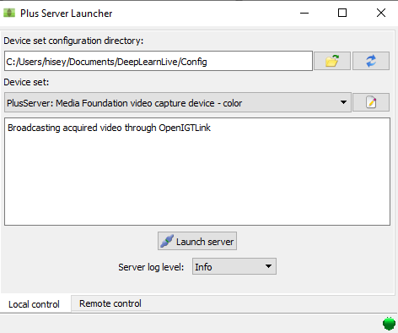
Recording a video
Open Plus server launcher
Navigate to the Config folder within DeepLearnLive
Select the config file
Launch Server

Slide 8
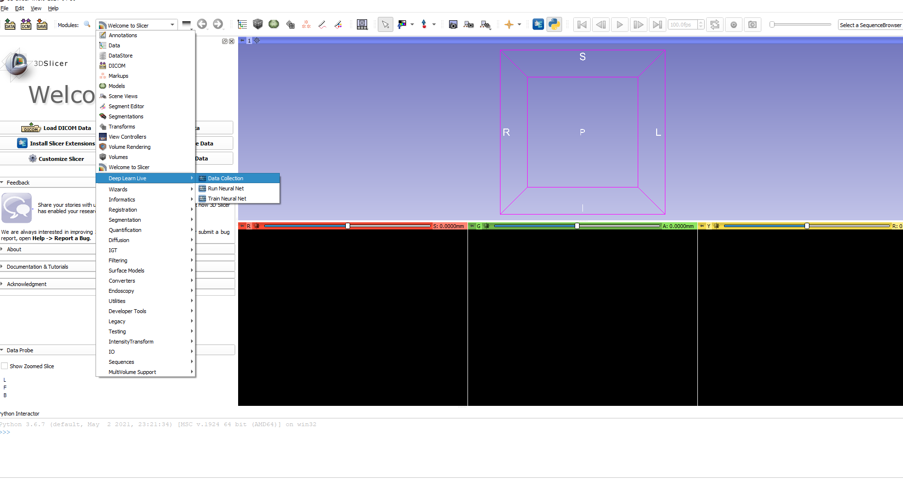
Recording a video
In Slicer go to DeepLearnLive → Data Collection

Slide 9
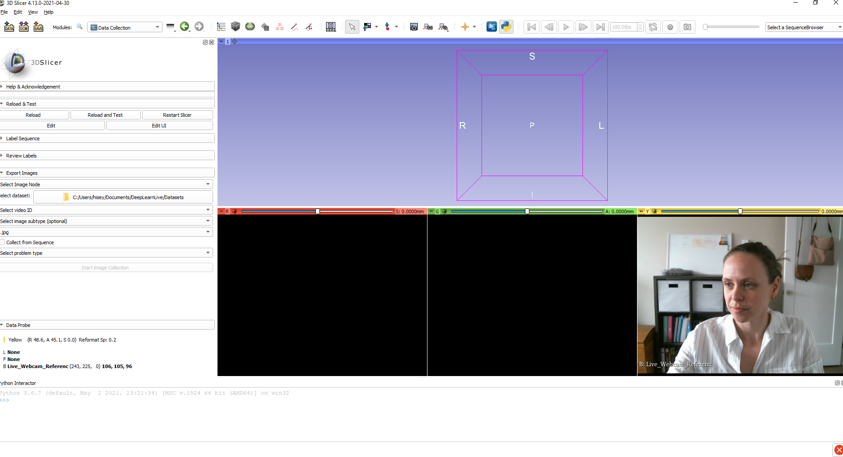
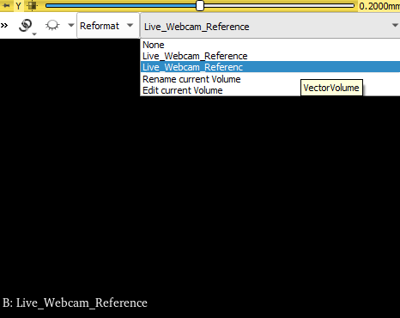
Recording a video
Webcam video should appear in Yellow slice
If it doesn’t check if there’s a node called “Live_Webcam_Referenc”
Click Re-center button

Slide 10
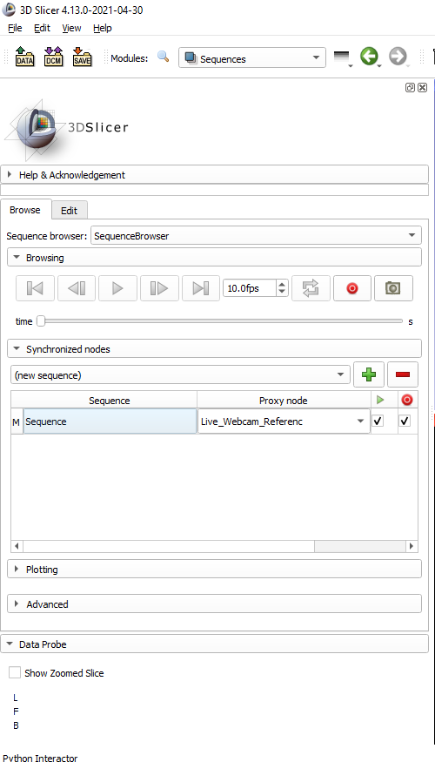
Recording a video
Navigate to Sequence module
Create a new sequence
Add Live_Webcam_Referenc(e) as a synchronized node

Slide 11
Recording a video
Click record button
Pick any two objects you have nearby
Record a video of yourself picking up the objects one at a time (~1 min)
Stop Recording and Save
Restart Slicer
Stop PLUS

Slide 12
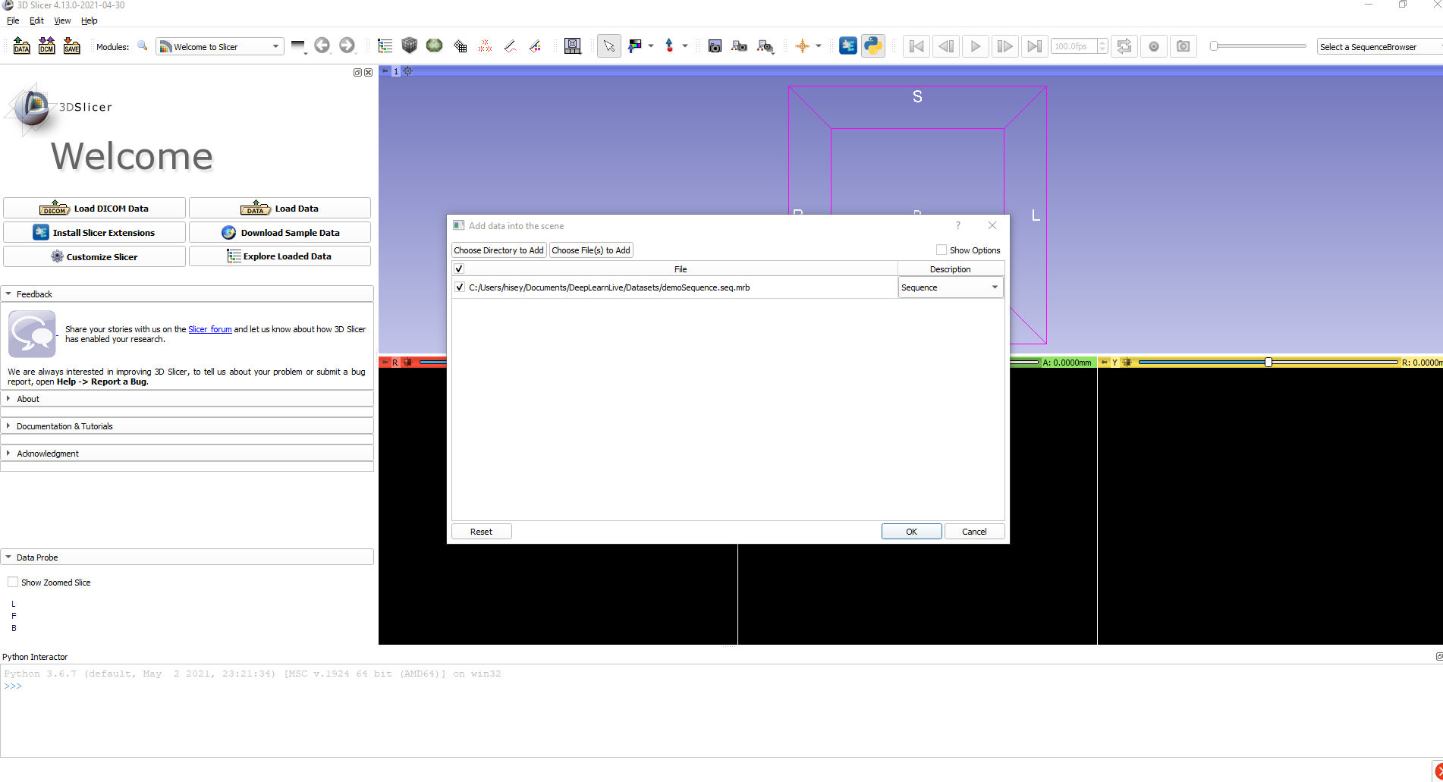
Creating a dataset from video data
Navigate to DeepLearnLive → Data Collection
Drag and drop your recorded sequence into Slicer Scene

Slide 13
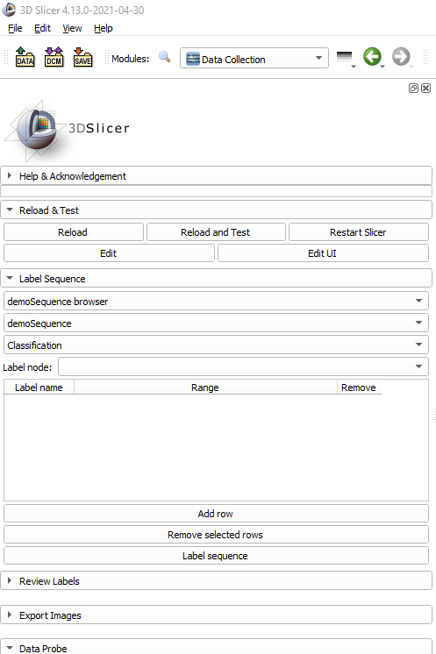
Creating a dataset from video data
Expand “Label Sequence” tab
Ensure your sequence browser is selected
Select your Sequence as the Image Node
Select “Classification” as your problem type

Slide 14
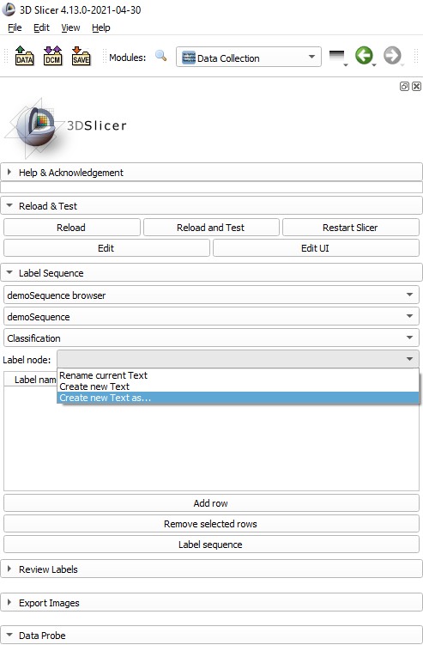
Creating a dataset from video data
Create a new text node to hold our labels
Use the add row button to add entries to our table
Each row will label one segment of the video

Slide 15
Creating a dataset from video data
Modify the label name to reflect the object that is visible
If no object is visible make label name “nothing”
Play through the sequence using the sequence browser toolbar

Slide 16
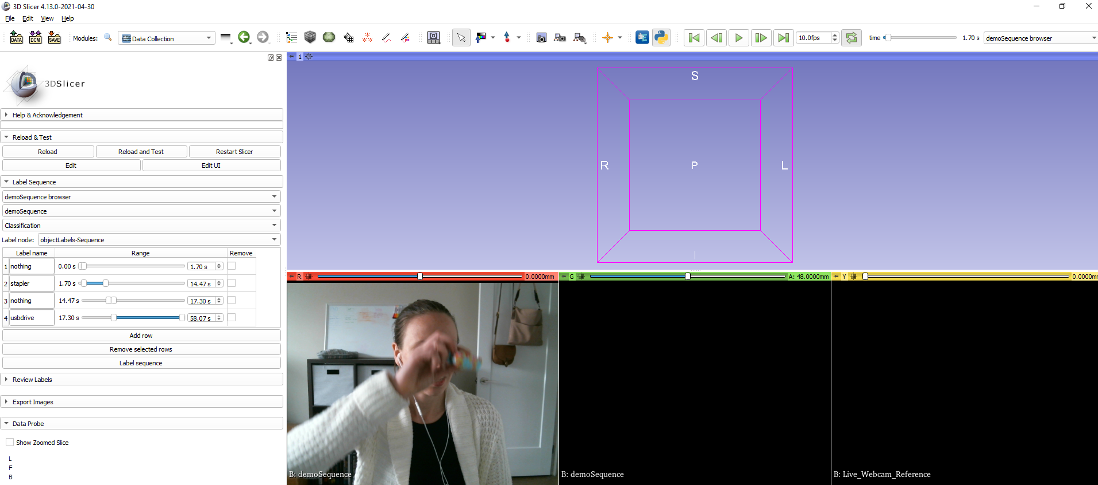
Creating a dataset from video data
Each time the object that is visible changes add a row to the table
Modify the end time of the previous row to reflect the time from the sequence browser

Slide 17
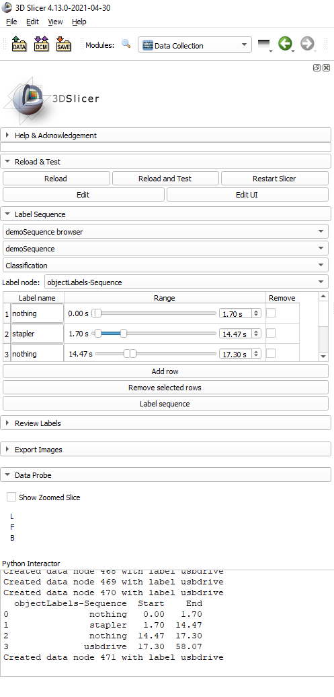
Creating a dataset from video data
Continue until entire video is labelled
When finished click “Label sequence”
If done correctly, you will see a printout of your table in the python console

Slide 18
Creating a dataset from video data
Save your label sequence for use later
We now have a labelled video
Now we need labelled images

Slide 19
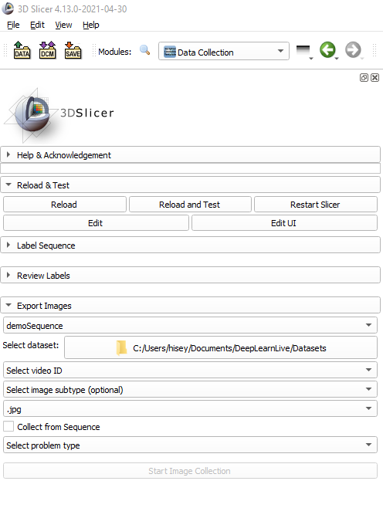
Creating a dataset from video data
Expand the “Export Images” tab
Select your sequence as your Image Node
Use the file browser to select your dataset
We want to make a new dataset so create a new folder and select it

Slide 20
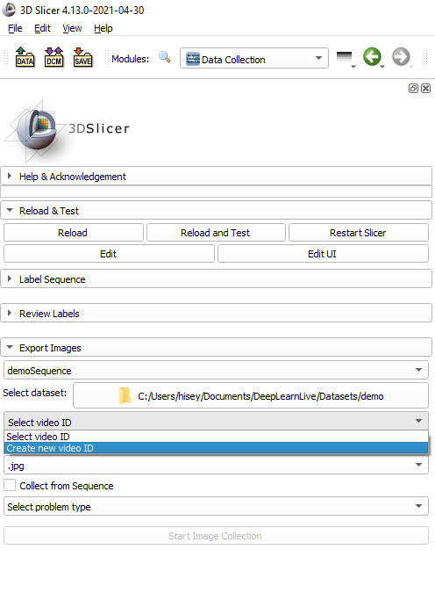
Creating a dataset from video data
This is our first time using this video so we need to assign it a unique ID

Slide 21
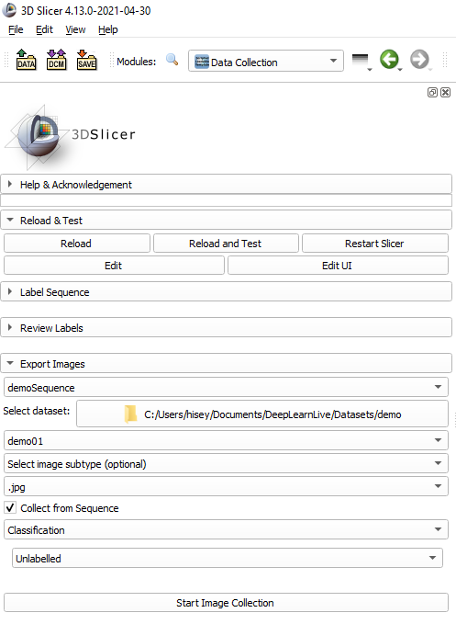
Creating a dataset from video data
Select the file type of the images
Check “Collect from Sequence” box
Select “Classification” as our problem type

Slide 22
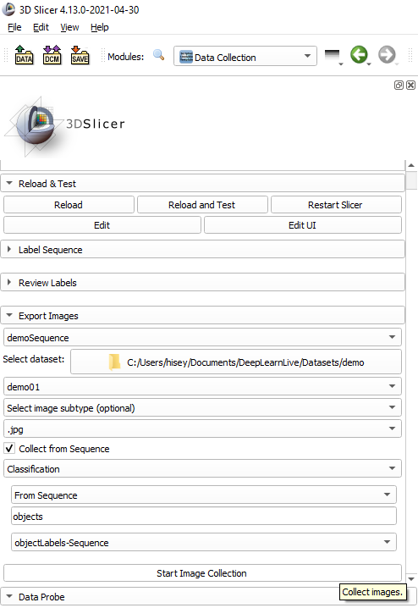
Creating a dataset from video data
Select “From Sequence” as our labelling method
Give your labels a title to identify them
Select your label sequence
Click Start Image Collection

Slide 23
Creating a dataset from video data
Once the process completes check your dataset directory
You should see a new folder with your video ID
Inside you should see a collection of images and a csv file that contains all of the labels for that video
Now that we have a dataset, we need a network to use it

Slide 24
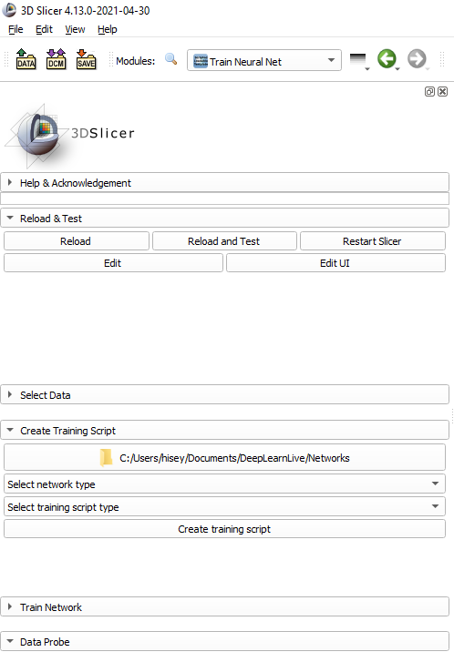
Creating a network (simple CNN)
Navigate to DeepLearnLive → Train Neural Net
Expand the tab labelled “Create Training Script”

Slide 25
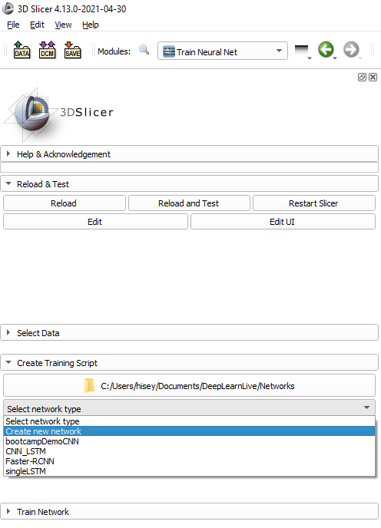
Creating a network (simple CNN)
The file browser allows you to select where you would like to save your network
From network type selector, choose “Create a new network”
Give your network a name to identify it

Slide 26
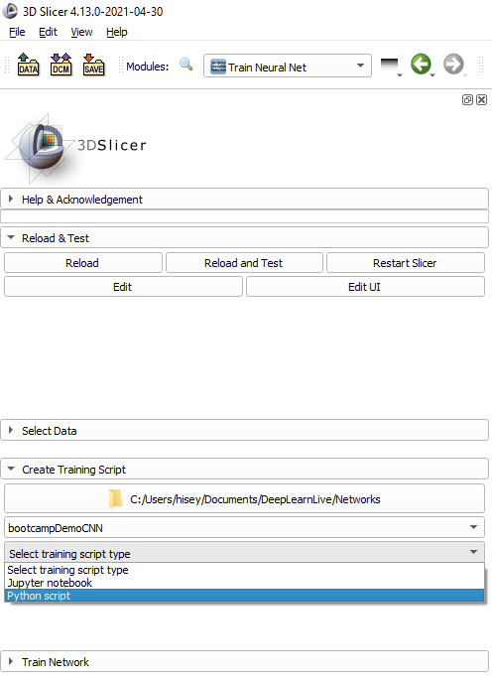
Creating a network (simple CNN)
We have a network
Now we need a script that defines our training protocol
Under training script type, select “Python Script”
Jupyter notebook is a future feature that’s not functional yet
Click “Create training script”

Slide 27
Creating a network (simple CNN)
In your file explorer, navigate to where you saved the network
If you can’t remember it should have printed to the python console
You should now see two python files
<Network name>.py → Network file
Train_<Network name>.py → Training script

Slide 28
Creating a network (simple CNN)
Network file defines:
The structure of the network
Layers used
Input/output dimensions
How to save and load the model
Preprocessing steps that are necessary to predict on incoming images
Training script defines:
The specific training protocol

Slide 29
Creating a network (simple CNN)
We now have:
A dataset
A network
A training script
It’s time to train!

Slide 30
Training a network
Before we can run our training script, we need to select the data that we want to train our network with

Slide 31
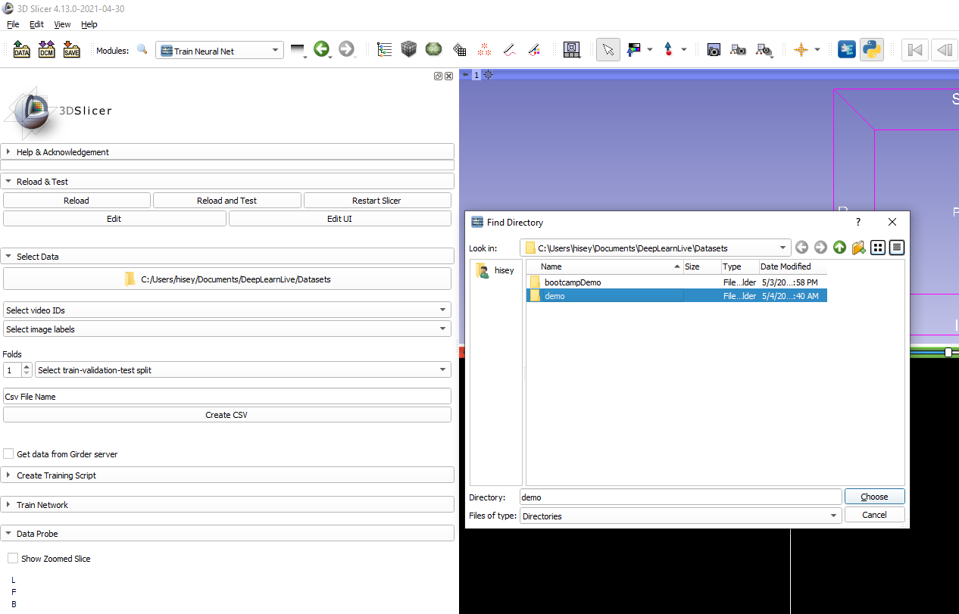
Training a network
Expand the “Select Data” tab in Train Neural Net
Use the file browser to navigate to the dataset folder created at the beginning of the tutorial

Slide 32
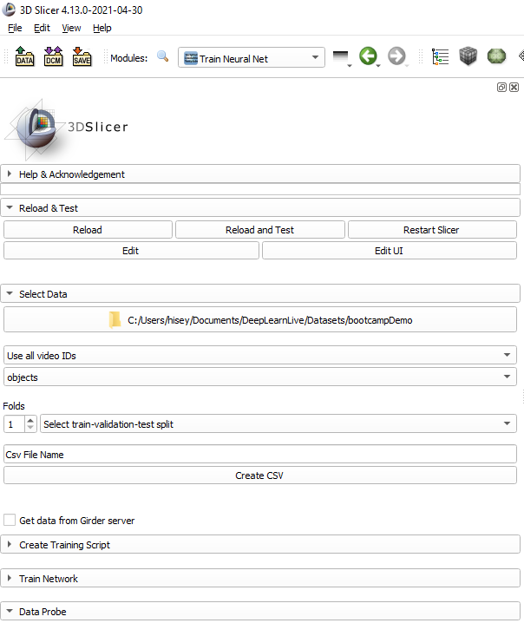
Training a network
We only have 1 video so select “Use all video IDs”
Select the name of your labels from the image labels menu

Slide 33
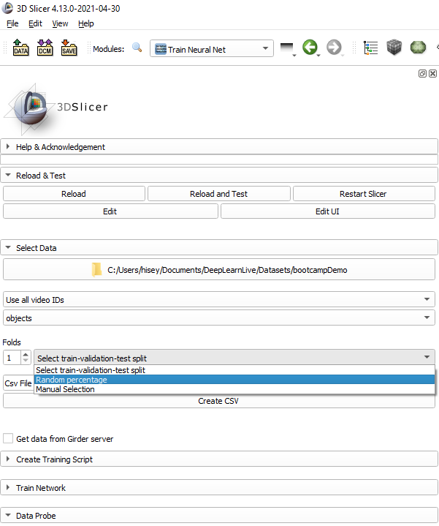
Training a network
We’ve now selected which data we want to use
Now we need to divide that data into training, validation and testing sets
Since we only have 1 video, we’ll split by random percentage

Slide 34
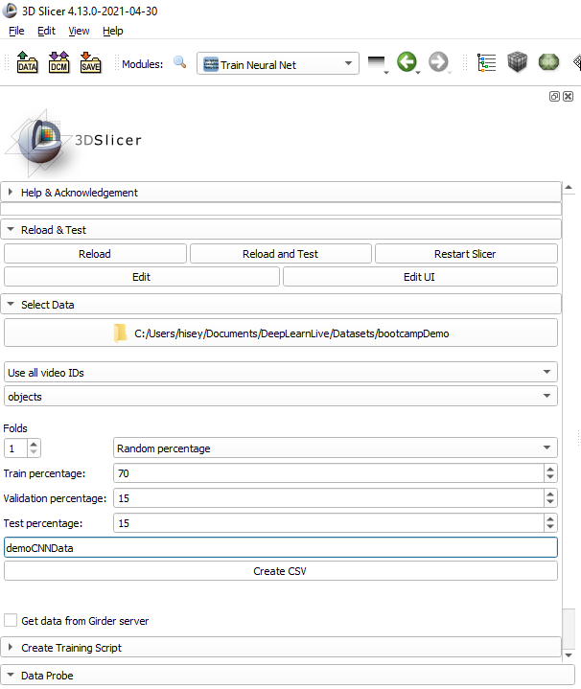
Training a network
You can modify the percentage of data that is used for each set
Must sum to 100
No set can be 0
Name your csv file
“Click create CSV”

Slide 35
Training a network
Now we know what data we want to use, now it’s time to run our training script
Expand the “Train Network” tab

Slide 36
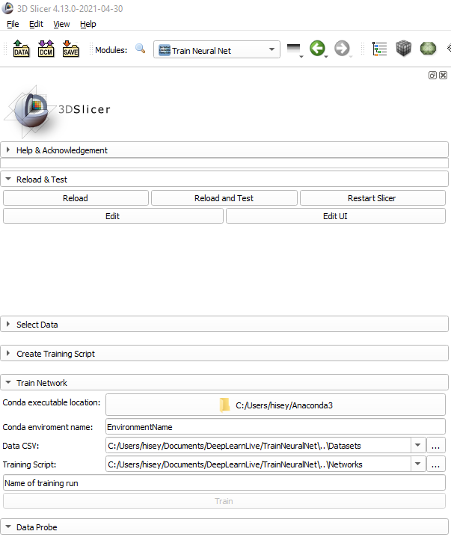
Training a network
The module should automatically find where anaconda is installed on your computer
If the module can’t find it, use the file browser to locate your Anaconda3 folder

Slide 37
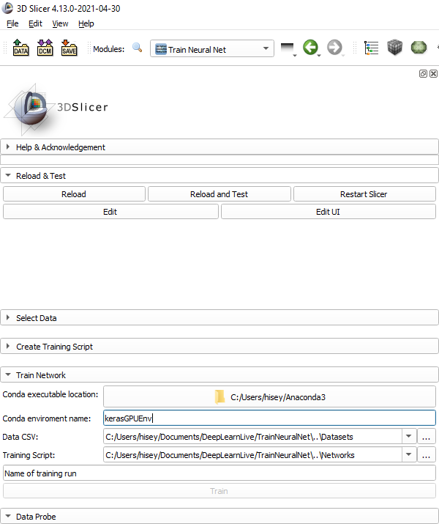
Training a network
Fill in the name of your conda environment
If you normally need to include the filepath to activate the network, include that too

Slide 38
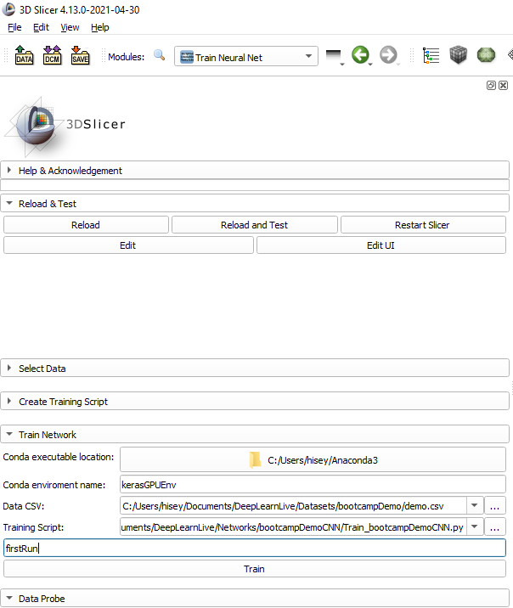
Training a network
Select the data csv that we just created and the training script that we created earlier
Name your training run
E.g. firstRun

Slide 39
Training a network
Click “Train”
A command prompt window should appear
Wait until your network has completed training

Slide 40
Training a network
Once training is complete, in your network folder you’ll find a new directory containing:
Plots of the accuracy and loss
The network structure file (.json)
The network weights file (.h5)
Label text file
Training info
Contains all relevant information about parameters used in training, and all statistics

Slide 41
Training a network
We now have:
A dataset
A network definition
A training script
A trained network
Now it’s time to deploy our network in real-time!

Slide 42
Deploying a network
Deploying our network allows us to:
Predict on new incoming data in real-time
Store the predictions in the Slicer Scene
Use the predictions within other slicer applications
Modules, extensions, guidelets etc.

Slide 43

Deploying a network
Setup your webcam video as described earlier on slides 7-9
Navigate to DeepLearnLive → Run Neural Net

Slide 44
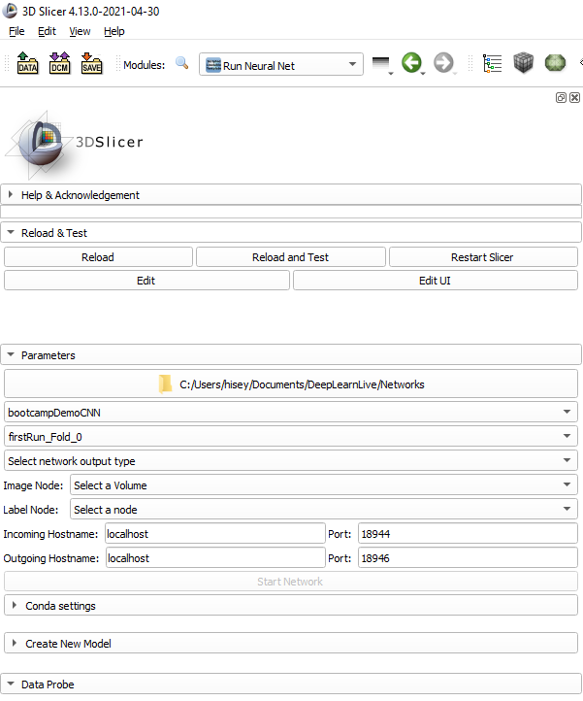
Deploying a network
Use the file browser to navigate to where you saved your network
For network type, select the network you created
For model, select the training run we just completed

Slide 45
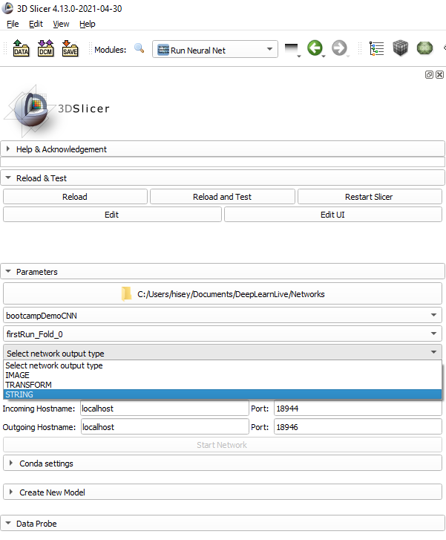
Deploying a network
Since this is a classification network, our output type is STRING
The output type defines what type of node will store our networks predictions in the scene

Slide 46
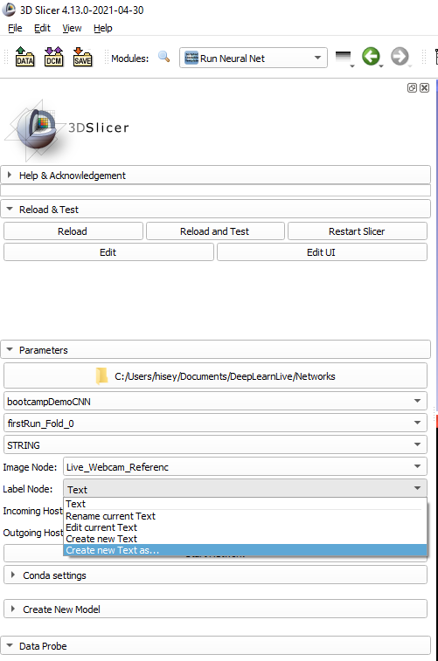
Deploying a network
Select Live_Webcam_Referenc(e) as the image node
This defines which node’s data should be sent to the network
Create a new text node as the label node
This will store the network’s output in the scene

Slide 47
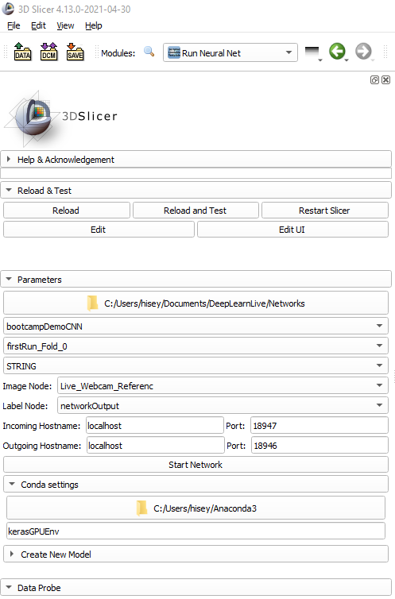
Deploying a network
Modify the Incoming Port so it doesn’t conflict with our Plus server
Update your Conda environment name in the “Conda settings” tab
Click “Start Network”

Slide 48
Deploying a network
After clicking Start Network a command prompt window should appear
Once the network is running you should see it printing numbers

Slide 49
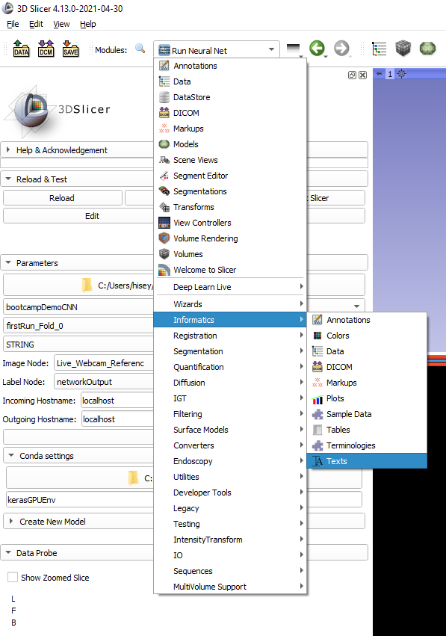
Deploying a network
To check that your network is working, navigate to Informatics → Texts using the module menu
If your network is working, you should see the contents of your text node updating as the network classifies images

Slide 50
Deploying a network
Congratulations!! You’ve now successfully:
Created and annotated a dataset
Defined a neural network and a training script
Trained that network
Deployed that network on real-time video data

Slide 51
Customizing a Network
This tutorial showed only a simple example of a CNN for image classification
Classification is not the only task we want to use deep learning to solve

Slide 52
Customizing a Network
Deep Learn Live allows you to fully customize your networks
Only requirement is that you include the same function headers that are in the template scripts
Everything else can be modified!!

Slide 53
Customizing a Network
Complex custom examples:
CNN-LSTM → 2 combined networks for surgical workflow recognition
U-Net → Designed for ultrasound segmentation

Slide 54
Conclusion
Deep Learn Live is a useful extension for anyone looking to:
Annotate video data
Integrate deep learning into their Slicer applications
Create networks that are easily reproducible and can be shared open-source
Deep Learn Live is still a work in progress!
Many more features planned in the coming months

