Slide 1
Managing your project in the PerkLab
Project management and GitHub and Git basics

Slide 2
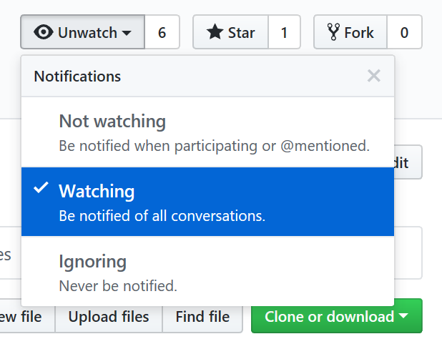
Basic mechanisms
Set up project space
Which repository? Ask your mentor. Most commonly: https://github.com/PerkLab private project. Make it public when published.
Do not ignore email notifications. May set to Not watching. Avoid Ignoring.
Create README.md
Overall goal, approach, high-level plan.
Resources: directory on file server, other repositories, etc.
Set up project board
Set up regular (weekly) execution control meeting
Review what was done vs. planned, check if help needed => update issues, add notes.
Update short-term plan (2 weeks) => update project board.
Check if long-term plan is still OK => update plan if needed.

Slide 3
Documentation
Frequently changing, temporary information (short-term planning, administration), not for archival => issue tracker, project board, dropbox
Software documentation:
User manual, Developer manual => few Markdown (.md) files in root folder.
API documentation => in source code. Use doxygen style for C++, Sphinx docstring / restructured text for Python.
Key papers, presentations create for the project => Doc subfolder in source code repository, in editable format (Word, PowerPoint); avoid large binary files and frequent updates

Slide 4
Issue tracking
Tracking tasks: issues, feature requests, enhancement ideas
Entering a bug report: What did you do? What did you expect? What happened instead? Attach logs, screenshot.
Add comment whenever making progress
Refer to issues in source code commits to automatically link them
@mention people in a comment to get input from someone (instead of writing an email)

Slide 5
GitHub Projects vs. Releases
Projects: typically for small projects
Supports continuous, organic evolution
Works across repositories, easy drag-and-drop
Columns on the project board
To do: when tasks are completed, we choose what to do next from this column.
In progress: currently somebody working on it; make sure somebody is assigned.
Done: closed issues, no further action is planned.
Some other useful columns:
To test: useful for projects where users and developers are different group.
Future: collection of ideas for the future
Example: https://github.com/twbs/bootstrap/projects/13 (we only use in private projects)
Releases: for larger projects
Supports upfront planning and monitoring progress
The way to define deadlines (no deadlines for individual tickets)
Files can be attached (e.g., installation package)
Example: https://github.com/PlusToolkit/PlusLib/milestone/4

Slide 6
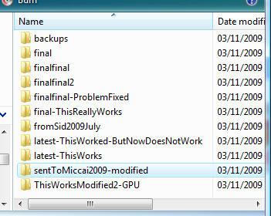
Revision control – the naïve way

Slide 7
Organized storage of multiple file versions
Numbered commits:
cryptographic hash (SHA-1, 160 bit, 40 character hex string) ca8fbe9085c4f67be170 528b53b8ac3f64dd5acb
Tree structure: main + other branches
Tags: human-readable name for specific version
9
8
tag
7
6
5
PLUS-1.8.1
4
branch
3
2
commit
1
main (formerly: master)

Slide 8
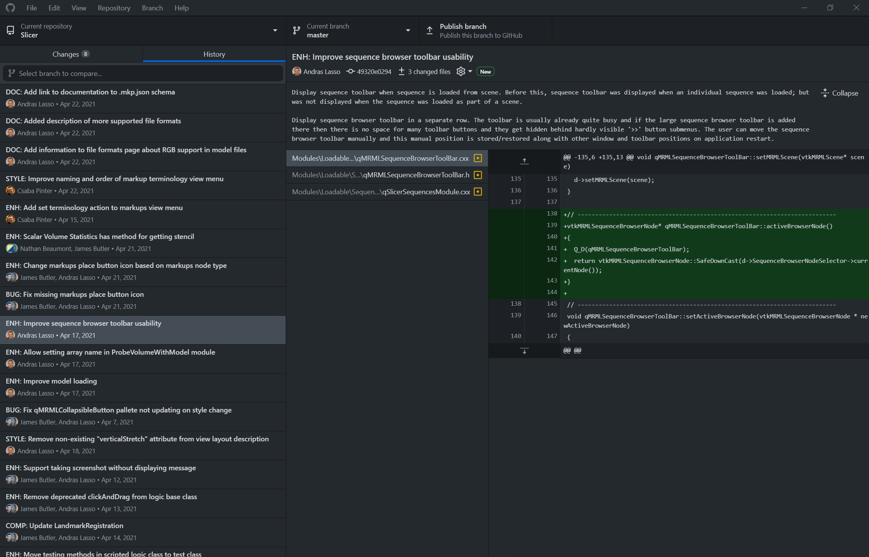
Records history of all file changes
Recorded for each modification:
What? When? Who? - automatically
Why? add as comment

Slide 9
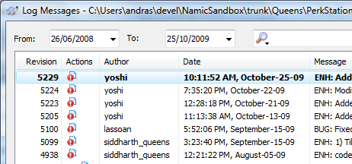
Concurrent modifications by multiple people
One common server stores all versions
Automatic merge of trivial changes (if a line is not modified by multiple people)

Slide 10
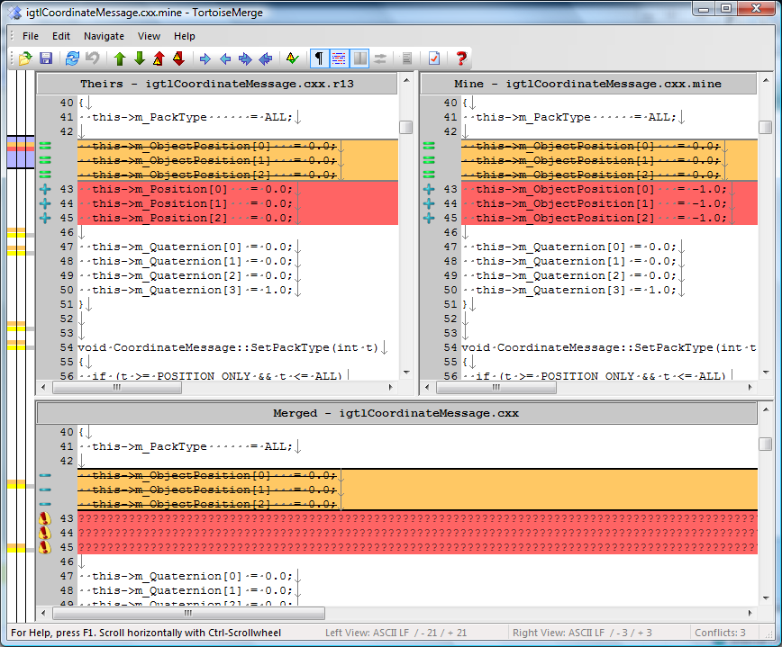
Manages concurrect changes (merge)
Their modifications
My modifications
merge
10
8
9
6
7
5
4
3
2
1

Slide 11

Distributed revision control
PerkLab/BootcampSandbox (upstream)
GitHub servers (remotes)
Alice/BootcampSandbox (origin)
Bob/ BootcampSandbox (origin)
Fork
Fork
Clone
Clone
Alice’s computer
Bob’s computer

Slide 12
Setup Git
Install Git (command-line tool): https://git-scm.com/download/win
Install Git client with graphical user interface:
TortoiseGit: http://tortoisesvn.net/downloads all git features are available, only on Windows
GitHub desktop: https://desktop.github.com/ optimized for beginners, sufficient for simple workflows
Visual Studio Code: several plugins with varying complexity and feature set
Optional: for private repositories with SSH authentication, install putty: http://www.chiark.greenend.org.uk/~sgtatham/putty /latest.html

Slide 13
Forking: copy the repository for yourself
PerkLab/BootcampSandbox (upstream)
GitHub servers
Alice/BootcampSandbox (origin)
Bob/ BootcampSandbox (origin)
Fork
Fork
Clone
Clone
Alice’s computer
Bob’s computer

Slide 14
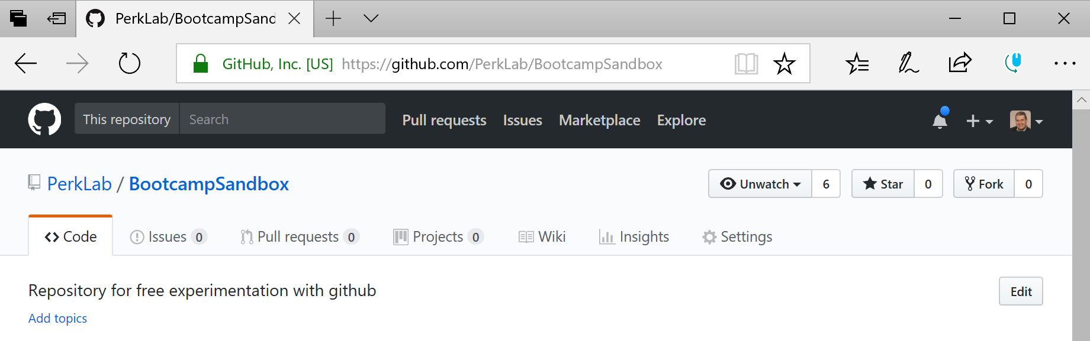
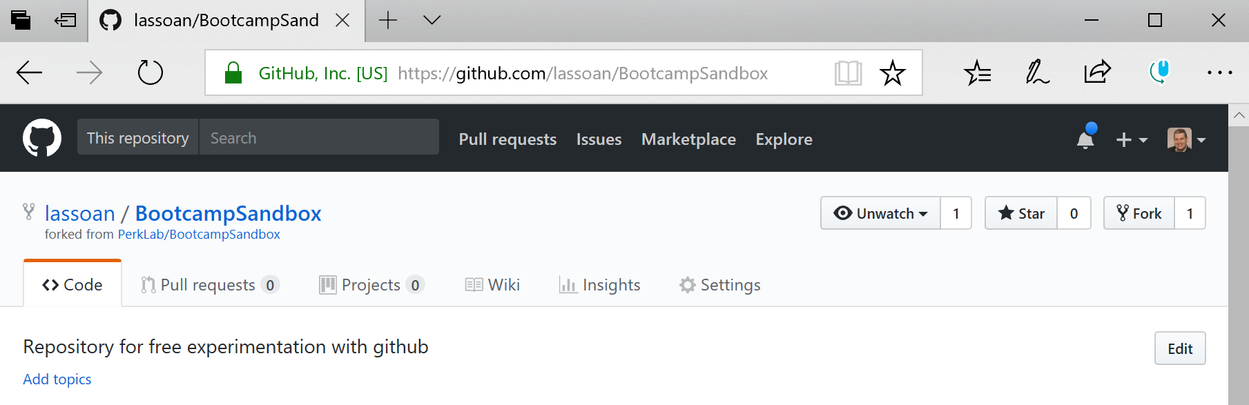
Fork: in GitHub
Open repository webpage: https://github.com/PerkLab/BootcampSandbox
Fork the repository: clone the repository for yourself so that you can make changes freely

Slide 15
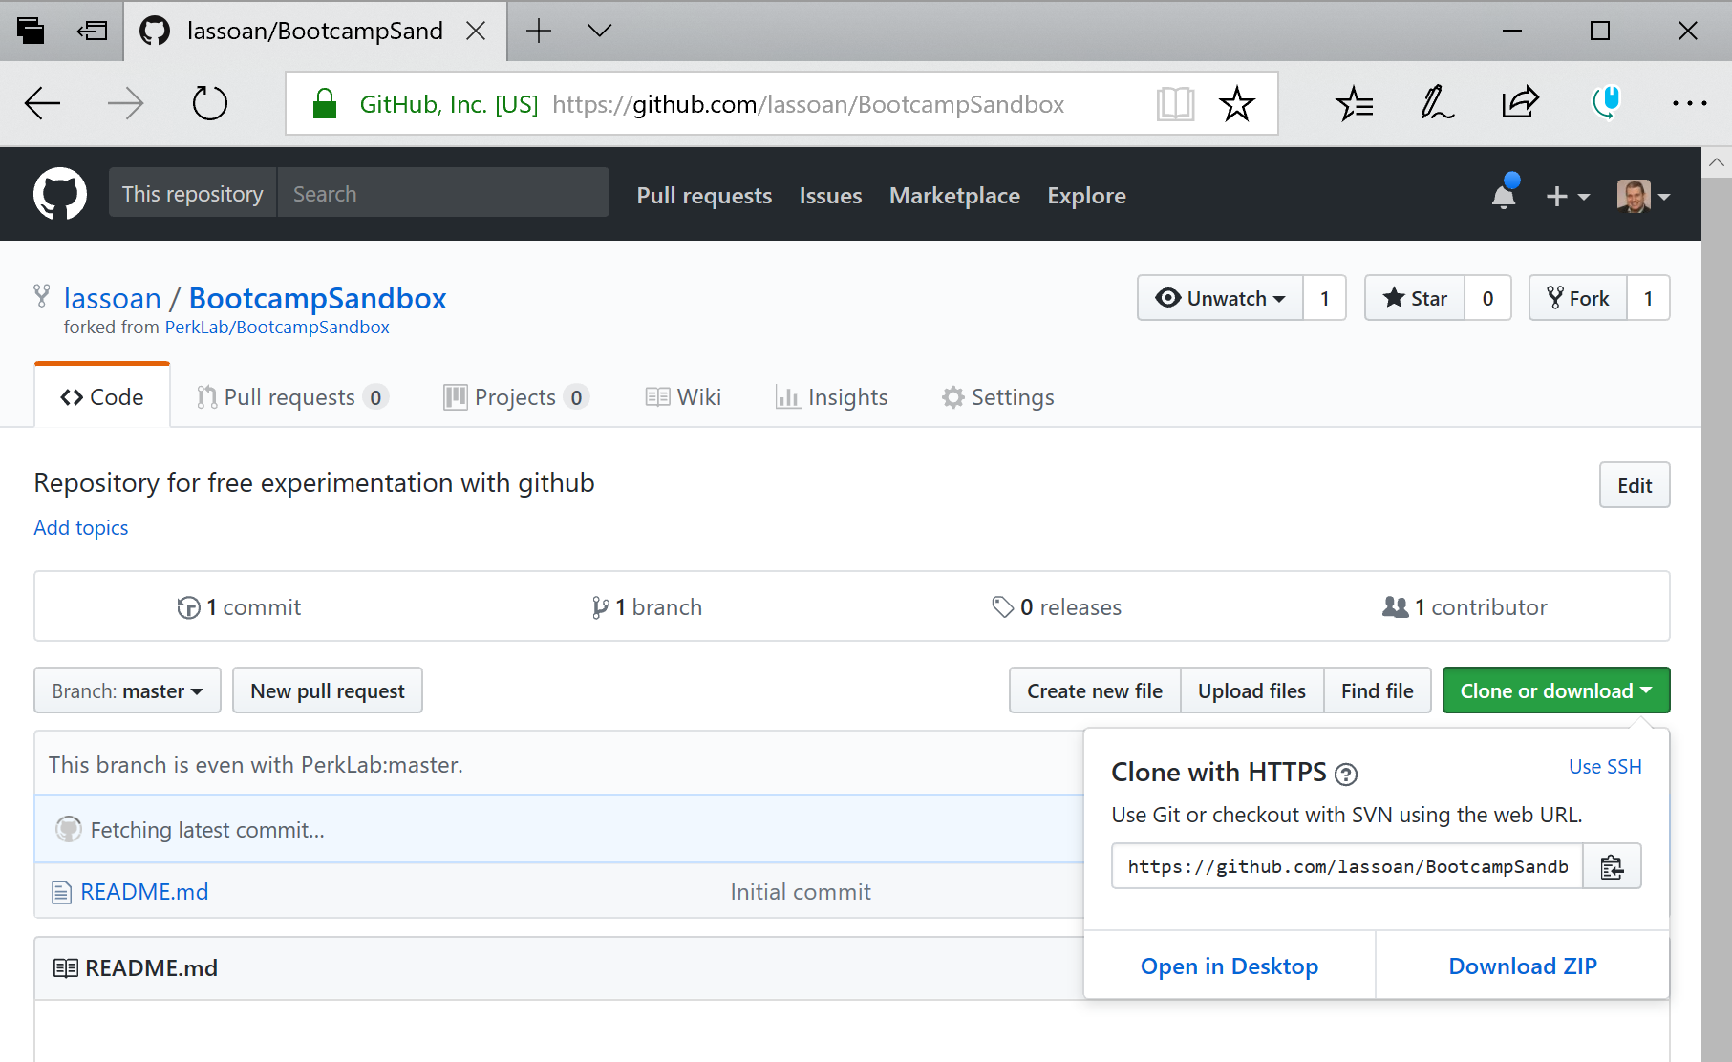
Clone: create a local copy of your repository
1
2

Slide 16
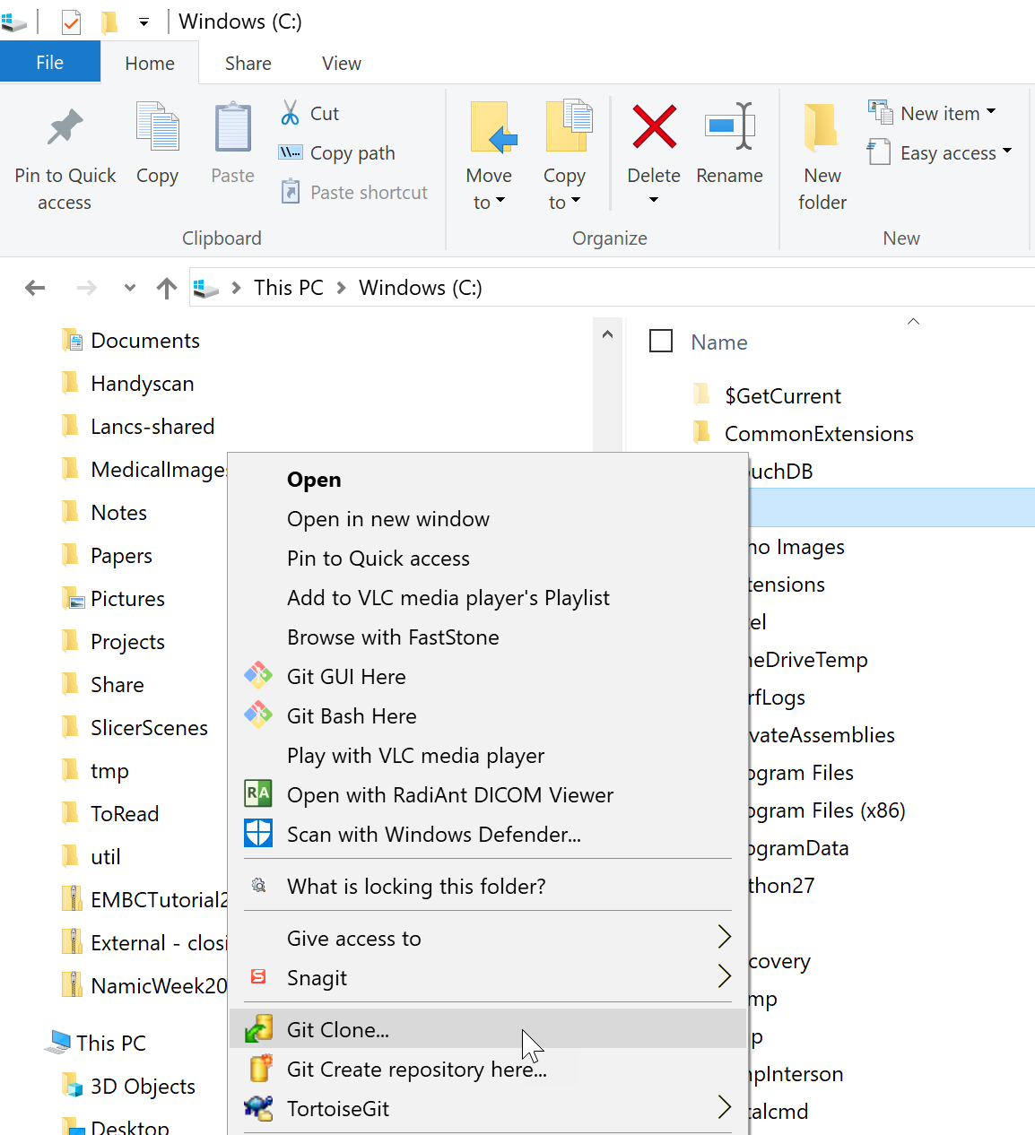
Clone: using TortoiseGit /1
1 Right-click on a folder
2

Slide 17
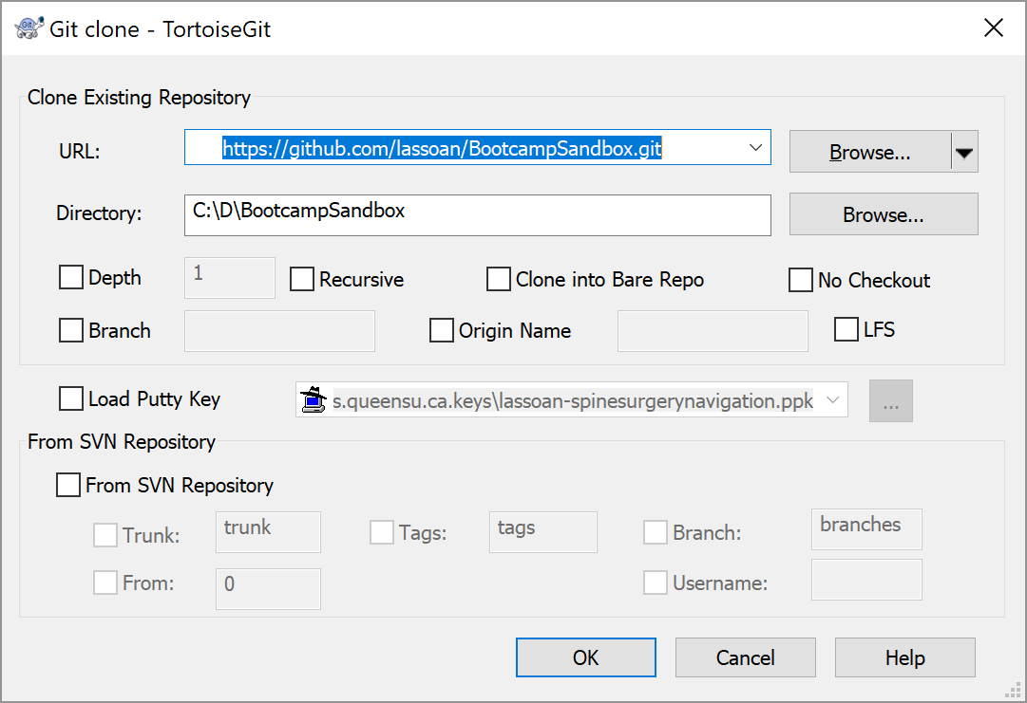
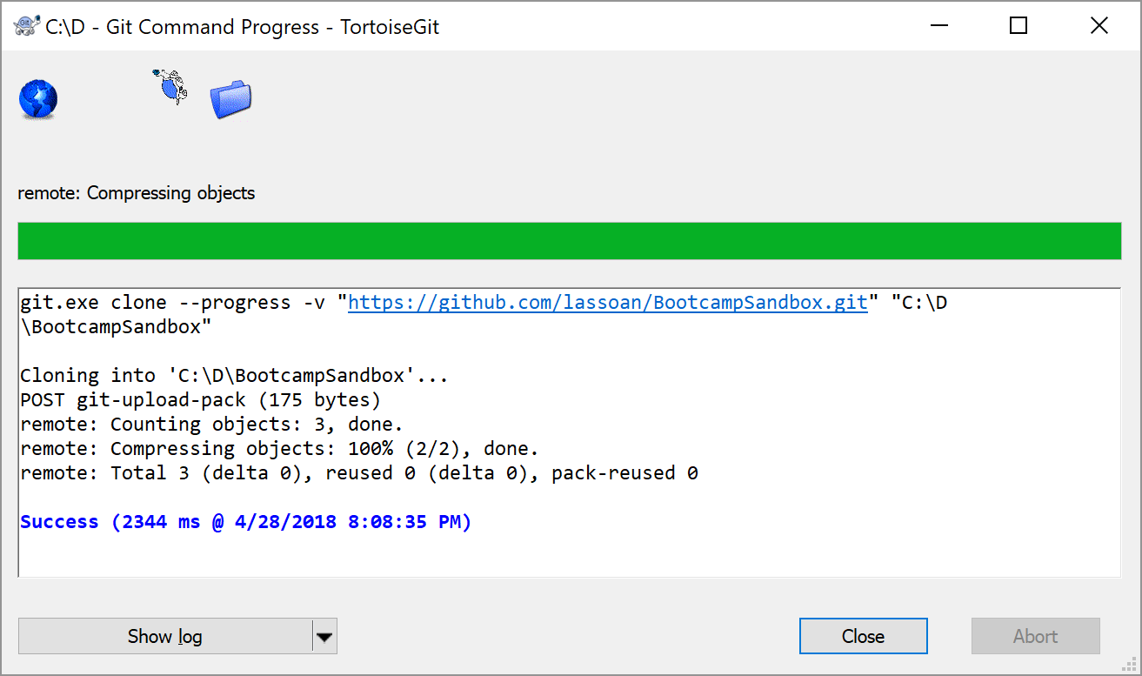
Clone: using TortoiseGit /2
1
2

Slide 18
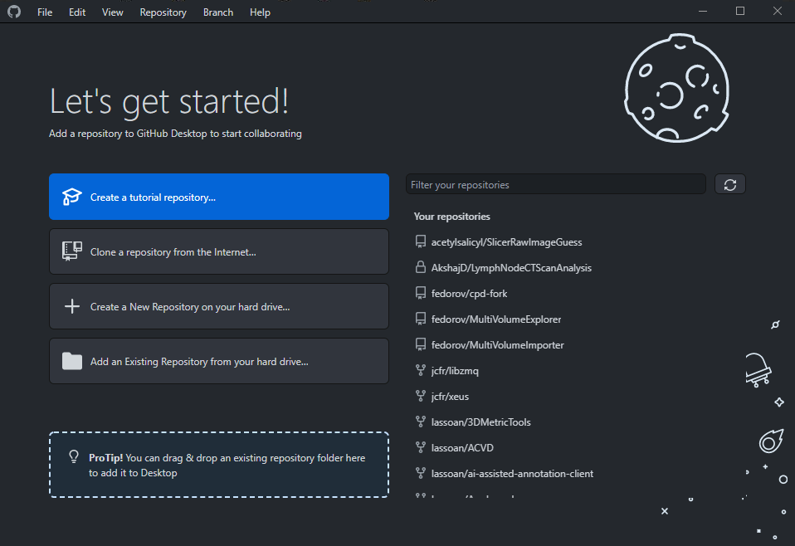
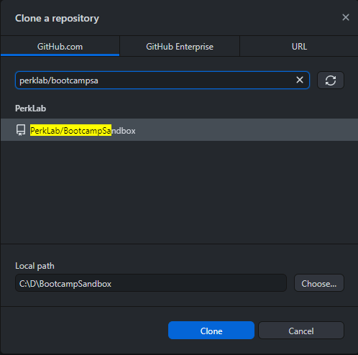
Clone: using GitHub Desktop
2
1
3
4

Slide 19
Clone: using terminal
Use “cd” (change directory) to navigate to where you’d like to clone the repository
Run the command (changing the url for a different repository): git clone <url> <destination>
git clone https://github.com/PerkLab/PerkLabBootcamp .

Slide 20
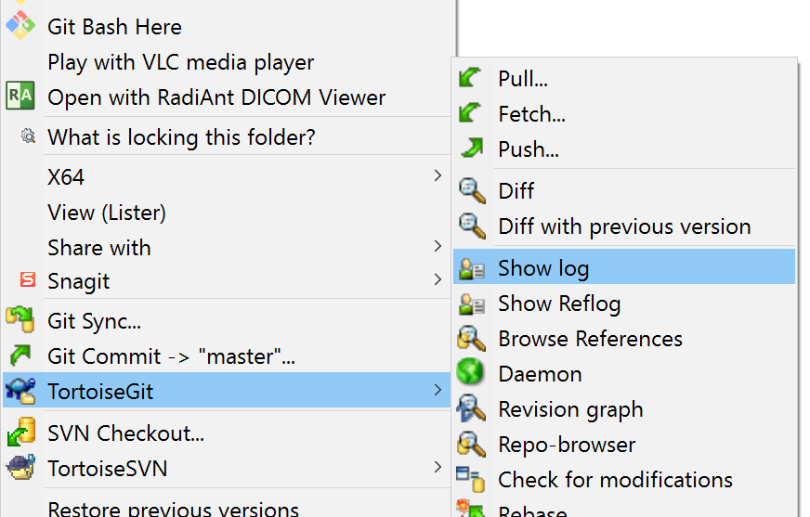
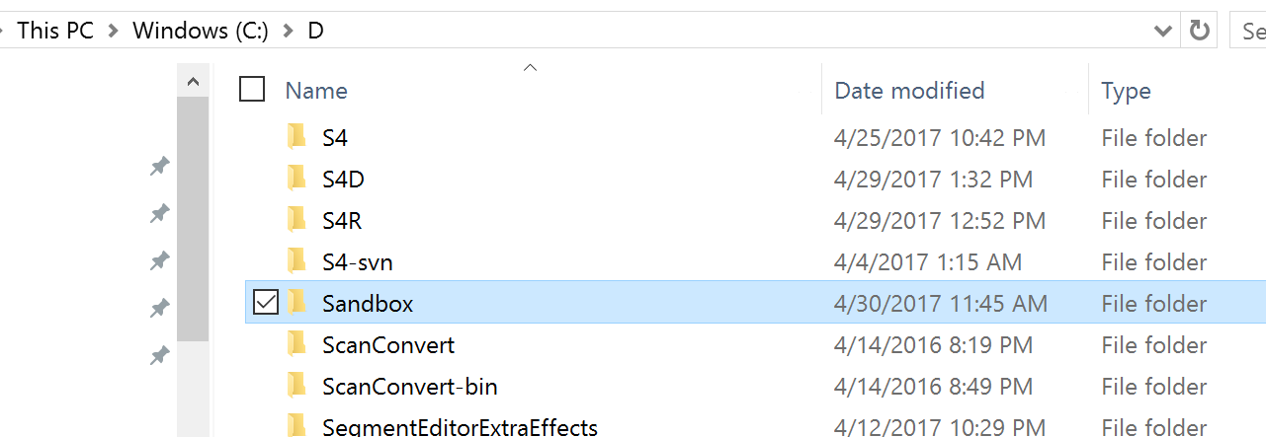
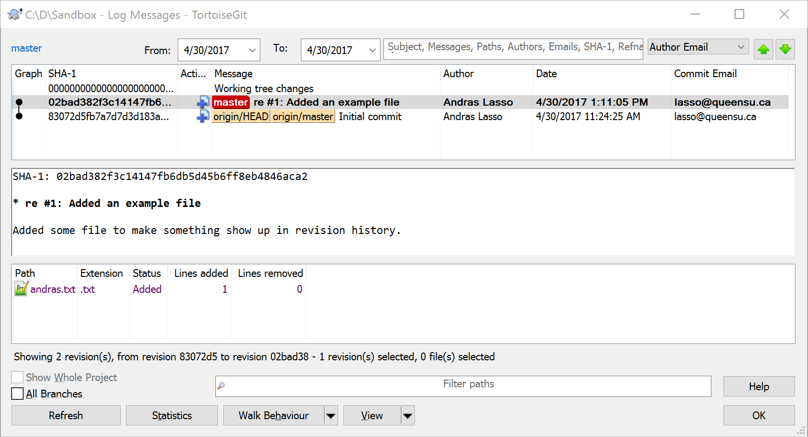
Review change history: using TortoiseGit
1: right-click
3
2

Slide 21
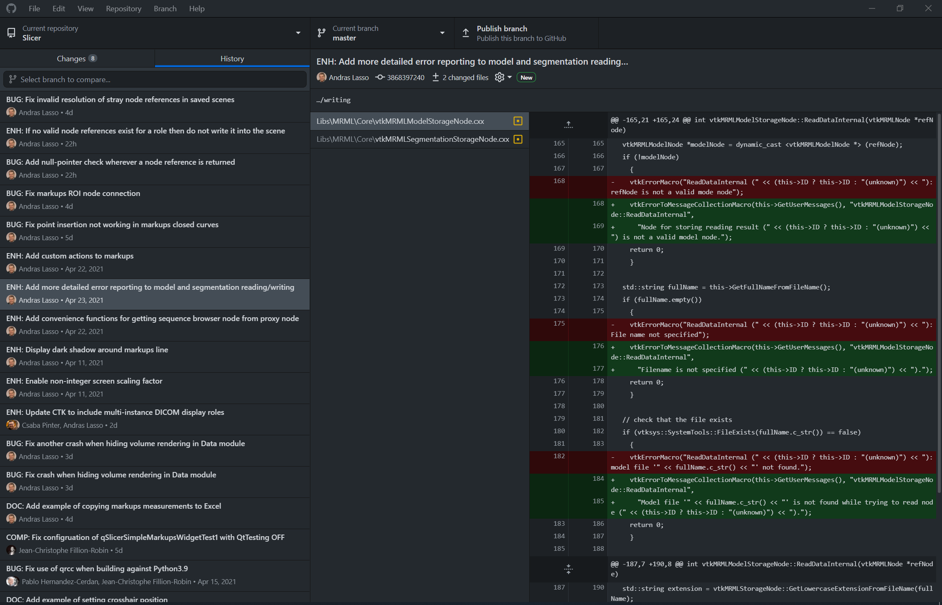
Review change history: using GitHub Desktop

Slide 22
Commit and push: save changes to server
Add/modify/delete files
Test your modifications (compilation is OK, no crash, etc.)
Commit -> “master” to save changes to local repository
Enter a commit message
One-line summary: re #123
describe why was modified
include the issue/ticket number to make the commit show up in the ticket comment list
Click Push to upload changes to GitHub servers to make it available to your collaborators
Alice/Sandbox
GitHub servers
Push
Commit
Alice’s computer

Slide 23
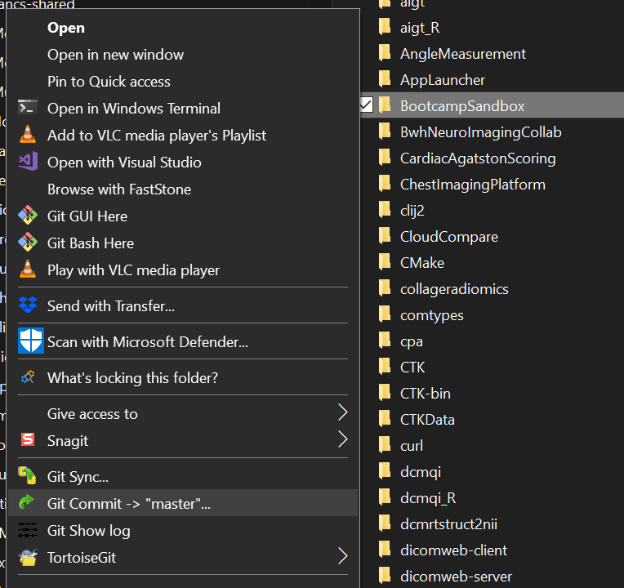
Commit and push: using TortoiseGit
Right-click on the revision controlled directory
Click Git Commit -> “master”
Review your changes
Enter a commit message
Click Push to upload to GitHub
1: right-click
2

Slide 24
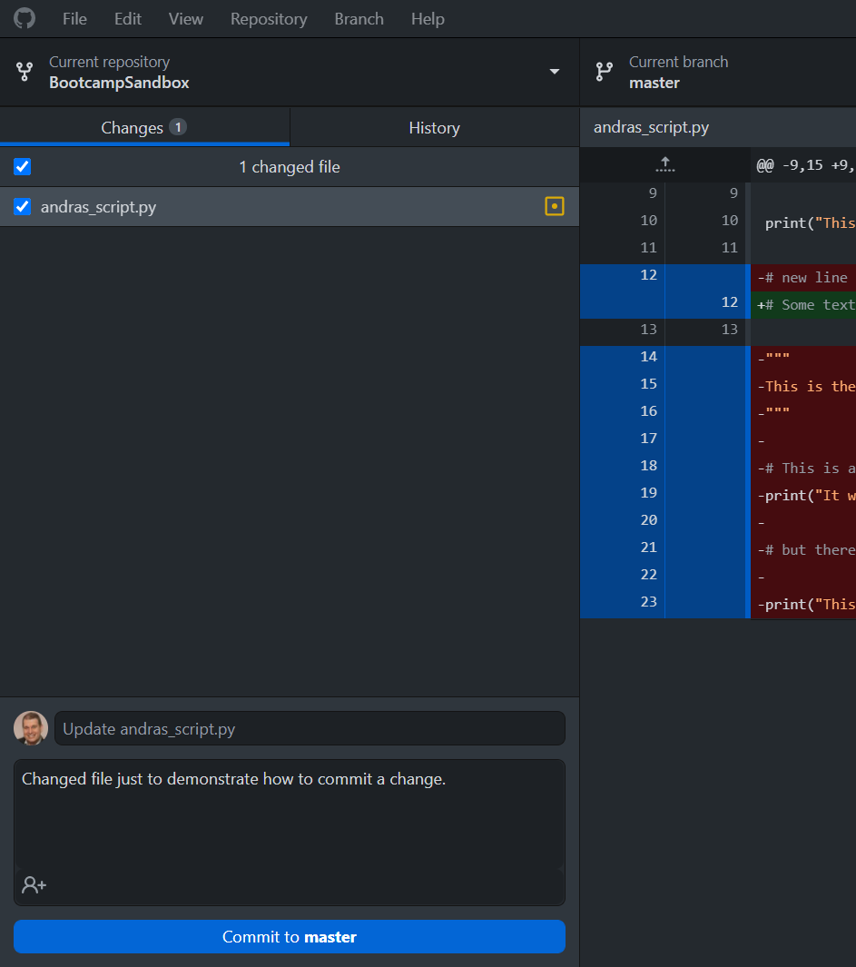
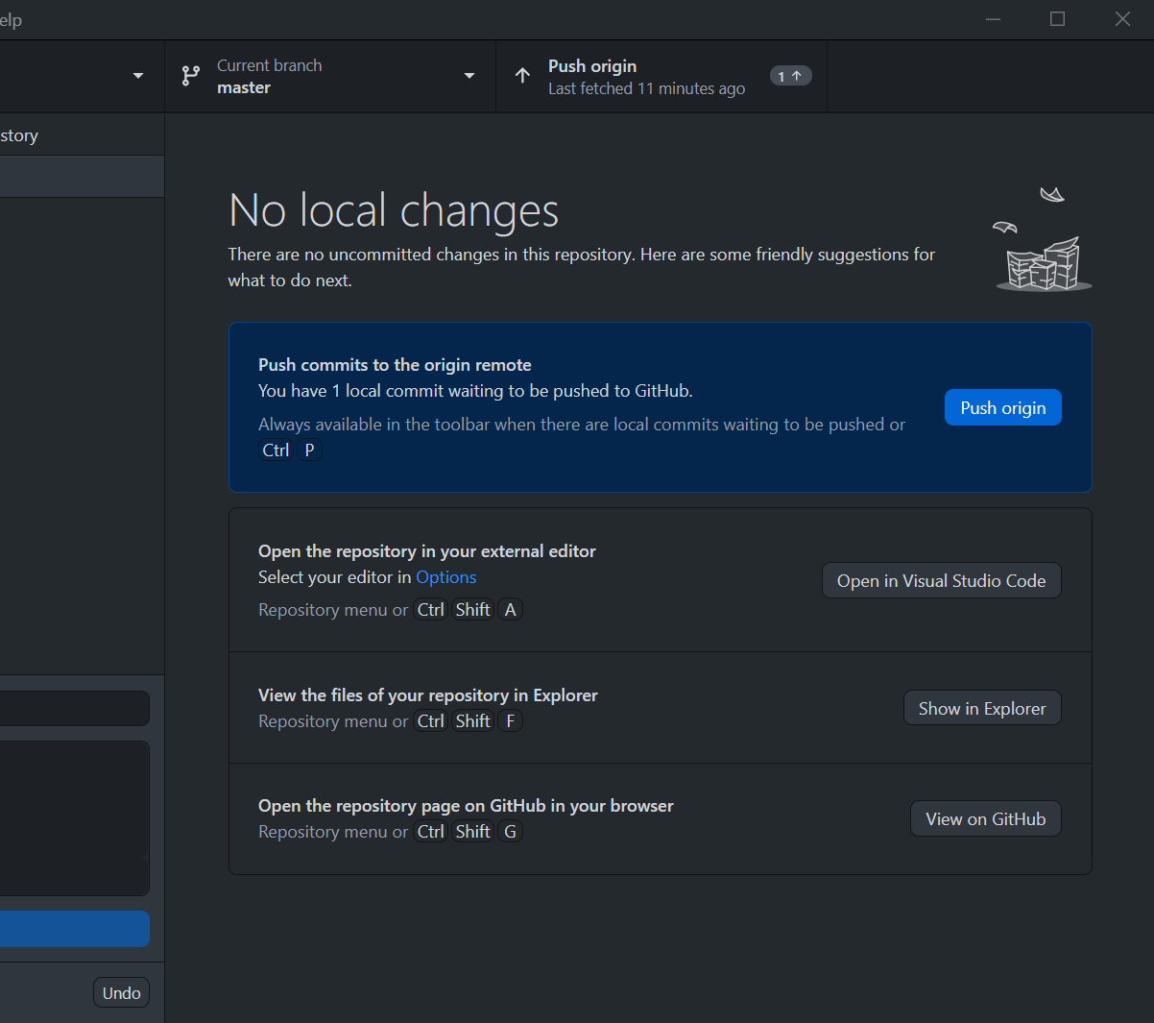
Commit and push: using GitHub Desktop
4
1
2
2
3

Slide 25
git commit (terminal)
Review changes:
git diff
Stage our changes to be committed. To add everything use:
git add –A
To add only specific files, use: git add <filename>
Commit:
git commit –m “<commit-message-here>”
Push:
git push origin master

Slide 26
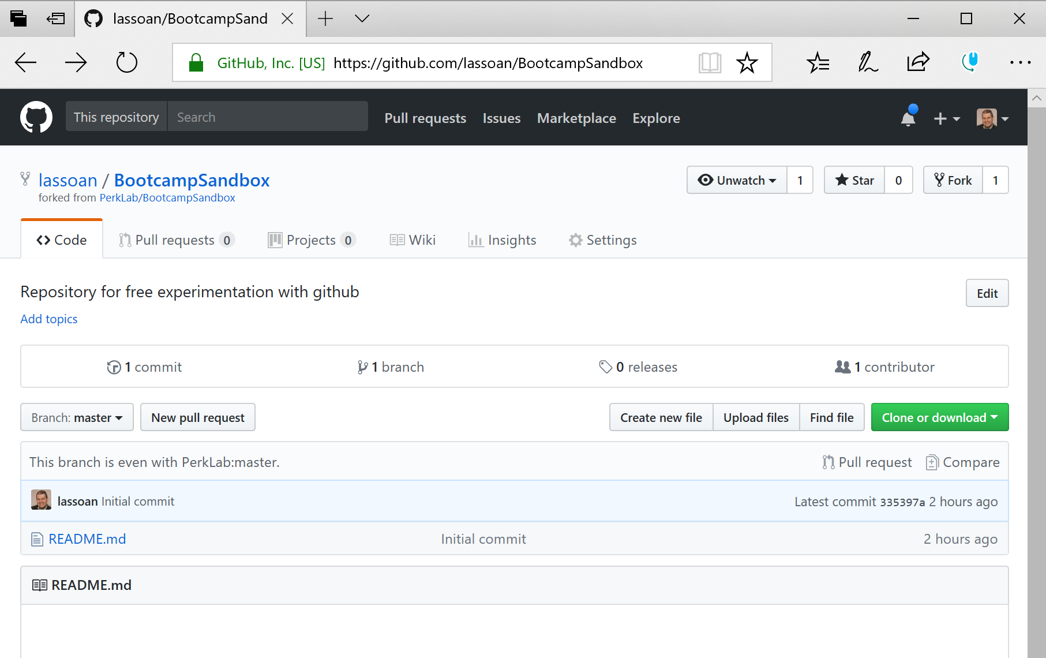
Pull request: get your changes merged into the official repository
PerkLab/BootcampSandbox
GitHub servers
Alice/Sandbox
Pull request
Open your repository page on GitHub
Click New pull request
Accept all default parameters
Provide description
Click Create pull request
Wait for the official repository maintainer to merge your changes

Slide 27
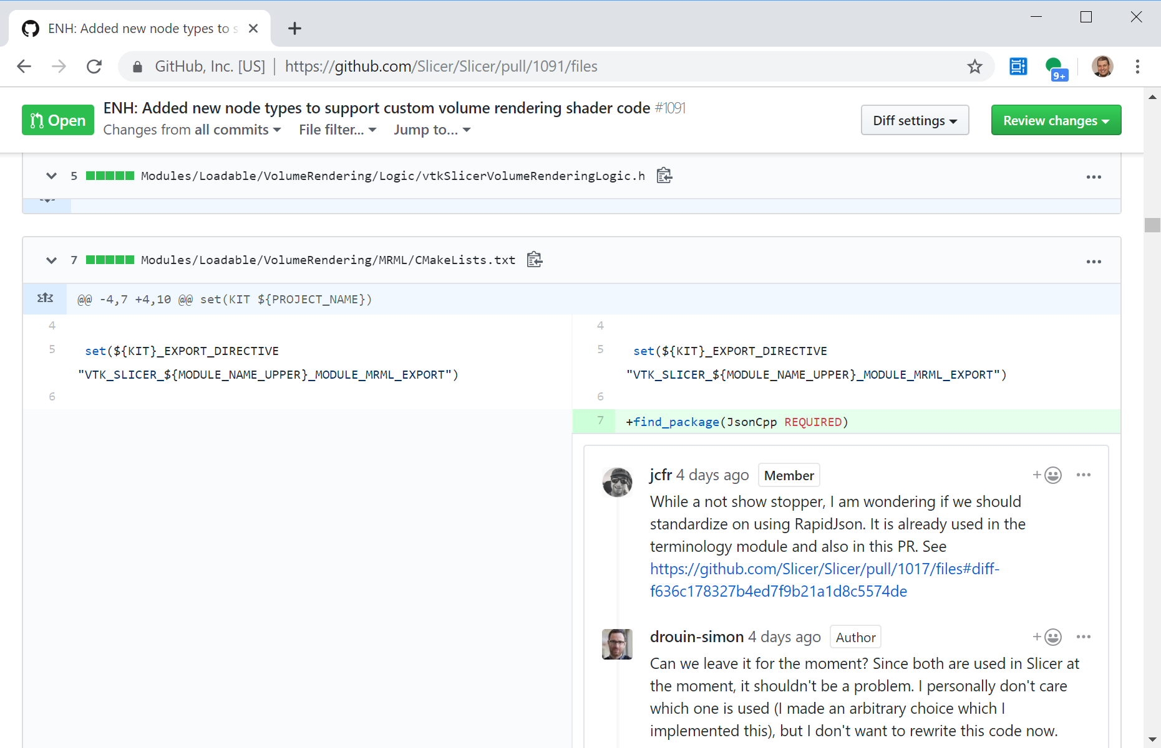
Code review
Open the pull request, go to Files changed tab
Hover over the line that you want to comment on, click on [+] icon in the source code
The author will be notified

Slide 28
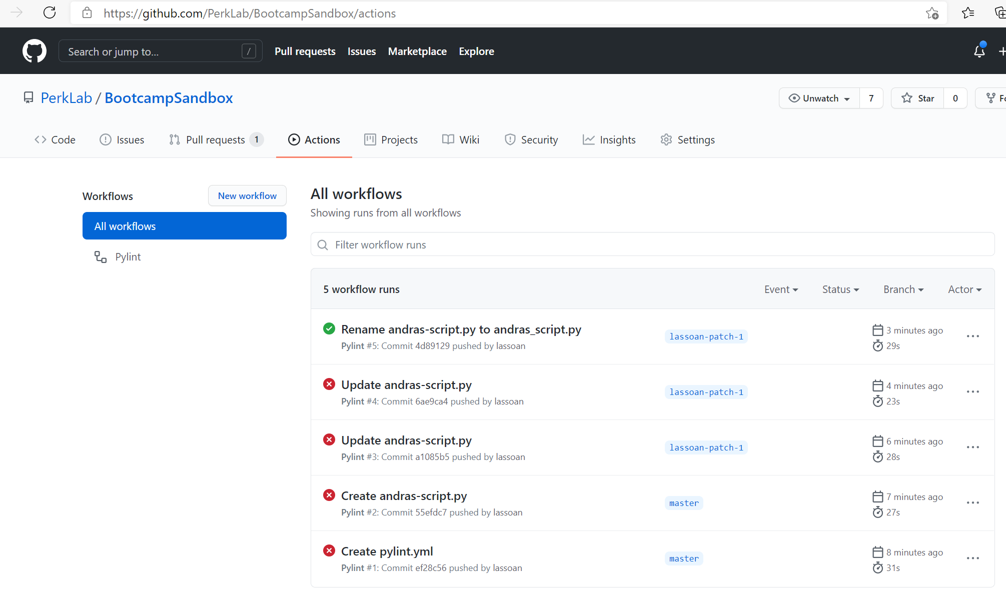
Github actions
Style checks
Automated tests
Documentation generation/preview
Publish to Python Package Index
...many more
Shields: https://shields.io/
Example: Github Repository Size - https://shields.io/category/size

Slide 29
Pull: get latest changes from the official repository
PerkLabBootcamp/Sandbox
GitHub servers
Alice/Sandbox
Pull
Alice’s computer

Slide 30
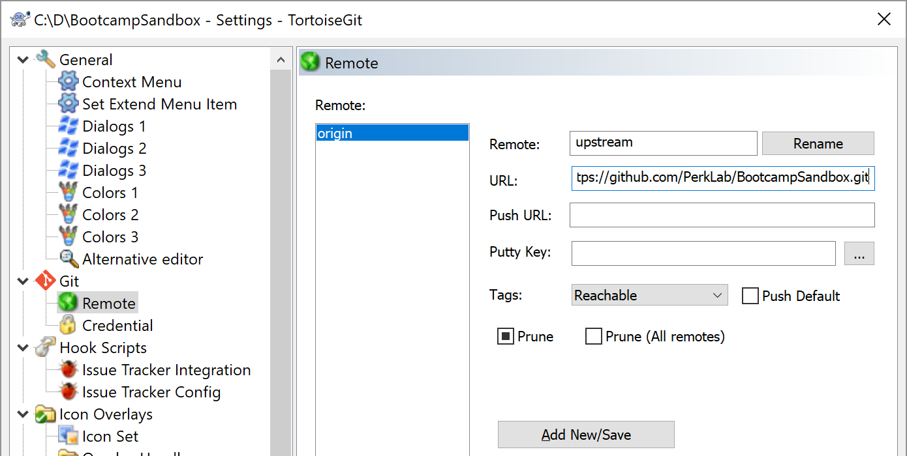
Pull: using TortoiseGit /1
Right-click on the revision controlled directory
Click TortoiseGit, click Settings…
3
2
4
1
5

Slide 31
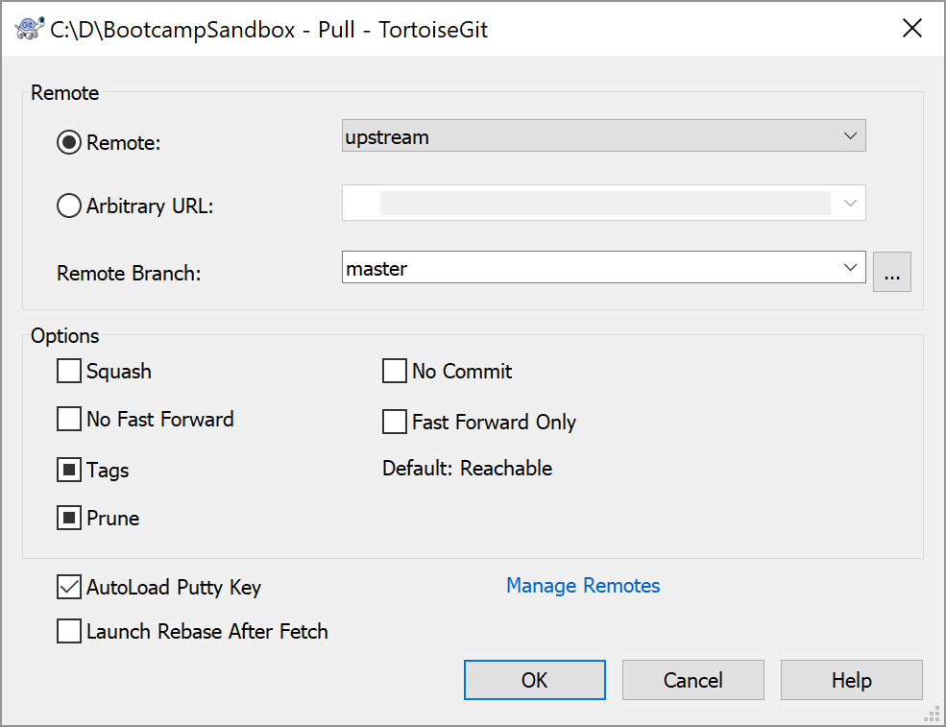
Pull: using TortoiseGit /2
Pull: Fetch and Merge changes
Right-click on the revision controlled directory
Click TortoiseGit, click Pull…
1
2

Slide 32
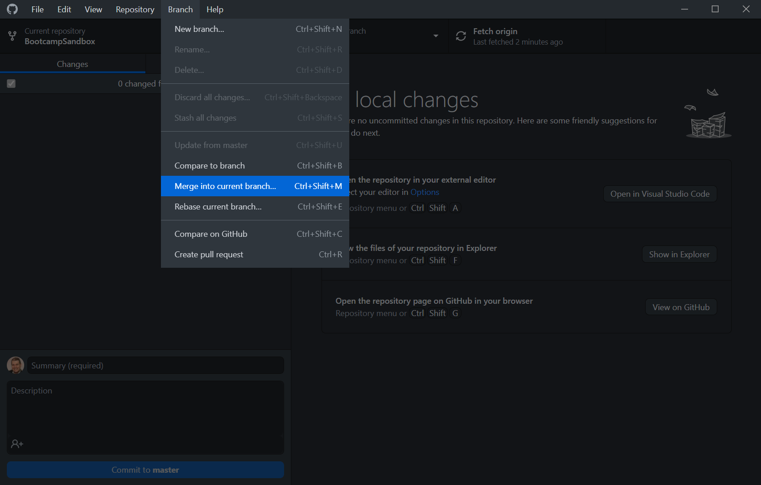
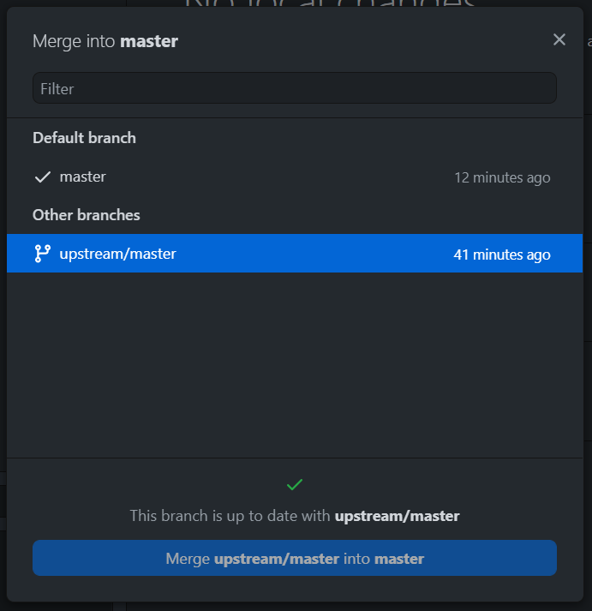
Pull: using GitHub desktop
Click Fetch origin to download changes from server
Menu: Branch / Merge into current branch…
Select upstream/master, click Merge
1
2
3
4

Slide 33
Get changes: pull or fetch+rebase?
Pull = Fetch + Merge
Fetch: download changes from remote servers
Merge: special commit that merges changes between branches. Makes the change history messy. Does not change history.
Fetch + Rebase:
Alternative to Pull
Rebase: make all changes appear as your changes were done after upstream changes. Makes change history clean (just simple commits). Changes commit history (cannot be used on branches used by others, may lose data if done incorrectly).
Recommendation: Follow requirements of the repository. Fetch + Rebase if confident enough.

Slide 34
Recommendations
Before committing any code changes build all and run the automatic tests to make sure there are no regressions
Commit:
One fix/enhancement at a time (and not multiple independent developments in one single commit) whenever it's possible
Commit comments: Include the related issue number (this will automatically link the changeset to the ticket) and describe what did you change (in past tense) and why. Example: e.g., in the format: re #123: Added MyClass:MyObject method to allow doing something
After pushing code changes or submitting pull request, have a look at the GitHub Actions results (test results, style check results, etc.). Usually email notification is sent in case of failure.
Read all notification emails about ticket updates!
If you feel that you get too many emails then set project to “Not watching” – then you only get notified about @mentions and events that directly affect you. Never just blindly ignore/delete any notification emails without reading it.

Slide 35
Summary
PerkLabBootcamp/Sandbox (upstream)
GitHub servers
Alice/Sandbox (origin)
Bob/Sandbox (origin)
Fork
Pull request
Push
Clone
Pull
Pull
Alice’s computer
Bob’s computer
Commit

Slide 36
Common terms
Fork
Clone
Pull
Push
Commit
Squash
Merge
Fetch
Rebase
Show log
Diff
Blame
Cherry-pick
Stash changes
Stash pop
Switch to
Repository
Remote
Pull request
Main/master
Origin
Upstream
Branch
Git hash

