Slide 1
MONAILabel
Deep-learning based segmentation tool
Andras Lasso

Slide 2
What is MONAI Label?
Create annotated datasets and build AI annotation models
Active learning: image labeling + AI training tool
Enables application developers to build labeling apps in a ”serverless” way – i.e., it provides its own MONAI Label Server interface (REST API)
Uses MONAI
Open-source, permissive license, many contributors
https://github.com/Project-MONAI/MONAILabel

Slide 3
Annotation modes
DeepGrow is a click-based interactive segmentation model, where the user can guide the segmentation with positive and negative clicks. The positive clicks are intended to guide the segmentation towards the region of interest while the negative clicks are used for neglecting the background.
DeepEdit is an algorithm that combines the power of two models in one single architecture. It allows the user to perform inference, as a standard segmentation method, and also to interactively segment part of an image using clicks.
Scribbles provide free-hand drawing based interactive segmentation approach, where an annotator provides scribbles to label each regions within an input volume. It can be used to interactively annotate as a stand-alone approach as well as by using inference from a standard segmentation method.
Automated Segmentation is the non-interactive paradigm available in MONAI Label. It allows the researcher to create a segmentation pipeline using a standard UNet or any network available in MONAI (i.e. UNet, Highresnet, ResNet, DynUnet, etc ) to automatically segment images.
https://github.com/Project-MONAI/MONAILabel/wiki/Annotation-Paradigms

Slide 4
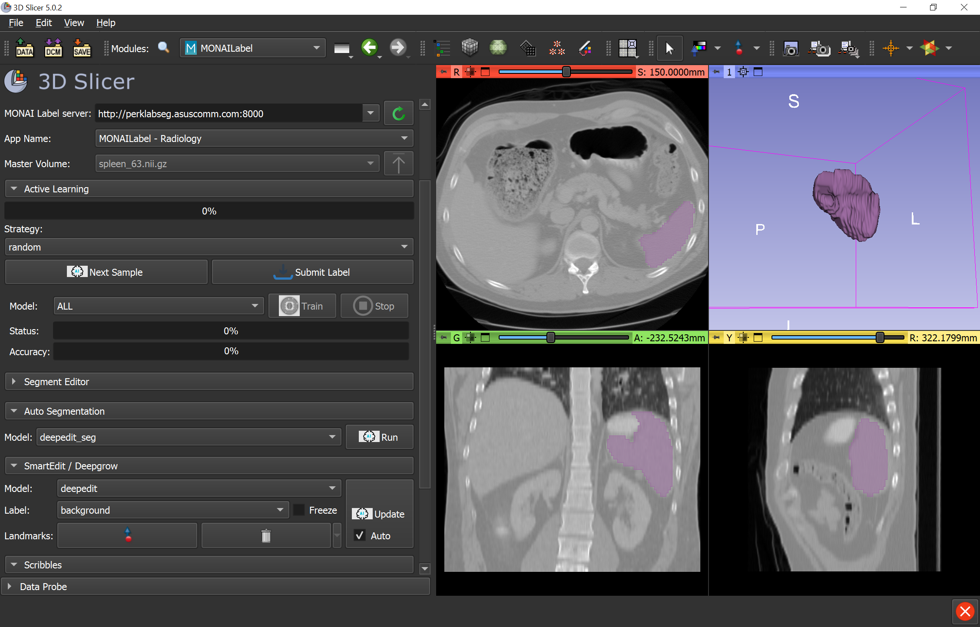
Example applications
pip install monailabel
monailabel apps --download --name radiology --output apps
monailabel datasets --download --name Task09_Spleen --output datasets
monailabel start_server --app apps/radiology --studies datasets/Task09_Spleen/imagesTr --conf models deepedit
Demo server: http://perklabseg.asuscomm.com:8000

