Slide 1
Writing correct and understandable code
Andras Lasso
Laboratory for Percutaneous Surgery (Perk Lab) School of Computing Queen’s University, Kingston, ON, Canada

Slide 2
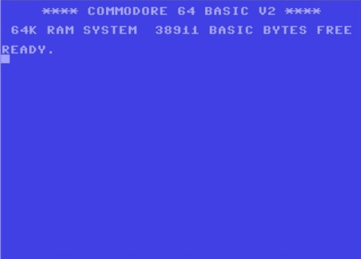
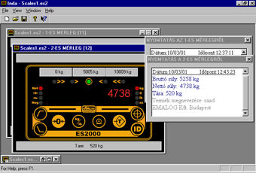
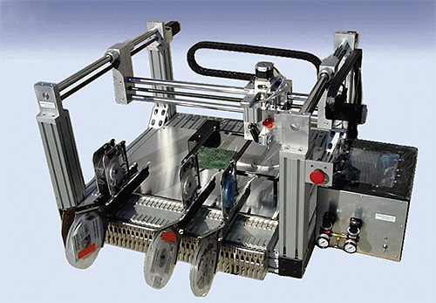
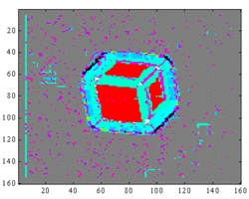
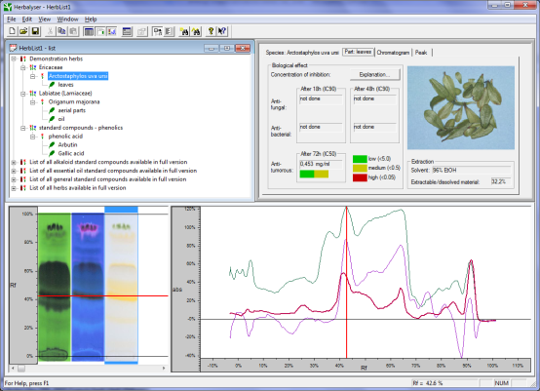
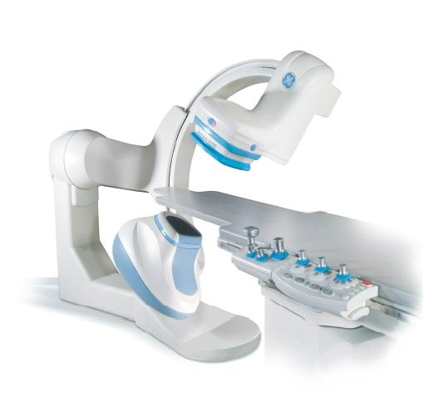
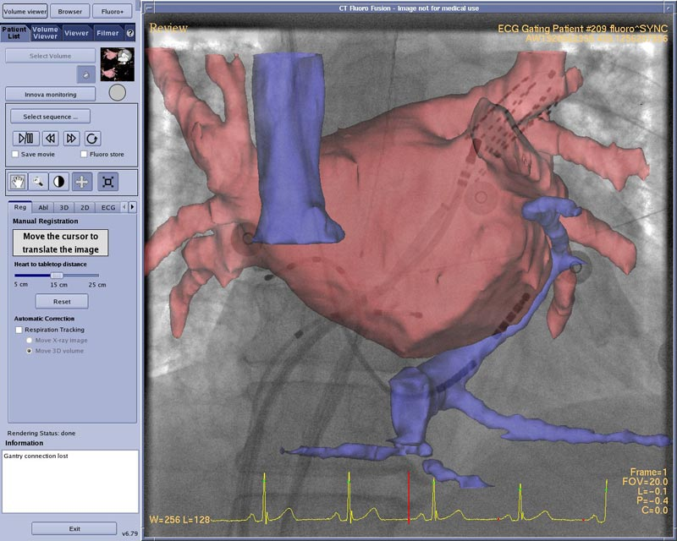
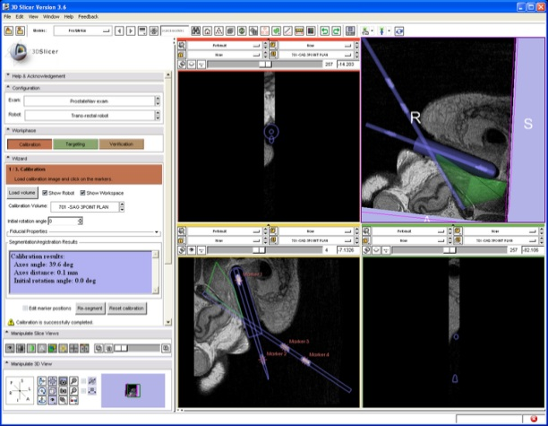
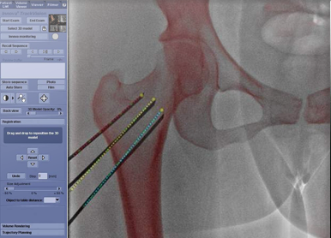
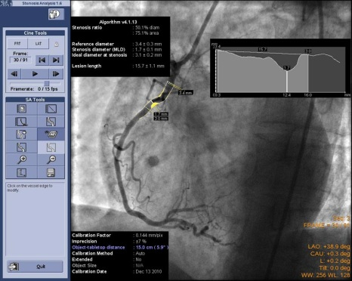
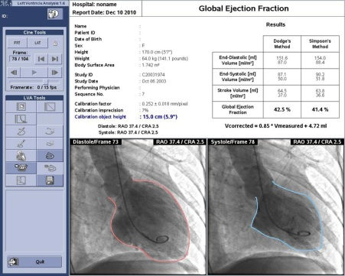
1984
1992
2009
2000

Slide 3
Organization of information
Computed data
Source data
Source code
Compiled code
Docs
Tools
1. Data, documents, and source code in separate folders, backed up

Slide 4
Organization of information
Version control
src
data
2022-05-05_ExperimentName
(tools)
doc
2022-10-29_ExperimentName
tools
compiled code
computed data
(tools)
File server
(releases)
(releases)
Local computer
…
Temporary cache for quick access
Changing
Valuable

Slide 5
Organization of information
Source code
Tests
Algo-rithms
GUI, etc.
I/O
2. Algorithms, tests, input/output, and others in separate files

Slide 6

Separation of algo, test, I/O, other
clear all;
…
file_name='lena.bmp';
cover_image=double(imread(file_name));
Mc=size(cover_image,1);
Nc=size(cover_image,2);
file_name='copyright.bmp';
watermark=double(imread(file_name));
Mm=size(watermark,1);
Nm=size(watermark,2);
watermark_vector=fix(reshape(watermark,Mm*Nm,1)./2);
rand('state',16);
[cA1,cH1,cV1,cD1] = dwt2(cover_image,'haar');
[cA2,cH2,cV2,cD2] = dwt2(cA1,'haar');
[cA3,cH3,cV3,cD3] = dwt2(cA2,'haar');
..
cA2 = idwt2(cA3,cH3,cV3,cD3,'haar',[Mc/4,Nc/4]);
cA1 = idwt2(cA2,cH2,cV2,cD2,'haar',[Mc/2,Nc/2]);
watermarked_image = idwt2(cA1,cH1,cV1,cD1,'haar',[Mc,Nc]);
watermarked_image_uint8=uint8(watermarked_image);
imwrite(watermarked_image_uint8,'watermarked_lena.bmp','bmp');
psnr=psnr(cover_image,watermarked_image_uint8,Mc,Nc),
figure(1)
imshow(watermarked_image_uint8,[])
title('Watermarked Image')
…
Tests
Algo-rithms
GUI, etc.
I/O
Image source: Code Complete (Steve McConnell)

Slide 7
Separation of algo, test, I/O, other
function test_result=watermark_test_01
background_file_name='lena.bmp';
watermark_file_name='copyright.bmp';
output_file_name='watermarked_lena.bmp‘;
Reference_output_file_name = 'watermarked_lena_baseline.bmp‘;
background_image = double(imread(background_file_name));
watermark_image = double(imread(watermark_file_name));
output_image=apply_watermark (background_image, watermark_image);
…
test_result=compare_results(output_image, reference_output_image)
if (interactive)
display_watermarking_results(background_image, watermark_image, output_image, test_result)
end
Tests
I/O
GUI, etc.
Algo-rithms
Jupyter notebooks
Python packages
function output_image=apply_watermark(background_image, watermark_image)
…
Mc=size(background_image,1);
Nc=size(background_image,2);
Mm=size(watermark_image,1);
Nm=size(watermark,_image2);
watermark_vector=fix(reshape(watermark,Mm*Nm,1)./2);
rand('state',16);
[cA1,cH1,cV1,cD1] = dwt2(cover_image,'haar');
[cA2,cH2,cV2,cD2] = dwt2(cA1,'haar');
[cA3,cH3,cV3,cD3] = dwt2(cA2,'haar');
..
function display_watermarking_results(background_image, watermark_image, output_image)
figure(1)
imshow(watermarked_image_uint8,[])
title('Watermarked Image')
…

Slide 8
Optimization priorities
Important
Rarely needed
Extraordinary solutions for ordinary problems
Optimization for performance (premature optimization)
Maintainability
Readability
Robustness
3. Optimize for readability

Slide 9

What do these code snippets do?
for( char *p = str, *q = strchr(str, 0) - 1, t; p < q; t = *p, *p++ = *q, *q++ = t );
Source: http://stackoverflow.com

Slide 10
What do these code snippets do?
for( char *p = str, *q = strchr(str, 0) - 1, t; p < q; t = *p, *p++ = *q, *q++ = t );
Source: http://stackoverflow.com
char *sourcePtr = str;
char *destinationPtr = str+strlen(str)-1;
while (sourcePointer<destinationPtr)
{
swap(sourcePtr, destinationPtr);
sourcePtr++;
destinationPtr--;
}

Slide 11
What do these code snippets do?
for( char *p = str, *q = strchr(str, 0) - 1, t; p < q; t = *p, *p++ = *q, *q++ = t );
Source: http://stackoverflow.com
char *sourcePtr = str;
char *destinationPtr = str+strlen(str)-1;
while (sourcePointer<destinationPtr)
{
swap(sourcePtr, destinationPtr);
sourcePtr++;
destinationPtr--;
}
Reverses the str string

Slide 12
Naming #1
Take the time to find the right name for classes, methods, variables: focus on clarity
Do not abbreviate: slows down code reading
Give names that contain useful information
No useful information in these: i, j, k, a, b, c, pos, tmp
Magic number: unnamed numeric constant value
Include the unit (e.g., NeedleToTargetDistancePixel, NeedleToTargetDistanceMm, NeedleAngleDeg)
4. Make names fit

Slide 13
What’s wrong?
function BSh = CalcBoneShadow(imMask, im)
[imH, imW] = size(im);
BSh = zeros(imH, imW);
% Create the shadow model estimated by a gaussian
Gsigma = 6;
tt = 1 : imH;
ShadowM = exp(-(tt-1).^2/(2*Gsigma*Gsigma));
…

Slide 14
What’s wrong?
function BSh = CalcBoneShadow(imMask, im)
[imH, imW] = size(im);
BSh = zeros(imH, imW);
% Create the shadow model estimated by a gaussian
Gsigma = 6;
tt = 1 : imH;
ShadowM = exp(-(tt-1).^2/(2*Gsigma*Gsigma));
…
What is BSh?
What is imH, imW?
What is the unit of Gsigma? Why it is 6?
What is tt? What is the unit?
What is ShadowM?
function bone_shadow_image = CalcBoneShadow(mask_image, input_image, intensity_halving_depth_pixel)
[image_height, image_width] = size(input_image);
bone_shadow_image = zeros(image_height, image_width);
% Create the shadow model estimated by a gaussian
gaussian_sigma_pixel = …some…computation…; % Computed from intensity_halving_depth_pixel
depth_pixel = 1 : image_height;
ShadowModel = exp(-(depth_pixel-1).^2/(2*gaussian_sigma_pixel*gaussian_sigma_pixel));
…

Slide 15
What’s wrong?
Magic number!
Magic number!
if( 1 == mMethodToIncorporateBeamWidth || 3 == mMethodToIncorporateBeamWidth )
{
// Option: BWVar or BWTHEVar
Weight4ThisAxialDepth = 1/( USBeamWidthEuclideanMagAtThisAxialDepthInMM/4 * 0.001 );
}
else
{
// Option = BWRatio
Weight4ThisAxialDepth = sqrt( 1/mUS3DBeamwidthAndWeightFactorsInUSImageFrameTable5xM.get(4,0) );
}
enum BeamWidthComputationMethodType {BEAMWIDTH_EUCLIDEAN_NORMALIZED, BEAMWIDTH_EUCLIDEAN, BEAMWIDTH_RATIO); // …documentation of the options…
…
switch (mMethodToIncorporateBeamWidth )
{
case BEAMWIDTH_EUCLIDEAN_NORMALIZED:
case BEAMWIDTH_EUCLIDEAN:
Weight4ThisAxialDepthM = 1/( USBeamWidthEuclideanMagAtThisAxialDepthInMM/4 * 0.001 );
break;
case BEAMWIDTH_RATIO
Weight4ThisAxialDepthM= sqrt(1/mUS3DBeamwidthAndWeightFactorsInUSImageFrameTable5xM.get(4,0));
break:
default:
LOG_ERROR(“Unknown beamwidth method: “<< mMethodToIncorporateBeamWidth );
return FAIL;
}

Slide 16
Naming #2
Distinguish global, local, member variables by the name
e.g., THIS_IS_A_CONSTANT, m_MemberVariable, localVariable
Naming conventions:
Class name, variables name: noun (e.g., DataCollector, InputImage)
Method/function name: start with a verb (e.g., Get…/Set…, Add…/Remove…, Display…, Compute…)
Cannot find a good name? => underlying conceptual problem
LoadAndDisplayInputData => need to split into two methods
…Manager, …Controller => do you have any idea what this class should do?
4. Make names fit

Slide 17
Naming #3 - spatial information
PerkLab conventions (not generally known rules)
Point:
4-element vector, last element is 1
Name: somePoint_CoordinateSystemName
Vector:
4-element vector, last element is 0
Name: someVector_CoordinateSystemName
Transform:
4x4 element matrix, last row is [0 0 0 1]
somePoint_Frame2 = Frame1ToFrame2Transform * somePoint_Frame1
Name: FromCoordinateSystemNameToToCoordinateSystemNameTransform
4. Make names fit

Slide 18
Which 4 names are wrong?
ProbeCalibrationMatrix
ScanlineEndPoint_Image
ProbeTransform
ImagePlaneNormalVector_Tracker
ImageToProbeTransform
NeedleTipVector
NeedleTrackerMatrix
StylusTipToTrackerTransform

Slide 19
Comments
Try to write self-documenting code; use comments to
describe purpose (the why, not the what or how)
provide interface documentation (Matlab: following standard templates, C++: Doxygen, etc.)
Need for too much commenting may indicate problems
Don’t maintain the change log in comments: the version control system does a better job
Remove dead (commented out) code: it can be retrieved from the version control system if needed
Use standard TODO comment tags:
// TODO: double-check this
5. Comment judiciously

Slide 20
Comments
"I cdn'uolt blveiee taht I cluod aulaclty uesdnatnrd waht I was rdanieg: the phaonmneel pweor of the hmuan mnid. Aoccdrnig to a rseearch taem at Cmabrigde Uinervtisy, it deosn't mttaer in waht oredr the ltteers in a wrod are, the olny iprmoatnt tihng is taht the frist and lsat ltteer be in the rghit pclae. The rset can be a taotl mses and you can sitll raed it wouthit a porbelm. Tihs is bcuseae the huamn mnid deos not raed ervey lteter by istlef, but the wrod as a wlohe. Scuh a cdonition is arppoiatrely cllaed Typoglycemia ."Amzanig huh? Yaeh and you awlyas thguoht slpeling was ipmorantt."
Feel free to make typos.
Not really. May be a sign of tired developer.

Slide 21
What’s wrong?
if ( theta < M_PI/4 || theta > 3*M_PI/4 ) {
for ( uint y = 0; y < rows; y++ ) {
// name removed - retouched for ANSI-C++
//float x = roundf(( p - y * sin(theta) ) / cos(theta));
float x = floor( ( p - y * sin(theta) ) / cos(theta) + 0.5 );
uint r = rows - y - 1;
uint c = (uint)x;
if ( c >= 0 && c < cols )
image[r*cols+c] = UCHAR_MAX;
}
}

Slide 22
What’s wrong?
// Important FrameBufferMutex rules:
//
// The frame grabs are generally done asynchronously, and it is necessary
// to ensure that when the frame buffer is valid when it is being written
// to or read from
//
// The following information can only be changed within a mutex lock,
// and the lock must not be released until the frame buffer agrees with the
// information.
//
// FrameBuffer
// FrameBufferTimeStamps
// FrameBufferSize
// FrameBufferIndex
// FrameBufferExtent
// FrameBufferBitsPerPixel
// FrameBufferRowAlignment
//
// After one of the above has been changed, and before the mutex is released,
// the following must be called to update the frame buffer:
//
// UpdateFrameBuffer()
//
// Likewise, the following function must only be called from within a
…

Slide 23
High cohesion
Keep file size between approximately 2KB-30KB
Keep methods/functions short (preferably within 1-2 screens)
Keep blocks within 1 screen (in C++: don’t put closing braces more than one screen away from the matching opening brace)
Declare your variables as close as possible to the place where you will use them
6. Maintain high cohesion

Slide 24
What’s wrong?
void vtkV4L2VideoSource::UpdateFrameBuffer()
{
int i, oldExt;
int ext[3];
vtkDataArray *buffer;
// clip the ClipRegion with the FrameSize
for (i = 0; i < 3; i++)
{
oldExt = this->FrameBufferExtent[2*i+1] - …;
this->FrameBufferExtent[2*i] = …
ext[i] = this->FrameBufferExtent[2*i+1] - …;
if (oldExt > ext[i])
{ // dimensions of framebuffer changed
this->OutputNeedsInitialization = 1;
}
} …
int totalSize = bytesPerRow * ext[1] * ext[2];
i = this->FrameBufferSize;
while (--i >= 0)
{
buffer = reinterpret_cast<vtkDataArray *>(this->FrameBuffer[i]);
if (buffer->GetNumberOfTuples() != totalSize …)
{
buffer->Delete();
buffer = vtkUnsignedCharArray::New();
this->FrameBuffer[i] = buffer; …
}
}
}
void vtkV4L2VideoSource::UpdateFrameBuffer()
{
// clip the ClipRegion with the FrameSize
int ext[3]={0,0,0};
for (int i = 0; i < 3; i++)
{
int oldExt = this->FrameBufferExtent[2*i+1] - …;
this->FrameBufferExtent[2*i] = …
ext[i] = this->FrameBufferExtent[2*i+1] - …;
if (oldExt > ext[i])
{ // dimensions of framebuffer changed
this->OutputNeedsInitialization = 1;
}
} …
int totalSize = bytesPerRow * ext[1] * ext[2];
for (int frameIndex = this->FrameBufferSize-1; frameIndex>=0; --frameIndex)
{
vtkDataArray *buffer = reinterpret_cast<vtkDataArray *> (this->FrameBuffer[frameIndex]);
if (buffer->GetNumberOfTuples() != totalSize …)
{
buffer->Delete();
this->FrameBuffer[frameIndex] = vtkUnsignedCharArray::New(); …
}
}
}

Slide 25
Summary
Data, documents, and source code in separate folders, backed up
Algorithms, tests, input/output, and others in separate files
Optimize for readability
Make names fit
Comment judiciously
Maintain high cohesion

