Slide 1
3D Slicer Segmentation basics
Andras Lasso

Slide 2
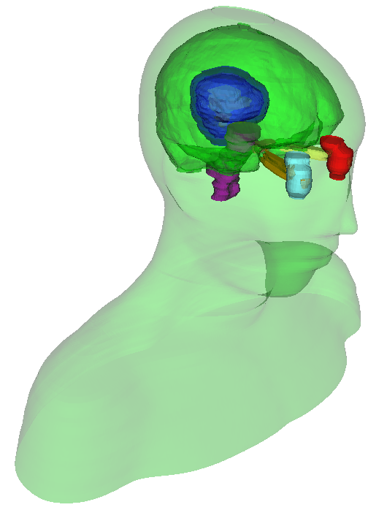
Segmentation
Also known as contouring
Delineates structures of interest
Manual contouring: Slice by slice
Automatic / semi-automatic
Omnipresent in medical imaging
Surgical/radiation therapy planning
Intra-operative navigation
Volume/shape analysis
3D printing (interventions)
Education
Head and neck RT phantom case

Slide 3
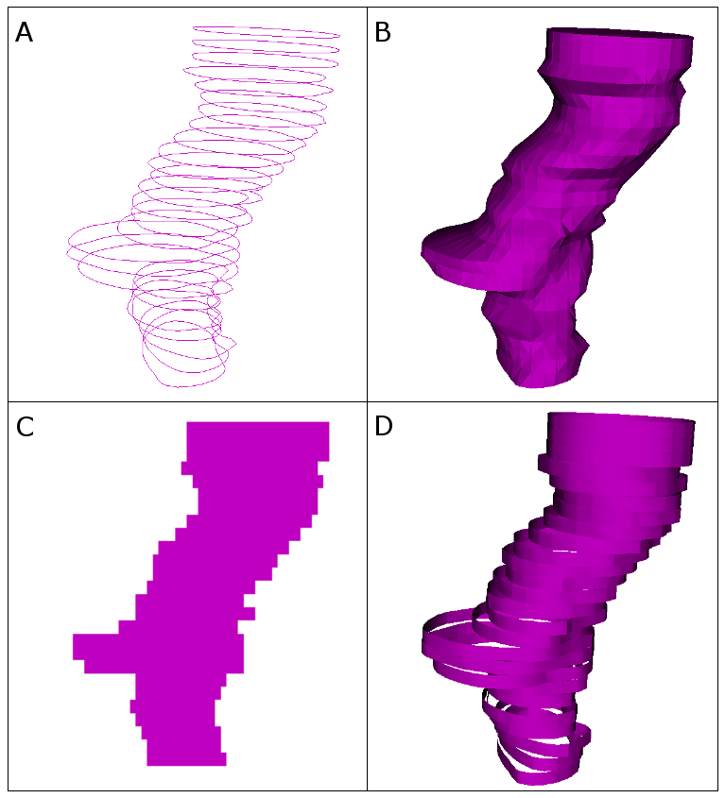
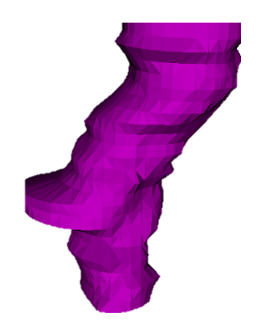

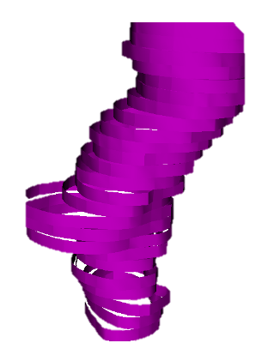
Representations
Binary labelmap
+ Easy 2D viewing and editing
+ Robust (always valid, even if transformed or edited)
- Inaccurate (finite resolution)
- Requires lots of memory if overlap allowed
Closed surface
+ Easy 3D visualization
- Difficult to edit
- May be invalid (e.g., self-intersecting), especially after non-linear transformation
Fractional labelmap
+ Quite easy 2D viewing and editing
+ Robust
+ Quite Accurate
- Requires lots of memory
Planar contours, Ribbons
+ Accurate 2D viewing and editing
- Ambiguous in 3D
- Poor 3D visualization

Slide 4
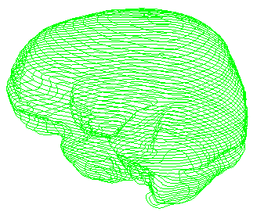
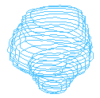



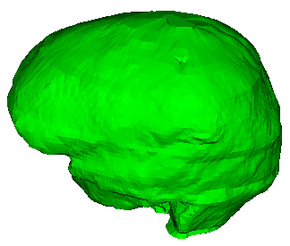

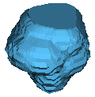
Data storage
Patient
Segmentation: MRML node, may contain multiple segments (each segment is a column)
Each segment contains multiple representations (each representation is a row)
Master representation:
Editable
All other representations are computed from this
Stored persistently
Segmentation
Segment: Brain
Brain (contour)
Segment: Tumor
Tumor (contour)

Slide 5
Conversion between representations
Driven by a dynamic graph
Nodes are the representations
Edges are the converters
Can be dynamically added
Can define representations
Cost metrics for edges
Automatic conversion follows cheapest path
Happens when an absent representation is requested
Ribbon
1.5
Contours
2.5
3.5
Binary image
2.5
Surface
2.0
2.0
Fractional image
4.0

Slide 6
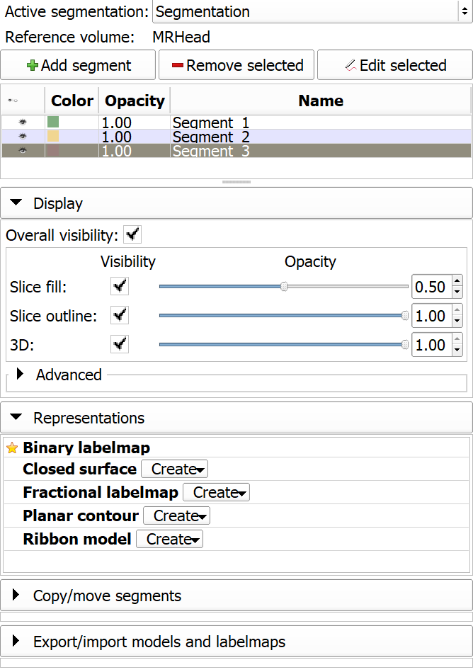
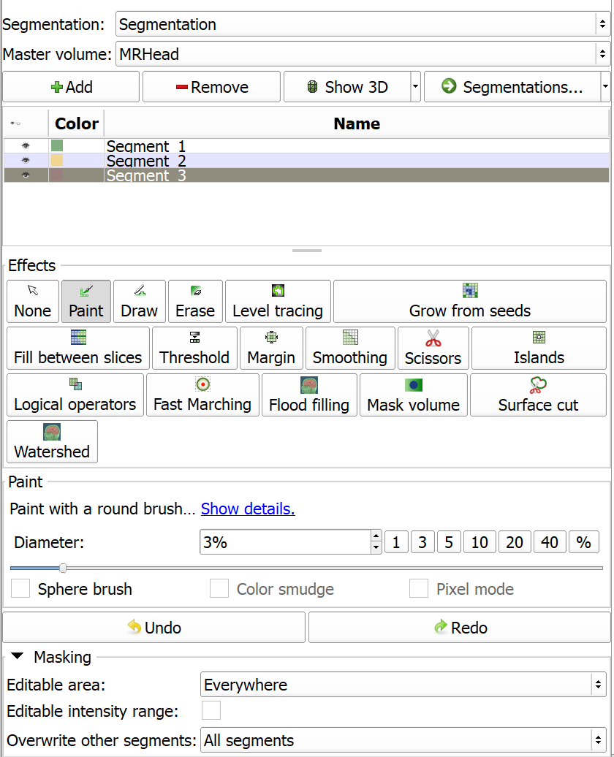
Slicer modules
Segmentations module:
Create/delete segmentation nodes
Create/delete/update representations
Edit display properties
Import from/export to different MRML nodes
Copy/move segments
Segment editor module:
Edit labelmap representation

Slide 7
Hands-on
CTACardio
Thresholding
180-max
Apply
Disable surface smoothing, Show 3D
Crop to a kidney: Scissors, erase outside
Islands, Keep selected island, click on kidney
Undo 3x
Delete segment
Use for masking
Paint:
Segment vessel in right arm
Sphere paint
Erase
Draw

Slide 8
Hands-on
Grow from seeds: contrast difference but not globally
MRBrainTumor1
Show 3D
Fix leakage
Apply
Smoothing
Segment stats
Grow from seeds: multiple segments
CTACardio
Paint, Sphere brush
4 segments, paint in 4 ventricles
Color smudge
Paint in an orthogonal view

Slide 9
Hands-on
Masking:
Editable area: inside all segments
Paint
Grow
New segment, Outside all segments
Grow
New segment, Overwrite other segments (default)
Paint
Overwrite other segments: None
Fast marching:
Panoramix
Paint in a couple of blobs in the aorta and aneurysm
1% maximum
Subtract segment
Cut ends

Slide 10
Hands-on
Hollow model:
Outside surface
Apply
Cut ends using Scissors effect
Fill between slices: geometric interpolation, tall segments
CTACardio
Abdominal muscles
Scissors:
CTChest, bone threshold
Island / Keep largest
Show 3D
Create new segment (for ribs)
Editable: inside all
Scissors - fill outside
Split islands to segments
Separate lowest vertebra with 3d scissors

Slide 11
Hands-on
HD-BET:
Uses pytorch
MRBrainTumor1

Slide 12
Hands-on
Slice thickness is used by paint tool 2D size
Segmentation on oblique slices
Segmentation on vesselness filtering result

