Slide 1
PerkLab research methodology overview
Andras Lasso, PhD
Associate Director
Laboratory for Percutaneous Surgery (PerkLab)
School of Computing
Queen’s University, Kingston, ON, Canada

Slide 2

PerkLab
About 20-25 members
From computer science, electrical engineering, and mechanical engineering departments and medical school
1/4 undergrad 1/4 Masters 1/4 PhD, postdoc 1/4 faculty, staff research engineers – continuity
Research focus:
Percutaneous interventions
Image guidance
Tool navigation
Translational research

Slide 3
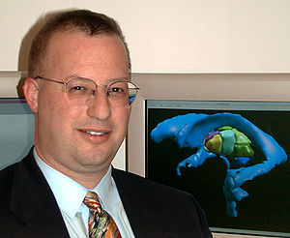
Scope
From algorithms to tools
Can it be done?
Prototypes
Is it worth doing?
Tools for translational research
Standard of care
Commercially available clinical “devices” with regulatory approval
Ron Kikinis, Harvard SPL, 2012

Slide 4
Reproducible research – theory
Scientific method: propose hypothesis, prove it by experiments
Mistakes, bias, … => repeatability
Full specification Victoria Stodden, Enabling reproducible research: licensing for scientific innovation
Research paper
Data (with description the data, how it was acquired, processed, including the source code that was used for processing, …)
Experiment (source code, instructions, parameters, …)
Results (source code, documentation, data, …)
Reduced duplicate efforts, higher credibility, higher quality outcome, community, …
J.P.A. Ioannidis, Why Most Published Research Findings are False, PLoS Med 2(8), 2004

Slide 5

Reproducible research – practice
By default openly available source code, full documentation, all data
Permissive license – no strings attached
BSD: redistribution, modification, … all allowed
Provided as is
Don’t use the author name for endorsement
Don’t remove the license
Can we afford to give away all these?
Full disclosure mostly delayed until publication
Exceptional ideas are patented before publication
Maintain competitive advantage by continuous improvement
We get a lot in return

Slide 6





Industry best practices
Brought in by industry-trained staff members
Adopt procedures that increase quality & productivity
Keep overhead at the minimum
Usually no need to comply to external regulations (Health Canada, FDA, CE, …), just institutional ethics board
Learning these: investment with a short payback period

Slide 7
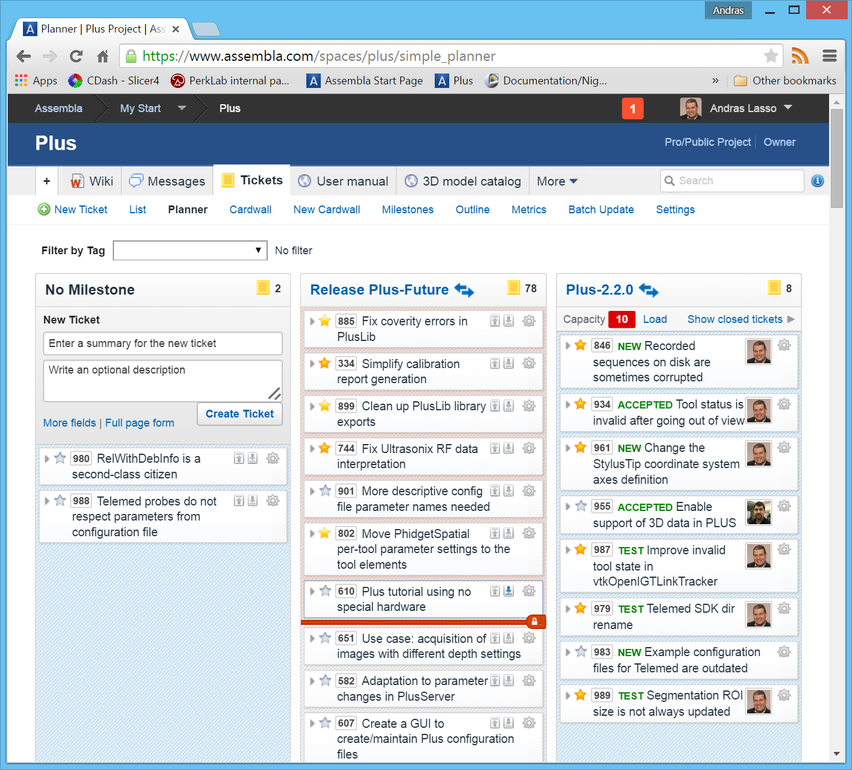
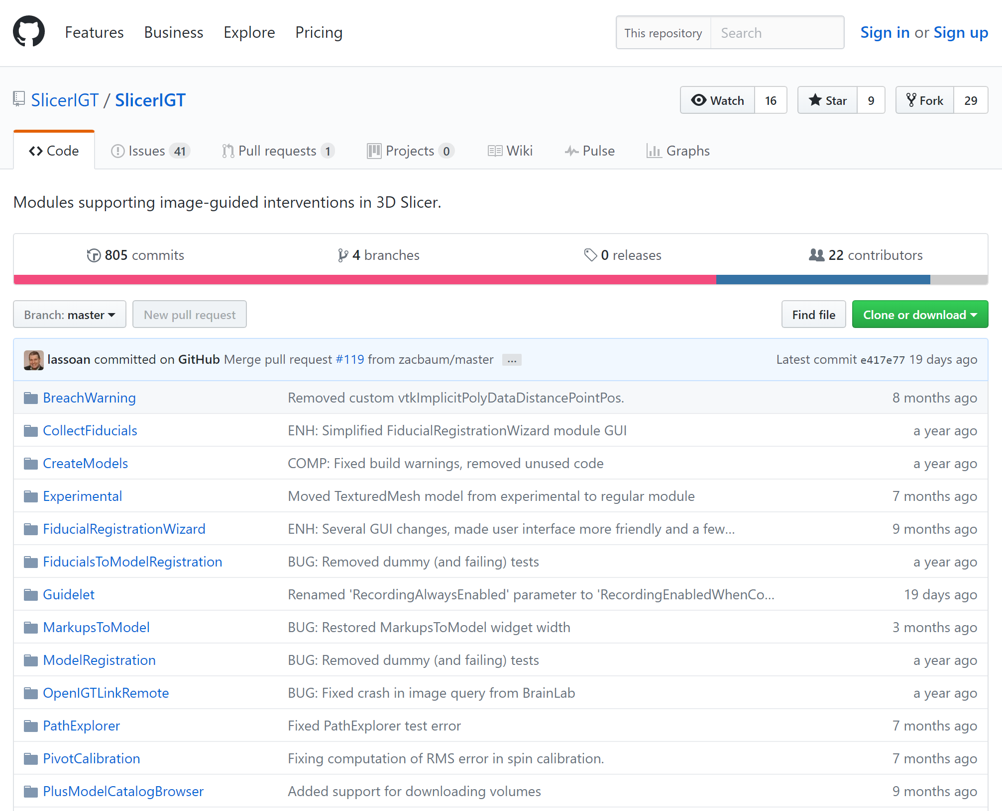
Planning, design, implementation
Web-based, integrated project management:
GitHub: unlimited public repositories for free; free private repositories for university research labs
Tools: revision control, code review, bugtracking, project boards, releases, website hosting; very limited: messaging, discussion
Automated build and API documentation generation (CMake, Doxygen), tutorials

Slide 8
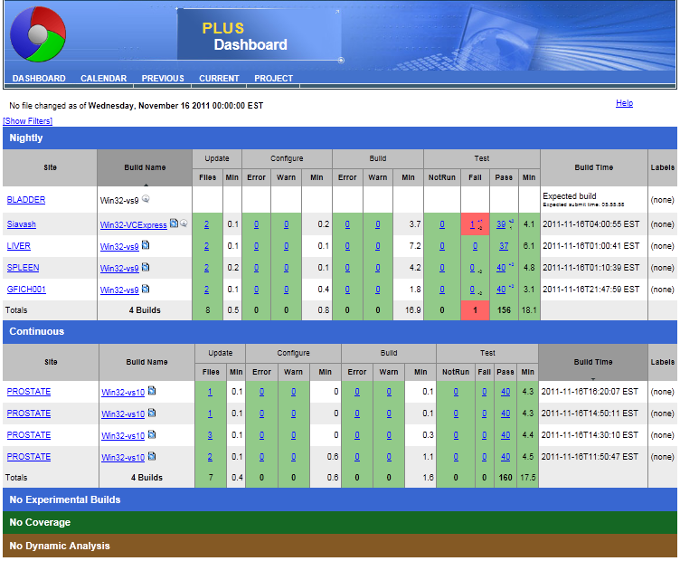
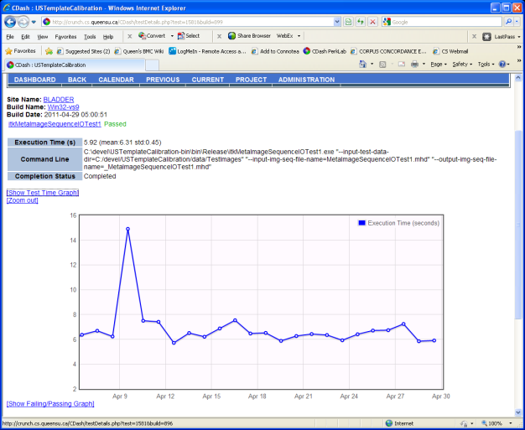
Verification
Automatic continuous and nightly build and test (CTest)
Web-based dashboard (CDash)
Automatic GUI testing with QtTesting: record&replay Qt events
CTest results reported on CDash

Slide 9
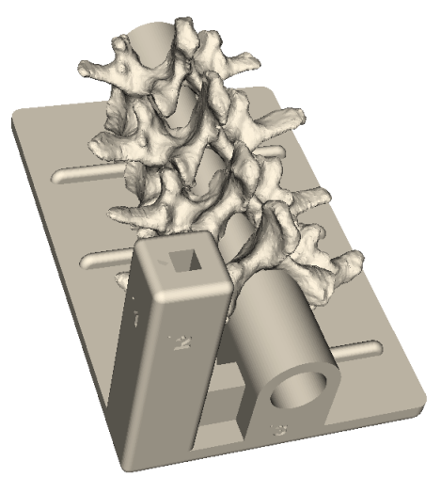
Validation
Fidelity levels: Simulated < Synthetic phantoms < Animal tissue (butcher shop) < Cadaver < Patient
Ethics approval: required for human subject studies, evaluation on patient cases
Phantoms
Hard tissue (bone): 3D printed, with Barium coating for X-ray visibility
Soft tissue: water based (agar, gelatin), PVC, silicon
Skin: super soft silicon rubber
Vessels: rubber tubes
Targets, validation points
http://perk-software.cs.queensu.ca/plus/doc/nightly/modelcatalog/

Slide 10
Software platform

Slide 11


Without an application platform
Building on an application platform
Each application is developed from ground up
Completely new software is developed for each problem/procedure/device
Significant work is needed to integrate new, advanced algorithms
Core functionalities are already implemented
New software modules can be developed for specific needs
Many new, advanced algorithms are available
Well-supported with a large user and developer community
Quick start.
Huge waste of time, money, and effort overall.
Investment at the beginning: learning.
Minimal wasted efforts.
Notes:
Because, without an application platform
Show animations
On the other hand, if you are building your work on a pre-existing application platform
1. Portable (Win, Linux, Mac), Open-source

Slide 12
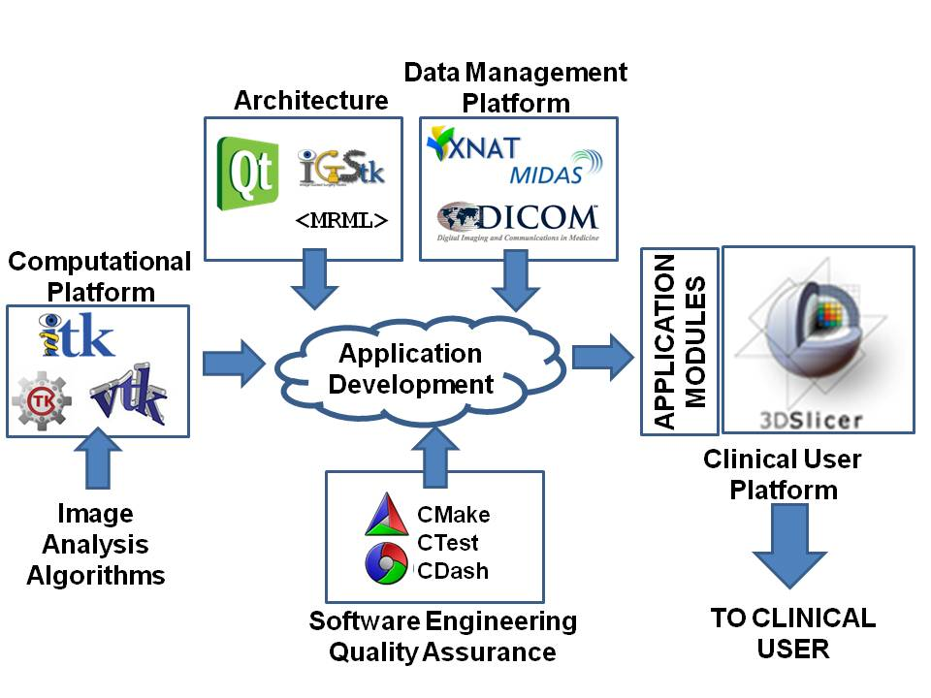

3D Slicer and the NA-MIC Kit
<MRML>
www.na-mic.org

Slide 13
PerkLab systems overview
Slicelets
(custom Slicer applets)
LumpNav
...
ProstateNav
...
Gel dosimetry
SlicerIGT
Breach warning
SlicerRT
Slicer extensions
...
Pivot calibration
Model registration
...
Tool watchdog
DICOM-RT import
Dose volume histogram
...
Dose comparison
3D Slicer
Visualization
Registration
Segmentation
...
Quantification
VTK, ITK, CTK, QT, DCMTK, …
OpenIGTLink
DICOM
PLUS
OpenIGTLink
Calibration, synchronization, pre-processing, simulation, record&replay
Device interface
software
hardware
Surgical microscopes, endoscopes
Ultrasound
scanners
Navigation
systems
Robotic devices, manipulators
MRI, CT, PET scanners
hundreds of devices (imaging, position tracking, various sensors, and manipulators)
Notes:
Using OpenIGTLink (which is a Network Interface for Image-Guided Therapy), PLUS can stream this data in real-time to 3D Slicer and can also be used for pre-processing, and calibration for navigated image-guided interventions.

Slide 14
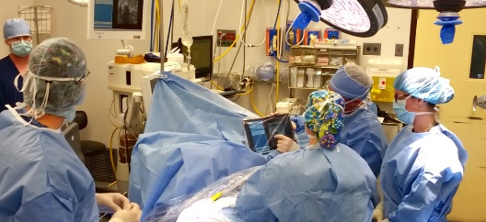
Building on a platform
Notes:
Using OpenIGTLink (which is a Network Interface for Image-Guided Therapy), PLUS can stream this data in real-time to 3D Slicer and can also be used for pre-processing, and calibration for navigated image-guided interventions.

Slide 15
Summary
Translational research
Reproducible research
Industry best practices
Building on one platform

