Slide 1
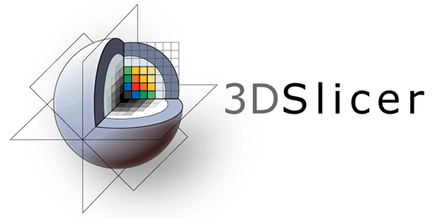
3D Slicer DICOM Tutorial
Csaba Pinter

Slide 2
Prerequisites
Please finish the ‘Data loading and visualization’ tutorial before starting this one: https://www.slicer.org/wiki/Documentation/Nightly/Training#Slicer4_Data_Loading_and_3D_Visualization
Install the TCIABrowser and SlicerRT extensions from the Extension Manager
Download and unzip this dataset: https://github.com/PerkLab/PerkLabBootcamp/blob/master/Data/eclipse-8.1.20-phantom-prostate.zip

Slide 3
Digital Imaging and Communications in Medicine (DICOM)
The industry standard for storage and network transfer of medical images
Freely available
Full documentation: http://medical.nema.org
DICOM tag lookup: http://dicomlookup.com
“Designed by committee” - many device manufacturers collaborate to specify the standard
Very large (about 3500 pages), complex → implementation is difficult
There is no reference implementation or standard conformance test suite
Implementation is always only partial and very often incorrect

Slide 4
Digital Imaging and Communications in Medicine (DICOM)
DICOM file structure
Meta-information header (version, encoding, endianness, etc.)
List of attributes
Attribute name: human-readable name
Tag: 4+4 digit hexadecimal identifier (group+element)
Even group number: standard data
Odd group number: private data (see DICOM conformance statement)
Type: 1 = mandatory, 2=may be empty, 3=may be missing; 1C, 2C, 3C: conditional, it depends on other attributes if required or not
Description: specification of the attribute
Value representation (VR): decimal string, date, time, code string, etc. Special: sequence (SQ) can contain a list of attributes
Value multiplicity (VM): 1, 2, 1-n (string separator: backslash)
Pixel data is stored in an attribute, too

Slide 5
Digital Imaging and Communications in Medicine (DICOM)
Most important parts of the standard
Part 3: Information Object Definitions (IOD): an IOD represents the acquired image (CT, MR, US, etc.); this part specifies the required attributes for each IOD
Part 5: Data Structures and Encoding: definition of how the data is stored in memory, explains private, conditional, sequence, etc.
Part 6: Data Dictionary: tag, name, VR, VM for each attribute

Slide 6
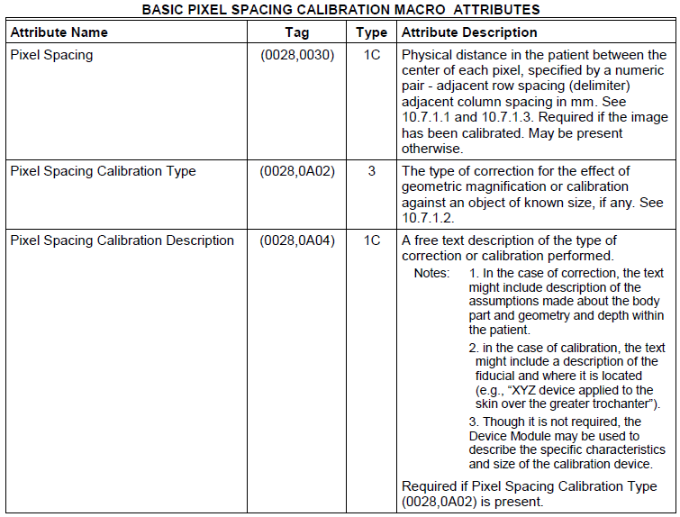
Digital Imaging and Communications in Medicine (DICOM)
Part 3:

Slide 7
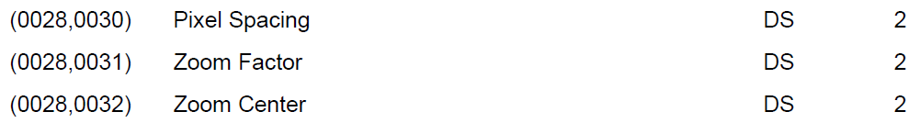
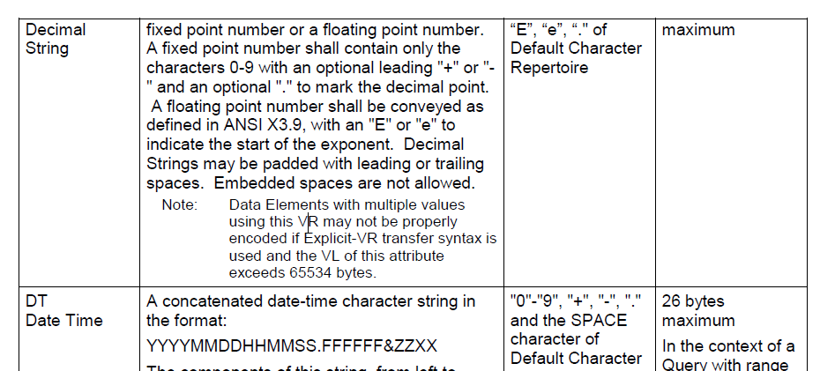
Digital Imaging and Communications in Medicine (DICOM)
Part 6:
Part 5:

Slide 8
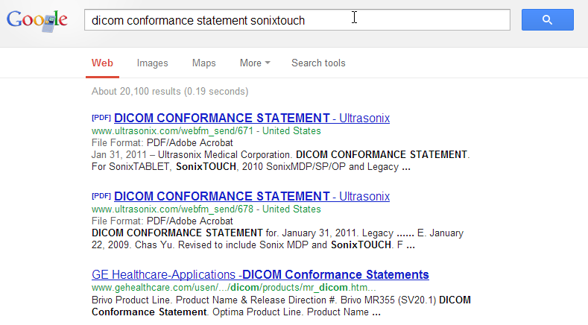
Digital Imaging and Communications in Medicine (DICOM)
DICOM conformance statement
Publicly available for all DICOM compliant devices
Describes what parts of the standard are implemented and specifies all the private fields.

Slide 9
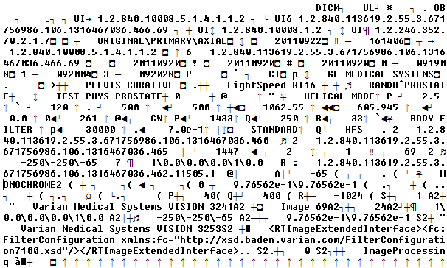
Digital Imaging and Communications in Medicine (DICOM)
Header and attributes are not human-readable

Slide 10
Digital Imaging and Communications in Medicine (DICOM)
Use the free, open-source dcmdump tool to print it in a human-readable form (part of the DCMTK toolkit)
(0008,0008) CS [ORIGINAL\PRIMARY\AXIAL] # 22, 3 ImageType
(0008,0012) DA [20110922] # 8, 1 InstanceCreationDate
(0008,0013) TM [161402] # 6, 1 InstanceCreationTime
(0008,0016) UI =CTImageStorage # 26, 1 SOPClassUID
(0008,0018) UI [1.2.840.113619.2.55.3.671756986.106.1316467036.466.1] # 52, 1 SOPInstanceUID
(0008,0020) DA [20110920] # 8, 1 StudyDate
(0008,0021) DA [20110920] # 8, 1 SeriesDate
(0008,0060) CS [CT] # 2, 1 Modality
(0008,0070) LO [GE MEDICAL SYSTEMS] # 18, 1 Manufacturer
(0008,0090) PN (no value available) # 0, 0 ReferringPhysicianName
(0008,103e) LO [PELVIS CURATIVE] # 16, 1 SeriesDescription
(0008,1090) LO [LightSpeed RT16] # 16, 1 ManufacturerModelName
(0010,0010) PN [RANDO^PROSTATE] # 14, 1 PatientName
(0010,0020) LO [TEST PHYS PROSTATE] # 18, 1 PatientID
…
(0020,0032) DS [-250\-250\105] # 14, 3 ImagePositionPatient
(0020,0037) DS [1\0.0\0.0\0.0\1\0.0] # 20, 6 ImageOrientationPatient
…
(0028,0010) US 512 # 2, 1 Rows
(0028,0011) US 512 # 2, 1 Columns
(0028,0030) DS [9.76562e-1\9.76562e-1] # 22, 2 PixelSpacing
(0028,0100) US 16 # 2, 1 BitsAllocated
(0028,0101) US 16 # 2, 1 BitsStored
(0028,0102) US 15 # 2, 1 HighBit
(0028,0103) US 0 # 2, 1 PixelRepresentation
(7fe0,0010) OW 0018\0018\0018\0018\0018018\0018\0018... # 524288, 1 PixelData

Slide 11
Digital Imaging and Communications in Medicine (DICOM)
Use the free, open-source dcmodify tool to add/remove/modify tags for:
Anonymization (removal of information that can identify the patient)
Fixing of invalid files (e.g., too much info was removed when anonymization was done)
Generating synthetic data sets
dcmodify.exe --modify 0028,0030=0.14\0.14 --modify-from-file 7fe0,0010=image0.raw inputslice1.dcm

Slide 12
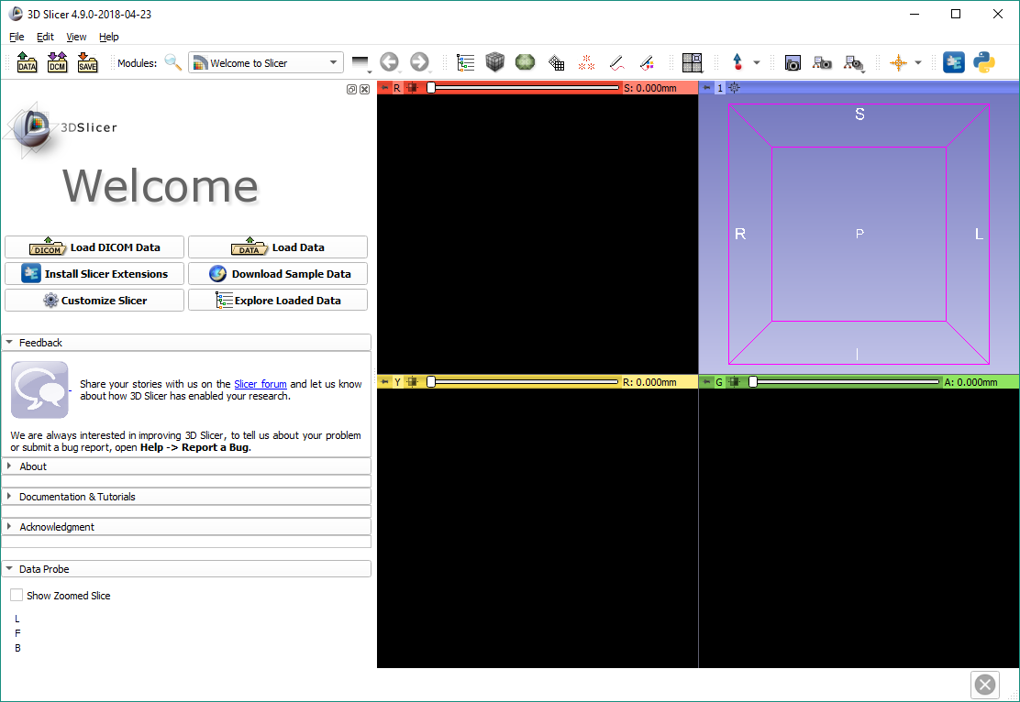

Set up DICOM database

Slide 13
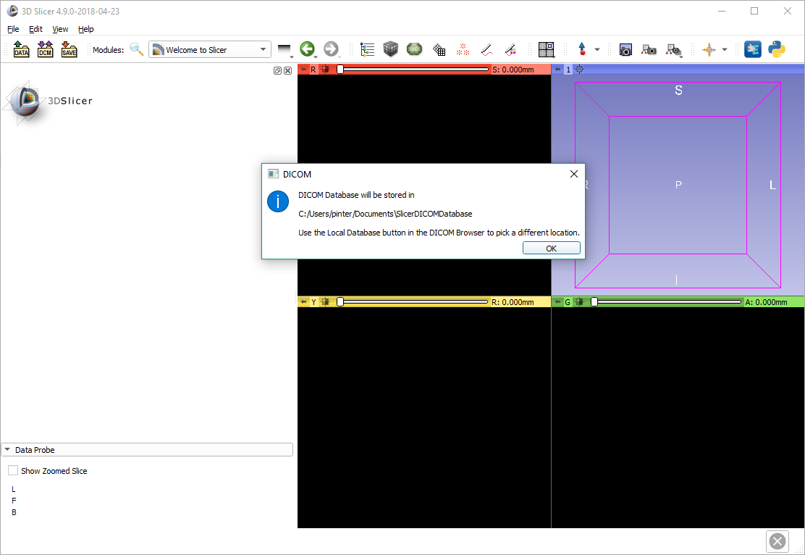
Make sure the database is writeable
The pop-up window will point to the automatically created DICOM database. In some cases it is in a read-only folder. Please double-check that the folder is writeable.

Slide 14
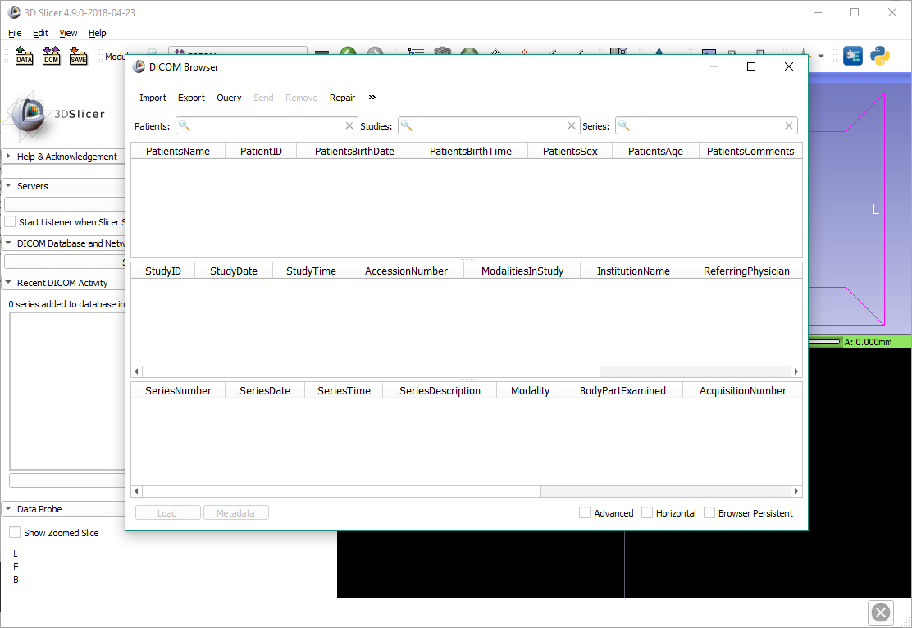
Optional: Change database path
Click the ‘>>’ button to expand the path selector.

Slide 15
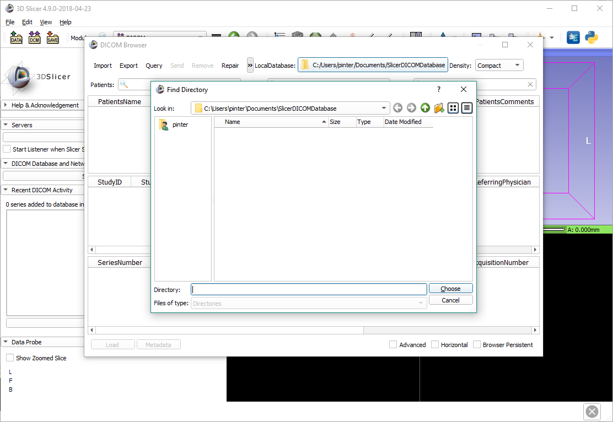
Optional: Change database path
Click the path selector button and browse to the desired folder.
Make sure it is writeable.

Slide 16
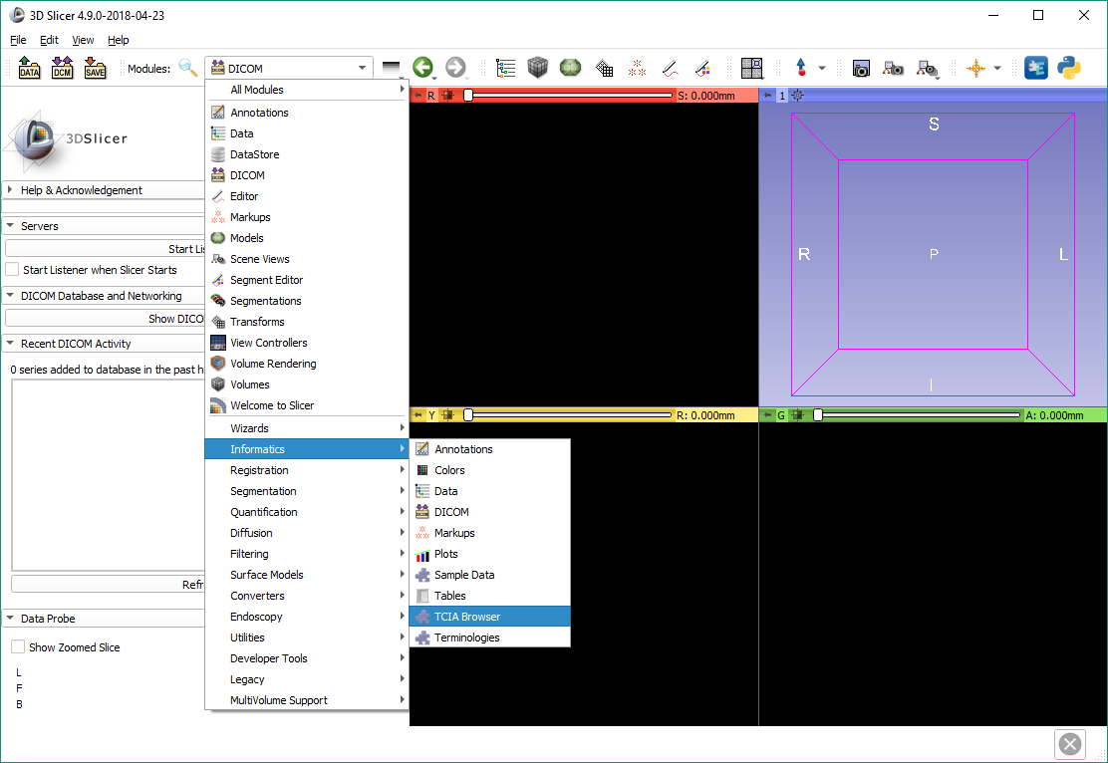
Open the TCIA browser

Slide 17
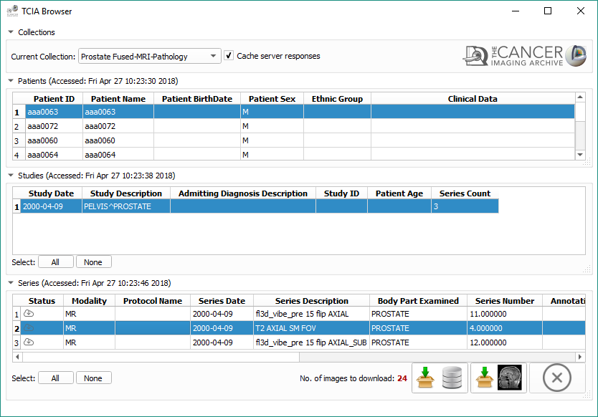
Select MR prostate dataset
Choose the ‘Prostate Fused-MRI-Pathology’ collection.
Select first patient, only study, and second series.
Click ‘Download and Load’ button.

Slide 18
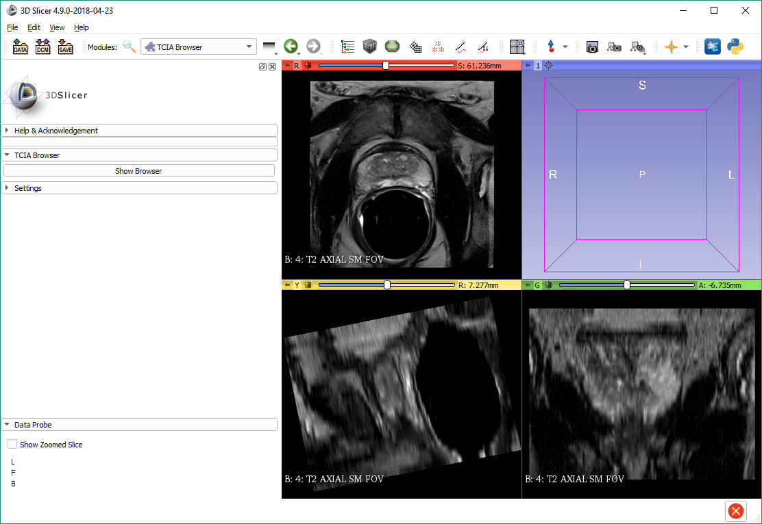
The MR dataset is loaded

Slide 19
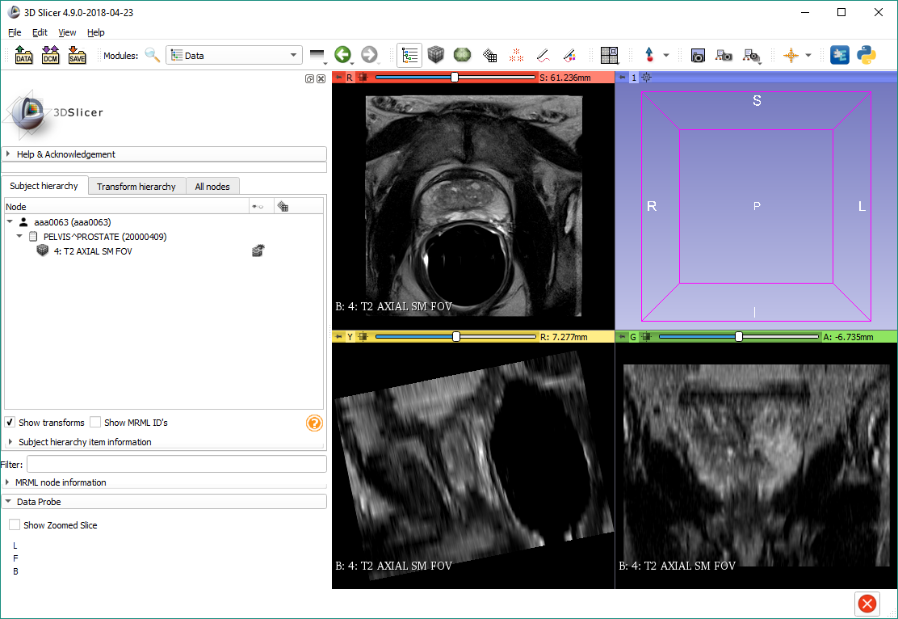
Switch to Data module
Notice that the DICOM data is organized in a patient/study/series structure.

Slide 20
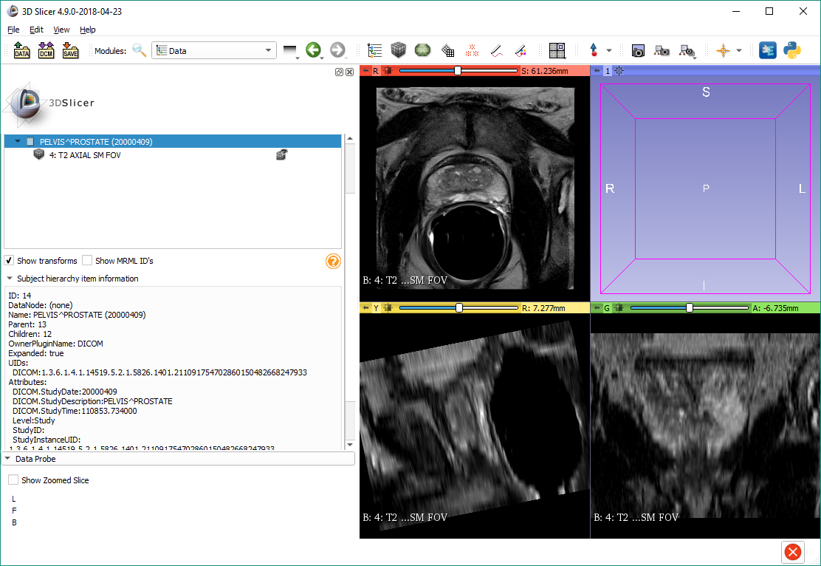
Explore DICOM information
Click the study, then open the ‘Subject hierarchy item information’ panel.
Basic DICOM tag information will be displayed in the panel.

Slide 21
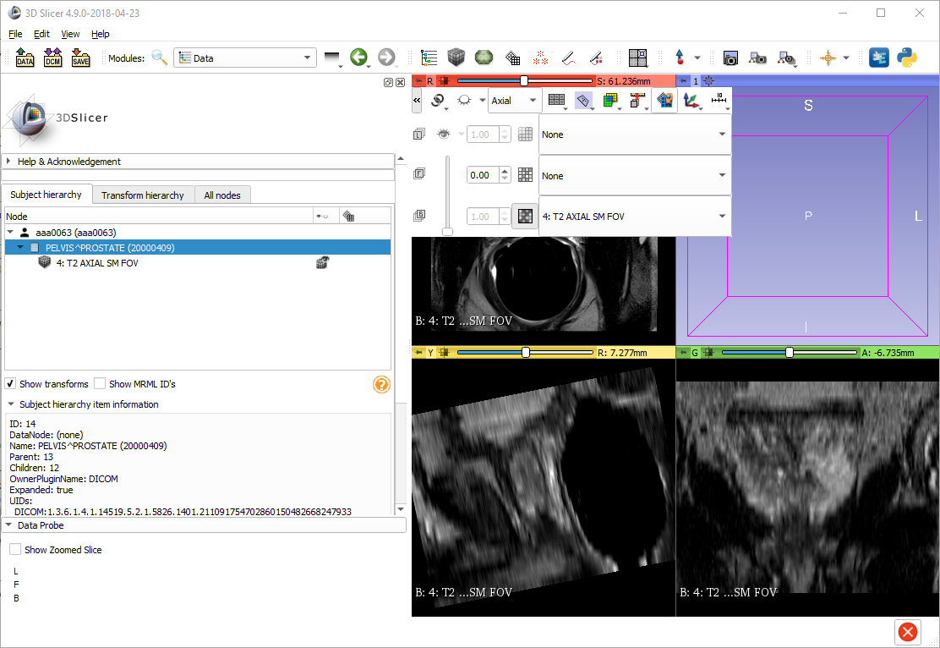
Rotate to volume plane
It is apparent from the coronal plane that the MRI is non-axis-aligned. This poses a problem especially for segmentation, as the axial view is actually an oblique view, and traverses multiple slices. In this case the ‘Rotate to volume plane’ function needs to be used to align the axial view with the orientation of the slices.

Slide 22

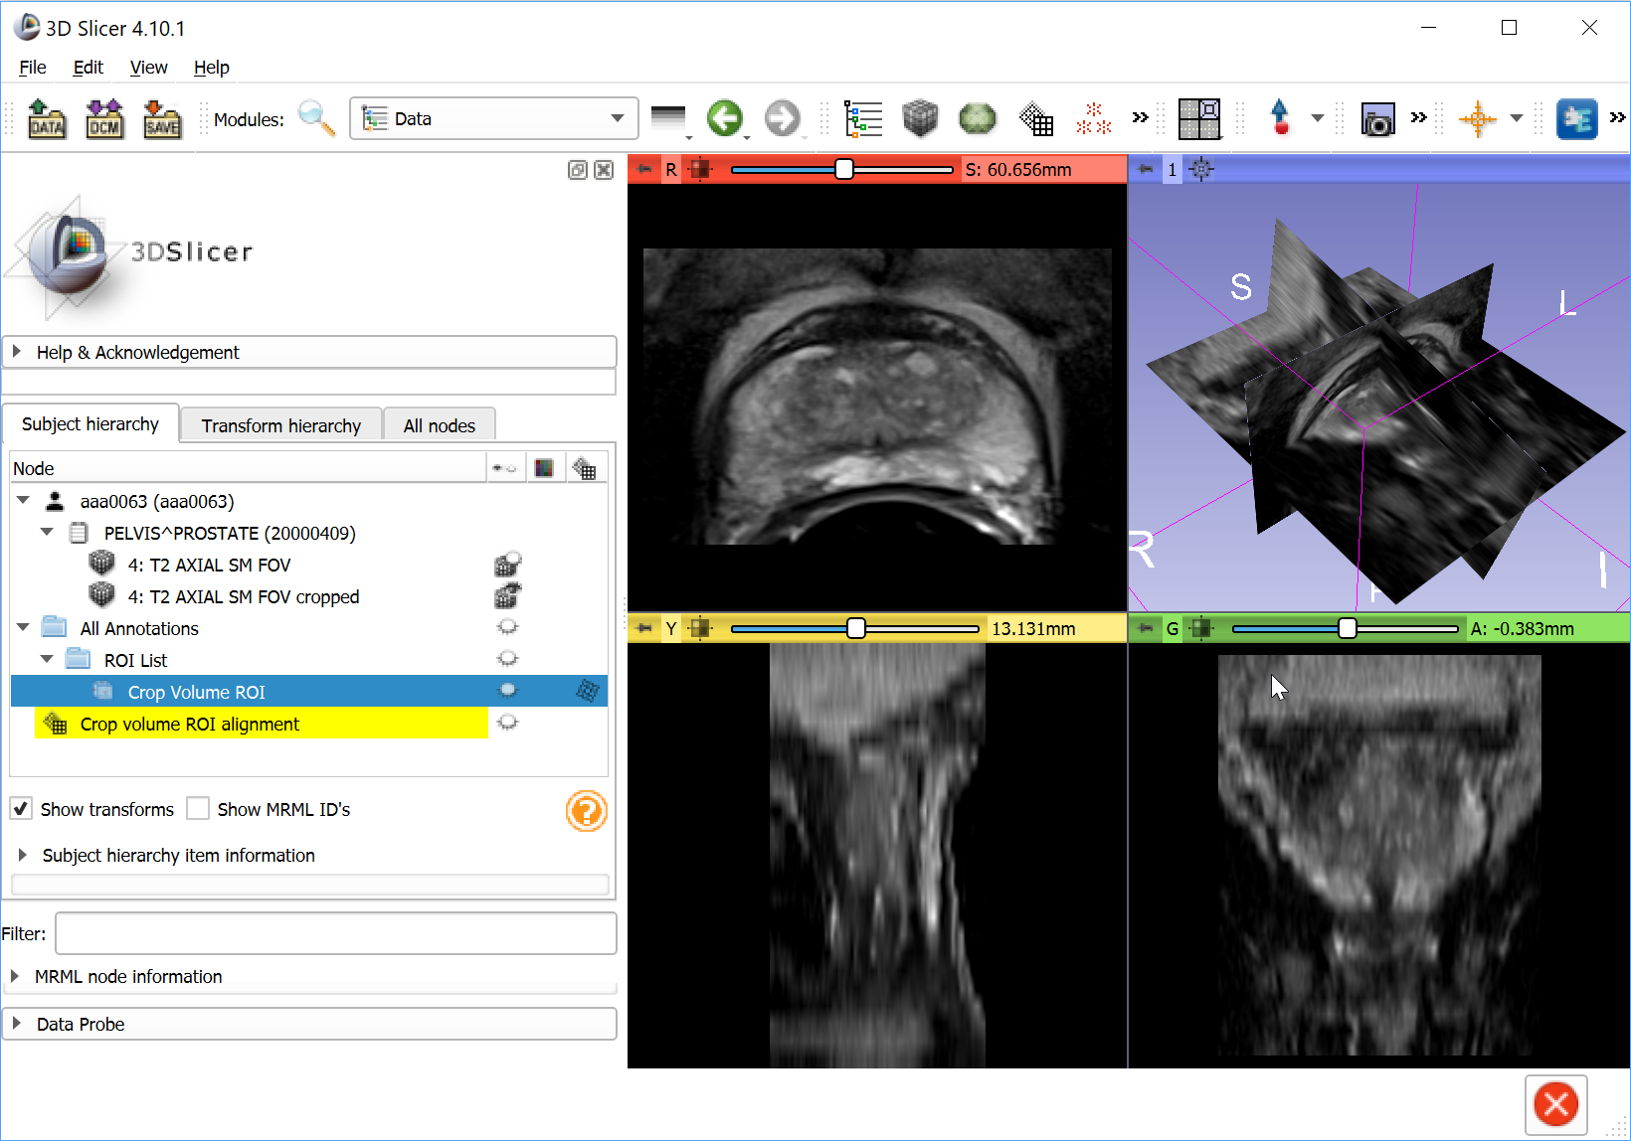
Part 2: Export DICOM
DICOM
import
DICOM
push
Slicer DICOM database
DICOM
query/retrieve
Remote PACS
DICOM files
DICOM
loading
DICOM
export
Slicer scene

Slide 23
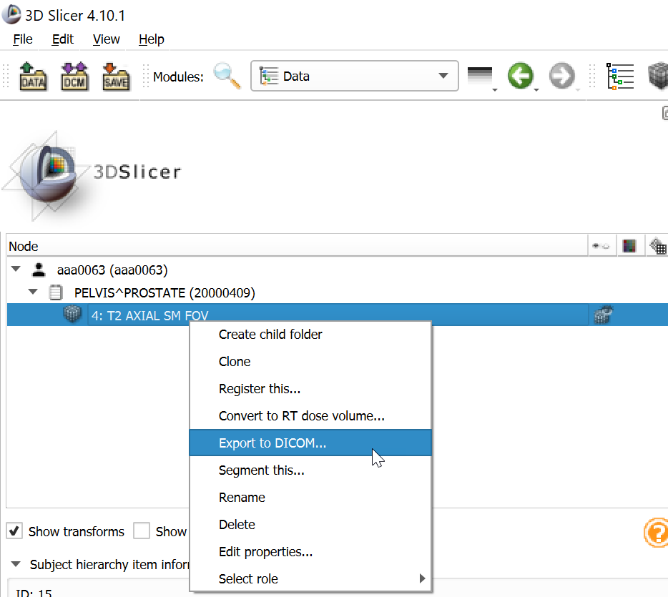
Export image to DICOM files 1

Slide 24
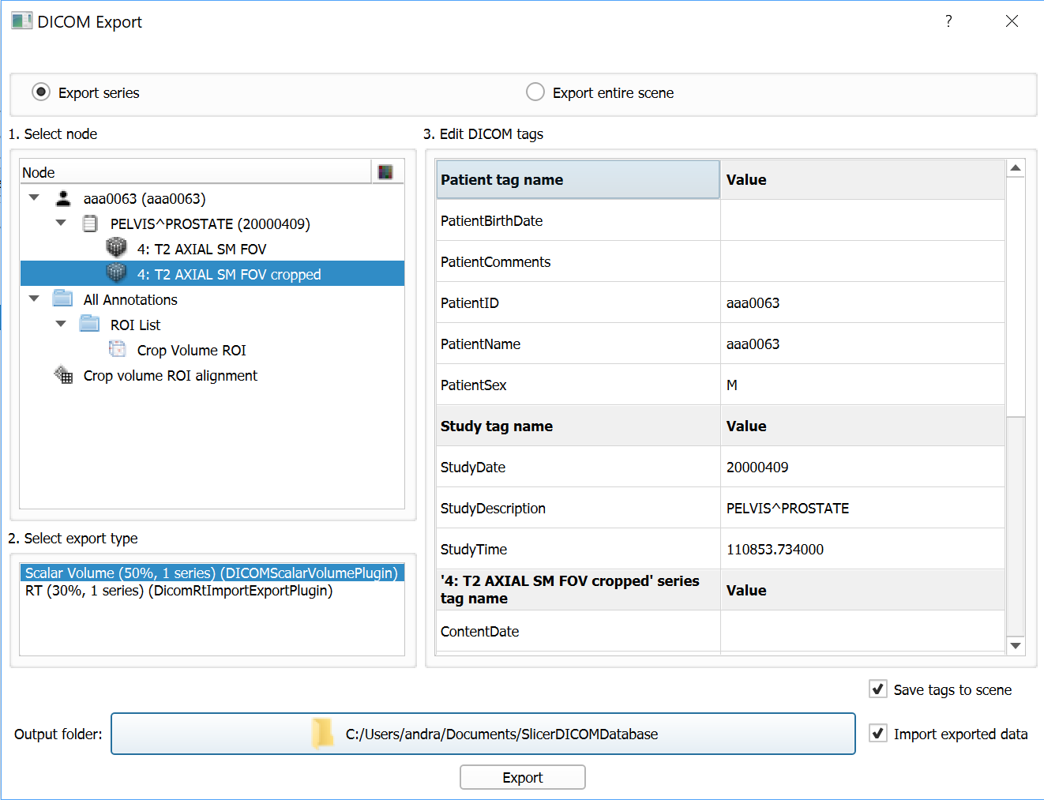
Export image to DICOM files 2

Slide 25
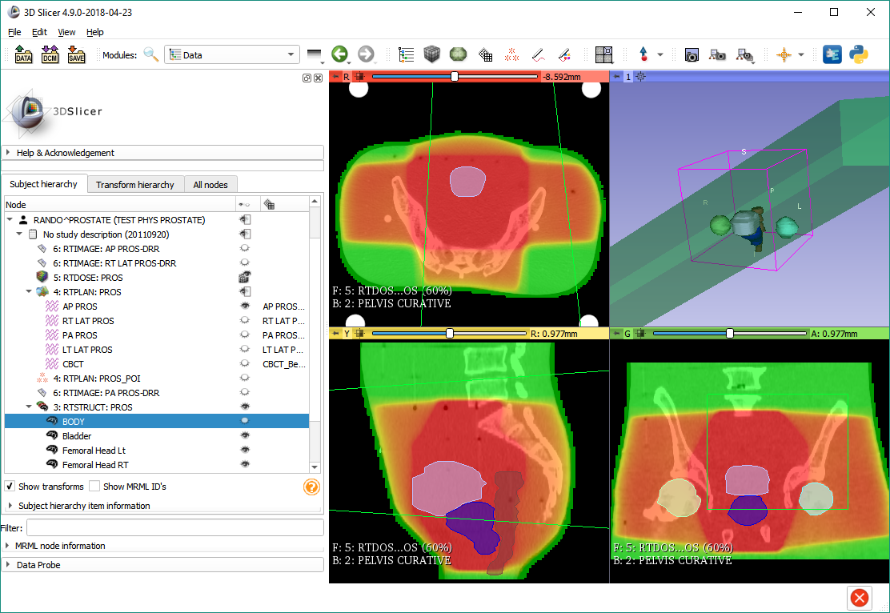
Part 3: Using DICOM data from local storage

Slide 26
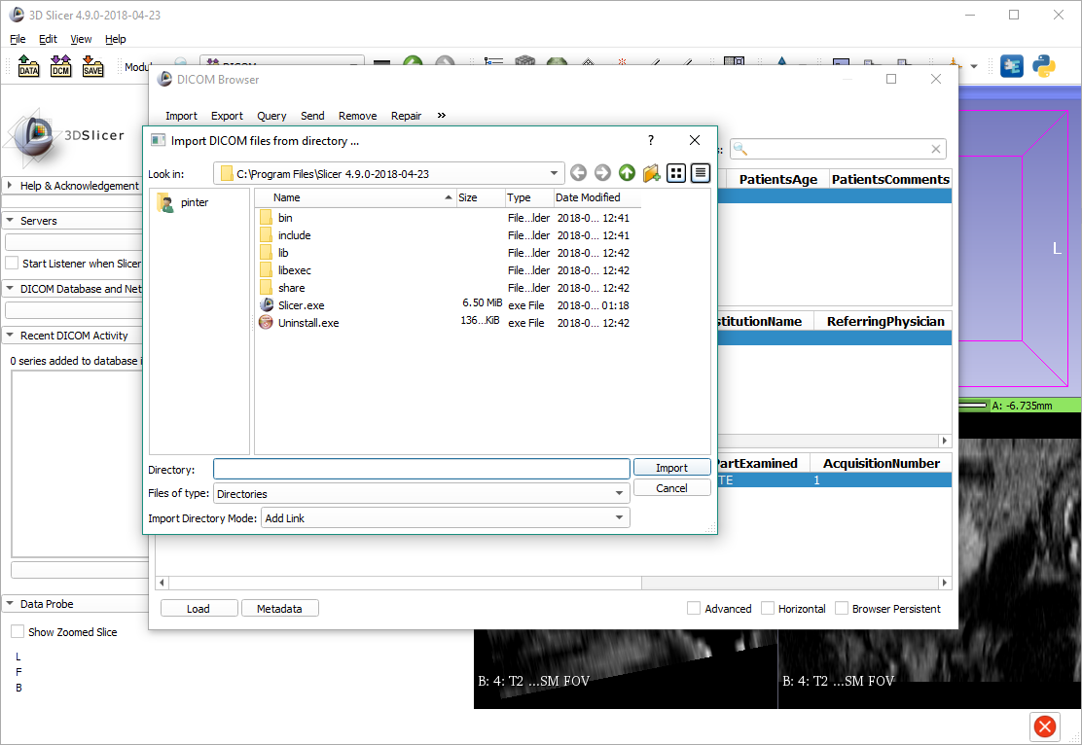
Import DICOM data from disk
Open the DICOM browser one more time, and click ‘Import’.

Slide 27
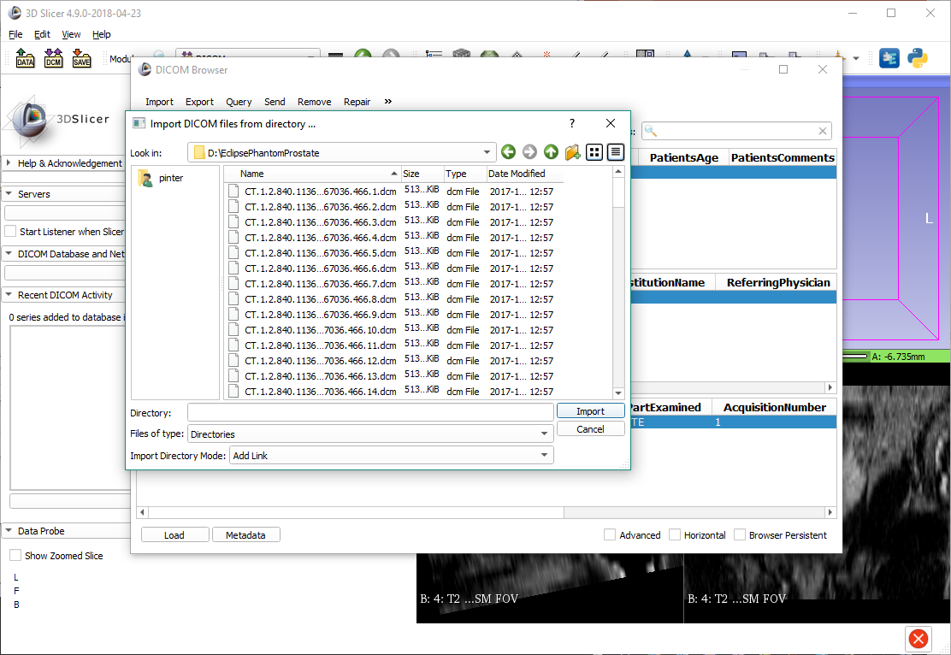
Import DICOM data from disk
Browse to the folder containing the tutorial dataset, and click ‘Import’.

Slide 28
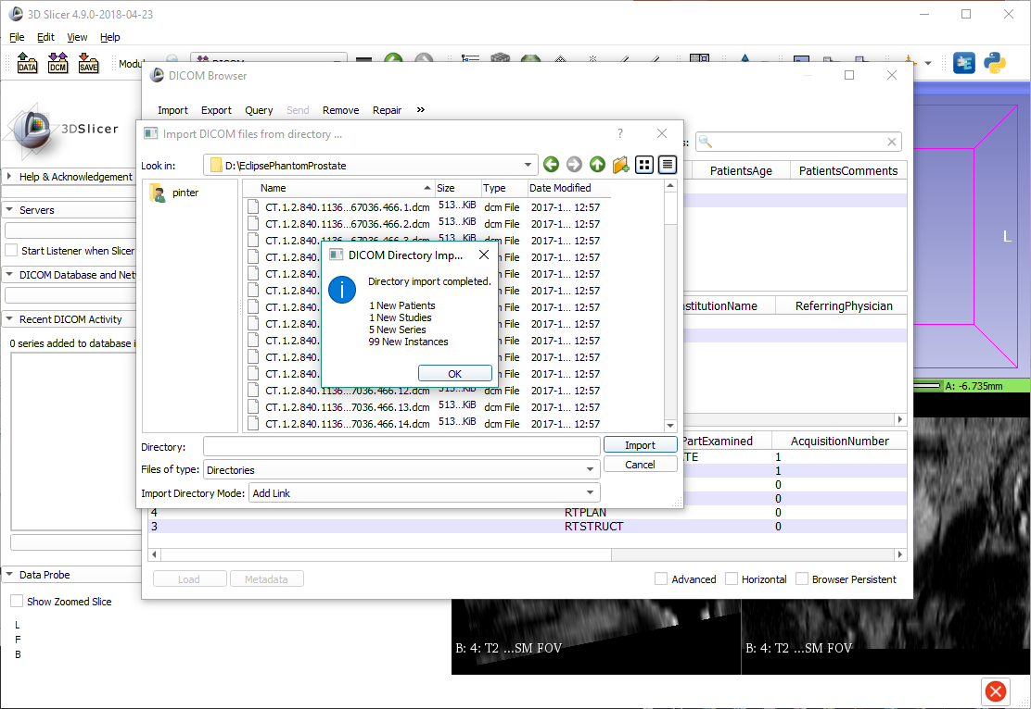
Dataset is now in the database

Slide 29
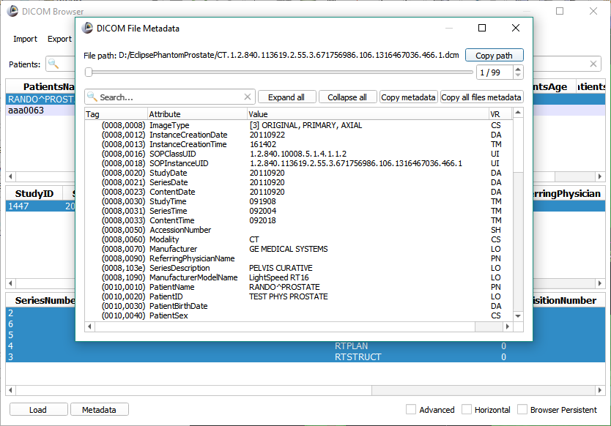
Discover DICOM metadata
Select the new patient. Note that all its studies and series are automatically selected.
Click the ‘Metadata’ button to see all the raw DICOM tags belonging to the first series in the selection. Instances in the series can be browsed using the slider. Double-clicking the tag opens the DICOMLookup page in a web browser.

Slide 30
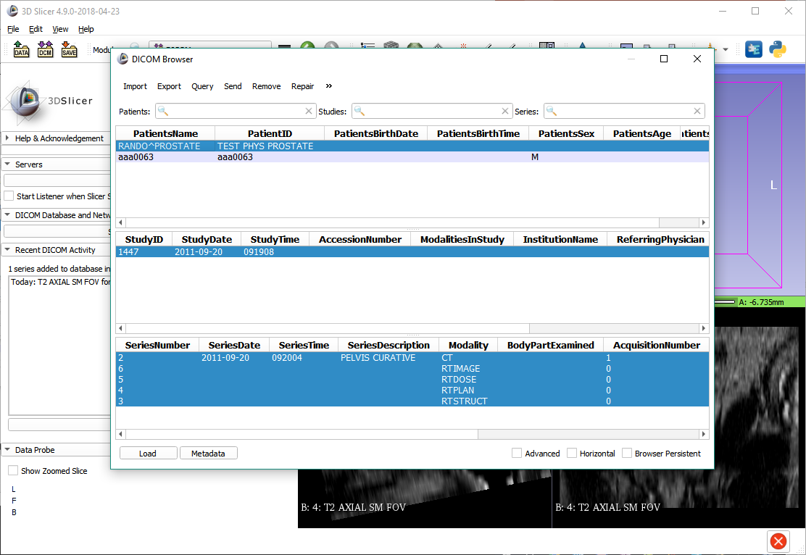
Load prostate phantom RT data
After closing the Metadata window, load the study using the ‘Load’ button.

Slide 31
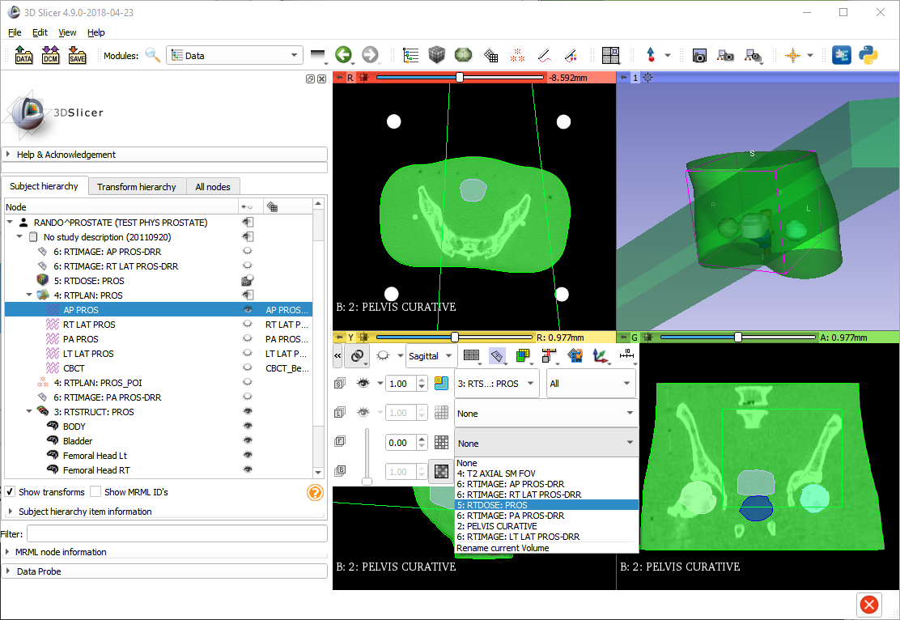
Explore radiotherapy dataset
You can show the dose volume in the foreground layer to overlay it with the anatomy. Use the slider to adjust opacity.

Slide 32
Thanks for participating!

