Slide 1
Volume reconstruction from AI-segmented ultrasound
Please cite these articles for methods presented:
Hu, Z., Nasute Fauerbach, P.V., Yeung, C. et al. Real-time automatic tumor segmentation for ultrasound-guided breast-conserving surgery navigation. Int J CARS (2022). doi: 10.1007/s11548-022-02658-4
T. Ungi et al., "Automatic Spine Ultrasound Segmentation for Scoliosis Visualization and Measurement," in IEEE Transactions on Biomedical Engineering, vol. 67, no. 11, pp. 3234-3241, Nov. 2020, doi: 10.1109/TBME.2020.2980540.

Slide 2
Prerequisites – download data
Install 3D Slicer version 5.0.2 or later
Download tutorial data (.mrb scene and .h5 AI model )
Data scene: Q006_SagittalSpineScan.mrb (size: 389 MB) https://1drv.ms/u/s!AhiABcbe1DByhMt5E3NjCmJ-RIlTZA?e=9Lqusg
Trained AI model: SagittalSpine_05.h5 (size: 4 MB) https://1drv.ms/u/s!AhiABcbe1DByhMtwLY-z7kvKg1D5Ww?e=1loPhn

Slide 3
Prerequisites – install extensions
Install extensions (plug-ins) for 3D Slicer
SlicerOpenIGTLink: Communication interface to hardware
SlicerIGT: Utility modules for IGT (registration and visualization)
SlicerIGSIO: Infrastructure, algorithms module for IGT
ParallelProcessing: Template for running Python scripts in parallel

Slide 4
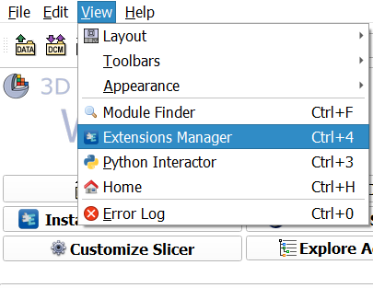
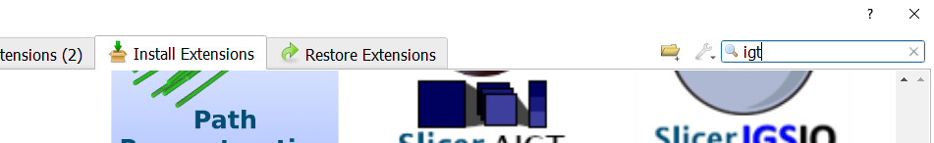
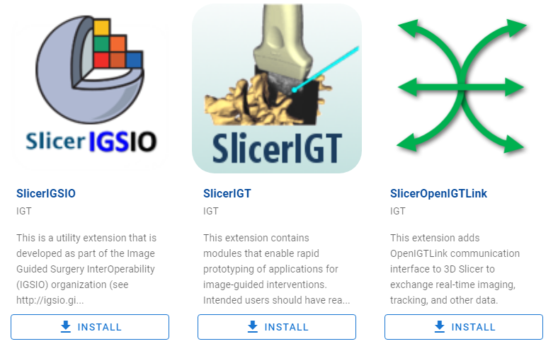
2. Search “igt” to find these modules
1. Open Extension Manager
3. Install

Slide 5
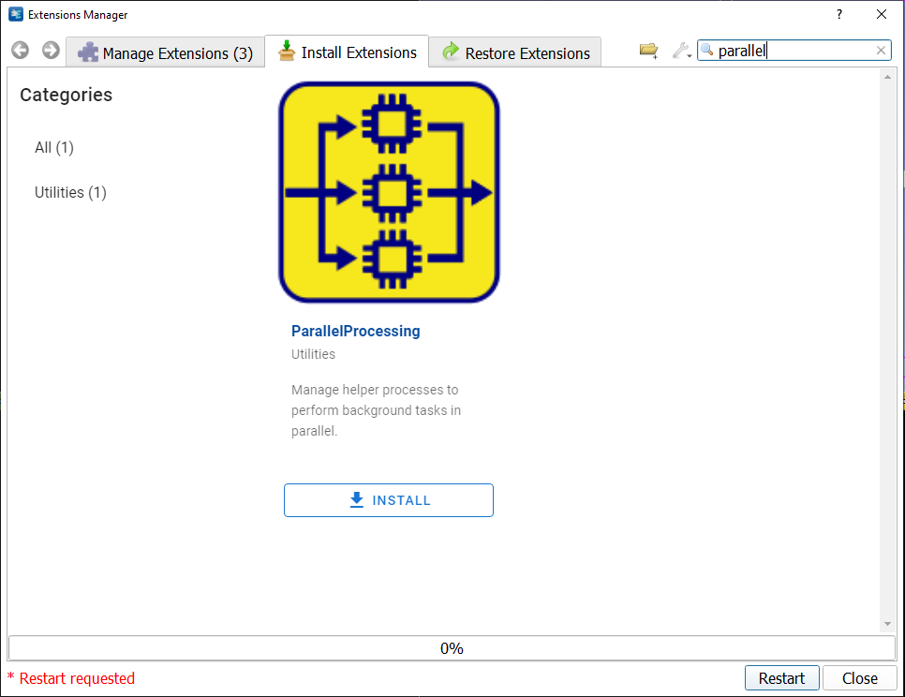
1. Install ParallelProcesses extension too
2. Close, no need to restart Slicer yet

Slide 6
Install TensorFlow in Slicer
Optional! If you want TensorFlow to use your GPU, install CUDA v. 11.3 and CuDNN v. 8.2
For downloads and further instructions, check out the NVidia website: https://developer.nvidia.com/cuda-toolkit-archive
In Slicer / View/ Python Interactor use command:
>>> pip_install('tensorflow')
Once install process ends, you may test your environment:
>>> import tensorflow as tf
>>> tf.config.list_physical_devices()

Slide 7
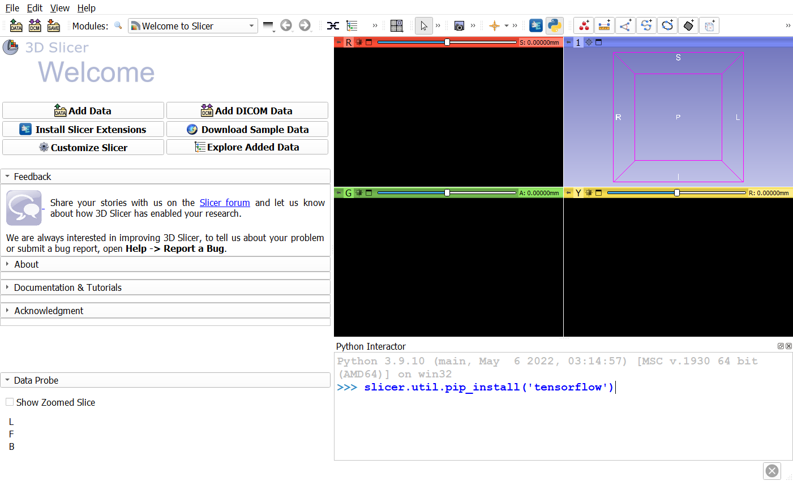
1. Open Python Interactor
2. Type commands here

Slide 8
Clone the SlicerIGT/aigt repository
Clone aigt repository on your computer using: https://github.com/SlicerIGT/aigt
Locate SegmentationUNet.py file in your clone …aigt/SlicerExtension/LiveUltrasoundAi/SegmentationUNet/
Open Slicer / Edit / Application Settings / Modules
Drop the SegmentationUNet.py file in the area in Slicer settings called Additional module paths
Press OK on the Settings window and restart Slicer application

Slide 9
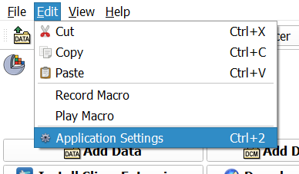
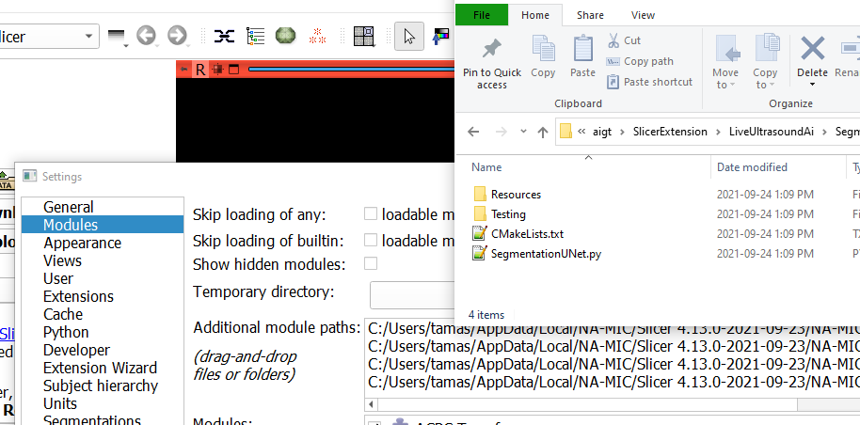
1. Open Application Settings
2. Select Modules
3. Drag and drop .py file to this area from cloned source code
4. Restart Slicer!

Slide 10
Data processing overview
Load Slicer scene with data
Set up input and output for segmentation module
Initialize prediction by updating input
Visualize prediction
Set up volume reconstruction
Start ultrasound replay
Set up volume rendering to visualize spine volume

Slide 11
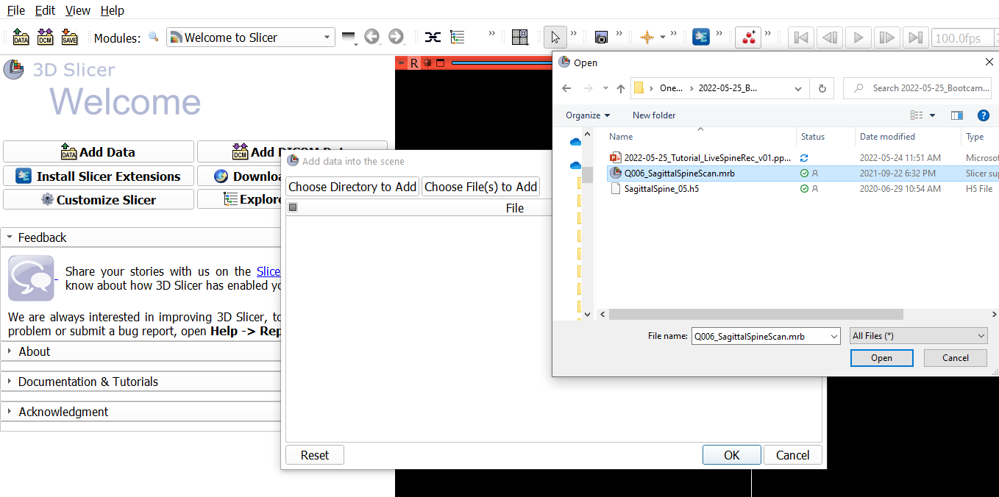
1. Click DATA
3. Find tutorial data folder
2. Click
4. Choose the .mrb file
5. Click
6. Click

Slide 12
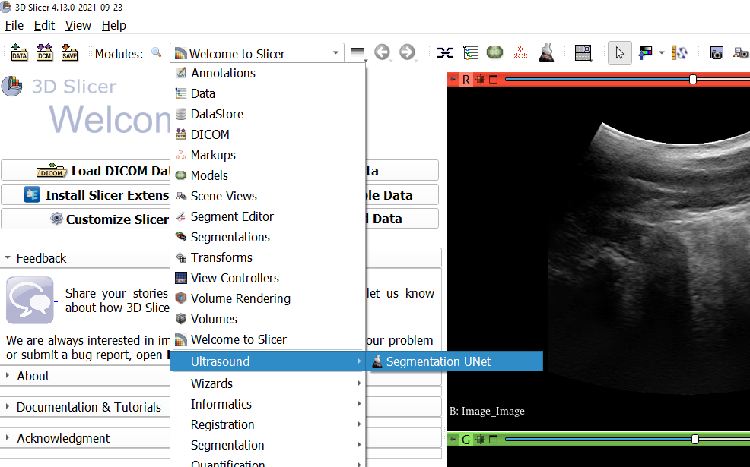
Switch to Segmentation UNet module

Slide 13
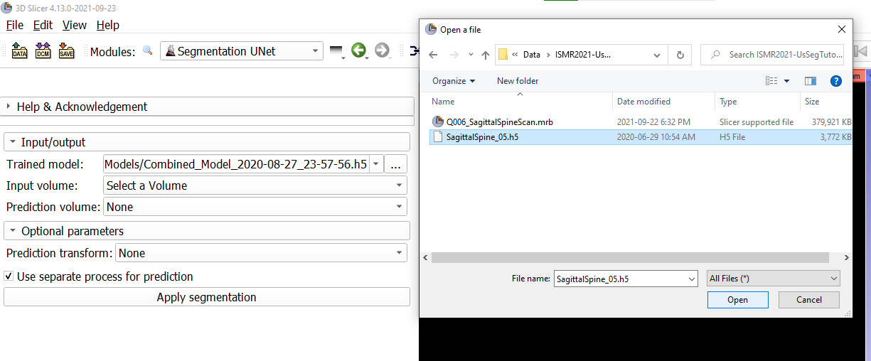
1. Open file browser for AI model
2. Find .h5 model file in tutorial data folder
3. Click

Slide 14
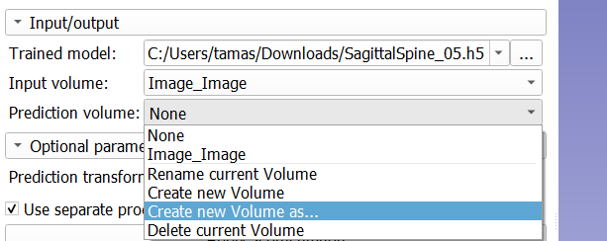
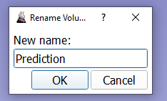
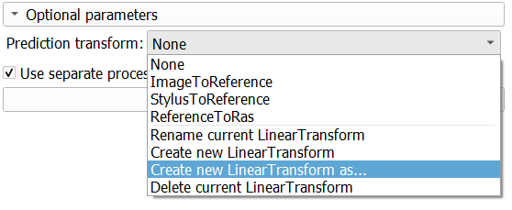
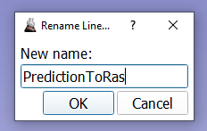
1. Select Image_Image as input volume
2. Create new volume for Prediction
1. Create new transform node for Prediction

Slide 15
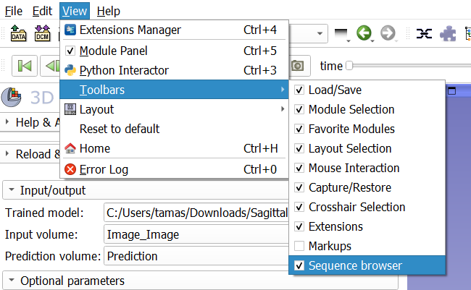
Make sure Sequence browser toolbar is visible

Slide 16
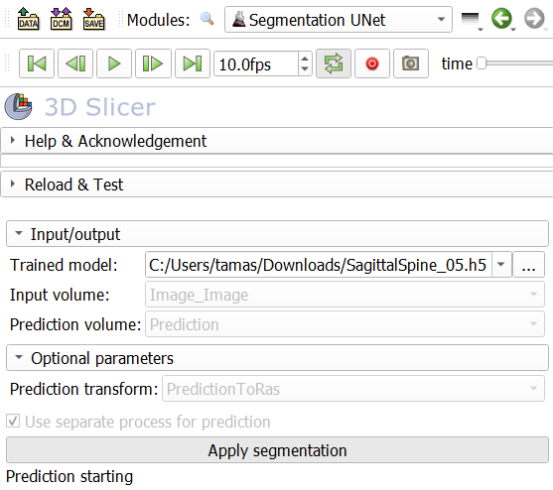
2. Step the recorded sequence so the AI process fully starts
1. Start the AI segmentation process
On MacOS, uncheck this before Apply

Slide 17
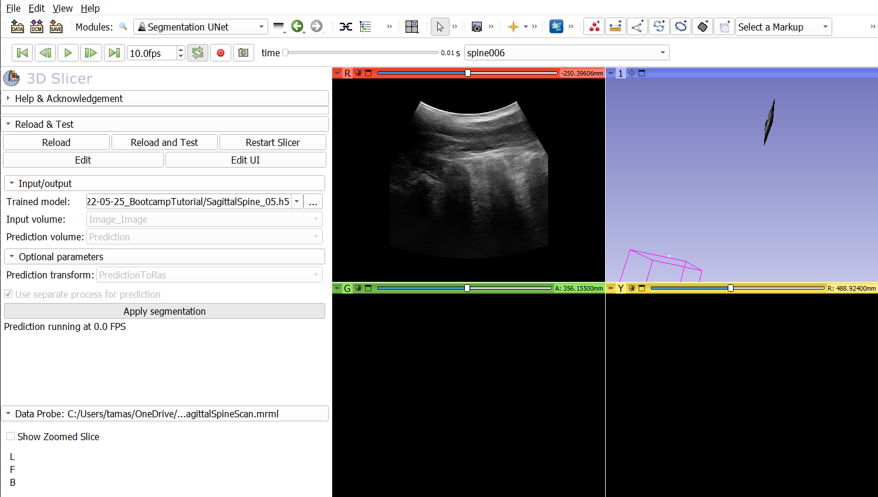
Switch to Four-Up layout

Slide 18
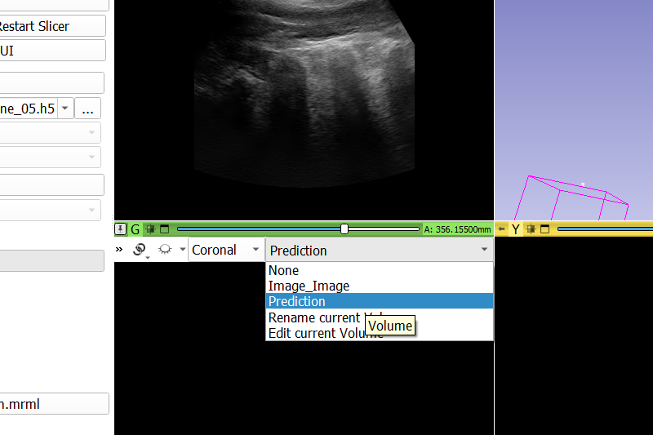
2. Make sure views are not linked
1.
3. Select Prediction to be shown in the green view

Slide 19
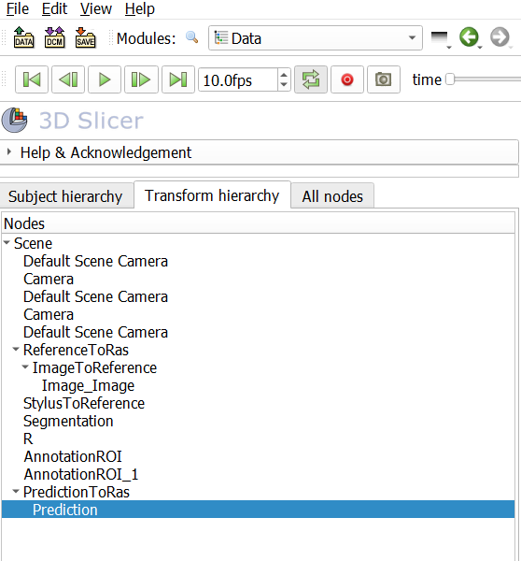
1. Switch to Data module
2. Select Transform hierarchy
3. Drag and drop Prediction volume on PredictionToRas transform node

Slide 20
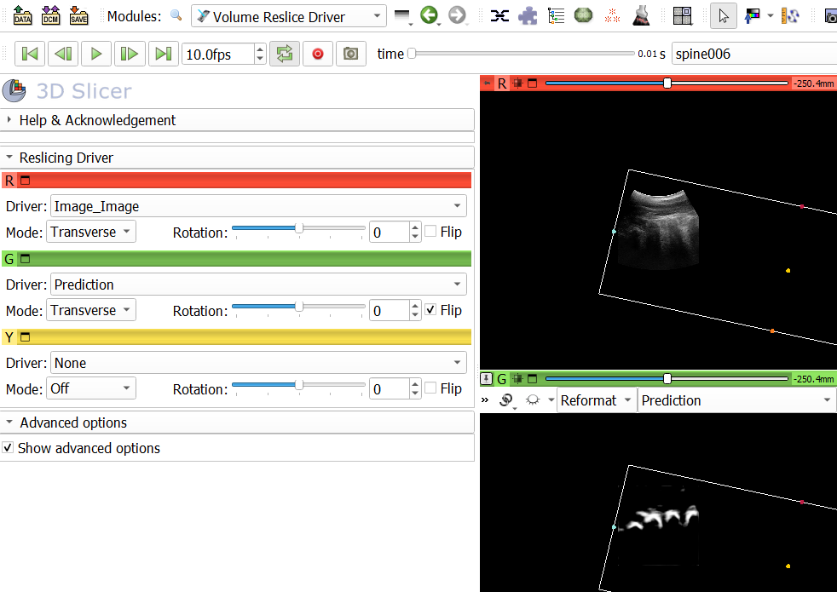
1. Switch to Volume Reslice Drive module (IGT category)
2. Select Prediction to drive green view
3. Show advanced option and flip the prediction image so it matches the ultrasound orientation

Slide 21
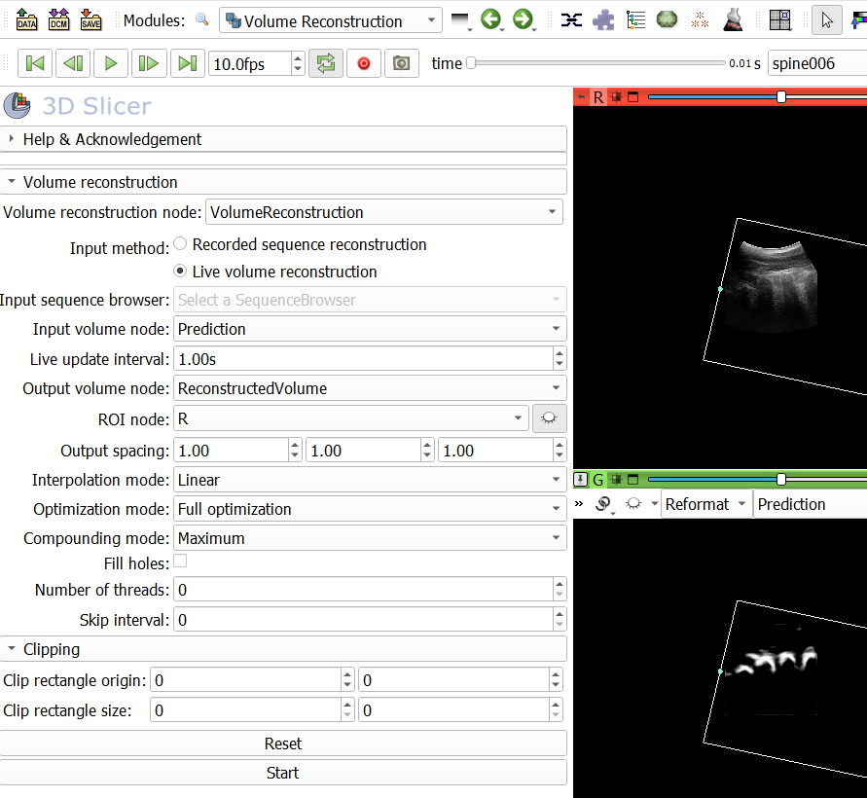
1. Switch to Volume Reconstruction module (IGT category)
2. Select these options
3. Create a new volume and name it ReconstructedVolume for output
4. Press Start

Slide 22
5. Press the play button to replay ultrasound scan (and reconstruct volume)

Slide 23
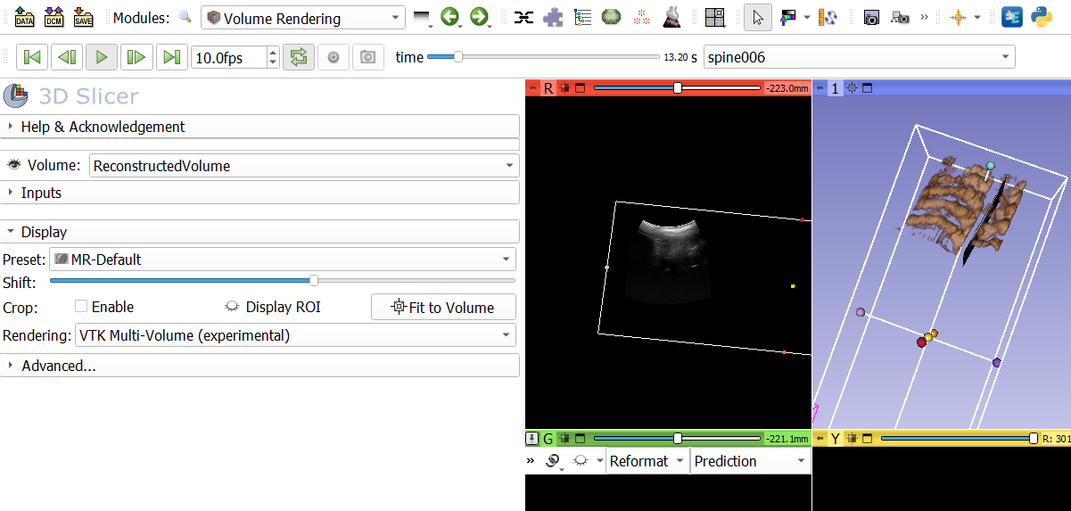
1. Switch to Volume Rendering module
2. Select ReconstructedVolume
3. Select MR-Default preset
4. Visualize volume and see it in 3D view
5. Increase threshold to only show bones

Slide 24
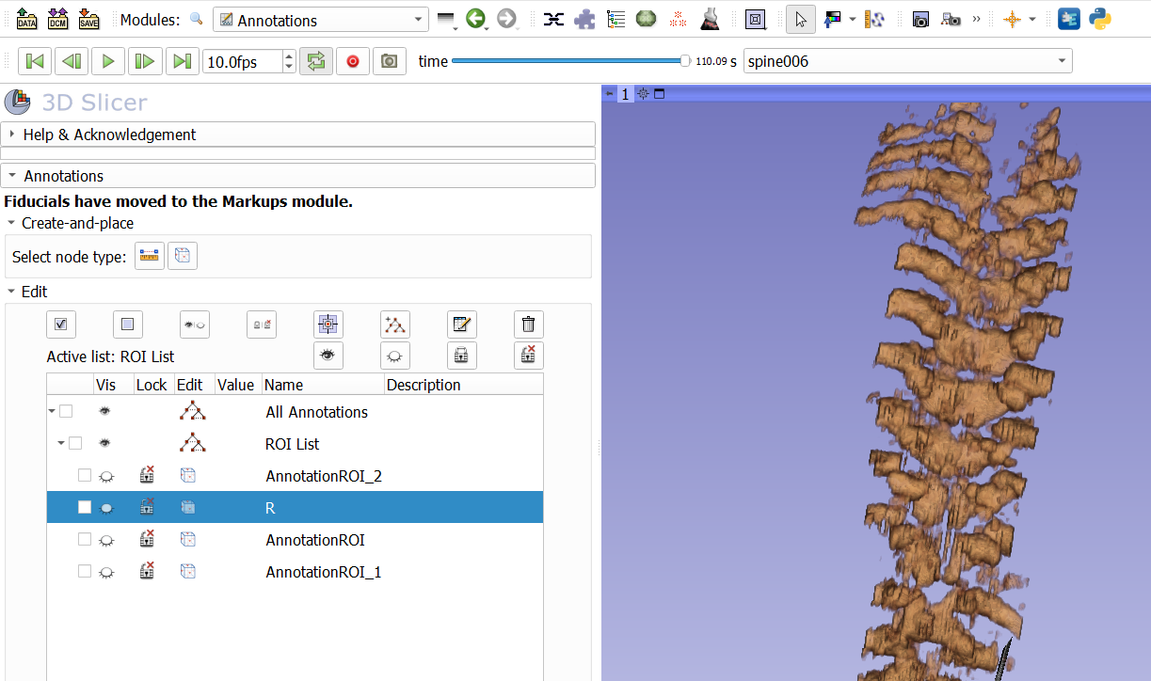
1. Switch to 3D-only view
2. Select Annotations
3. Hide R (ROI)
4. Stop playback when volume ready
(5. Stop Volume Reconstruction and Segmentation UNet modules too)

