Slide 1
Managing your project in the PerkLab
Andras Lasso
Laboratory for Percutaneous Surgery (Perk Lab) School of Computing Queen’s University, Kingston, ON, Canada

Slide 2
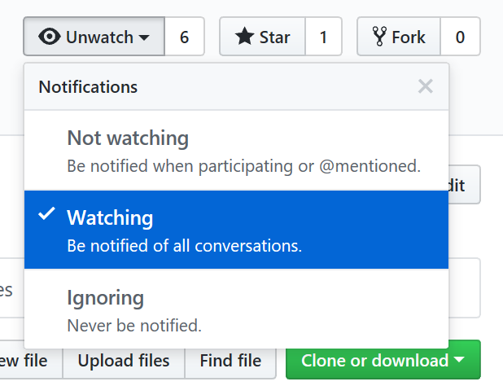
Basic mechanisms
Set up project space
Which repository? Ask your mentor. Most commonly: https://github.com/PerkLab private project. Make it public when published.
Do not ignore email notifications. May set to Not watching. Avoid Ignoring.
Create README.md
Overall goal, approach, high-level plan.
Resources: directory on file server, other repositories, etc.
Set up project board
Set up regular (weekly) execution control meeting
Review what was done vs. planned, check if help needed => update issues, add notes.
Update short-term plan (2 weeks) => update project board.
Check if long-term plan is still OK => update plan if needed.

Slide 3
Documentation
Frequently changing, temporary information (short-term planning, administration), not for archival => issue tracker, project board
Software documentation:
User manual, Developer manual => few Markdown (.md) files in root folder.
API documentation => in source code. Use doxygen style for C++, Sphinx docstring / restructured text for Python.
Key papers, presentations create for the project => Doc subfolder in source code repository, in editable format (Word, PowerPoint); avoid large binary files, frequent updates

Slide 4
Issue tracking
Tracking tasks: issues, feature requests, enhancement ideas
Entering a bug report: What did you do? What did you expect? What happened instead? Attach logs, screenshot.
Add comment whenever making progress
Refer to issues in source code commits to automatically link them
@mention people in a comment to get input from someone (instead of writing an email)

Slide 5
GitHub Projects vs. Releases
Projects:
Supports continuous, organic evolution
Works across repositories, easy drag-and-drop
Columns on the project board
To do: when tasks are completed, we choose what to do next from this column.
In progress: currently somebody working on it; make sure somebody is assigned.
Done: closed issues, no further action is planned.
Some other useful columns:
To test: useful for projects where users and developers are different group.
Future: collection of ideas for the future
Example: https://github.com/twbs/bootstrap/projects/13 (we only use in private projects)
Releases:
Supports upfront planning and monitoring progress
The way to define deadlines (no deadlines for individual tickets)
Files can be attached (e.g., installation package)
Example: https://github.com/PlusToolkit/PlusLib/milestone/4

Slide 6
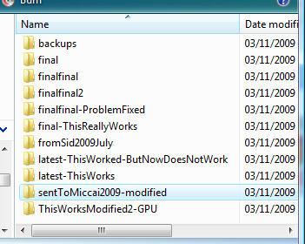
Revision control – the naïve way

Slide 7
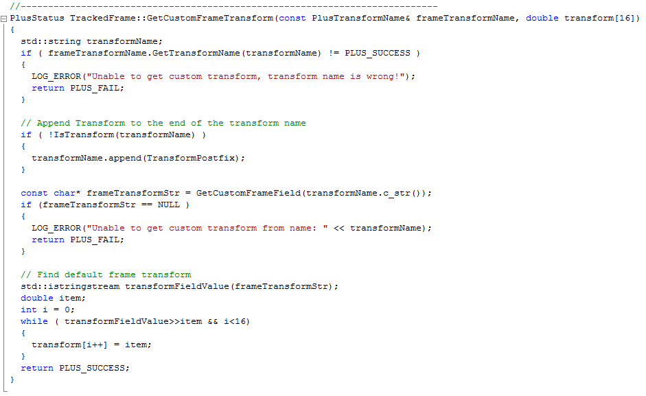
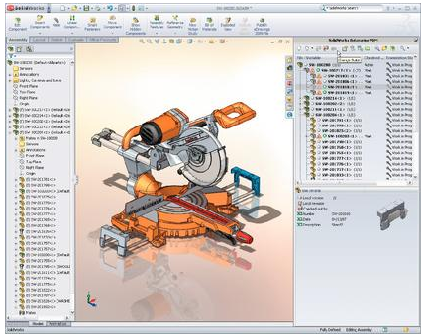
What does revision control offer?
Organized storage of multiple file versions
Records history of all file changes (who modified, what, when, why)
Convenient user interface for comparing and merging different file versions
Allows concurrent modifications by multiple people

Slide 8



Alternative #1
“I can do the same by saving a copy of my complete source code directory, whenever I have a new version“
Organized storage of multiple file versions
Records history of all file changes (who modified, what, when, why)
Convenient user interface for comparing and merging different file versions
Allows concurrent modifications by multiple people

Slide 9
Revision control – Myth #2
“I just use Dropbox“
Organized storage of multiple file versions
Records history of all file changes (who modified, what, when, why)
Convenient user interface for comparing and merging different file versions
Allows concurrent modifications by multiple people

Slide 10
Revision control – Myth #2
“It is necessary only when there are multiple developers“
Organized storage of multiple file versions
Records history of all file changes (who modified, what, when, why)
Convenient user interface for comparing and merging different file versions
Allows concurrent modifications by multiple people

Slide 11
Organized storage of multiple file versions
Numbered revisions/commits:
Git: cryptographic hash (SHA-1, 160 bit, 40 character hex string) ca8fbe9085c4f67be170 528b53b8ac3f64dd5acb
SVN: monotonously increasing integers 1, 2, 3, …
Tags
Tree structure
9
8
7
6
tag
5
4
branch
PLUS-1.8.1
3
Revision (SVN)
2
Commit / revision (Git)
1
master (Git) trunk (SVN)

Slide 12
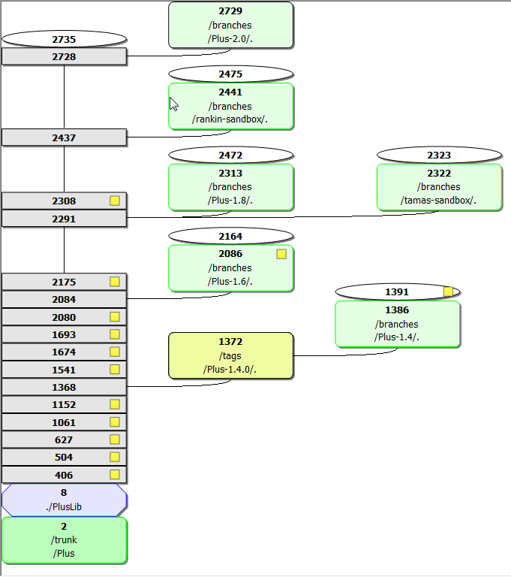
Organized storage of multiple file versions
Revision graph
(version tree)

Slide 13
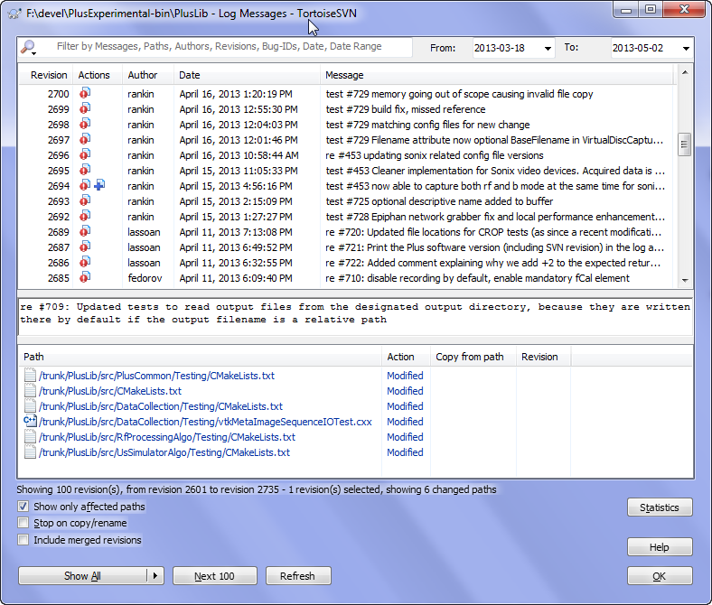
Records history of all file changes
Recorded for each modification:
What?
When?
Who?
Why?
auto
Show log

Slide 14
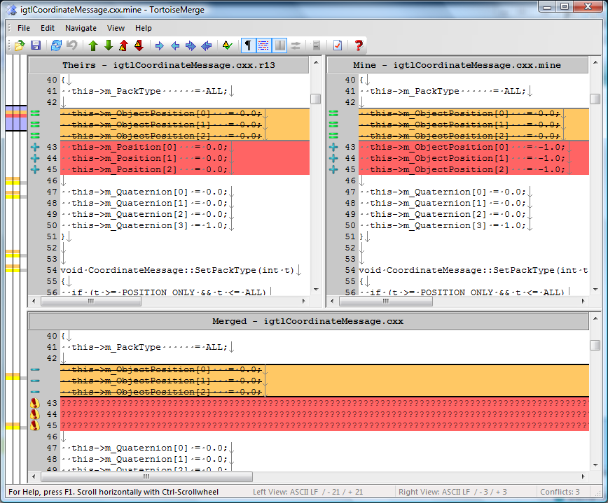
User interface for compare and merge
Their modifications
My modifications
merge
10
8
9
6
7
5
4
3
2
1

Slide 15
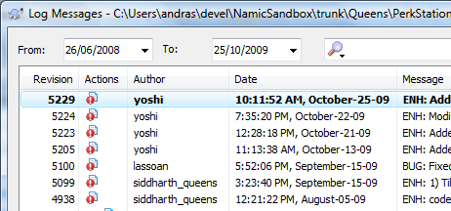
Concurrent modifications by multiple people
One common server stores all versions
Automatic merge of trivial changes (if a line is not modified by multiple people)

Slide 16
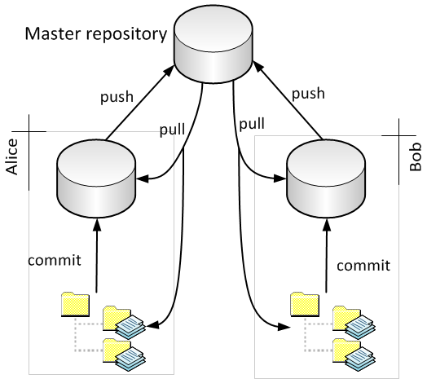
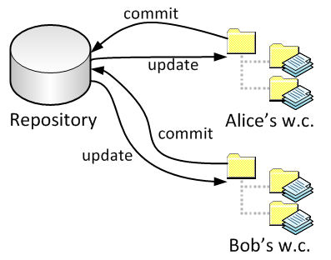
Which one to use? – git has won
Commercial: very good, but expensive (ClearCase, Perforce, Team Foundation Server, etc.)
Non-commercial: good enough, free
http://pages.cs.wisc.edu/~driscoll/software/vcs/
Centralized: Subversion (SVN)
=> simpler to use
Distributed: Git, Mercurial
=> more flexible, for very distributed projects

Slide 17
Setup Git
Install Git (command-line tool): https://git-scm.com/download/win
Install TortoiseGit (GUI client): http://tortoisesvn.net/downloads
Optional: for private repositories with SSH authentication, install putty: http://www.chiark.greenend.org.uk/~sgtatham/putty /latest.html

Slide 18

Create a modifiable local copy of a repository
PerkLab/BootcampSandbox
GitHub servers
Alice/BootcampSandbox
Bob/ BootcampSandbox
Fork
Fork
Clone
Clone
Alice’s computer
Bob’s computer

Slide 19
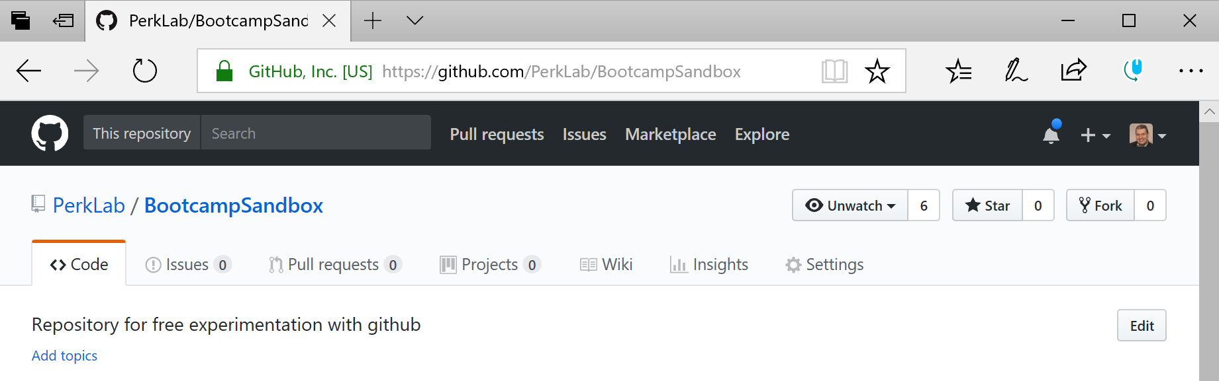
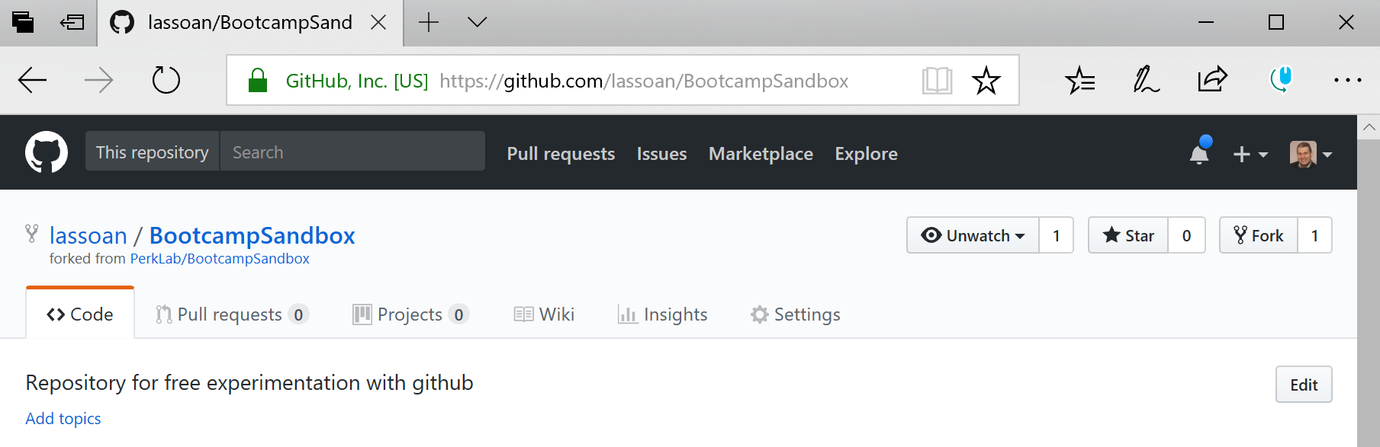
Fork: create copy of official repository
Open repository webpage: https://github.com/PerkLab/BootcampSandbox
Fork the repository: clone the repository so that you can make changes freely

Slide 20
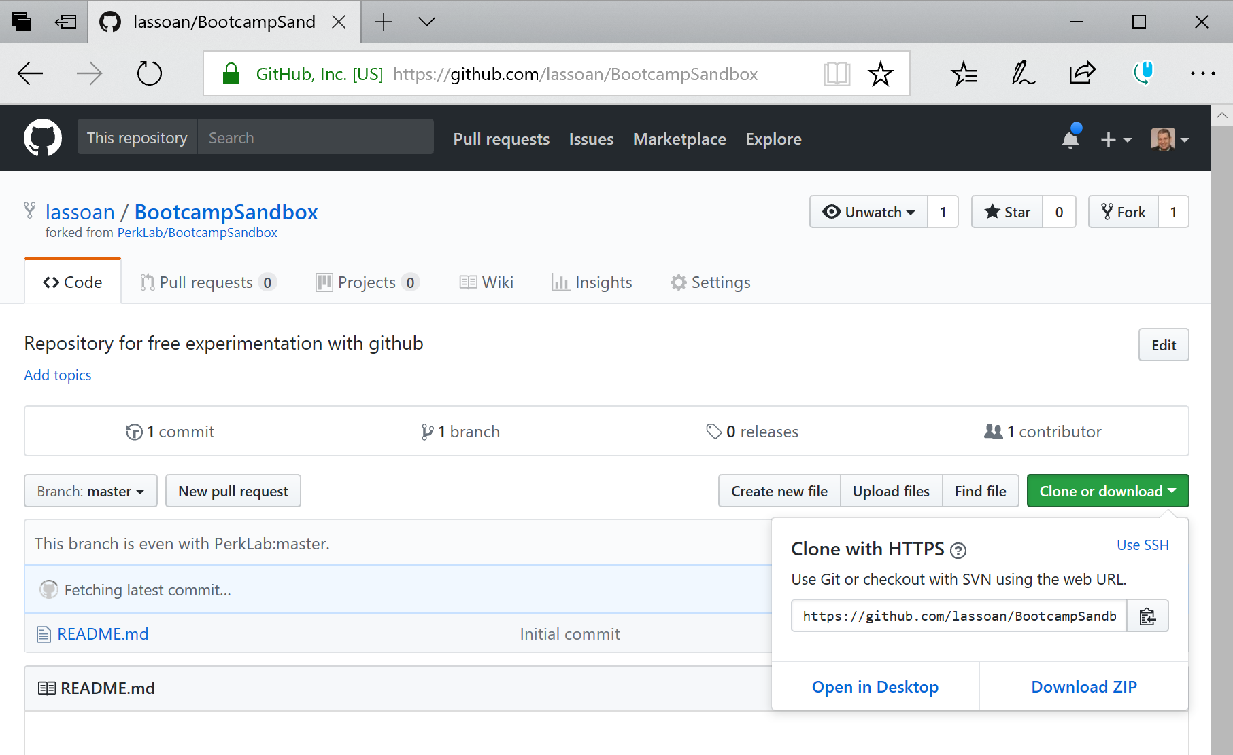
Clone: create a local copy of your repository
1
2

Slide 21
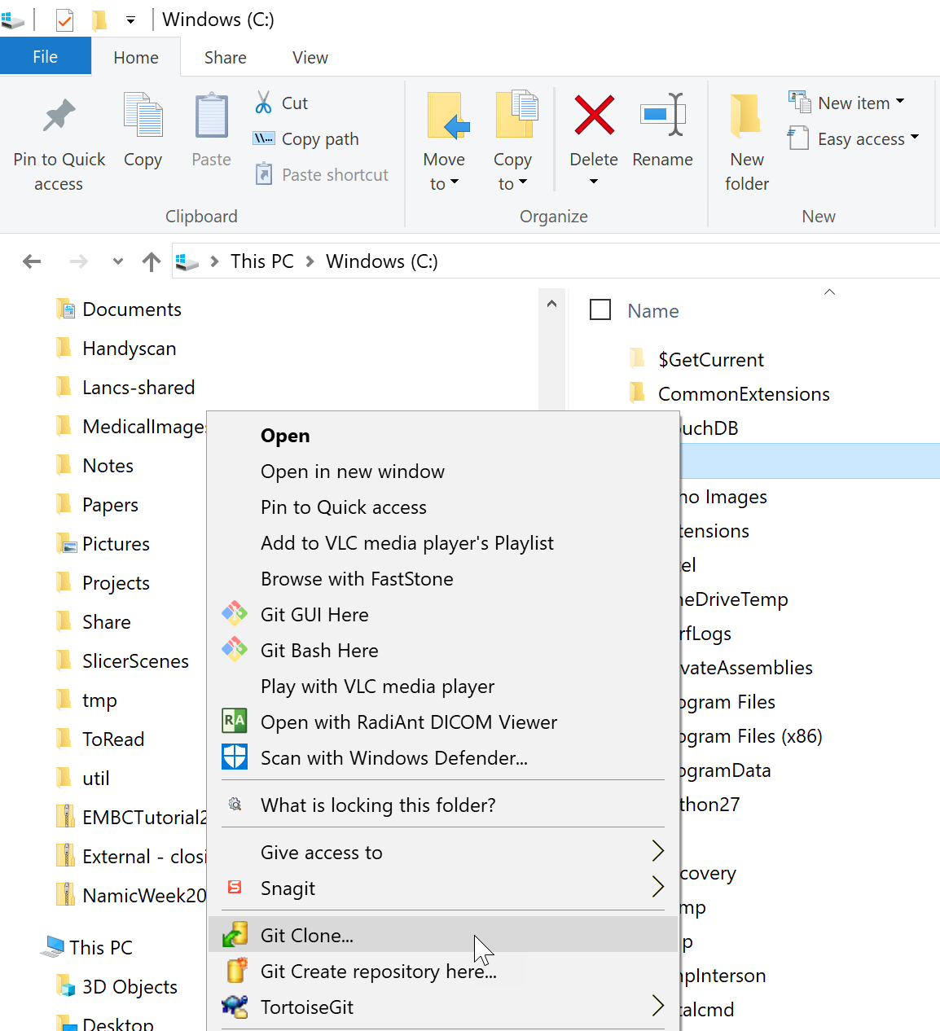
Clone: create a local copy of your repository
1 Right-click on a folder
2

Slide 22
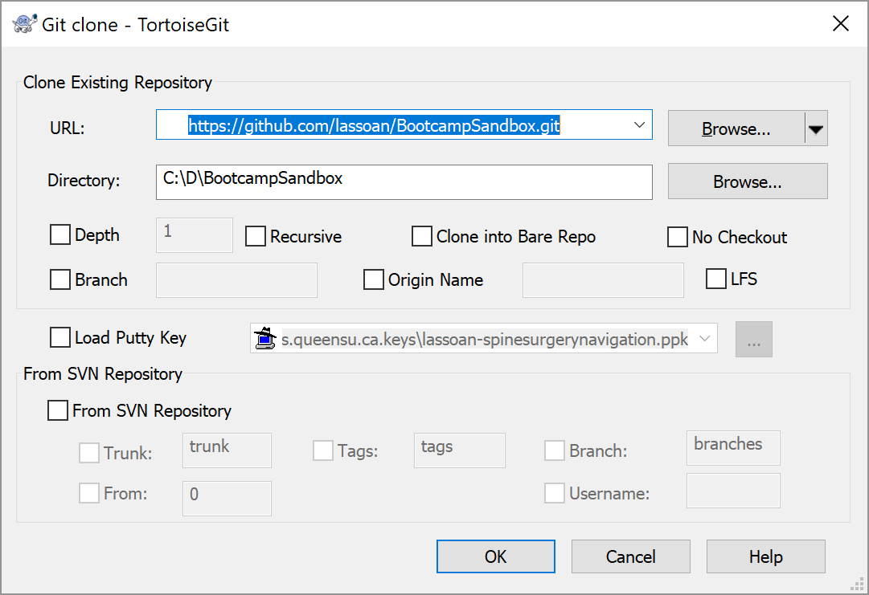
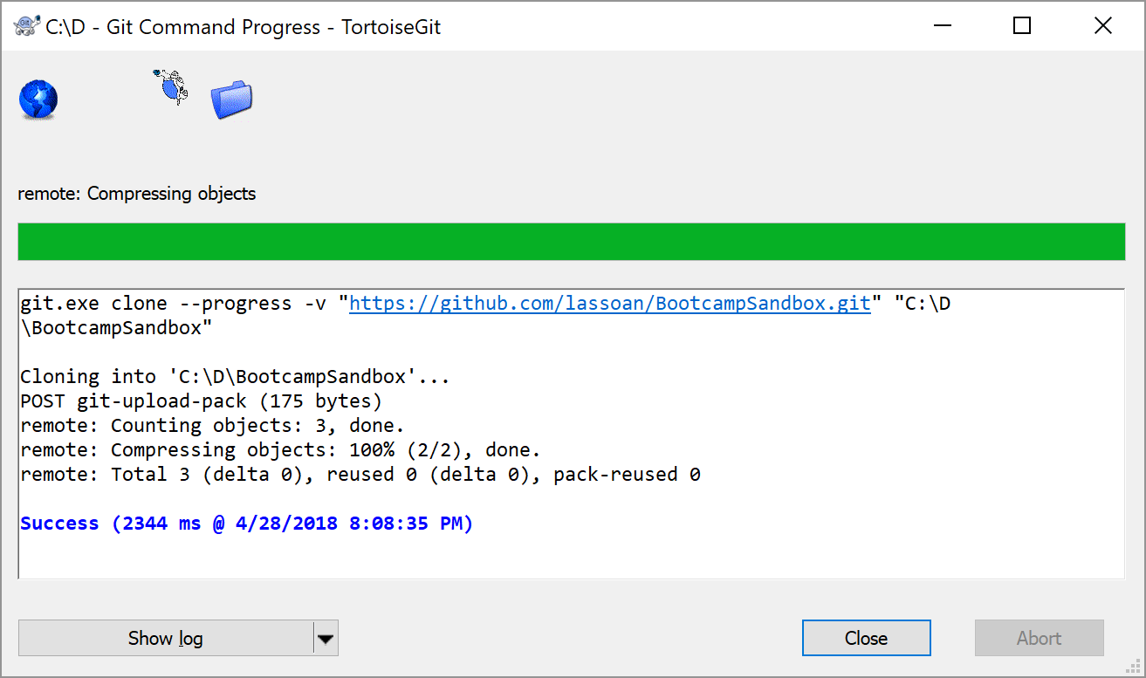
Clone: create a local copy of your repository
1
2

Slide 23
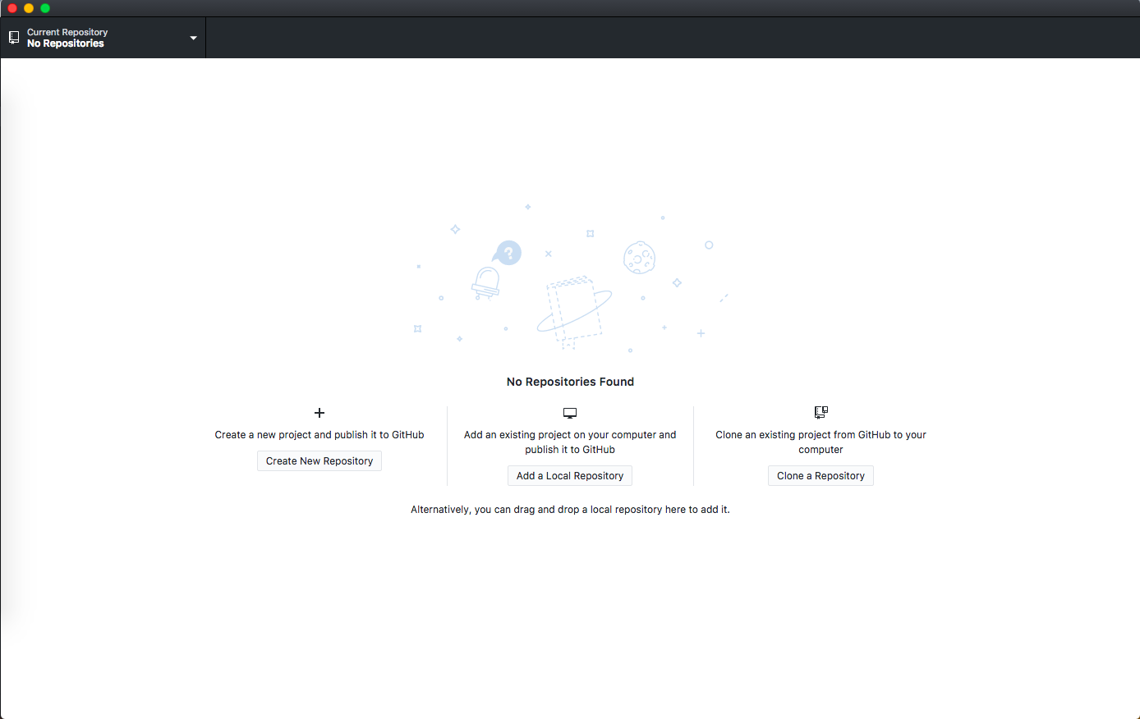
git clone (GitHub Desktop)
a.k.a. downloading a repository
Or, you can use File->Clone Repository
Press “Clone a Repository”

Slide 24
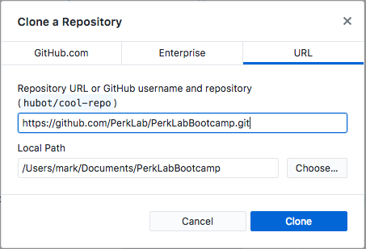
git clone (GitHub Desktop)
Input URL to clone
from
Choose where on your
PC to clone it to

Slide 25
git clone (terminal)
Use “cd” (change directory) to navigate to where you’d like to clone the repository
Run the command (changing the url for a different repository):
git clone <url> <destination>
git clone https://github.com/PerkLab/PerkLabBootcamp .
(“.” on Unix means current directory)

Slide 26
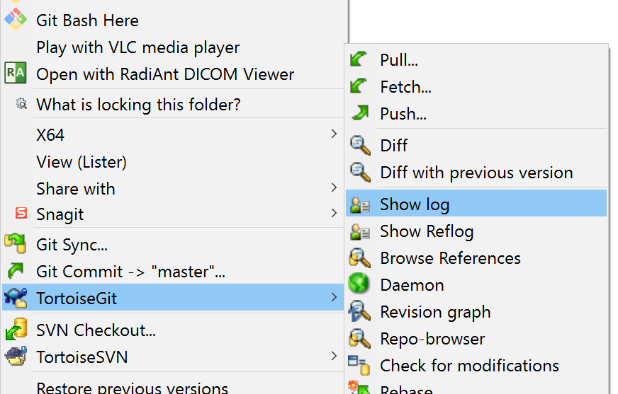
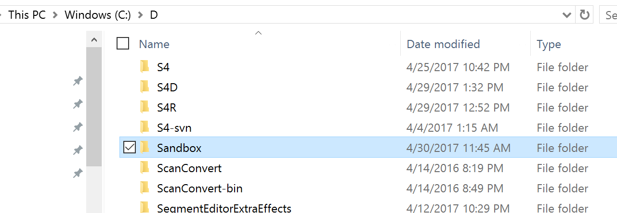
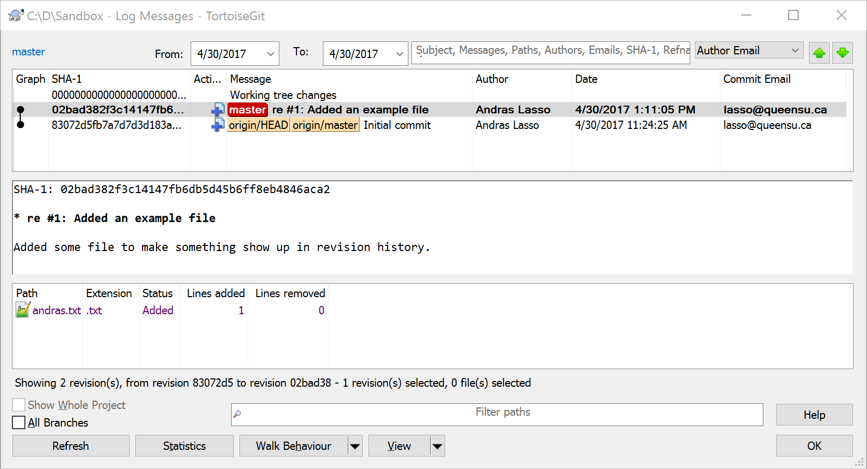
Review change history
1: right-click
3
2

Slide 27
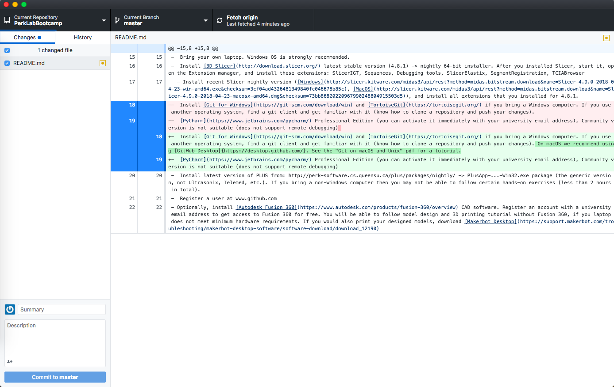
git commit (GitHub Desktop)
a.k.a “saving” your work
Changed
files,
click to
see changes.
To commit, type a commit message where it says summary,
and optionally add a description. Press “Commit to master”

Slide 28
git commit (terminal)
First we need to see our changes - use:
git diff
Now we want to stage our changes to be committed. To add everything use:
git add –A
Or, to add only specific files, use:
git add <filename>
Lastly, we do our commit
git commit –m “<commit-message-here>”

Slide 29
Pull request: get your changes merged into the official repository
Add/modify/delete files
Test your modifications (compilation is OK, no crash, etc.)
Right-click on the revision controlled directory
Click Git Commit -> “master”
Review your changes
Enter a commit message
One-line summary: re #123
describe why was modified
include the issue/ticket number to make the commit show up in the ticket comment list
Click Push to upload changes to GitHub servers to make it available to your collborators
Alice/Sandbox
GitHub servers
Push
Commit
Alice’s computer

Slide 30
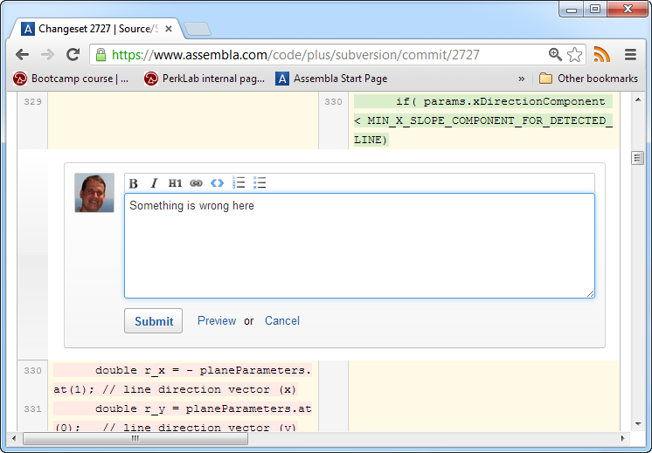
Code review
Go to the list of commits in Assembla
Click on the green [+] icon in the source code
The author will be notified

Slide 31
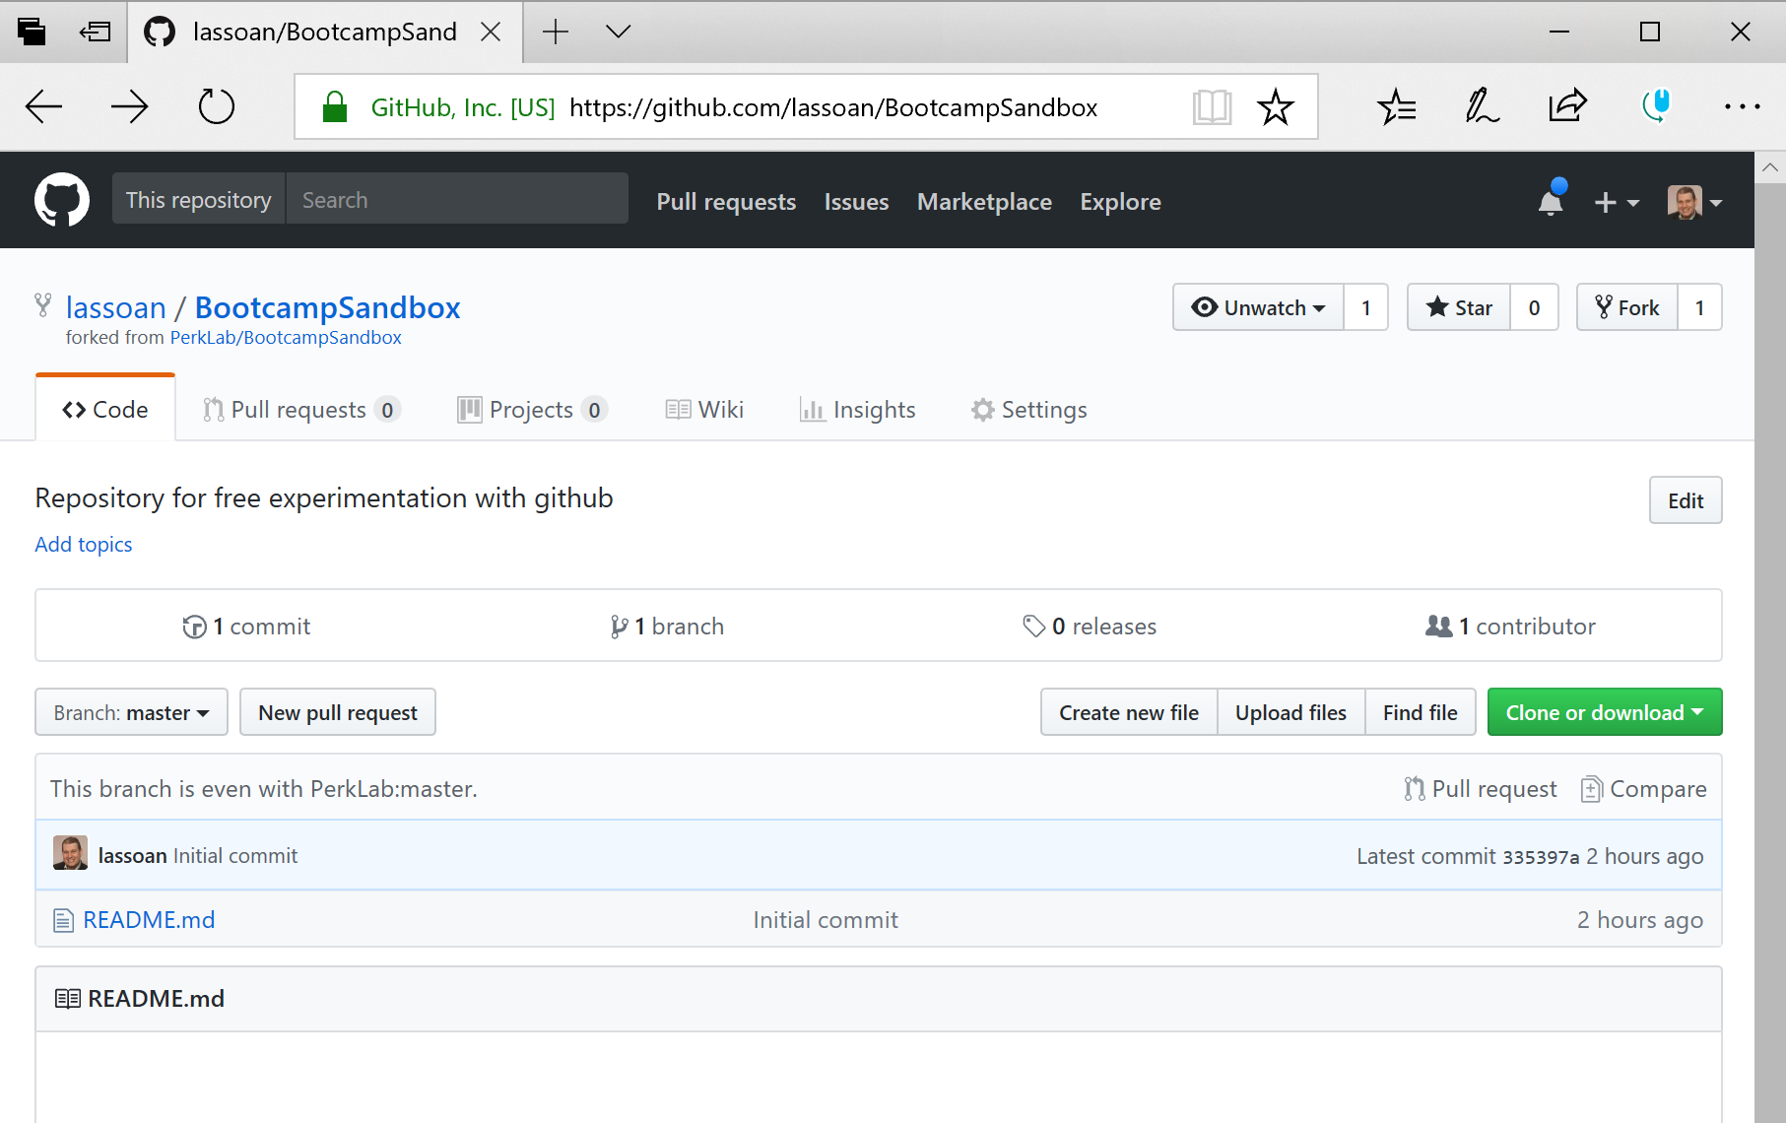
Pull request: get your changes merged into the official repository
PerkLab/BootcampSandbox
GitHub servers
Alice/Sandbox
Pull request
Open your repository page on GitHub
Click New pull request
Accept all default parameters
Provide description
Click Create pull request
Wait for the official repository maintainer to merge your changes

Slide 32
Pull: get latest changes from the official repository
PerkLabBootcamp/Sandbox
GitHub servers
Alice/Sandbox
Pull
Alice’s computer

Slide 33
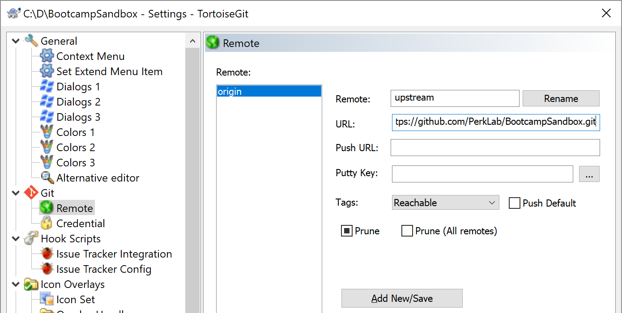
Pull: get latest changes from the official repository
Right-click on the revision controlled directory
Click TortoiseGit, click Settings…
3
2
4
1
5

Slide 34
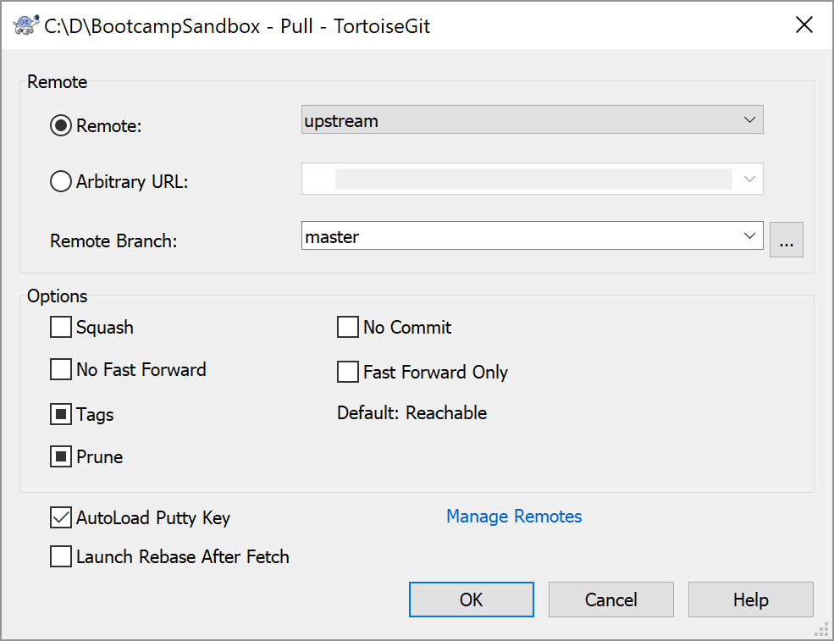
Pull: get latest changes from the official repository
Pull: Fetch and Merge changes
Right-click on the revision controlled directory
Click TortoiseGit, click Pull…
1
2

Slide 35
Recommendations
Before committing any code changes build all and run the automatic tests to make sure there are no regressions
Commit:
One fix/enhancement at a time (and not multiple independent developments in one single commit) whenever it's possible
Commit comments: Include the related issue number (this will automatically link the changeset to the ticket) and describe what did you change (in past tense) and why. Example: e.g.,. in the format: re #123: Added MyClass:MyObject method to allow doing something
After committing code changes have a look at the dashboard about half an hour later to make sure that all the automatic builds still pass. You can get an automatic notification from CDash about any errors that you introduced if you register yourself on the dashboard.
Read all notification emails about ticket updates!
If you feel that you get too many emails then set project to “Not watching” – then you only get notified about @mentions and events that directly affect you. Never just blindly ignore/delete any notification emails without reading it.

Slide 36
Summary
PerkLabBootcamp/Sandbox
GitHub servers
Alice/Sandbox
Bob/Sandbox
Fork
Pull request
Pull
Push
Clone/Pull
Alice’s computer
Bob’s computer
Commit

