Slide 1
Tutorial
on 3D Slicer python scripting and programming

Slide 2
Agenda
Part 1
Software architecture
Part 2
Use python console in Slicer
Simple scripted module example
Part 3
Write simple scripted module individually

Slide 3
Slicer application architecture
Slicer application core
Extensions
MRML scene
Module X
Module A
Module Y
Module B
…
…
Module Z
Module N
Libraries (Qt, VTK, ITK, CTK, …)
Notes:
Questions to attendees:
Who has Linux / C++ / python / Slicer / VTK / ITK / Qt experience?

Slide 4
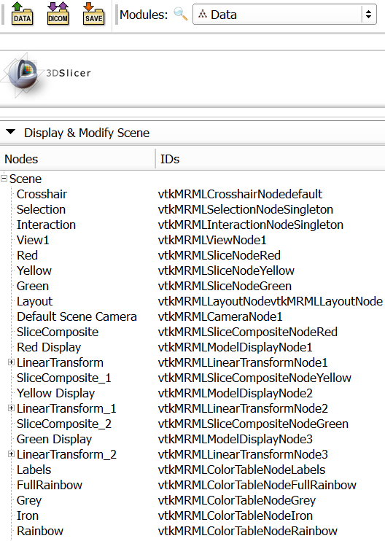
Slicer data model
Global repository for all data: MRML scene (MRML: Medical Reality Markup Language)
List of MRML nodes, each identified by a unique string ID
References, observations between nodes
Modules communicate through reading/writing MRML nodes
Modules do not need to know about each other!
Notes:
Questions to attendees:
Who has Linux / C++ / python / Slicer / VTK / ITK / Qt experience?

Slide 5
MRML node
Responsibilities:
Store data
Serialization to/from XML for file storage
No display or processing methods
Basic types:
Data node
Display node: visualization options for data node content; multiple display nodes allowed
Storage node: what format, file name to use for persistent storage of the data node content
Notes:
Questions to attendees:
Who has Linux / C++ / python / Slicer / VTK / ITK / Qt experience?

Slide 6
Scripted module implementation
Module
(MyFirst)
Widget
(MyFirstWidget)
Logic
(MyFirstLogic)
Notes:
Questions to attendees:
Who has Linux / C++ / python / Slicer / VTK / ITK / Qt experience?

Slide 7
Module class
Required. Only one global instance exists:
module = slicer.modules.volumes
Stores module name, description, icon, etc.
Creates and holds a reference to logic and widget:
Loadable modules:
widget = module.widgetRepresentation()
logic = module.logic()
Python scripted modules:
widget = module.widgetRepresentation().self()
logic = widget.logic
Notes:
Questions to attendees:
Who has Linux / C++ / python / Slicer / VTK / ITK / Qt experience?

Slide 8
Scripted module implementation
Module
Create
Create
Widget
Logic
Logic
Create (only for scripted)
Scripted module logic is not created automatically, it has to be instantiated in the Widget class.
Notes:
Questions to attendees:
Who has Linux / C++ / python / Slicer / VTK / ITK / Qt experience?

Slide 9
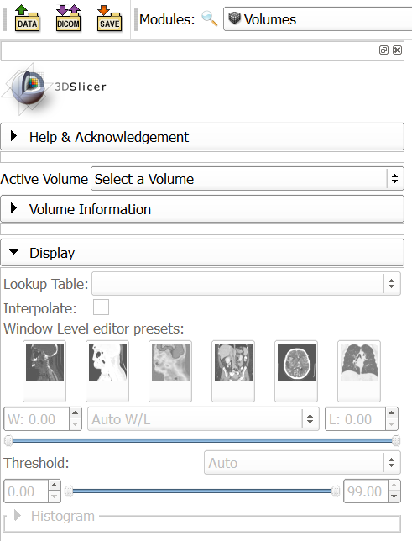
Widget class
Needed if the module has a user interface
Typically only one global instance exists
Defines the module’s user interface
Keeps user interface and nodes in sync (observes MRML nodes to get change notifications)
Launches processing methods implemented in the logic class
Notes:
Questions to attendees:
Who has Linux / C++ / python / Slicer / VTK / ITK / Qt experience?

Slide 10
Widget class
Include a parameter node selector at the top (or use a singleton parameter node)
If a parameter node is selected then add an observer to its modified events; if modified then call widget’s updateGUIFromParameterNode()
If a parameter is changed in the GUI then update MRML node
Notes:
Questions to attendees:
Who has Linux / C++ / python / Slicer / VTK / ITK / Qt experience?

Slide 11
Scripted module implementation
Module
Create
Create
Widget
Use
Logic
Notify
Observe
Modify
MRML node
Notes:
Questions to attendees:
Who has Linux / C++ / python / Slicer / VTK / ITK / Qt experience?

Slide 12
Logic class
Needed if the module does any processing (always?)
The module must be usable from another module, just by calling logic methods
Must not rely on the Widget class: the module must be usable without even having a widget class
Logic may be instantiated many times (to access utility functions inside)
Logic may observe nodes: only if real-time background processing is needed (e.g., we observe some input nodes and update other nodes if input nodes are changed)
Notes:
Questions to attendees:
Who has Linux / C++ / python / Slicer / VTK / ITK / Qt experience?

Slide 13
Scripted module implementation
Module
Create
Create
Widget
Use
Logic
X
Notify
Notify
Observe
Modify
MRML node
Modify
Notes:
Questions to attendees:
Who has Linux / C++ / python / Slicer / VTK / ITK / Qt experience?
Green area: does not depend on Qt, does not need GUI – can be used for batch processing.

Slide 14
Common mistakes 1
Module
Create
Create
Widget
Logic
Notify
Observe
Modify
MRML node
Everything is implemented in the widget, therefore the module is not usable from another module or with a custom GUI!
Notes:
Questions to attendees:
Who has Linux / C++ / python / Slicer / VTK / ITK / Qt experience?

Slide 15
Common mistakes 2
Module
Create
Create
Widget
Use
Logic
Problem: changes made to the MRML node are not reflected in the GUI!
Modify
MRML node
Modify
Notes:
Questions to attendees:
Who has Linux / C++ / python / Slicer / VTK / ITK / Qt experience?

Slide 16
Common mistakes 3
Module
Create
Create
Widget
Use
Logic
No parameter node is used. When the scene is saved and reloaded all the settings in the module user interface are lost!
Notes:
Questions to attendees:
Who has Linux / C++ / python / Slicer / VTK / ITK / Qt experience?

Slide 17
Communication between modules
X
X
Use
Module
Module
Create
Create
Use
Create
Create
Widget
Use
Logic
Widget
Use
Logic
Notify
Notify
Observe
Modify
Observe
Modify
MRML node
Modify
MRML node
Module logic may modify any MRML nodes – most common form of communication
Module logic class may use another module’s logic class
Module class may use another module class (e.g., to access module logic and pass it to its own logic)
Notes:
Questions to attendees:
Who has Linux / C++ / python / Slicer / VTK / ITK / Qt experience?

Slide 18
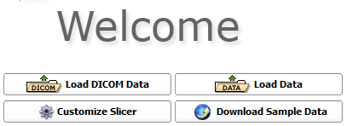

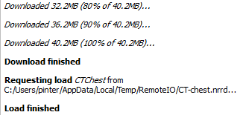
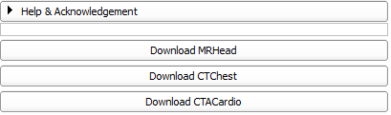
Launch Slicer and load data
Notes:
Open new terminal tab: Ctrl+Shift+T
Switching between tabs: Alt+[tab#]

Slide 19
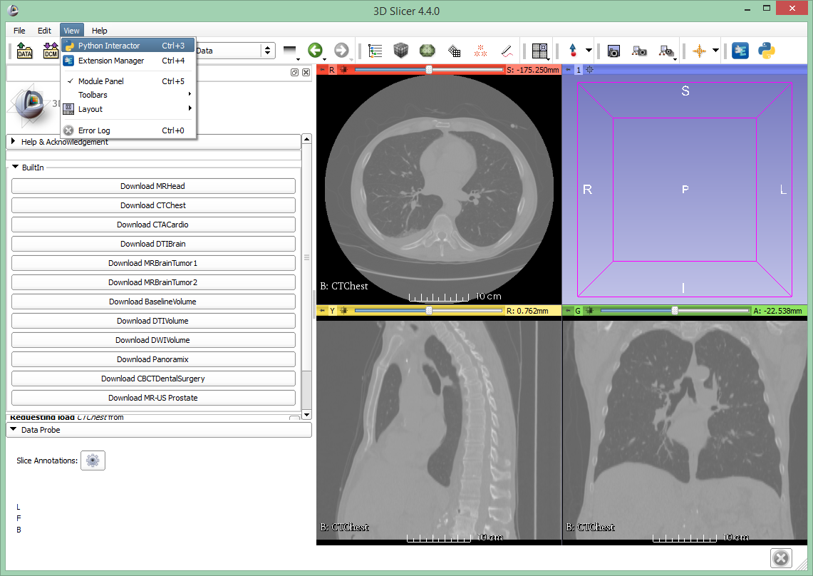
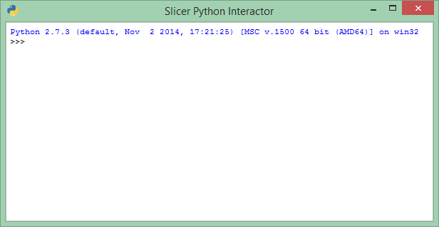
Introducing the python console

Slide 20
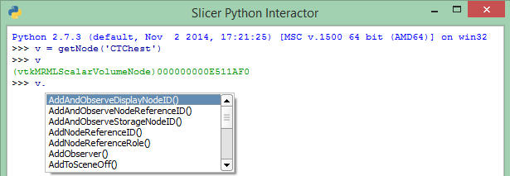
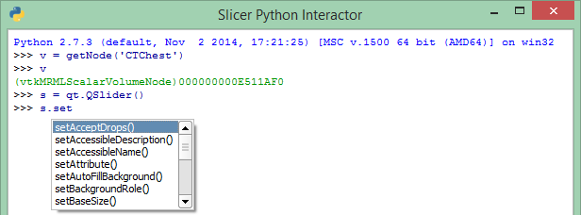
Auto-completion feature
Essential tool that provides API information
Press TAB to bring up auto-complete window to
Explore available functions of a certain object
Save typing

Slide 21
Accessing the MRML scene and nodes
Using utility functions – in slicer.util
v = getNode('CTChest')
OR
v = getNode('CT*')
getNode: somewhat ambiguous, recommended for testing & debugging only
Accessing MRML scene directly
v=slicer.mrmlScene.GetFirstNodeByName('CTChest')
OR
v=slicer.mrmlScene.GetFirstNodeByClass('vtkMRMLScalarVolumeNode')
Notes:
Press tab to get suggestions
Verify object by giving its name;

Slide 22
Information about variables
Get variable type and pointer: enter the variable name
v
(vtkMRMLScalarVolumeNode)0000008FF76243B8
Note: It’s always good to check the variable after you create it
Show node content: all members and attributes inheritance tree
print(v)
Show node API: description of all methods
help(v)
Notes:
Press tab to get suggestions
Verify object by giving its name;

Slide 23
Manipulating Volumes
Setting window/level values programmatically
vd = v.GetDisplayNode()
vd.SetAutoWindowLevel(0)
vd.SetWindowLevel(350,40)
What methods/parameters are available:
help(vd)
OR
vd
(vtkCommonCorePython.vtkMRMLScalarVolumeDisplayNode)0000021AD5436588
http://www.slicer.org/doc/html/classes.html
Notes:
Press tab to get suggestions
Verify object by giving its name
Mention similar VTK and ITK references

Slide 24
Manipulating Volumes
Accessing, changing voxels – using numpy
Get voxel value at (100,200,30) position
va = slicer.util.arrayFromVolume(v)
va[100,200,30]
-986
Thresholding
vaOriginal=va.copy()
va[va<200] = -3000
va[va>200] = 2000
slicer.util.arrayFromVolumeModified(v)
Process with arbitrary function
va[:] = vaOriginal[:]*2.5-500; v.Modified()
<= get voxels as a numpy array
<= voxel value
<= save the original voxel values
<= indicate to Slicer that updates are completed
Notes:
Press tab to get suggestions
Verify object by giving its name
Mention similar VTK and ITK references

Slide 25
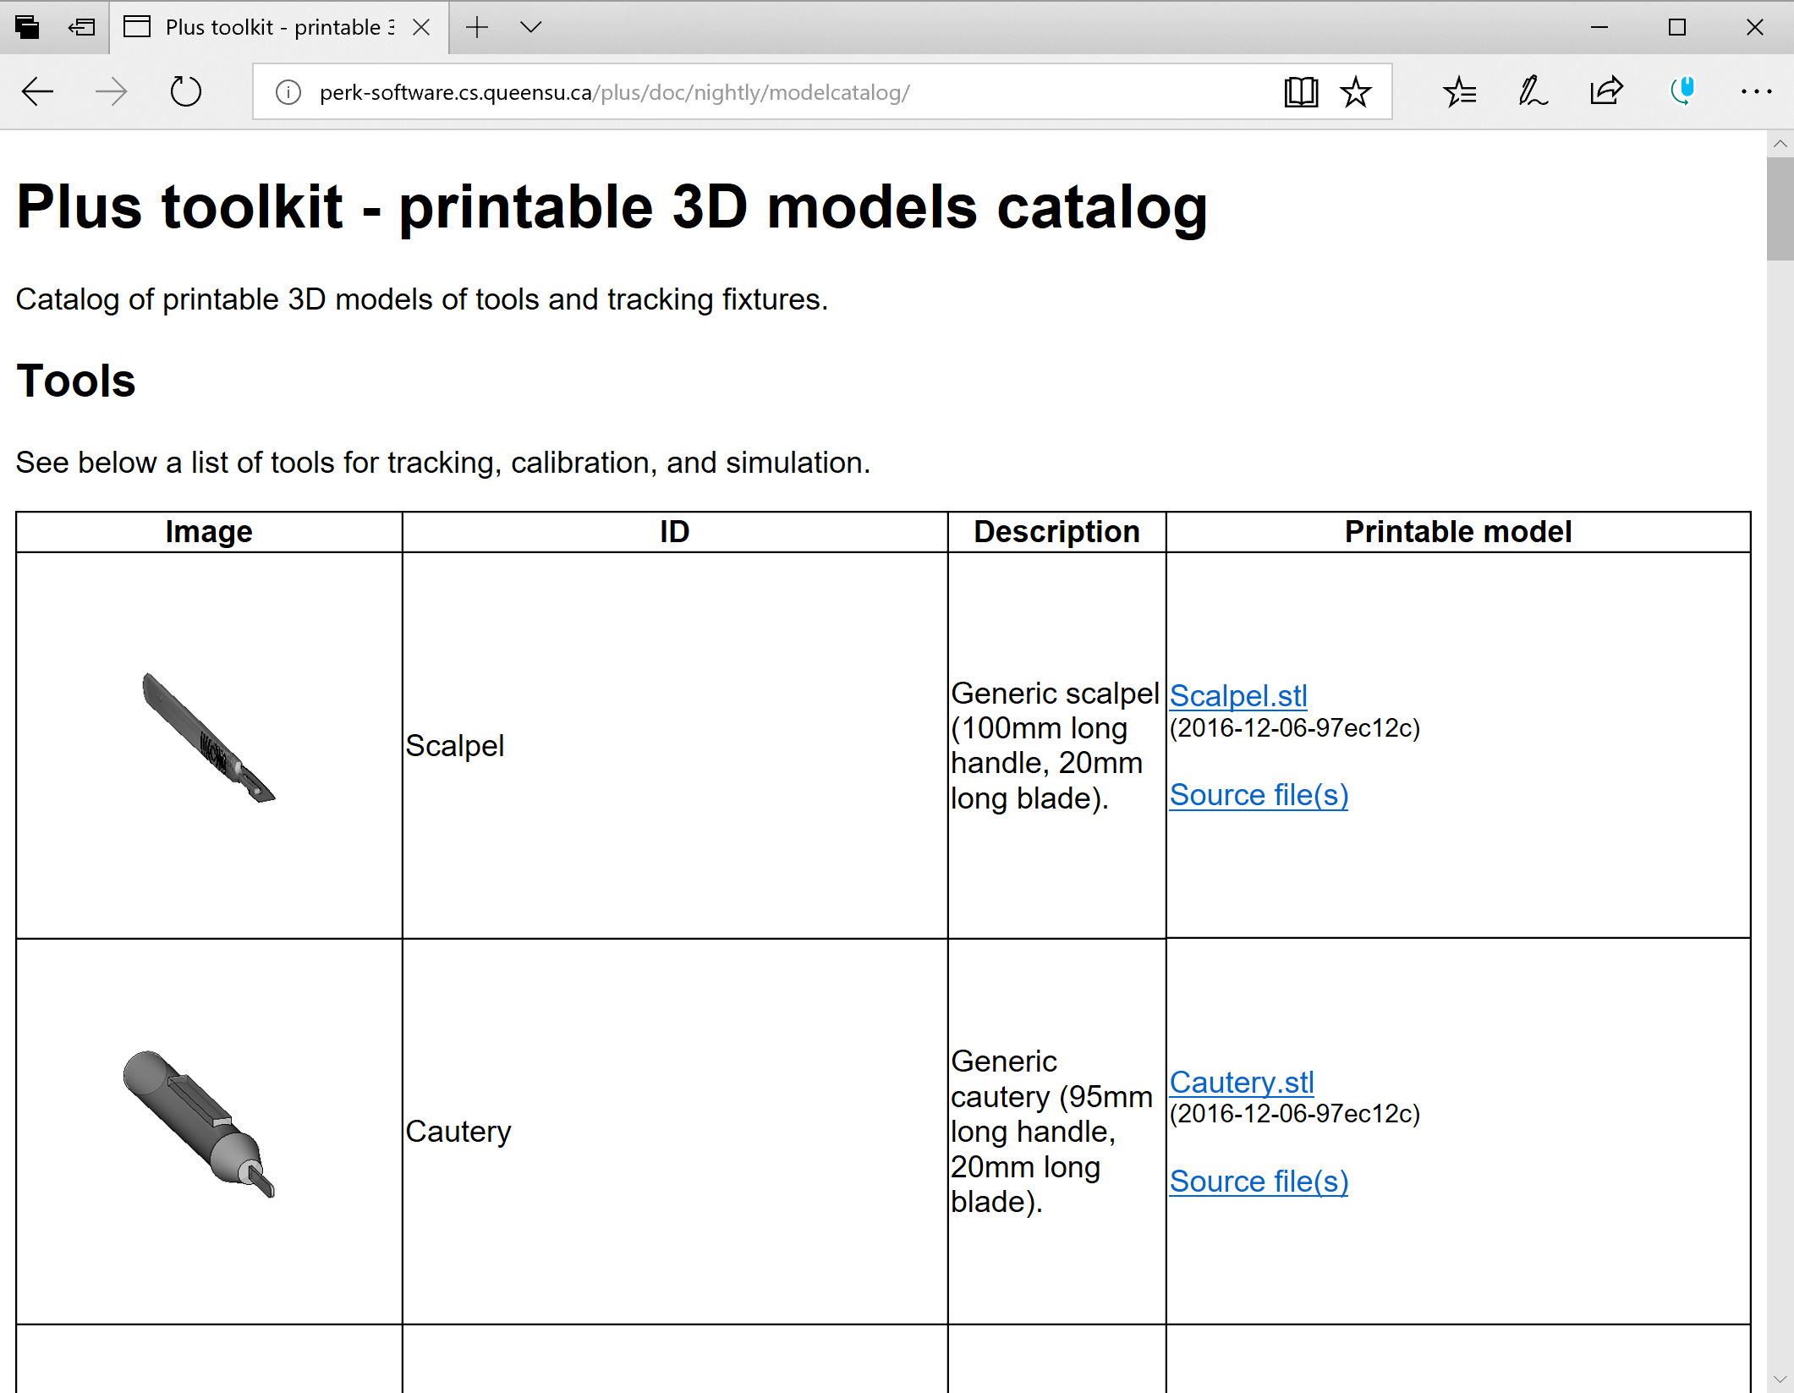
Load model
http://perk-software.cs.queensu.ca/plus/doc/nightly/modelcatalog/
Notes:
Open new terminal tab: Ctrl+Shift+T
Switching between tabs: Alt+[tab#]

Slide 26
Manipulating Models
Setting model color programmatically
c = getNode('Cautery')
cd = c.GetDisplayNode()
cd.SetColor(1,0,0)
Change model to a sphere
s = vtk.vtkSphereSource()
s.SetRadius(30)
s.SetCenter(30,40,60)
s.Update()
c.SetAndObservePolyData(s.GetOutput())
Notes:
Press tab to get suggestions
Verify object by giving its name
Mention similar VTK and ITK references

Slide 27
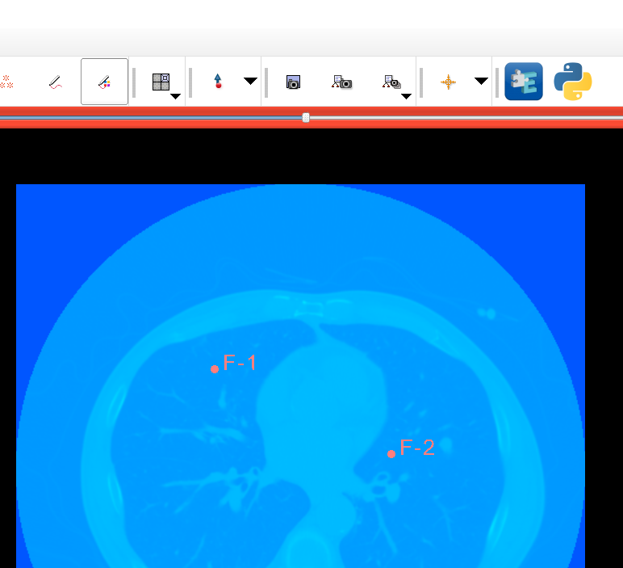
Manipulating Markups
Create 2 markup points (this creates a markup fiducial list node named ‘F’)
Get markup position
f = getNode('F')
pos=[0,0,0]
f.GetNthFiducialPosition(0,pos)
pos
[58.93727622783058, 45.58082600473318, -170.2500000000001]
1, 3
2
4
Notes:
Press tab to get suggestions
Verify object by giving its name
Mention similar VTK and ITK references

Slide 28
Observing MRML objects
def printPos(caller=None, event=None):
f = getNode('F')
pos=[0,0,0]
f.GetNthFiducialPosition(0,pos)
print(pos)
printPos()
[58.93727622783058, 45.58082600473318, -170.2500000000001]
obsTag=f.AddObserver(vtk.vtkCommand.ModifiedEvent, printPos)
[20.267904116373643, 4.977985287703447, -170.2500000000001]
[21.92516292115039, 1.6634676781499849, -170.2500000000001]
[22.477582522742637, 1.1110480765577364, -170.2500000000001]
[24.687260929111574, 0.5586284749655164, -170.2500000000001]
[26.34451973388832, 0.00620887337326792, -170.2500000000001]
f.RemoveObserver(obsTag)
These lines start with 2 spaces!
=> Drag-and-drop first fiducial
Notes:
Press tab to get suggestions
Verify object by giving its name
Mention similar VTK and ITK references

Slide 29
Part 2
Use python console in Slicer
Simple scripted module example

Slide 30
Python in general
Blocks defined by indentation: 2 spaces
Case sensitive
Comments
# This whole row is a comment
”””This is a potentially multi-line comment”””
Blocks defined by indentation
An object refers to itself as self (in C++: this)
Namespaces: slicer, ctk, vtk, qt
Blocks … indentation … spaces!

Slide 31
Text editor / IDE
Using a proper text editor is essential
Replace all, Easy comment/uncomment, indent, …
Syntax highlighting
Keyboard shortcuts
Recommended: Windows-only: Notepad++, Mac-only: Xcode Cross-platform: Atom, Sublime Text
Integrated development environment:
Text editor + debugger, code browser, …
Recommended: PyCharm, Visual Studio Code, LiClipse

Slide 32
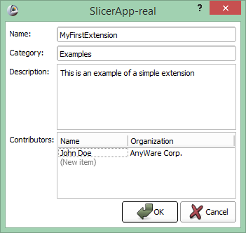
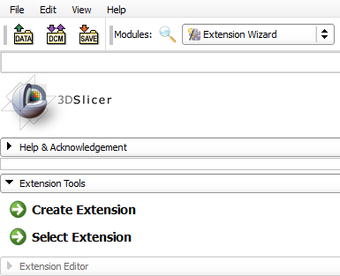
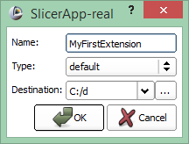
Create extension
Enter name: MyFirstExtension
Choose destination: In your Git repo!
Notes:
Questions to attendees:
Who has Linux / C++ / python / Slicer / VTK / ITK / Qt experience?

Slide 33
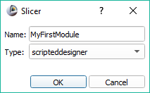
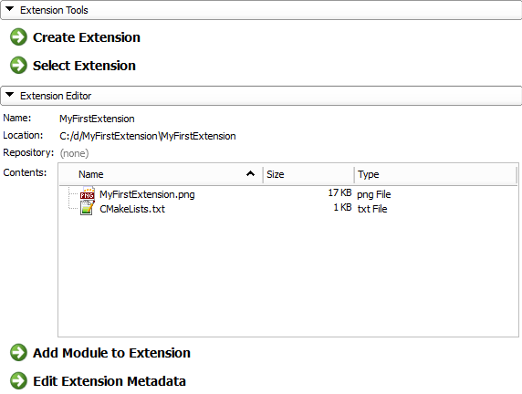
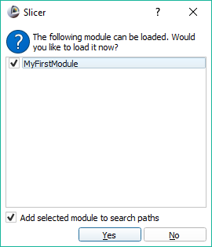
Create module
Choose “scripted” in recent Slicer-4.11 and later versions

Slide 34
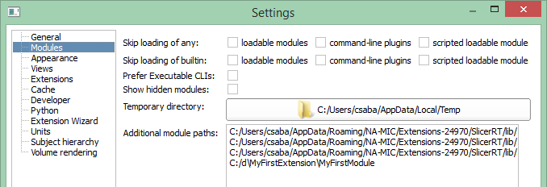
Module paths
In Application Settings
You can add by drag&drop
But you don’t need to because checking the “Add selected module to search paths” checkbox did it for you

Slide 35
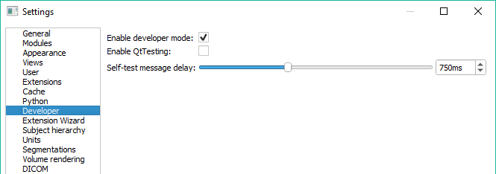
Developer mode
Enable features useful for development
Allow dynamic reload of source code etc.
In Application Settings
Restart Slicer

Slide 36
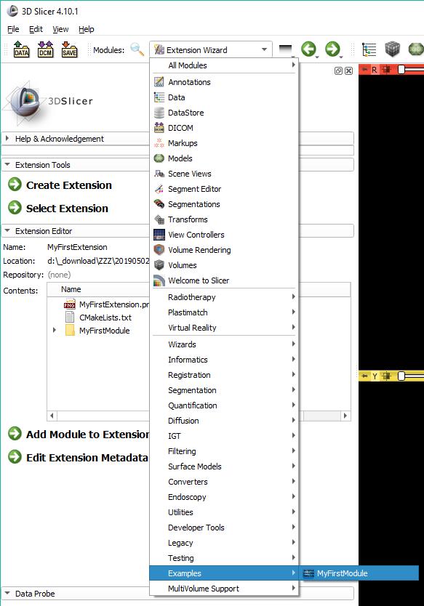
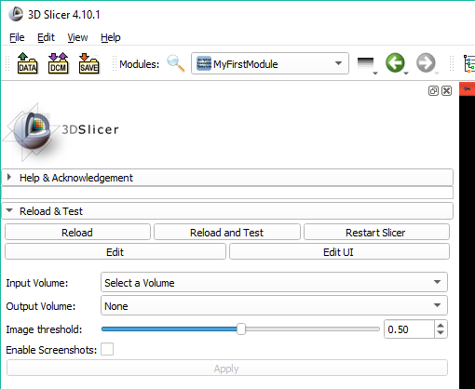
Find the new module in Slicer

Slide 37
Commit your changes regularly
Commit your changes
New files need to be added explicitly
Commit message should look like this: "Re #7: Description of why I did what I did" (do not describe what you did, it's obvious from the diff)
When you think you're done "Test #7: Description of why I did what I did"
When everybody agrees you're done "Fixed #7: Description of why I did what I did"
Pull before each commit!

Slide 38
Write our scripted module #1
Rename the module in the .py file
def __init__(self, parent):
ScriptedLoadableModule.__init__(self, parent)
self.parent.title = "Center of Mass"

Slide 39
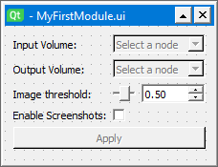

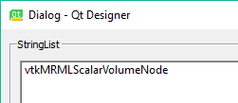

Write our scripted module #2
Customize widgets in Qt Designer:
Double-click “Input Volume” and enter “Input Markups”
Select node selector next to Input Markups, and edit nodeTypes
Double-click on “vtkMRMLScalarVolumeNode” and replace it with “vtkMRMLMarkupsFiducialNode”
Turn off “selectNodeUponCreation”
Don’t forget to save the .ui file in Qt Designer

Slide 40

Write our scripted module #3
Look for class MyFirstModuleLogic
Insert this code above the Run function
Click the Reload button to see the changes (remember to save the files first)
def getCenterOfMass(self, markupsNode):
centerOfMass = [0,0,0]
import numpy as np
sumPos = np.zeros(3)
for i in range(markupsNode.GetNumberOfMarkups()):
pos = np.zeros(3)
markupsNode.GetNthFiducialPosition(i,pos)
sumPos += pos
centerOfMass = sumPos / markupsNode.GetNumberOfMarkups()
logging.info('Center of mass for \'' + markupsNode.GetName() + '\': ' + repr(centerOfMass))
return centerOfMass
Notes:
Take extra care of the indentation! 2 spaces before the whole thing and 2 spaces before each sub-block

Slide 41
Write our scripted module #4
Change the Run function to look like this:
def run(self, inputMarkups, outputVolume, imageThreshold, enableScreenshots=0):
"""
Run the actual algorithm
"""
self.centerOfMass = self.getCenterOfMass(inputMarkups)
return True

Slide 42
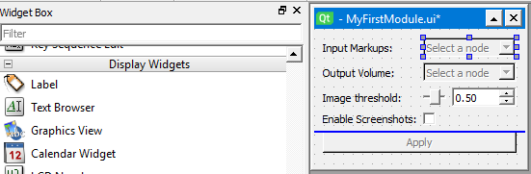

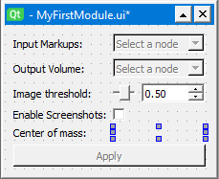
Write our scripted module #5
Drag&drop a Label in the module widget above the Apply button
Double-click the label and enter “Center of mass:”
Drag&drop a second one in the right column, make it empty
Rename the object to centerOfMassValueLabel
It should look like this:

Slide 43
Write our scripted module #6
Validating button state and displaying the output into MyFirstModuleWidget – replace these functions:
Pay attention to correct indentation!
def onSelect(self):
self.ui.applyButton.enabled = self.ui.inputSelector.currentNode()
def onApplyButton(self):
logic = MyFirstModuleLogic()
enableScreenshotsFlag = self.ui.enableScreenshotsFlagCheckBox.checked
imageThreshold = self.ui.imageThresholdSliderWidget.value
logic.run(self.ui.inputSelector.currentNode(), self.ui.outputSelector.currentNode(), imageThreshold, enableScreenshotsFlag)
self.ui.centerOfMassValueLabel.text = str(logic.centerOfMass)

Slide 44
Try our scripted module
Go to our module in Examples / Center of Mass
Add a few markups
Press Apply
1. Display displacement center of mass position → works!
2. Displays nothing → error can be seen in the Python interactor

Slide 45

Add auto-update
Repurpose the checkbox:
Change checkbox text to “Enable auto-update”:
Add this in the setup function to the bottom of the connections section:
self.observedMarkupNode = None
self.markupsObserverTag = None
self.ui.enableScreenshotsFlagCheckBox.connect("toggled(bool)", self.onEnableAutoUpdate)
Respond to modification events: add these above onApplyButton()
def onEnableAutoUpdate(self, autoUpdate):
if self.markupsObserverTag:
self.observedMarkupNode.RemoveObserver(self.markupsObserverTag)
self.observedMarkupNode = None
self.markupsObserverTag = None
if autoUpdate and self.ui.inputSelector.currentNode:
self.observedMarkupNode = self.ui.inputSelector.currentNode()
self.markupsObserverTag = self.observedMarkupNode.AddObserver(
vtk.vtkCommand.ModifiedEvent, self.onMarkupsUpdated)
def onMarkupsUpdated(self, caller=None, event=None):
self.onApplyButton()

Slide 46
Part 3
Write simple scripted module (somewhat) independently

Slide 47
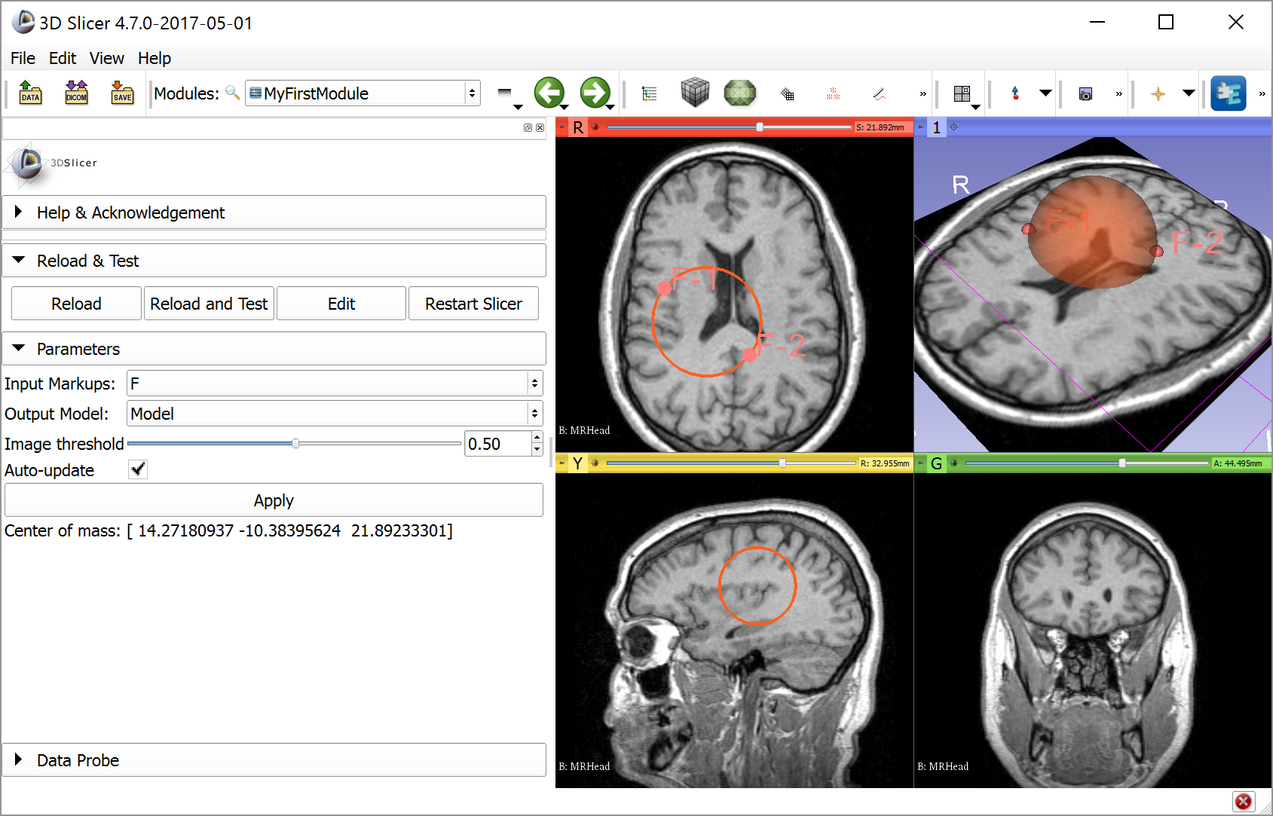
Task description
Goal: Position a sphere-shaped model with two markup points

Slide 48
API documentation
Generic computing and GUI libraries
Toolkit | API documentation
Python | https://docs.python.org/2/index.html
Numpy | http://docs.scipy.org/doc/numpy/reference
VTK | http://www.vtk.org/doc/release/7.1/html/classes.html
SimpleITK | http://www.itk.org/SimpleITKDoxygen/html/classes.html
Qt | http://doc.qt.io/qt-5.10/classes.html
Slicer-specific libraries
Toolkit | API documentation
Slicer core | C++: http://www.slicer.org/doc/html/classes.html Python: http://mwoehlke-kitware.github.io/Slicer/Base/slicer.html For up-to-date docs, type this into Python console: help(slicer.util)
CTK | http://www.commontk.org/docs/html/classes.html
Notes:
Questions to attendees:
Who has Linux / C++ / python / Slicer / VTK / ITK / Qt experience?

Slide 49
Where to find examples
Slicer core: https://github.com/Slicer/Slicer
Extensions:
Index of extensions (see repository in *.s4ext): https://github.com/Slicer/ExtensionsIndex
SlicerIGT: https://github.com/SlicerIGT/SlicerIGT/
SlicerRT: https://app.assembla.com/spaces/slicerrt/subversion/source/HEAD/trunk
Notes:
Questions to attendees:
Who has Linux / C++ / python / Slicer / VTK / ITK / Qt experience?

Slide 50
Hints
To be able to show a model node, create display node:
outputModel.CreateDefaultDisplayNodes()
To show model intersections with a 2D slice viewer: outputModel.GetDisplayNode().SetSliceIntersectionVisibility(True)
Remember that all the logic is implemented in the run function in the logic class, which is called in the onApplyButton function

Slide 51

Congratulations!
Thanks for attending!

Slide 52
Appendix

Slide 53
Transforms
Slicer world coordinate system: RAS (right-anterior-superior)
Get linear transform from the node to RAS:
nodeToRas = vtk.vtkMatrix4x4()
if node.GetTransformNodeID():
nodeToRasNode = slicer.mrmlScene.GetNodeByID(node.GetTransformNodeID())
nodeToRasNode.GetMatrixTransformToWorld(nodeToRas)
Transform may be non-linear
At least log an error if transform is present but it is ignored
Notes:
Questions to attendees:
Who has Linux / C++ / python / Slicer / VTK / ITK / Qt experience?

Slide 54
Node references
Always use this whenever a node relies on data stored in other nodes
Specified by role name, referenced node ID, index (multiple references with the same role is allowed)
Saved/restored with the scene
Not trivial: When importing a scene and a node ID is already found in the current scene, the imported node ID is automatically renamed and all references are updated
Scene
ModelNode1
ModelDisplayNode1
ModelDisplayNode2
ModelStorageNode1
VolumeNode1
VolumeDisplayNode1
VolumeStorageNode1
Notes:
Questions to attendees:
Who has Linux / C++ / python / Slicer / VTK / ITK / Qt experience?

Slide 55
GUI design
Qt designer can be used
Generated UI file can be loaded to create module GUI: http://www.slicer.org/slicerWiki/index.php/Documentation/Nightly/Developers/Tutorials/PythonAndUIFile
Notes:
Questions to attendees:
Who has Linux / C++ / python / Slicer / VTK / ITK / Qt experience?

Slide 56






Overview of API’s accessible from python
Notes:
Questions to attendees:
Who has Linux / C++ / python / Slicer / VTK / ITK / Qt experience?

Slide 57
Qt
Main page: http://www.qt.io
Slicer uses version 4.8.6
Features
User interface
Run-time control (signal-slot mechanism)
Class list (bible) http://doc.qt.io/qt-4.8/classes.html Qt Assistant (desktop application)
Notes:
Questions to attendees:
Who has Linux / C++ / python / Slicer / VTK / ITK / Qt experience?

Slide 58
VTK Visualization Toolkit (by Kitware)
Main page: http://www.vtk.org
Slicer uses version 6.3.0
Features
Visualization
Data handling
Simple image processing functions
Class list (your bible when you use the API) http://www.vtk.org/doc/release/6.3/html/classes.html
Notes:
Questions to attendees:
Who has Linux / C++ / python / Slicer / VTK / ITK / Qt experience?

Slide 59
ITK / SimpleITK Insight Toolkit (by Kitware)
Main page: http://www.itk.org, http://www.simpleitk.org
Slicer uses version 4.10.0
Features: Complex image processing functions for segmentation, registration, etc.
Class list (bible) for SimpleITK: http://www.itk.org/SimpleITKDoxygen/html/classes.html
Tutorial: http://www.na-mic.org/Wiki/images/a/a7/ SimpleITK_with_Slicer_HansJohnson.pdf
Notes:
Questions to attendees:
Who has Linux / C++ / python / Slicer / VTK / ITK / Qt experience?

Slide 60
CTK Common Toolkit
Main page: http://www.commontk.org
No releases, Slicer uses trunk
Features
User interface elements used in medical imaging
DICOM interface
Class list (bible): http://www.commontk.org/docs/html/classes.html
Notes:
Questions to attendees:
Who has Linux / C++ / python / Slicer / VTK / ITK / Qt experience?

Slide 61
NumPy
Main page: http://www.numpy.org
Slicer uses version 1.9.2
Features: fundamental package for scientific computing with Python (arrays, lin. alg., Fourier, etc.)
Reference (bible): http://docs.scipy.org/doc/numpy/reference
Notes:
Questions to attendees:
Who has Linux / C++ / python / Slicer / VTK / ITK / Qt experience?

Slide 62
MRML (Slicer API)
Features: Slicer data management and processing pipeline
Slicer developers manual: http://www.slicer.org/slicerWiki/index.php/Documentation/Nightly/Developers
Class list (bible): http://www.slicer.org/doc/html/classes.html
Notes:
Questions to attendees:
Who has Linux / C++ / python / Slicer / VTK / ITK / Qt experience?

