Slide 1
Ultrasound image processing with deep learning
Introduction

Slide 2
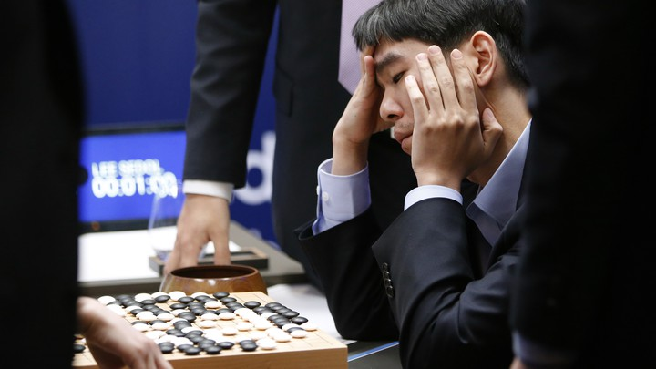
World’s best Go player, Lee Sedol reviews the match after finishing against Google’s AlphaGo (2016)

Slide 3

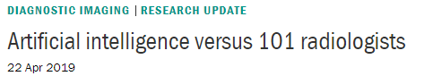
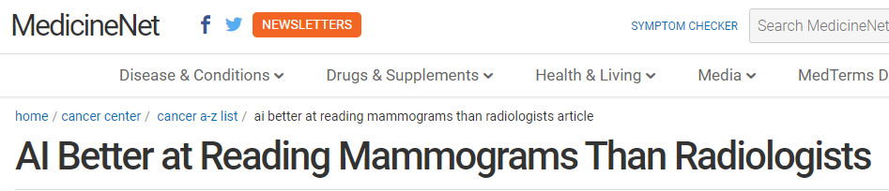
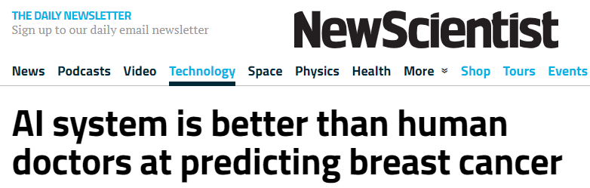
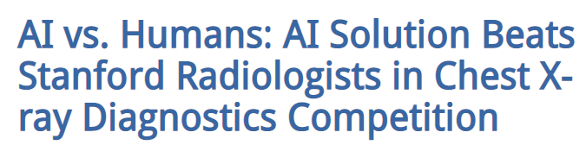

Slide 4
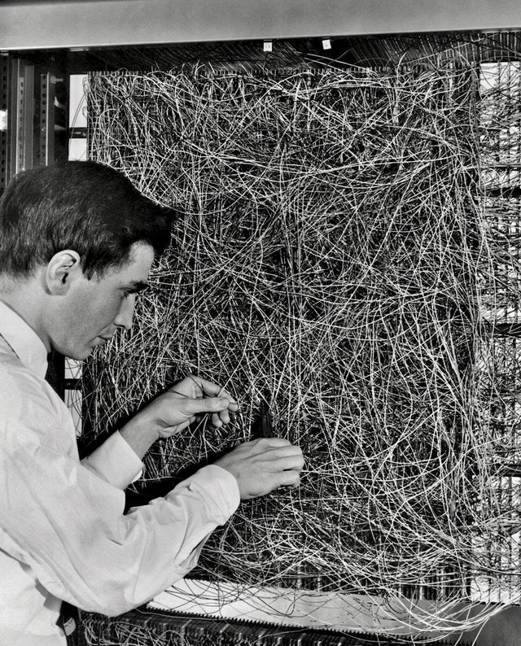
How did we get here?
1890’s integrative action of neurons
1944 McCullough and Pitts, NN
1970 Seppo Linnainmaa, reverse differentiation program
1998 LeCun et al., LeNet (MNIST)
2012 Krizhevsky et al., AlexNet
2014 Goodfellow et al., GANs
He et al., ResNet surpassed human performance
2018 Y. LeCun, G. Hinton, Y. Bengio, Turing Award
Frank Rosenblatt with a Mark I Perceptron computer in 1960

Slide 5
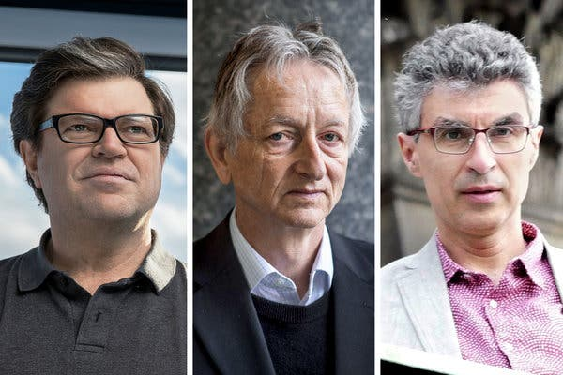
Yann LeCun
Geoffrey Hinton
Yoshua Bengio
2018 Turing Award for conceptual and engineering breakthroughs that have made deep neural networks a critical component of computing

Slide 6
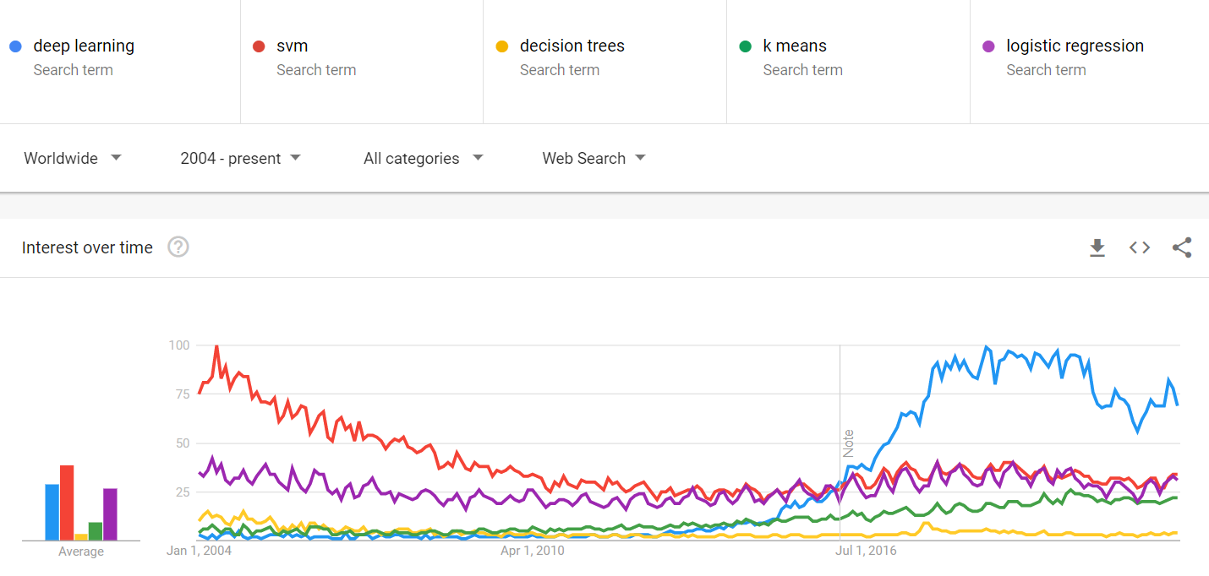
Google trends

Slide 7
Classification
Saturation
0: bad, 1: good
94
1
88
0

Slide 8
Classification
Saturation
0: bad, 1: good
94
1
88
0
Blood pressure
0: bad, 1: good
Tensor: n-dimensional matrix
145
92
0
132
88
1

Slide 9
Classification
Image pixels
0: healthy, 1: cancer
Saturation
0: bad, 1: good
145
92
110
92
94
1
211
80
46
14
0
145
41
89
9
88
0
145
85
27
15
Blood pressure
0: bad, 1: good
131
23
73
89
199
80
46
14
145
92
0
1
117
41
54
10
132
88
1
99
85
45
65

Slide 10
Classification - segmentation
Image pixels
0: healthy, 1: cancer
145
92
110
92
0
0
0
0
211
80
46
14
0
0
0
0
145
41
89
9
0
0
0
0
145
85
27
15
0
0
0
0
131
23
73
89
0
0
0
0
199
80
46
14
0
1
0
0
117
41
54
10
1
1
0
0
99
85
45
65
1
0
0
0

Slide 11
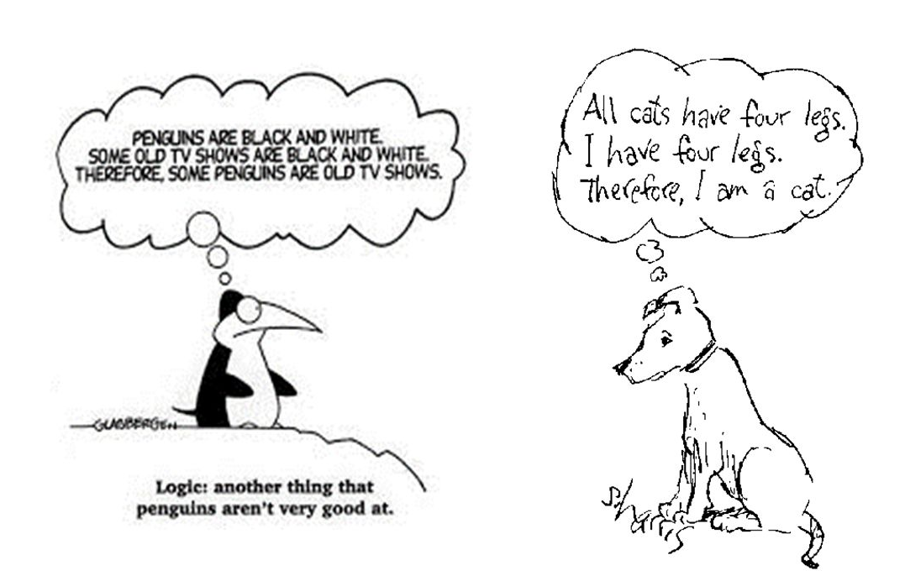
Machine learning is the science of generalization

Slide 12
Very short introduction to how deep convolutional neural networks work
Sources:
https://ujjwalkarn.me/2016/08/11/intuitive-explanation-convnets/
http://cs231n.github.io/convolutional-networks/

Slide 13
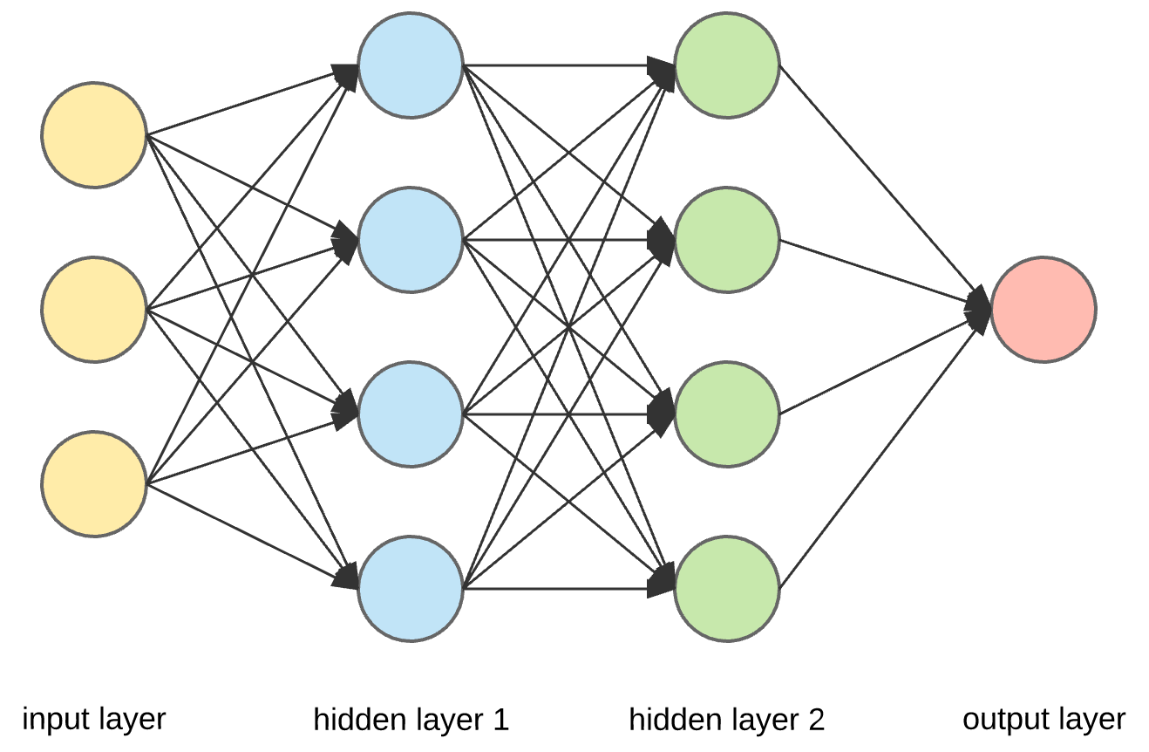
?
?
...

Slide 14
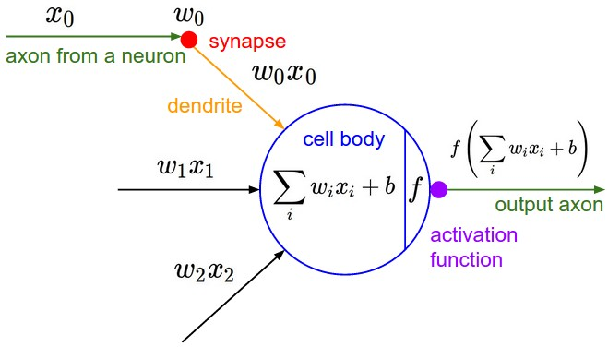
Activation function (non-linear)

Slide 15
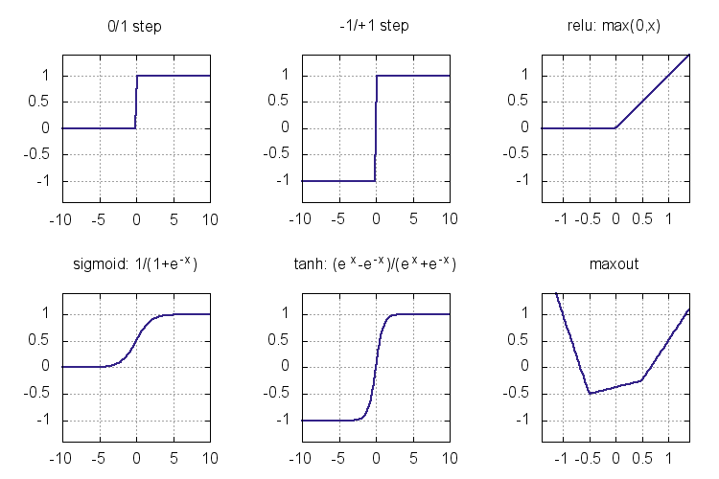
Winner!

Slide 16
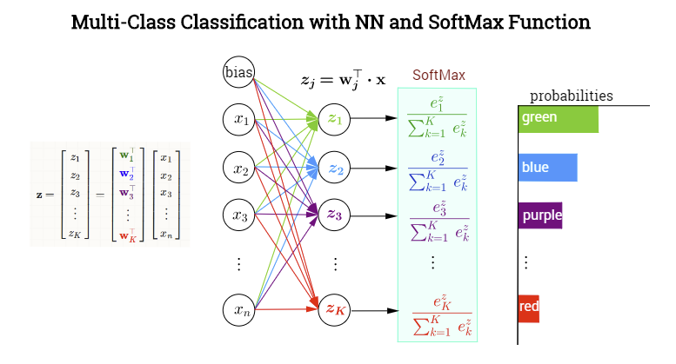
Σ = 1

Slide 17
multiply activation with weights
sum, and apply activation function
repeat for every neuron in every layer
0.024
0.004
Blood pressure
0.024
Does this patient need medication?
96
0.184
0.098
0.014
0.184
0.016
0.012
0.016
0.034
0.016
0.412
Heart rate
0.072
0.412
70
0.002
0.21
0.062
0.002
0.098
0.063
0.062
0.062
0.24
0.093
0.24
0.093
0.24
Age
35
0.064
0.184
0.074
0.074
0.01
0.018
0.011

Slide 18
multiply activation with weights
sum, and apply activation function
repeat for every neuron in every layer
0.024
0.004
pixel 1
0.024
Does this image show tumor?
96
0.184
0.098
0.014
0.184
0.016
0.012
0.016
0.034
0.016
0.412
pixel 2
0.072
0.412
70
0.002
0.21
0.062
0.002
0.098
0.063
0.062
0.062
0.24
0.093
0.24
0.093
0.24
pixel 3
35
0.064
0.184
0.074
0.074
0.01
0.018
0.011

Slide 19
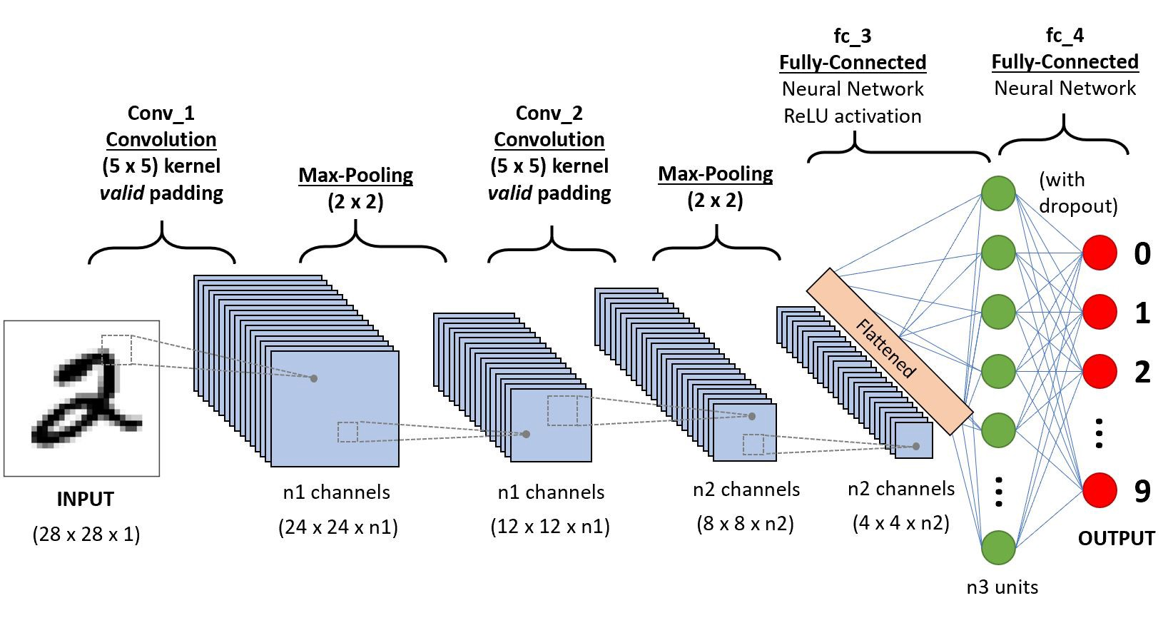
Convolutional Neural Network
https://towardsdatascience.com/

Slide 20
Training neural networks
Compute predictions on a batch of inputs
(and record gradients)
response
4.
Repeat until close enough
2. Compare to truth
3. Update weights to get closer to truth (using recorded gradients)

Slide 21
Gradient descent optimizer
Loss function: a single value that is lower for better output
Image source: firsttimeprogrammer.blogspot.co.uk

Slide 22
Real life optimizer
Never done with a single training data sample
Gradients of w_{i} are averaged on a batch of training data
Batch size is a training hyperparameter that can be optimized (e.g. 32 or 128)
Gradients of w_{i} are damped by step size
Step size is another training hyperparameter that can be optimized (e.g. 0.01). Step size is usually large in the beginning, and decays near the end of training
Using all training data by the optimizer is one epoch. Training requires usually hundreds of epochs.

Slide 23
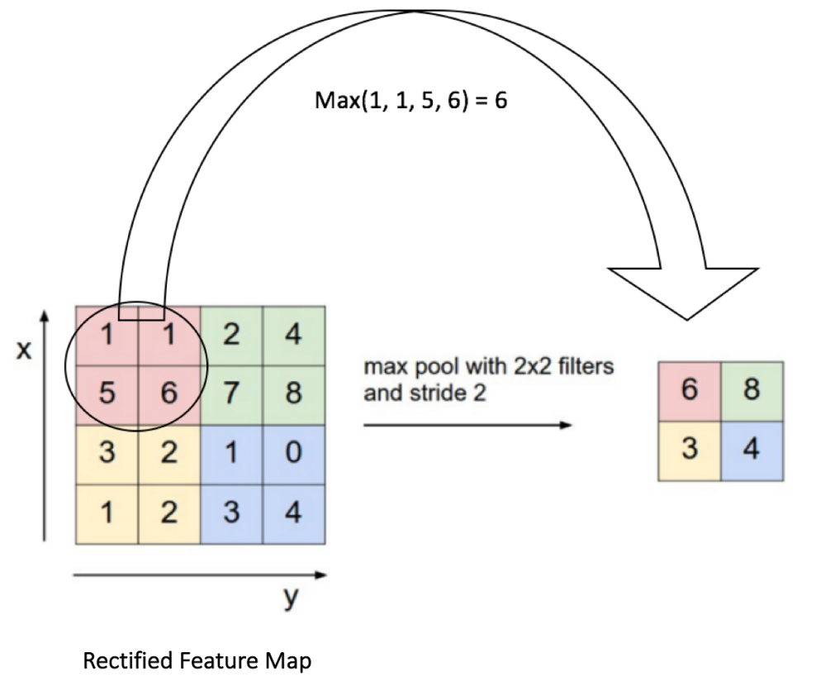
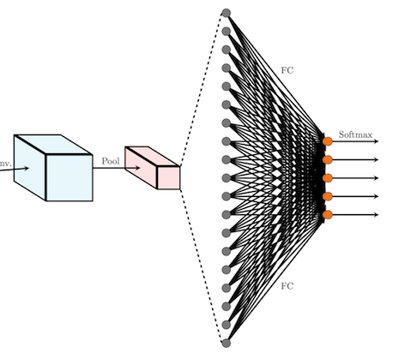
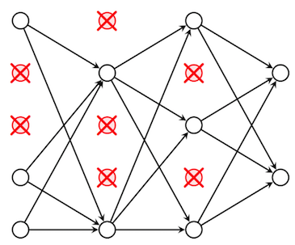
Common network layers
Conv2D, Conv3D
Max pooling
Dropout
Flatten
Dense

Slide 24
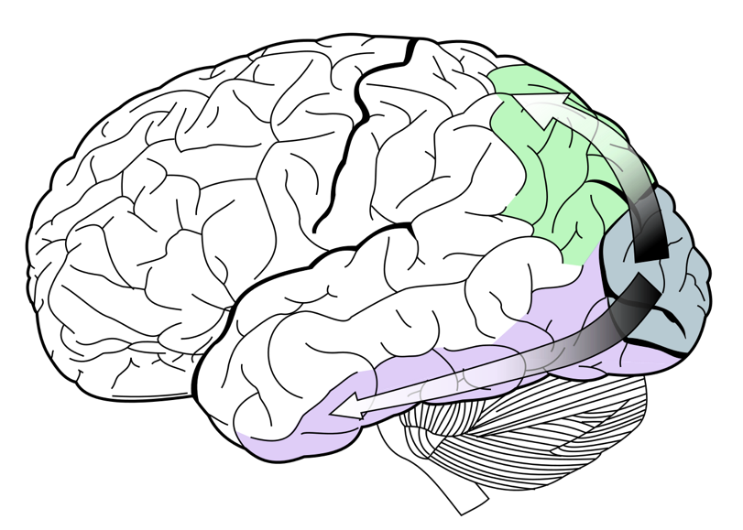
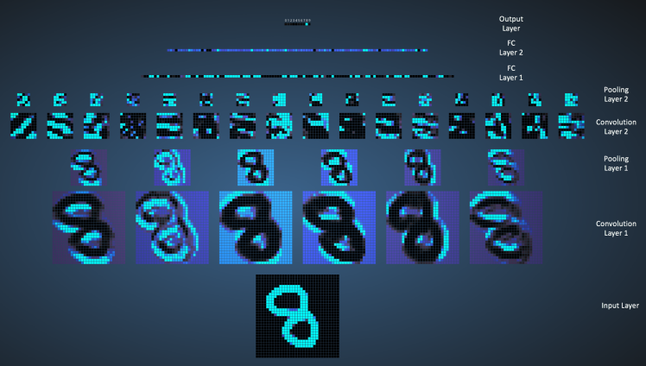
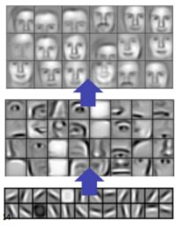
Features at different depths
Maximum excitation of neurons in a face-detector model
http://scs.ryerson.ca/~aharley/vis/conv/
https://poloclub.github.io/cnn-explainer/

Slide 25

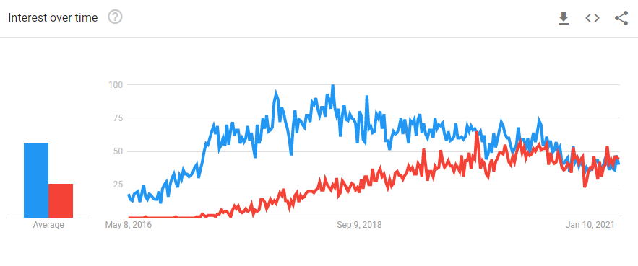
Platforms

Slide 26
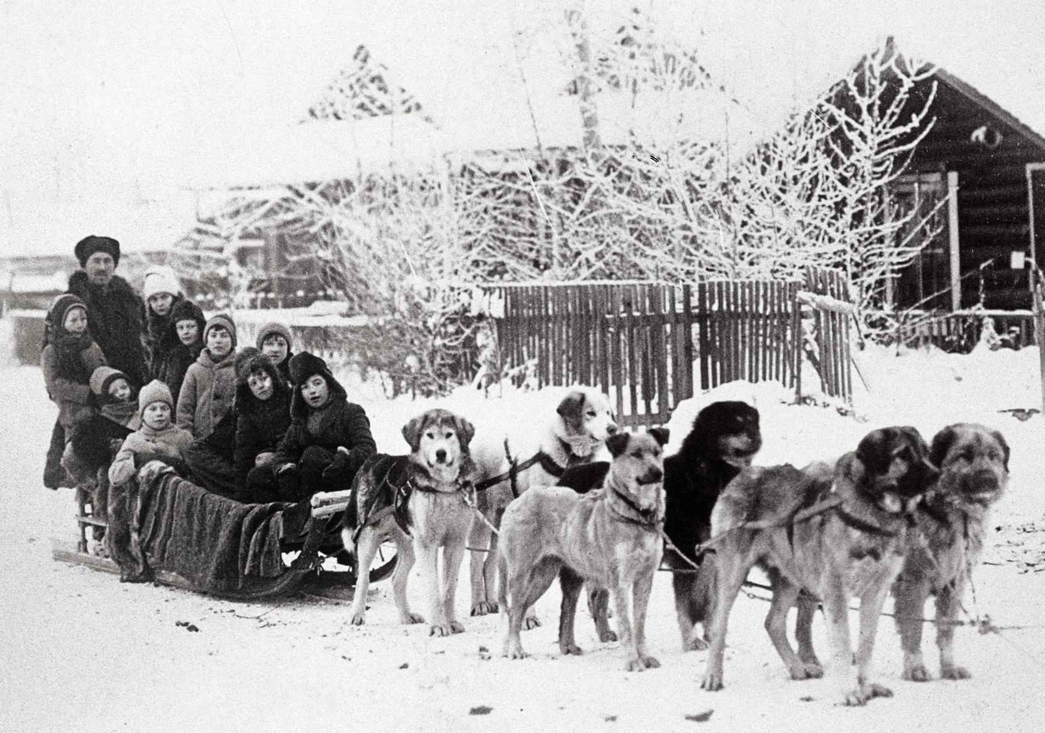
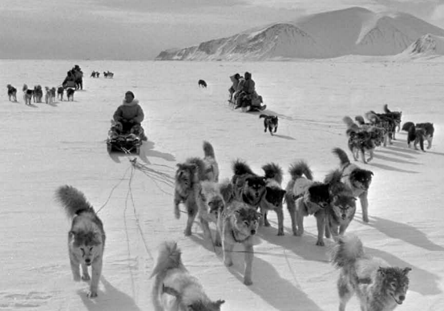
Project code organization
User friendly
Difficult to change parts
Faster workflow
Easy to automate
Developer friendly
Easy to change parts
Slower workflow
Difficult to automate

Slide 27
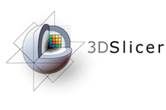


Workflow
Live data
PLUS
Python
Girder
Live data
Training data
Sequences
OpenIGTLink
Exporter
script
Annotations
Live data
Python
Model
ML
Model
Live output
Slicer solutions

Slide 28
What an AI scientist actually does...
Security
Data import and cleaning
Storage
Training scheduling
UI
Parameter optimization
Data annotation
Visualization
Machine learning
Logging and monitoring

Slide 29
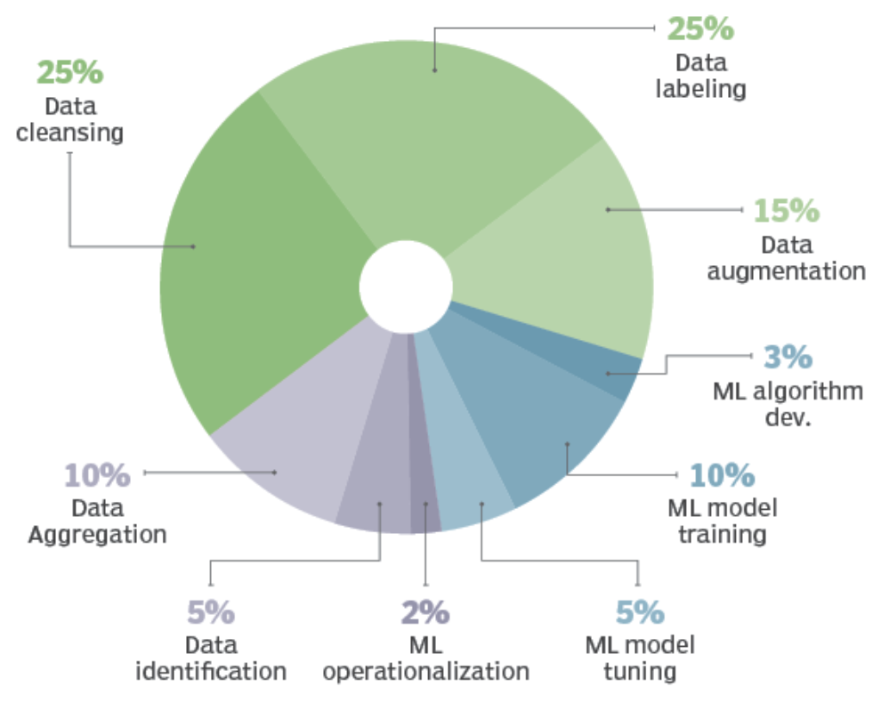
Time allocated to DL project tasks
(source: Cognilytica report March 2019)

Slide 30
Some resources for learning CNNs
Good introduction: Stanford CS231n http://cs231n.stanford.edu/
Comprehensive course by Andrew Ng: https://www.deeplearning.ai/
Fun hands-on tutorials (lots of OpenCV): https://www.pyimagesearch.com/
Several YouTube channels, e.g. 3blue1brown, deeplizard, Siraj Raval, deeplearning.ai, MIT OpenCourseWare

