Slide 1
Unlocking medical image files
Andras Lasso

Slide 2
Motivation
How can I read this file that I received from a clinical collaborator?
What format should I choose to store my images?
How can I save this image in X format?
How can I modify this file (to anonymize, inject modified/processed data to other software)?

Slide 3
Medical image file formats
Standard, commercially used
DICOM
Standard, for research use
MetaIO image
NRRD
NIfTI
VTK
Proprietary
Header + uncompressed raw data
Other
Generic-purpose
JPEG
TIFF
PNG ...
Similar to NRRD, but more limited. Not much reason to use it.
Very poorly designed. Only use for neuroimaging!
Don’t use! No image orientation. No metadata.
Convert to a standard format as soon as possible
Don’t use!
No standardized medical metadata storage
Compression

Slide 4
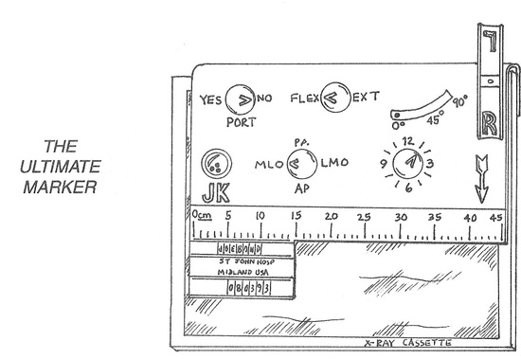
Image metadata

Slide 5
Basic image metadata
Dimensions: mostly 3 (3D spatial, 2D spatial + time), rarely 4 or more
Image size: typically a few-hundred pixels along each axis (512x512x512)
Pixel type:
Scalar type: mostly 8-bit unsigned or 16-bit signed integer (can be also 32 or 64-bit, floating-point)
Number of components: typically 1 (scalar), sometimes 3 (color or 3D vector)
Encoding: mostly non-compressed (raw), sometimes lossless compression (run-length encoding, deflate, ...), endianness

Slide 6
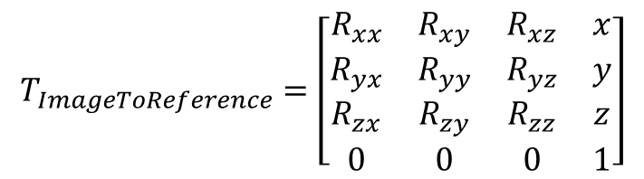
Image pose
Origin, spacing, orientation: best defined by a linear transform, relative to a reference coordinate system
Spacing and orientation
Origin
$$T_{ImageToReference}=\left[\begin{matrix}R_{xx} & R_{xy} & R_{xz} & x \\ R_{yx} & R_{yy} & R_{yz} & y \\ R_{zx} & R_{zy} & R_{zz} & z \\ 0 & 0 & 0 & 1\end{matrix}\right]$$
x
y
y
z
z
Image
x
Reference

Slide 7
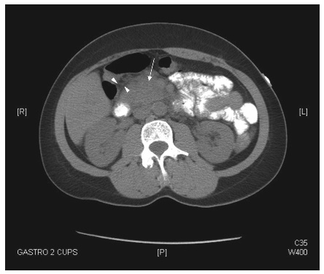
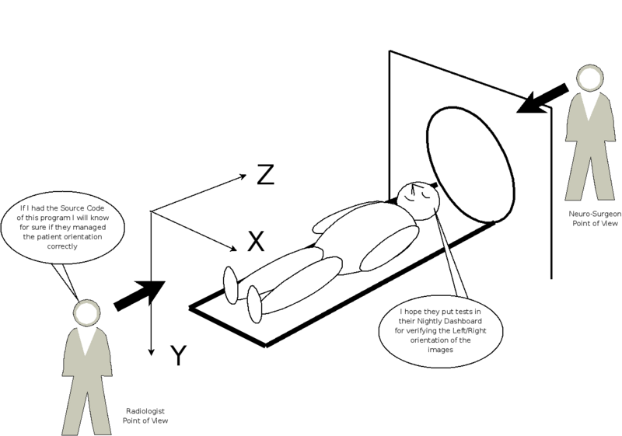
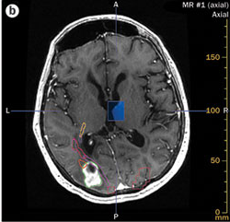
Reference coordinate system
Patient right is image left!
http://labmed.ascpjournals.org
http://www.vtk.org/Wiki/Proposals:Orientation
http://www.nature.com
Patient right is image right!
There is no one single “correct” reference coordinate system.
Not a problem – as long as the coordinate system is properly specified.

Slide 8
Reference coordinate system
Usually linked to patient anatomy (sometimes to the device)
DICOM standard, ITK toolkit: LPS (reference coordinate system axis directions: patient’s left, posterior, superior)
3D Slicer: RAS (right, anterior, superior)
VTK toolkit: no arbitrary orientation is supported (only axis-aligned images)
Unit is millimeter
Origin is application-specific (usually center of the organ of interest)

Slide 9
Medical image file formats
Standard, commercially used
DICOM
Standard, for research use
MetaIO image
NRRD
NIfTI
VTK
Proprietary
Header + uncompressed raw data
Other
Generic-purpose
JPEG
TIFF
PNG ...
Single-file or header/pixel data are in separate files
Various pixel types
Optional lossless compression (deflate)
Anatomical reference frame
Extensible with custom fields
Supported in ITK, VTK and 3D Slicer

Slide 10
MetaIO
http://www.itk.org/Wiki/ITK/MetaIO/Documentation
Originates from UNC, Chapel Hill, around 2000
Maintained by the Insight Software Consortium, Kitware
Extension: mha, mhd+zraw, mhd+raw
ObjectType = Image
NDims = 3
BinaryData = True
BinaryDataByteOrderMSB = False
CompressedData = True
CompressedDataSize = 102251258
TransformMatrix = -1 0 0 0 -1 0 0 0 1
Offset = 149.707 314.707 -949
CenterOfRotation = 0 0 0
AnatomicalOrientation = LPI
ElementSpacing = 0.585938 0.585938 2
DimSize = 512 512 472
ElementType = MET_SHORT
ElementDataFile = LOCAL
xœl½Y’cG¬e;ƒºR§'Òµ7ÿâã‰˜U–&)AžÆíÆüŠ3ŽØbýï¿ï¿q‹¿b‰ë¿?ÿþYcÿïßûçßÇç¿÷ÿ~ûþüößßß¿=>ß<?ÿ¿ÿ÷ï÷ïÏÿ½úþÖUÿ>?ŸÝ?¿Ùú»ÛŸ_>¿ÿÿúß÷Ïç…

Slide 11
MetaIO
Pro
Can also store points, lines, tubes (for vessels, etc.), cubes, spheres, …
Human-readable header
Con
No standard way of specifying image dimensions
ITK image reader implementation ignores patient orientation (https://issues.itk.org/jira/browse/ITK-1287 and http://www.na-mic.org/Bug/view.php?id=2173)
Pushback against making changes or improvements (no funding, synchronized change in ITK and VTK, backward compatibility)

Slide 12
NRRD (nearly raw raster data)
http://teem.sourceforge.net/nrrd/
Univ. Utah, Chicago, BWH, from about 1998
Originally for diffusion-weighted imaging
Default image format for 3D Slicer
Extension: nrrd, nhdr
NRRD0004
# Complete NRRD file format specification at:
# http://teem.sourceforge.net/nrrd/format.html
type: short
dimension: 3
space: left-posterior-superior
sizes: 343 362 144
space directions: (-0.58593749999999989,0,0) (0,-0.58593749999999989,0) (0,0,2)
kinds: domain domain domain
endian: little
encoding: gzip
space origin: (100.48828124999994,256.69921875,-641)
‹ T]|eÅõžàkÑçÛÝl’uÍîf“­³‹»k‹K±Bq/îî-…B±R ´@KbE…

Slide 13
NRRD (nearly raw raster data)
Pro
Strong support for generic N-dimensional images: each dimension can be described well with standard fields
Human-readable header
Con
Complete implementation is only available as part of a larger toolkit (teem). Trimmed-down versions are built into ITK and VTK are somewhat different.

Slide 14
Sequence NRRD/Meta File format
Our Plus toolkit specifies custom fields for storing essential metadata for image-guided therapy (tracking data, ultrasound image sequences)
Custom extensions:
ultrasound image orientation (image flip)
per-frame image position and orientation
See complete specification here: http://perk-software.cs.queensu.ca/plus/doc/nightly/user/FileSequenceFile.html

Slide 15
NIfTI
http://www.nitrc.org/projects/nifti/
Developed and maintained by the Neuroimaging Informatics Technology Initiative (NIfTI) from about 2003
Developed for neuroimaging
Extensions: nia, nii, nii.gz
\ r Wj €? ? ? @ °C €? úÈÂ€Y€Ã @ Ä ? € úÈÂ ? €€Y€Ã @ @ Ä n+1 üüüüüüüüüüüüüüüüüüü üüüüüüüüüüüüüüüüüüüüüüüüüüüüüüüüüüüüüüüüüüüüüüüüüüüüüüüüüüüüüüüüüüüüüüüüüüüüüüüüüüüüüü üüüü!üüüüüüüüüüüüüüüüüüüüüüüüüüü#ü,ü-ü'üüüüüüüüüüüüüüüüüüüüü.üWü¤üÖüÄüŸübü0üüüüüü'üBüSü‚üKýœþ‡ÿ»ÿeÿ]þýPü"üüüü'ü#ü#ü!üü%ü_üŽü¬üŽüaü[üÍüÅý þÔþUþlý•üAü%ü!ü#üü …

Slide 16
NIfTI
Pro
Used extensively neuroimaging (BIDS)
Some multi-dimensional image support (but not generic)
Clean, moderate-sized implementation (used by ITK)
Con
Binary (not human-readable) header
Lots of fields only useful for neuroimaging
Storing custom metadata is practically impossible
Ambiguities and redundancies in how image orientation is defined (sform and qform; what to do with non-orthogonal image axes, etc.)
Many issues in its implementations

Slide 17
Medical image file formats
Standard, commercially used
DICOM
Standard, for research use
MetaIO image
NRRD
NIfTI
VTK
Proprietary
Header + uncompressed raw data
Other
Generic-purpose
JPEG
TIFF
PNG ...
Supports various geometric objects
Good N-dimensional image support
Used a lot in neuroimaging

Slide 18

Medical image file formats
Standard, commercially used
DICOM
Standard, for research use
MetaIO image
NRRD
NIfTI
VTK
Proprietary
Header + uncompressed raw data
Other
Generic-purpose
JPEG
TIFF
PNG ...

Slide 19
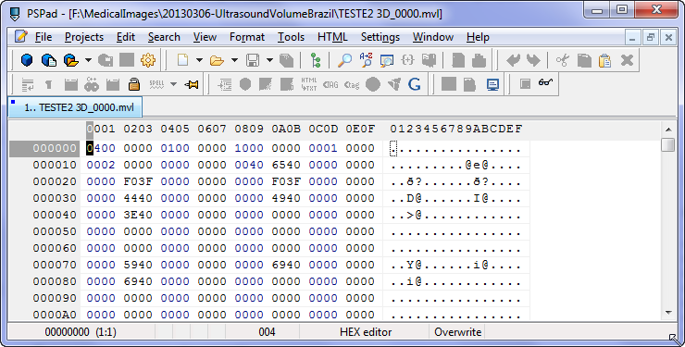
Reverse engineering an unknown file
Web search based on extension and readable text in the file. Specification found? => Done
Open the file in a hex editor (e.g., PSPad)

Slide 20
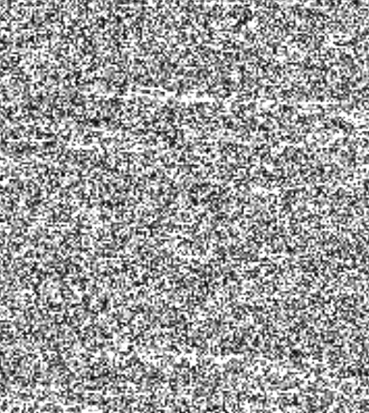
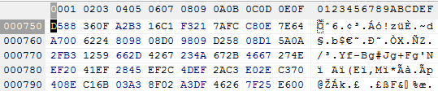
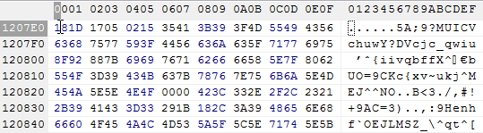
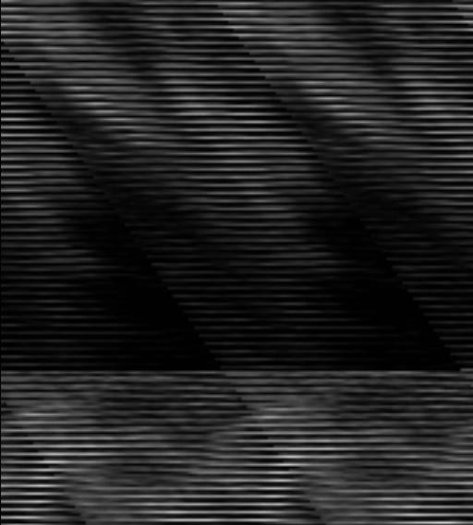
Reverse engineering an unknown file
Scroll into the middle of the data. Mostly slowly changing values?
No: Probably compressed data. Try web search, compare multiple files acquired with the same parameters, etc. to find out the compression method. Difficult.
Yes: Good. Probably simple uncompressed data.

Slide 21

Reverse engineering an unknown file
Number of bytes per voxel: length of repeating byte pattern
1 byte per voxel (8 bit)
Repeating pattern of 2 bytes (00 and then around 15)
=> 2 bytes per voxel (16 bit)

Slide 22
Reverse engineering an unknown file format
Install RawImageGuess extension in Slicer to guess:
Pixel type: usually 8 or 16 bit, trial and error for signed/unsigned
Endianness: trial and error
Header size: remove “random noise” from the beginning
Dimension: number of rows, columns, slices by trial and error
Spacing: usually just guessing (unless known from other sources, for example screenshots)

Slide 23
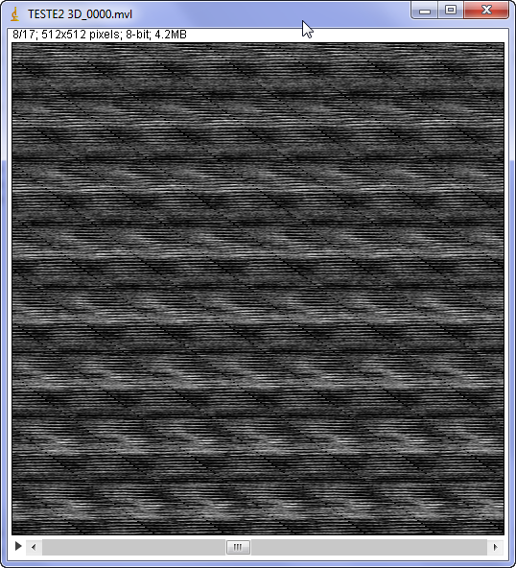
X dimension (image width)
Width=512
Repeating diagonal pattern => row length is too short/long

Slide 24
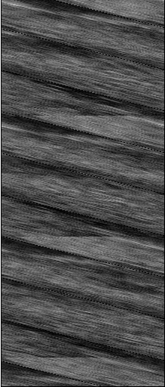
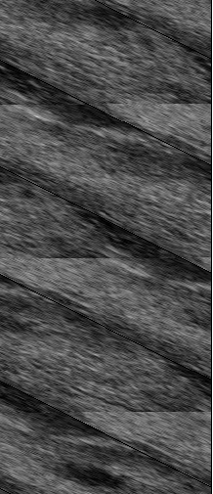
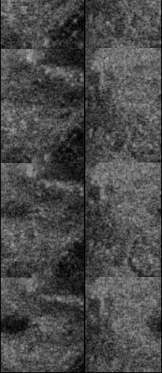
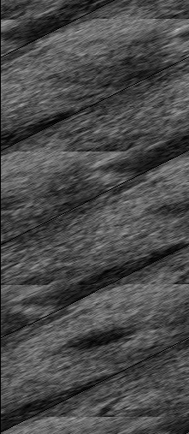
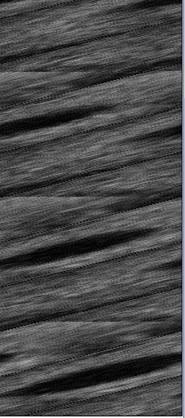
X dimension (image width)
Width=216
Width=218
Width=220
Width=222
Width=224
Width=256

Slide 25
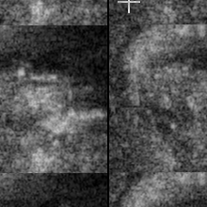
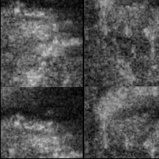
Y dimension (image height)
63 lines between them
=> Height = 220 – 63 = 157
Frame 10
Frame 11
Width=220
Height=220
Width=220
Height=220

Slide 26
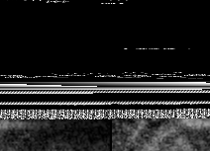
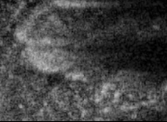
Header size
Frame 0
First pixel position: (116, 122)
=> Offset to first image = = 122*220+116 = 26956
Frame 0
Width=220
Height=157
Width=220
Height=157
Offset to first image=26956

Slide 27
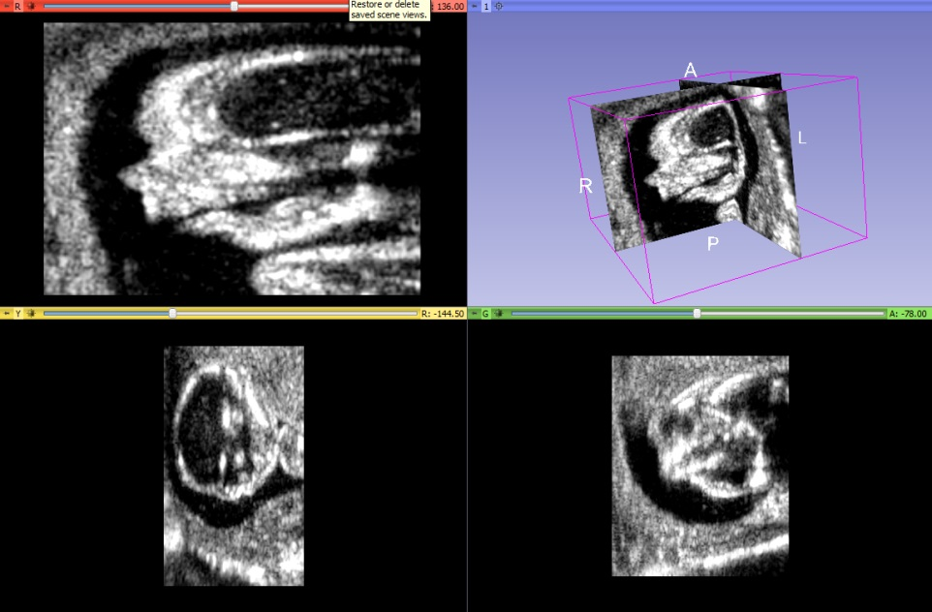

Reverse engineering an unknown file
Create NRRD image header (.nhdr)
Use the header file to load the volume into 3D Slicer
NRRD0004
# Complete NRRD file format specification at:
# http://teem.sourceforge.net/nrrd/format.html
type: uchar
dimension: 3
space: left-posterior-superior
sizes: 271 148 180
space directions: (1.0, 0.0, 0.0) (0.0, 1.0, 0.0) (0.0, 0.0, 1.0)
kinds: domain domain domain
endian: big
encoding: raw
space origin: (0.0, 0.0, 0.0)
byte skip: 145622
data file: IMG_20181020_6_2.vol
Don’t use a text editor to modify the header in a binary file, because text encoding and/or line end (CR/CRLF) conversion may modify the pixel data. Use a hex editor or choose a file format where the header and the pixel data are in separate files.
Reverse-engineering the header:
Save images with different sizes and see how and where the header changes
Try to find the known image size etc. values in the header
Notes:
Example: c:\Users\andra\OneDrive\Projects\SlicerTesting2\20170831-GeDicomImport\data\20181020-FromSlicerForumPublic\IMG_20181020_6_2.vol

Slide 28
Medical image file formats
Standard, commercially used
DICOM
Standard, for research use
MetaIO image
NRRD
NIfTI
VTK
Proprietary
Header + uncompressed raw data
Other
Generic-purpose
JPEG
TIFF
PNG ...

