Slide 1

MatlabBridge Extension
Andras Lasso¹, Jean-Christophe Fillion-Robin², Kevin Wang³, Gabor Fichtinger¹
¹¹Laboratory for Percutaneous Surgery, Queen’s University, Canada
²Kitware
³University Health Network, Toronto, ON, Canada
lasso@cs.queensu.ca
© 2013, All Rights Reserved

Slide 2
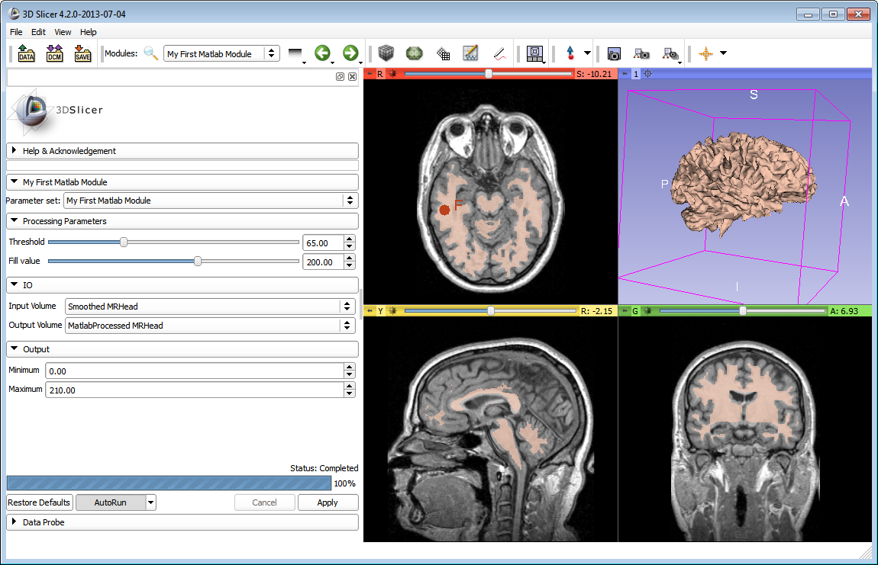
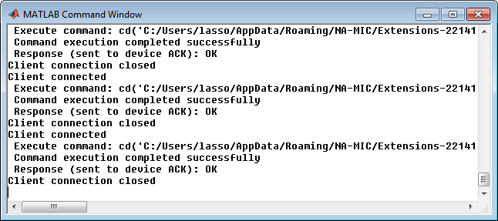
Learning Objective
This tutorial demonstrates how 3D Slicer can be used to run Matlab functions and visualize the processing results in
3D Slicer, using the
MatlabBridge
extension.
© 2013, All Rights Reserved

Slide 3
Pre-requisites
Matlab installed
A nightly release of 3D Slicer installed.
Download the 3D Slicer installer package from the nightly build row at:
http://www.slicer.org/pages/Downloads/
© 2013, All Rights Reserved

Slide 4



Platforms
Platforms
Windows: fully supported
Linux: not tested extensively,
check this page for the current status
Mac: not tested extensively,
check this page for the current status
© 2013, All Rights Reserved

Slide 5
Overview
Overview
Install and configure
Create a simple Matlab module
Use your Matlab module
Customize your Matlab module
© 2013, All Rights Reserved

Slide 6
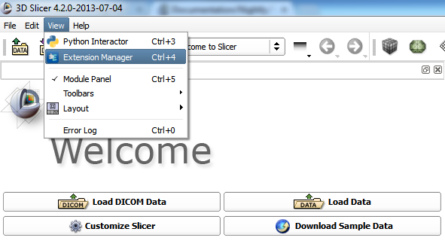

1.1 Install and configure
© 2013, All Rights Reserved

Slide 7
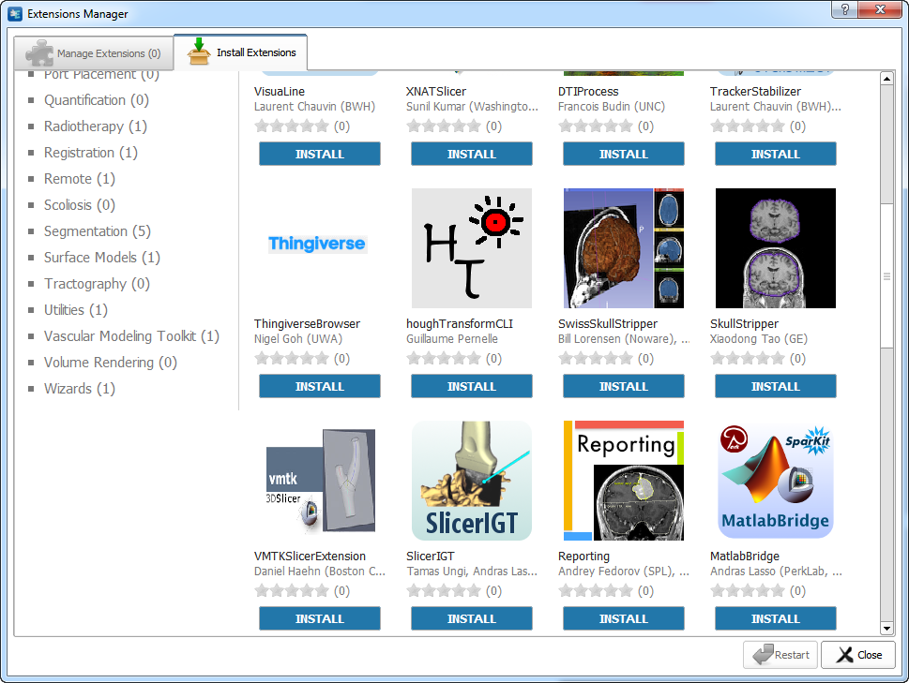
1.2 Install and configure
© 2013, All Rights Reserved

Slide 8
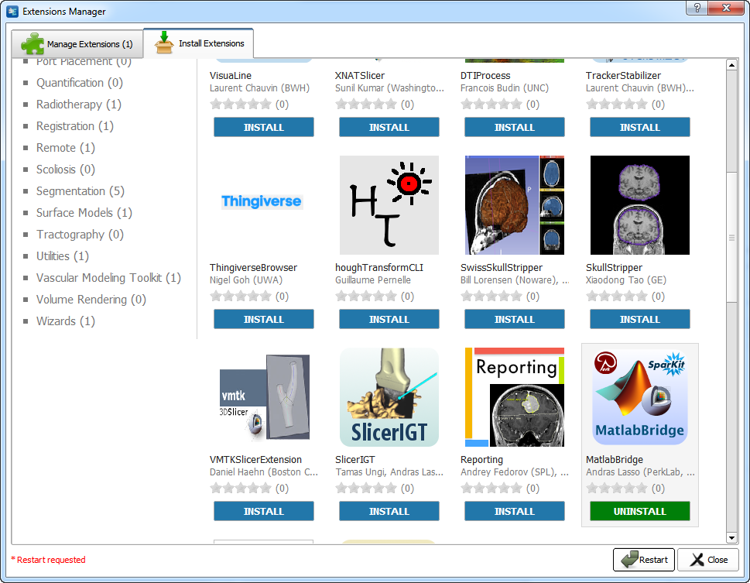
1.3 Install and configure
© 2013, All Rights Reserved

Slide 9
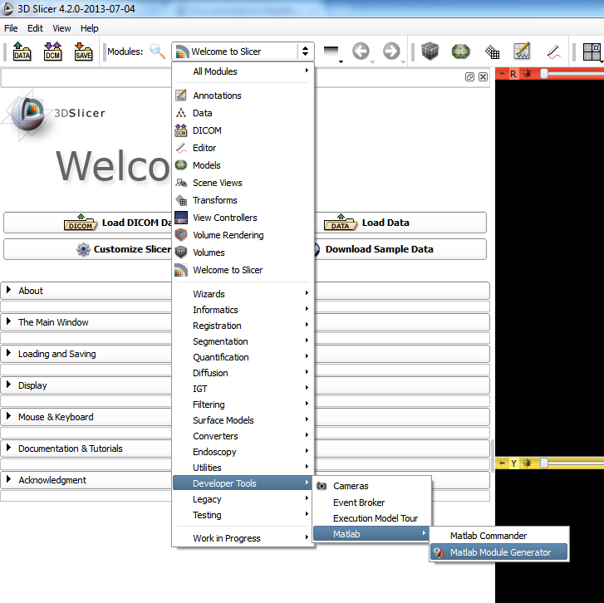
1.4 Install and configure
Note: MatlabBridge modules appear under Developer Tools / Matlab category in the module list
Start the Matlab Module Generator module
© 2013, All Rights Reserved

Slide 10
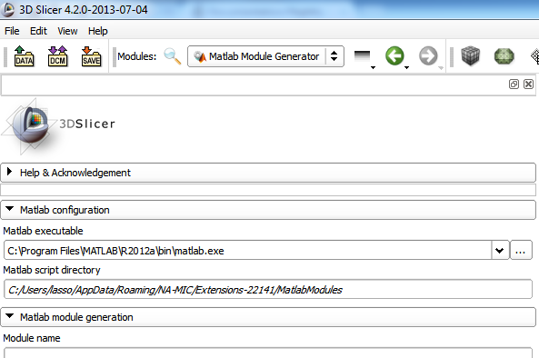
1.5 Install and configure
1. Verify that the path to Matlab is correct
2. Click here to change the default location of the Matlab executable
© 2013, All Rights Reserved

Slide 11
2.1 Create a Matlab module
Start the Matlab Module Generator module
© 2013, All Rights Reserved

Slide 12
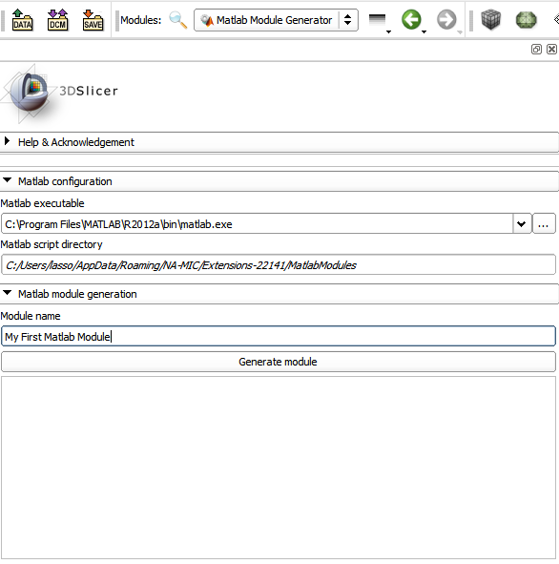
2.2 Create a Matlab module
1. Enter your module name into the Module name box:
My First Matlab Module
2. Click Generate module button
© 2013, All Rights Reserved

Slide 13
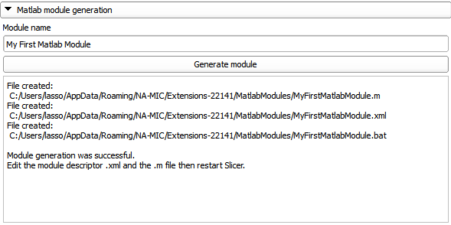
2.3 Create a Matlab module
Note: status of the module generation and the file path of the generated files are shown in the textbox
© 2013, All Rights Reserved

Slide 14
2.4 Create a Matlab module
Each Matlab module consists of three files:
Matlab script (*.m): the Matlab function that Slicer calls, this file has to be customized by the user to perform all the necessary data input, processing, and output
Module descriptor (*.xml): this XML file defines the graphical user interface that will be displayed for the module in 3D Slicer, this file has to be customized for the specific Matlab function
Module proxy (*.bat): this file is generated once and need not to be changed
© 2013, All Rights Reserved

Slide 15
2.5 Create a Matlab module
Generated module descriptor: MyFirstMatlabModule.xml
<?xml version="1.0" encoding="utf-8"?>
<executable> <category>Matlab</category> <title>My First Matlab Module</title> …
<parameters> <label>Processing Parameters</label>
<integer> <label>Threshold</label> <longflag>threshold</longflag> </integer>
</parameters>
<parameters> <label>IO</label>
<image> <label>Input Volume</label> <longflag>inputvolume</longflag> <channel>input</channel> </image>
<image> <label>Output Volume</label> <longflag>outputvolume</longflag> <channel>output</channel> </image>
</parameters>
<parameters> <label>Output</label>
<double> <label>Minimum</label> <name>min</name> <channel>output</channel> </double>
<double> <label>Maximum</label> <name>max</name> <channel>output</channel> </double>
</parameters>
</executable>
Description of the module (category, title, etc.)
Input numerical value
Input image
Output image
Two output numerical values
© 2013, All Rights Reserved

Slide 16
2.6 Create a Matlab module
Geenerated Matlab script: MyFirstMatlabModule.m
% Example function that returns the minimum and maximum voxel
% value in a volume and performs thresholding operation
% on the volume.
function outputParams = MyFirstMatlabModule( inputParams )
img=cli_imageread(inputParams.inputvolume);
outputParams.min=min(min(min(img.pixelData)));
outputParams.max=max(max(max(img.pixelData)));
img.pixelData=(double(img.pixelData)>inputParams.threshold)*100;
cli_imagewrite(inputParams.outputvolume, img);
Input image
Two output numerical values
Input numerical value
Output image
© 2013, All Rights Reserved

Slide 17
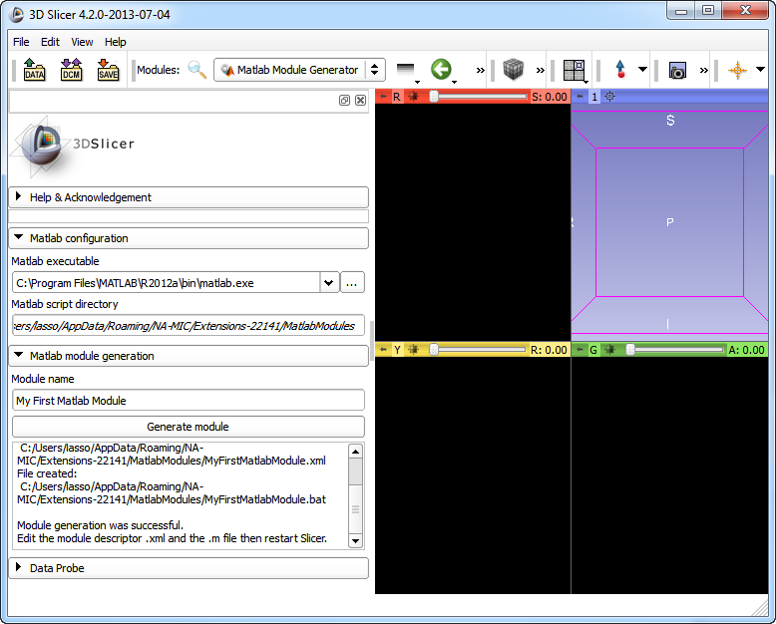
3.1 Use your Matlab module
1. Exit 3D Slicer
2. Start 3D Slicer
Module graphical user interfaces are created when Slicer is started. So, we need to restart Slicer to see the new module.
© 2013, All Rights Reserved

Slide 18
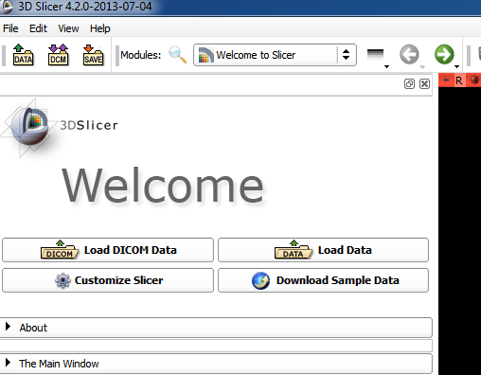
3.2 Use your Matlab module
Matlab modules work exactly the same way as other Command-Line Interface (CLI) Slicer modules.
Click Download Sample Data module to load some sample data that we will process.
© 2013, All Rights Reserved

Slide 19
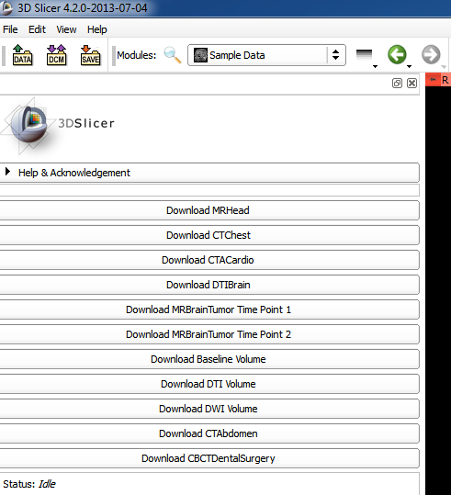
3.3 Use your Matlab module
Click Download MRHead
© 2013, All Rights Reserved

Slide 20
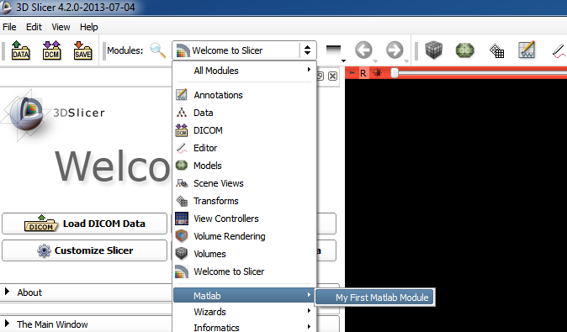
3.4 Use your Matlab module
Open our new, generated Matlab module.
It is shown in the Matlab category.
Click on the module name to start.
© 2013, All Rights Reserved

Slide 21
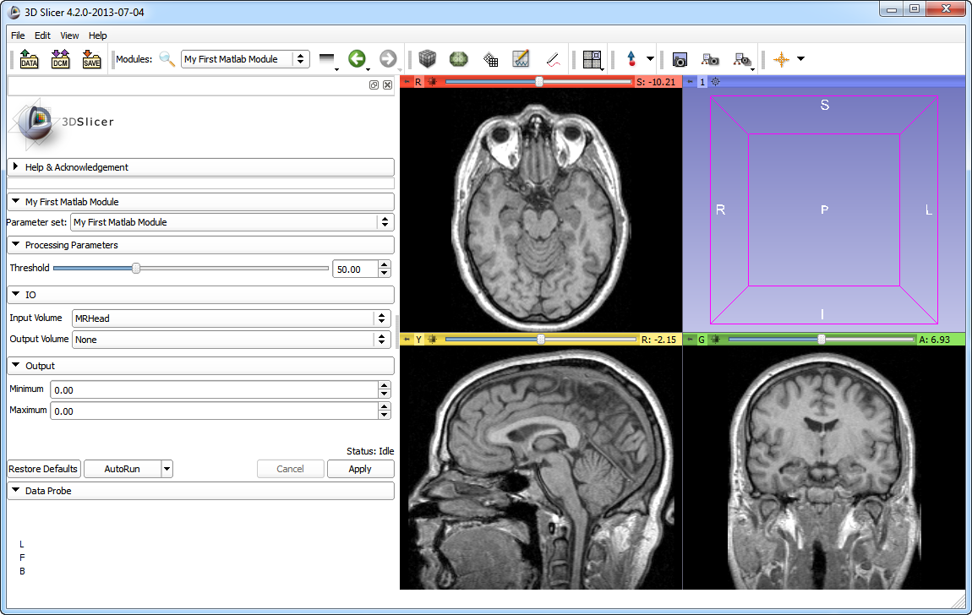
3.5 Use your Matlab module
Select Input Volume: MRHead
© 2013, All Rights Reserved

Slide 22

3.6 Use your Matlab module
Select Output Volume: Create new Volume
© 2013, All Rights Reserved

Slide 23
3.7 Use your Matlab module
Click Apply button to run the module
The first time the Apply button is clicked you may have to wait for Matlab to start.
© 2013, All Rights Reserved

Slide 24
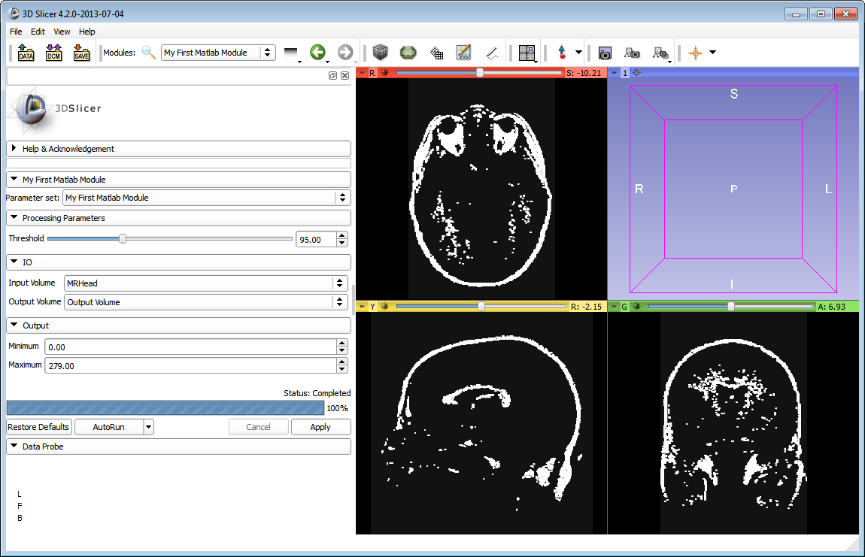
3.8 Use your Matlab module
1. Change the Threshold value
2. Click the Apply button to re-run the module
© 2013, All Rights Reserved

Slide 25
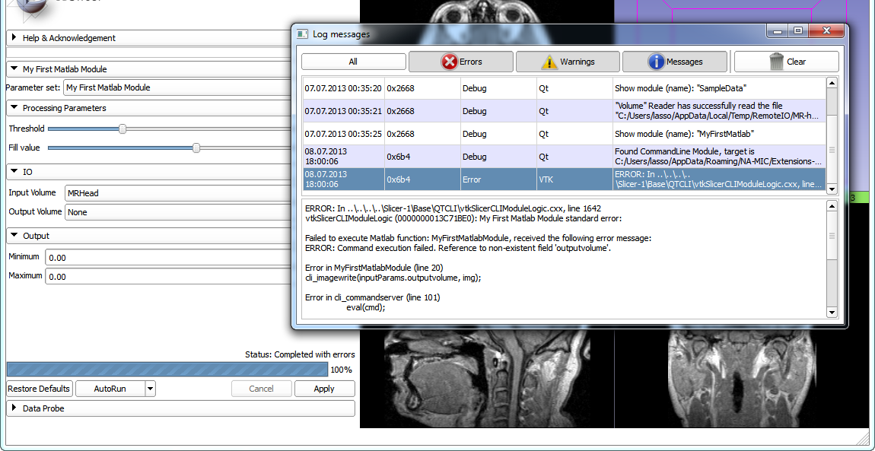
3.9 Use your Matlab module
If an error occurs during the execution of the Matlab function: open the error log in Slicer (View / Error log or
ctrl-0) or open the Matlab window to see the error message.
1. Set the Output Volume to None
3. Status is “Completed with errors”.
Press ctrl-0 to see the error log.
2. Click the Apply button to re-run the module
© 2013, All Rights Reserved

Slide 26
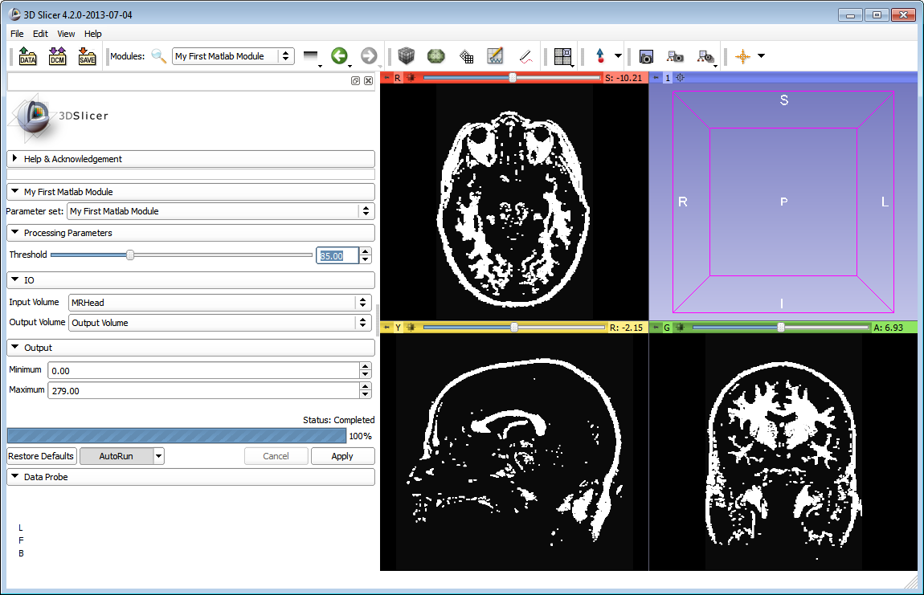
3.10 Use your Matlab module
Enable the AutoRun feature to avoid the need of clicking Apply each time an input parameter is changed.
2. Change the input parameters
1. Click AutoRun
After each change the Matlab function is executed automatically with the new parameters, and the new results are updated on the screen.
© 2013, All Rights Reserved

Slide 27
3.11 Use your Matlab module
By using AutoRun, a pipeline of many pre-processing and post-processing filters and visualization methods
can be constructed!
Choose the output of a CLI module as the input of the subsequent processing module
Enable AutoRun on modified input option of AutoRun
Enable AutoRun
Input volume
Gaussian Blur Image Filter
Input fiducial point
My First Matlab Module
Simple Region Growing Segmentation
CheckerBoard Filter
Model Maker
Output comparison volume
Output model
© 2013, All Rights Reserved

Slide 28
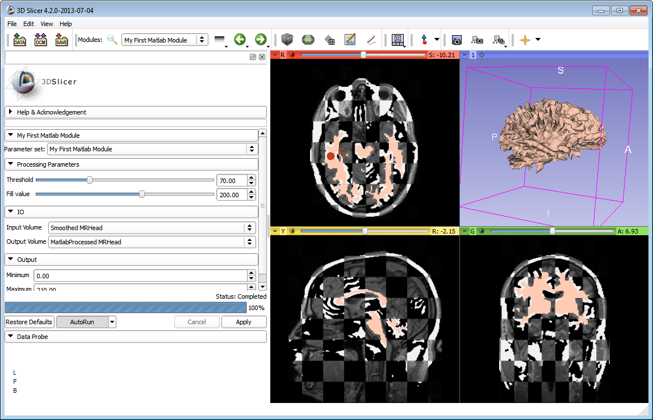
3.12 Use your Matlab module
If any input or processing parameter is changed, then the pipeline is refreshed and the updated results are displayed.
© 2013, All Rights Reserved

Slide 29
4.1 Customize your Matlab module
Example: We would like to introduce one more input parameter, Fill value. It is a simple numerical value specifying the value that will be set in the output volume for the values that are above the chosen threshold.
© 2013, All Rights Reserved

Slide 30
4.2 Customize your Matlab module
Add the following lines in a <parameters> section in the MyFirstMatlabModule.xml file:
<integer>
<label>Fill value</label>
<description>
<![CDATA[Voxels above the threshold will be set to this value]]>
</description>
<longflag>fillvalue</longflag>
<default>200</default>
<constraints>
<minimum>-1000</minimum>
<maximum>1000</maximum>
<step>5</step>
</constraints>
</integer>
© 2013, All Rights Reserved

Slide 31
4.3 Customize your Matlab module
Update the Matlab function: replace the line
img.pixelData=(double(img.pixelData)>inputParams.threshold)*100;
by
img.pixelData=(double(img.pixelData)>inputParams.threshold)*inputParams.fillvalue;
Restart Slicer to see the updated module graphical user interface and try the module.
© 2013, All Rights Reserved

Slide 32
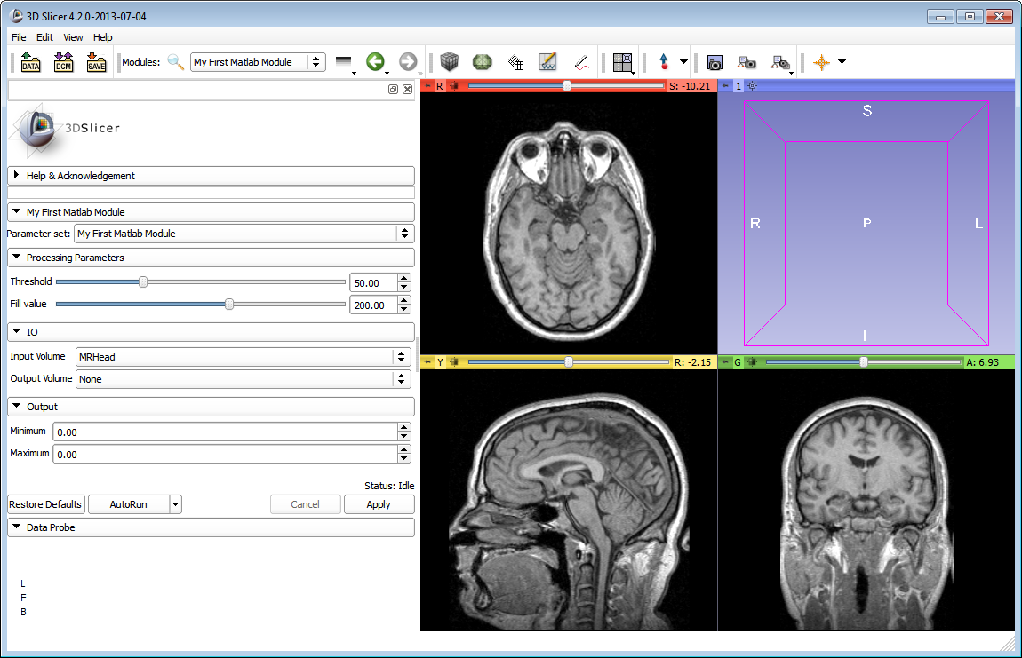
4.4 Customize your Matlab module
The new parameter appears in the user interface.
© 2013, All Rights Reserved

Slide 33
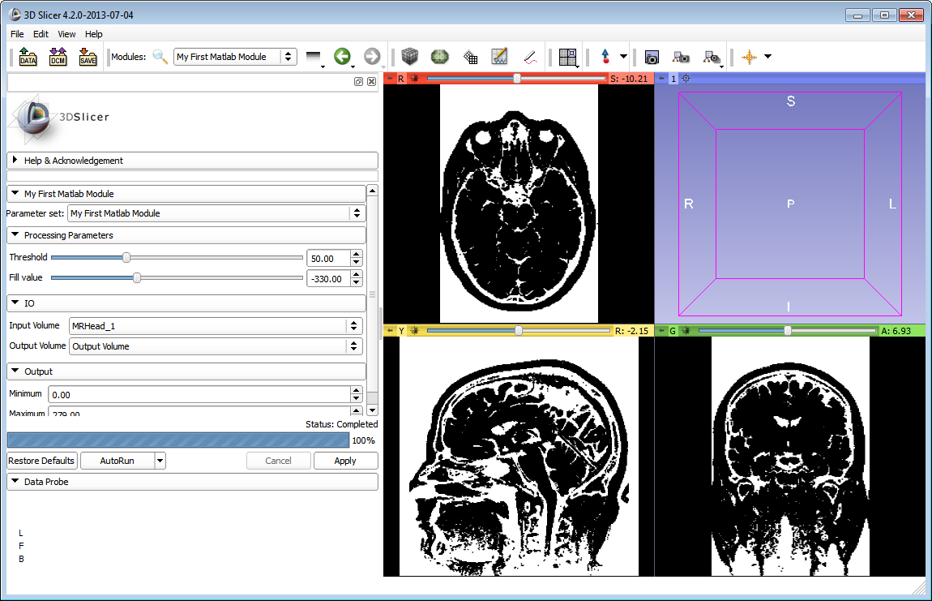
4.5 Customize your Matlab module
If the fill value is negative then the values above the threshold value will appear darker.
1. Set the Fill value to a negative number
2. Click Apply
© 2013, All Rights Reserved

Slide 34
4.6 Customize your Matlab module
Modifying and testing the Matlab function: simply edit the .m file, save the file, then click Apply on the module GUI in Slicer to re-run the module (no need to restart Slicer)
Setting a breakpoint in the Matlab function:
  Option A: stop the command server in Matlab (ctrl-c), add breakpoints in the Matlab GUI, restart the cli_commandserver Matlab function
  Option B: execute a Matlab message using the MatlabCommander module, for example:
  dbstop in c:\Users\MyUsername\AppData\Roaming\NA-MIC\Extensions-NNNNN\MatlabModules\MyModule.m
© 2013, All Rights Reserved

Slide 35
4.7 Customize your Matlab module
More information for customizing the XML file:
  Complete specification of the XML file
  XML files of all the core Slicer CLI modules
A few more Matlab module examples
  Fill around seeds: fills region in a volume around point positions marked in Slicer
  Landmark registration: computes a linear transform between two point sets marked in Slicer
  Matlab Bridge parameter passing test: example for using different kind of input and output parameters
© 2013, All Rights Reserved

Slide 36
Conclusion
Slicer can be used for running Matlab functions using a convenient graphical user interface.
Matlab modules behave exactly as any other command-line interface (CLI) module.
Automatic update feature (AutoRun) allows quick visualization of the processing results whenever any input or processing parameter is changed.
Existing Slicer modules can be used for importing data, pre-processing, post-processing, and visualization.
© 2013, All Rights Reserved

Slide 37
More information
Extension documentation page: http://www.slicer.org/slicerWiki/index.php/Documentation/Nightly/Extensions/MatlabBridge
Add/view bug reports and feature requests at: https://www.assembla.com/spaces/dG15GuCs4r4l4UeJe5cbCb/tickets/report/u783013
Project webpage: http://www.slicerrt.org/
PerkLab webpage: http://perk.cs.queensu.ca
Email contact: Andras Lasso (lasso@cs.queensu.ca)
© 2013, All Rights Reserved

Slide 38



Acknowledgments
Acknowledgments
Cancer Care Ontario
SparKit
(Software Platform and Adaptive Radiotherapy Kit)
National Alliance for Medical
Image Computing
NIH U54EB005149
© 2013, All Rights Reserved

