Slide 1
React,Reflux and WebSockets
By Iain C Docherty

Slide 2
Introduction.
Introduction to React
Introducing Flux (and Reflux)
Adding Web Sockets (client)
Web Sockets (server side Perl)

Slide 3
React
Docs. https://reactjs.org/docs/getting-started.html
React vs Angular https://hackernoon.com/angular-vs-react-the-deal-breaker-7d76c04496bc

Slide 4
React Demonstration
Simple app demonstrating
- React Components
- JSX
- State and Properties data flow

Slide 5
React Summary
A React codebase is made up of components.
These components are written using JSX.
Data flows from parent to children, except when it comes to state, which originates inside a component.
Components possess a small set of lifecycle and utility methods.
Components can also be written as pure functions.

Slide 6
Reflux
Facebook docs. https://github.com/facebook/flux/tree/master/examples
Reflux https://github.com/reflux/refluxjs/tree/master/docs
Reflux vs Flux https://github.com/reflux/refluxjs/blob/master/docs/other/reflux-vs-flux.md

Slide 7
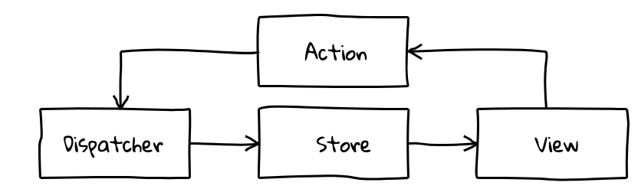
Standard Flux data-flow

Slide 8
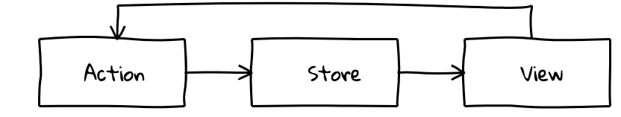
Reflux data-flow

Slide 9
Reflux Demonstration
Extend React app to include Reflux
Counter Store
Counter Actions
Uni directional data flow

Slide 10
Reflux Summary
In Reflux each action is it’s own dispatcher
Loose coupling using pub-sub actions.
Data flow is one-way
Pure functions make testing easier

Slide 11
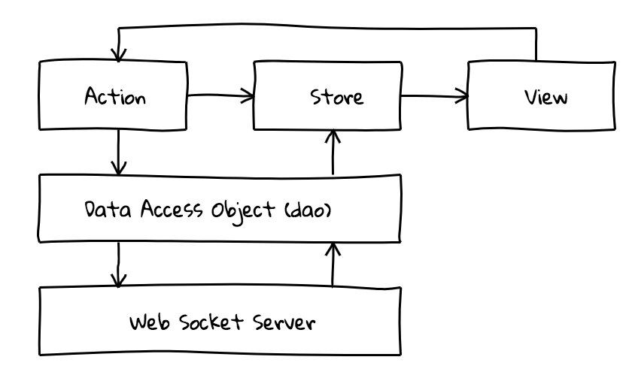
Reflux with Web-Sockets

Slide 12
Websocket Demonstration
DAO listens to actions which send data to server
DAO takes server web socket messages and converts to actions
All state is now held on the server. Server is ‘stateful’

Slide 13
Websocket Summary
DAO Decouples websocket from Reflux
Data flow is still one-way
Server side Perl uses AnyEvent and Twiggy
Catalyst and Mojolicious now support WebSockets too.

Slide 14
Server code
Server based on ‘Twiggy’ a light-weight, fast PSGI application.
Bespoke Websocket implementation with routing
Design principle, fast web-socket code, delegate slow code.
Job queues using beanstalk.

