Slide 1
Dancer
A micro framework for
writing web applications
Alexis Sukrieh
OSDCfr 2009

Slide 2
Alexis Sukrieh
http://sukria.net
http://twitter.com/sukria
http://search.cpan.org/~sukria/

Slide 3
Dancer
http://dancer.sukria.net
$ sudo cpan Dancer
http://github.com/sukria/Dancer

Slide 4
Description
Syntax
Application Tree
Environments
Deployment

Slide 5
webapp framework for Perl

Slide 6
Again, another one !!?

Slide 7
YES.

Slide 8
Why ?

Slide 9
Web Development in Perl
can be :

Slide 10
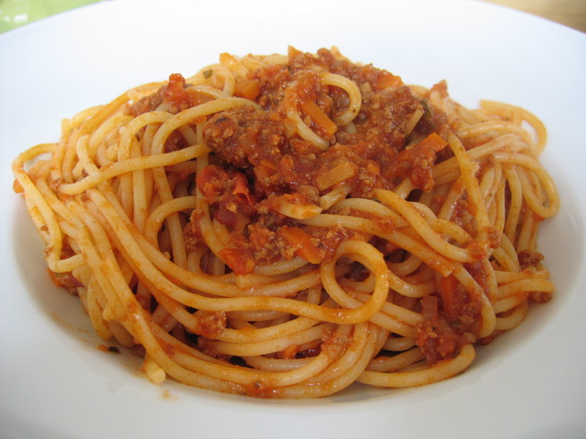
CGI.pm : fat webapp junkfood

Slide 11
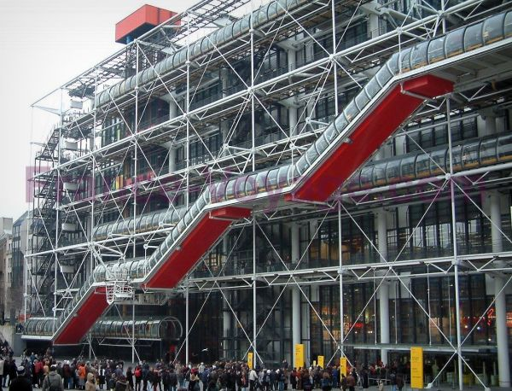
Catalyst : it's huge, but, it's huge.

Slide 12

Plenty of other frameworks alike

Slide 13

Ruby introduced something else

Slide 14

A new approach to
webapp development

Slide 15
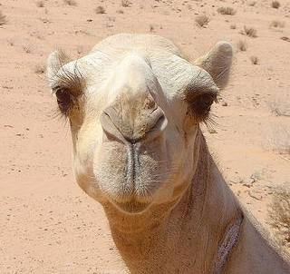
Perl needed the same

Slide 16
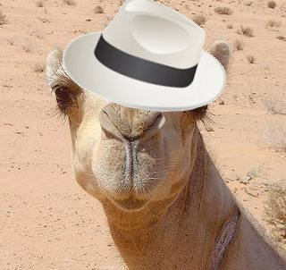
definetly

Slide 17
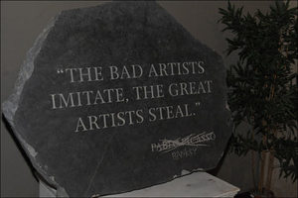
Kindly stolen from Ruby

Slide 18
So, Dancer is a framework ...

Slide 19
a micro framework

Slide 20
Lightweight

Slide 21
Standalone

Slide 22
PSGI/Plack compliant

Slide 23
expressive syntax

Slide 24
few configuration

Slide 25
painless for the developer

Slide 26
enough talking,
let's dance

Slide 27


Slide 28
Sorry, I mean ...

Slide 29
package MyApp;
use Dancer;
get '/' => sub {
'Hello OSDCfr 2009!'
};
dance;

Slide 30
A dancer script is a webserver

Slide 31
$ ./myApp.pl
>> Listening on 127.0.0.1:3000
== Entering the development dance floor ...

Slide 32
Working webapp ready to be hacked

Slide 33
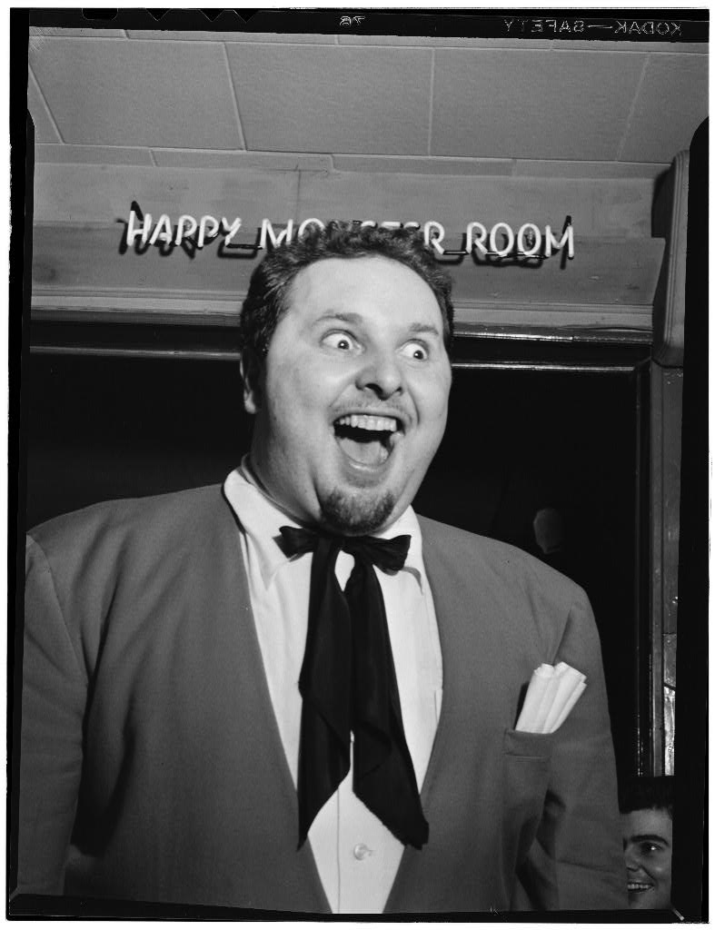
» happiness : he can WSFC now

Slide 34
Description
Syntax
Application Tree
Environments
Deployment

Slide 35
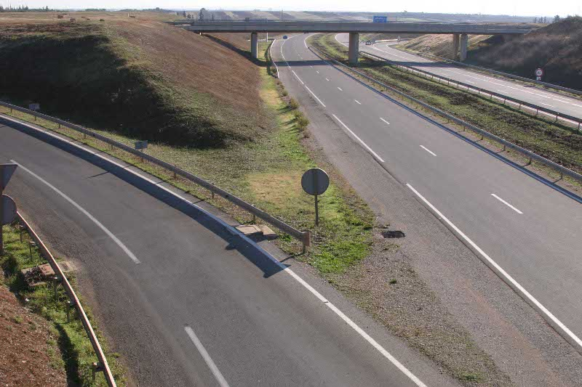
A Dancer app is defined with
route handlers

Slide 36
a route handler is basically a sub

Slide 37
bound to an HTTP method
(typically 'get' or 'post')

Slide 38
with a path pattern

Slide 39
/foo
/bar/:var
/baz/*
r('/stuff/([a-z0-9]+)/')

Slide 40
Static pattern (path)
/
/foo
/bar/baz

Slide 41
pattern with named tokens
/hello/:buddy
my $name = params->{buddy}

Slide 42
pattern with anonymous tokens
/show/*.*
my ($file, $ext) = splat;

Slide 43
pseudo-regexp-defined patterns
r('/post/([a-z0-9]+)')
my ($post) = splat; # $1

Slide 44
processing a request
=
finding a matching route handler

Slide 45

404
No matching route handler » no joy

Slide 46

Route handler found » Joy

Slide 47
When found,
a route handler is executed

Slide 48
it can alter the response headers
get '/' => sub {
content_type 'text/plain';
return 'this is plain text'
};

Slide 49
pass to the next matching handler
get '/lazy' => sub {
pass and return false;
};

Slide 50
serve a static file
get '/dowload/:file' => sub {
my $file = params->{file};
if (! -f $file) {
pass and return false;
}
send_file $file;
};

Slide 51
throw an error
get '/forbidden' => sub {
send_error 'Nope';
};

Slide 52
redirect to somewhere else
get '/forbidden' => sub {
redirect '/better/place'
};

Slide 53
and of course, render a content
get '/showme' => sub {
template 'showme', {
var => 'foo'};
};

Slide 54
return value
=
content to render

Slide 55
logging ?

Slide 56
get '/' => sub {
# ...
debug 'here it is';
};
» logs/development.log

Slide 57
pre-processing ?

Slide 58
before sub {
do_some_init_stuff();
params->{foo} = 'beenthere';
};

Slide 59
static file serving ?

Slide 60
existing file in $appdir/public
=
file served, no handler needed

Slide 61
Description
Syntax
Application Tree
Environments
Deployment

Slide 62
app.pl

Slide 63
app.pl
views/
index.tt

Slide 64
app.pl
views/
index.tt
layouts/
main.tt

Slide 65
app.pl
views/
index.tt
layouts/
main.tt
config.yml

Slide 66
app.pl
views/
index.tt
layouts/
main.tt
config.yml
environments/
development.yml
production.yml

Slide 67
app.pl
views/
index.tt
layouts/
main.tt
config.yml
environments/
development.yml
production.yml
public/

Slide 68
bootstraping ?

Slide 69
$ dancer -a MyApp

Slide 70
+ MyApp
+ MyApp/views
+ MyApp/views/index.tt
+ MyApp/views/layouts
+ MyApp/views/layouts/main.tt
+ MyApp/environments
+ MyApp/environments/development.yml
+ MyApp/environments/production.yml
+ MyApp/config.yml
+ MyApp/app.psgi
+ MyApp/MyApp.pm
+ MyApp/MyApp.pl
+ MyApp/public
+ MyApp/public/css
+ MyApp/public/css/style.css
+ MyApp/public/css/error.css
+ MyApp/public/images
+ MyApp/public/404.html
+ MyApp/public/500.html

Slide 71
» Working webapp, pre-configured, pre-designed and waiting for your hacks

Slide 72
Description
Syntax
Application Tree
Environments
Deployment

Slide 73

settings : customizing the app

Slide 74
settings in the app code

Slide 75
use Dancer;
set layout => 'application'
set foo => 42;
set content_type =>'text/plain';

Slide 76
handy at first, but dirty

Slide 77
YAML config files: goodness

Slide 78
# config.yml
layout: 'application'
foo: 42
content_type: 'text/plain'

Slide 79
config.yml
=
global configuration

Slide 80
environments/foo.yml
« foo » configuration

Slide 81
$ dancer -e foo
runs the app in « foo » environment

Slide 82
development.yml
warnings: 1
show_errors: 1
...

Slide 83
production.yml
warnings: 0
show_errors: 0
...

Slide 84
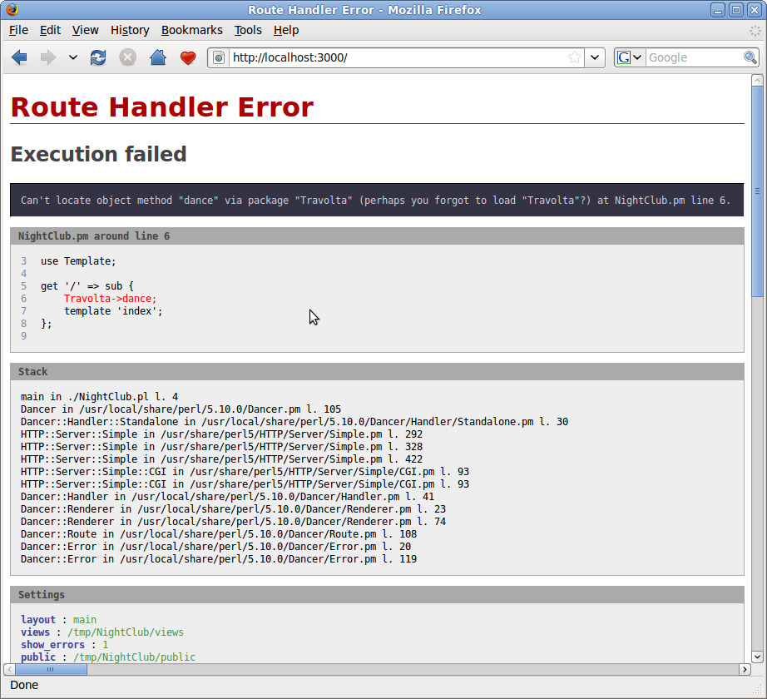
show_errors: 1

Slide 85
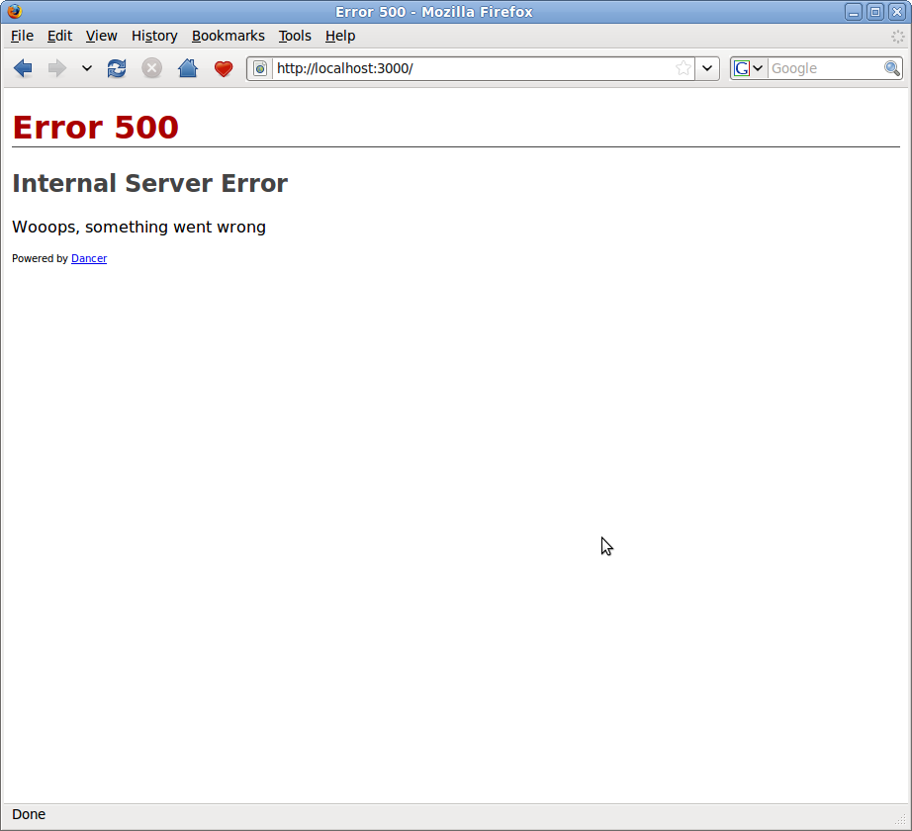
show_errors: 0

Slide 86
Description
Syntax
Application Tree
Environments
Deployment

Slide 87
For production needs,
use PSGI/Plack

Slide 88
Plack is to Perl :
what Rack is to Ruby
what WSGI is to Python

Slide 89
universal
server <-> application
gateway

Slide 90
PSGI/Plack
miyagawa
http://plackperl.org

Slide 91
Dancer supports Plack since 0.9904

Slide 92
app.psgi
tells Plack how to dance

Slide 93
use CGI::PSGI;
use MyApp;
my $handler = sub {
my $env = shift;
my $cgi = CGI::PSGI->new($env);
Dancer->dance($cgi);
};

Slide 94
The app is now PSGI/Plack aware

Slide 95
$ plackup -a app.psgi &

Slide 96
Webservers have PSGI adapters

Slide 97
Apache (mod_psgi)
nginx
Perlbal
HTTP::Server::Fast
Plack (standalone)

Slide 98
Conf example with Apache
<Location />
SetHandler perl-script
PerlHandler
Plack::Server::Apache2
PerlSetVar psgi_app /path/app.psgi
</Location>

Slide 99
Works pretty well

Slide 100
enjoy web development with Perl

Slide 101
DANCE!

