Slide 1


Data Science Bootcamp
Team 4
Hospitalization Problem
Dimitris Kasseropoulos
Maria Kritharidou
Stefanos Perlantidis-Papadopoulos
Mantiana Topouzi

Slide 2
Back-end architecture
Functionalities of the back-end
Create data storage
Keep system behavior you find relevant
Create two end points:
Statistics (/stats)
Prediction (/model)

Slide 3
Back-end architecture
The basic files/folders of the Flask application were the bellow
Folder/File name | Functionality
Services | Apply computations in the data
Repository | Storage for datasets
Controllers | Sending results to the Front-End
App.py | Starts the application

Slide 4
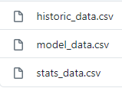
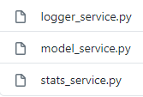

Back-end architecture
Repository
Services
Controllers
Front- End

Slide 5
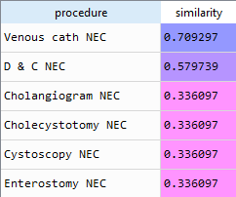
The challenging parts
User’s input values
The user fill some fields using raw text
“Venous NEC”
“Venous cath NEC”

Slide 6
The challenging parts
The form of the input values
Age | Gender | insurance | marital_status
45 | M | Medicare | MARRIED
Age | Gender_M | Gender_F | Insurance_ Private | Insurance_ Medicare | marital_status_MARRIED | marital_status_SINGLE | marital_status_UNKNOWN
45 | 1 | 0 | 0 | 1 | 1 | 0 | 0

Slide 7
Future work
Better handling the raw text fields
Filter the illogical input combinations

Slide 8
Data science part
DESCRIPTIVE STATISTICS
PREPROCESSING
MODELLING
model evaluation

Slide 9
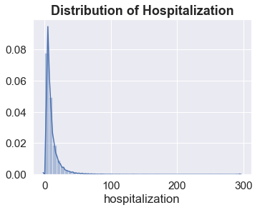
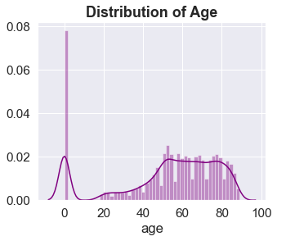
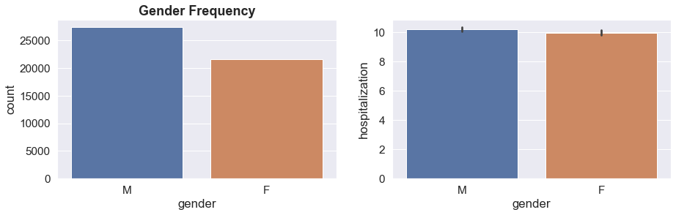
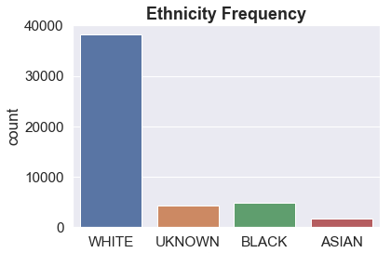
Descriptive Statistics

Slide 10
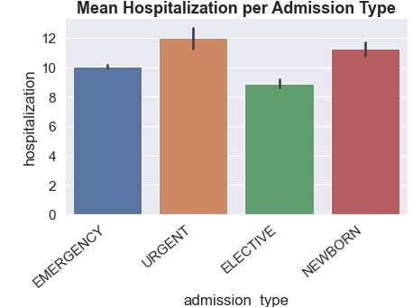
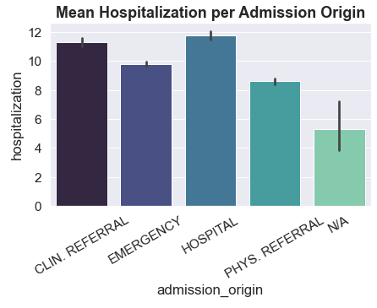
Meaningful insights (1)

Slide 11
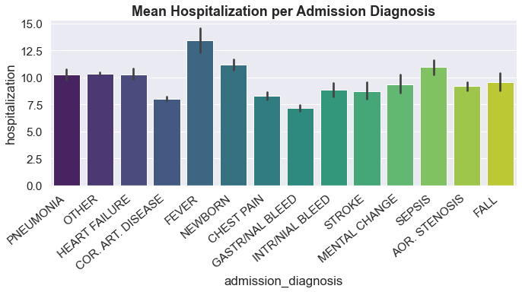
Meaningful insights (2)

Slide 12
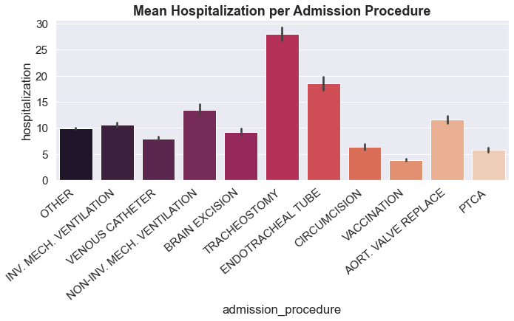
Meaningful insights (3)

Slide 13
Preprocessing: Model Variables
Used Variables | Dropped Variables
Gender Age Admission Type Admission Origin Admission Diagnosis Insurance Religion Marital Status Ethnicity Admission Procedure Hospitalization (y) | Num callouts Num diagnoses Num procedures Num cptevents Num inputevents Num labevents Num microbiologyevents Num noteevents Num outputevents Num procedureevents Num transfers Num chartevents expired Patient id

Slide 14
Preprocessing: Cleaning Data
Missing Values
Scaling
Encoding
Mode
Prediction
Standardization
One-Hot
Binary

Slide 15
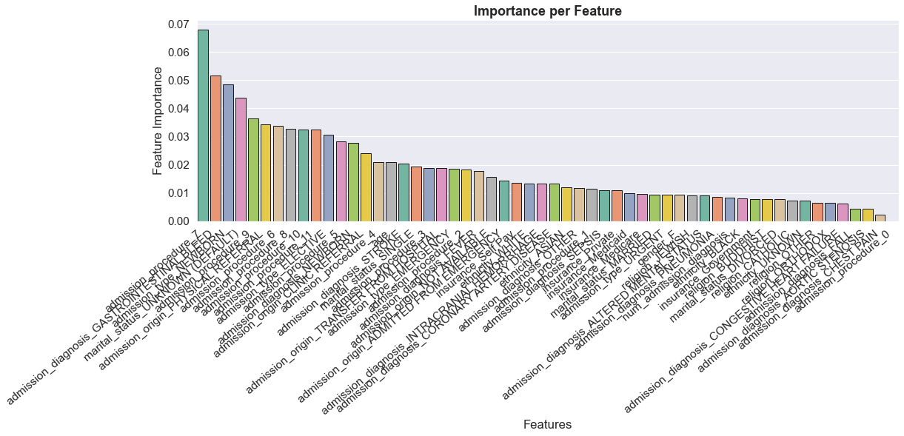
Feature Selection

Slide 16
Modelling (1)
Classification
Machine learning
Supervised learning
Regression
Classes
Day
Week
Two weeks
Month
More

Slide 17
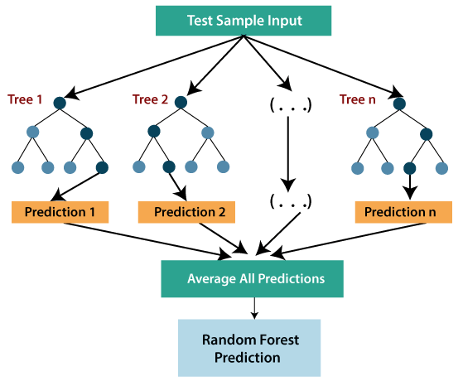
Ensemble methods
Modelling (2)
DecisionTreeRegressor
AdaBoost
Gradient Tree Boosting
Extremely Randomized Trees
Random Forests
GridSearch
Cross - Validation

Slide 18
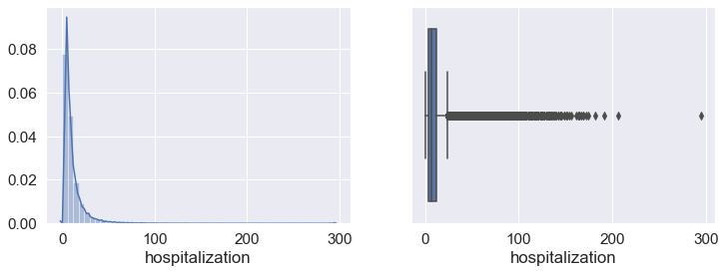
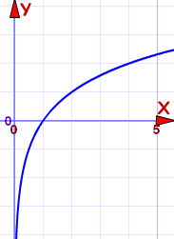
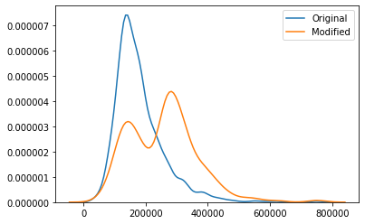
Modelling (3)
outliers
log
SmoteR

Slide 19
Model Evaluation
0: Day
1: Week
2: Two Weeks
3: Month
4: More
Our problem
Continuous values
Non – independent classes
Classification problem
Discrete values
Independent classes

Slide 20
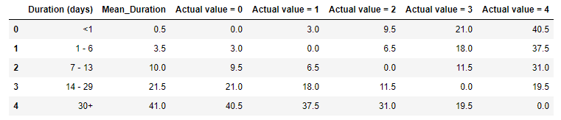
Model Evaluation
Mean Hospitalization Error
Random Forest
MHE
5.4 days

Slide 21
Future Work
More techniques to improve models
Feature creation to increase the performance

Slide 22
Thanks for your attention ! ! !

