Slide 1
Practical Concurrent and Parallel Programming III
Performance Measurements
Jørgen Staunstrup
Notes:
Fetch Benchmark.java so you are prepared to compile and run it in class

Slide 2
Motivations for Concurrency
Inherent: User interfaces and other kinds of input/output
Exploitation: Hardware capable of simultaneously executing multiple streams of statements
Hidden: Enabling several programs to share some resources in a manner where each can act as if they had sole ownership

Slide 3
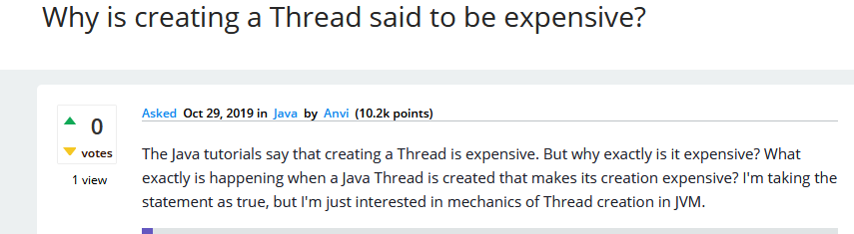
Motivation for performance measurements - 1
Threads are expensive
But how expensive ?
~600 ns to create (on this laptop)
~20 times more time than creating a simple object
40000 ns to start a thread !!! (on this laptop)
Today: How to get such numbers !

Slide 4
Motivation for performance measurements - 2
Sorting 1_000_000 numbers with Quicksort takes 9 µs (using 1 Thread)
How fast can we do it using N threads?
www.menti.com : 38 23 09 6
Explanation and animation:
https://en.wikipedia.org/wiki/Quicksort
Notes:
After 1 do a manual quicksort on the board
1 2 43 78 19 54 64 21 33 52 53 17
Any guesses for 8 Threads:
Mentimeter 3196 4083

Slide 5
Agenda
Performance measurements: motivation and introduction
Pitfalls (and avoiding them)
Calculating means and variance (efficiently)
Measurements of thread and lock overhead
Algorithms for parallel computing

Slide 6
Agenda
Performance measurements: motivation and introduction
Pitfalls (and avoiding them)
Calculating means and variance (efficiently)
Measurements of thread and lock overhead
Algorithms for parallel computing

Slide 7
(Performance) Measurements
Key in many sciences (experiments, observations, predictions, ...)
A bit of statistics
A bit of numerical analysis
A bit of computer architecture (number representation)
Code for measuring execution time
Based on Microbenchmarks in Java and C# by Peter Sestoft (see benchmarkingNotes.pdf in material for this week)
All numbers in these slides were measured in August 2021 on a: Intel Core i5-1035G4 CPU @ 1.10GHz, 4 Core(s), 8 Logical Processor(s)
Notes:
Change link

Slide 8
Example: measuring a (simple) function
private static int multiply(int i) {
return i * i;
}
1700 ns
1500 ns
2500 ns
~ 1 - 2ns
start= System.nanoTime();
multiply(126465);
end= System.nanoTime();
System.out.println(end-start+" ns");
What is going on?
Notes:
Each call to the method performs 1 floating-point multiplications. Performing these operations should take 2–5 CPU cycles, or 2-4 nanoseconds (ns), on a contemporary laptop or desktop Intel i5 CPU with a clock frequency of 1.1 GHz, since 5/ 1.1 GHz is around 4nS

Slide 9
Java compiler and virtual machine
Input
.java
javac
.class
java VM
Program
Compiler
Bytecode
Abstract
machine
Output
for (int i=0; i<n; i++)
sum += sqrt(arr[i]);
21 iconst_0
22 istore 5
24 iload 5
26 iload 2
27 if_icmpge 46
30 dload 3
31 aload 1
32 iload 5
34 daload
35 invokestatic Math.sqrt:(D)D
38 dadd
39 dstore 3
40 iinc 5, 1
43 goto 24
JIT (Just In Time)
19 xorl %ebx,%ebx
1b jmp 3a
1d leal 0x00(%ebp),%ebp
20 fldl 0xec(%ebp)
23 cmpl %ebx,0x0c(%edi)
26 jbe 49
2c leal 0x10(%edi,%ebx,8),%eax
…
JVM
x86

Slide 10
Agenda
Performance measurements: motivation and introduction
Pitfalls (and avoiding them)
Calculating means and variance (efficiently)
Measurements of thread and lock overhead
Algorithms for parallel computing

Slide 11
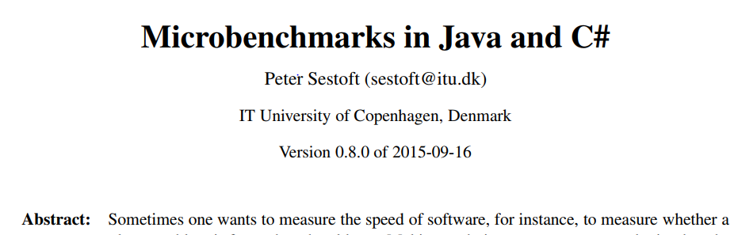
Benchmarking note
A goldmine of good advice
Accompanying code: Benchmark.java
class Benchmark {
public static void main(String[] args) { new Benchmark(); }
public Benchmark() {
SystemInfo();
// Mark0();
// Mark1();
Mark2();
...
// Mark8("random_index", i -> rnd.nextInt(n));
...
// SortingBenchmarks();
...

Slide 12
Example: measuring a simple function
private static double multiply(int i) {
double x = 1.1 * (double)(i & 0xFF);
return x * x * x * x * x * x * x * x * x * x
* x * x * x * x * x * x * x * x * x * x;
}
public static double Mark2() {
Timer t = new Timer();
int count = 100_000_000;
double dummy = 0.0;
for (int i=0; i<count; i++)
dummy += multiply(i);
double time = t.check() * 1e9 / count;
System.out.printf("%6.1f ns%n", time);
return dummy;
}
Get the code from
timingMultiplication.java
Try running it yourself
Report result in poll
www.menti.com : 38 23 09 6
# OS: Windows 10; 10.0; amd64
# JVM: Oracle Corporation; 1.8.0_181
# CPU: Intel64 Family 6 Model 126 Stepping 5, GenuineIntel; 8 "cores"
# Date: 2021-09-12T09:14:34+0200
24.0 ns
Notes:
Highligthed in yellow to fool the optimizer
Code in timingMultiplication.java
Let all students try. Poll results

Slide 13
The Timer class (in Benchmark.java)
A simple Timer class for Java Works on all platforms (Linux, MacOS, Windows)
public class Timer {
private long start, spent = 0;
public Timer() { play(); }
public double check()
{ return (System.nanoTime()-start+spent)/1e9; }
public void pause() { spent += System.nanoTime()-start; }
public void play() { start = System.nanoTime(); }
}

Slide 14
Automating multiple runs (Mark3)
Results will usually vary
public static double Mark3() {
int n = 10; int count = 100_000_000; double dummy = 0.0; for (int j=0; j<n; j++) { Timer t = new Timer(); for (int i=0; i<count; i++) dummy += multiply(i); double time = t.check() * 1e9 / count; System.out.printf("%6.1f ns%n", time); } return dummy; }
24.6 ns
24.6 ns
24.5 ns
24.6 ns
24.4 ns
24.3 ns
24.5 ns
24.4 ns
24.7 ns
24.6 ns

Slide 15
What is the running time?
What should you report as the result, when the observations are:
30.7 ns 30.3 ns 30.1 ns 30.7 ns 30.5 ns 30.4 ns 30.9 ns 30.3 ns 30.5 ns 30.8 ns ??
Mean: 30.4 ns
What if they are:
30.7 ns 100.2 ns 30.1 ns 30.7 ns 20.2 ns 30.4 ns 2.0 ns 30.3 ns 30.5 ns 5.4 ns ??
Mean: 31.0 ns

Slide 16
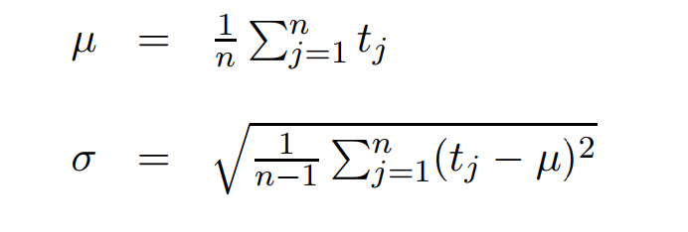
Standard deviation/variance
Benchmark note p6
30.7 ns 30.3 ns 30.1 ns 30.7 ns 50.2 ns 30.4 ns 30.9 ns 30.3 ns 30.5 ns 30.8 ns ??
Mean: 32.5 ns Standard deviation: 6.2

Slide 17
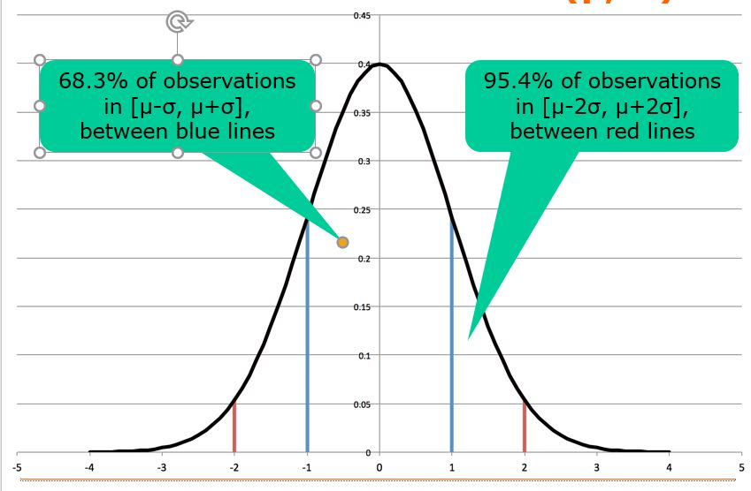
Normal distribution

Slide 18
Outliers
What should you report as the result, when the observations are:
30.7 ns 30.3 ns 30.1 ns 30.7 ns 50.2 ns 30.4 ns 30.9 ns 30.3 ns 30.5 ns 30.8 ns ??
Mean: 32.5 ns Standard deviation: 6.2
50.2 is an outlier
because there is a probability of less than 4.6 % that 50.2 is a correct observation

Slide 19
Agenda
Performance measurements: motivation and introduction
Pitfalls (and avoiding them)
Calculating means and variance (efficiently)
Measurements of thread and lock overhead
Algorithms for parallel computing

Slide 20

Computing the variance
Requires two passes through the data
Can be done in one pass (on-line alg.)
for (int j=0; j<n; j++) {
Timer t = new Timer();
for (int i=0; i<count; i++)
...
double time = t.check() * 1e9 / count;
st += time;
sst += time * time;
}
double mean = st/n, sdev = Math.sqrt((sst - mean*mean*n)/(n-1));
System.out.printf("%6.1f ns +/- %6.3f%n", mean, sdev);

Slide 21

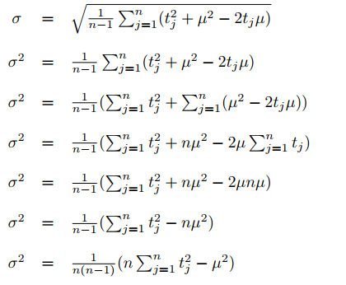

The two formulas give the same result
Formula in Benchmark note
See exercises03.pdf
see also https://en.wikipedia.org/wiki/Algorithms_for_calculating_variance
Formula used in code (one pass algorithm)

Slide 22
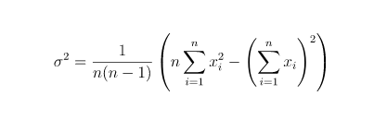
Warning
int n = 10;
...
for (int j=0; j<n; j++) {
Timer t = new Timer();
for (int i=0; i<count; i++)
...
double time = t.check() * 1e9 / count;
st += time;
sst += time * time;
}
double mean = st/n, sdev = Math.sqrt((sst - mean*mean*n)/(n-1));
System.out.printf("%6.1f ns +/- %6.3f%n", mean, sdev);
Beware: sst - mean * mean * n
can be a very small number

Slide 23
Digit loss
Beware of cancellation when subtracting numbers that are close to each other:
1010101000010110110001110101.111
-1010101000010110110001110001.100
--------------------------------
0000000000000000000000000100.011

Slide 24
Digit loss
Beware of cancellation when subtracting numbers that are close to each other:
1010101000010110110001110101.111
-1010101000010110110001110001.100
--------------------------------
0000000000000000000000000100.011
(sst - mean*mean) can be problematic.
How to do it: https://en.wikipedia.org/wiki/Algorithms_for_calculating_variance

Slide 25
Mark5 - computes mean and variance
public static double Mark5() {
int n = 10, count = 1, totalCount = 0;
double dummy = 0.0, runningTime = 0.0, st = 0.0, sst = 0.0;
do {
count *= 2;
st = sst = 0.0;
for (int j=0; j<n; j++) {
Timer t = new Timer();
for (int i=0; i<count; i++) dummy += multiply(i);
runningTime = t.check();
double time = runningTime * 1e9 / count;
st += time;
sst += time * time;
totalCount += count;
}
double mean = st/n, sdev = Math.sqrt((sst - mean*mean*n)/(n-1));
System.out.printf("%6.1f ns +/- %8.2f %10d%n", mean, sdev, count);
} while (runningTime < 0.25 && count < Integer.MAX_VALUE/2);
return dummy / totalCount;
}

Slide 26
Mark5 - computes mean and variance
public static double Mark5() {
int n = 10, count = 1, totalCount = 0;
double dummy = 0.0, runningTime = 0.0, st = 0.0, sst = 0.0;
do {
count *= 2;
st = sst = 0.0;
for (int j=0; j<n; j++) {
Timer t = new Timer();
for (int i=0; i<count; i++) dummy += multiply(i);
runningTime = t.check();
double time = runningTime * 1e9 / count;
st += time;
sst += time * time;
totalCount += count;
}
double mean = st/n, sdev = Math.sqrt((sst - mean*mean*n)/(n-1));
System.out.printf("%6.1f ns +/- %8.2f %10d%n", mean, sdev, count);
} while (runningTime < 0.25 && count < Integer.MAX_VALUE/2);
return dummy / totalCount;
}
Notes:
Becomes boring to just measure multiplication !

Slide 27
Mark 6
private static double multiply(int i) { . . .
}
Java: multiply(i) is a number
Java: i -> multiply(i) is a function
https://docs.oracle.com/javase/tutorial/java/javaOO/lambdaexpressions.html
Mark6( . . . , i -> multiply(i));
www.menti.com : 38 23 09 6
Notes:
Mentimeter

Slide 28
Mark6 - introducing a functional argument
public static double Mark6(String msg, IntToDoubleFunction f) {
int n = 10, count = 1, totalCount = 0;
double dummy = 0.0, runningTime = 0.0, st = 0.0, sst = 0.0;
do {
count *= 2;
st = sst = 0.0;
for (int j=0; j<n; j++) {
Timer t = new Timer();
for (int i=0; i<count; i++) dummy += f.applyAsDouble(i);
runningTime = t.check();
double time = runningTime * 1e9 / count;
st += time; sst += time * time; totalCount += count;
}
double mean = st/n, sdev = Math.sqrt((sst - mean*mean*n)/(n-1));
System.out.printf("%-25s %15.1f ns %10.2f %10d%n", msg, mean, sdev, count);
} while (runningTime < 0.25 && count < Integer.MAX_VALUE/2);
return dummy / totalCount;
}
public interface IntToDoubleFunction { double applyAsDouble(int i); }
Mark6("multiply", i -> multiply(i));
// same as line above, for motivation see here
// https://docs.oracle.com/javase/tutorial/java/javaOO/methodreferences.html
The function f is
benchmarked

Slide 29
Example use of Mark6
Mark6("multiply", i -> multiply(i));
multiply 800.0 ns 1435.27 2
multiply 250.0 ns 0.00 4
multiply 212.5 ns 80.04 8
multiply 187.5 ns 39.53 16
multiply 200.0 ns 82.92 32
multiply 57.8 ns 24.26 64
multiply 46.9 ns 4.94 128
...
multiply 30.6 ns 0.61 2097152
multiply 30.0 ns 0.10 4194304
multiply 30.1 ns 0.15 8388608

Slide 30
Mark7 - printing only final values
public static double Mark7(String msg, IntToDoubleFunction f) {
...
do {
...
} while (runningTime < 0.25 && count < Integer.MAX_VALUE/2);
double mean = st/n, sdev = Math.sqrt((sst - mean*mean*n)/(n-1));
System.out.printf("%-25s %15.1f %10.2f %10d%n", msg, mean, sdev, count);
return dummy / totalCount;
}

Slide 31
Agenda
Performance measurements: motivation and introduction
Pitfalls (and voiding them)
Calculating means and variance (efficiently)
Measurements of thread and lock overhead
Algorithms for parallel computing

Slide 32
Thread creation
Mark7("Thread create",
i -> {
Thread t = new Thread(() -> {
for (int j=0; j<1000; j++) // not executed
ai.getAndIncrement(); // thread t created, but not started
});
return t.hashCode();
});
Takes 700 ns
Slow or fast?
Notes:
Try running it with mark7

Slide 33
Creating an object
A thread is an object, so let us start finding the cost of creating a simple object.
class Point {
public final int x, y;
public Point(int x, int y) { this.x = x; this.y = y; }
}
Mark7("hashCode()", i -> myPoint.hashCode());
Mark7("Point creation",
i -> {
Point p = new Point(i, i);
return p.hashCode();
});
hashCode() 3 ns
Point creation 50 ns
So object creation is: ~ 47 ns
Thread creation: 700 ns
Notes:
Code in TestTimeThreads

Slide 34
Thread create + start
Mark6("Thread create start",
i -> {
Thread t = new Thread(() -> {
for (int j=0; j<1000; j++) //most iterations not done
ai.getAndIncrement(); // Why?
});
t.start();
return t.hashCode();
});
Takes ~ 47000 ns
So, a lot of work goes into starting a thread
Even after creating it
Note: does not include executing the loop (why?)
Never create threads for small computations

Slide 35
Agenda
Performance measurements: motivation and introduction
Pitfalls (and voiding them)
Calculating means and variance (efficiently)
Measurements of thread and lock overhead
Algorithms for parallel computing

Slide 36
Algorithms for parallel computing
Quicksort:
https://www.chrislaux.com/quicksort.html
private static void qsort(int[] arr, int a, int b) {
if (a < b) {
int i = a, j = b;
int x = arr[(i+j) / 2];
do {
while (arr[i] < x) i++;
while (arr[j] > x) j--;
if (i <= j) { swap(arr, i, j); i++; j--; }
} while (i <= j);
qsort(arr, a, j); qsort(arr, i, b);
}
} see SearchAndSort.java in week 03 material
Prime counting:
https://www.dcode.fr/prime-number-pi-count
long count = 0;
final int from = 0, to = range;
for (int i=from; i<to; i++) if (isPrime(i)) count++;
see TestCountPrimes.java in week 03 material
Notes:
Make a drawing on the board: problem sort (I, j)

Slide 37
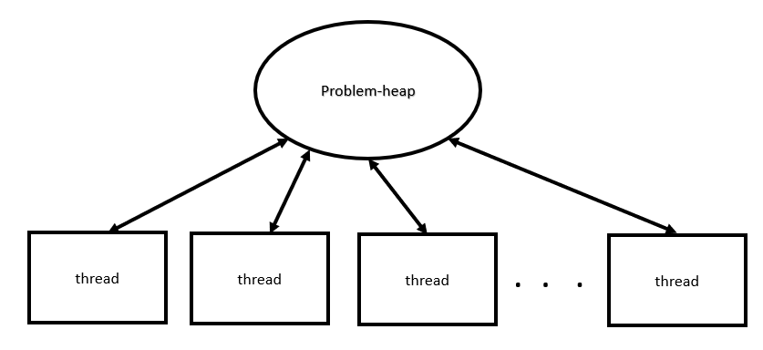
Multi-threaded version of Quicksort
class Problem {
public int[] arr;
public int low, high;
}
class ProblemHeap {
list<Problem> heap= new List<Problem>;
... }
private static void qsort(Problem problem, ProblemHeap heap) {
int[] arr= problem.arr;
int a= problem.a;
int.b= problem.b;
...
heap.add(new Problem(arr, a, j); //qsort(arr, a, j);
heap.add(new Problem(arr, i, b));//qsort(arr, i, b);
}

Slide 38
Mark 8 Quicksort
Quicksort 1 14196896.3 ns 136477.51
Quicksort 2 8112412.2 ns 67791.32
Quicksort 4 4912498.3 ns 71961.04
Quicksort 8 3880639.1 ns 32812.31
Quicksort 16 4553503.8 ns 40945.07
Quicksort 32 6312270.0 ns 43905.97
Disappointing ?

Slide 39
Multithreaded version of CountPrimes
2, 3, 4, 5, ……… range
thread0
thread1
threadN
Code for exercises week03: testCountPrimes.java

Slide 40
Mark7 Count Primes
countSequential 5922958.0 ns 289879.33
countParallel 1 7107236.6 ns 448417.55
countParallel 2 6069944.7 ns 802224.61
countParallel 3 3621185.5 ns 152693.03
countParallel 4 3124067.0 ns 640480.51
countParallel 5 3699514.7 ns 364428.77
countParallel 6 4114074.2 ns 642562.19
countParallel 7 2049595.7 ns 26888.15
countParallel 8 1801465.6 ns 12532.85
countParallel 9 1793099.1 ns 11017.57
countParallel 10 1798921.4 ns 11541.43
countParallel 11 1807408.3 ns 9763.61

Slide 41
To be continued in week 6

