Slide 1

Reliable Market-Data Distribution for a Networked Electronic Exchange
Computer Networks (CSC-303) • Group 11 • IIT Roorkee
Project Guide: Dr. Sandeep Kumar Garg
TCP order entry
UDP multicast
Dual feeds
Replay & snapshot
SHA-256 verified
Notes:
Introduce the project: a prototype electronic exchange with a reliability layer for UDP multicast market data. Mention the guide and the course.

Slide 2
Team Members
Name | Enrollment No. | Contribution
Anurag Kishor Patil | 24114015 | System architecture, exchange and order-book design, integration of the main components.
Prabhat Chandra Tiwari | 24114066 | Order-entry mechanism, TCP communication, integration of client orders with the matching engine.
Vaibhav Kumar | 24114103 | Market-data publishing and subscription, dual-feed mechanism, UDP multicast.
Samarth Maheshwari | 24114084 | Sequence tracking, duplicate detection, packet-loss identification, recovery of missing events.
Vishal Kumar Shaw | 24114105 | Snapshot recovery, SHA-256 integrity verification, recovery history and scheduling.
Rishabh Gupta | 24114077 | GUI dashboard, performance metrics, fault-injection experiments, testing and result analysis.
Project Guide: Dr. Sandeep Kumar Garg • Department of Computer Science and Engineering
Notes:
Introduce each member and what they built.

Slide 3



Why this Project
The Problem
Existing Approaches Fall Short
Our Solution
Order entry is request/response; market data is a high-volume one-to-many stream. UDP multicast is efficient but guarantees no delivery, ordering or duplicate suppression, so a subscriber that misses an update holds an incomplete order book.
Single UDP feed: no repair, gaps persist.
UDP + TCP retransmit: fails once history expires.
Dual feeds only: cannot fix correlated loss.
Dual feeds A and B
Sequence tracking and duplicate suppression
Bounded TCP replay for recent gaps
Verified snapshot fallback
SHA-256 final book digest
Motivation: a subscriber sees sequence 100, then 102. It cannot assume 101 was irrelevant, since it may have changed the best price, removed liquidity or recorded a trade.
Notes:
Order entry and market data have different needs. UDP multicast is efficient but unreliable. Our layer closes that gap.

Slide 4
Key Concepts
ORDER-BOOK BASICS
NETWORK & RELIABILITY BASICS
Limit Order Book
UDP Multicast
Per-instrument bids (highest first) and asks (lowest first), organised by price and time. The matching engine executes crossing orders.
One datagram reaches every subscriber in the group, efficient for one-to-many but with no promise of arrival.
Price-Time Priority
Replay vs Snapshot
At the same price the earlier resting order trades first. An unfilled limit remainder rests in the book.
Replay resends retained events for a known gap. A snapshot is a book checkpoint, used when events have aged out.
Market-Data Event
SHA-256 Integrity Digest
A published message for a book or trade change. Each carries an increasing sequence number so gaps and duplicates are visible.
Snapshot hashes chain to the previous checkpoint, giving tamper evidence (not authentication or persistence).
Notes:
Quick vocabulary so the architecture slides make sense.

Slide 5
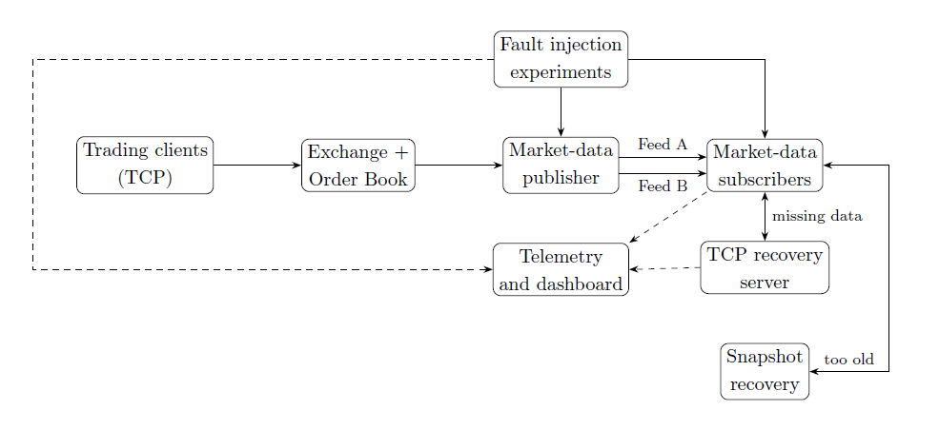
System Architecture
01
Order Entry
Clients send framed orders over TCP; the exchange matches them in one authoritative book.
02
Market-Data Feeds
Book changes become sequence-numbered events sent over UDP multicast on Feeds A and B.
03
Recovery & Telemetry
Subscribers repair gaps by TCP replay or snapshot; telemetry feeds the dashboard.
Figure 1. Initial project-level architecture
Notes:
Walk the figure left to right: clients, exchange, publisher, two feeds, subscribers, recovery.

Slide 6
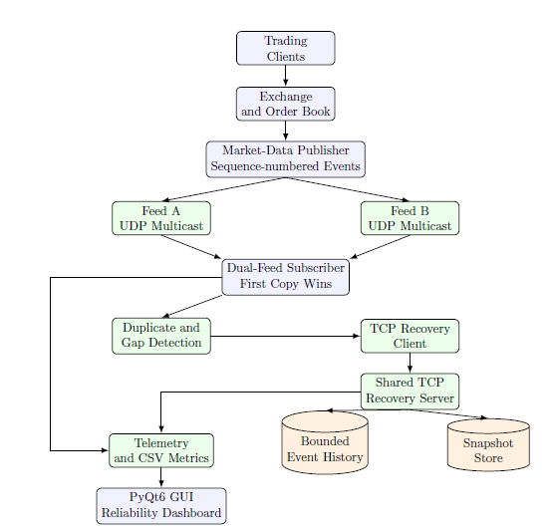
System Workflow
1
Order in Client submits a framed order over TCP; the matching engine updates the book.
2
Event out The book change becomes a sequence-numbered market-data event.
3
Two feeds The publisher sends the same stream to Feed A and Feed B.
4
First copy wins Subscriber drops duplicates and buffers events beyond a gap.
5
Repair Second feed, then TCP replay, then verified snapshot.
6
Reconcile At shutdown, local and exchange book digests are compared.
Figure 2. Detailed reliability pipeline
Notes:
Follow the pipeline top to bottom, then the six operating steps on the right.

Slide 7

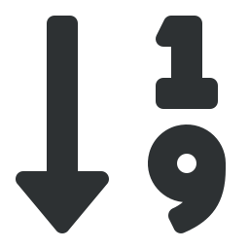






System Components
Exchange Side
Subscriber & Recovery Side
Order-Entry Server
Sequence Tracker & DualFeed
Framed TCP, multi-client, bounded mutex-protected queue.
First-copy-wins, gap buffering, ordered drain.
Order Book & Matching
TCP Recovery Server
Price-time priority for AAPL, GOOGL, AMZN, NFLX, META.
Bounded history, chunked replay, FCFS or Round-Robin scheduler.
Market-Data Publisher
Snapshot Store & Hasher
Global sequence numbers, ring buffer, publisher thread.
Retained checkpoints chained by SHA-256.
Dual Multicast Feeds
Telemetry & Dashboard
Feed A 239.1.1.1:9999 and Feed B 239.1.1.2:10000.
CSV metrics and a PyQt6/pyqtgraph control room.
Notes:
Exchange side produces events; subscriber and recovery side consumes and repairs them.

Slide 8
Core Algorithms
Sequence Tracking & Gap Detection
First-Copy-Wins Dual Feed
Keep the expected sequence E. For a received S:
The first valid copy of a sequence is delivered; the later copy from the other feed is counted as a duplicate.
S < E: old or duplicate, ignore
S = E: deliver and advance E
S > E: buffer S, request [E, S−1]
A loss on one feed avoids a TCP request
Bounded Replay & Snapshot Fallback
Recovery Fairness
If range [a, b] is retained, replay the original datagrams. If not, the server answers TOO_OLD.
FCFS serves requests in arrival order. Round-Robin rotates across subscriber queues so one noisy subscriber cannot monopolise recovery.
Verified snapshot resumes at checkpoint seq + 1
Measured with a Jain fairness index
Notes:
Sequence tracking is the foundation; the other three build on it.

Slide 9
Three-Layer Recovery
LAYER 1
LAYER 2
LAYER 3
Second Feed
TCP Replay
Verified Snapshot
A short gap-grace window lets Feed B supply the missing event. Feed B repaired 91 of 101 Feed-A gaps (90.1%).
The missing range is requested from bounded history and replayed as original datagrams, chunked if large.
On TOO_OLD the subscriber fetches a checkpoint, verifies its SHA-256 hash, and resumes after it.
p50 ≈ 0.15 ms
p50 ≈ 3.15 ms
20 recoveries, 0 failed
Final reconciliation
Stop UDP reception, poll STATUS until stable, drain any tail gap, then compare the subscriber's local book digest with the exchange's digest. Success requires both accounting and integrity checks to pass.
Notes:
Each layer is used only when the previous one cannot fill the gap.

Slide 10





Key Novelty and Innovations
Redundant Multicast + Selective Repair
Two Recovery Scales
Verified Reconstruction
The second feed repairs some losses instantly; TCP is used only for gaps that remain.
Event-level replay for recent gaps, state-level snapshot for older ones.
Receiving packets is not proof of correctness; SHA-256 book digests are compared.
Recovery Fairness
Repeatable Experiments
Observable Platform
FCFS vs Round-Robin judged by per-subscriber queue wait under contention.
Seeded fault injection on in-process and live multi-process paths, with CSV export.
Structured telemetry and a six-chart dashboard for teaching and evaluation.
Notes:
The novelty is in the integration and evaluation of several mechanisms in one prototype, not a new matching algorithm or cryptographic primitive.

Slide 11
Tools and Technologies
Technology / Tool | Purpose
C++23 | Order book, order entry, market-data publishing, recovery, hashing and metrics
CMake (3.24+) | Native build system, Clang and GCC toolchains
Boost, spdlog | Build dependencies
GoogleTest | Unit test suite (51 tests)
TCP / UDP sockets | TCP for order entry and recovery; UDP multicast for market-data feeds
Python 3.11+ | Experiment orchestration and GUI
pybind11 | Connects the C++ order book to Python
PyQt6, pyqtgraph | Desktop GUI and live charts
matplotlib | Plotting utilities for results
Notes:
Mostly C++23 for the core; Python for the GUI and experiment orchestration.

Slide 12






Dashboard Interface
Market Visualisation
Exchange Control
Manual Order Testing
Price, depth and volume charts from a local order-book simulator.
Launch the exchange and workload clients; view process status and results.
Send a real TCP order and see the ACK or reject with round-trip time.
LAN Setup
Previous Results
Reliability Dashboard
Commands for running clients from another machine on a private LAN.
Browse saved workload and reliability CSV files.
Six data-driven charts and per-subscriber result tables.
Market Visualisation is an in-process simulator and does not publish UDP data; live exchange control is a separate process-based workflow.
Notes:
Six views in the PyQt6 / pyqtgraph control room.

Slide 13
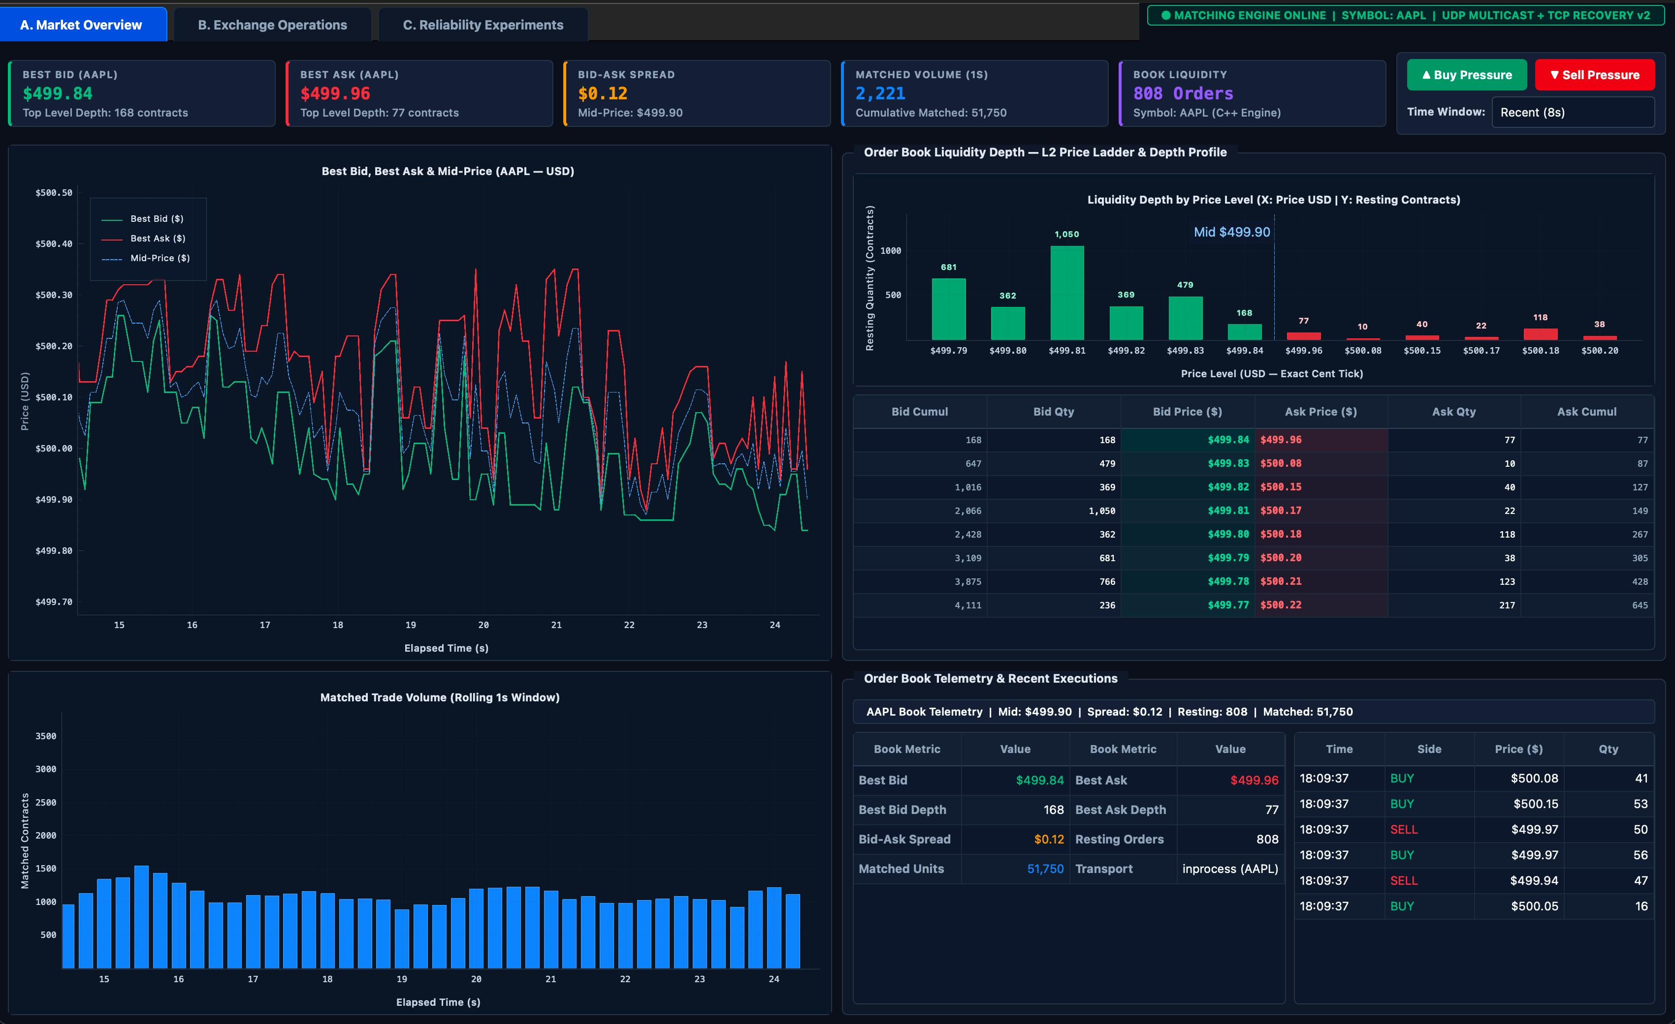
Application Screenshots
Market Visualisation tab
Notes:
Insert genuine captures from the running application before presenting.

Slide 14
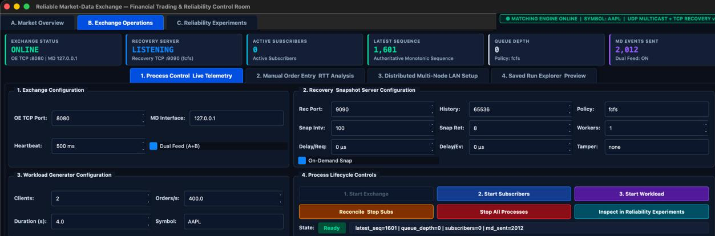
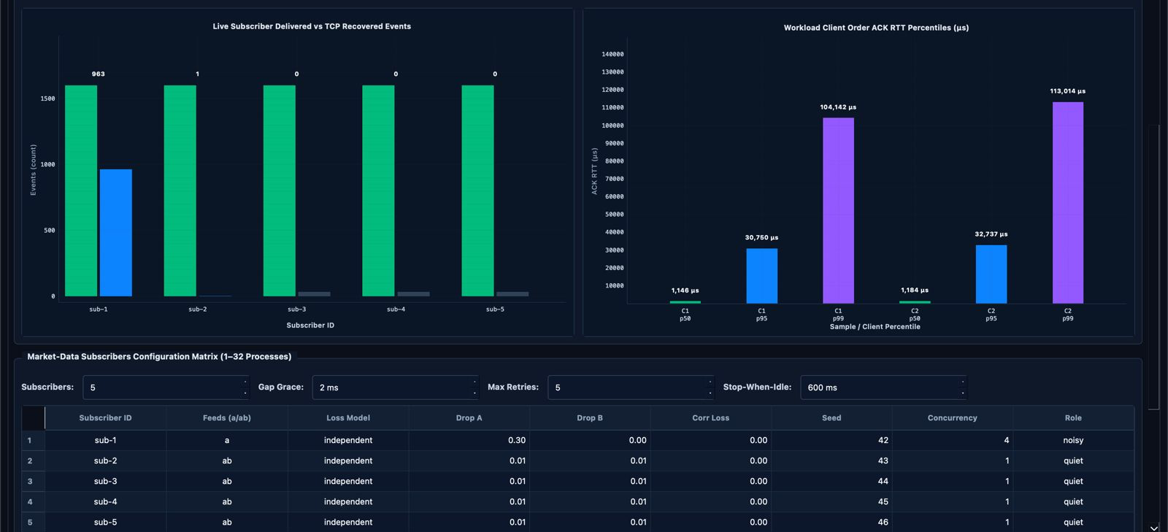
Exchange Control with exchange, clients and subscribers running
Notes:
Insert genuine captures from the running application before presenting.

Slide 15
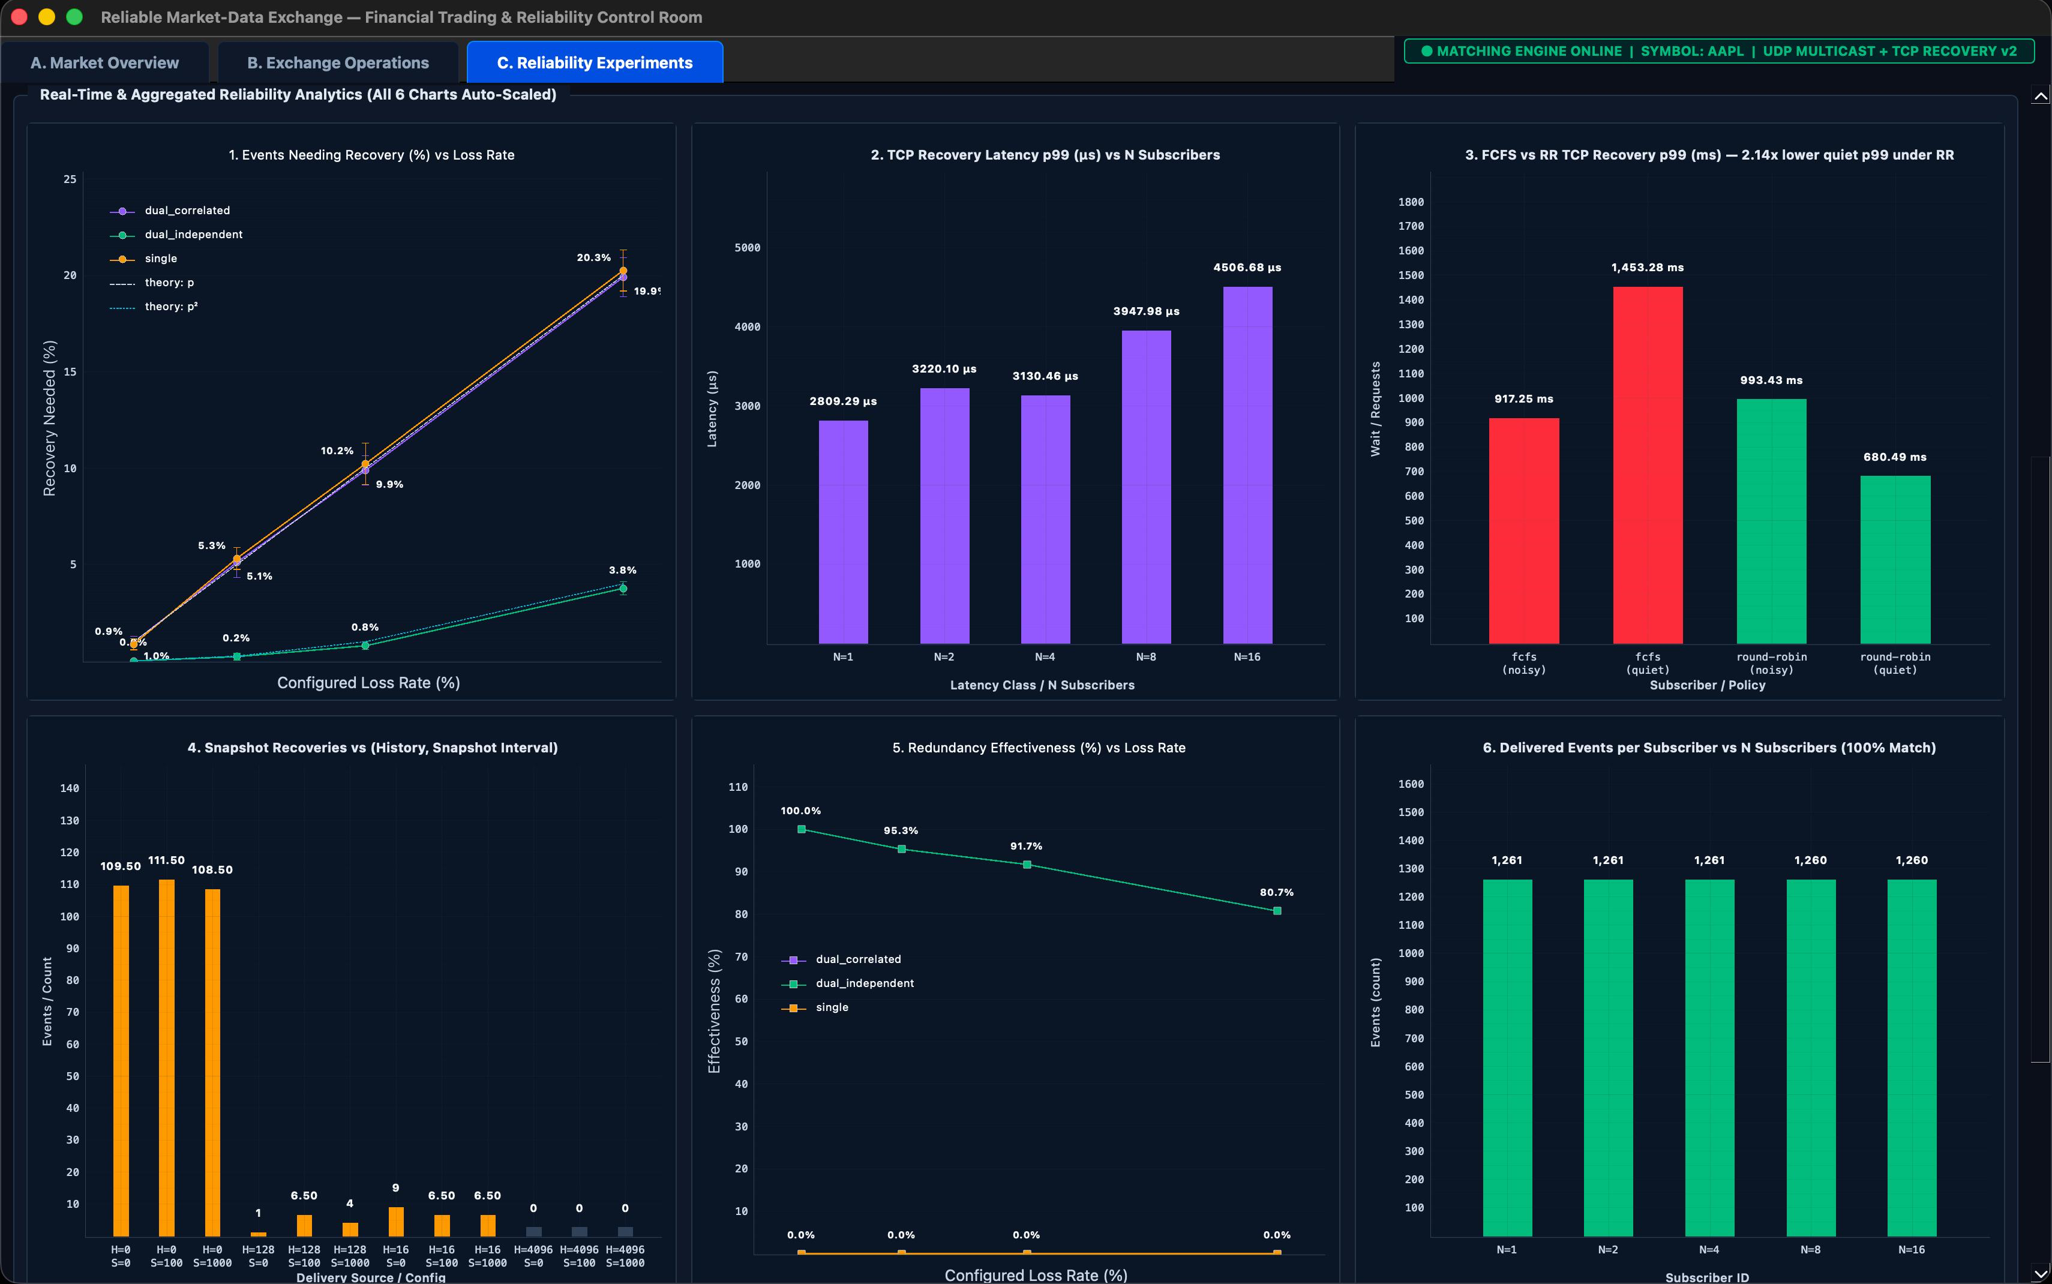
Reliability Dashboard with six charts
Notes:
Insert genuine captures from the running application before presenting.

Slide 16
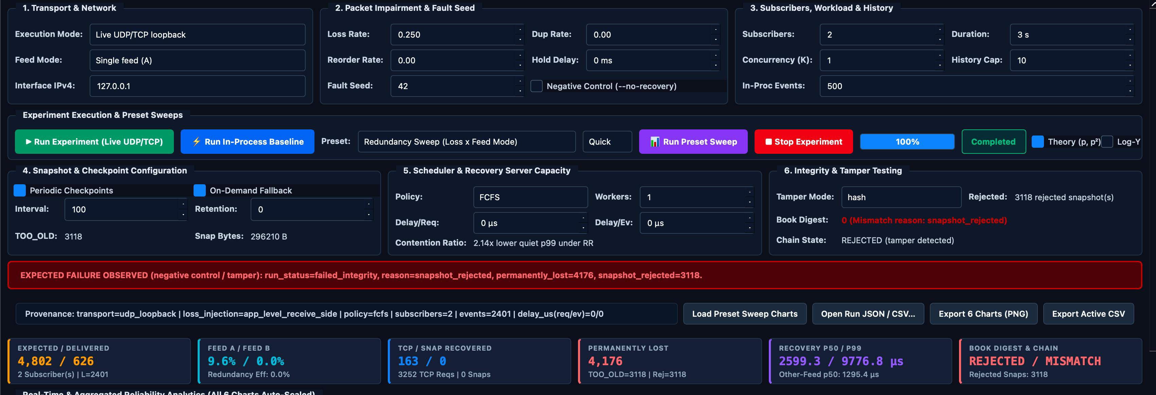
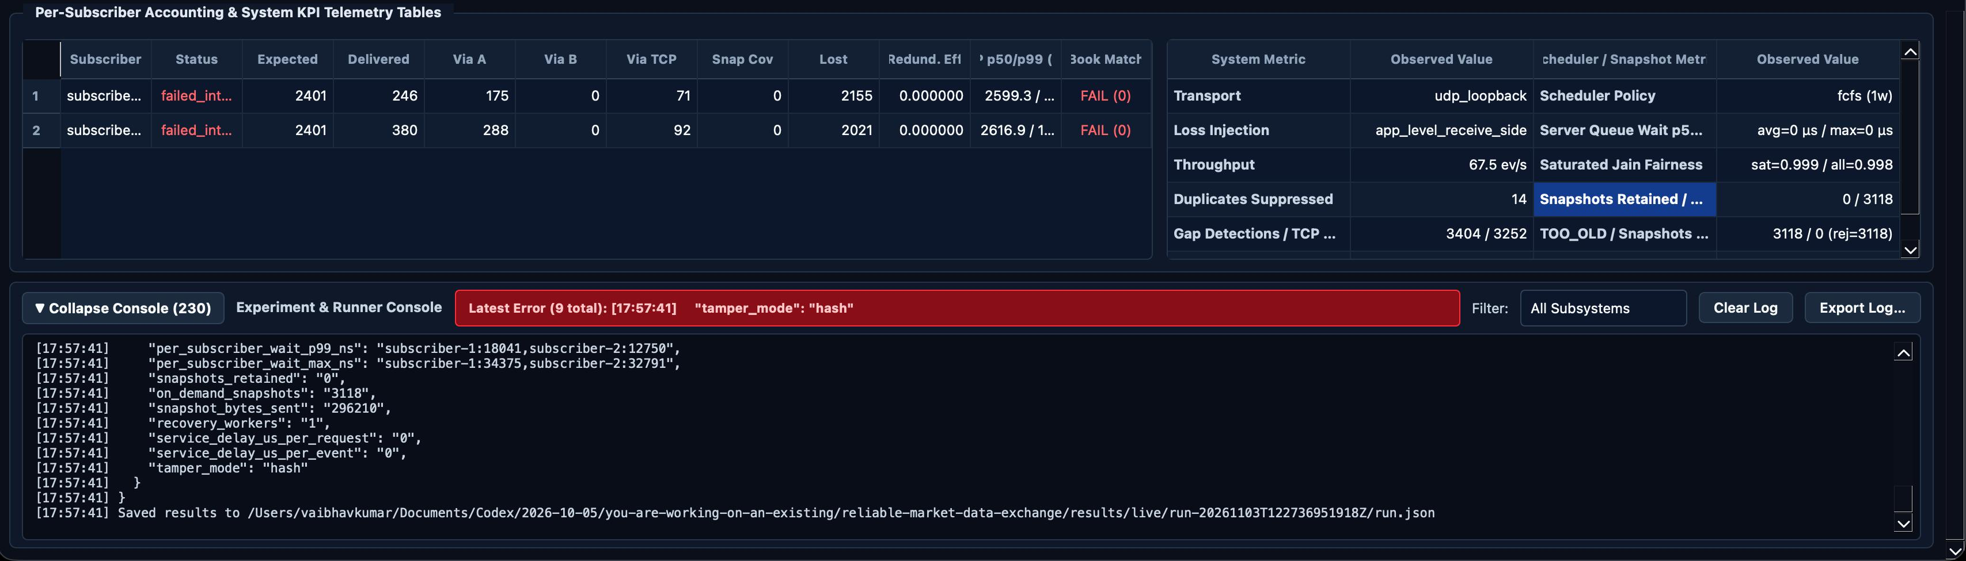
Snapshot tamper experiment: rejected snapshot
Notes:
Insert genuine captures from the running application before presenting.

Slide 17
Software Engineering Principles
Verification Ledger
Iterative lifecycle, not a one-pass waterfall
Findings F0–F15 mapped to fixes and regression tests, e.g. tail-gap races and out-of-order recovery.
Problem identification & scope
Requirement analysis
Architecture & protocol design
1
2
3
Modular build
Unit testing
Multi-process & fault testing
Modular Design
4
5
6
Independent libraries and executables with documented interfaces and protocols.
Metrics & evaluation
GUI & documentation
Final verification
7
8
9
Docs & Version Control
Design doc, protocol spec, metrics definitions, viva guide; one shared GitHub repository.
Notes:
Iterative lifecycle with traceable verification findings.

Slide 18
Testing and Evaluation
51/51
30/30
32/32
90.1%
GoogleTest unit tests passed
lossy runs passed with eight subscribers
subscribers completed, none permanently lost
of Feed-A gaps repaired by Feed B (91 of 101)
On-demand snapshot fallback
Snapshot tamper test
20 snapshot recoveries, zero failures, book matches the exchange (short history, 30% single-feed loss).
A mutated snapshot was rejected by the subscriber and an integrity failure was observed.
Notes:
Unit, live end-to-end, GUI smoke and preset experiments. All figures are repository-reported results.

Slide 19
Recovery Performance
Seed 42, 10% independent feed loss. TCP recovery ranges fell from 88 to 8.
Scheduler contention: a 3.05× improvement under Round-Robin.
Closer to 1.0 means fairer service across subscribers.
Notes:
Other-feed repair is fastest; Round-Robin protects quiet subscribers under contention.

Slide 20
Comparison with Existing Approaches
Approach | Loss handling | When history expires | State verification | Main trade-off
Single UDP multicast feed | No repair; gaps remain | Usually absent | Not inherent | Low overhead, weaker assurance
UDP + TCP retransmission | Repairs gaps while retained | Fails if data not retained | Implementation-dependent | Recovery RTT and server load
Dual UDP feeds only | Second feed masks independent loss | No solution if both miss | Not inherent | Cannot fix correlated loss or long outages
Proposed Group 11 system | Second feed, bounded TCP replay, snapshot | Verified snapshot fallback | SHA-256 chain and final book digest | More components; observable recovery path
Notes:
Architectural comparison of design patterns, not a benchmark against commercial exchanges.

Slide 21
Limitations and Scope
Centralised design
Integrity is not security
One authoritative order book per instrument. No consensus or replicated matching engine.
The hash chain gives tamper evidence only: no persistence, publisher authentication, encryption or key management.
Two paths, kept separate
Approximate execution reports
In-process demo results and live UDP/TCP results are not mixed; the GUI simulator does not publish multicast.
Execution price is taken from the best opposite-side level after matching and may differ from the actual fill.
Educational and experimental prototype: not certified for production trading, high availability or regulatory compliance.
Notes:
Be upfront about what the prototype does and does not claim.

Slide 22
Conclusion and Future Work
Achievements
Future Improvements
End-to-end workflow: order submission to matching to market-data reconstruction.
Layered recovery: dual feeds, gap detection, bounded replay, snapshot fallback.
Verified state: SHA-256 digests compared at end of run.
Fair recovery: Round-Robin scheduling measured against FCFS.
Observable: telemetry, CSV exports and a GUI dashboard.
Durable storage for snapshots and event history.
Authenticated, encrypted recovery transport and publisher identity.
Exact per-fill execution reports and richer order types.
Larger tests: cross-platform LAN, higher event rates and subscriber counts.
Crash/restart recovery tests and comparison with open-source feed handlers.
Notes:
Reliable delivery needs more than sending packets: detect, repair, verify, reconcile.

Slide 23
THANK YOU
Group 11 • Computer Networks (CSC-303) • IIT Roorkee
Notes:
Invite questions. Repo link is on the previous slide.

