Slide 1
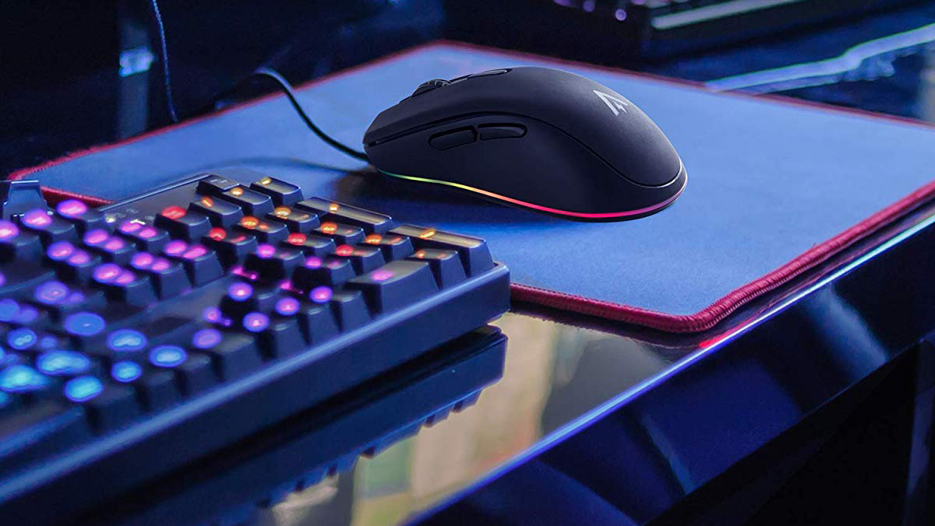
COC.
R.L
L.O.L
Dota 2
OVERWATCH
CBHS ESPORTS
CLUB
Patreon
Suggestions!!

Slide 2



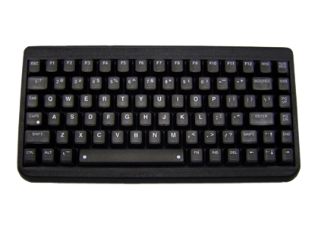

Rocket league
League of Legends
Clash of Clans
Overwatch
Beach Buggy Racing
Dota 2
Sonic dash
Clash Royale
Discord
Notices
Patreon/support the boys
Suggestions
ESPORTS

Slide 3

Games
Contacts
Teams

