Slide 1
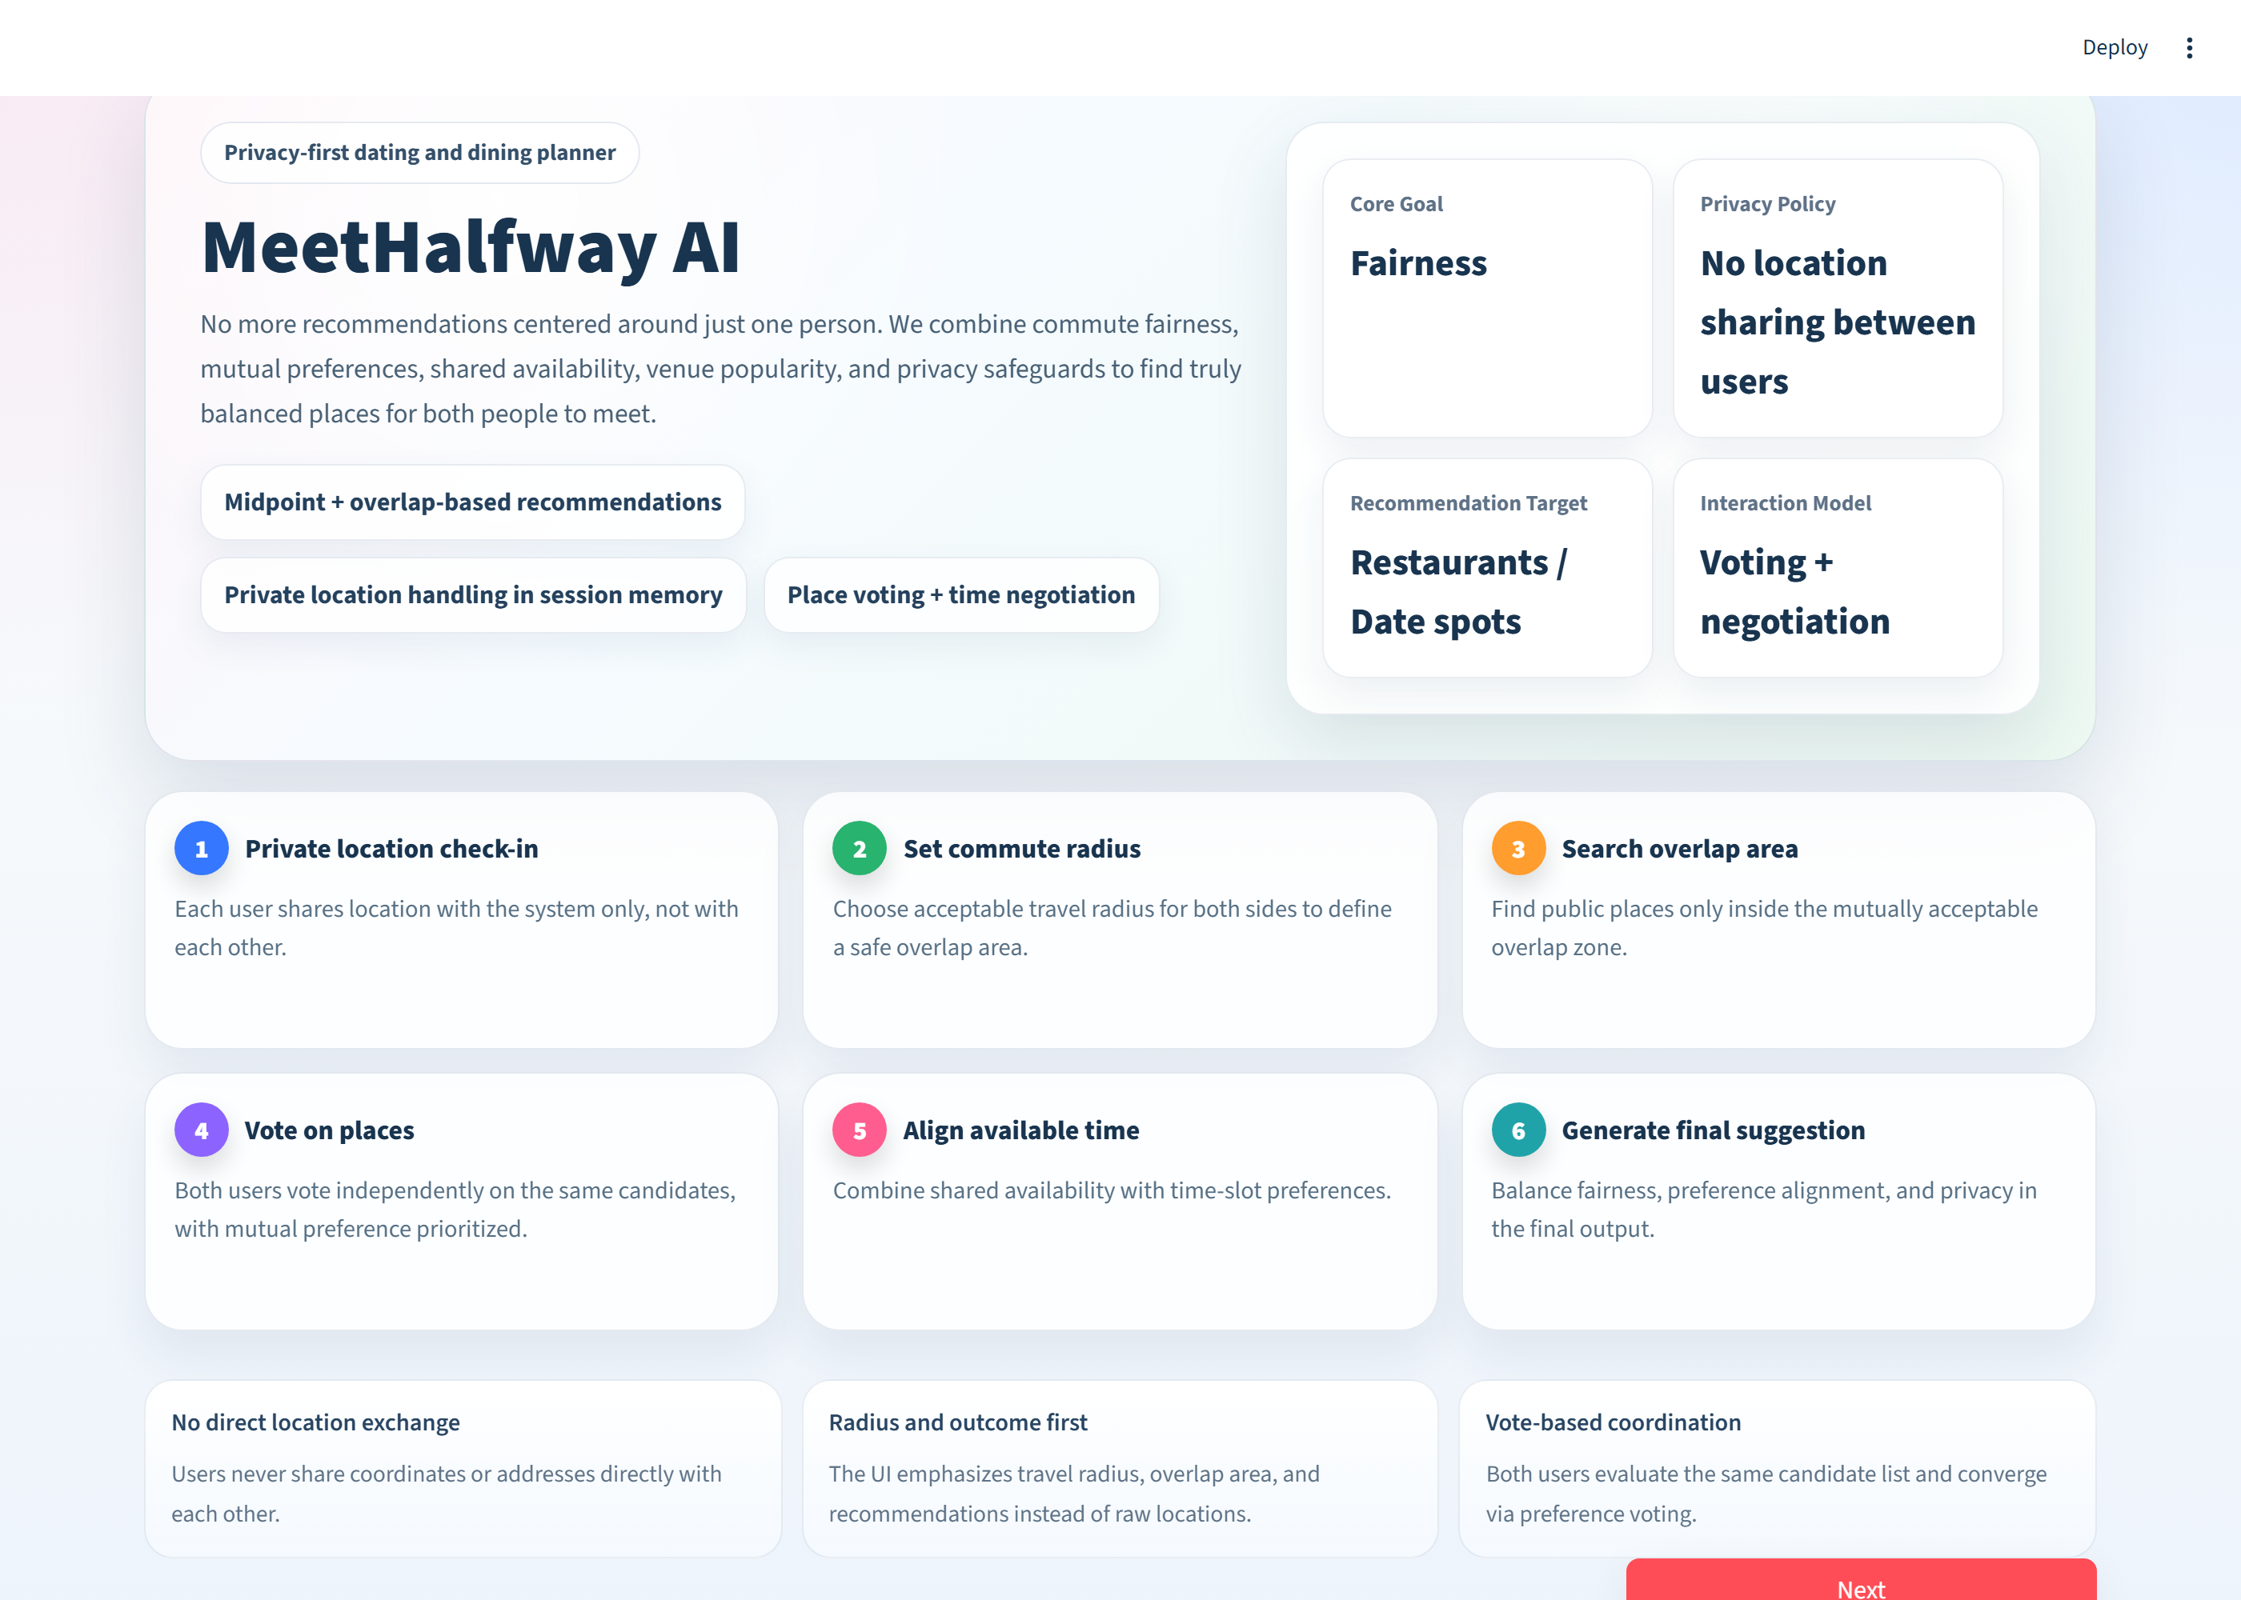
MeetHalfway Demo Interface — Home Page
Project title and positioning
Project name and tagline frame the system as a privacy-first meeting-place planner.
Design principles at a glance
Core goal, privacy policy, recommendation target, and interaction model presented as summary cards.
Six-step privacy-separated workflow
From private check-in to commute radius, overlap search, voting, time alignment, and final suggestion.
Privacy guarantees
Participants never exchange raw coordinates with one another; only outcomes are shown.
Entry point into the meeting query
The Next button advances the user from the landing page to the participant input flow.

Slide 2
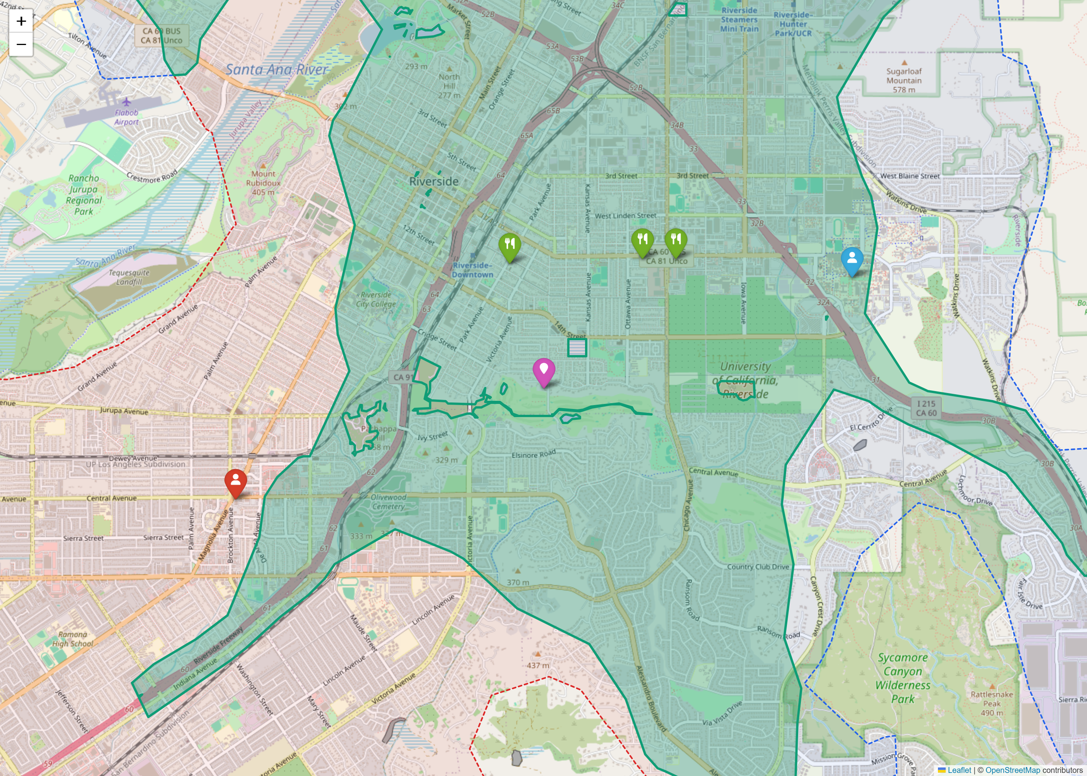
MeetHalfway Demo Result — Shared Feasible Region & Candidates
Shared feasible region
Green shaded polygon is the intersection of the two travel-time isochrones — the jointly reachable area.
Ranked candidate venues
Green pins denote candidate POIs retrieved inside the shared region and ranked by the fairness score.
Participant B starting location
Blue pin marks the second participant's geocoded starting point.
Geometric midpoint baseline
Magenta pin shows the naive midpoint a non-fairness-aware tool would return, for contrast.
Participant A starting location
Red pin marks the first participant's geocoded starting point.

