Slide 1
NSF-NRT challenge A
Team insight : ppt and product made by Zelong Huang and Perry Liang

Slide 2
Contents
1:Problem Statement & Mission
2:Hardware: High-Precision Sensing
3:Gateway & Data Processing Logic
4:Conclusion & Future Work

Slide 3

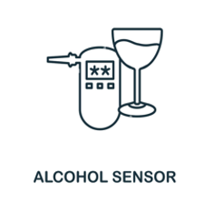
Problem Statement & Mission
Problem: The Invisible Challenge
Safety Risks:Invisible alcohol vapors and hazardous leaks pose significant threats to public health and industrial safety.
Resolution Bottleneck: Standard 10-bit microcontrollers (4.88 mVper bit) are too coarse to capture subtle fluctuations.
Interference Vulnerability: Single-sensor nodes are highly susceptible to cross-sensitivity (e.g.smoke or cleaning agents), leading to frequent false alarms.
Mission:Redefinine Precision Sensing
Cross-Sensing Architecture:Integrating heterogeneous sensor array(MQ-2, 3, 9, 135) to achieve multi-dimensional environmental coverage.
Signature Fingerprinting: Utilizing data fusion to extract unique "chemical fingerprints," distinguishing target events from baseline drift.
High-Precision Insight: Leveraging 16-bit ADC resolution and PC-side algorithms to provide robust, laboratory-grade monitoring insights.

Slide 4
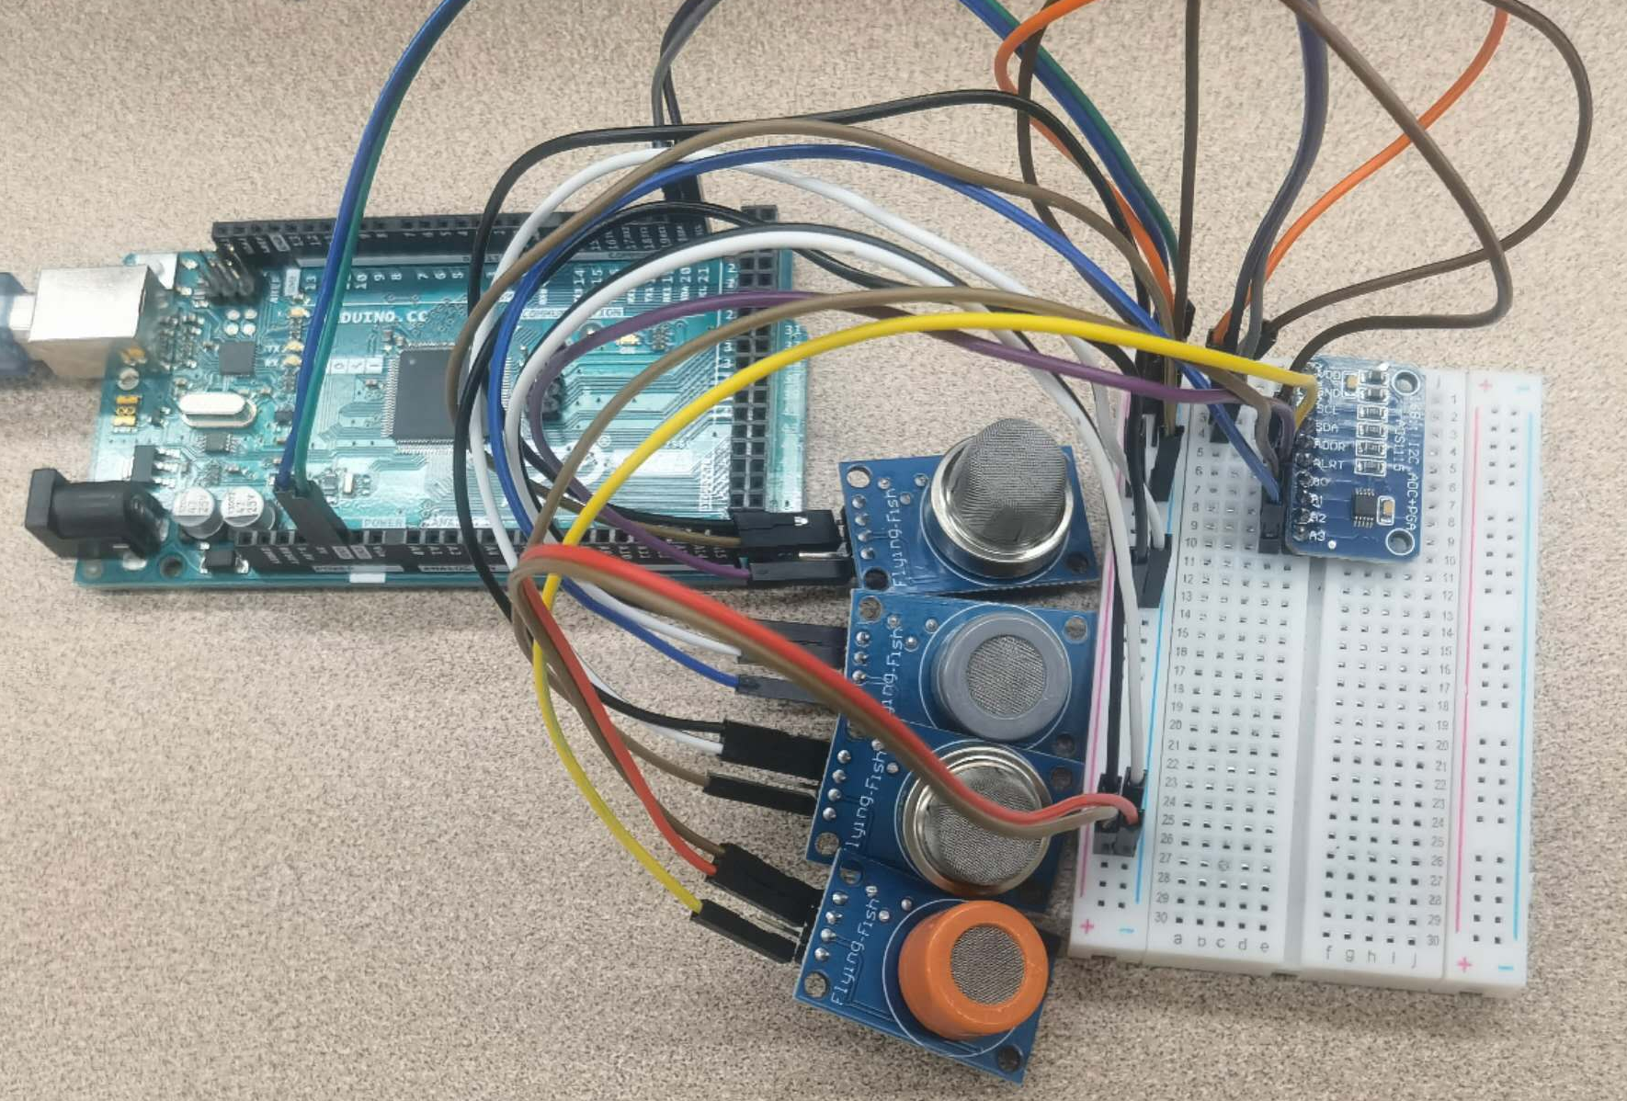
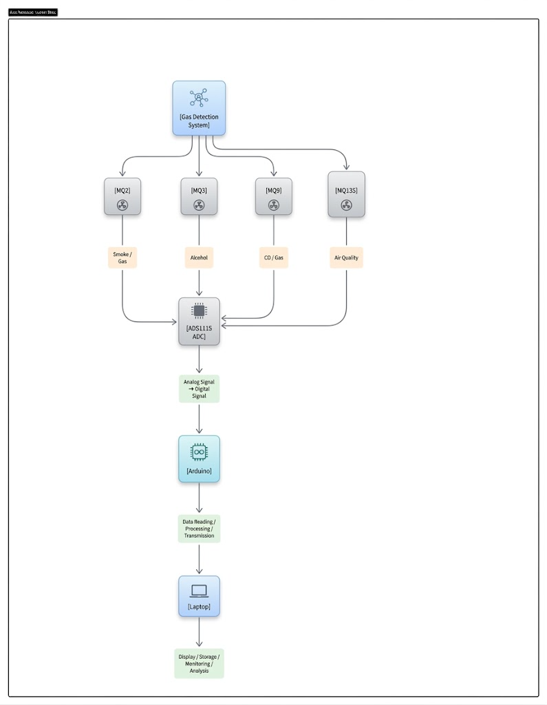
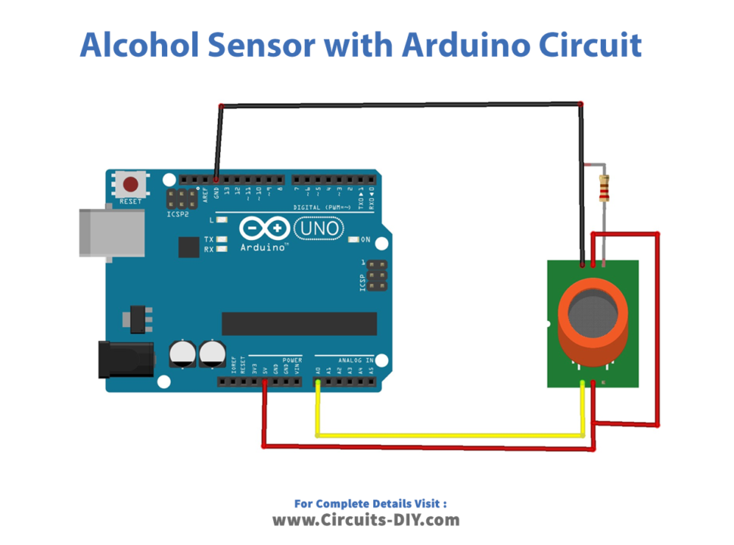
Hardware: High-Precision Sensing
CoreArchitecture
Sensor Fusion: Integrated MQ-2, 3, 9, and 135 to capture a comprehensive "chemical fingerprint" instead of a single data point.
Precision Upgrade: Replaced Arduino’s internal 10-bit ADC with the ADS1115 (16-bit external ADC).
pic left below:simple MQ3-board
pic mid up:MQ239135-board
pic mid below:board design
Key Advantages over Standard Setup
64x Resolution Boost:Improving detection granularity.
Programmable Gain :Capability to "zoom in" on micro-fluctuations in vapor concentration.
Power Stability: Independent 5V external supply ensures reliable heater operation for the entire array

Slide 5



Gateway & Data Processing Logic
Adaptive Feature Engineering
(Eliminating Environmental Drift and Signal Noise)
Dynamic Baseline Tracking:
Robust Scaling:
Adaptive Activation Trigger:
Multi-Sensor Fusion Scoring
（Heuristic Weighted Models for Gas Classification）
Alcohol Score (Targeted Sensitivity):
Smoke Score (Multi-Channel Sync):
Air Quality (Broad Spectrum):
System Health & Reliability
（Real-Time Data Quality Metrics）
Core Metric:
Stability (70%) + Signal Quality (30%)
Reliability Formula:
SNR Mapping (Signal-to-Noise Ratio):

Slide 6
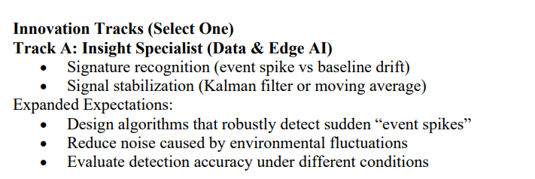
Track A

Slide 7
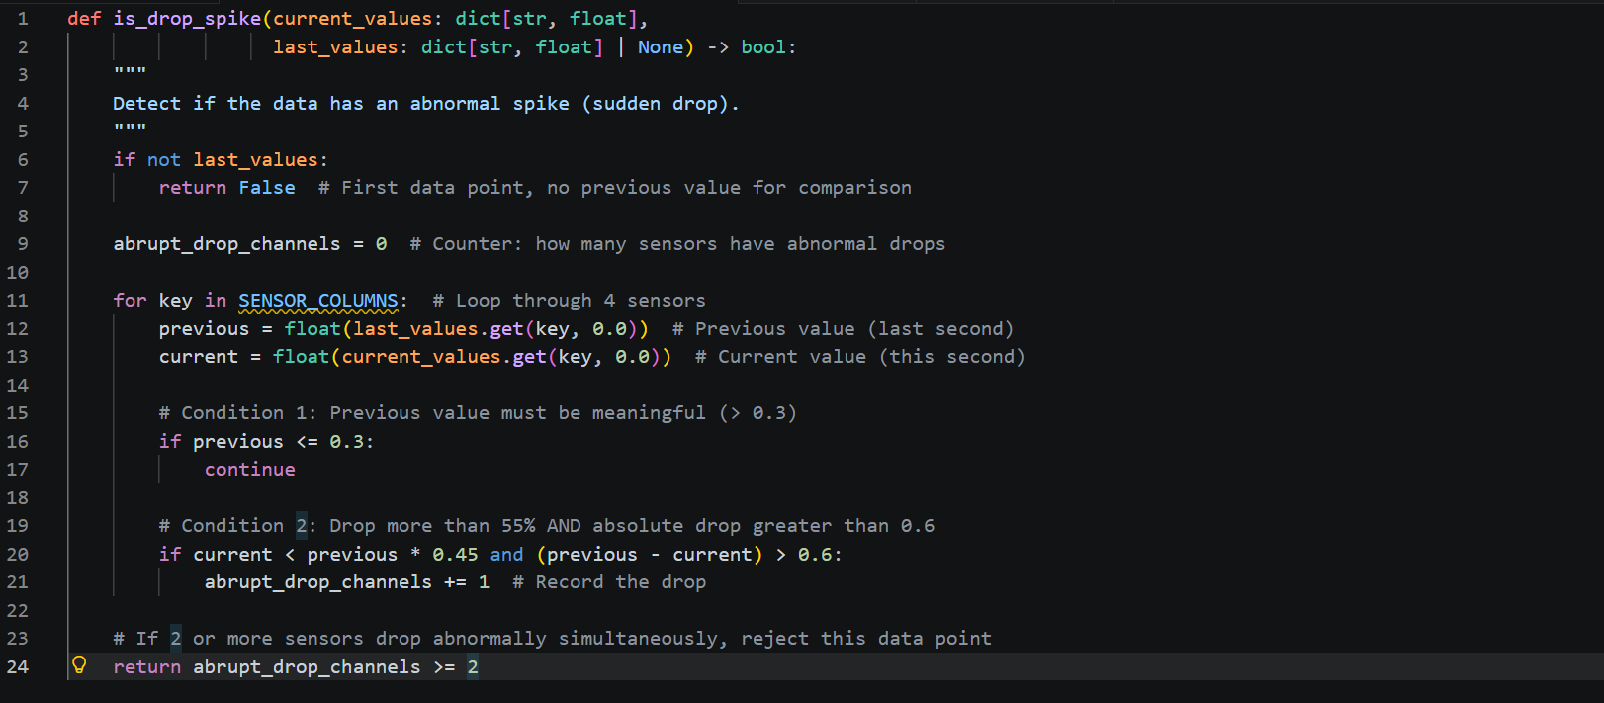
Signature recognition-event spike

Slide 8
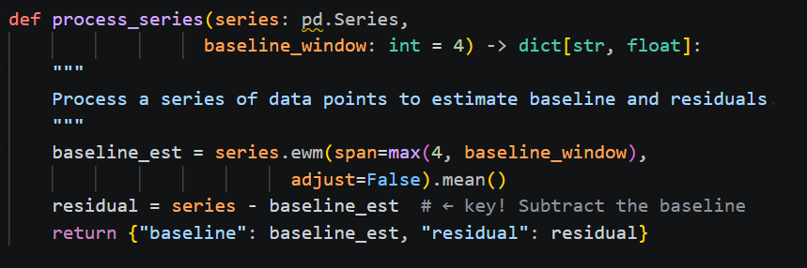

baseline drift

Slide 9
5 algorithms
Moving Average
Core Code:
```python
smoothed = series.rolling(window=ma_window, min_periods=1).mean()
```
idea: Sliding window averaging smooths out high-frequency noise and stabilizes the signal.

Slide 10
5 algorithms
Kalman Filter
Core Code:
```python
gain = error_est / (error_est + measurement_noise)
estimate = estimate + gain * (measurement - estimate)
```
Idea: A dynamic gain balances trust between historical estimates and new measurements.

Slide 11
5 algorithms
Dynamic Adaptive Threshold
Core Code:
```python
robust_scale = residual.abs().ewm(span=baseline_window).mean() * 1.4826
adaptive = (residual - adaptive_sigma * robust_scale).clip(lower=0.0)
```
Idea: Sensitivity is automatically adjusted according to signal variability.

Slide 12
5 algorithms
Derivative
Core Code:
```python
derivative = series.diff().div(SAMPLE_INTERVAL_SECONDS)
derivative = derivative.rolling(window=3, min_periods=1).mean()
```
Idea: It tracks rate of change instead of absolute values, so sudden spikes are detected quickly.

Slide 13
5 algorithms
Sensor Fusion
Core Code:
```python
fusion["MQ3"] = 0.70 * activation["MQ3"] + 0.30 * activation["MQ135"] + 0.08 * derivative["MQ3"]
fusion["MQ135"] = 0.20 * activation["MQ3"] + 0.60 * activation["MQ135"] + 0.20 * activation["MQ2"]
```
Idea: Four sensors are fused with weighted voting to improve reliability and reduce false positives.

Slide 14
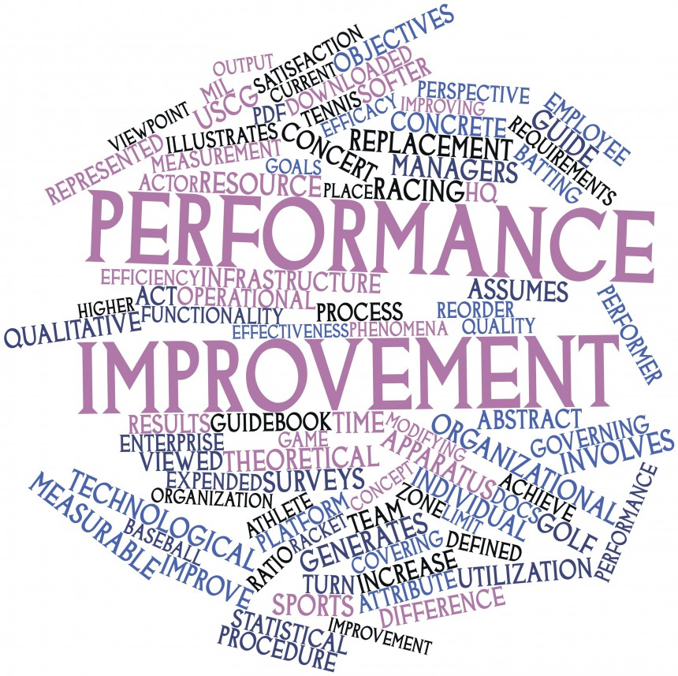
Conclusion & Future Work
Conclusion: A Scalable Multi-Channel Framework
Success: Developed a functional, high-precision IoT hub capable of signature recognition for alcohol and smoke.
Reliability: Integrated real-time health monitoring (SNR & Packet Loss) to ensure data integrity.
Future Work：
Hardware：
Sensor Calibration: Address the lower-than-expected sensitivity of the MQ-3 sensor through advanced multi-point calibration.
Broadening Scope: Expand the testing database to include a wider variety of volatile gases.
Stress Testing: Evaluate system performance under extreme environmental conditions (high heat/humidity).
software：
Latency Reduction: Optimize the data polling cycle to minimize waveform delay between sensing and visualization.
Communication Stability: Resolve intermittent interface instability to lower the packet loss rate.
Robust Protocol: Implement error-correction algorithms to stabilize the serial-to-web data stream.

Slide 15
THE END THANKS FOR WATCHING!

