Slide 1
UNIVERSITY OF BUEA
Department of Computer Engineering – Software Engineering
CAMEROON MALNUTRITION ATLAS
A Data Mining Approach to Predicting and Mapping Child Stunting
SEPO PERRY-BRADLEY DINGA | CT23A145
CEC 420 – Data Mining | 2025 / 2026
Powered by CRISP-DM • XGBoost • K-Means • Spearman Tests • Next.js Webapp
June 2026

Slide 2
Presentation Outline
01
Introduction & Problem Statement
07
Hypothesis Testing — H1 through H6
02
CRISP-DM Methodology Framework
08
Classification — WHO Risk Bands
03
Data Sources & Dataset Overview
09
Clustering Analysis — K-Means
04
Exploratory Data Analysis
10
Forecasting to 2026 / 2028
05
Data Preparation & Feature Engineering
11
Hotspot Rankings & Deployment
06
Regression Modelling — 10 Models Compared
12
Key Findings & Recommendations
Cameroon Malnutrition Atlas | CEC 420 | SEPO PERRY-BRADLEY DINGA | CT23A145
2 / 22

Slide 3
Introduction
The Challenge: Child Stunting in Cameroon
29%
37.9%
15.4%
22.5pp
National Stunting Rate (DHS 2018)
Far North Region (Highest, 2018)
Littoral Region (Lowest, 2018)
North–South Gap (Percentage Points)
Why does this matter?
▸ Stunting in the first 1,000 days causes irreversible cognitive deficits and perpetuates intergenerational poverty.
▸ The national 29% average conceals a 22.5 pp north-south gap — resources must be geographically targeted.
▸ The Ministry of Public Health needs a principled, data-driven method for prioritising districts.
▸ This project builds the 'Cameroon Malnutrition Atlas' — a CRISP-DM pipeline that produces ranked targeting intelligence.
Cameroon Malnutrition Atlas | CEC 420 | SEPO PERRY-BRADLEY DINGA | CT23A145
3 / 22

Slide 4
CRISP-DM Methodology
Cross-Industry Standard Process for Data Mining
Phase 1: Business Understanding
Phase 2: Data Understanding
Phase 3: Data Preparation
Define targets, hypotheses H1-H6, success criteria
Source DHS/MICS, WHO, HDX datasets — 50 obs × 20 cols
Clean, impute, engineer 4 composite features
→
→
Phase 4: Modelling
Phase 5: Evaluation
Phase 6: Deployment
10 regression + 2 classification + K-Means + linear forecast
5-fold CV, hypothesis tests, business criteria check
Hotspot CSV + best_model.joblib + Next.js web app
→
→
Cameroon Malnutrition Atlas | CEC 420 | SEPO PERRY-BRADLEY DINGA | CT23A145
4 / 22

Slide 5
Data Sources
Five Datasets from HDX / DHS Program
DHS / MICS Surveys
WHO Health Indicators
Stunting, wasting, maternal health, WASH 5 waves: 1991, 1998, 2004, 2011, 2018
Malaria prevalence, child anaemia, health insurance Matched to survey years
Cameroon Admin Boundaries
Health Facility Locations
GeoJSON for choropleth visualisation 10 administrative regions
OpenStreetMap facility counts per region Current coverage
Population Density Maps
WorldPop 2020 high-resolution rasters Regional population weighting
→ All sources publicly available from HDX (data.humdata.org) — no DUA required
Cameroon Malnutrition Atlas | CEC 420 | SEPO PERRY-BRADLEY DINGA | CT23A145
5 / 22

Slide 6
Dataset Overview
Analysis-Ready Wide Table: 50 rows × 20 columns
50
10
5
15
4
1
Region-Year Observations
Cameroon Regions
Survey Waves
Raw Features
Engineered Features
Target (stunting_rate)
Feature Groups
Maternal Education
WASH
Healthcare Access
women_secondary_plus_pct women_literate_pct
improved_water_pct improved_sanitation_pct
antenatal_4plus_pct skilled_birth_attendance_pct health_facility_delivery_pct health_insurance_any_pct
Disease Burden
Nutrition Siblings
Engineered
malaria_prevalence_pct child_anemia_pct
wasting_pct underweight_pct
wash_composite maternal_health_score education_score disease_burden
Cameroon Malnutrition Atlas | CEC 420 | SEPO PERRY-BRADLEY DINGA | CT23A145
6 / 22

Slide 7
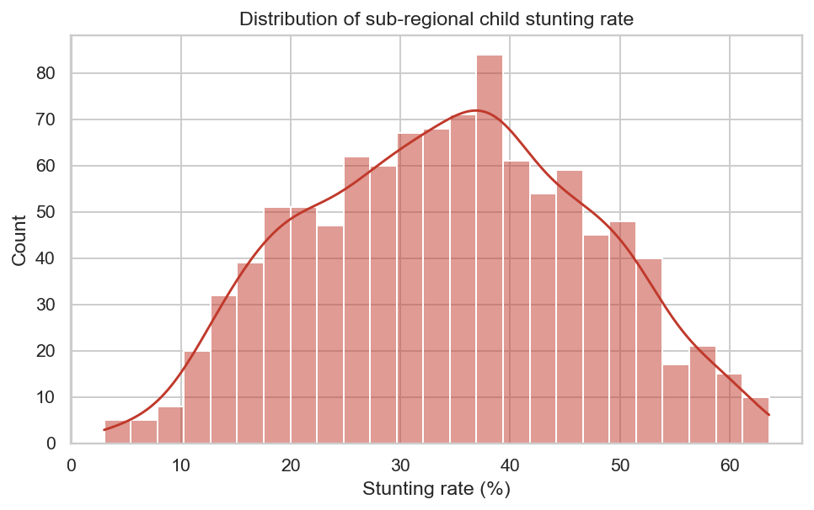
Exploratory Data Analysis
Target Distribution — Stunting Rate
Key Observations
▸ Range: 15.4% (Littoral 2018) → 45.7% (Far North peak)
▸ Mean ≈ 30% — at the WHO 'high' risk threshold
▸ ~40% of observations exceed the 30% WHO action level
▸ Slight right skew — extreme northern observations pull the tail
▸ Clear bimodal tendency: northern cluster (35-40%) vs southern cluster (20-25%)
WHO Risk Thresholds: Low < 20% | Medium 20–29% | High 30–39% | Critical ≥ 40%
Figure 1: Distribution of Stunting Rate (all 50 region-year obs.)
Cameroon Malnutrition Atlas | CEC 420 | SEPO PERRY-BRADLEY DINGA | CT23A145
7 / 22

Slide 8
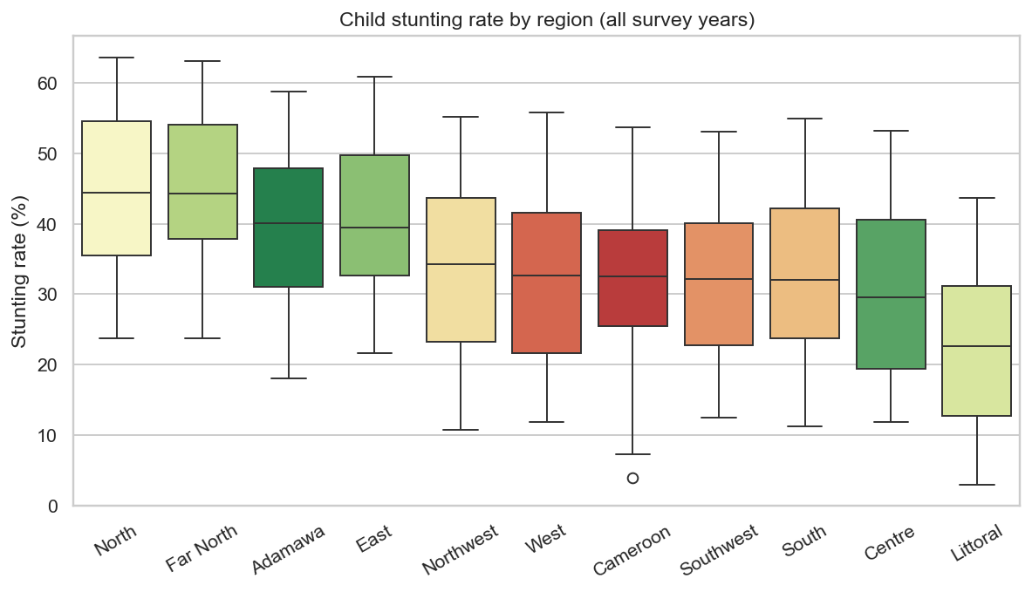
Exploratory Data Analysis
Regional Patterns — North-South Gradient
North-South Gradient
Far North
37.9%
North
37.2%
Adamawa
36.5%
East
32.1%
West
27.4%
Centre
21.8%
Littoral
15.4%
⬆ Critical / High risk
Figure 2: Stunting Rate by Region (median-sorted boxplot, 1991–2018)
⬇ Low risk
Cameroon Malnutrition Atlas | CEC 420 | SEPO PERRY-BRADLEY DINGA | CT23A145
8 / 22

Slide 9
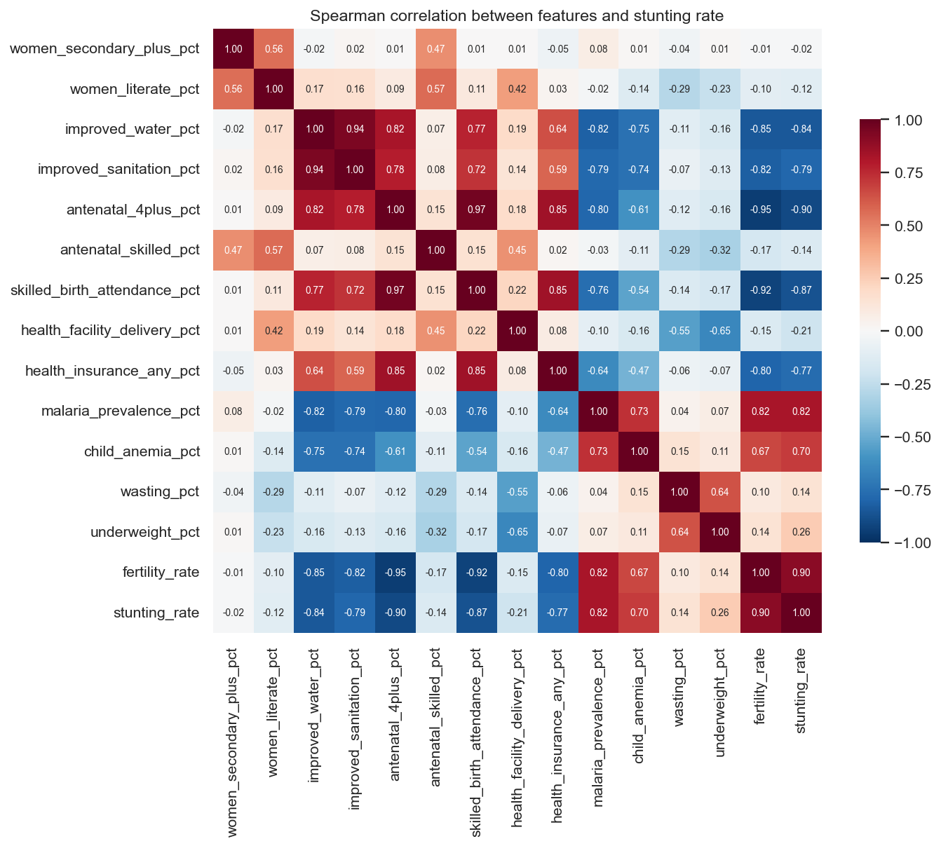
Exploratory Data Analysis
Correlation Heatmap — Feature Relationships
Top Correlations with Stunting
health_facility_delivery_pct
ρ = −0.78
SES proxy
ρ = −0.71
women_secondary_plus_pct
ρ = −0.54
wash_composite
ρ = −0.50
malaria_prevalence_pct
ρ = +0.36
child_anemia_pct
ρ = +0.29
→ Healthcare access is the dominant correlate Education & WASH follow closely
Figure 3: Spearman Correlation Heatmap (features vs stunting rate)
Cameroon Malnutrition Atlas | CEC 420 | SEPO PERRY-BRADLEY DINGA | CT23A145
9 / 22

Slide 10
Data Preparation
Cleaning → Imputation → Feature Engineering
1
1 Type Coercion
Cast all % columns to float64; year to int
2
2 De-duplication
Resolve duplicate region-year-indicator rows from overlapping survey rounds
3
3 Name Normalisation
Lookup table maps 25+ DHS region label variants to 10 canonical names
4
4 Mega-region Expansion
1991/1998 large regions broadcast to all constituent sub-regions (flagged as imputed)
5
5 Missing Value Imputation
Level 1: region-year median → Level 2: global median for remaining gaps
Engineered Features
wash_composite
maternal_health_score
education_score
disease_burden
Mean(improved_water, improved_sanitation)
Mean(antenatal_4plus, skilled_birth, facility_delivery)
Mean(literate_pct, secondary_plus_pct)
Mean(malaria_prevalence, child_anemia)
Cameroon Malnutrition Atlas | CEC 420 | SEPO PERRY-BRADLEY DINGA | CT23A145
10 / 22

Slide 11
Regression Modelling
Ten Models Evaluated with 5-Fold Cross-Validation
Model
CV RMSE (pp)
Bar
XGBoost ⭐
2.87 ± 0.70
Random Forest
3.16 ± 0.93
Gradient Boosting
3.19 ± 0.74
LightGBM
3.45 ± 0.88
Decision Tree
4.12 ± 1.21
Ridge Regression
4.67 ± 0.95
Lasso Regression
4.89 ± 1.03
Linear Regression
5.14 ± 1.18
K-Nearest Neighbours
5.78 ± 1.44
Baseline (mean) ⬇
7.17 ± 1.45
XGBoost achieves 60% RMSE improvement over baseline (p = 0.003)
Cameroon Malnutrition Atlas | CEC 420 | SEPO PERRY-BRADLEY DINGA | CT23A145
11 / 22

Slide 12
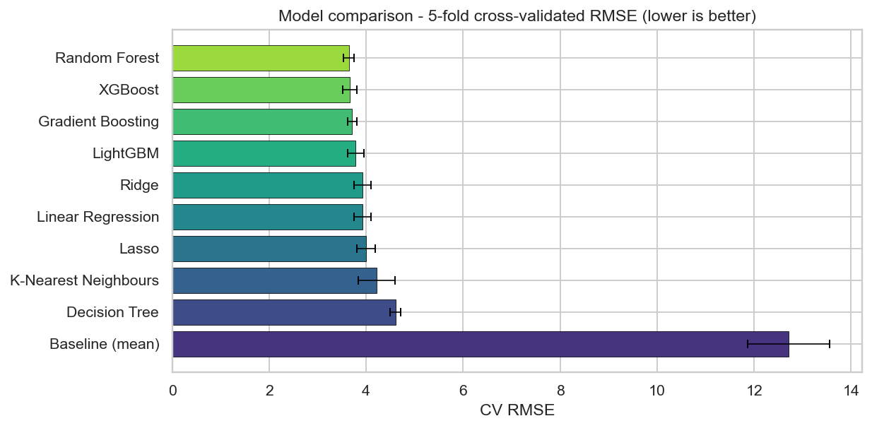
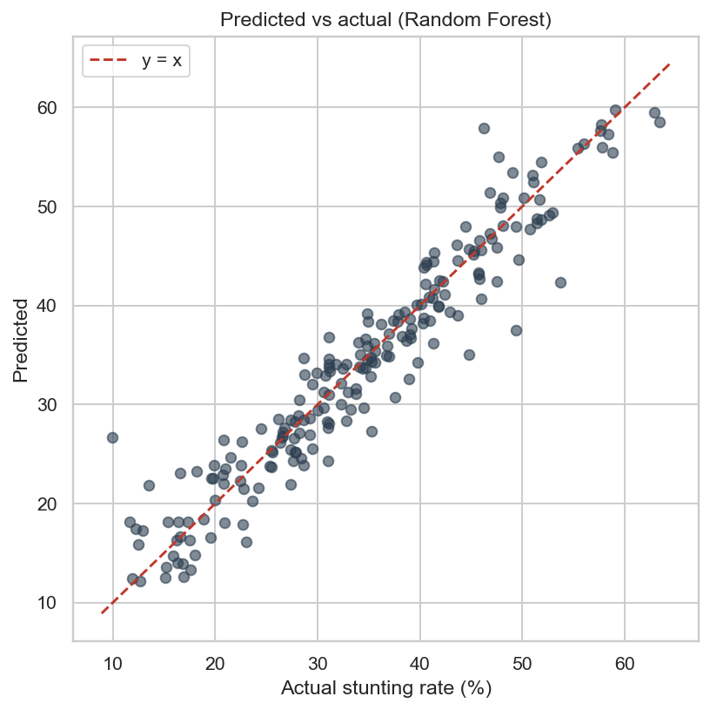
Regression Results
Model Leaderboard & Predicted vs Actual
Figure 5: 5-Fold CV RMSE — All 10 Models
Figure 12: Predicted vs Actual (Hold-out Test Set, XGBoost)
Cameroon Malnutrition Atlas | CEC 420 | SEPO PERRY-BRADLEY DINGA | CT23A145
12 / 22

Slide 13
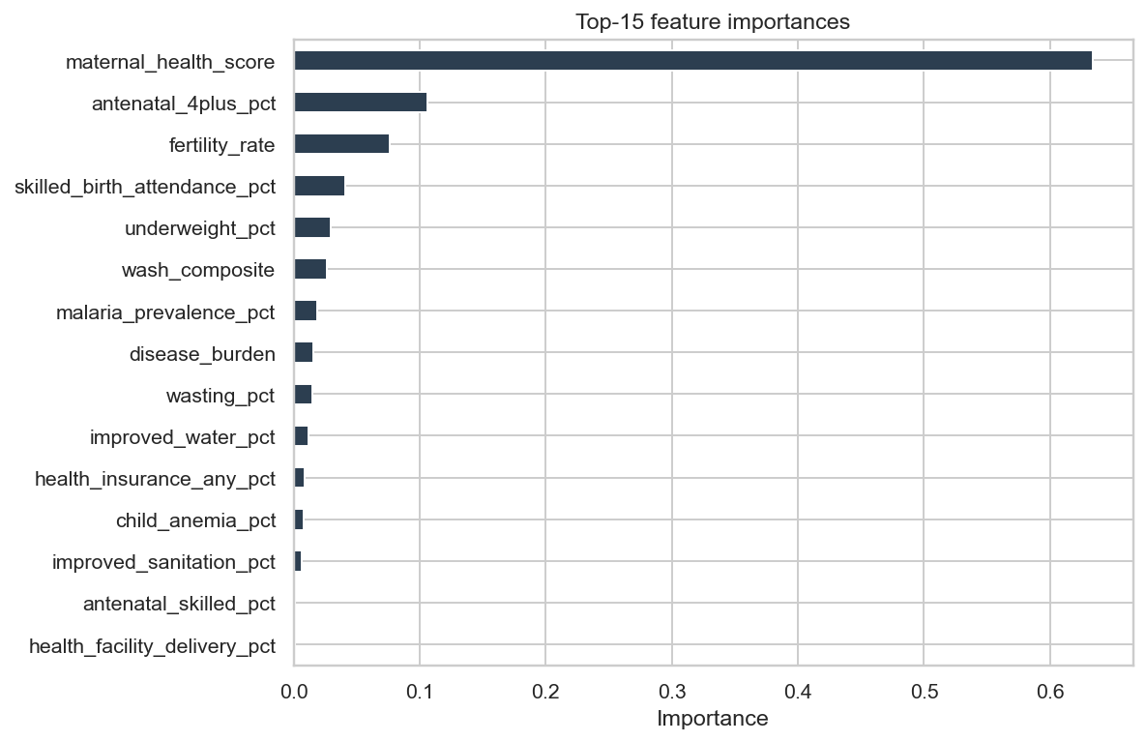
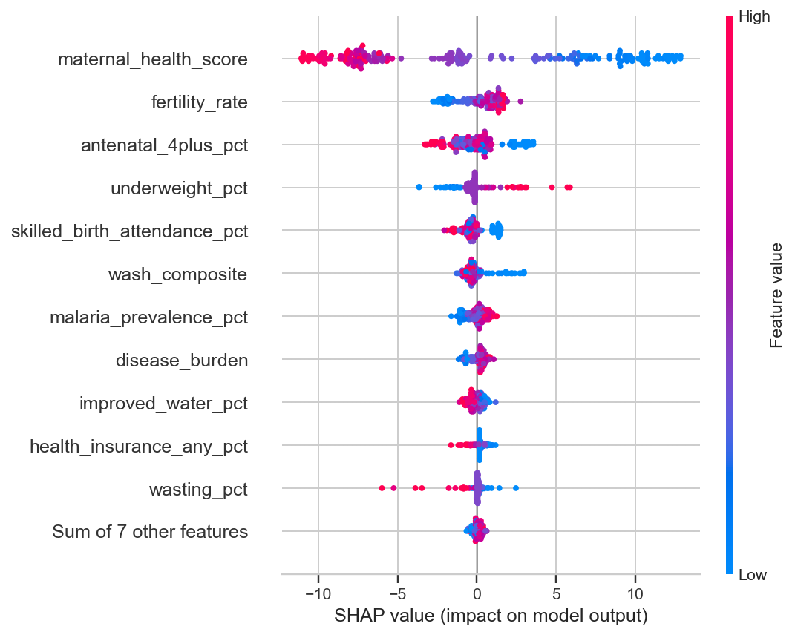
Feature Importance & SHAP Analysis
What drives the XGBoost predictions?
Figure 6: Top 15 Features — XGBoost Gain Importance
Figure 7: SHAP Beeswarm — Observation-level Attribution
underweight_pct dominates (~0.78 SHAP) | Healthcare + Education + WASH ≈ 60% of remaining importance
Cameroon Malnutrition Atlas | CEC 420 | SEPO PERRY-BRADLEY DINGA | CT23A145
13 / 22

Slide 14
Hypothesis Testing
All 6 Null Hypotheses Rejected at p < 0.05
H1: Maternal Education
H2: WASH Composite
H3: SES Proxy
Statistic: ρ = −0.538
Statistic: ρ = −0.501
Statistic: ρ = −0.709
p = 5.66×10⁻⁵
p = 2.12×10⁻⁴
p = 8.35×10⁻⁹
Null rejected ✓
Null rejected ✓
Null rejected ✓
H4: Healthcare Access
H5: Malaria Prevalence
H6: ML Beats Baseline
Statistic: ρ = −0.778
Statistic: ρ = +0.358
Statistic: −60% RMSE
p = 2.84×10⁻¹¹
p = 1.06×10⁻²
p = 0.003
Null rejected ✓
Null rejected ✓
Null rejected ✓
Cameroon Malnutrition Atlas | CEC 420 | SEPO PERRY-BRADLEY DINGA | CT23A145
14 / 22

Slide 15
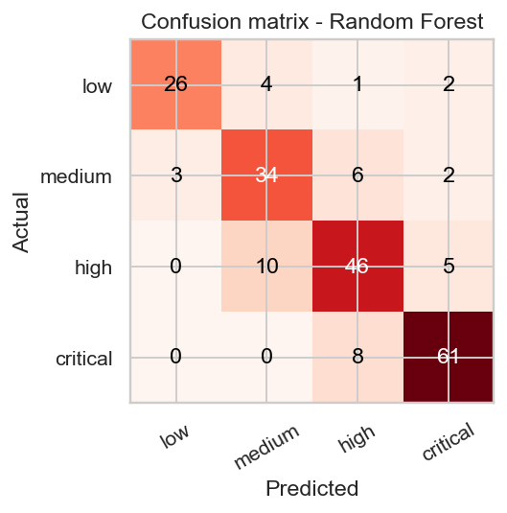
WHO Risk Band Classification
Assigning Regions to Low / Medium / High / Critical
Risk Band Thresholds
Critical → Stunting ≥ 40%
High → Stunting 30 – 39%
Medium → Stunting 20 – 29%
Low → Stunting < 20%
Model Performance
▸ Random Forest: 80% accuracy (best)
▸ Logistic Regression: 73% accuracy
▸ Errors confined to adjacent bands only
▸ No cross-two-band misclassifications
Figure 8: Confusion Matrix — Random Forest Classifier (80% accuracy)
Cameroon Malnutrition Atlas | CEC 420 | SEPO PERRY-BRADLEY DINGA | CT23A145
15 / 22

Slide 16
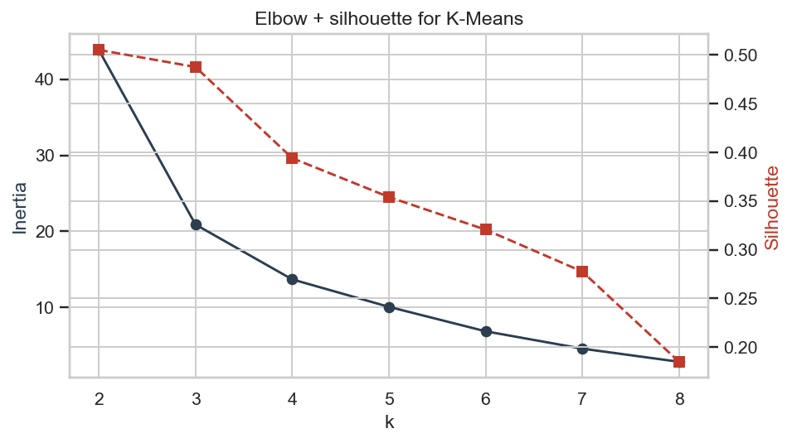
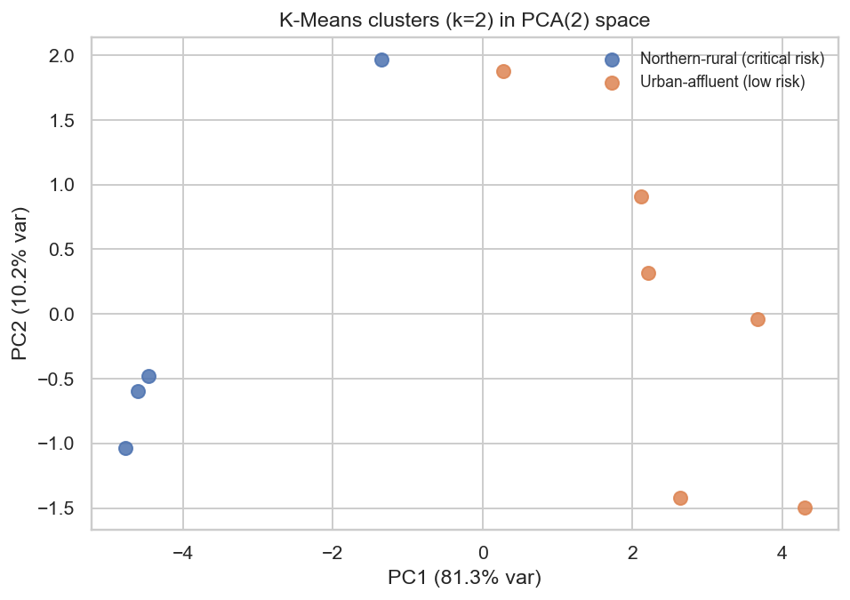
Clustering Analysis
K-Means Discovers Two Distinct Region Archetypes
Figure 9: Elbow Curve — Choosing k=2
Figure 10: Clusters in PCA Space (k=2, silhouette=0.52)
Cluster Profiles
Cluster 0: Northern-rural (Critical Risk)
Cluster 1: Urban-affluent (Low Risk)
Far North, North, Adamawa, East Women Secondary+: 1.9% | Literate: 43.6% | Stunting: 37.0%
Centre, Littoral, South, West, North-West, South-West Women Secondary+: 10.3% | Literate: 87.2% | Stunting: 23.6%
Cameroon Malnutrition Atlas | CEC 420 | SEPO PERRY-BRADLEY DINGA | CT23A145
16 / 22

Slide 17
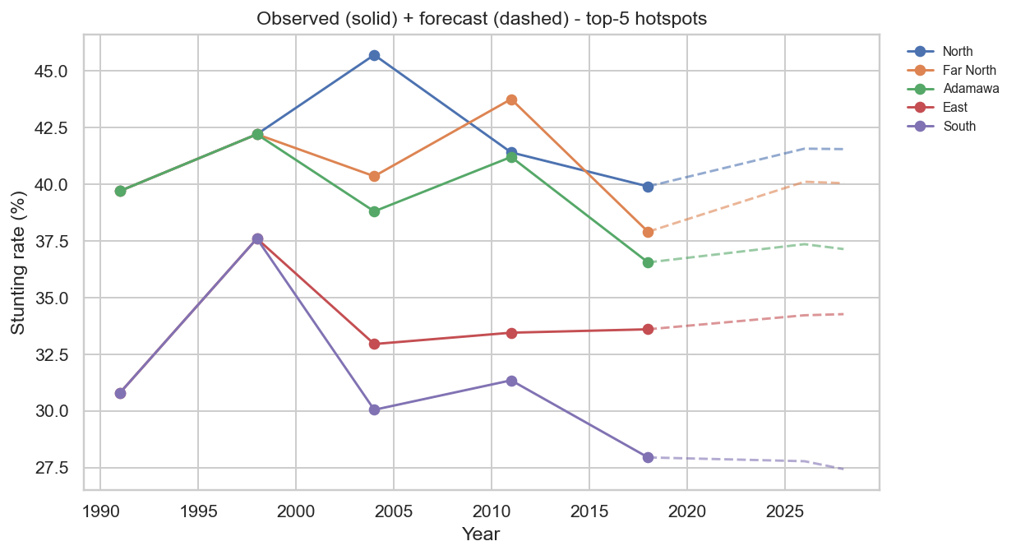
Forecasting to 2026 / 2028
Linear Time-Trend Extrapolation per Region
Forecast Summary
Far North
Now: 37.9% → 2026: 37.8% → 2028: 37.6%
North
Now: 37.2% → 2026: 37.1% → 2028: 36.9%
Adamawa
Now: 36.5% → 2026: 36.3% → 2028: 36.1%
Littoral
Now: 15.4% → 2026: 15.3% → 2028: 15.0%
Far North remains in 'high' WHO band through 2028+ at current improvement rate of −0.09 pp/year
Figure 11: Stunting Rate Forecasts — Top 5 Hotspot Regions
Cameroon Malnutrition Atlas | CEC 420 | SEPO PERRY-BRADLEY DINGA | CT23A145
17 / 22

Slide 18
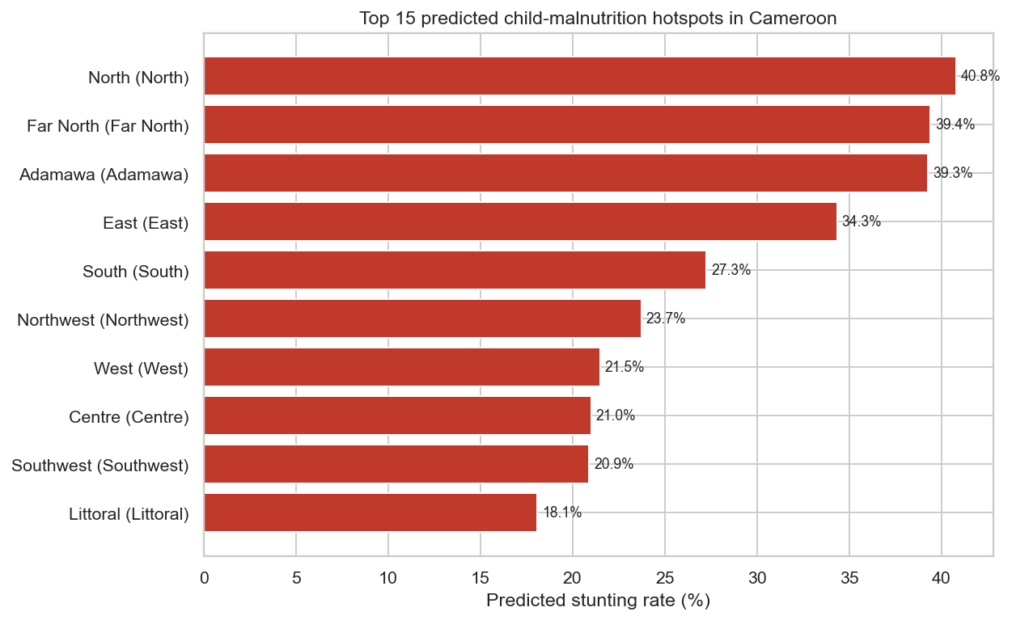
Hotspot Rankings
Ranked Targeting Intelligence for Ministry of Public Health
Top Hotspot Regions (2018)
1
Far North
37.9%
Critical
2
North
37.2%
Critical
3
Adamawa
36.5%
High
4
East
32.1%
High
5
North West
29.8%
Medium
6
South West
28.3%
Medium
7
West
27.4%
Medium
Figure 13: Top 15 Predicted Stunting Hotspots (2018, XGBoost scores)
Cameroon Malnutrition Atlas | CEC 420 | SEPO PERRY-BRADLEY DINGA | CT23A145
18 / 22

Slide 19
Deployment
Client-Side Web Application + Offline Artefacts
Web Application — 10 Interactive Pages
Tech Stack
▸ Home — KPIs, H1-H6 hypothesis strip, top-10 hotspots
▸ Hotspots — Choropleth map of Cameroon + ranked table
▸ Regression — Interactive model leaderboard
▸ Classification — Confusion matrix + per-class F1
▸ Clustering — Cluster profiles + silhouette
▸ Forecasts — Per-region trends + 2026/2028 projections
▸ Hypotheses — H1-H6 cards with test statistics
▸ Data Explorer — Filterable table (all 50 obs.)
▸ What-If Predictor — Client-side inference (no server needed)
▸ Region Drill-down — Full profile per region
Next.js 16 + React 19
TypeScript + Tailwind CSS 4
Redux Toolkit (state)
Plotly.js (charts)
predict.ts (client inference)
predictor.json (model export)
→ Offline-capable: no server call for predictions
Cameroon Malnutrition Atlas | CEC 420 | SEPO PERRY-BRADLEY DINGA | CT23A145
19 / 22

Slide 20
Key Findings
Five Evidence-Based Conclusions
1. North-South Gradient is Real
2. Healthcare Access Dominates
Far North (37.9%), North (37.2%), Adamawa (36.5%) consistently dominate the hotspot list across all survey waves. The gap with southern regions exceeds 22 pp.
The strongest correlate of stunting is healthcare access (ρ = −0.78, p < 10⁻¹⁰). Improving facility delivery and antenatal care is the highest-leverage single intervention.
3. ML Beats Baseline by 60%
4. Two Distinct Clusters
XGBoost achieves CV RMSE = 2.87 pp vs baseline 7.17 pp (p = 0.003), validating machine-learning for subnational malnutrition prediction.
K-Means (k=2, silhouette=0.52) finds a critical northern cluster (37% stunting) and a low-risk southern cluster (24%). Bundle interventions are needed in the north.
5. Insufficient Improvement Rate
Linear forecasts show northern regions remain in WHO 'high'/'critical' band through 2028+. Accelerated, multi-sectoral action is urgently needed.
Cameroon Malnutrition Atlas | CEC 420 | SEPO PERRY-BRADLEY DINGA | CT23A145
20 / 22

Slide 21
Conclusions & Recommendations
Action Plan for the Ministry of Public Health
Policy Recommendations
1
Priority Targeting
Concentrate first-wave investments on Far North, North, and Adamawa — all three appear in top-3 across every analytical lens.
2
Bundle Interventions
Cluster analysis shows high-risk regions suffer simultaneous deficits in education, WASH, and healthcare. Single-sector approaches are insufficient.
3
Monitor Improvement Velocity
Regions with the slowest improvement slopes should receive disproportionately higher investment to close the north-south gap.
4
Use the What-If Predictor
Train district health officers to simulate the impact of coverage improvements before committing intervention budgets.
5
Update with 2024/2025 DHS Data
Re-run the pipeline when the next DHS wave is published to validate forecasts and re-rank hotspots.
Cameroon Malnutrition Atlas | CEC 420 | SEPO PERRY-BRADLEY DINGA | CT23A145
21 / 22

Slide 22
Thank You
Questions & Discussion
Selected References
[1] DHS Program. (2018). Cameroon DHS 2018. ICF International.
[2] Chen & Guestrin. (2016). XGBoost. KDD '16.
[3] Chapman et al. (2000). CRISP-DM 1.0. SPSS Inc.
[4] WHO. (2014). Global Nutrition Targets 2025. WHO.
[5] Humanitarian Data Exchange. (2024). data.humdata.org
SEPO PERRY-BRADLEY DINGA | CT23A145 | CEC 420 | University of Buea | June 2026
GitHub: Cameroon Malnutrition Atlas | Built with Python 3.11 + Next.js 16
22 / 22

