Slide 1
INTRODUCTION TO ANATOMY AND PHYSIOLOGY ( HPFP-II) SEPTEMBER 2025
DR.E.KUNDA
-BSc H.B (UNZA) MBchB ( UNZA), HPCZ.
-Certificate in Teaching Methodology , Project Management and Planning-UNZA And Seizure Management-ZLAE.

Slide 2
OBJECTIVES
1.Describe the types of nerves.
2.Explain nerve impulses and transmission.
3.Describe the Central Nervous System (CNS).
4.Describe the Peripheral Nervous System (PNS).
5.Explain functions of sense organs.

Slide 3
INTRODUCTION
The nervous tissue its one of the four basic tissues.A nerve is a bundle of axons (nerve fibers) located outside the brain and spinal cord . The excitable characteristic of nervous tissue allows for the generation of nerve impulses (action potentials) that provide communication with and regulation of most body tissues The Nervous System has a mass of only 2 kg , about 3% of the total body weight, the nervous system is one of the smallest and yet the most complex of the 11 body systems. This intricate network of billions of neurons and even more neuroglia is organized into two main subdivisions: the central nervous system and the peripheral nervous system.

Slide 4
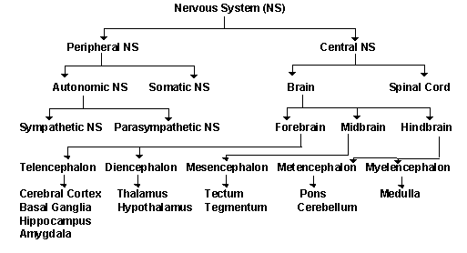
Continuation……

Slide 5
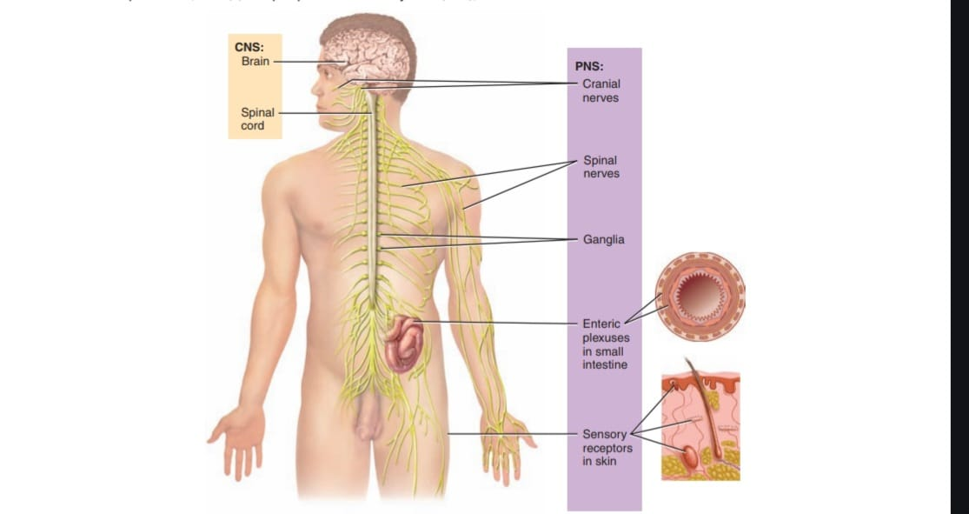

Slide 6
Continuation………
A.The central nervous system (CNS), consists of the brain and spinal cord , The brain is the part of the CNS that is located in the skull and contains about 100 billion neurons while the spinal cord is connected to the brain through the foramen magnum of the occipital bone and is encircled by the bones of the vertebral column. The spinal cord contains about 100 million neurons. The CNS processes many different kinds of incoming sensory information. It is also the source of thoughts, emotions, and memories. Most signals that stimulate muscles to contract and glands to secrete originate in the CNS.

Slide 7
Continuation……
B.The peripheral nervous system consists of all nervous tissue outside the CNS , Components of the PNS include nerves, ganglia, enteric plexuses, and sensory receptors. A nerve is a bundle of hundreds to thousands of axons plus associated connective tissue and blood vessels that lies outside the brain and spinal cord. Twelve pairs of cranial nerves emerge from the brain and thirty-one pairs of spinal nerves emerge from the spinal cord. Ganglia (a swelling or knot; singular is ganglion) are small masses of nervous tissue, consisting primarily of neuron cell bodies, that are located outside of the brain and spinal cord. Ganglia are closely associated with cranial and spinal nerves.

Slide 8
Continuation……
The PNS is divided into 1. somatic nervous system (SNS) , 2.an autonomic nervous system (ANS) And 3. an enteric nervous system (ENS) ( enteron ;intestines).
1.The SNS consists of (1) sensory neurons that convey information from somatic receptors in the head, body wall, and limbs and from receptors for the special senses of vision, hearing, taste, and smell to the CNS and (2) motor neurons that conduct impulses from the CNS to skeletal muscles only. Because these motor responses can be consciously controlled, the action of this part of the PNS is voluntary.

Slide 9
Continuation…..
2.The ANS consists of (1) sensory neurons that convey information from autonomic sensory receptors, located primarily in visceral organs such as the stomach and lungs, to the CNS and (2) motor neurons that conduct nerve impulses from the CNS to smooth muscle, cardiac muscle, and glands. Because its motor responses are not normally under conscious control, the action of the ANS is involuntary. The motor part of the ANS consists of two branches, the sympathetic division and the parasympathetic division, usually the two divisions have opposing actions. For example, sympathetic neurons increase heart rate, and parasympathetic neurons slow it down.

Slide 10
Continuation….
In general, the sympathetic division helps support exercise of emergency actions, the “fight-or-flight” responses, and the parasympathetic division takes care of “rest-and-digest” activities.
3.The ENS, the “brain of the gut,” is involuntary. Once considered part of the ANS, the ENS consists of enteric plexuses that extend most of the length of the gastrointestinal (GI) tract. Many of the neurons of the enteric plexuses function independently of the ANS and CNS to some extent, although they also communicate with the CNS via sympathetic and parasympathetic neurons. S

Slide 11
continuation
Sensory neurons of the ENS monitor chemical changes within the GI tract as well as the stretching of its walls. Enteric motor neurons govern contraction of GI tract smooth muscle to propel food through the GI tract, secretions of the GI tract organs such as acid from the stomach, and activity of GI tract endocrine cells, which secrete hormones.
Functions of the Nervous System
The nervous system carries out a complex array of tasks. It allows us to sense various smells, produce speech, and remember past events; in addition, it provides signals that control body movements and regulates the operation of internal organs.

Slide 12
Continuation….
These diverse activities can be grouped into three basic functions: sensory (input), integrative (process), and motor (output).
Sensory function. Sensory receptors detect internal stimuli, such as an increase in blood pressure, or external stimuli (for example, a raindrop landing on your arm). This sensory information is then carried into the brain and spinal cord through cranial and spinal nerves.
Integrative function. The nervous system processes sensory information by analyzing it and making decisions for appropriate responses—an activity known as integration.

Slide 13
Continuation……
3. Motor function. Once sensory information is integrated, the nervous system may elicit an appropriate motor response by activating effectors (muscles and glands) through cranial and
spinal nerves. Stimulation of the effectors causes muscles to contract and glands to secrete.

Slide 14
TYPE OF NERVOUS CELLS
The nervous tissue comprises two types of cells—neurons and neuroglia,The cells combine in a variety of ways in different regions of the nervous system. In addition to forming the complex processing networks within the brain and spinal cord, neurons also connect all regions of the body to the brain and spinal cord. As highly specialized cells capable of providing most of the unique functions of the nervous system, such as sensing, thinking, remembering, controlling muscle activity, and regulating glandular secretions. As a result of their specialization, they have lost the ability to undergo mitotic divisions.

Slide 15
Continuation….
Neuroglia are smaller cells but they greatly outnumber neurons, perhaps by as much as 5-25 times. Neuroglia support, nourish, and protect neurons, and maintain the interstitial fluid that bathes them. Unlike neurons, neuroglia continue to divide throughout an individual’s lifetime.
1.Neurons
Like muscle cells, neurons (nerve cells) possess electrical excitability , the ability to respond to a stimulus and convert it into an action potential. A stimulus is any change in the environment that is strong enough to initiate an action potential.

Slide 16
continuation
A stimulus is any change in the environment that is strong enough to initiate an action potential. Action potential is an electrical signal that propagates along the surface of the membrane of a neuron. Begins and travels due to the movement of ions between interstitial fluid and the inside of a neuron through specific ion channels in its plasma membrane. Once begun, a nerve impulse travels rapidly and at a constant strength.
Parts of a Neuron; (1) a cell body, (2) dendrites, and (3) an axon. The cell body, also known as the perikaryon or soma, contains a nucleus surrounded by cytoplasm that includes typical cellular organelles such as lysosomes, mitochondria, and a Golgi complex.

Slide 17
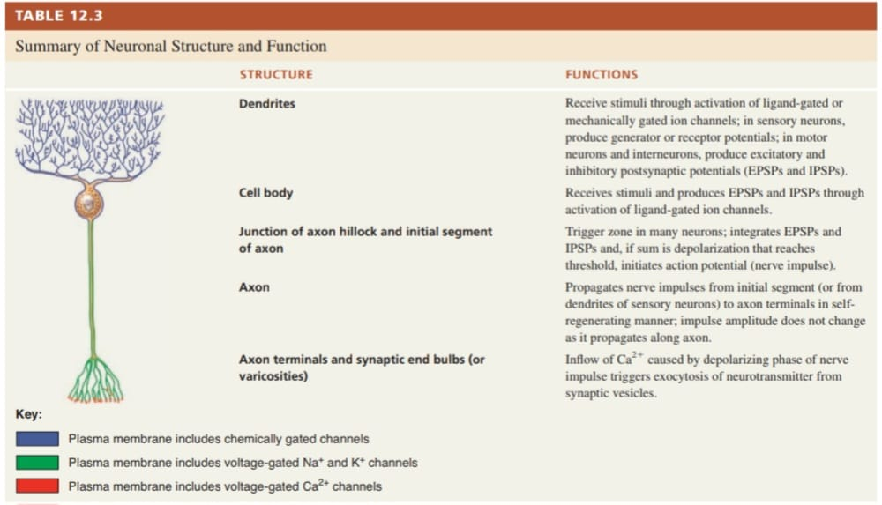

Slide 18
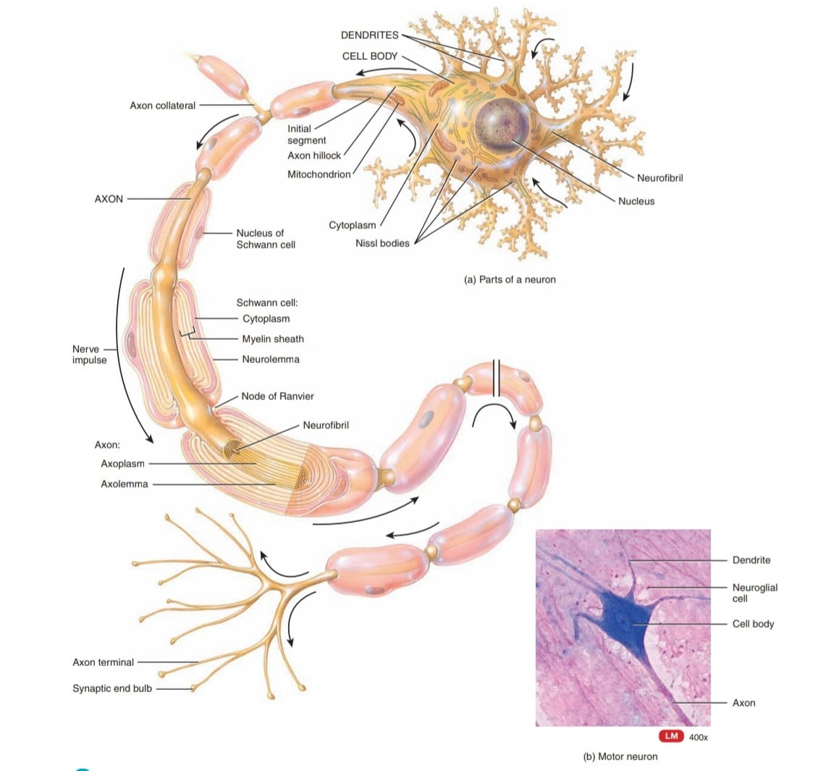

Slide 19
continuation
Neuronal cell bodies also contain free ribosomes and prominent clusters of rough endoplasmic reticulum, termed Nissl bodies . The ribosomes are the sites of protein synthesis. Newly synthesized proteins produced by Nissl bodies are used to replace cellular components, as material for growth of neurons, and to regenerate damaged axons in the PNS. The cytoskeleton includes both neurofibrils , composed of bundles of intermediate filaments that provide the cell shape and support, and microtubules , which assist in moving materials between the cell body and axon.

Slide 20
Continuation……
A nerve fiber is a general term for any neuronal process (extension) that emerges from the cell body of a neuron. Most neurons have two kinds of processes: multiple dendrites and a single axon.Dendrites (little trees) are the receiving or input portions of a neuron. The plasma membranes of dendrites and cell bodies contain numerous receptor sites for binding chemical messengers from other cells. Dendrites usually are short, tapering, and highly branched. In many neurons the dendrites form a tree shaped array of processes extending from the cell body. Their cytoplasm contains Nissl bodies, mitochondria, and other organelles.

Slide 21
Continuation….
The single axon ( axis) of a neuron propagates nerve impulses toward another neuron, a muscle fiber, or a gland cell. An axon is a long, thin, cylindrical projection that often joins to the cell body at a cone-shaped elevation called the axon hillock (small hill). The part of the axon closest to the axon hillock is the initial segment. In most neurons, nerve impulses arise at the junction of the axon hillock and the initial segment, an area called the trigger zone, from which they travel along the axon to their destination. An axon contains mitochondria, microtubules, and neuro-fibrils. Because rough endoplasmic reticulum is not present , protein synthesis does not occur in the axon.

Slide 22
Continuation…..
Cytoplasm of an axon or axoplasm, is surrounded by a plasma membrane or axolemma . Side branches called axon collaterals may branch off , typically at a right angle to the axon. The axon and its collaterals end by dividing into many fine processes called axon terminals (telodendria) .The site of communication between two neurons or between a neuron and an effector cell is called a synapse . The tips of some axon terminals swell into bulb-shaped structures called synaptic end bulbs; others exhibit a string of swollen bumps called varicosities. Both synaptic end bulbs and varicosities contain many tiny membrane-enclosed sacs called synaptic vesicles that store a chemical called a neurotransmitter .

Slide 23
Continuation…..
A neurotransmitter is a molecule released from a synaptic vesicle that excites or inhibits another neuron, muscle fiber,or gland cell. Many neurons contain two or even three types of neurotransmitters, each with different effects on the postsynaptic cell. The substances synthesized or recycled in the neuron cell body are needed in the axon or at the axon terminals, two types of transport systems carry materials from the cell body to the axon terminals and back.

Slide 24
Two types of Transport system
1.The slower system, which moves materials about 1–5 mm per day, is called slow axonal transport. It conveys axoplasm in one direction only—from the cell body toward the axon terminals. Slow axonal transport supplies new axoplasm to developing or regenerating axons and replenishes axoplasm in growing and mature axons.
2. Fast axonal transport, which is capable of moving materials a distance of 200–400 mm per day, uses proteins that function as “motors” to move materials along the surfaces of microtubules of the neuron’s cytoskeleton. Fast axonal transport moves materials in both directions—away from and toward the cell body.

Slide 25
Continuation……
A.Fast axonal transport that occurs in an anterograde (forward) direction moves organelles and synaptic vesicles from the cell body to the axon terminals.
B.Fast axonal transport that occurs in a retrograde (backward) direction moves membrane vesicles and other cellular materials from the axon terminals to the cell body to be degraded or recycled. Substances that enter the neuron at the axon terminals are also moved to the cell body by fast retrograde transport.These substances include trophic chemicals such as nerve growth factor and harmful agents such as tetanus toxin and the viruses that cause rabies, herpes simplex, and polio.

Slide 26
Classification of Neurons
Both structural and functional features are used to classify the various neurons in the body.
A.STRUCTURAL , neurons are classified according to the number of processes extending from the cell body.
1. Multipolar neurons usually have several dendrites and one axon . Most neurons in the brain and spinal cord are of this type, as well as all motor neurons .
2. Bipolar neurons have one main dendrite and one axon. They are found in the retina of the eye, the inner ear, and the olfactory (olfact to smell) area of the brain.

Slide 27
Continuation….
3.Unipolar , dendrite and one axon that are fused together to form a continuous process that emerges from the cell body . Also called pseudounipolar neurons because they begin in the embryo as bipolar neurons. During development, the dendrites and axon fuse together and become a single process. The dendrites of most unipolar neurons function as sensory receptors that detect a sensory stimulus such as touch, pressure, pain, or thermal stimuli The trigger zone for nerve impulses in a unipolar neuron is at the junction of the dendrites and axon . The impulses then propagate toward the synaptic end bulbs. The cell bodies of most unipolar neurons are located in the ganglia of spinal and cranial nerves.

Slide 28
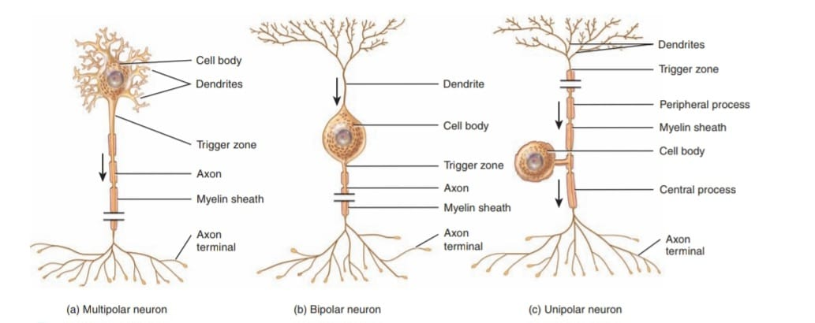

Slide 29
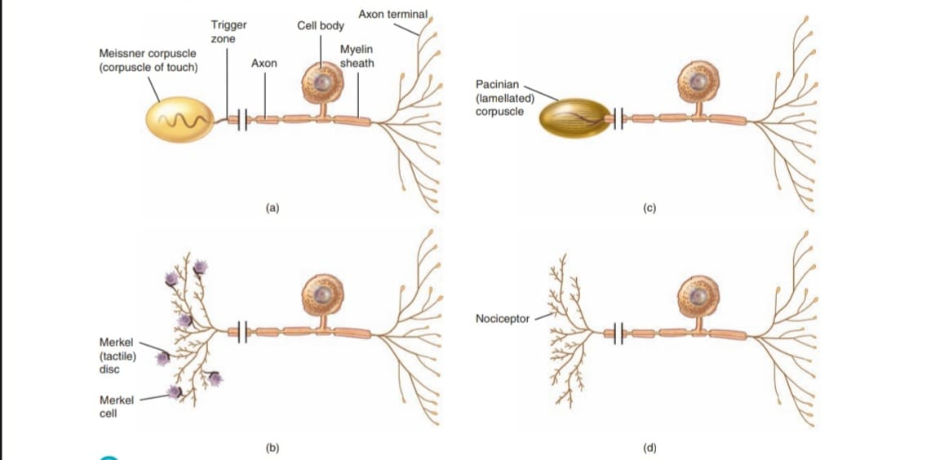

Slide 30
Continuation…
Sensory receptors that are dendrites of unipolar neurons are;a).A Meissner corpuscle is a touch receptor , consists a mass of dendrites enclosed in capsule of connective tissue. (b) A Merkel disc is a touch receptor that consists of free nerve endings that make contact with Merkel cells. (c) A pacinian corpuscle is a pressure receptor composed of a multilayered connective tissue capsule that encloses a dendrite. (d) A nociceptor is a pain receptor that consists of free nerve endings . Thermoreceptors (which detect thermal sensations), itch receptors, and tickle receptors resemble nociceptors in that they are unipolar neurons with free nerve endings that serve as sensory receptors.

Slide 31
Functional classification
Functionally, neurons are classified according to the direction in which the nerve impulse (action potential) is conveyed with respect to the CNS.
1. Sensory or afferent neurons ;( af-toward; -ferrent carried) either contain sensory receptors at their distal ends (dendrites) or are located just after sensory receptors that are separate cells. Once an appropriate stimulus activates a sensory receptor, the sensory neuron forms an action potential in its axon and the action potential is conveyed into the CNS through cranial or spinal nerves. Most sensory neurons are unipolar in structure.

Slide 32
Continuation…..
2. Motor or efferent neurons ( ef- away from) convey action potentials away from the CNS to effectors (muscles and glands) in the periphery (PNS) through cranial or spinal nerves . Motor neurons are multipolar in structure.
3. Interneurons or association neurons are mainly located within the CNS between sensory and motor neurons . Interneurons integrate (process) incoming sensory information from sensory neurons and then elicit a motor response by activating the appropriate motor neurons. Most interneurons are multipolar in structure.

Slide 33
Continuation…
2. NEURAGLIA
Neuroglia or glia make up about half the volume of the CNS. In contrast to neurons, glia do not generate or propagate action potentials, and they can multiply and divide in the mature nervous system. In cases of injury or disease, neuroglia multiply to fill in the spaces formerly occupied by neurons.Brain tumors derived from glia, called gliomas ,tend to be highly malignant and to grow rapidly. Of the six types of neuroglia, includes;

Slide 34
CNS GLIA CELLS
1.ASTROCYTES ( astro- star) ;These star shaped cells have many processes and are the largest and most numerous of the neuroglia. There are two types of astrocytes. Protoplasmic astrocytes have many short branching processes and are found in gray matter. Fibrous astrocytes have many long unbranched processes and are located mainly in white matter . The processes of astrocytes make contact with blood capillaries, neurons, and the pia mater.The functions of astrocytes include the following:
1.Astrocytes contain microfilaments that give them considerable strength, which enables them to support neurons.

Slide 35
Continuation…
2.Processes of astrocytes wrapped around blood capillaries isolate neurons of the CNS from various potentially harmful substances in blood by secreting chemicals that maintain the unique selective permeability characteristics of the endothelial cells of the capillaries. In effect, the endothelial cells create a blood–brain barrier, which restricts the movement of substances between the blood and interstitial fluid of the CNS.
3.In the embryo, astrocytes secrete chemicals that appear to regulate the growth, migration, and interconnection among neurons in the brain.

Slide 36
Continuation….
4.Astrocytes help to maintain the appropriate chemical environment for the generation of nerve impulses. For example, they regulate the concentration of important ions such as K; take up excess neurotransmitters; and serve as a conduit for the passage of nutrients and other substances between blood capillaries and neurons.
5.Astrocytes may also play a role in learning and memory by influencing the formation of neural synapses
2.OLIGODENDROCYTES ( oligo- few;-dendro- tree); These resemble astrocytes but are smaller and contain fewer processes.

Slide 37
Continuation….
Oligodendrocyte processes are responsible for forming and maintaining the myelin sheath around CNS axons. Myelin sheath is a multilayered lipid and protein covering around some axons that insulates them and increases the speed of nerve impulse conduction. Such axons are said to be myelinated.
3.MICROGLIA ; Function as phagocytes. Like tissue macrophages, they remove cellular debris formed during normal development of the nervous system and phagocytize microbes and damaged nervous tissue.

Slide 38
Continuation….
4.EPENDYMAL CELLS ( epen- above; -dym- garment) ; are cuboidal to columnar cells arranged in a single layer that possess microvilli and cilia. These cells line the ventricles of the brain and central canal of the spinal cord . Functionally, ependymal cells produce, possibly monitor, and assist in the circulation of cerebrospinal fluid. They also form the blood–cerebrospinal fluid barrier

Slide 39
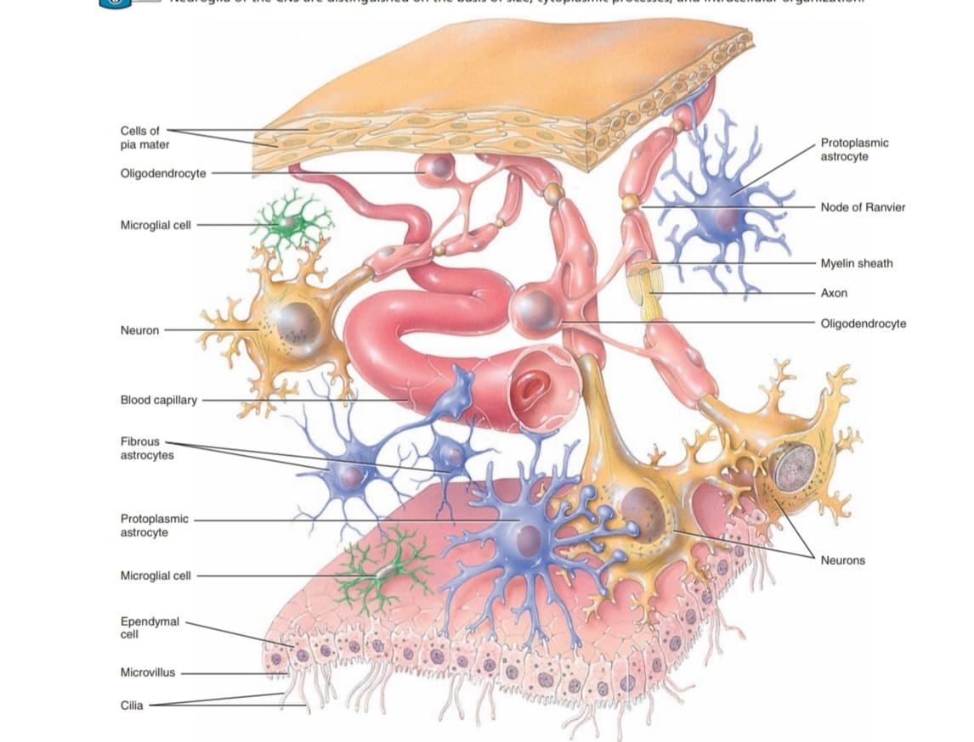

Slide 40
Neuroglia of the PNS
1.SCHWANN CELLS ; Like oligodendrocytes, they form the myelin sheath around axons. However, a single oligodendrocyte myelinates several axons, but each Schwann cell myelinates a single axon . A single Schwann cell can also enclose as many as 20 or more unmyelinated axons . Schwann cells participate in axon regeneration, which is more easily accomplished in the PNS than in the CNS.
2.SATELLITE CELLS ;Surround the cell bodies of neurons of PNS ganglia. Besides providing structural support, satellite cells regulate the exchanges of materials between neuronal cell bodies and interstitial fluid.

Slide 42
Myelination
Axons are surrounded by a multilayered lipid and protein covering, called the myelin sheath, are said to be myelinated . The sheath electrically insulates the axon of a neuron and increases the speed of nerve impulse conduction.Two types of neuroglia produce myelin sheaths: Schwann cells(in the PNS) and oligodendrocytes (in the CNS). Schwann cells begin to form myelin sheaths around axons during fetal development.Each Schwann cell wraps about 1 millimeter of a single axon’s length by spiraling many times around the axon. Eventually, multiple layers of glial plasma membrane surround the axon, with the Schwann cell’s cytoplasm and nucleus forming the outermost layer.

Slide 43
Continuation…..
The inner portion, consisting of up to 100 layers of Schwann cell membrane, is the myelin sheath. The outer nucleated cytoplasmic layer of the Schwann cell, which encloses the myelin sheath, is the neurolemma . A neurolemma is found only around axons in the PNS. When an axon is injured, the neurolemma aids regeneration by forming a regeneration tube that guides and stimulates regrowth of the axon. Gaps in the myelin sheath, called nodes of Ranvier , appear at intervals along the axon .In the CNS, an oligodendrocyte myelinates parts of several axons.Each oligodendrocyte puts forth about 15 broad, flat processes that spiral around CNS axons, forming a myelin sheath.

Slide 44
Contuation….
A neurolemma is not present, because the oligodendrocyte cell body and nucleus do not envelop the axon. Nodes of Ranvier are present, but they are fewer in number. Axons in the CNS display little regrowth after injury. This is thought to be due, in part, to the absence of a neurolemma, and in part to an inhibitory influence exerted by the oligodendrocytes on axon regrowth.

Slide 45
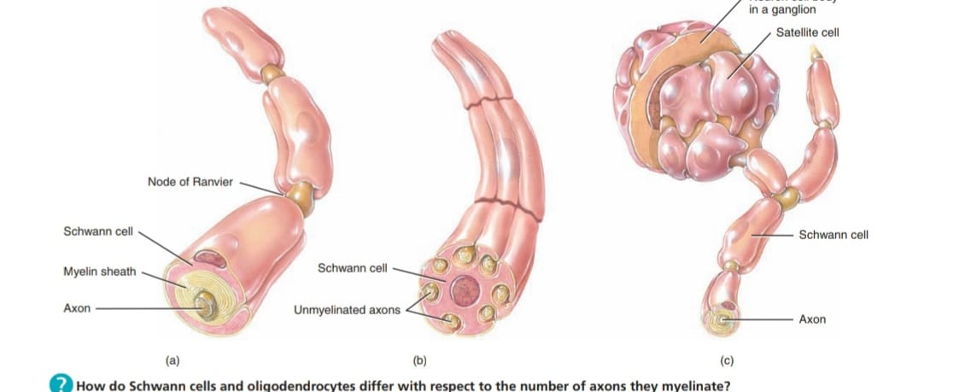

Slide 46
Terminologies
1.Clusters of Neuronal Cell Bodies;A ganglion (plural is ganglia) refers to a cluster of neuronal cell bodies located in the PNS. ganglia are closely associated with cranial and spinal nerves. By contrast,a nucleus is a cluster of neuronal cell bodies located in the CNS.
2.Bundles of Axons;A nerve is a bundle of axons that is located in the PNS.Cranial nerves connect the brain to the periphery, whereas spinal nerves connect the spinal cord to the periphery. A tract is a bundleof axons that is located in the CNS. Tracts interconnect neurons in the spinal cord and brain.

Slide 47
Continuation….
3.Gray and White Matter;White matter is composed primarily of myelinated axons. The whitish color of myelin gives white matter its name.The gray matter of the nervous system contains neuronal cell bodies, dendrites, unmyelinated axons, axon terminals, and neuroglia.It appears grayish, rather than white, because the Nissl bodies impart a gray color and there is little or no myelin in these areas. Blood vessels are present in both white and gray matter. In the spinal cord, the white matter surrounds an inner core of gray matter that, its shaped like a butterfly or the letter H; in the brain, a thin shell of gray matter covers the surface of the largest portions of the brain, the cerebrum and cerebellum .

Slide 48
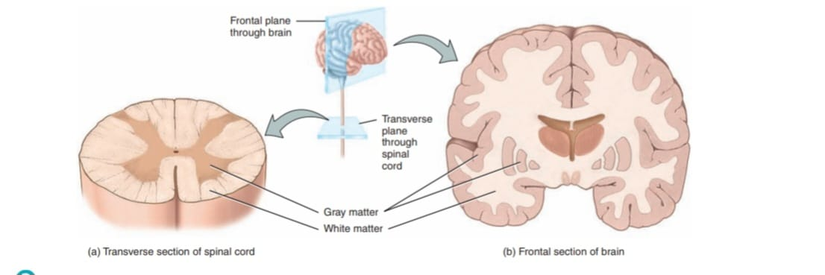

Slide 49
RESTING MEMBRANE POTENTIAL
Its the electrical voltage difference across the cell at rest.In neurons, the resting membrane potential typical value is -70 mV. The minus sign indicates that the inside of the cell is negative relative to the outside.Major factor that contributes to the inside-negative resting membrane potential of a cell is the unequal distribution of ions in the ECF and cytosol. The ECF is rich in Na+ and Cl– ions and the cytosol is rich in K +ions and anions such as phosphates in ATP and amino acids in proteins. Because the plasma membrane has more +K leak channels than Na leak channels, the number of K ions that leave the cell is greater than the number of + Na ions that enter the cell.

Slide 50
Continuation…..
The activity of the Na+/K+ ATPases is another factor that contributes to the resting membrane potential. The Na+/K +ATPase expels 3 Na+ ions for every 2 K +ions imported. Since the Na/K ATPase removes more positive charges from the cell than it brings into the cell, it is electrogenic and helps establish the inside-negative resting membrane potential.Their total contribution, however, is very small: only 3 mV of the total -70 mV resting membrane potential in a typical neuron.

Slide 51
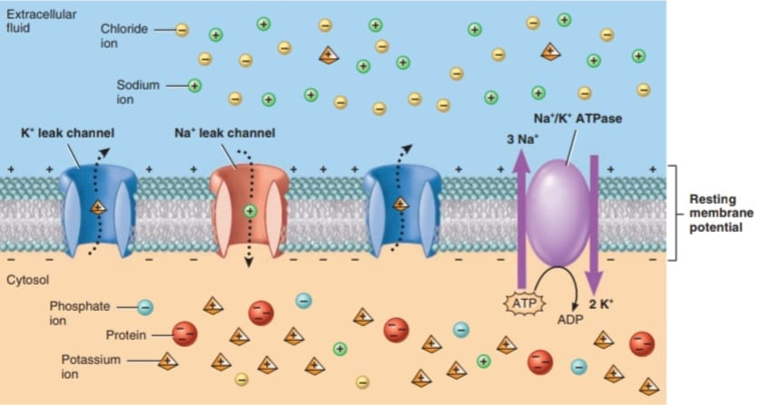

Slide 52
GRADED POTENTIAL
Its a small deviation from the membrane potential that makes the membrane either more polarized or less polarized. When the response makes the membrane more polarized ,it is termed a hyperpolarizing graded potential . When the response makes the membrane less polarized (inside less negative), it is termed a depolarizing graded potential .A graded potential occurs when a stimulus causes mechanically gated or ligand-gated channels to open or close in an excitable cell’s plasma membrane . Typically, ligand-gated channels are numerous in the dendrites and cell bodies of interneurons and motor neurons. graded potentials occur mainly in the dendrites and cell body of a neuron.

Slide 53
Continuation…..
To say that these electrical signals are graded means that they vary in amplitude (size), depending on the strength of the stimulus. The opening or closing of these ion channels alters the flow of specific ions across the membrane, producing a flow of current that is localized, which means that it spreads to adjacent regions along the plasma membrane in either direction from the stimulus source for a short distance and then gradually dies out as the charges are lost across the membrane through leak channels.This mode of travel by which graded potentials die out as they spread along the membrane is known as decremental conduction .

Slide 54
Continuation…..
Although an individual graded potential undergoes decremental conduction, it can become stronger and last longer by summating with other graded potentials. Summation is the process by which graded potentials add together. If two depolarizing graded potentials summate, the net result is a larger depolarizing graded potential . If two hyperpolarizing graded potentials summate, the net result is a larger hyperpolarizing graded potential.If two equal but opposite graded potentials summate (one depolarizing and the other hyperpolarizing), then they cancel each other out and the overall graded potential disappears.

Slide 55
Continuation…..
Graded potentials have different names depending on which type of stimulus causes them and where they occur. For example, when a graded potential occurs in the dendrites or cell body of a neuron in response to a neurotransmitter, it is called a postsynaptic potential . On the other hand, the graded potentials that occur in sensory receptors and sensory neurons are termed receptor potentials and generator potential.

Slide 56
Excitatory and Inhibitory Postsynaptic Potentials
A neurotransmitter causes either an excitatory or an inhibitory graded potential. A neurotransmitter that causes depolarization of the postsynaptic membrane is excitatory because it brings the membrane closer to threshold . A depolarizing postsynaptic potential is called an excitatory postsynaptic potential (EPSP). Although a single EPSP normally does not initiate a nerve impulse, the postsynaptic cell does become more excitable. Because it is partially depolarized, it is more likely to reach threshold when the next EPSP occurs. A neurotransmitter that causes hyperpolarization of the postsynaptic membrane is inhibitory.

Slide 57
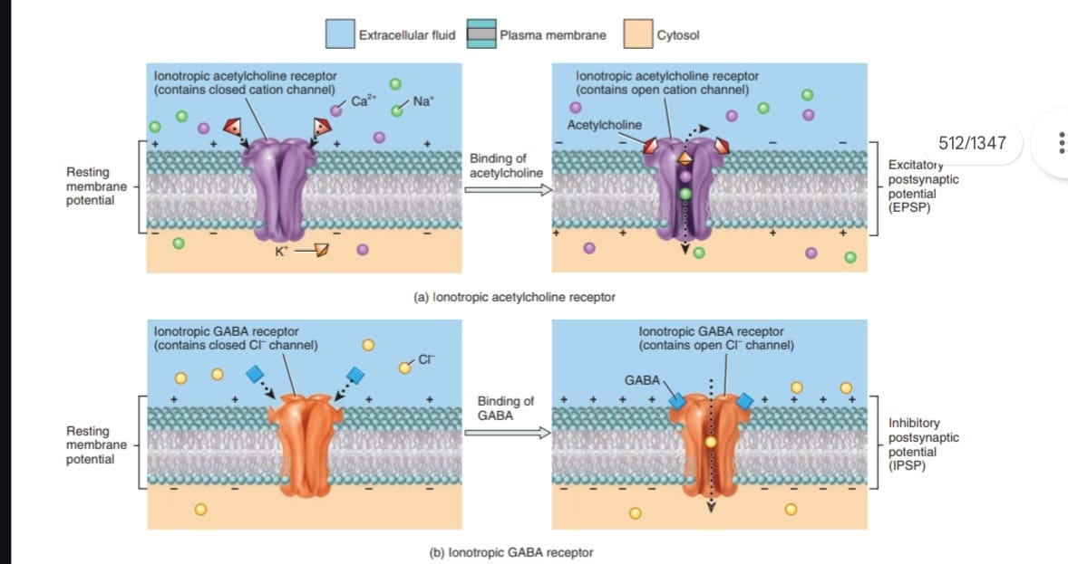

Slide 58
Continuation…..
During hyperpolarization, generation of an action potential is more difficult than usual because the membrane potential becomes inside more negative and thus even farther from threshold than in its resting state. A hyperpolarizing postsynaptic potential is termed an inhibitory postsynaptic potential (IPSP).
Spatial and Temporal Summation of Postsynaptic Potentials
A typical neuron in the CNS receives input from 1000 to 10,000 synapses. Integration of these inputs involves summation of the postsynaptic potentials that form in the postsynaptic neuron.

Slide 59
Continuation…..
Recall that summation is the process by which graded potentials add together. The greater the summation of EPSPs, the greater the chance that threshold will be reached. At threshold, one or more nerve impulses (action potentials) arise. There are two types of summation: spatial summation and temporal summation. Spatial summation is summation of postsynaptic potentials in response to stimuli that occur at different locations in the membrane of a postsynaptic cell at the same time. For example, spatial summation results from the buildup of neurotransmitter released simultaneously by several presynaptic end bulbs .

Slide 60
Continuation……
Temporal , is summation of postsynaptic potentials in response to stimuli that occur at the same location in the membrane of the postsynaptic cell but at different times. For example, temporal summation results from buildup of neurotransmitter released by a single presynaptic end bulb two or more times in rapid succession. Because a typical EPSP lasts about 15 msec, the second (and subsequent) release of neurotransmitter must occur soon after the first one if temporal summation is to occur. Summation is rather like a vote on the Internet. Many people voting “yes” or “no” on an issue at the same time can be compared to spatial summation.

Slide 61
Continution…..
One person voting repeatedly and rapidly is like temporal summation. Most of the time, spatial and temporal summations re acting together to influence the chance that a neuron fires an action potential. A single postsynaptic neuron receives input from many presynaptic neurons, some of which release excitatory neurotransmitters and some of which release inhibitory neurotransmitters The sum of all the excitatory and inhibitory effects at any given time determines the effect on the postsynaptic neuron.

Slide 62
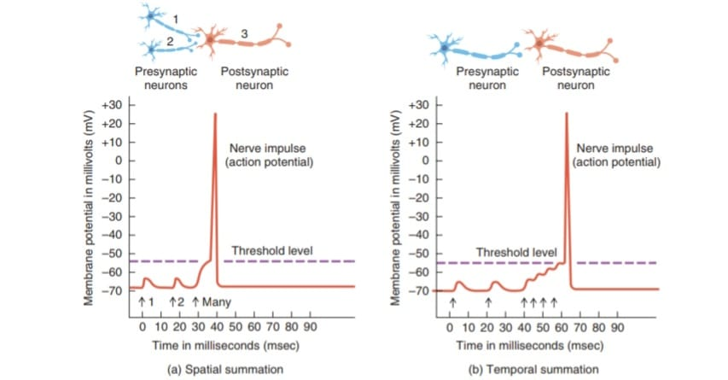

Slide 63
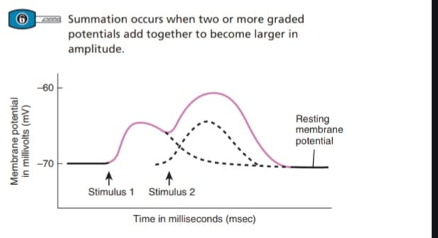

Slide 64
ACTION POTENTIAL
is an electrical signal that propagates (travels) along the surface of the membrane of a neuron.
Stages
1. Resting State
Membrane polarized ;−70 mV
2. Depolarization
Sodium channels open.
Na⁺ enters neuron.
Membrane becomes positive.

Slide 65
Continuation…
3. Repolarization
Potassium channels open.
K⁺ leaves neuron.
Membrane returns negative.
4. Hyperpolarization
Excess K⁺ exits.
Membrane becomes more negative than resting state.

Slide 66
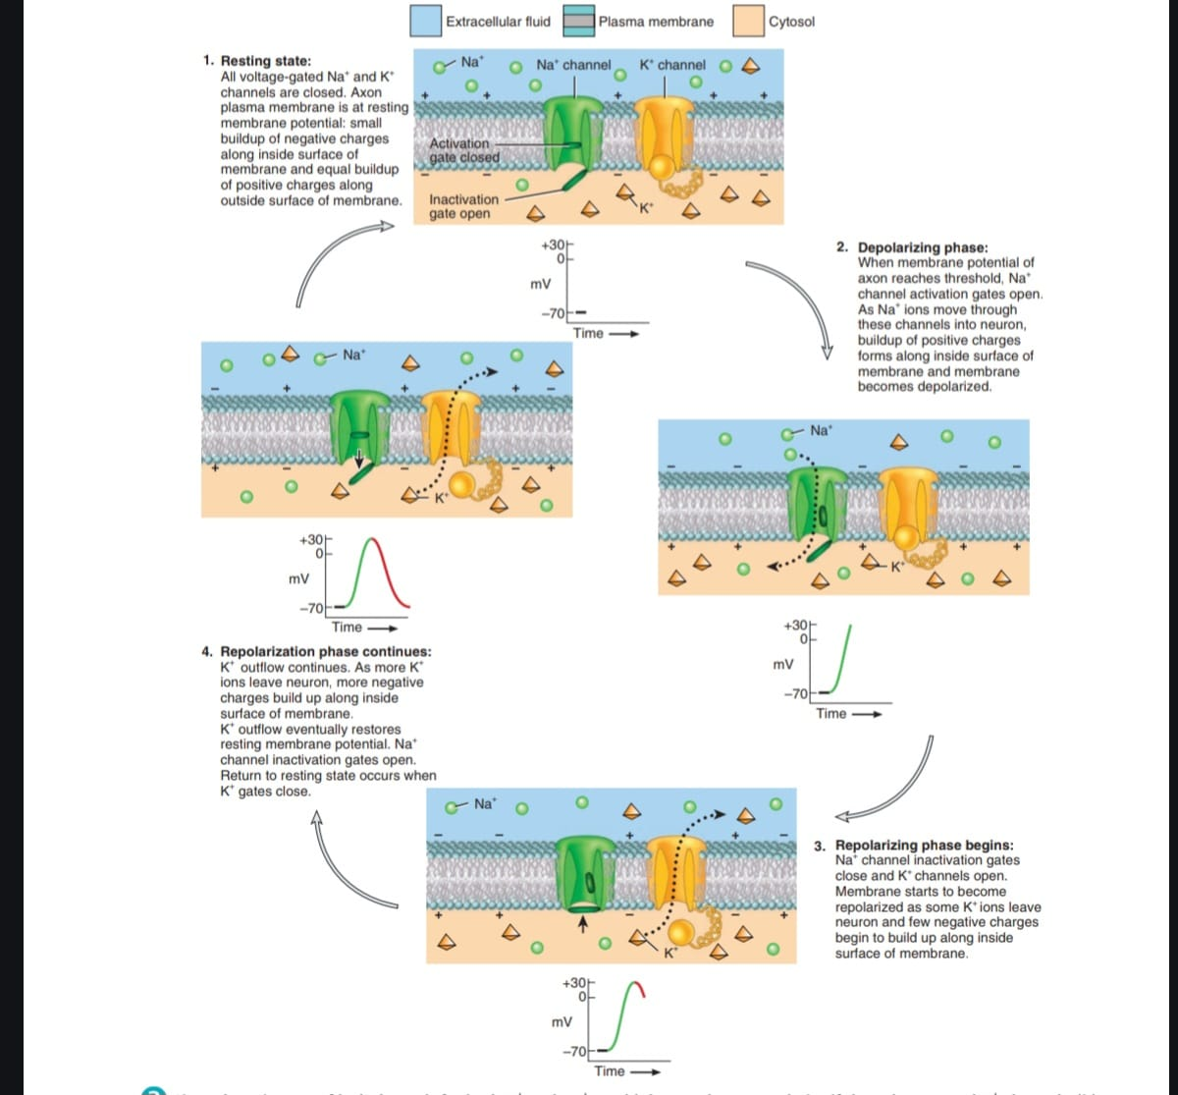

Slide 67
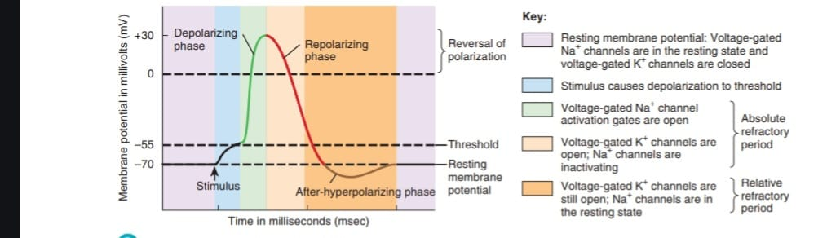

Slide 68
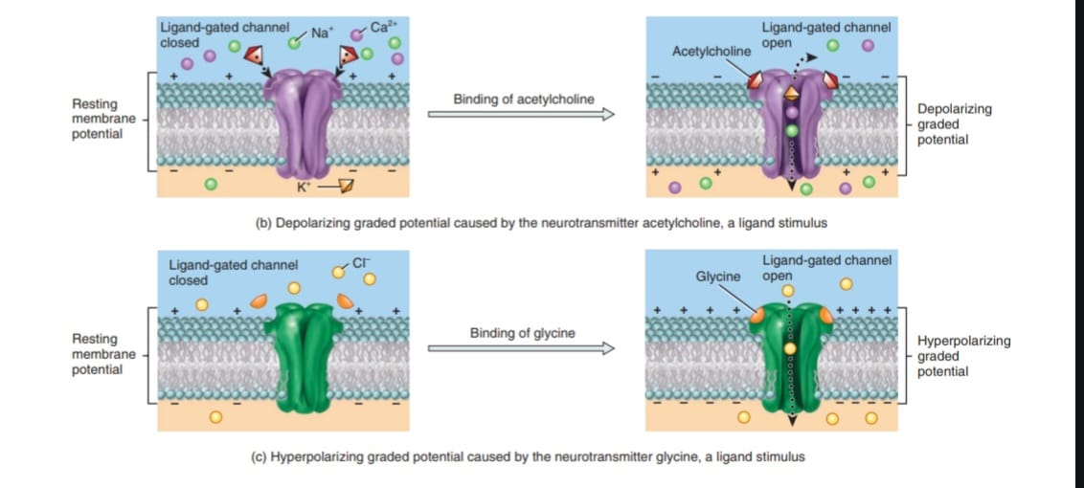

Slide 69
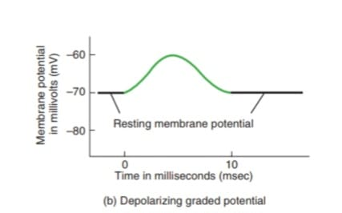
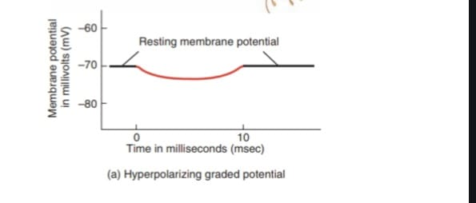

Slide 70
Factors That Affect the Speed of Propagation
1. Amount of myelination. As you have just learned, action potentials propagate more rapidly along myelinated axons than along unmyelinated axons.
2. Axon diameter. Larger-diameter axons propagate action potentials faster than smaller ones due to their larger surface areas.
3. Temperature. Axons propagate action potentials at lower speeds when cooled.

Slide 71
Removal of Neurotransmitter
1. Diffusion. Some of the released neurotransmitter molecules diffuse away from the synaptic cleft. Once a neurotransmitter molecule is out of reach of its receptors, it can no longer exert an effect.
2. Enzymatic degradation. Certain neurotransmitters are inactivated through enzymatic degradation. For example, the enzyme acetylcholinesterase breaks down acetylcholine in the synaptic cleft.
3. Uptake by cells. Many neurotransmitters are actively transported back into the neuron that released them (reuptake).

Slide 72
IMPULSE TRANSMISSION ACROSS SYNAPSES
Synapse ; Junction between neurons.
Components
1.Presynaptic neuron
2.Synaptic cleft
3.Postsynaptic neuron

Slide 73
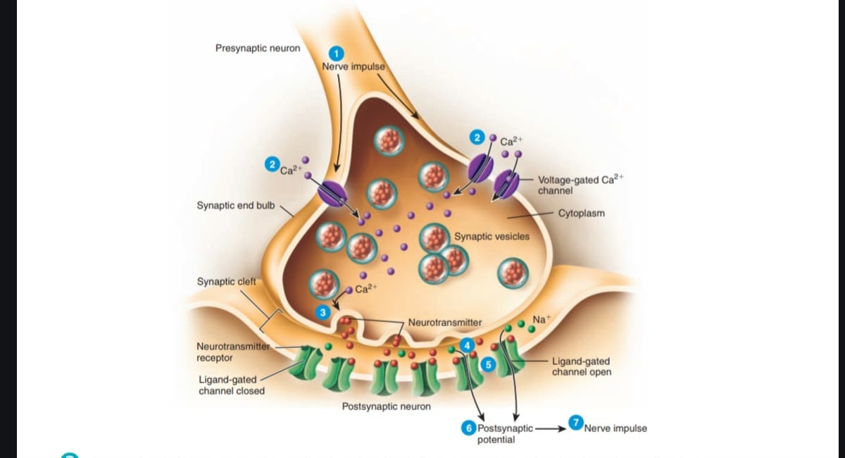

Slide 74
Steps in Synaptic Transmission
●1. A nerve impulse arrives at a synaptic end bulb (or at a varicosity) of a presynaptic axon.
●2 .The depolarizing phase of the nerve impulse opens voltage gated Ca2 +channels, which are present in the membrane of synaptic end bulbs. Because calcium ions are more concentrated in the extracellular fluid, Ca2+ flows inward through the opened channels.
●3.Increase in the concentration of Ca2+ inside the presynaptic neuron serves as a signal that triggers exocytosis of the synaptic vesicles. As vesicle membranes merge with the plasma membrane, neurotransmitter molecules within the vesicles are released into the synaptic cleft.

Slide 75
Continuation…
Each synaptic vesicle contains several thousand molecules of neurotransmitter.
.4 The neurotransmitter molecules diffuse across the synaptic cleft and bind to neurotransmitter receptors in the postsynaptic neuron’s plasma membrane.
5 .Binding of neurotransmitter molecules to their receptors on ligand-gated channels opens the channels and allows particular ions to flow across the membrane.
6 .As ions flow through the opened channels, the voltage across the membrane changes. This change in membrane voltage is a postsynaptic potential.

Slide 76
Continuation…..
Depending on which ions the channels admit, the postsynaptic potential may be a depolarization (excitation) or a hyperpolarization (inhibition). For example, opening of Na +channels allows inflow of Na+,which causes depolarization. However, opening of Cl– or K channels causes hyperpolarization. Opening Cl– channels permits Cl– to move into the cell, while opening the K channels allows K to move out—in either event, the inside of the cell becomes more negative.
7 When a depolarizing postsynaptic potential reaches threshold, it triggers an action potential in the axon of the postsynaptic neuron.

Slide 77
Continuation….
At most chemical synapses, only one-way information transfer can occur—from a presynaptic neuron to a postsynaptic neuron or an effector, such as a muscle fiber or a gland cell. For example, synaptic transmission at a neuromuscular junction (NMJ) proceeds from a somatic motor neuron to a skeletal muscle fiber (but not in the opposite direction). Only synaptic end bulbs of presynaptic neurons can release neurotransmitter, and only the postsynaptic neuron’s membrane has the receptor proteins that can recognize and bind that neurotransmitter . As a result, action potentials move in one direction

Slide 78
Common Neurotransmitters
1.Acetylcholine(Muscle contraction)
2.Dopamine(Movement, reward)
3.Serotonin(Mood regulation)
4.Norepinephrine(Alertness)
5.GABA(Inhibitory actions)
6.Glutamate(Excitatory actions)

Slide 79
CENTRAL NERVOUS SYSTEM (CNS)
The CNS consists of;Brain and Spinal Cord.
A. BRAIN
1.Cerebrum
Largest part of the brain , as four lobe ; frontal(motor),parietal(sensory),occipital(vision) and temporal(hearing).
Functions : Intelligence,Memory,Learning,Speech and Voluntary movement

Slide 80
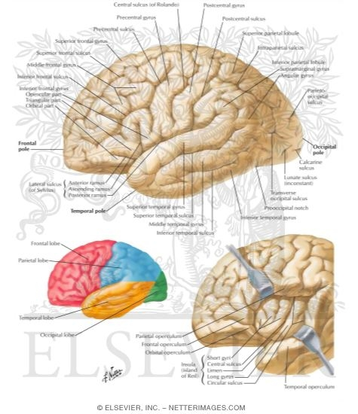

Slide 81
Continuation….
2. Cerebellum
Functions:Balance,Coordination and Posture
3.Brainstem
Consists of:Midbrain,Pons and Medulla Oblongata(Heart rate,Respiration,Blood pressure)
B.SPINAL CORD
Functions: Conduction Carries impulses To and From brain

Slide 82
MENINGES
Protective membranes covering CNS;Dura ,arachnoid and pia mater
CEREBROSPINAL FLUID (CSF)
Functions:
1.Shock absorption
2.Nutrient transport
3.Waste removal

Slide 83
PERIPHERAL NERVOUS SYSTEM (PNS)
The PNS includes all neural tissue outside CNS. Components
Cranial Nerves 12 pairs and Spinal Nerves 31 pairs
DIVISIONS OF PNS
1.Sensory Division ;Carries impulses toward CNS
2. Motor Division; Carries impulses away from CNS . further subdivided into ,1.Somatic(Skeletal muscles Voluntary movements) and ANS(:Cardiac muscle ,Smooth muscle and Glands Involuntary actions ,this are Sympathetic Division “ Fight or Flight“ and Parasympathetic Division "Rest and Digest“)

Slide 84
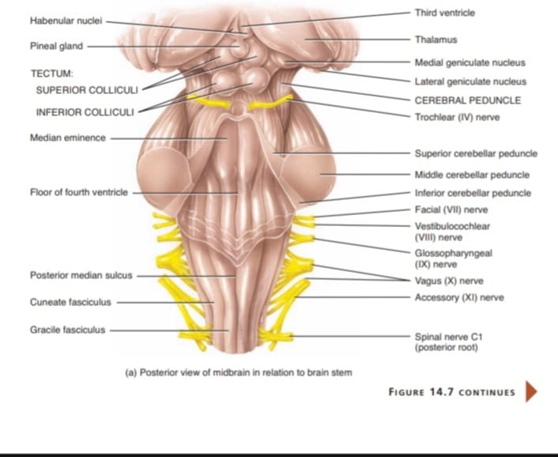
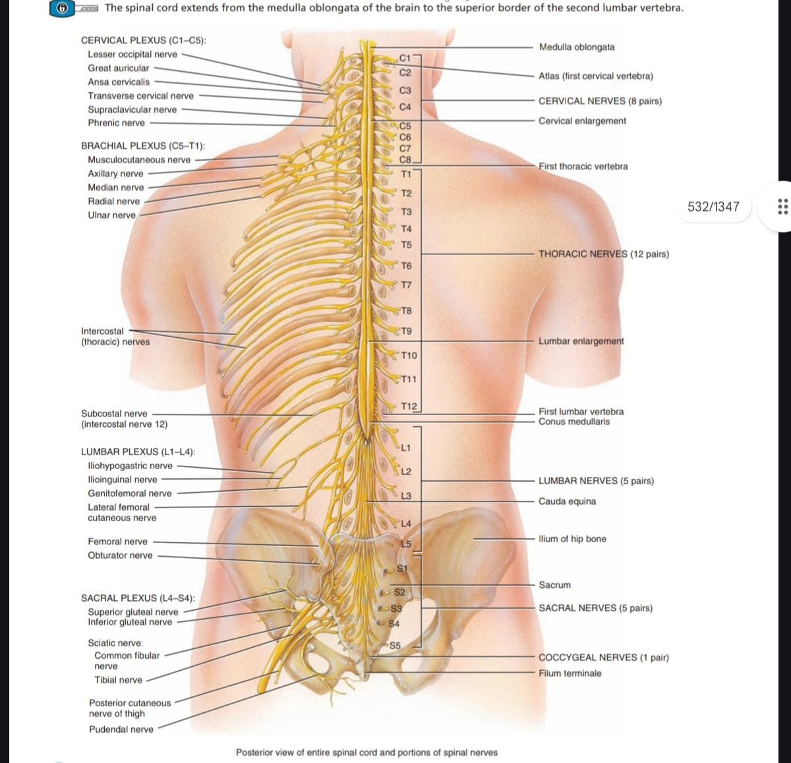

Slide 85
SENSE ORGANS
Sense organs contain receptors that detect stimuli.includes the following:
1.eye;vision
2.nose;smell
3.skin ;touch
4.ear;hearing and balance
5.tongue ;taste

Slide 86
QUIZ
1. The structural and functional unit of the nervous system is:
A. Neuroglia B. Neuron C. Axon D. Synapse
2. Nerves that carry impulses toward the CNS are:
A. Motor nerves B. Mixed nerves C. Sensory nerves
D. Autonomic nerves
3. 5. How many pairs of cranial nerves are present?
A. 10 B. 11 C. 12 D. 31

Slide 87
CONTINUATION…
4. Nerves that carry impulses away from the CNS are:
A. Sensory nerves B. Motor nerves C. Cranial nerves
D. Receptors
5. A mixed nerve contains:
A. Only sensory fibers B. Only motor fibers C. Sensory and motor fibers D. Neuroglia only
6. Dendrites function to:
A. Conduct impulses away from the cell body B. Receive stimuli
C. Produce CSF D. Form myelin

Slide 88


Slide 89
THANK YOU!!!
Thank you for listening and interacting

