Slide 1
EE5111-CA1
Multi-Sensor Pose Estimation for Autonomous Vehicles
Team 14 members: Li Weihao*, Li Xiaotian, Wan Quanzhen, Miao Chenxin, Zou Yanfeng

Slide 2
Performance Indicators
·Reliability - The system's consistency and trustworthiness
·Accuracy - Precision of the system, measured at the 95th percentile.
Reliability ensures dependable performance even in the presence of noise, sensor failures, or environmental challenges.
Industry: LiDAR, radar, IMUs
Academic: probabilistic sensor fusion algorithms
Accurate positioning ensures safe and reliable navigation, reducing the risk of accidents and improving system performance.
Industry: Solid-state LiDAR,Millimeter-wave radar sensors
Academic:GNNs
A
B
C
D
·Real-Time Performance - Rapid and informed decisions
·Others
Real-time performance enables timely decision-making, critical for safe effective autonomous driving in dynamic environments.
Industry: 5G Network, GPUs
Academic: High-Speed Imaging
Cost, stability, latency, integrity, etc.
14

Slide 3
Sensors
Global Positioning System (GPS) is a satellite-based navigation system that provides accurate location and time information to users worldwide.
I. Global Positioning: GPS provides accurate location data, helping to know its absolute position, velocity as well as acceleration in global coordinates.
II. Redundancy: GPS can be integrated with global mapping solutions for applications that require location-based services.
III. Time Synchronization: GPS provides highly accurate time data, vital for applications that need precise synchronization.
IV. Failover: In cases where other positioning systems fail or get disrupted, GPS serves as a reliable backup.
Geodesy and geodynamics 11.6 (2020): 401-410.
14

Slide 4
GPS
Sensor Proposal - GPS
Global Positioning System (GPS) is a satellite-based navigation system that provides accurate location and time information to users worldwide.
We propose 3 suitable GPS modules
Pricing range from $30.66 to $299.42
In general, all three modules support multiple navigation systems (reliability)
ZED-F9R-03B supports GPS + Galileo + GLONASS + Beidou
Supports simultaneous usage of all 4 systems
NEO-M8U and MAX-M10S supports GPS + GLONASS
NEO-M8U support simultaneous usage of both system
MAX-M10S only supports 1 system at any time
14

Slide 5
GPS information
Sensor Proposal - GPS
14

Slide 6
GPS
Sensor Proposal - GPS
The more expensive systems supports multiple positioning system
There are several advantages:
Improved Accuracy: The more the number of visible satellites at any given time, leads to better accuracy and faster position fixes. This is valuable in challenging environments with obstructions or in urban canyons where signals from one constellation may be obstructed.
Global Coverage: With support for multiple constellations, a GPS chip can provide global coverage, ensuring that your device can determine its position accurately in various parts of the world. This also lead to a faster time to first fix (TTFF)
Redundancy: Multiple constellations offer redundancy. If one satellite constellation experiences an outage or interference, the chip can switch to another, maintaining continuous positioning capabilities.
14

Slide 7
GPS
Sensor Proposal - GPS
The more expensive systems supports multiple Global Navigation Satellite Systems
RTK (Real-Time Kinematic):
RTK is a high-precision GNSS technique used for precise positioning and navigation. Provides centimeter-level accuracy in positioning and is commonly used in applications like surveying, precision agriculture, and autonomous vehicles.
Relies on a base station with a known location to transmit correction signals to a rover (a mobile GNSS receiver) in real-time.
PVT (Position, Velocity, and Time):
PVT is a basic output from a GNSS receiver, providing information about the device's current position, velocity, and time.
It typically offers meter-level to sub-meter-level accuracy, depending on the GNSS constellation (e.g., GPS, GLONASS, Galileo, or BeiDou) and the quality of the receiver.
SBAS (Satellite-Based Augmentation System):
SBAS is a system designed to improve the accuracy and reliability of GNSS positioning, especially in challenging environments or regions with limited satellite visibility.
Examples of SBAS include WAAS (Wide Area Augmentation System) in the United States and EGNOS (European Geostationary Navigation Overlay Service) in Europe.
SBAS provides correction data to GNSS receivers, enhancing their accuracy to within a few meters or better.
A robot that could take advantage from centimeter level accuracy can consider the more expensive GPS module with RTK features.
14

Slide 8
Sensor Proposal - IMU
IMU
Inertial Measurement Unit (IMU) is a sensor device that measures and records motion-related data, including acceleration and angular velocity.
We propose 3 suitable IMU modules
Pricing range from $10.77 to $1900
14

Slide 9
IMU information
Sensor Proposal - IMU
14

Slide 10
Sensor Proposal - IMU
IMU
For the cheapest model, from the datasheet itself:
“…delivers best-in-class motion sensing that can detect orientation and gestures…”
Missing lots of specification including resolution, drift etc….
Likely not suited for robot unless cost is really of concern since it does not provide bias stability and accuracy
14

Slide 11
IMU
Sensor Proposal - IMU
For the other two models
Both take advantage of multi-axis sensing and high simplicity
3DM-GX5-IMU has a much higher sampling rate, lower bias stability and higher accuracy. However it is also more expensive.
438-OPENIMU300RI is sufficient for most scenario where bias stability is not as important an factor, as its accuracy, resolution and noise stability are sufficient for many commercial robots as per our research
14

Slide 12
Sensors
Inertial Measurement Unit (IMU) is a sensor device that measures and records motion-related data, including acceleration and angular velocity.
I. Time Synchronization: IMUs provide real-time data, measuring and recording object motion and orientation at high frequencies.
II. High Precision: IMUs can offer high precision in measuring accelerations and angular rates.
III. Redundancy: IMUs can be used in conjunction with other sensors, such as GPS, to provide redundancy and enhance overall system reliability and accuracy.
IV. Robustness and Reliability: IMUs are less susceptible to environmental factors like magnetic interference.
14

Slide 13
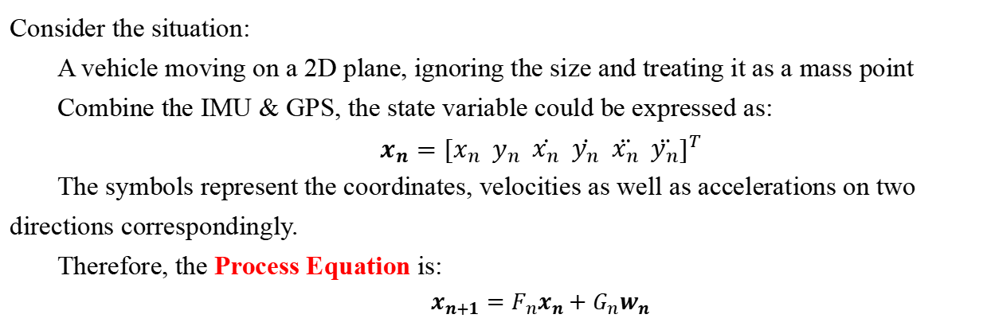
Methodology - Status Equation
Consider the situation:
A vehicle moving on a 2D plane, ignoring the size and treating it as a mass point
Combine the IMU & GPS, the state variable could be expressed as:
$$x_{n}={[x_{n} y_{n} \dot{x_{n}} \dot{y_{n}} \ddot{x_{n}} \ddot{y_{n}}]}^{T}$$
The symbols represent the coordinates, velocities as well as accelerations on two directions correspondingly.
Therefore, the Process Equation is:
$$x_{n+1}=F_{n}x_{n}+G_{n}w_{n}$$
Gaussian noises:
Newton’s Law
14

Slide 14
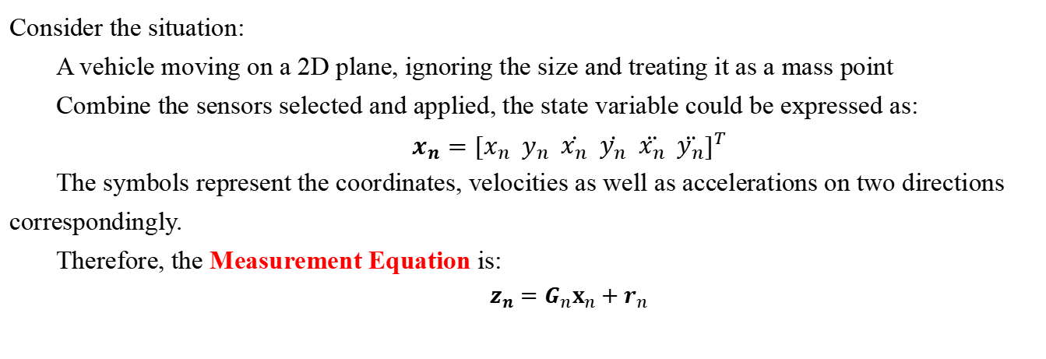
Methodology - Status Equation
Consider the situation:
A vehicle moving on a 2D plane, ignoring the size and treating it as a mass point
Combine the sensors selected and applied, the state variable could be expressed as:
$$x_{n}={[x_{n} y_{n} \dot{x_{n}} \dot{y_{n}} \ddot{x_{n}} \ddot{y_{n}}]}^{T}$$
The symbols represent the coordinates, velocities as well as accelerations on two directions correspondingly.
Therefore, the Measurement Equation is:
$$z_{n}=G_{n}x_{n}+r_{n}$$
Gaussian noises:
2D-Position Information
14

Slide 15
Methodology - Status Equation
·Process Equation:
Consider the covariance of perturbation:
Set the transition matrix T as:
The total covariance of perturbation is:
14

Slide 16
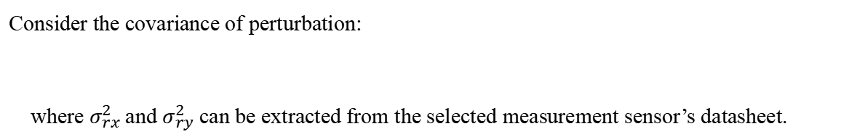
Methodology - Status Equation
·Measurement Equation:
Consider the covariance of perturbation:
where $σ_{rx}^{2}$ and $σ_{ry}^{2}$ can be extracted from the selected measurement sensor’s datasheet.
Now, Focus on the Perturbations and Generate estimated value: Kalman Filter
14

Slide 17
Methodology - Kalman Filter
Initialize P, R, Q
PREDICTION
CORRECTION
Project the state ahead:
Project the error covariance ahead:
Compute the Kalman Gain:
Update the estimate via measurement:
Update the error covariance:
J are the Jacobians
·Among them, the transition function matrix of state is:
·The transition function matrix of noise is:
·The whole covariance matrix P:
14

Slide 18
Methodology - Kalman Filter
Initialize P, R, Q
PREDICTION
CORRECTION
Project the state ahead:
Project the error covariance ahead:
Compute the Kalman Gain:
Update the estimate via measurement:
Update the error covariance:
J are the Jacobians
·Considering the error-state-measurement, the measurement function matrix J is:
·The noise matrix R is:
14

Slide 19
Methodology - Kalman Filter
Initialize P, R, Q
PREDICTION
CORRECTION
Project the state ahead:
Project the error covariance ahead:
Compute the Kalman Gain:
Update the estimate via measurement:
Update the error covariance:
14

Slide 20
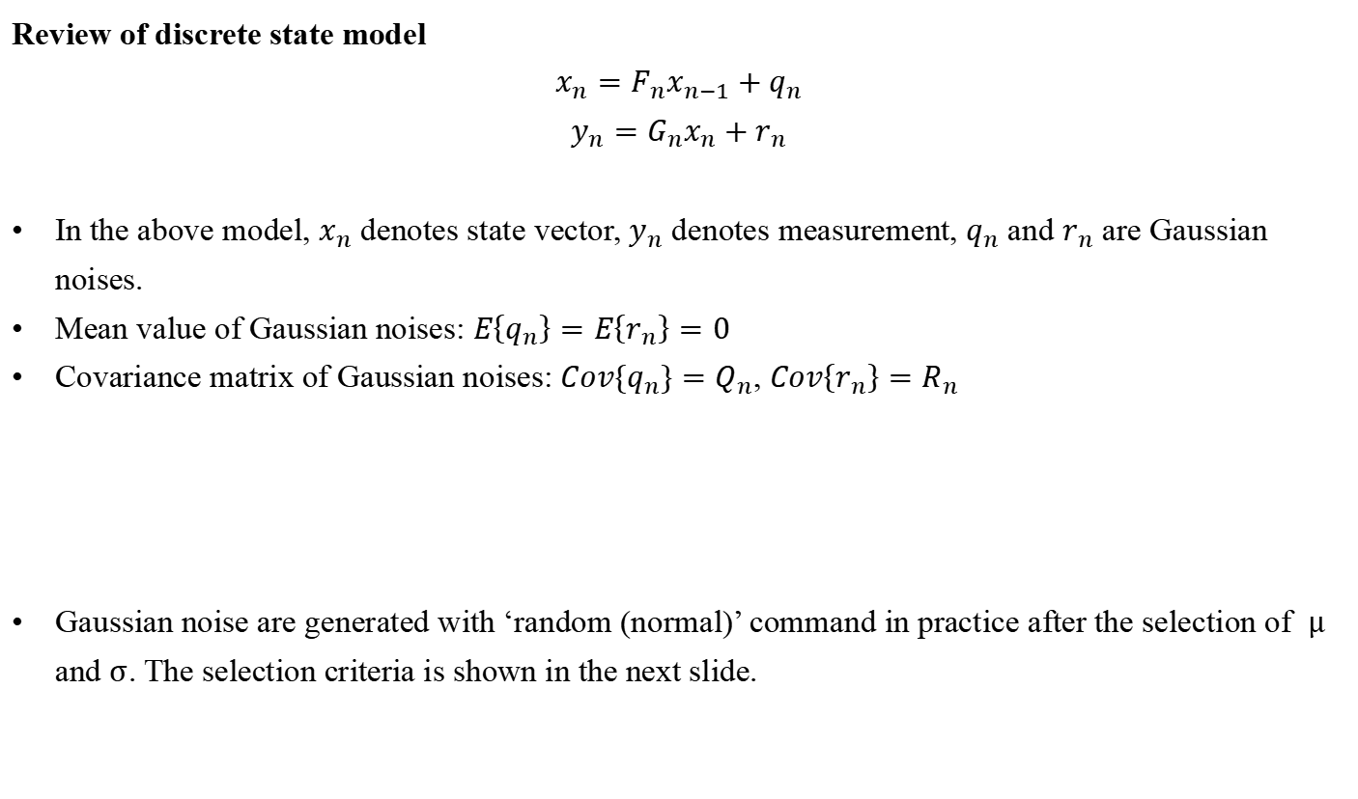
Question 4 - Estimation method and results
Review of discrete state model
$$x_{n}=F_{n}x_{n−1}+q_{n}$$
$$y_{n}=G_{n}x_{n}+r_{n}$$
In the above model, $x_{n}$ denotes state vector, $y_{n}$ denotes measurement, $q_{n}$ and $r_{n}$ are Gaussian noises.
Mean value of Gaussian noises: $E\left\{q_{n}\right\}=E\left\{r_{n}\right\}=0$
Covariance matrix of Gaussian noises: ${Cov\{q}_{n}\}=Q_{n}$, $Cov\left\{r_{n}\right\}=R_{n}$
Gaussian noise are generated with ‘random (normal)’ command in practice after the selection of $μ$ and $σ$. The selection criteria is shown in the next slide.
14

Slide 21
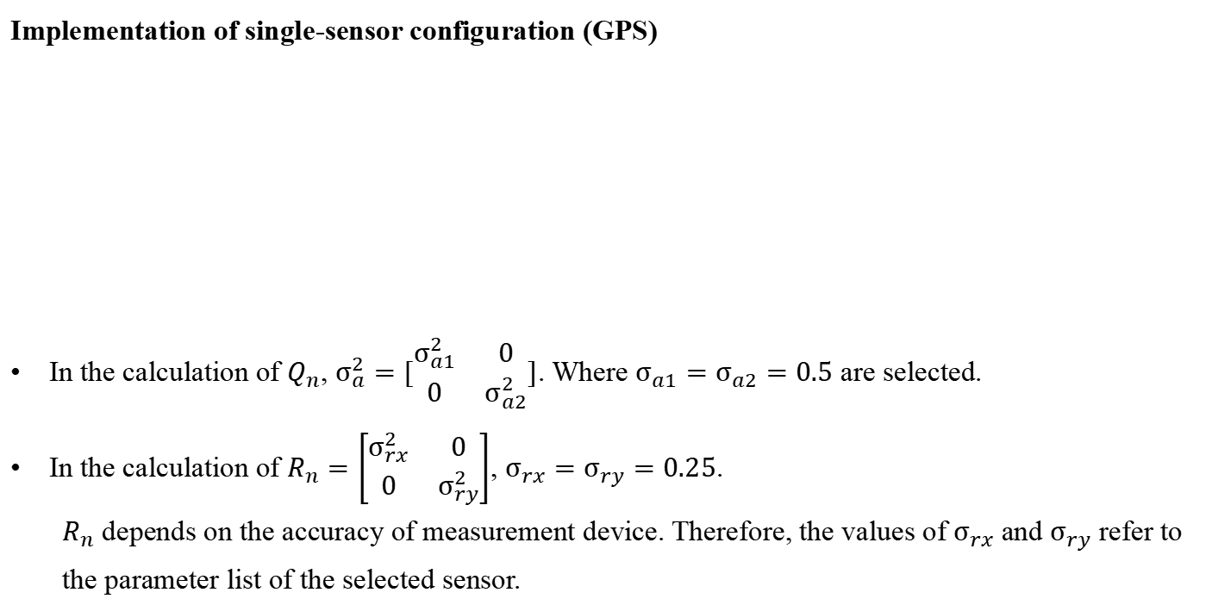
Question 4 - Estimation method and results
Implementation of single-sensor configuration (GPS)
In the calculation of $Q_{n}$, $σ_{a}^{2}=[\begin{matrix}σ_{a1}^{2} & 0 \\ 0 & σ_{a2}^{2}\end{matrix}]$. Where $σ_{a1}=σ_{a2}=0.5$ are selected.
In the calculation of $R_{n}=\left[\begin{matrix}σ_{rx}^{2} & 0 \\ 0 & σ_{ry}^{2}\end{matrix}\right]$, $σ_{rx}=σ_{ry}=0.25$.
$R_{n}$ depends on the accuracy of measurement device. Therefore, the values of $σ_{rx}$ and $σ_{ry}$ refer to the parameter list of the selected sensor.
14

Slide 22

Question 4 - Estimation method and results
Results of single-sensor configuration (GPS)
Figure 4-1 shows the comparison between real trace, measurement trace, and filtered trace.
Figure 4-2 shows the estimation error of x-position and y-position with single sensor.
The estimation error is evaluated based on the mean squared error $MSE=\frac{1}{N}\sum_{k=1}^{N}{{\left\|\hat{x}−x\right\|}^{2}}$
When single-sensor is deployed, the mean squared error of the six states are computed as ${MSE= [\begin{matrix}0.2357 & 0.1897 & 4.6584\end{matrix} \begin{matrix}5.4338 & 5.0761 & 6.9189\end{matrix}]}^{T}$
Figure 4-1. Estimation trace
Figure 4-2. Position error curve
14

Slide 23
Question 4 - Estimation method and results
Implementation of multi-sensor configuration (GPS & IMU Fusion)
IMU can observe acceleration and gyroscopic rotation rate. Extended Kalman Filter (EKF) should be applied instead of Kalman Filter to realize the linearization of the prediction part and measurement part.
In this project, only acceleration measurement is collected from IMU. The information of rotation rate is not considered for simplification. Thus, Kalman Filter can still be applied in the estimation of multi-sensor fusion.
14

Slide 24


Question 4 - Estimation method and results
Implementation of multi-sensor configuration (GPS & IMU Fusion)
In the calculation of $Q_{n}$, $σ_{a}^{2}=[\begin{matrix}σ_{a1}^{2} & 0 \\ 0 & σ_{a2}^{2}\end{matrix}]$. Where $σ_{a1}=σ_{a2}=0.5$ are selected.
In the calculation of $R_{n}=\left[\begin{matrix}\begin{matrix}σ_{1}^{2} & 0 \\ 0 & σ_{2}^{2}\end{matrix} & \begin{matrix}0 & 0 \\ 0 & 0\end{matrix} \\ \begin{matrix}0 & 0 \\ 0 & 0\end{matrix} & \begin{matrix}σ_{3}^{2} & 0 \\ 0 & σ_{4}^{2}\end{matrix}\end{matrix}\right]$. $σ_{1}=σ_{2}=0.25$, and $σ_{3}=σ_{4}=0.2$ are selected.
$$G_{n}=\left[\begin{matrix}\begin{matrix}1 & 0 & 0 \\ 0 & 1 & 0\end{matrix} & \begin{matrix}0 & 0 & 0 \\ 0 & 0 & 0\end{matrix} \\ \begin{matrix}0 & 0 & 0 \\ 0 & 0 & 0\end{matrix} & \begin{matrix}0 & 1 & 0 \\ 0 & 0 & 1\end{matrix}\end{matrix}\right]$$
14

Slide 25

Question 4 - Estimation method and results
Results of multi-sensor configuration (GPS & IMU Fusion)
Figure 4-3 shows the comparison between real trace, measurement trace, and filtered trace.
Figure 4-4 shows the estimation error of x-position and y-position with single sensor.
The estimation error is evaluated based on the mean squared error $MSE=\frac{1}{N}\sum_{k=1}^{N}{{\left\|\hat{x}−x\right\|}^{2}}$
When multi-sensor is deployed, the mean squared error of the six states are computed as ${MSE= [\begin{matrix}0.6075 & 0.4979 & 1.0390\end{matrix} \begin{matrix}0.7991 & 0.1764 & 0.1585\end{matrix}]}^{T}$
Figure 4-3. Estimation trace
Figure 4-4. Position error curve
14

Slide 26
Question 5 – Review of design
Comparison and discussion
By comparing the MSE and of single-senor and multi-sensor, it is reported that the estimation error of velocity and acceleration of multi-sensor fusion significantly lower than that of single sensor by over 77.8%. High accuracy of multi-sensor results could be leaded by more aspects of sensory information introduced by multi-sensor.
However, the estimation error of position of multi-sensor fusion is slightly higher than that of single sensor. The reason can be that more measurement error is introduced by the application of new sensors. The modification of model and fusion algorithm is required.
14

Slide 27
Question 5 – Review of design
Evaluation based on performance indicators
Reliability
Gaussian noise is introduced, and pseudo measurement is generated in this project. The result shows that our designs have good performance in the presence of noise.
The effective performance of single-sensor estimation shows that our design can still perform well when sensor failure occurs.
In summary, our design is reliable and trustworthy.
Accuracy
Based on the result and analysis of mean squared error, the estimation of our design is reported to be accurate. The accuracy of position estimation of multi-sensor can be improved.
Real-time performance
According to figures of the position error curves, the settling time of our system is short. The estimation process can quickly adapt to the dynamic environment. Therefore, our design have good real-time performance.
14

Slide 28
Question 5 – Review of design
Question 5 – Review of design
Improvement
More indicators
The sensors’ datasheets in reality usually provide various indicators. In this project, we only used the variance information to build the measurement noise matrix and haven’t considered others such as delay or asynchronization. Also, we didn’t take zero bias into consideration. Therefore, more diverse aspects of performance indicators are left to be considered.
2 Model improvement
In reality, the vehicle has an actual length and width, which can further introduce Euler Angle, angular velocity, and angular acceleration, thereby establishing the physical equation of rotational motion. In this project, we treat the car as an ideal point without dimensions, which cannot add such angular velocity information. In view of this, the two-round Ackermann dynamic model can be well improved.
14

Slide 29
contribution weights
No. | Name | Student Number | Weight
1 (team leader) | Li Weihao | A0260186E | 1
2 | Li Xiaotian | A0243915A | 1
3 | Wan Quanzhen | A0260269B | 1
4 | Miao Chenxin | A0260045R | 1
5 | Zou Yanfeng | A0183651A | 1
14

Slide 30
Thank you for your kind attention!
Team members: Li Weihao*, Li Xiaotian, Wan Quanzhen, Miao Chenxin, Zou Yanfeng

