Slide 1
Prediction of Top Categories on Twitch
Perry Antonelli

Slide 2
The Data
200 most watched categories on Twitch each months since January 2016
Hours watched
Hours streamed
Rank
Other streaming and viewing data
Attempted to predict the Top 10, 20, 50, 100 most watched categories for the next month
Notes:
Rank – based on the hours watched, most watched category is 1, 200th most watched is 200

Slide 3
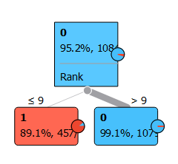
Modeling
Neural Network
Logistics Regression
Naïve Bayes
Tree – as simple as possible

Slide 4
Modeling Results
Tree outperformed other models
Target | Cutoff | Precision | Recall
Top 10 | 9 | 89.1% | 82.9%
Top 20 | 20 | 96.6% | 96.5%
Top 50 | 49 | 93.1% | 92.9%
Top 100 | 93 | 85.9% | 85.7%
Notes:
Precision: percentage of predicted are actually in the category
Recall: percentage of actual that are predicted correctly

Slide 5
Recommendations
Best predictor of how popular a game will be on Twitch next month is how popular it is this month.
There might be a way to improve the results we have so far, but since our simplest model works so well it’s hard to justify spending more time or resources on that
A better course of action might be to attempt to predict how popular upcoming games will be

