Slide 1
Prediction of Heart Disease and Stroke using Unbalanced Data sets
Perry Antonelli
Notes:
My presentation is on the Prediction of Heart Disease and Stroke using Unbalanced Datasets

Slide 2
The Data
Two different data sets, one for heart disease and one for strokes.
Both are unbalanced- contain an excess of one the values for the target attribute
Models trained on this type of data are often good at predicting the over represented class but bad at predicting the under represented class
Notes:
I analyzed two different data sets, one for heart disease and one for strokes. Both are unbalanced- they contain an excess of one the values for the target attribute. So for the heart disease data set it contains more data points labeled as having heart disease than not having. And the stroke data set contain more data points labeled as stroke than not. Models trained on this type of data are often good at predicting the over represented class but bad at predicting the under represented class.

Slide 3
Modeling
Naïve Bayes
Logistics Regression
Neural Network
Undersampling
Oversampling
Decision Threshold
Notes:
I looked at three different models Naïve Bayes, Logistics Regression, and Neural Network.
I also looked at three different techniques that can be used to deal with unbalanced data sets.
Undersampling reduces the size of the over-represented class so that is the same size as the under-represented class.
Oversampling increase the size of the under-represented class until it is the same size as the over-represented class.
I also looked at adjusting the decision threshold. This changes which points are assigned to which value of the target attribute. Lowering it will cause more points to be predicted as having either heart disease or stroke and raising it will do the opposite.

Slide 4
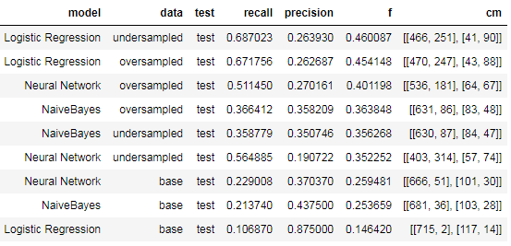
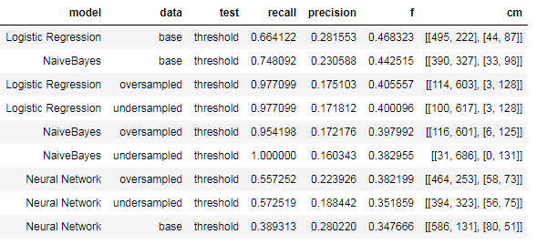
Modeling Results – Heart Disease
Notes:
These are the results for the heart disease data set. The top chart is without adjusting the decisions threshold and the bottom is with.
The charts are sorted according to F-score with the best value at the top of the chart. This value is combination of the recall and the precision, the version I’m using has a slight weighting to prefer increasing the recall.
The rows labeled as ‘base’ are the data set without either undersampling or oversampling. And in the top the chart we can see they performed the worst, but in the bottom chart two of them actually performed the best.
The model with the best overall f-score is the logistics regression without undersampling or over sampling and with adjusting the decision threshold.
The top f-score is only .47, a 1 would be a perfect score, it’s not great but better than the .2-.3 on the base data set.

Slide 5
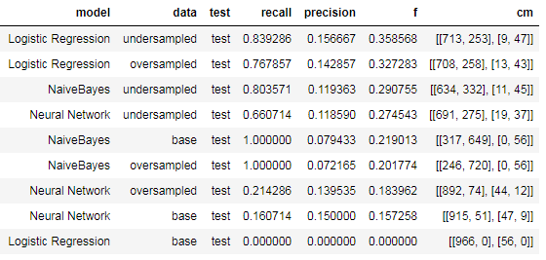
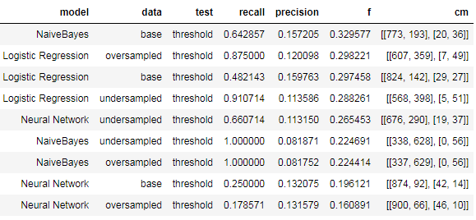
Modeling Results – Stroke
Notes:
Similar charts as previous slide, but for the stroke data set.
Again we see in the top chart that model fit on the base data performed pretty poorly, but got better when either type of sampling was added or adjusting the decision threshold.
The model with the best overall f-score is the logistics regression with undersampling without adjusting the decision threshold.
Again top f-score is pretty low at only .36, but it’s an improvement on the base data set.

Slide 6
Recommendations
While undersampling, oversampling, and adjusting the decision threshold did improve the fit of models on these data sets, the models are still far from perfect.
Look at different models
Look at more sophisticated versions of under and over sampling.
Notes:
While undersampling, oversampling, and adjusting the decision threshold did improve the overall fit of models on these data sets, the models are still far from perfect.
I would be hesitant to use them for actually trying to predict heart disease or strokes.
Someone continuing this project could look at using different models or more sophisticated versions of under and over sampling. Or other techniques all together.

