Slide 1
Inheritance
Passing down the riches

Slide 2
Inheritance
In "the real world" inheritance involves passing down family wealth from one generation to the next, grandparents to parents to their children, generally at the end of life.
In computer science, wealth doesn't mean money, wealth is data and methods. Fortunately no one has to die to pass this wealth and on because computers can make copies of data and methods.

Slide 3
Classes are like blueprints
You can think of a Class as a blueprint for a house. It's the plan for making the house. The same blueprint can be used to build a lot of houses... you might have noticed from the development you live in. Features like color and address would be data for this class that distinguishes one instance from another.
Using the same blueprint over and over saves a lot of money. Architects are expensive. It would be crazy to create a new blueprint for each and every house. But what if you wanted to change the blueprint slightly... add a bigger garage or change the type of windows? Would you start over from scratch and create a completely new blueprint?

Slide 4
Extending the plan
Of course you wouldn't completely throw out your old plan to make small changes. You would simply modify that part of the plan. You would design the new garage and "override" the original design for the garage, but keep all of the rest of the features, leaving the kitchen and bathroom and bedrooms alone. And if someone else wanted a house with a larger garage like yours, they would be able to use the same blueprint.
This is what inheritance is all about... extending the concept represented by a Class by adding or changing features, but keeping all the rest of the existing features.

Slide 5
You've seen this already.
You've already experienced inheritance in Java.
Don't remember?
Think waaaaay back...

Slide 6

Remember Karl?

Slide 7
Karl is a Zombie
Zombie is a Java class. Zombies have just a few capabilities, including moving forward and turning right. We saw that this was enough for Karl to solve many problems, but when Karl evolved into an UltraZombie, he gained many new skills... like turning to the left or to any given direction.
These new skills added to the ones that Zombies already had. Becoming an UltraZombie EXTENDED the capabilities given to a Zombie. UltraZombies can still move forward and turn right, but they also know how to turn left and turn to particular directions.
Similarly, when you taught Karl to solve the ZombieLand puzzles, you EXTENDED his capabilities, giving him new skills (his plan and any methods it used).

Slide 8
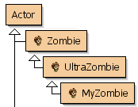
Karl is a Zombie
Greenfoot is designed to take advantage of this kind of inheritance. On the right hand side of the main interface, you can see a Class Diagram, with classes drawn as boxes connected by arrows. The arrows show that one class IS-A or EXTENDS another class. Ie, an UltraZombie IS-A Zombie and a MyZombie IS-A UltraZombie, and all EXTEND the Actor class.
The Actor class has very few features, Zombie extends it to add data and methods that apply to Zombies. Zombie is the SUPERCLASS for UltraZombie which adds more methods. Finally MyZombie EXTENDS UltraZombie and uses all of the methods supplied by all of these classes to implement Karl's plan.

Slide 9
Java Magic
The magic that makes this all possible takes place on the first line of the program:
public class MyZombie extends UltraZombie
The keyword extends means that MyZombie has all the power of an UltraZombie, and then some.
Every time you wrote some code like move(), what Java really saw was this.move(), using the move method provided by the MyZombie class on Karl. Since your MyZombie class didn't contain a move() method, Java used the one that was passed down (inherited) through the UltraZombie class from the Zombie class.
By extending UltraZombie, you inherited a pile of methods that Karl could use.

Slide 10
A New Example
Let's see this in action with a simple example. We'll look at some simple geometry: Rectangles and Squares.
This example is composed of 3 classes: a Main class, a Rectangle class and a Square class. Look at the Square class and the Rectangle class.
Notice that Square extends Rectangle. Rectangle includes several methods and Square relies on those methods. Square explicitly accesses Rectangle methods using the super keyword, including in the constructor. (super isn't technically required in the getSideLength method, you can access any method just by its name if Square doesn't have a method with the same name).
Simple Shapes

Slide 11
Look at this code
After the line
Square s = new Square(5);
Which of the following methods can you use on the Square object?
s.getSideLength()
s.getWidth()
s.getHeight()
s.getPerimeter()
s.getArea()
s.getName()

Slide 12
Some background
All code (methods) in Java has to be part of a class.
All classes extend ONE other class. No more, no less.
If no extends clause is specified, the class extends the Object class.
All classes descend from Object, Object is a superclass of all other classes.
Through the class hierarchy, classes can build upon each other, from one to another going back to the ultimate ancestor, the Object class.
Therefore, all classes by default have the features provided by Object... ie the toString() method that prints out ClassType@4F3C56 amongst others

Slide 13
Implications of Inheritance
A subclass gains all of the behavior (methods) and data (instance variables) of the super class and all of its ancestors.
Subclasses only have direct access to public or protected members. No direct access to private members.
Subclasses can add new fields and new methods and override existing methods
Subclasses cannot remove fields or members or change them from public to private (this would be like removing them).
When a subclass is instantiated, its constructor can set up its own instance variables, but it can't set up the private members from its ancestors itself.

Slide 14
Constructors
Constructors are a special case when it comes to inheritance in Java
Classes do not inherit the constructor of their parent. If one is needed it must be specified.
Exception: if no constructor is provided and the parent class has a default (or no constructor), that constructor will be used.
Constructors in a subclass can call the parent class using the super keyword.
The call to super must be the first (non-comment) line in the subclass constructor
If no call to super is made, the default constructor of the parent class is called before the child constructor begins.
You cannot call both super() and this(), you have to choose one.

Slide 15
Overriding methods
Any method that is not marked as final can be overridden by a descendant class
Overriding requires the same signature as the ancestor. Using different parameters would be overloading, not overriding. Use @Override tag before the method to have Java check that you are doing what you want.
Overriding a method replaces the behavior inherited from the parent class
Can augment (add to) the parent's behavior instead of completely overriding it with the super keyword. This is known as partial overriding.
Call super.methodName(...)

Slide 16
The super keyword
Super is used to access something (a field or method) from the superclass that has been overridden.
Think of how you use this to access fields that have the same name as parameters.
The square class uses super to access the Rectangle's constructor.
Java does not allow nested supers
super.super() is not allowed.

Slide 17
Abstract classes
An abstract class is used to describe some behaviors of a type, but it cannot be instantiated. This is often used for a generic type where some behaviors are common amongst all of the subclasses. The shared behaviors are defined as methods in the class, and inherited by the subclasses.
Abstract classes can also contain abstract methods. Abstract methods specify a method signature but no code. Subclasses will then implement the behavior as they require. If a method is marked as abstract, it's class must be abstract.
public abstract class Shape {
public abstract double getArea(); // All shapes have area, but it is calculated
} // differently

Slide 18
The Shapes Framework
Here is an example family of classes that build on an abstract Shape class.
Notice the base Shape class, declaring that all Shapes have a name, and an area.
All of the shapes that descend from the Shape class add features to it that are unique to each.
Shapes

Slide 19
Inheritance and Assignment
One feature that inheritance allows is assignment to superclass types. You've seen this:
List<t> myList = new ArrayList<t>();
Actor player = new Ghost();
Some more examples:
Rectangle r = new Square(15);
Shape s = r;

Slide 20
Inheritance and Assignment
Rectangle r = new Square(15);
Shape s = r;
Assignment like this limits what you can do with the object. You cannot use Square methods on s unless they are provided by the Shape class.

Slide 21
Inheritance and Assignment
Rectangle r = new Square(15);
Shape s = r;
Assignment only works in one direction, subclass assigned to superclass. The following won't compile:
Square sq = new Rectangle(5, 6); // All squares are rectangles, but not all
// rectangles are squares.

Slide 22
Inheritance and Assignment
If you know that a superclass variable is a subclass type, you can force the assignment with a cast.
Rectangle r = new Square(15);
Shape s = r;
Square sq = (Square)s;
However, if the object you are casting is not of the correct type, you get a ClassCastException.
Rectangle r = new Rectangle(5, 6);
Square sq = (Square)r; // That's a runtime error

Slide 23
Look at the code
After the following code:
Shape s = new Rectangle(15);
Which of the following can you do with the shape object s? (select one or more)
s.getHeight()
s.getWidth()
✔ s.toString()
✔ s.setName()
✔ s.getName()
✔ s.getArea()
s.getSideLength()

Slide 24
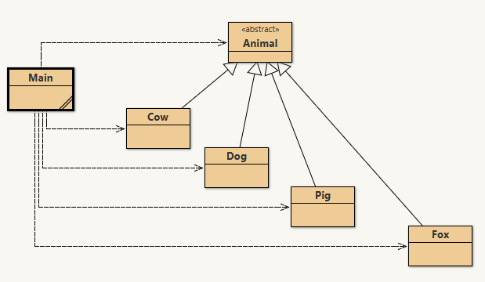
Polymorphism
Assignment to a parent class, along with overridden methods can cause some confusion.
In this animal project, Animal has an abstract method talk, that each subclass implements. The main method instantiates each type of animal. Calling talk() on the variable calls the talk method of the correct subclass, even though they are all Animals.
The animal project

Slide 25
Try it out
Let's take some time to work through a program.
Pizza!

Slide 26
Interfaces
We've seen interfaces before in Java. They are like classes that are entirely abstract, specifying method signatures but no code.
Classes extend other classes, they implement interfaces.
Classes can only extend one other class. They can implement any number of interfaces.
Classes implementing interfaces must implement all methods in those interfaces or must be declared abstract.
Interfaces are also a type. Remember List?
List<String> myList = new ArrayList<>();

Slide 27
A common interface
An interface used a lot in Java: Comparable - Determine the order of two objects
public class Card implements Comparable<Card>
{
public int compareTo(Card other) {
return this.value - other.value;
}
}
The Comparable Interface

Slide 28
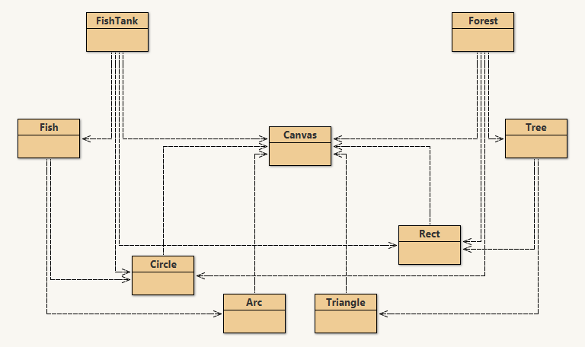
Diagramming class hierarchies
Programs often contain many, many classes and interfaces. In order to understand what is going on, we often create diagrams showing the inheritance hierarchies.
You have seen simplified versions of these diagrams in BlueJ.

Slide 29
Diagramming class hierarchies
The hierarchies we have seen so far display "HAS-A" relationships. For instance, a forest is drawn as a bunch of trees, the forest HAS-A tree, but is not a tree itself. The tree HAS-A triangle and rectangle, but is not a descendant of either. This relationship is show with dashed lines and open arrows.

Slide 30
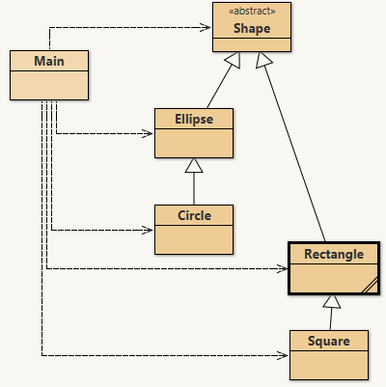
Diagramming class hierarchies
Diagramming the IS-A relationship is done with solid arrows and open arrowheads. Notice that the Main class uses all of these shapes, and the shapes relationship is also diagrammed to the right.
Also notice that Shape is abstract (as shown with <<abstract>>), interfaces are shown with <<interface>>.

Slide 31
Diagramming class hierarchies
This is a simplified version of a class diagram. Normally public (and sometimes private) methods and fields are also shown.

