Slide 1
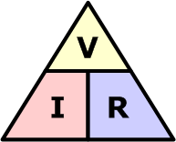
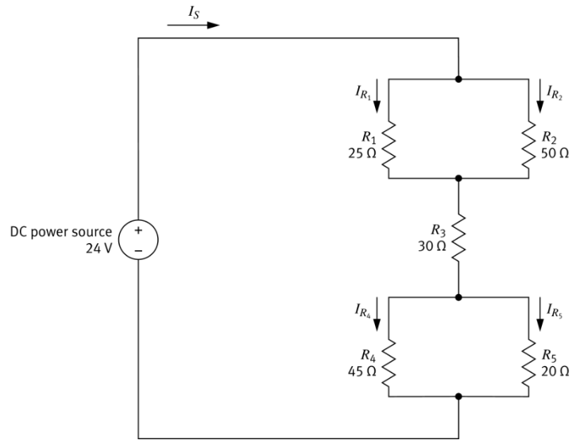
Your Turn
What steps would you take to solve this circuit?
Simplify Parallel Resistors
R₁ and R₂
R₄ and R₅
Simplify the Series of Equivalent Resistors
Calculate the parameters at each resistor (in reverse order)
Solve the parallel resistor pairs.

Slide 2


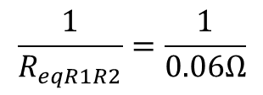



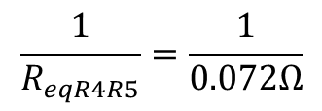
Your Turn
Simplify Parallel Resistors
$\frac{1}{R_{eq}}= \frac{1}{R_{1}}+$ $\frac{1}{R_{2}}+\frac{1}{R_{3}}+ …$
$\frac{1}{R_{eqR1R2}}= \frac{1}{25Ω}+$ $\frac{1}{50Ω}$
$$\frac{1}{R_{eqR1R2}}=\frac{1}{0.06Ω}$$
$R_{eqR1R2}=$ 16.7Ω
$\frac{1}{R_{eqR4R5}}= \frac{1}{45Ω}+$ $\frac{1}{20Ω}$
$$\frac{1}{R_{eqR4R5}}=\frac{1}{0.072Ω}$$
$R_{eqR4R5}=$ 13.8Ω

Slide 3
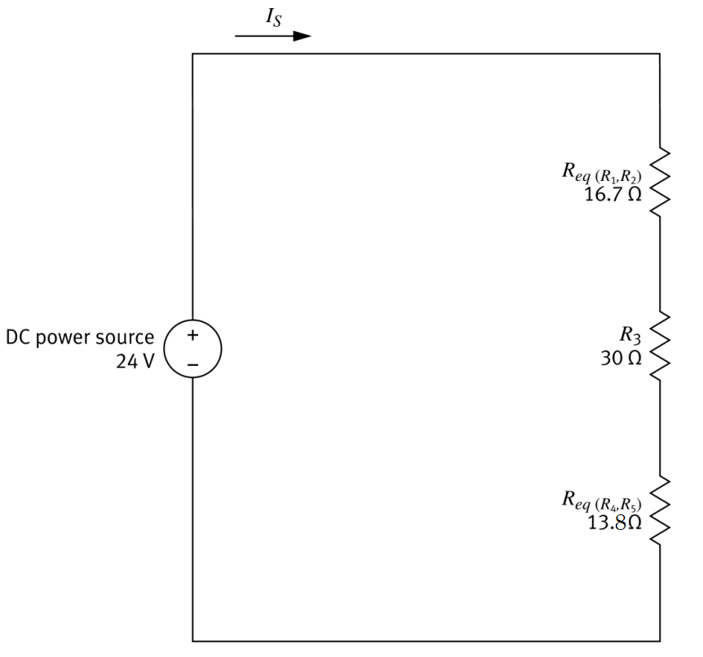



Your Turn
Simplify Series Resistors
$$R_{eq}=R_{eqR1R2}+ R_{3}+ R_{eqR4R5}$$
$$R_{eq}=16.7Ω+30Ω+13.8Ω$$
$$R_{eq}=60.6Ω$$

Slide 4
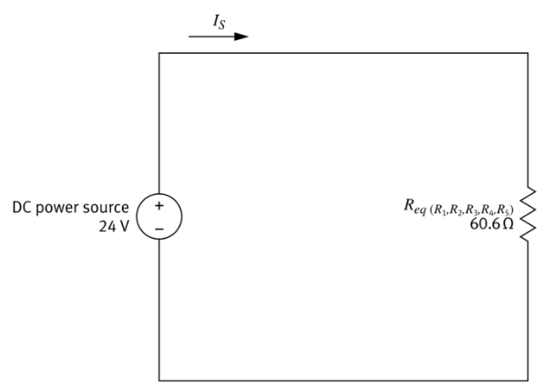
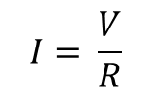
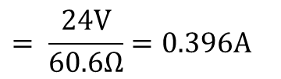
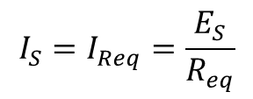

Your Turn
3. Calculate the parameters at each resistor (in reverse order)
$$I= \frac{V}{R}$$
$$I_{S}=I_{Req}=\frac{E_{S}}{R_{eq}}$$
$$= \frac{24V}{60.6Ω}=0.396A$$
$?A$, 24V

Slide 5















Your Turn
3. Calculate the parameters at each resistor (in reverse order)
$$V=IR$$
$$E_{R1R2}=I_{S}R_{eqR1R2}$$
$$E_{R1R2}=0.396A ×16.7Ω$$
$$0.396A$$
$$E_{R1R2}=6.6V$$
$$E_{R3}=I_{s}R_{3}$$
$0.396A$, ?V
$$E_{R3}=0.396A ×30Ω$$
$$E_{R3}=11.9V$$
$0.396A$, ?V
$$E_{R4R5}=I_{S}R_{eqR4R5}$$
$$E_{R4R5}=0.396A ×13.8Ω$$
$0.396A$, ?V
$$E_{R4R5}=5.5V$$
$$6.6V+11.9V+5.5V=24V‼$$

Slide 6
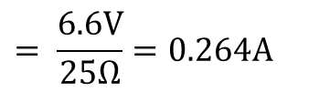

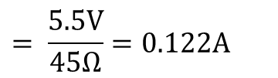
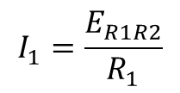


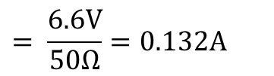
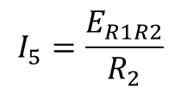


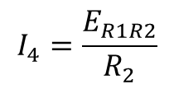
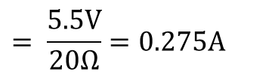

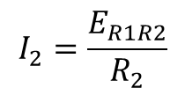
Your Turn
3. Calculate the parameters at each resistor (in reverse order)
$$0.264A+0.132A=0.396A‼$$
$$I= \frac{V}{R}$$
$$0.396A$$
$$I_{1}=\frac{E_{R1R2}}{R_{1}}$$
$$= \frac{6.6V}{25Ω}=0.264A$$
$$I_{2}=\frac{E_{R1R2}}{R_{2}}$$
$$= \frac{6.6V}{50Ω}=0.132A$$
$?A$, 6.6V
$?A$, 6.6V
$$I_{4}=\frac{E_{R1R2}}{R_{2}}$$
$$= \frac{5.5V}{45Ω}=0.122A$$
$0.396A$, 11.9V
$$I_{5}=\frac{E_{R1R2}}{R_{2}}$$
$$= \frac{5.5V}{20Ω}=0.275A$$
$?A$, 5.5V
$?A$, 5.5V
$$0.122A+0.275A≅0.396A‼$$

Slide 7




Your Turn
When all resistors have all 3 values, you are done!
$$0.396A$$
$0.264A$ 6.6V
$0.132A$, 6.6V
$0.396A$, 11.9V
$0.122A$5.5V
$0.275 A$, 5.5V

