Slide 1
Your Zombie and You

Slide 2
Meet Karl

Slide 3
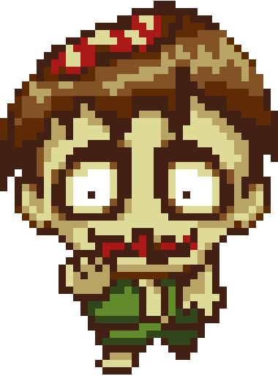
This is Karl

Slide 4

This is Karl

Slide 5
Karl is a Zombie

Slide 6
Karl lives in a place called ZombieLand.

Slide 7
ZombieLand is a hostile land, full of danger for someone like Karl.

Slide 8
You see, Karl isn't very smart.

Slide 9
You see, Karl isn't very smart.

Slide 10
Well, for a Zombie, Karl is really smart.

Slide 11
But you really can't expect much from someone whose brain is hanging out of his skull.

Slide 12
Zombies just don't have much going on upstairs.

Slide 13
The simplest obstacle is insurmountable when you are a zombie.

Slide 14
The simplest obstacle is insurmountable when you are a zombie.

Slide 15
Poor Karl

Slide 16
Karl has one advantage that most zombies don't.

Slide 17
Karl has you.
You can use your superior, delicious human brain to help Karl navigate the dangers of ZombieLand.
And maybe you will both survive.

Slide 18
Getting Started

Slide 19

You may be surprised to learn that ZombieLand isn't a real place.
It exists inside of a program called Greenfoot.
In order to solve ZombieLand scenarios, you will need to run Greenfoot.
If you want to run Greenfoot at home, you will need to download it.
You can download Greenfoot here:
https://www.greenfoot.org/download

Slide 20

Find the Greenfoot icon on your computer.
Start Greenfoot.

Slide 21
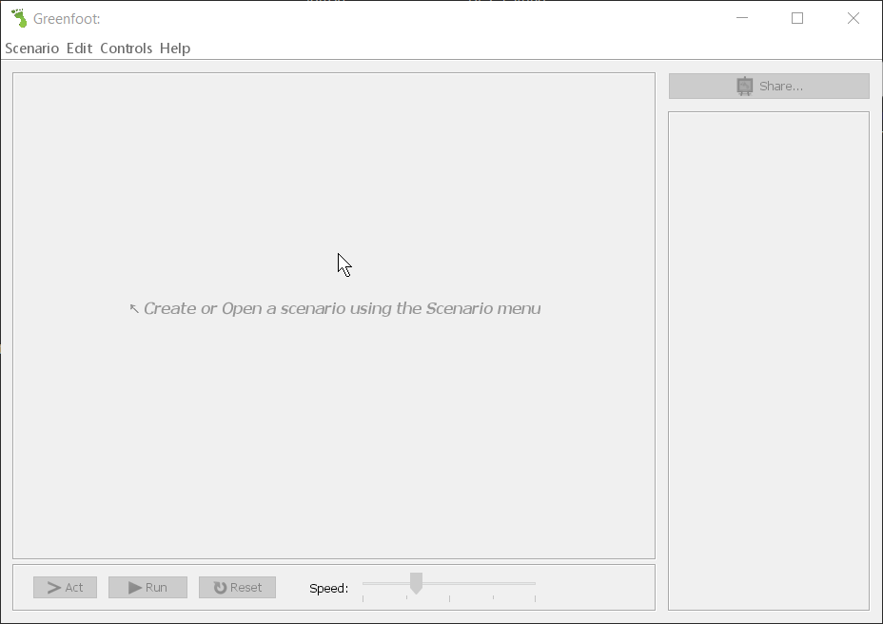
When Greenfoot starts, it will either load the last scenario that was open when it was last closed or, if this is the first time you've run Greenfoot, it will start with an empty window:

Slide 22
At the top of the window is the Greenfoot menu. The submenus of the Greenfoot menu contain options for loading and saving scenarios, accessing Help, etc.

Slide 23
One important option in the menus allows you to set up Greenfoot to your liking. Let's set a few of the preferences now. Open the Edit menu and select Preferences... to open the preferences window.

Slide 24
Change the preferences to look like those in this example.
You can choose whatever font size you prefer, 14 seems to be nice.
Make sure that Use Syntax highlighting, Display line numbers, Auto-indent, and Match brackets are checked. These will make coding easier as you go forward.
Click OK to save your preferences.

Slide 25
Now you are ready to help Karl survive the rigors of ZombieLand.
Download the project file for this assignment. Save it to your H: drive, then open it in Greenfoot.

Slide 26
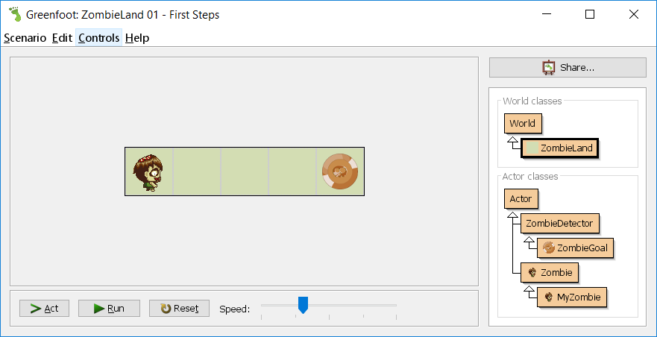
When you open the file, you should see a window like this one:

Slide 27
A Classy Zombie

Slide 28
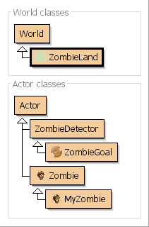
Look on the right side of the Greenfoot window, the white box filled with a bunch of other boxes is the Class Diagram.
The class diagram shows all of the types of objects that can exist in a Greenfoot scenario.
The first section, at the top of the class diagram, are the World classes.
The world classes represent the space that Karl lives in, the area he has to move around in.
Notice that ZombieLand has an arrow pointing to World.
That means that ZombieLand is a world.

Slide 29
Below the World Classes are the Actor classes.
Actor classes are the types of objects that can appear in a World.

Slide 30
In some scenarios there will be more actor classes. In some scenarios there will be fewer actor classes.
For this scenario, with only two objects that you can see, there are 5 actor classes.
We'll talk more about these classes later, but right now notice that, again, there are arrows from ZombieDetector and Zombie leading to Actor which mean that zombie detectors and zombies are both actors.

Slide 31
Similarly there is an arrow leading from ZombieGoal to ZombieDetector which means that zombie goals are zombie detectors and they are also actors.
The arrow from MyZombie to Zombie means that MyZombie is a Zombie so it is also an Actor.
You can see from the diagram that everything in the Actor classes heirarchy turns out to be an Actor. This is good because only Actors can appear in the World.

Slide 32
The last class in this diagram, the MyZombie class, is a special class for us.
It's special because Karl is a MyZombie.
You already knew Karl was a zombie, but now you know what kind... a MyZombie™. Just like a regular zombie, but better.

Slide 33
A "Man" with a Plan

Slide 34
Let's jump right in and see what happens when you click .
When things come to an end, click to put everything back where it was.

Slide 35


What happened when you clicked ?
Karl took one step forward and fell flat on his zombie face.
That's not great for Karl. He needs to get to the spinning zombie goal marker.
Let's see if we can help Karl out.

Slide 36
Double click on the MyZombie class in the class diagram and we'll see why Karl is so special.

Slide 37
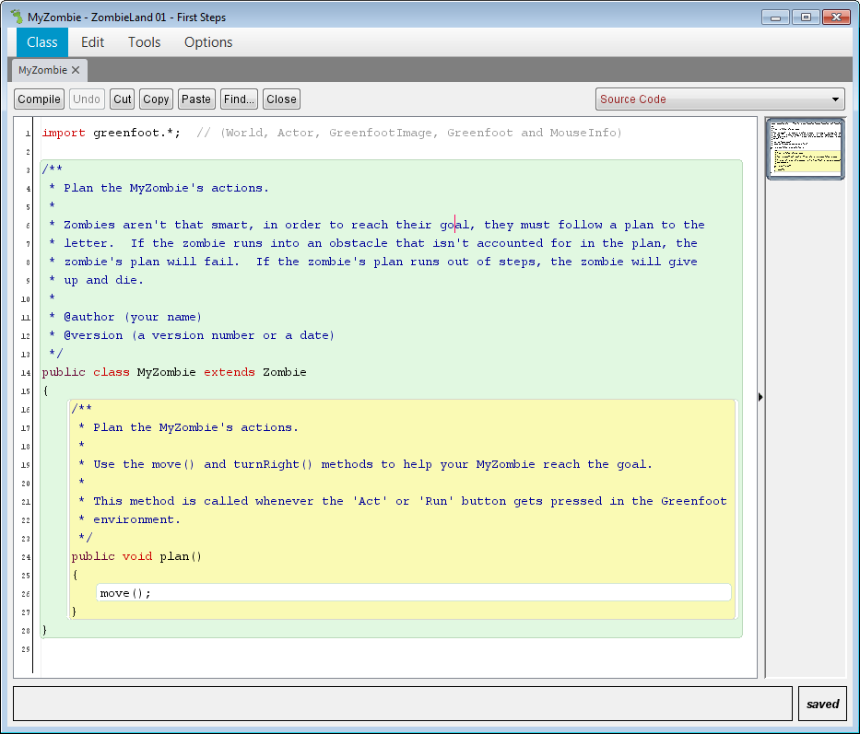
When you double click on the MyZombie class, a window similar to this one should have appeared. It may have popped up behind the main window, so look around.
This is the Code Editor window. It's where you will edit program code, and as you can see, for a MyZombie, this is where you plan out its actions.

Slide 38
Since Karl is a MyZombie, he will follow any actions you add to the plan. He will follow them to the letter, as long as you word them correctly.

Slide 39
Remember, Karl is a zombie. Zombies aren't that bright. If you want Karl to do something, you have to break it down into tiny little steps.
And you have to make sure that those steps are spelled just right, have just the right punctuation and capitalization, and even have the proper indentation.

Slide 40
Karl is very particular.

Slide 41
Let's take a closer look at his plan:
1. public void plan()
2. {
3. move();
4. }

Slide 42
It's not much of a plan.
But it's good to start small, and it doesn't get much smaller that this.
There are three important parts to this plan.
Let's look at each.
24. public void plan()
25. {
26. move();
27. }

Slide 43
The first line, public void plan(), is what Karl looks for to know that this is the plan he should follow.
If that line isn't there, Karl won't be able to find it.
There are some strange words on this line, so we should look at this a bit.
24. public void plan()
25. {
26. move();
27. }

Slide 44
The word public means that anyone can tell Karl to follow this plan. Without the word public, Karl wouldn’t listen to you when you click .
Later we'll see that there are some things that we don't want just anyone to be able to tell Karl to do, but for right now, we'll stick with making plans public.
24. public void plan()
25. {
26. move();
27. }

Slide 45
The second word, void, means that we don't expect Karl to give us anything back after he finishes the plan.
We don't really want Karl giving us anything; it would probably have zombie drool all over it.
That's how you get zombie germs.
Make sure that void is there... I don’t want zombie germs.
24. public void plan()
25. {
26. move();
27. }

Slide 46
The word plan is pretty self-explanatory; it simply says that the stuff that follows is the plan we want Karl to use.
The parentheses () that come after plan are a place where we could put what we call parameters, bits of information that change how Karl uses the plan.
For now we'll leave the parentheses empty, but they need to be there.
24. public void plan()
25. {
26. move();
27. }

Slide 47
That's the first line of the plan.
It's like the title at the top of a page, or a header.
It's important that the header look exactly like this or Karl won't know what to do with it.
24. public void plan()
25. {
26. move();
27. }

Slide 48
The second line and the last line are a matching pair of curly braces (or curly brackets) { and }.
These braces form a container for the plan.
Karl knows that whatever lines are between those curly brackets are steps of his plan.
Any lines before or after these curly braces might be important, but when Karl is looking for steps in the plan, he will only look between this pair of braces.
If either brace is missing, Karl will get confused.
24. public void plan()
25. {
26. move();
27. }

Slide 49
It seems that most of the lines in this plan are just there to help Karl find what he is supposed to do.
The one remaining line actually tells Karl to do something.
It tells him to move.
24. public void plan()
25. {
26. move();
27. }

Slide 50
When Karl sees move, he knows that he should take exactly one step forward, no more, no less.
24. public void plan()
25. {
26. move();
27. }

Slide 51
Of course you need to make sure to punctuate it correctly or, again, Karl won't understand.
The move command is followed by a set of parentheses, ( and ).
The parentheses, again, are there for parameters.
The move command doesn't need any special conditions, so the parentheses are empty.
Again, they have to be there even though they are empty.
24. public void plan()
25. {
26. move();
27. }

Slide 52
You can think of parentheses like this as telling Karl to do something.
If there are no parentheses, Karl won’t know that move is a command.
24. public void plan()
25. {
26. move();
27. }

Slide 53
A semicolon follows the parentheses.
Every command in the plan has to be followed by a semicolon.
Semicolons are like periods for zombies.
If it weren't for semicolons, zombies wouldn't know when one command ended and another began.
24. public void plan()
25. {
26. move();
27. }

Slide 54
One last thing to note:
Curly braces and the commands between them make up what we call a code block.
Code blocks are a set of commands that exist together, all wrapped up in curly braces.
In order to help Karl (and you!) read program code, we line up the curly braces with whatever is above them, then indent the lines inside of the curly braces by hitting the TAB key once (or Space 4 times).
24. public void plan()
25. {
26. move();
27. }

Slide 55
That's it.
That's the plan.
So many words for four little lines.
24. public void plan()
25. {
26. move();
27. }

Slide 56
Give Karl a Hand

Slide 57
When Karl tried to follow his current plan, he took one step forward and then fell on his face.
Karl isn't really an ambitious zombie.
If he runs out of things to do, well, he dies.

Slide 58
There's not much keeping him undead other than the purpose he is given by simply having a plan to follow.

Slide 59
Once the plan is done, so is Karl.

Slide 60
In order to keep Karl going, we need to show him that even he can accomplish something.
He needs to reach a goal.
In ZombieLand, all that zombies want from their un-life is zombie coins.
When a zombie gets a zombie coin, it knows it has done good.

Slide 61
Help Karl get to the coin.
Add steps to his plan so that he makes it there.
Remember, each step needs to be spelled and punctuated correctly, and it has to be in the right place.
Keep it simple for Karl.
All he really knows how to do is move();

Slide 62
When you have your plan written, hit Ctrl-S to save and compile it.

Slide 63
When you get Karl to the goal, you will need to turn in your plan.
You will need to find the MyZombie.java file. It will be located in a folder named ZombieLand 01 – First Steps, you’ll find this folder wherever you saved the project file… hopefully your H: drive
Submit your completed MyZombie.java in Canvas.

Slide 64
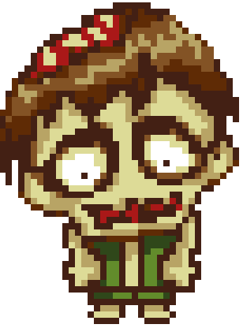
Karl says "Thank you".

