Slide 1
Hitch
App design presentation
Perry van Wesel - 0818131

Slide 2
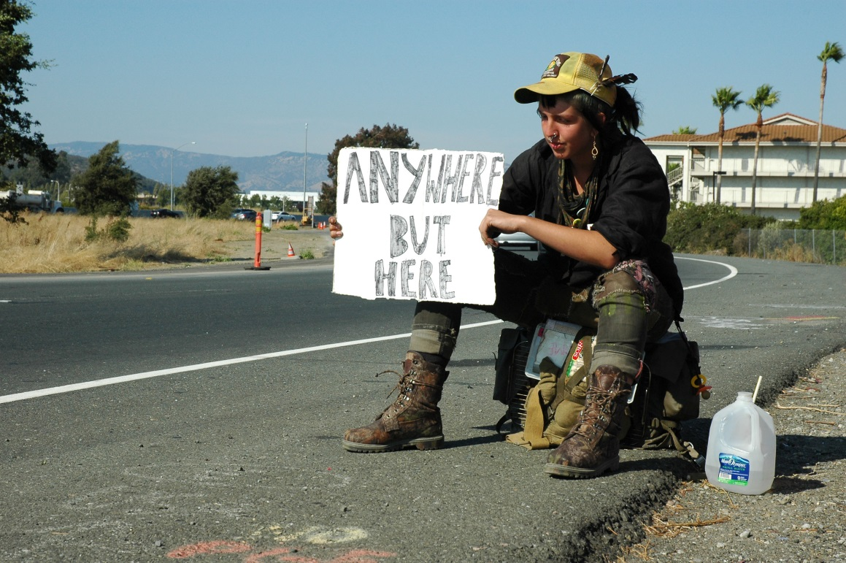
What was Hitch again?
Match hitchhikers with drivers
Hitchhikers can input location & destination
Drivers input their regular routes
Provide communication

Slide 3
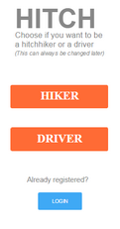
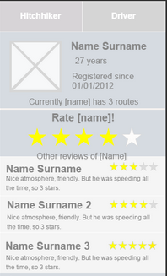
User interface – First use
→

Slide 4
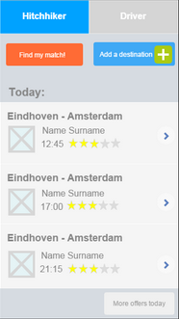
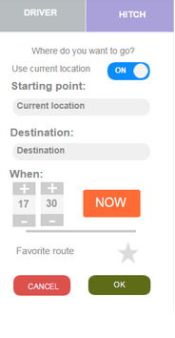
User interface - Hitchhiker
→

Slide 5
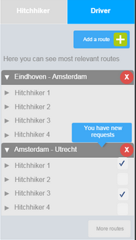
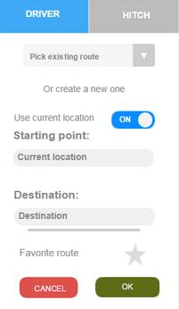
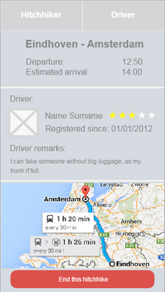
User interface - Driver
→
→

Slide 6
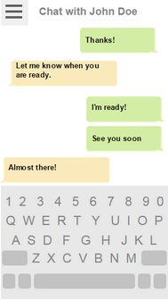
User interface - Chat

Slide 7
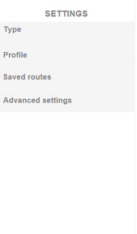
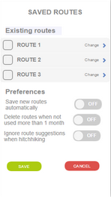
User interface - Settings
→

Slide 8
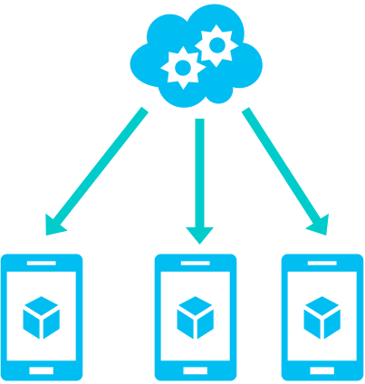
System Architecture
Server
HTTP-Requests
Clients

Slide 9
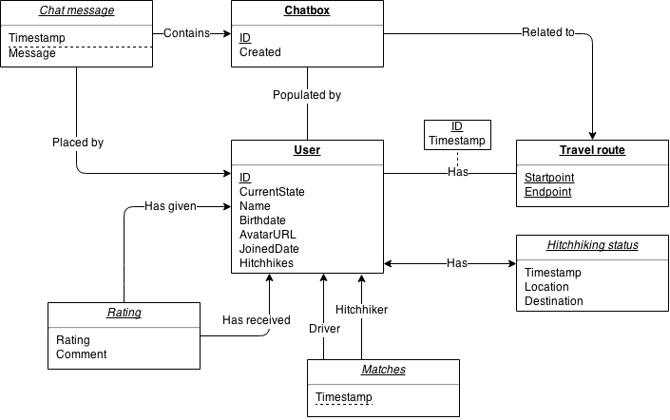
Server storage

Slide 10
State of the project
4 people working on UI and feature implementation
UI skeleton is in place
2 people working on back-end
Module management done
Database set up
Working on implementing API calls

Slide 11
Questions?

