Slide 1
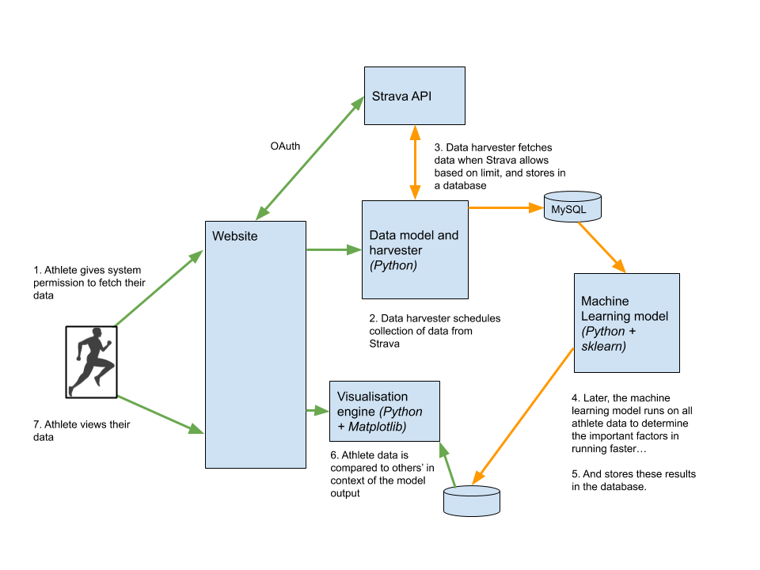
Notes:
https://medium.com/data-science/running-smart-with-machine-learning-and-strava-9ba186decde0

