Slide 1
DATA STRUCTURES & ALGORITHMS
LOSSLESS
DATA COMPRESSION
0 1
1 0
0 1
Fixed-length → RLE → Huffman → Canonical Huffman → LZ77
THEORY + NOTEBOOK + EMPIRICAL EVIDENCE
Group: [names to add] | Submission deadline: [verify]

Slide 2
02 / PROBLEM 8
What must be submitted
The handwritten component is indispensable; code and slides must agree with it.
HANDWRITTEN SOLUTIONS
WORKING CODE
SLIDE PRESENTATION
Q1–Q5: every calculation, heap merge, bitstream trace, canonical assignment, sliding-window trace, and complexity analysis.
All five compression/decompression pairs in Python, 20 required dataset round trips, plots and reproducible notebook.
Readable academic explanation of methods and results, plus an actual link to the team GitHub repository.
CRITICAL: Without handwritten work, the professor will not consider the submission.
Lossless Data Compression • Assignment pages 31–34
2 / 13

Slide 3
03 / PROBLEM 8
Five stages of increasing sophistication
Each version targets a limitation left by its predecessor.
V1
V2
V3
V4
V5
FIXED
RLE
HUFFMAN
CANONICAL
LZ77 + HUFF
›
›
›
›
Same bits
for all symbols
Consecutive
identical runs
Statistical
frequency skew
Codes reconstructed
from lengths
Repeated phrases
within a window
Lossless means: decompress(compress(data)) == data — for every valid input.
Lossless Data Compression • Assignment pages 31–34
3 / 13

Slide 4
04 / PROBLEM 8
Theoretical comparison: 100 symbols
Alphabet: A45, B13, C12, D16, E9, F5 — six distinct symbols.
V1 • fixed-length
V2 • 6 contiguous runs
V2 • 100 separate runs
V3 / V4 • Huffman
300 bits
60 bits
1,000 bits
224 bits
Shannon entropy
H(X) = −Σ pᵢ log₂(pᵢ) = 2.219880 bits/symbol
100 × H(X) = 221.988 theoretical bits
Huffman gap: only 2.012 bits above entropy bound.
Lossless Data Compression • Assignment pages 31–34
4 / 13

Slide 5
05 / PROBLEM 8
Huffman: five min-heap merges
The two smallest subtrees are combined at each step.
01
F5 + E9
→ 14
100
0
1
02
C12 + B13
→ 25
A45
55
0
1
03
14 + D16
→ 30
25
30
04
25 + 30
→ 55
0
1
0
1
C12
B13
14
D16
05
A45 + 55
→ 100
0
1
F5
E9
Read each path root → leaf: left=0, right=1
Lossless Data Compression • Assignment pages 31–34
5 / 13

Slide 6
06 / PROBLEM 8
Prefix-free codes make decoding unambiguous
Stage 3 codewords: A=0, B=101, C=100, D=111, E=1101, F=1100.
INPUT 0 1 0 1 0 1 1 0 0 1 1 1 0
0
101
0
1100
111
0
A
B
A
F
D
A
Decoded message: A B A F D A
No code is the prefix of another → every leaf ends exactly one symbol.
Lossless Data Compression • Assignment pages 31–34
6 / 13

Slide 7
07 / PROBLEM 8
Canonical Huffman: deterministic codebook
With a known symbol alphabet/order, lengths determine canonical codes.
code_next = (code_previous + 1) << (new_length − previous_length)
SYMBOL
LENGTH
ASSIGNMENT
CANONICAL CODE
A
1
0
0
B
3
(0+1) << 2 = 4
100
C
3
(4+1) << 0 = 5
101
D
3
(5+1) << 0 = 6
110
E
4
(6+1) << 1 = 14
1110
F
4
(14+1) << 0 = 15
1111
224-bit payload unchanged. Standalone V4 stores symbol + length pairs; headers may be larger.
Lossless Data Compression • Assignment pages 31–34
7 / 13

Slide 8
08 / PROBLEM 8
LZ77 sliding-window: seven emitted triples
S = ABRACADABRA_ABRACADABRA • W = 12 • L = 12 • “_” represents a space.
STEP
p
SEARCH BUFFER
TRIPLE (offset,len,next)
NEW p
1
0
—
(0,0,A)
1
2
1
A
(0,0,B)
2
3
2
AB
(0,0,R)
3
4
3
ABR
(3,1,C)
5
5
5
ABRAC
(2,1,D)
7
6
7
ABRACAD
(7,4,_)
12
7
12
ABRACADABRA_
(12,10,A)
23
Final step reserves one trailing “A” as next_char: 10 matched bytes + 1 literal.
Lossless Data Compression • Assignment pages 31–34
8 / 13

Slide 9
09 / PROBLEM 8
Q5 — Time, memory, and compression capability
Encoder-focused bounds; N=input length, m=alphabet size, W=window, L=lookahead.
STAGE
ENCODE TIME
AUX SPACE
HEADER
BEST AT
V1 fixed
O(N + m)
O(m)
Alphabet / width
Simple baseline
V2 RLE
O(N)
O(1) streaming
Minimal
Long same-symbol runs
V3 tree
O(N + m log m)
O(m)
Tree structure
Skewed byte frequencies
V4 canon.
O(N + m log m)
O(m)
Symbol + length
Skewed bytes; varies
V5 LZ77
O(NWL + m′ log m′)
O(N+W+m′) batch
Several codebooks
Repeated multi-byte phrases
V5’s conservative worst-case LZ77 matching bound is O(NWL); faster indexed search in typical inputs.
Lossless Data Compression • Assignment pages 31–34
9 / 13

Slide 10
10 / PROBLEM 8
Implementation: 20/20 exact round trips
Five encoders × four datasets; every decompressor reproduces its input byte-for-byte.
REQUIRED ROUND-TRIP TESTS
LONG RUNS
SKEWED DNA
20 / 20 PASS
A×5000 + B×5000
10,000 bytes
A 70%; C,G,T 10% each
12,000 bytes
PYTHON SOURCE
RANDOM BYTES
EXTRA TESTING
Pinned .py source snapshot
50 KiB
Pinned os.urandom sample
10,000 bytes
Empty input, one symbol, binary data, overlaps, 256 symbols.
Metrics: packet bits/original byte (header included) + encoder/decoder throughput in MiB/s.
Lossless Data Compression • Assignment pages 31–34
10 / 13

Slide 11
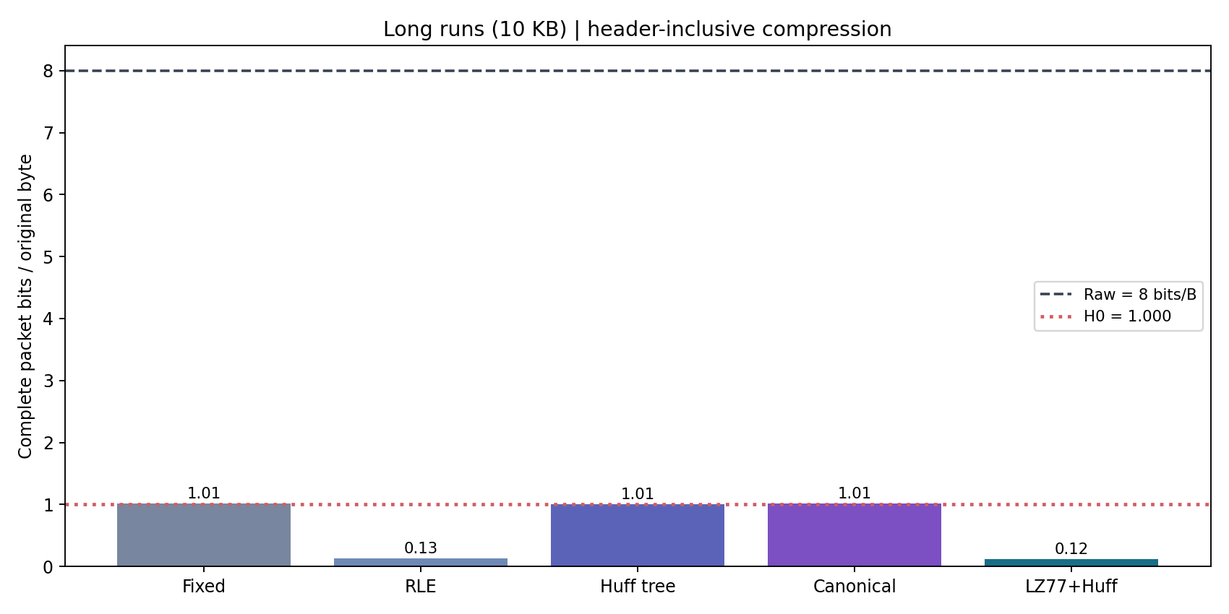
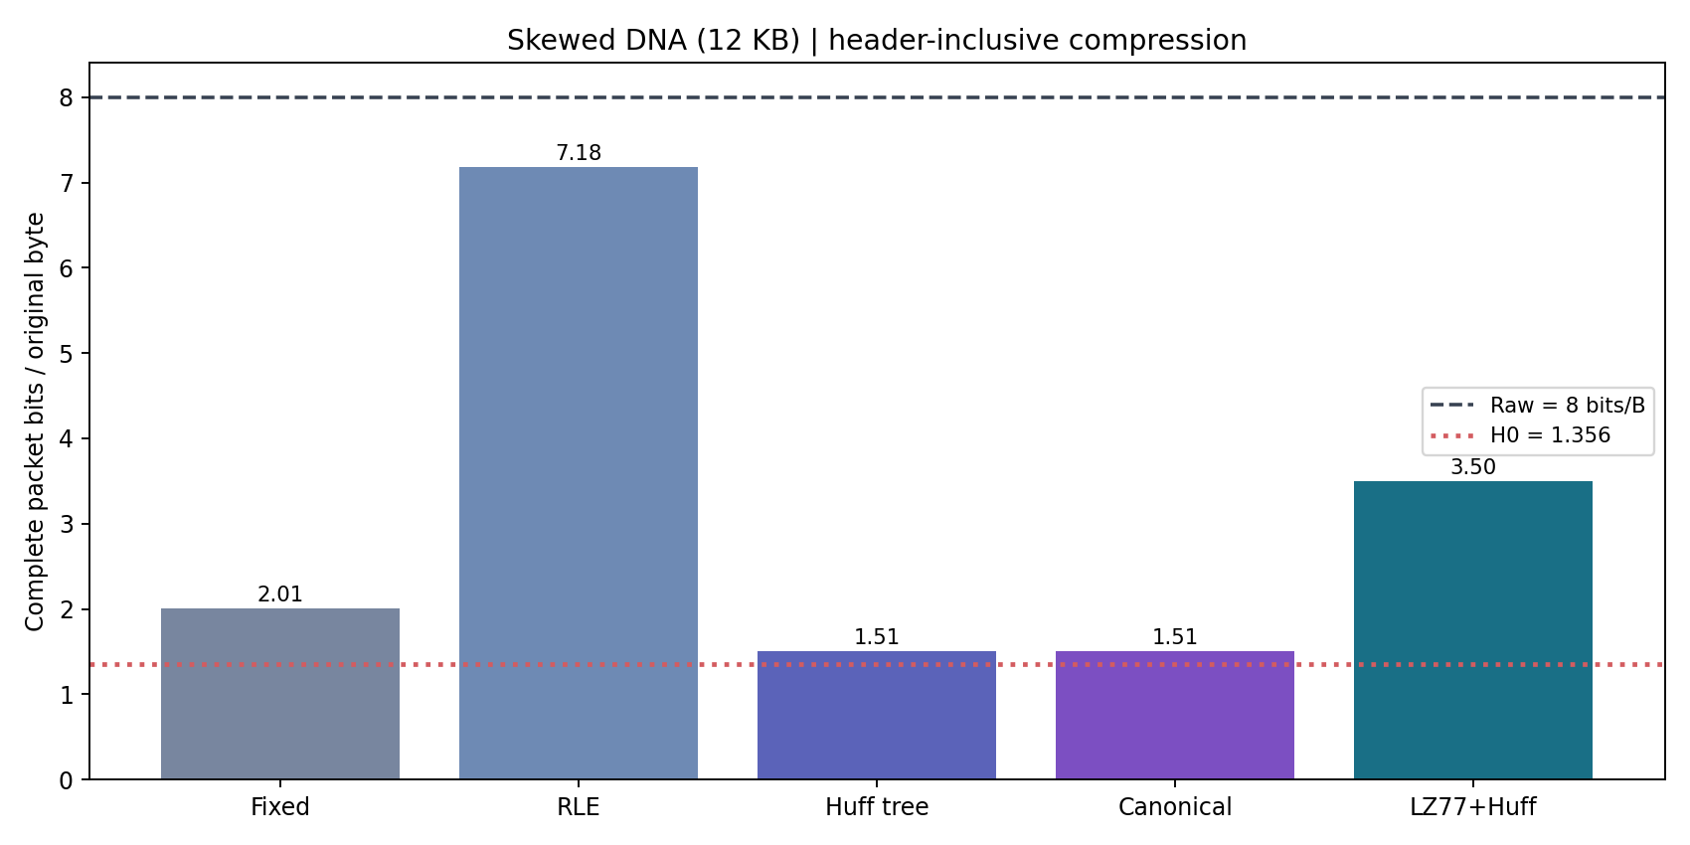
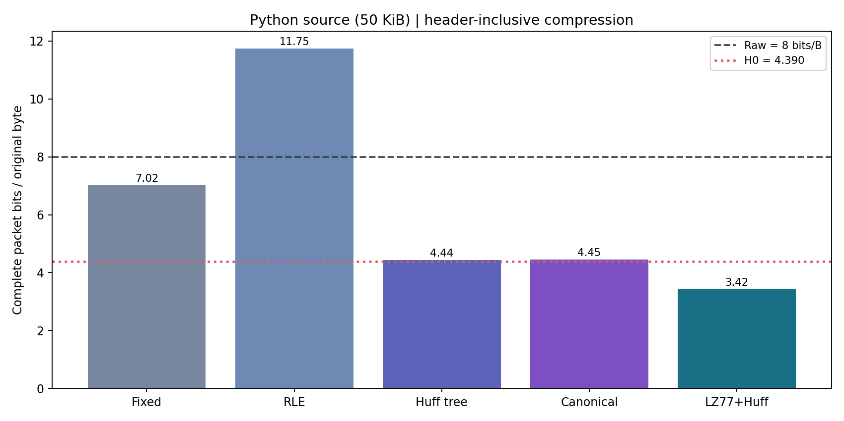
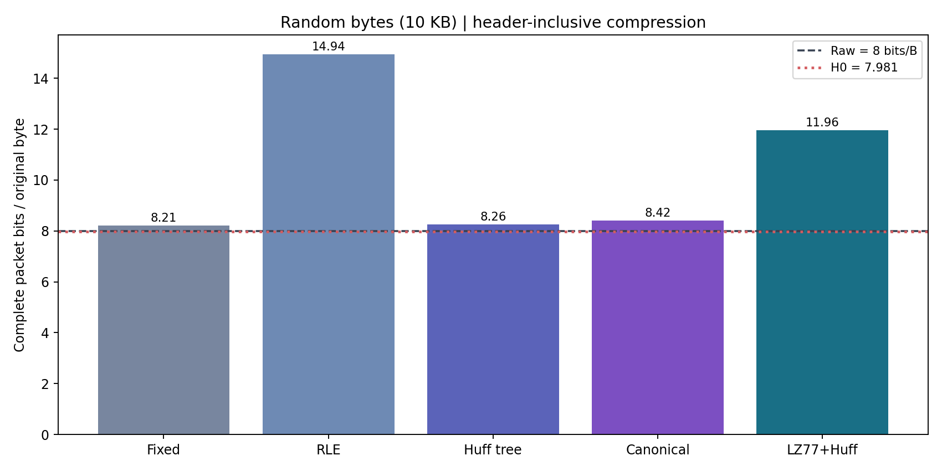
11 / PROBLEM 8
Compression ratio vs. entropy
Identical SHA256-pinned inputs; complete packet sizes include headers. Dashed=8.0; dotted=H₀.
Lossless Data Compression • Assignment pages 31–34
11 / 13

Slide 12
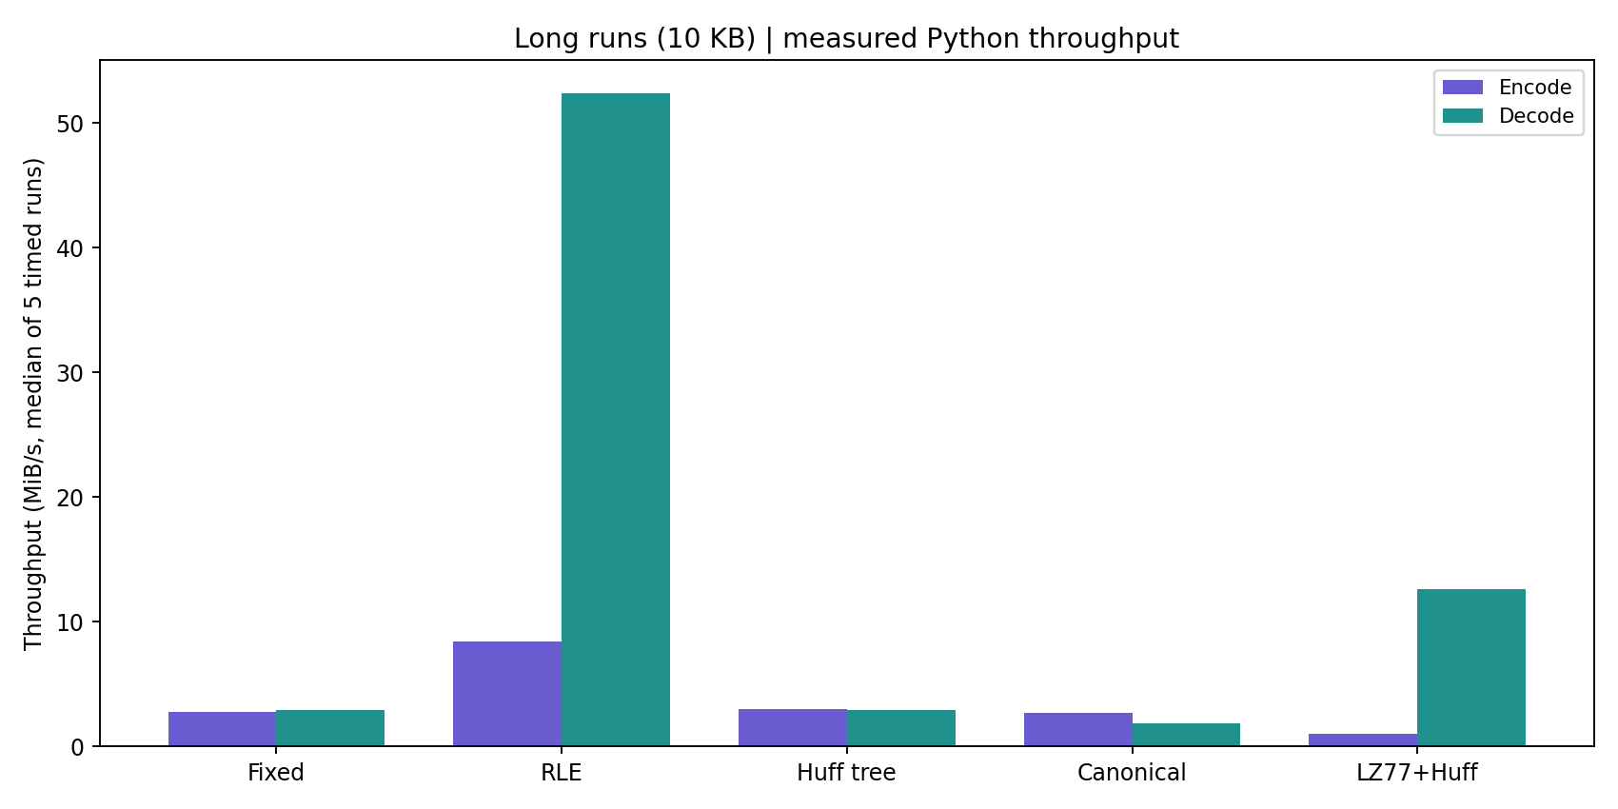
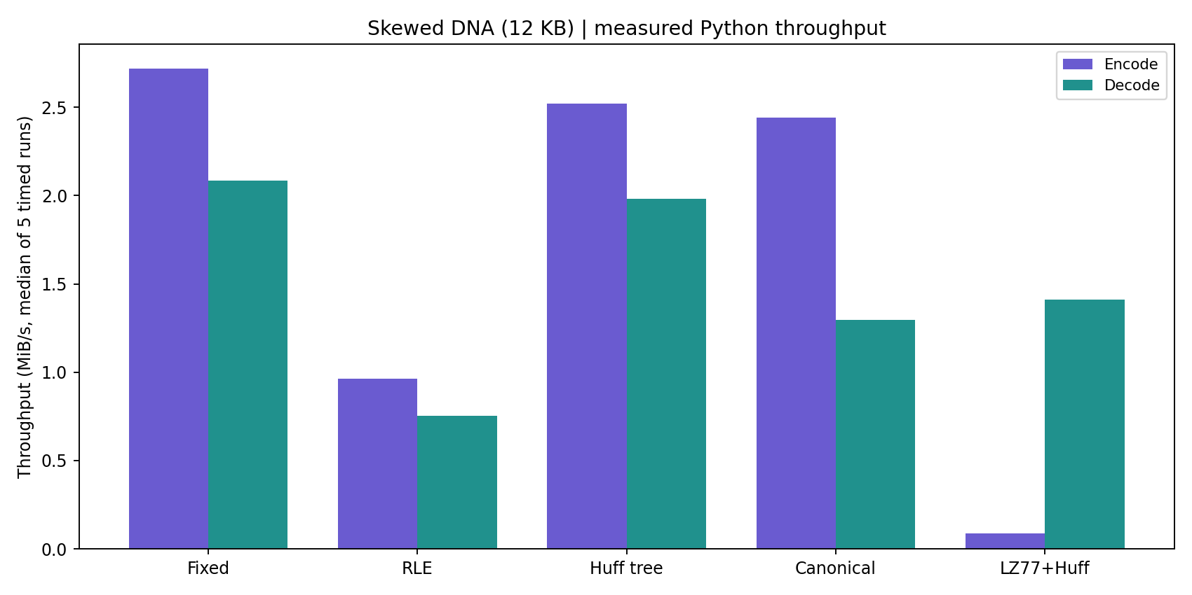
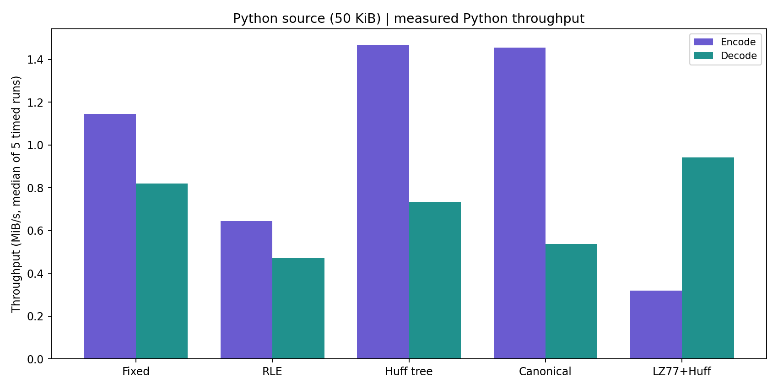
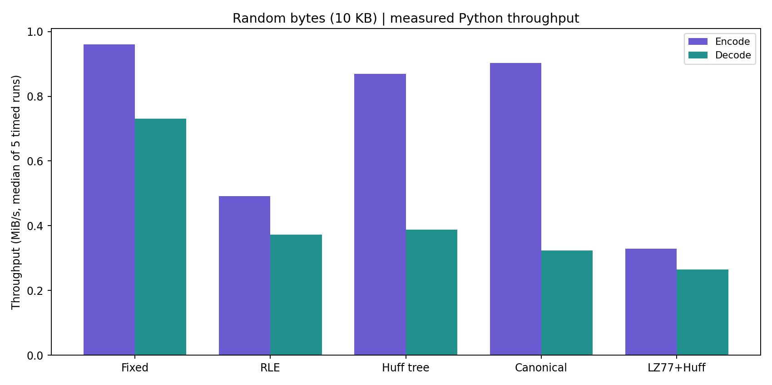
12 / PROBLEM 8
Encoding and decoding throughput
Median of 5 runs after 1 warm-up; input bytes pinned; rates depend on CPU and system load.
Lossless Data Compression • Assignment pages 31–34
12 / 13

Slide 13
13 / PROBLEM 8
Conclusion & submission readiness
V4: verified corpus hashes, unified benchmarks, corrected Q4 space byte, and honest header tradeoffs.
EMPIRICAL RESULTS
TECHNICAL LIMITATIONS
Runs: RLE or LZ77
Skewed DNA: Huffman
Python source: LZ77+Huffman
Uniform random: generally expands
V4 metadata may exceed V3 tree metadata. Pinned random-input PACKETS: V4 10,520 B vs V3 10,326 B. V5 is custom, not RFC DEFLATE.
GITHUB: [REPLACE WITH YOUR VERIFIED REPOSITORY URL]
Still required: physically handwritten pages + group details + confirmed deadline + GitHub upload.
Lossless Data Compression • Assignment pages 31–34
13 / 13

