Slide 1


Slide 2
Agenda
Introduction
Problem Statement and Data Source
Objective & Methodology
Solution Description
Impact

Slide 3
Introduction
A man wants to open a Wada Pav Shop near Shivaji Nagar in Pune. He has got a location where there are other 4 more wada pav shops. He is not able to understand what will be the strategy to take over his clients.
To solve this problem below are few suggested ideas.

Slide 4
Problem Statement & Data Source
A man wants to open a Wada Pav Shop near Shivaji Nagar in Pune. He has got a location where there are other 4 more wada pav shops. He is not able to understand what will be the strategy to take over his clients
a. What will be the price of each Wada Pav?
b. How will he differentiate from the other competitors?
c. How will you bring insights when he has no data of his shop?
d. Why will be the Customer comes to your shop? (What will be the positioning)
How will you come to a solutions which will make him an entrepreneur and will help him to grow?

Slide 5
Objective & Methodology
Objective:
To understand what will be the strategy to take over his clients
in wada pav business.
Methodology
Decide a name of the shop which would attract customers.
Get associated with Zomato, Swiggy, Foodpanda, UberEATS etc.
Have your social media pages ready.
Start marketing aggressively and give offers.

Slide 6
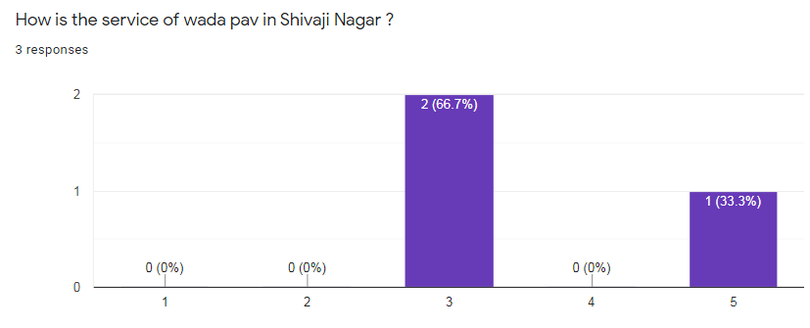
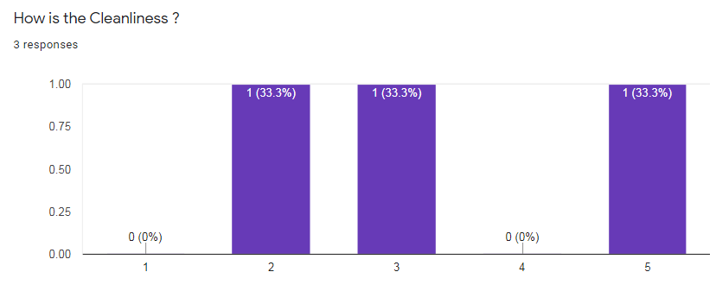
Analysis

Slide 7
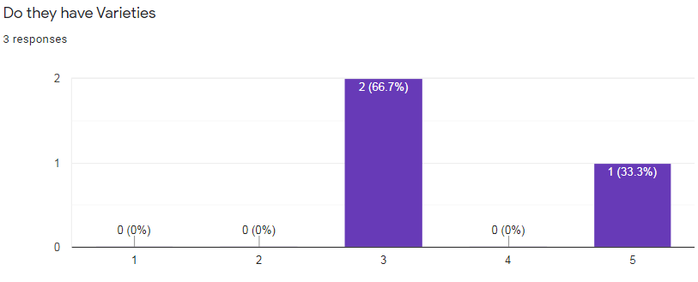
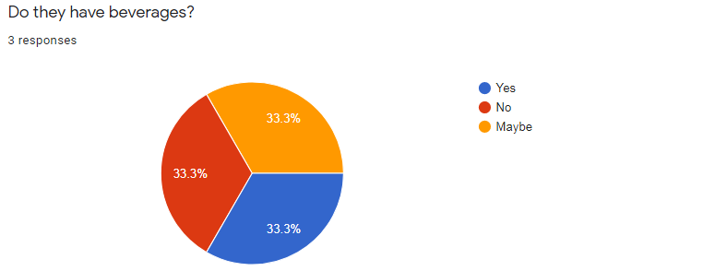

Slide 8
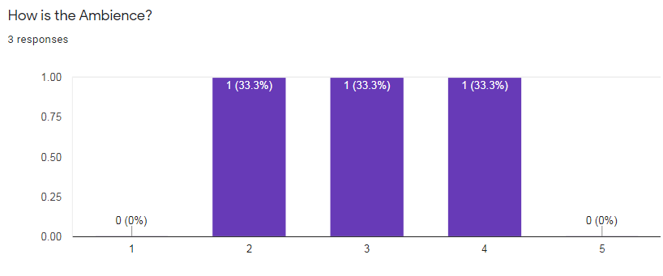
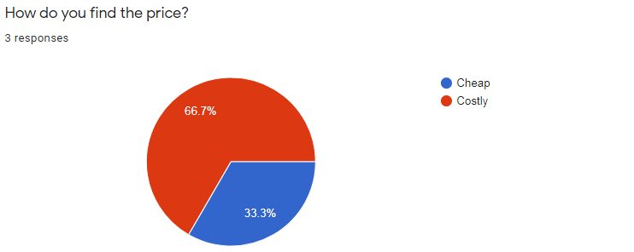

Slide 9
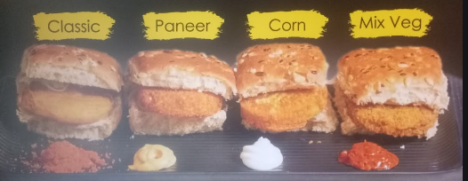
Solution Description
We can introduce different wadapav with different taste
We can serve various beverages along with wada pav.
We can start with medium price compared to our competitors.
We can provide good service and clean food.
We can give good ambience to eat their food.

Slide 10
Thank You
By-Persis Mathai

