Slide 1
Git for Version Control

Slide 2

Created by Linus Torvalds, creator of Linux, in 2005
– Came out of Linux development community
– Designed to do version control on Linux kernel
Installing & Learn form
Git website: http://git-scm.com/

Slide 3
Initial Git configuration
Set the name and email for Git to use when you commit:
– git config --global user.name "Bugs Bunny"
– git config --global user.email bugs@gmail.com
– To verify these values you can call below command
- git config –list
• Set the editor that is used for writing commit messages:
– git config --global core.editor nano • (it is vim by default)

Slide 4
Creating a Git repo
• To create a new local Git repo in your current directory:
– git init
• This will create a .git directory in your current directory.
• Then you can commit files in that directory into the repo.
– git add filename
– git commit –m "commit message"
• To clone a remote repo to your current directory:
– git clone url localDirectoryName ( important command)
• This will create the given local directory, containing a working copy of the files from the repo, and a .git directory (used to hold the staging area and your actual local repo)

Slide 5
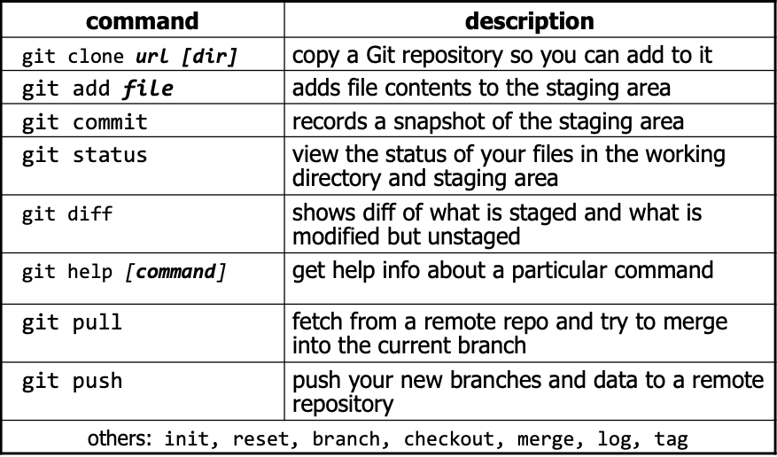
Git Commands

Slide 6
Add and commit a file
• The first time we ask a file to be tracked, and every time before we commit a file, we must add it to the staging area:
– git add Hello.java Goodbye.java
• Takes a snapshot of these files, adds them to the staging area.
• In older VCS, "add" means "start tracking this file." In Git, "add" means "add to
staging area" so it will be part of the next commit.
• To move staged changes into the repo, we commit:
– git commit –m "Fixing bug #22"
• To undo changes on a file before you have committed it:
– git reset HEAD -- filename (unstages the file)
– git checkout -- filename (undoes your changes)
– All these commands are acting on your local version of repo.

Slide 7
Viewing/undoing changes
• To view status of files in working directory and staging area:
– git status or git status –s (short version)
• To see what is modified but unstaged:
– git diff
• To see a list of staged changes:
– git diff --cached
• To see a log of all changes in your local repo:
– git log or git log --oneline (shorter version) 1677b2d Edited first line of readme
258efa7 Added line to readme
0e52da7 Initial commit
• git log -5 (to show only the 5 most recent updates), etc.

Slide 8
Branching and merging
Git uses branching heavily to switch between multiple tasks.
• To create a new local branch:
– git branch name git checkout -b student
• To list all local branches: (* = current branch)
– git branch
• To switch to a given local branch:
– git checkout branchname
• To merge changes from a branch into the local master:
– git checkout master
– git merge branchname

Slide 9
Interaction w/ remote repo
• Push your local changes to the remote repo.
• Pull from remote repo to get most recent changes.
– (fix conflicts if necessary, add/commit them to your local repo)
• To fetch the most recent updates from the remote repo into
your local repo, and put them into your working directory:
– git pull origin master
• To put your changes from your local repo in the remote repo:
– git push origin master
git branch test
git push --set-upstream origin test
Or
git push -u origin <branch-name>

Slide 10
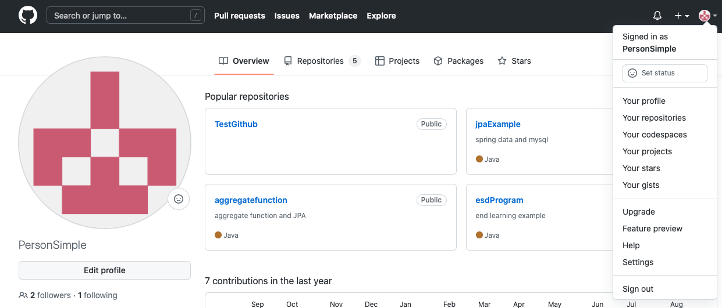

Slide 11
